Slide 1
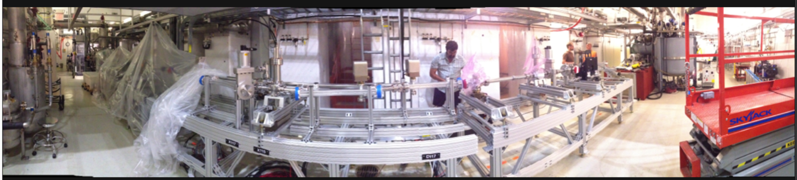
Beam Diagnostics at ASTA
Randy Thurman-Keup
2nd Annual ASTA Users Meeting
9-10 June 2014

Slide 2
Beam Diagnostics
Beam Position Monitors
  Button BPMs
Loss Monitors
  Scintillator with PMT
Intensity Monitors
  Faraday Cup
  Wall Current Monitors
  Toroids
Transverse Profile Monitors
  Aluminized Si OTR and YAG:Ce or LYSO Crystals
Longitudinal Profile Monitors
  Streak Camera for OTR, OSR
  Martin-Puplett Interferometer for CTR, CDR, CSR
  Ceramic Gap
  Access to Michaelson Interferometer and Bolometer
  Transverse Profile Shaper (Z Slicer) in center of bunch compressor
Emittance Monitor
  Insertable Slits
Bunch Arrival Monitor
  Laser Modulator
Spectrometer
  Dipole Magnet and bpm and YAG:Ce crystal
    Plus streak camera for E vs t longitudinal phase space

Slide 3
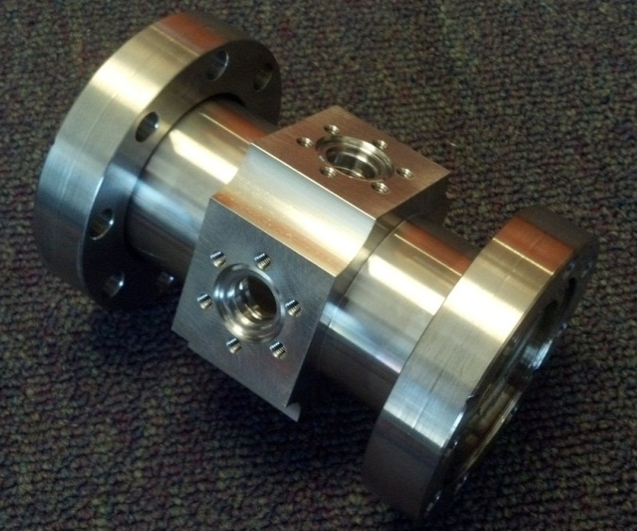
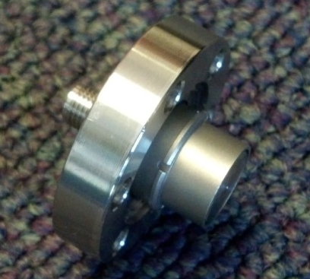
Beam Position Monitors
11 mm button electrode with SMA feedthrough in 47.5 mm inner diameter housing
4 Button electrodes provide horizontal and vertical measurement
23 in straight ahead to CM2
27 pickups in the HE beamlines
In-tunnel signal conditioning and downmix electronics for 650MHz
Digital signal processing via custom 12 channel 250MS/s VME/VXS digitizers
Upgrade of system developed for the ATF damping ring at KEK
For nominal bunch charge (3nC)
  <50μm micropulse (single bunch) resolution
  ~1μm full 1ms macropulse (3000 bunches) resolution
  Provide relative intensity and beam phase
Will provide sensitivity down
to ~50pC per bunch

Slide 4
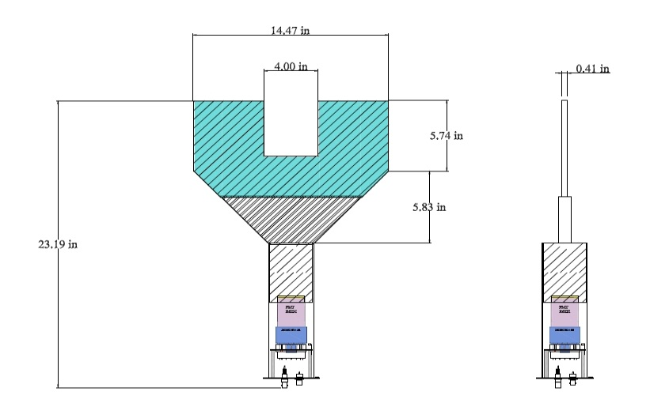
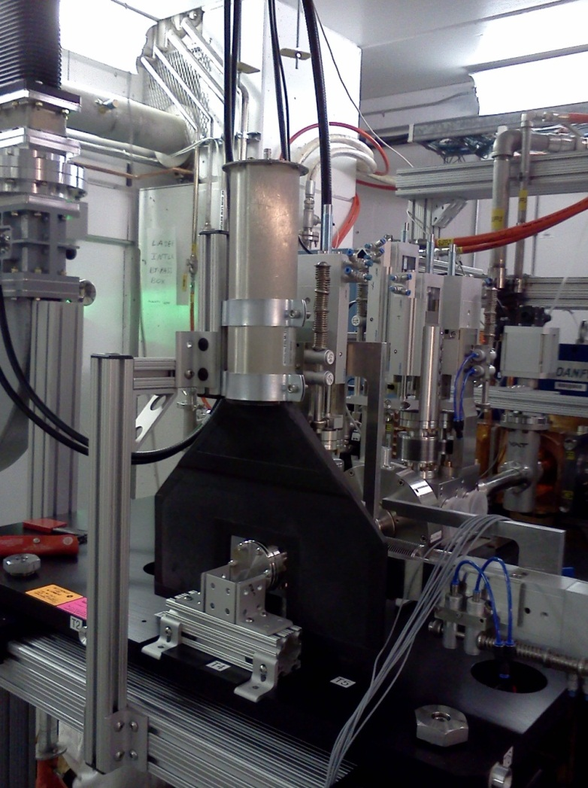
Beam Loss Monitors
led
EJ208
PMT/divider
µmetal Shield
HV, Anode signal and LED connections
EJ208 Scintillator properties | Value
Rise time | 1.0 ns
Scintillator Brightness | 76 p.e./ MeV
Wavelength of max emission | 435 nm
Detector sensitivity | 7.0 pC/Mev
Decay time | 3.3 ns
Density | 1.023 g/cc
Light attenuation length 1/e | 210 cm
Number of electrons | 3.37/cm³
PMT Specifications
Rise time | 3-5 ns
Gain (min) | 2.7 x 10⁵
Supply voltage (max) | 2000 volts
Sensitivity | 0.1 – 200 A/lm
Beam Loss Monitor

Slide 5
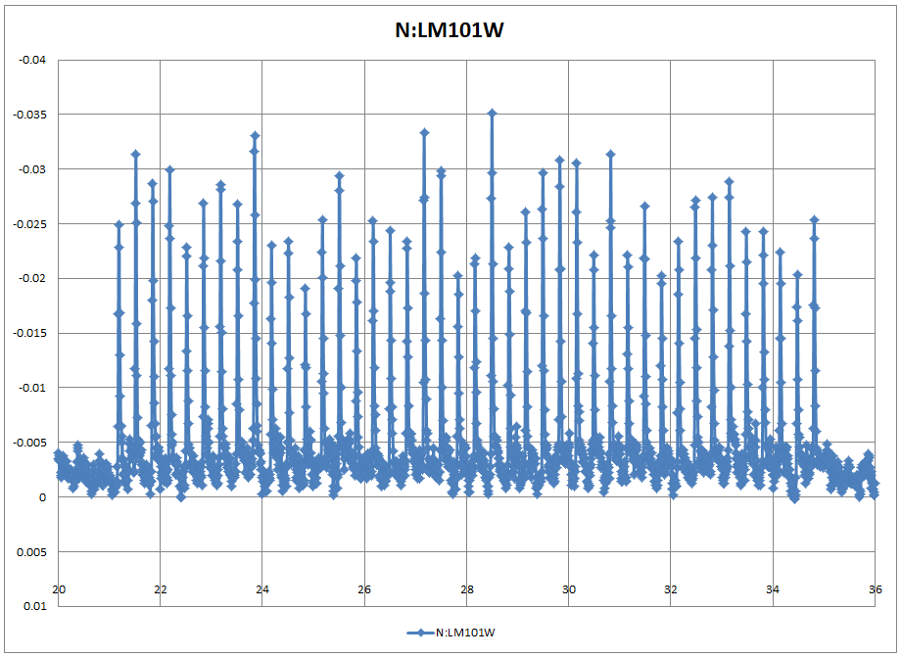
Beam Loss Monitors
Purpose and functionality:
  Provide both machine protection (alarm signal) and diagnostic functions for the machine; allowing to tune-up and monitor beam operations while machine protection is integrating the same signal (linear, logarithmic and integrating amplifiers)
  Instantaneous read-back of beam loss
  Fast response << 1 µs
  Macro-pulse repetition rate 1-5 Hz
  Sampling frequency of ADC output (3MHz)
  FPGA controlled
  VME interface and fully integrated into ACNET
  Built-in-self-test (voltage monitor) and onboard
  signal injection
  Local data buffer for beam loss transient play-back
  Minimum ADC buffer length per macro-pulse 1 ms (rf gate length)
  Max reaction time from analog beam loss signal to digital alarm ~ 1-2 µs (3-6 bunches)
  ADC resolution 12 bits (14 bits)
  Full ADC resolution for single\multi-bunch thresholds
  Signal discrimination between two successive ADC samples
  Resolution for integration over RF gate
  Pulse beam monitoring + continuous monitoring
  channels per board (8) to handle a total ~40 fast loss monitors For full scale project

Slide 6
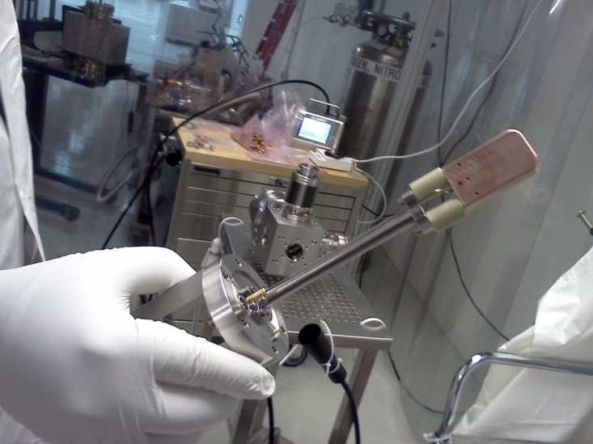
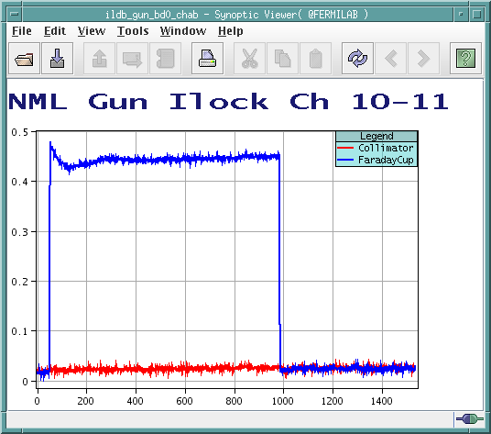
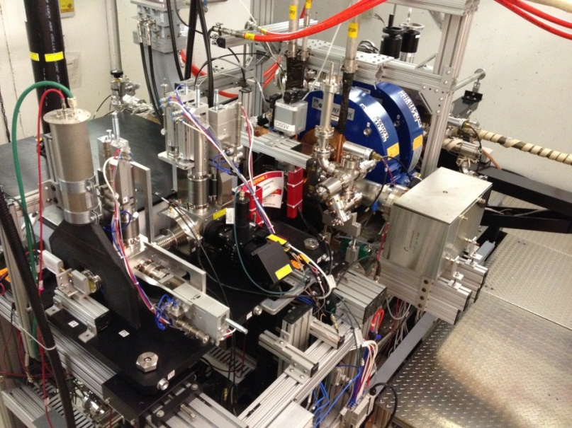
Beam Intensity Monitors
Faraday Cup
Constructed from OFHC copper with dimensions 1” x 1.75” x 0.5”.
Signal is directed out of the UHV system by means of a 0.051” diameter stainless steel wire
Can be inserted remotely via a horizontal pneumatic actuator on the Diagnostic Table 6-way Cross.
The output signal is digitized and accessible through the control system.
Diagnostic Table Faraday Cup pneumatic actuator

Slide 7
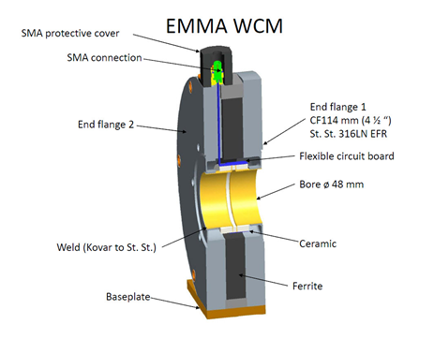
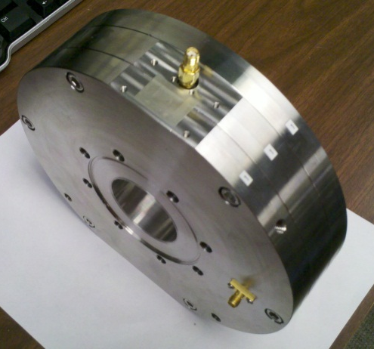
Beam Intensity Monitors
Wall Current Monitor and Toroid
Use high bandwidth Wall Current Monitor developed for EMMA
Compact 50mm design including flanges with 48mm diameter bore
Low frequency cutoff of ~16kHz due to gap resistance and ferrite inductance
High frequency range of ~4GHz limited by microwave cutoff of high order modes
2 in injector, 2 in HE end
Provide bunch by bunch intensity via analog integrator and custom digitizer
Use dual channels to sample signal and background for each bunch
For nominal 3nC bunch charge will provide 1% relative bunch intensity
Absolute calibration will be provided by Toroid
  2 in injector
Toroid
Calibration Port

Slide 8
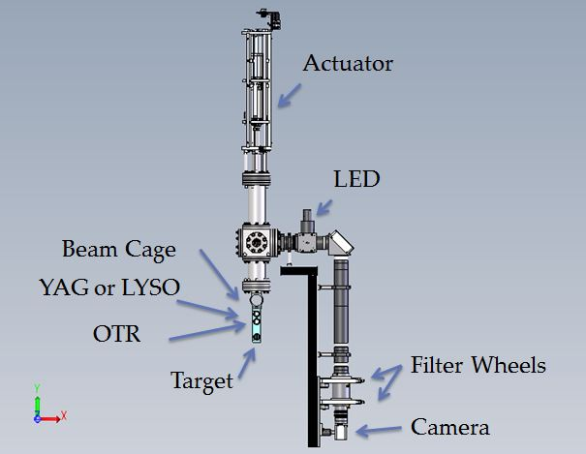
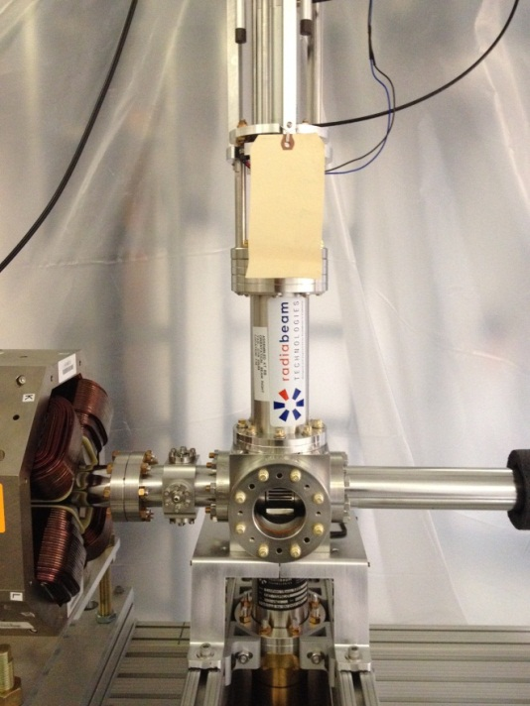
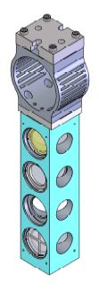
Transverse Profile Monitors
Contains YAG:Ce crystal and Al-coated Si for OTR, together with an Air Force target
8 in injector, 9 for HE end
Optics: 150mm, mirror, 150mm, 200mm (achromats), 75mm camera lens
Filter Wheels:
  A: Blank, ND0.3,ND1.0, ND2.0, ND3.0
  B: Blank, 400±35nm, 550±35nm,
  Horizontal Polarizer, Vertical Polarizer
Camera
  Prosilica GC2450: 5MegaPixel, GigE, 25μsec shutter
Single crystal, oriented normal to beam
  Reduce depth-of-focus and powder resolution effects
OTR and Crystal cover wide charge range
  20pC-3.2nC
RF Cage
YAG:Ce / LYSO
OTR
Target

Slide 9
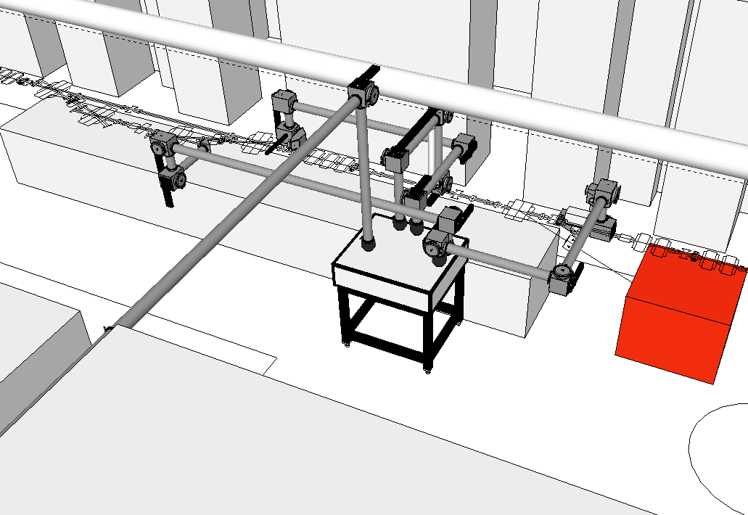
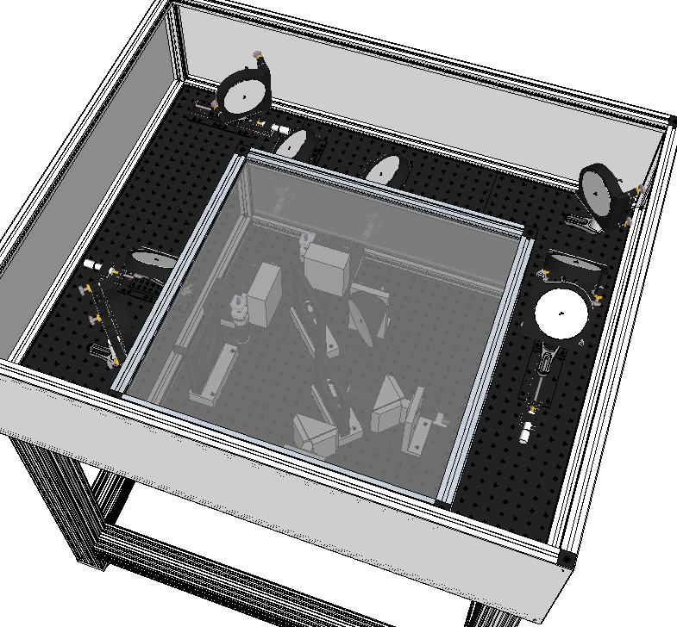
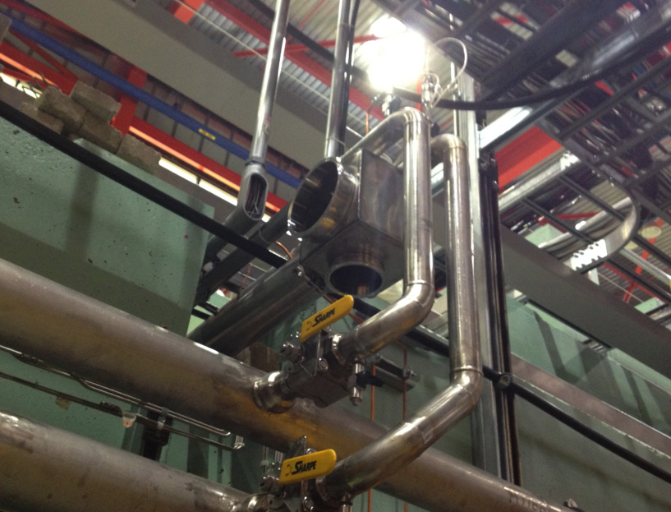
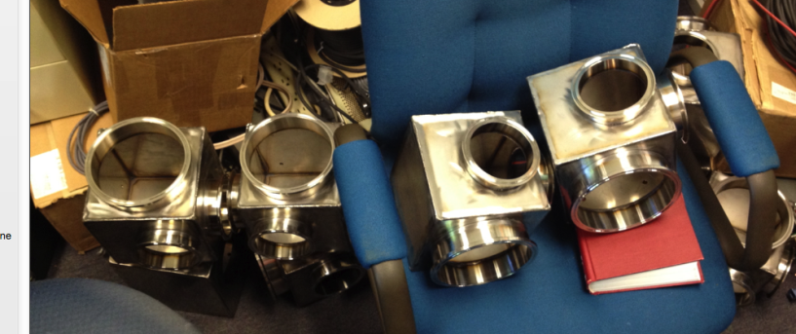
Longitudinal Diagnostics
Pipes are SS with
sanitary-style flanges
CSR/OSR
Port
Bunch
Compressor
CTR / OTR / CDR
CSR
Port
“E vs t”
OTR Port
Switching Box
To Streak Camera
Martin-Puplett
Interferometer

Slide 10
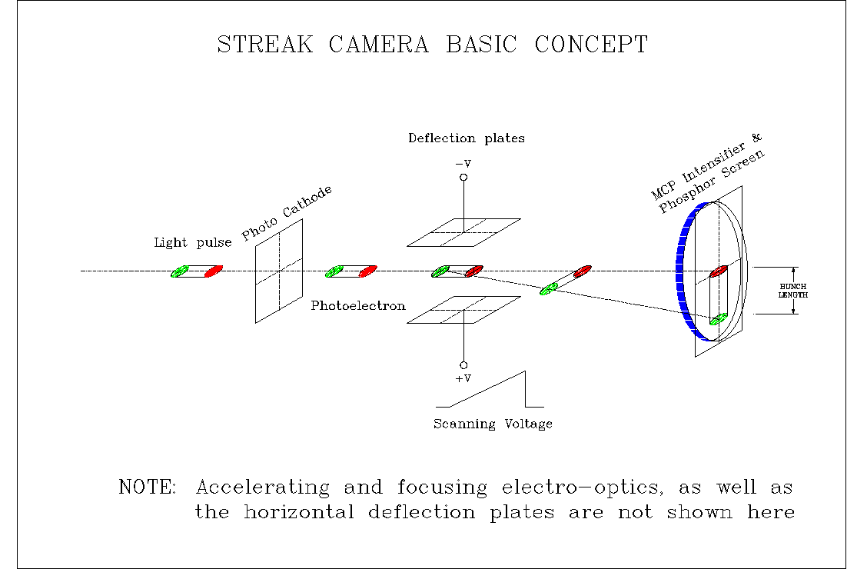
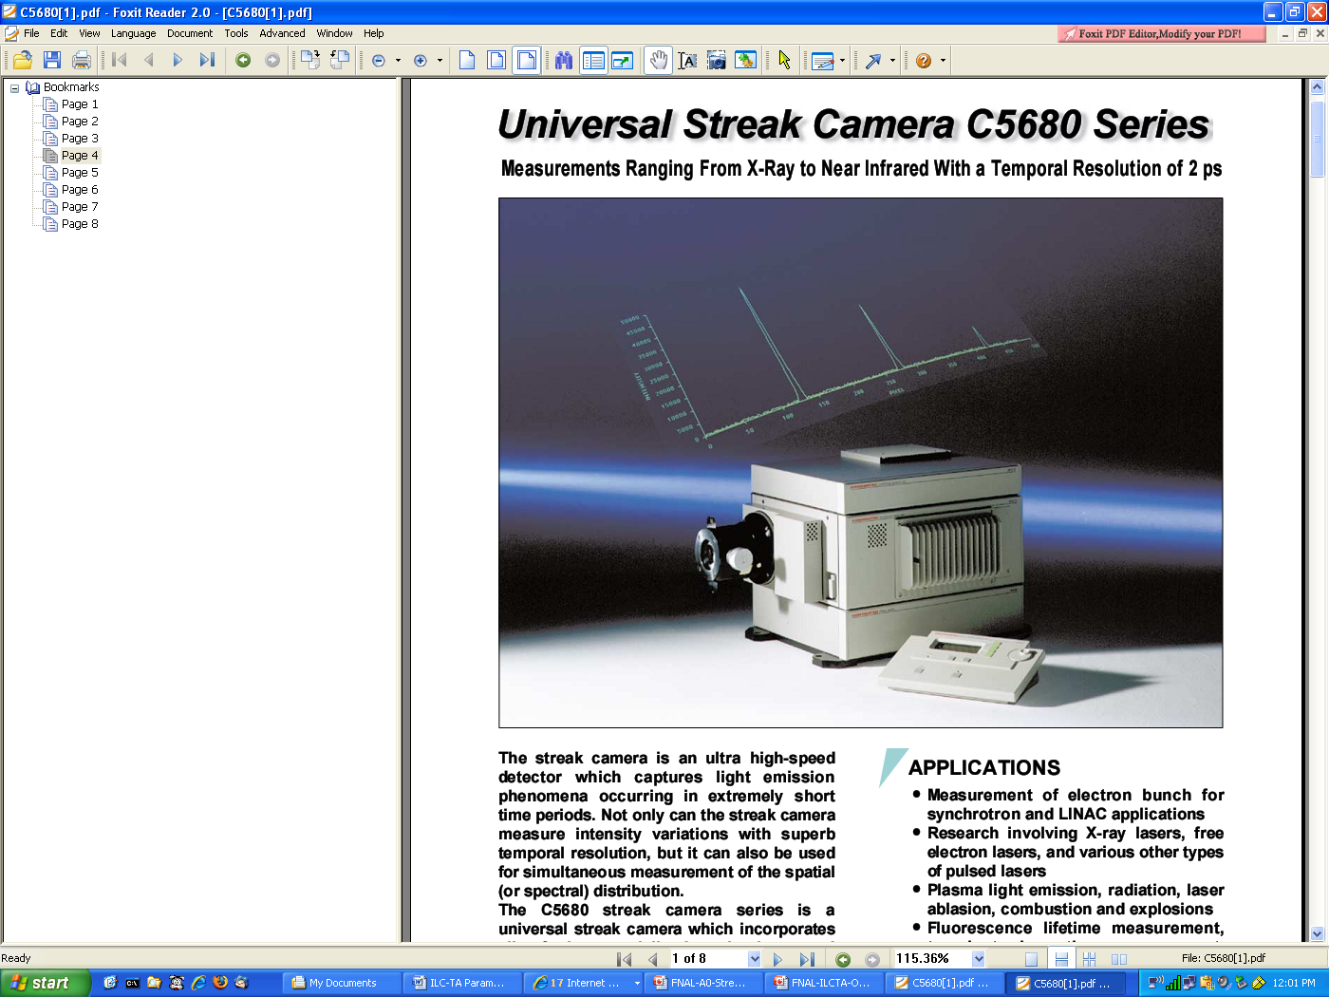
Streak Camera
Hamamatsu C5680 dual-sweep streak camera
The synchroscan vertical deflection unit in the mainframe of the streak camera is synchronized to 81.25 MHz from the master oscillator. The fastest range R1 provides about 0.6 to 1ps temporal resolution (sigma).
This unit provides low jitter (~1ps) of streak images compared to a single-sweep unit that has 20-ps internal trigger jitter plus 100-ps trigger jitter from the delay unit.
It also allows synchronous summing of signals from the micropulse train with about 200 fs phase stability within the train of micropulses. (beam arrival monitor)
Gating of the MCP in the streak tube allows selection of a 250-ns window, a single micropulse from the 3-MHz pulse train.
Slit
Based on VG by B.Yang for ANL/S35 review

Slide 11
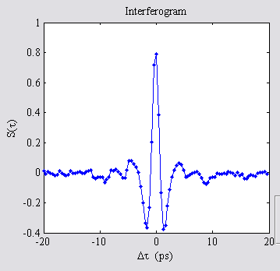
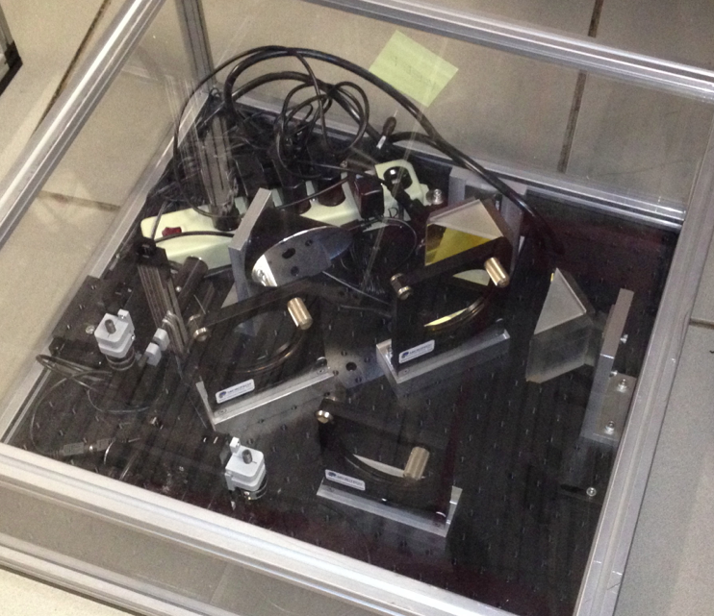
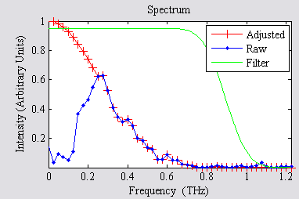
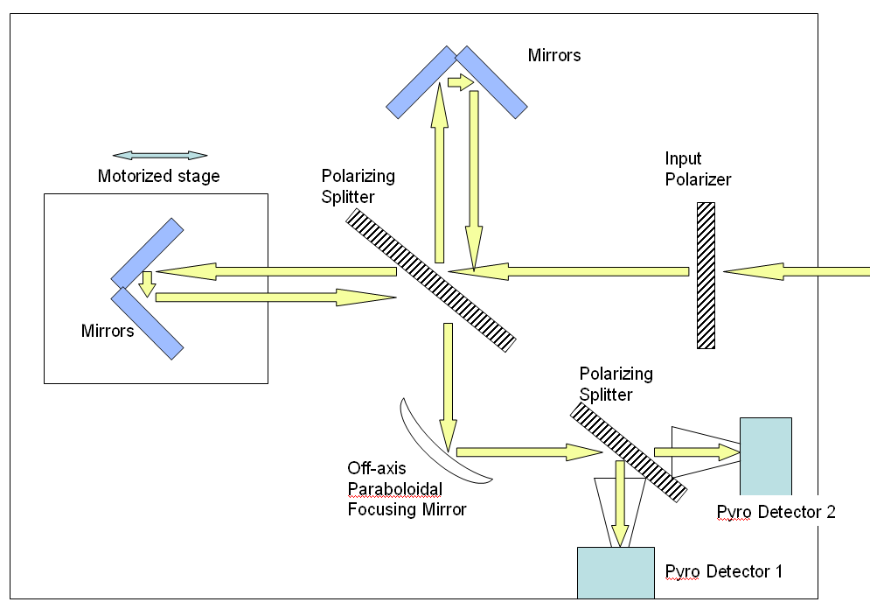
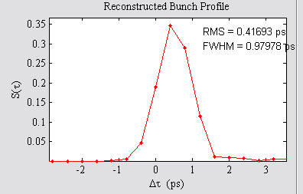
Martin-Puplett Interferometer
Bunch shape is related to autocorrelation trace, S(τ), of either CTR or CSR
Missing low frequencies have to be filled in
Incoherent
Coherent
Bunch Size
Data from A0 Emittance Exchange Experiment

Slide 12
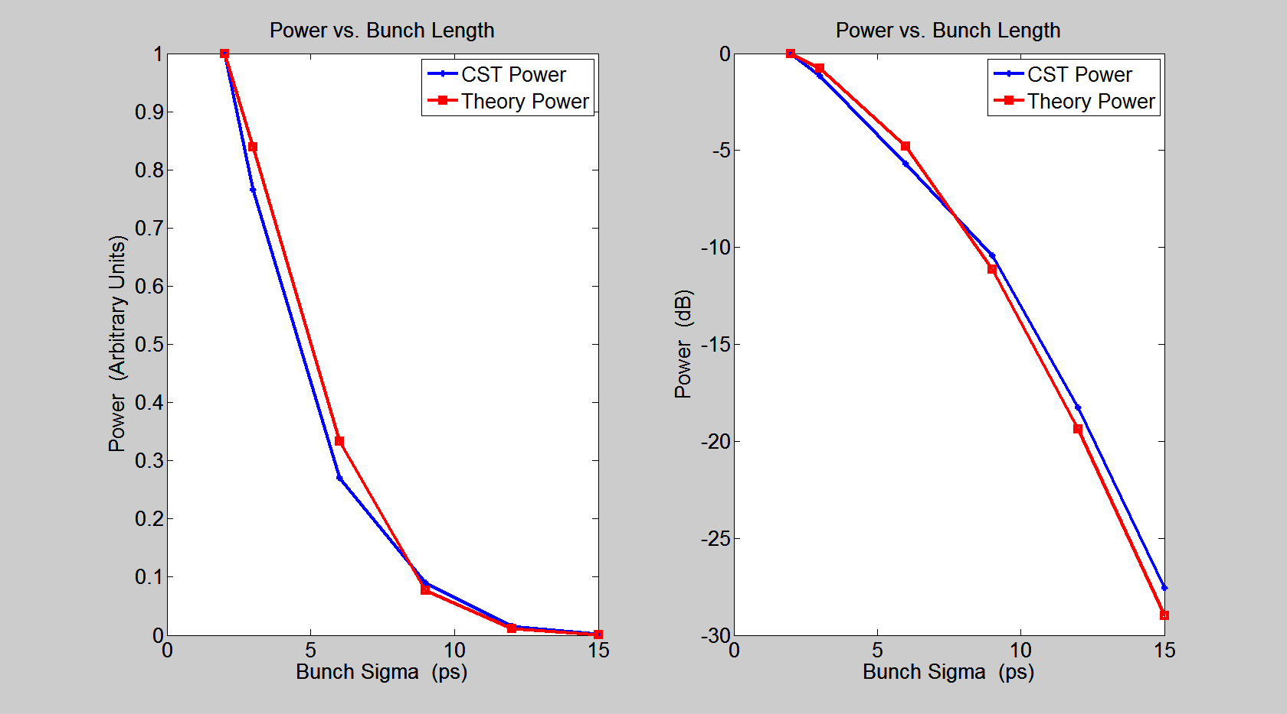
Gap Intensity Monitor
Measure the intensity of the radiation emitted from a gap in a narrow band
Bunch by bunch with fast detector
Remove some systematics
Detector
Step in
A
B
C
R
g
Superposition of the incoming and the outgoing fields is the total radiated field

Slide 13
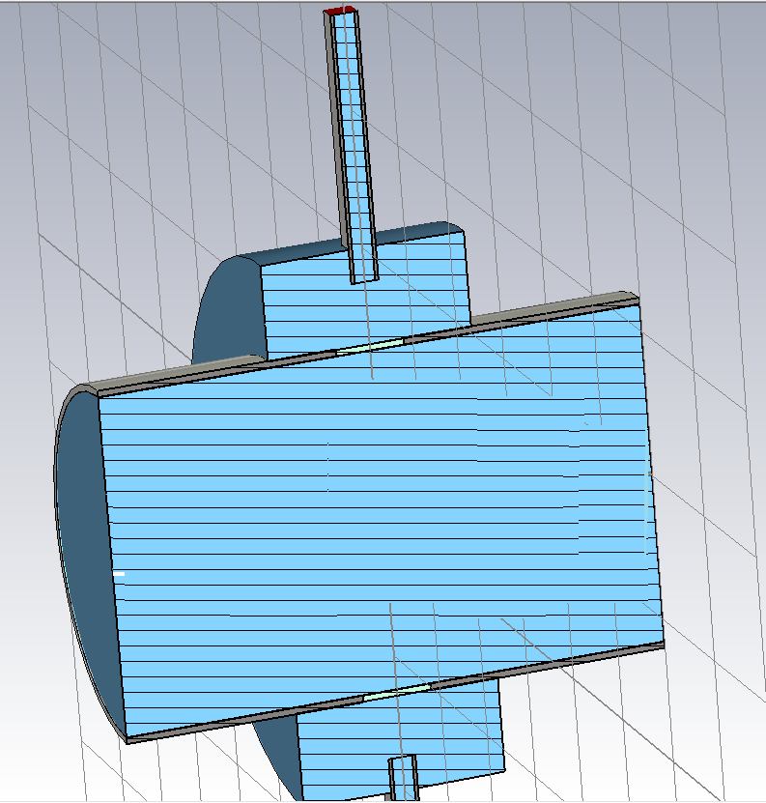
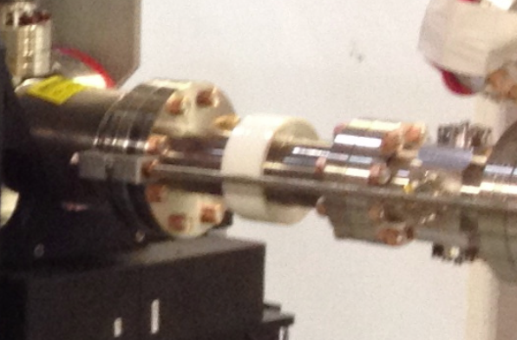
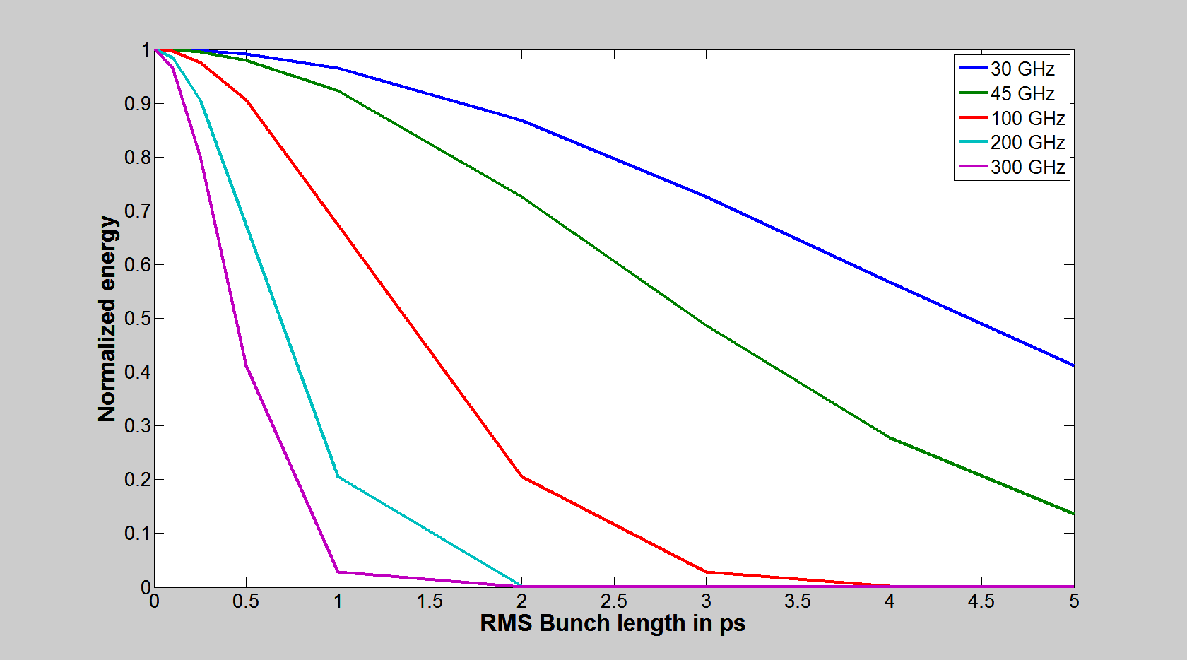
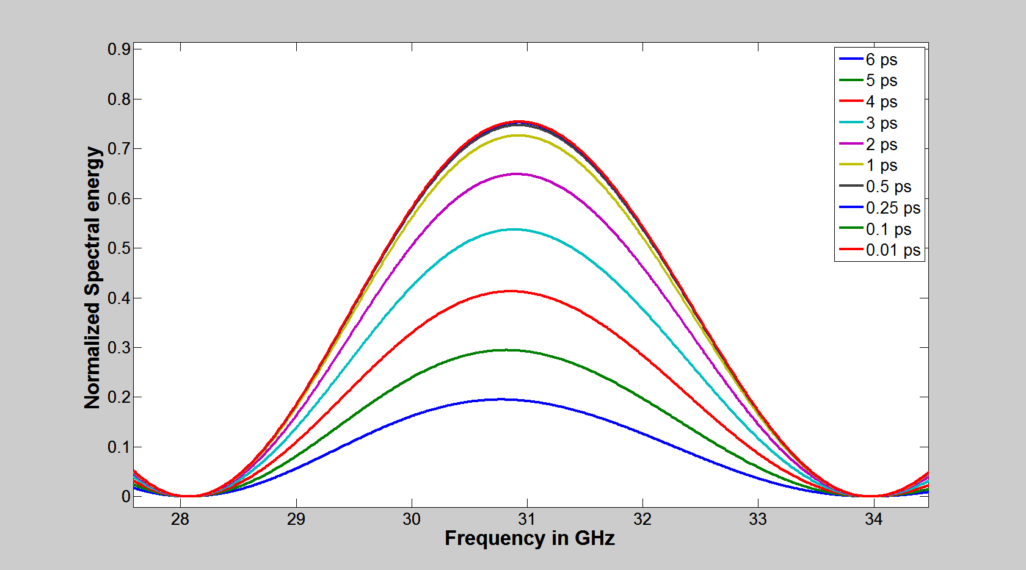
Gap Intensity Monitor
RF Schottky Diode
Waveguide
Ceramic gap

Slide 14
Longitudinal Diagnostics
Technique | Resolution | Charge needed
Streak camera | ~0.6 ps sigma at 800 nm, range 0.5-25ps, phase stable* | 8-10 nC
MPI | 0.15 ps, range 0.3 to 1ps. CTR,CSR,CDR | 10-50 nC, depends on σ_{t}
Ceramic gap | 0.5 – 5 ps range
*Temporal Jitter demonstrated at 0.5 ps rms shot to shot on laser.

Slide 15
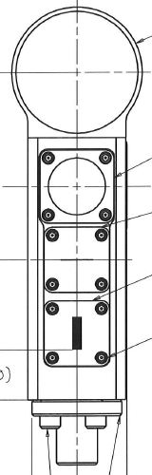
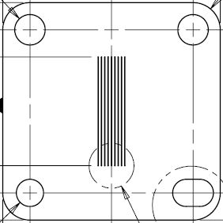
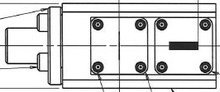
Emittance Monitor
Utilize a 1”x1”x0.5mm tungsten multi-slit mask with nine 40 micron wide slits for measuring the beam emittance.
Downstream transverse profile monitor will image the beam on a YAG:Ce crystal.
Each station has a horizontal and vertical multi slit mask on stepper motors.
YAG:Ce crystal is located in the same holder as slits so that the spot size of the electron beam can be measured.
A single 40 micron wide slit mask also resides in each holder.
The slit masks are currently being manufactured.
Multi slit
Single slit
Multi slit
YAG:ce
Single slit
RF Cage

Slide 16
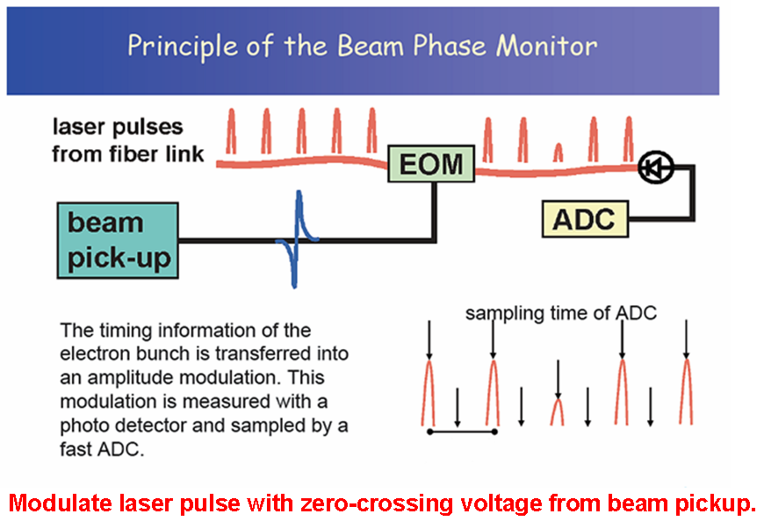
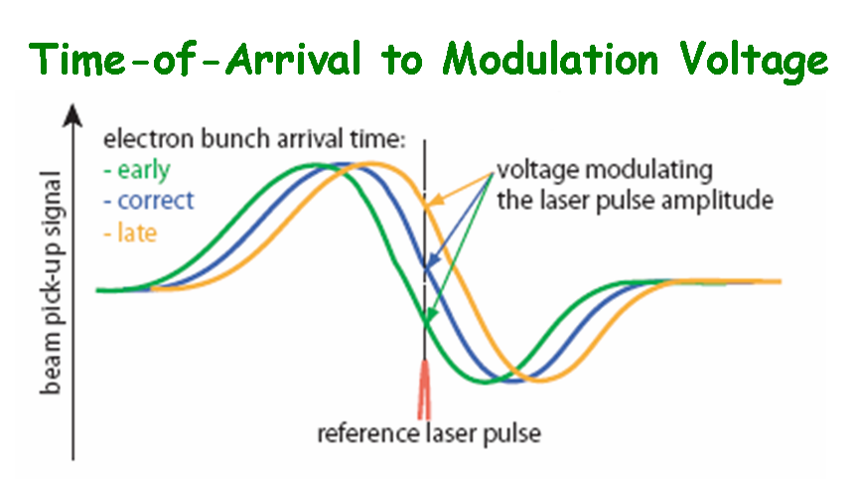
Bunch Arrival Monitor
ASTA requirement to measure bunch-by-bunch time-of-arrival to sub-ps levels
Utilize femtosecond laser and electro-optical modulation to sample bunch time-of-arrival relative to accelerator master oscillator
courtesy F. Loehl, DESY
81 MHz

Slide 17
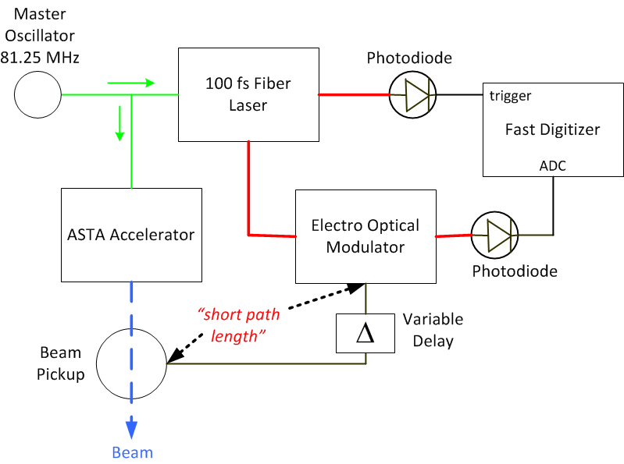
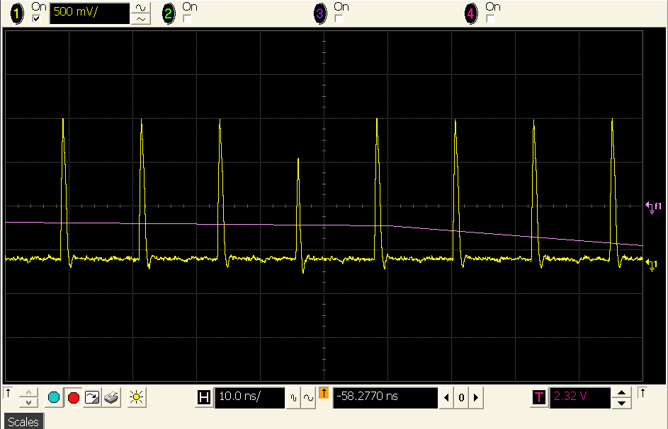
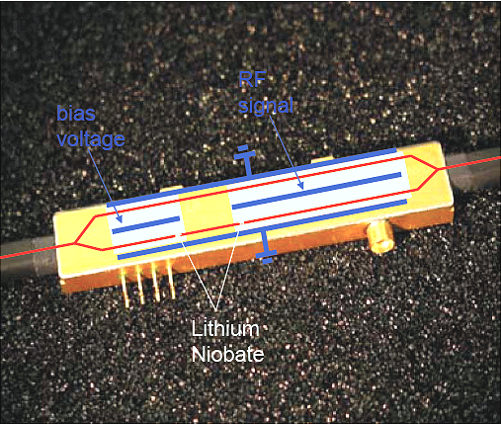
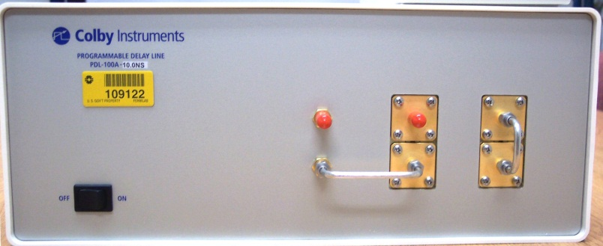
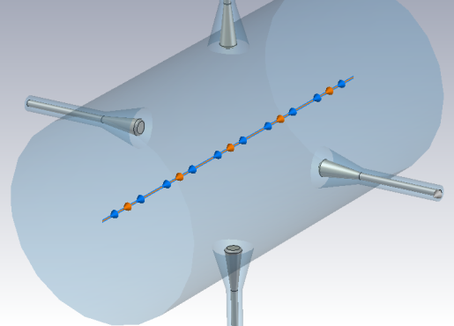
Beam Arrival Monitor
Modulated Laser Pulse
Programmable delay
0.5 ps steps; 10 ns range
Commercial EOM; 10 GHz BW

Slide 18
Spectrometer
Consists of a dipole magnet followed by BPMs and transverse profile station with both a YAG:Ce crystal and Aluminized Si OTR screen
Screen size allows up to ~8% FWHM dE/E measurement
Resolution on dE/E of ~10^-4

Slide 19
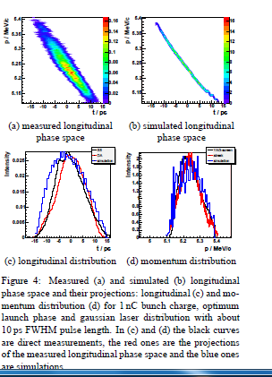
“E vs t” After Spectrometer
Send OTR after Spectrometer Dipole to Streak Camera
Tests at 5 MeV reported from the photoinjector test stand at Zeuthen (PITZ) using aerogel converter in a dispersive area and a streak camera (J. Ronsch et al. 27th FEL conf.)

Slide 20

“Z-slicer”
12 mm
x
Screen
0.5’’
t
Send the light to Interferometer or Streak camera
Could be difficult to detect such low charge
Possibly use a bolometer: a bit expensive.
Can we do something quicker and cheaper just for detection? Skew Quad!
CTR/OTR
50 um
0.5’’
500 um
500 um
3 mm
1 mm
0.5 ’’
0.5 ‘’
0.5 ‘’
20 um
600 um
0.1 mm
0.5 ’’
0.5 ’’
0.5 ‘’

Slide 21
Questions?

Slide 22
Beam Position Monitors
In-tunnel signal conditioning and downmix electronics for 650MHz
Digital signal processing via custom 12 channel 250MS/s VME/VXS digitizers
Upgrade of system developed for the ATF damping ring at KEK
For nominal bunch charge (3nC)
  <50μm micropulse (single bunch) resolution
  ~1μm full 1ms macropulse (3000 bunches) resolution
  Provide relative intensity and beam phase
Will provide sensitivity down to ~50pC per bunch
First Beam
Scope Data

Slide 23
Beam Intensity Monitors
Provide bunch by bunch intensity via analog integrator and custom digitizer
Use dual channels to sample signal and background for each bunch
For nominal 3nC bunch charge will provide 1% relative bunch intensity
Absolute calibration under study
  May include Toroid to facilitate calibration
First Beam

Slide 24

Toroid

Slide 25
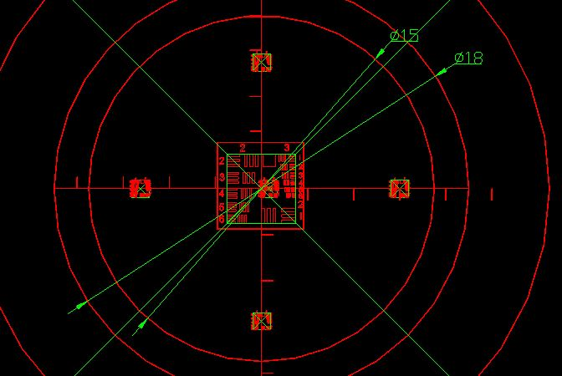
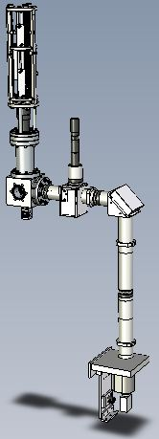
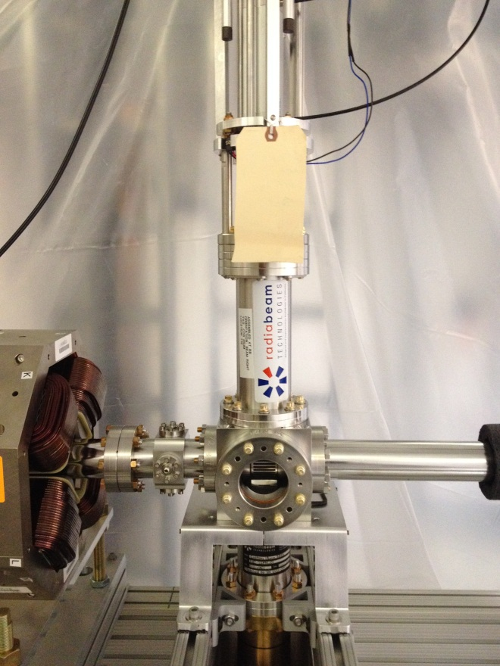
Transverse Profile Monitors
Transverse Profile Monitors are located throughout the ASTA beamline. The holder contains an RF Cage, cerium doped YAG crystal or LYSO crystal, and an optical target. The holder containing the diagnostics is inserted pneumatically. A USAF 1951 target is used for focusing and calibrating the 5 megapixel GigE interfaced camera image.
RF Cage
YAG:Ce
OTR
Target

Slide 26


Slide 27
Slit
Based on VG by B.Yang for ANL/S35 review

Slide 28
Gap Bunch Monitor
Measures bunch length (r. m. s) bunch-2-bunch
Attractiveness:
  Simple, cheap and non-invasive
  Covers a range of bunch length ( 5 ps – 0.5 ps)
  Can be useful for feedback control
  Absolute measurement is possible

