Slide 1
CM-2 Commissioning
Elvin Harms
ASTA Users Meeting
9 June 2014

Slide 2
Introduction
CM-2 is
Type 3+ ILC type Cryomodule
8 cavities (1.3 GHz) built by industry
Vertical and Horizontal tests at JLab & Fermilab (good to 35 MV/m)
Cryomodule assembled at Fermilab
first ILC type cryomodule which may(?) reach average gradient specification of 31.5 MV/m
Designed for pulsed operation
Main accelerating device for ASTA
Expect beam tests in FY2015
E. Harms AWLC14/SRF Technology WG 14 May 2014

Slide 3
Commissioning Process
Prerequisites
cryomodule installed
pipes welded and certified leak tight
pressure tests successful
vacuum circuits leak tight (beam tube, coupler, insulating vacuum)
instrumentation, tuners verified operational
warm conditioning completed
cooldown
Measure frequency spectra both warm and cold
Single cavity powering
Power all cavities together, characterize system performance
Follow-on studies
E. Harms AWLC14/SRF Technology WG 14 May 2014

Slide 4
Single Cavity
Tune cavity to resonance
Map out and set Q_{L}
System calibrations, calculate gradient, k
On-resonance conditioning
Determine peak performance
Final (high power) LLRF calibration
Lorentz Force Detuning Compensation set-up
Document dark current, x-rays vs. gradient
Dynamic Heat Load measurements (Q₀)
E. Harms APT Seminar 14 January 2014
E. Harms AWLC14/SRF Technology WG 14 May 2014

Slide 5
Commissioning Process
E. Harms APT Seminar 14 January 2014
E. Harms AWLC14/SRF Technology WG 14 May 2014

Slide 6
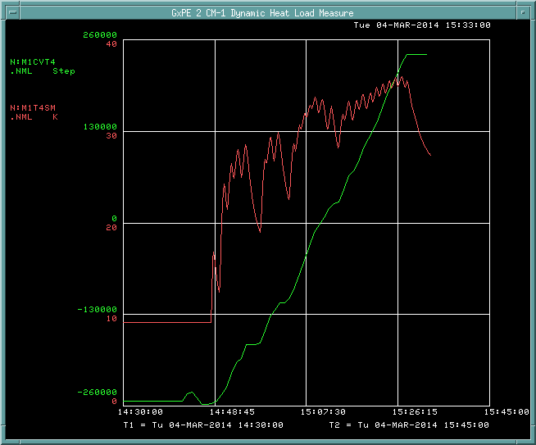
Tuning to resonance
Motor temperature
Δt ~ 25K
Δf ~ 240 MHz
Motor steps
Start here
Goal
1.30 GHz
E. Harms APT Seminar 14 January 2014
E. Harms AWLC14/SRF Technology WG 14 May 2014

Slide 7
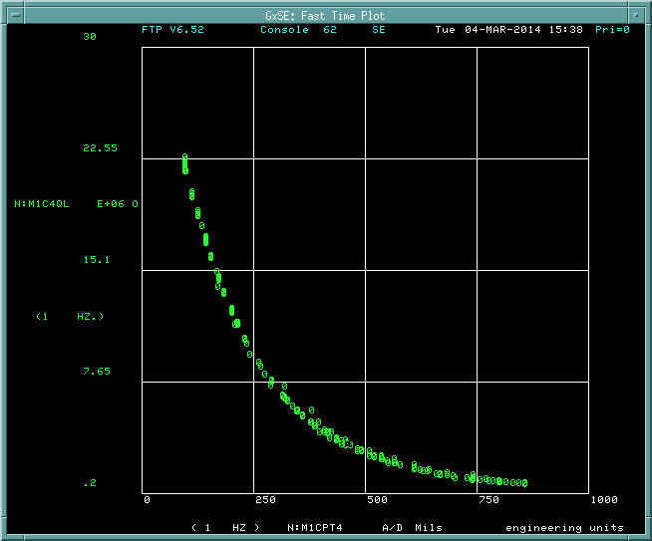
Setting Q_{L}
3 – 3.5 E6
E. Harms APT Seminar 14 January 2014
E. Harms AWLC14/SRF Technology WG 14 May 2014

Slide 8
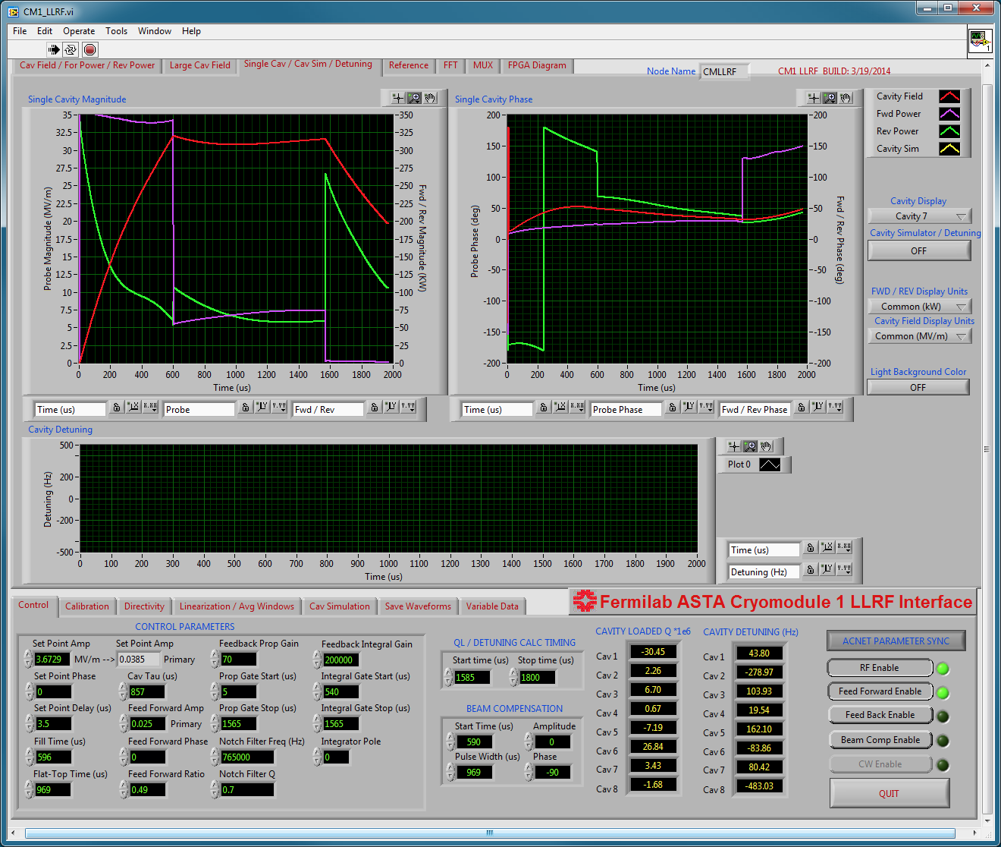
Low Level RF
Labview vi with all parameters available in ACNET
E. Harms APT Seminar 14 January 2014
E. Harms AWLC14/SRF Technology WG 14 May 2014

Slide 9
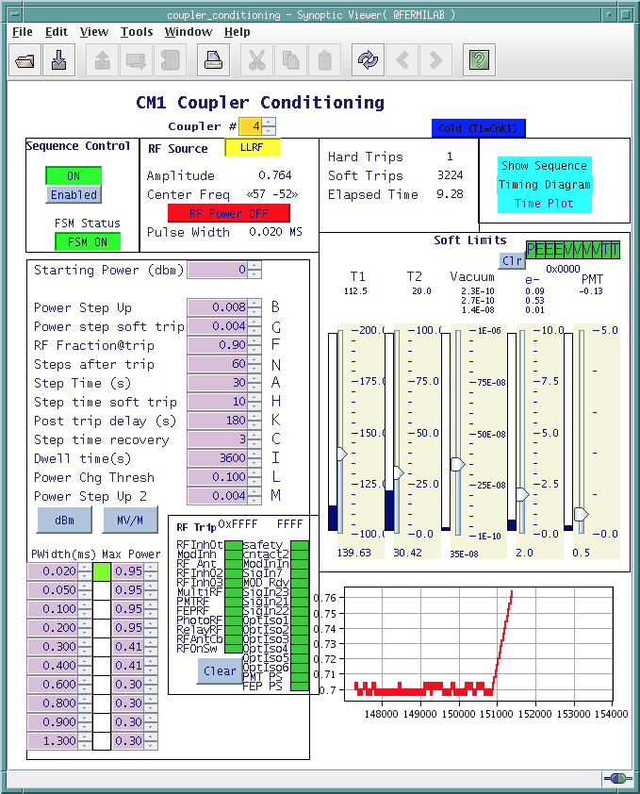
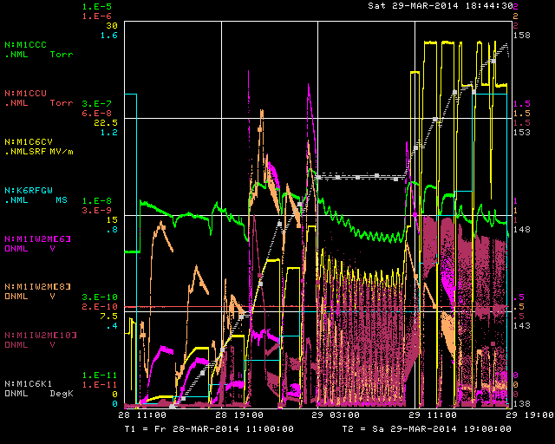
On-resonance conditioning
20 μs to 1.3 ms pulse width (500 μs fill time)
1-2 Hz repetition rate
Peak power 1 MW (narrow pulse width) or < 25 MV/m
Monitor
Vacuum
Field Emission (3 points)
PMT
Coupler window temperatures
Automated process (mostly)
Conditioning Sequencer
Cavity #6 Conditioning
E. Harms APT Seminar 14 January 2014
E. Harms AWLC14/SRF Technology WG 14 May 2014

Slide 10
Peak Gradient
27 February 2014:
CM-2 Cavity 3 achieves 31.5 MV/m (Administrative limit)
5 Hz, 1.6 ms pulse width, LFDC Active
E. Harms APT Seminar 14 January 2014
E. Harms AWLC14/SRF Technology WG 14 May 2014

Slide 11
Lorentz Force Detuning
Off
On
E. Harms APT Seminar 14 January 2014
E. Harms AWLC14/SRF Technology WG 14 May 2014

Slide 12
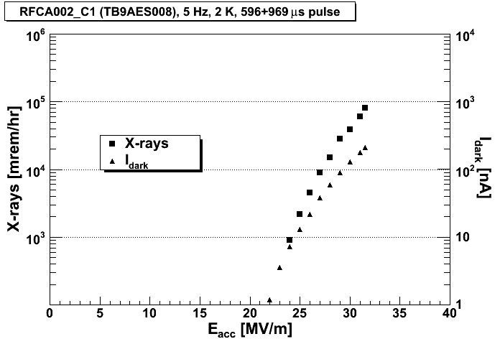
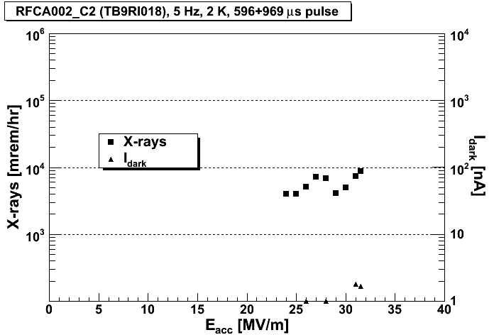
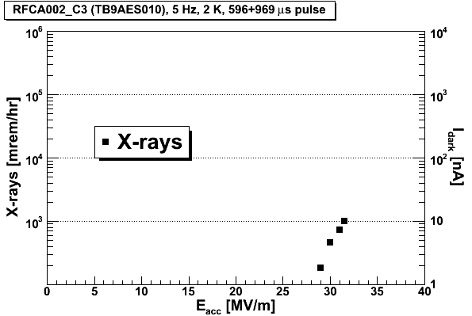
Dark Current/X-rays
courtesy Andy Hocker, TD
Threshold ≥ 20 MV/m
E. Harms APT Seminar 14 January 2014
E. Harms AWLC14/SRF Technology WG 14 May 2014

Slide 13
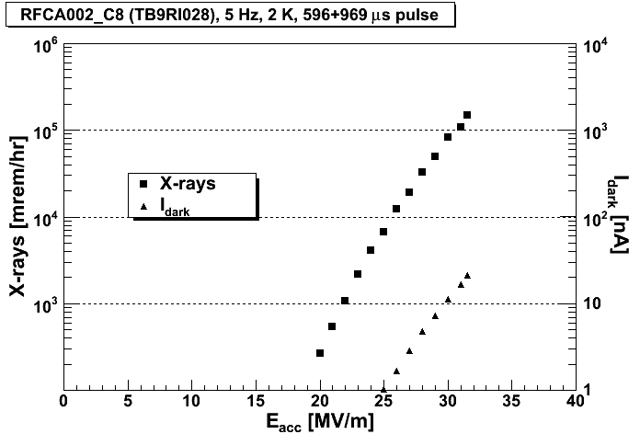
Dark Current/X-rays
courtesy Andy Hocker, TD
response from
Upstream
Faraday cup
Threshold ≥ 20 MV/m
E. Harms APT Seminar 14 January 2014
E. Harms AWLC14/SRF Technology WG 14 May 2014

Slide 14
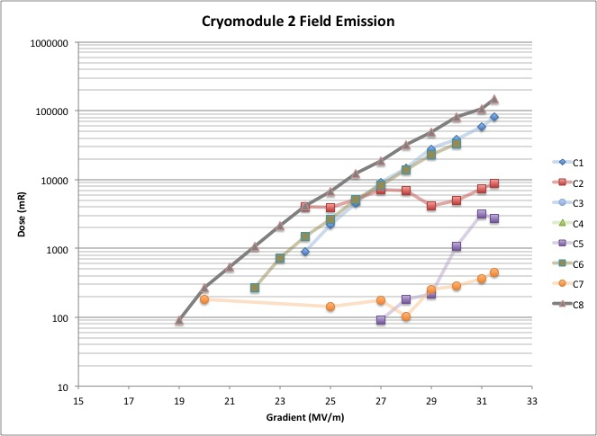
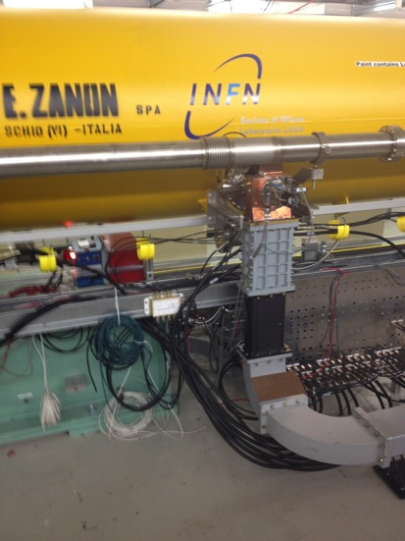
Dark Current/X-rays
X-ray threshold
= 19 MV/m
E. Harms APT Seminar 14 January 2014
E. Harms AWLC14/SRF Technology WG 14 May 2014

Slide 15
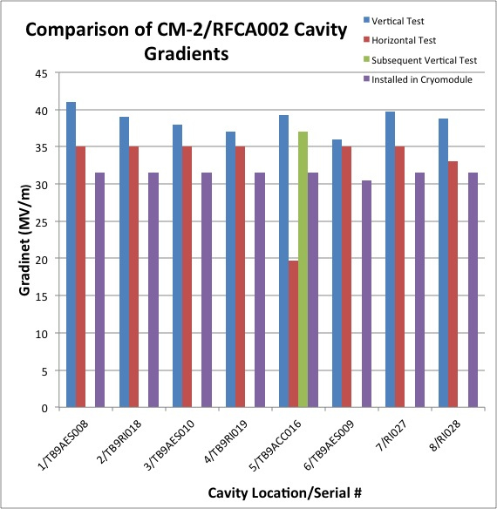
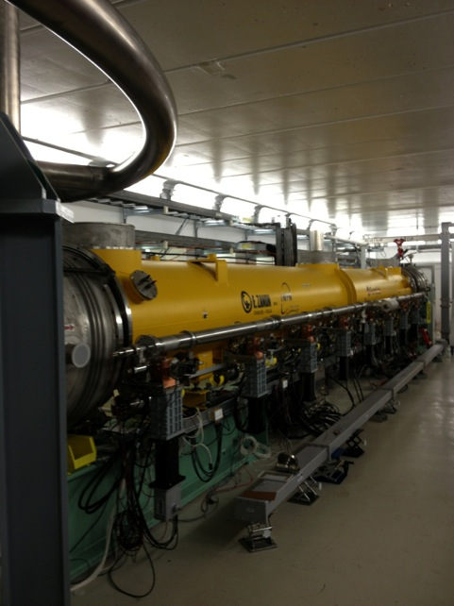
Performance to Date - Gradient
ILC Milestone
31.5 MV/m
CM2 installed at ASTA
E. Harms AWLC14/SRF Technology WG 14 May 2014

Slide 16
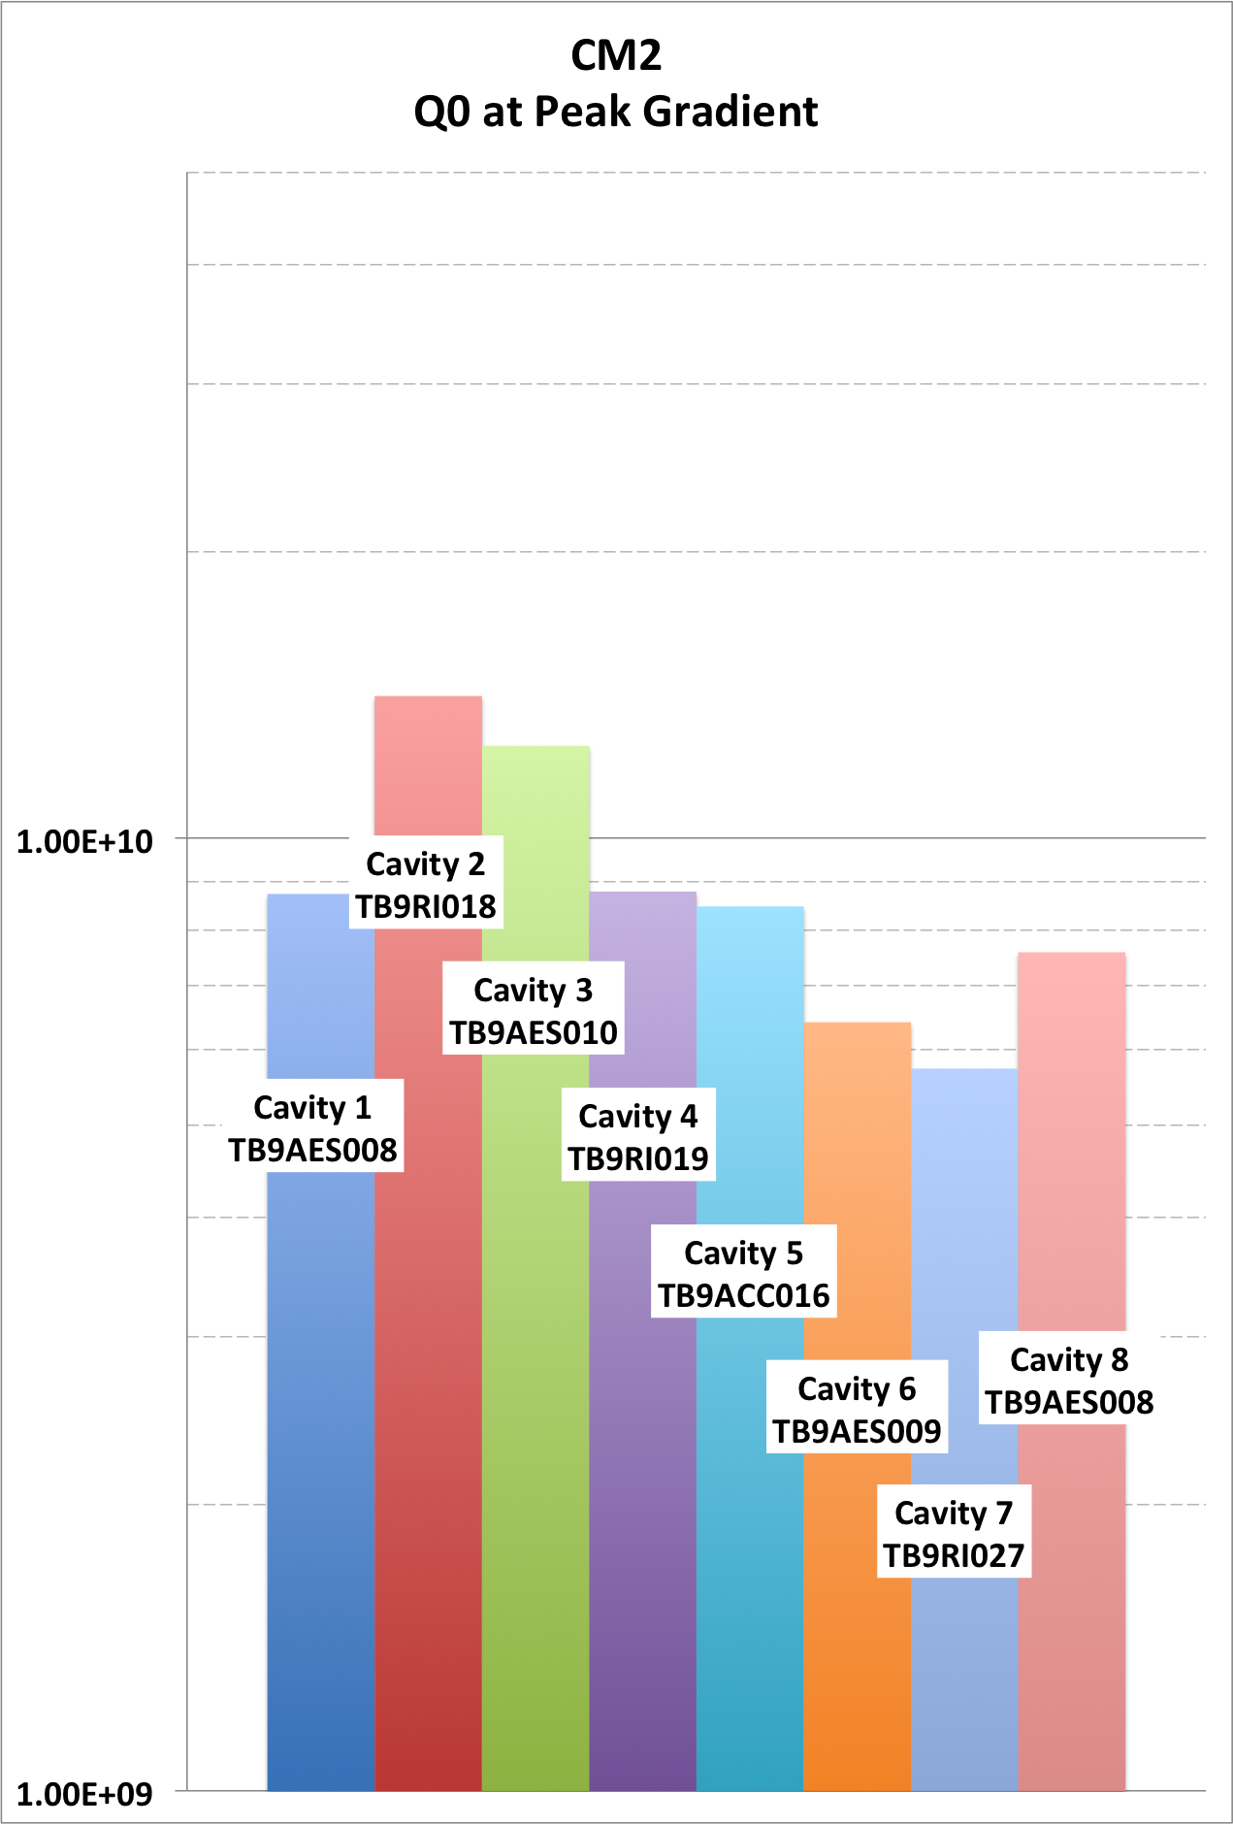
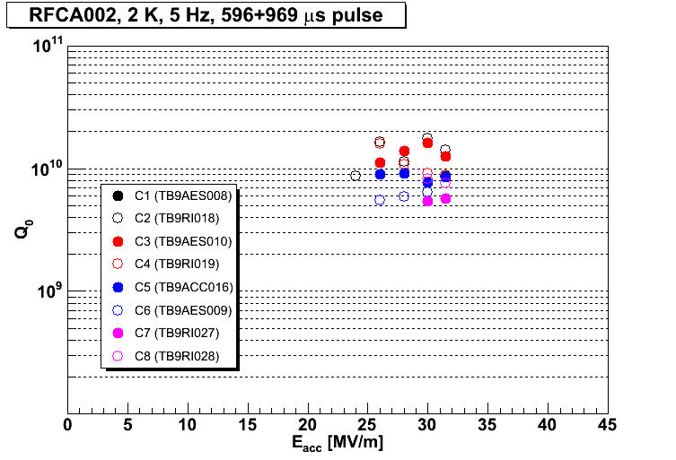
Performance to Date – Q₀
courtesy Andy Hocker, TD
E. Harms AWLC14/SRF Technology WG 14 May 2014

Slide 17
Timeline
Cryomodule installed in NML/ASTA – April 2013,
Warm coupler conditioning (one cavity at a time) – 9 May to 18 June 2013
Cooldown – 23 October to 11 November 2013
Begin cold operation, Cavity 1 only – 13 November 2013
Cavity 1 complete (13 November - 30 January)
Cavity 2 complete ( 31 January - 15 February, 16 days)
Cavity 3 complete ( 24 February – 4 March, 9 days)
Cavity 4 complete ( 4 – 10 March, 6 days)
Cavity 5 complete ( 18 - 26 March, 9 days)
Cavity 6 complete ( 28 March - 3 April, 7 days )
Cavity 7 complete (4 April – 7 May, mostly done by 8 April, coupler vacuum)
Cavity 8 complete (23 May – 6 June) warm coupler vacuum issue
E. Harms APT Seminar 14 January 2014
E. Harms AWLC14/SRF Technology WG 14 May 2014

Slide 18
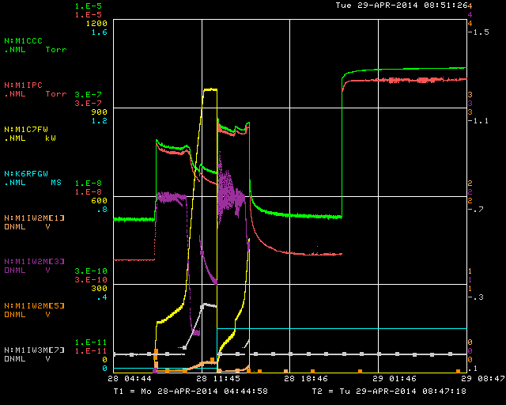
Cavity 8 Vacuum
Warm coupler vacuum issues on cavity #8
the only significant hiccup
E. Harms AWLC14/SRF Technology WG 14 May 2014

Slide 19
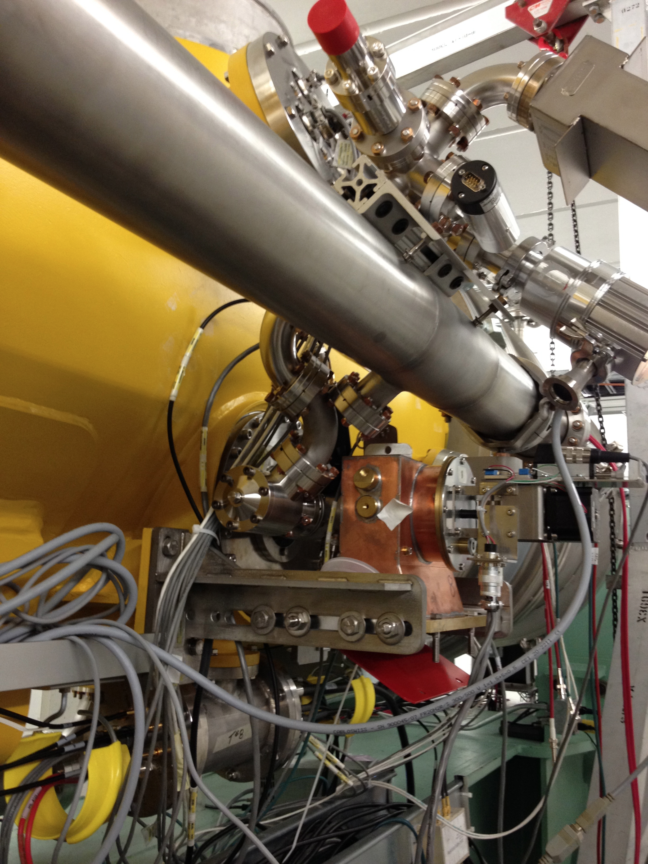
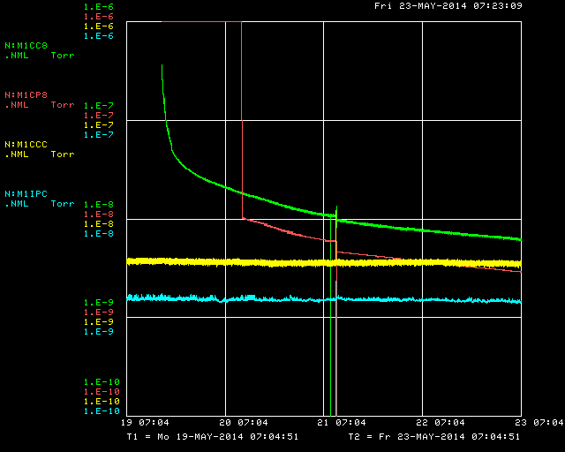
Cavity 8 Vacuum
Warm coupler vacuum issues on cavity #8
Unable to localize leak
Isolated C8 from coupler system and pumped independently with 20 l/s ion pump backed by a turbo
Success!
1E-06
Coupler 8 Ion pump
(2.8 E-09)
Coupler space Ion pump
1E-10
E. Harms AWLC14/SRF Technology WG 14 May 2014

Slide 20
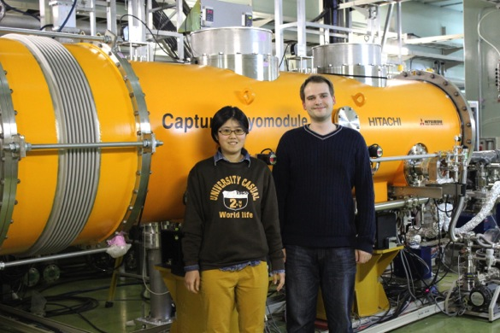
Students
In addition to ongoing studies by Auralee Morin from CSU
Visit in March by 2 PhD students from KEK
Ayaka Kuramot
supervised by Hitoshi Hayano
HOM spectra characterization
comparison with other Tesla style 9-cell cavities at DESY and KEK
Mathieu Omet
supervised by Shinichiro Michizono
extensive measurements of the klystron driving CM2
developed an algorithm in firmware to cancel the klystron nonlinearities in both amplitude and phase
Additional visitors welcome!
E. Harms AWLC14/SRF Technology WG 14 May 2014

Slide 21
On the horizon
Revisit selected cavities (8, 6, 1)
Install waveguide distribution system
Power all cavities together
Additional studies
LLRF
LFDC
Long pulse
thermal cycling/Q₀
others as requested
Beam in 2015
E. Harms AWLC14/SRF Technology WG 14 May 2014

Slide 22
Summary
CM2 cold commissioning since December
8/8 of the Cavities are now characterized
Average Gradient = 31.375 MV/m
Estimated ~2 weeks/cavity, 1 week achievable
Performance almost as hoped for so far
Fewer problems than with CM1
Full cryomodule testing in this summer
anxious for results!
Welcome visitors and additional studies requests
Collaborative effort by MANY people, especially TD & AD
E. Harms AWLC14/SRF Technology WG 14 May 2014

Slide 23
Thank you for your attention
E. Harms AWLC14/SRF Technology WG 14 May 2014

