Slide 1

Machine Learning and Accelerators:
Neural Network Based Modeling and Control at ASTA
Auralee L. Morin
2nd Annual ASTA Users Meeting
9-10 June, 2014
CSU: Auralee Morin (Graduate Student), Sandra Biedron, Stephen Milton (Faculty)
Fermilab: Brian Chase, Pierpaolo Stabile, and many others
Notes:
At the last Users meeting, I described a little bit about CSU’s interest in adaptive, machine-learning based control, and described what neural networks are, under what circumstances they are useful, and why accelerators are first of all, useful test-beds for nonlinear adaptive control techniques, but also are systems which could benefit significantly from the advancement of these Modeling and controls techniques. That presentation is online, so feel free to check it out. What I am going to do today is give you a peek at the model-building process we’ve used to generate a neural network plant model of the temperature regulation systems of the RF gun.

Slide 2
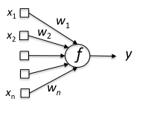
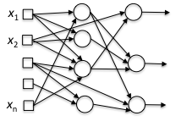
Nonlinear Modeling Using Neural Networks
What are neural networks?
a neuron (node)
a neural network
Notes:
So, for those who aren’t familiar with neural networks in the context of nonlinear modeling, I’m just going to give you 30-second the highlight reel.
Neural networks are nothing more than a linear combination of nonlinear activation functions. For nonlinear modeling, one can apply an optimization procedure to adjust the weights, biases, and (in some cases) activation function parameters such that an input-output mapping is generated

Slide 3
Nonlinear Modeling Using Neural Networks
What are neural networks?
When are they useful?
  When there is a lot of available data
  When system dynamics are
      not well-known, or change over time
      not captured sufficiently well by analytic models
      are very complicated/time-consuming to model analytically (but could be in principle)
  When fast I-O is needed for a complicated model
a neuron (node)
a neural network
Notes:
So, for those who aren’t familiar with neural networks in the context of nonlinear Modeling, I’m just going to give you 30-second the highlight reel.
Neural networks are nothing more than a linear combination of nonlinear activation functions. For nonlinear Modeling, one can apply an optimization procedure to adjust the weights, biases, and (in some cases) activation function parameters such that an input-output mapping is generated

Slide 4
Nonlinear Modeling Using Neural Networks
What are neural networks?
When are they useful?
  When there is a lot of available data
  When system dynamics are
      not well-known, or change over time
      not captured sufficiently well by analytic models
      are very complicated/time-consuming to model analytically (but could be in principle)
  When fast I-O is needed for a complicated model
What are the disadvantages?
  Poor generalization
  Computationally intensive to train
  Long, iterative design procedure
  Good design requires substantial expert knowledge
a neuron (node)
a neural network

Slide 5
Control Using Neural Networks
Two major classes of approaches
  NN model based
  Reinforcement learning/ adaptive critic

Slide 6
Control Using Neural Networks
Two major classes of approaches
  NN model based
  Reinforcement learning/ adaptive critic
Where are they being pursued?
  Lots of interest in industrial process control
  Lots of academic papers on simple experiments, but still rarely used

Slide 7
Control Using Neural Networks
Two major classes of approaches
  NN model based
  Reinforcement learning/ adaptive critic
Where are they being pursued?
  Lots of interest in industrial process control
  Lots of academic papers on simple experiments, but still rarely used
Major hurdles
  Achieving stability requires significant tradeoffs (and is usually not mathematically guaranteed)
  Adaptive NN-based control is computationally intensive
  Often, the most appealing solutions rely on controls techniques that have not yet reached maturity
  Lack of prior track record on complicated systems

Slide 8
Control Using Neural Networks
Two major classes of approaches
  NN model based
  Reinforcement learning/ adaptive critic
Where are they being pursued?
  Lots of interest in industrial process control
  Lots of academic papers on simple experiments, but still rarely used
Major hurdles
  Achieving stability requires significant tradeoffs (and is usually not mathematically guaranteed)
  Adaptive NN-based control is computationally intensive
  Often, the most appealing solutions rely on controls techniques that have not yet reached maturity
  Lack of prior track record on complicated systems
So, why bother?

Slide 9
Control Using Neural Networks
Two major classes of approaches
  NN model based
  Reinforcement learning/ adaptive critic
Where are they being pursued?
  Lots of interest in industrial process control
  Lots of academic papers on simple experiments, but still rarely used
Major hurdles
  Achieving stability requires significant tradeoffs (and is usually not mathematically guaranteed)
  Adaptive NN-based control is computationally intensive
  Often, the most appealing solutions rely on controls techniques that have not yet reached maturity
  Lack of prior track record on complicated systems
So, why bother?
→ Starting to look promising for improving the control of complicated MIMO processes
→ Not a panacea, but very useful when applied intelligently

Slide 10
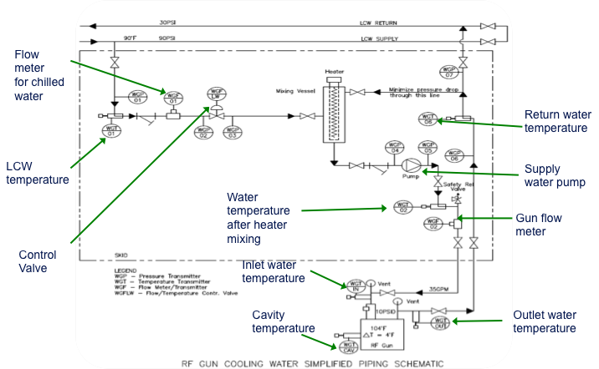
Initial Studies at ASTA
Start simple → NN temperature control of the RF gun
Figure courtesy P. Stabile
Notes:
Want to get a comprehensive benchmark for how the model and controllers will perform
Want to look at both NN-only and NN-combined with traditional control approaches

Slide 11
Model Design: What is Involved

Slide 12
Model Design: What is Involved
Design training/validation/testing data

Slide 13
Model Design: What is Involved
Design training/validation/testing data
Determine what input parameters to include

Slide 14
Model Design: What is Involved
Design training/validation/testing data
Determine what input parameters to include
Determine what preprocessing is needed
  Standardization and scaling range (e.g. -1 to 1, -0.5 to 0.5)
  Dimensionality reduction (PCA, CCA), dead-time removal (if desired)

Slide 15
Model Design: What is Involved
Design training/validation/testing data
Determine what input parameters to include
Determine what preprocessing is needed
  Standardization and scaling range (e.g. -1 to 1, -0.5 to 0.5)
  Dimensionality reduction (PCA, CCA), dead-time removal (if desired)
Determine which activation functions to use

Slide 16
Model Design: What is Involved
Design training/validation/testing data
Determine what input parameters to include
Determine what preprocessing is needed
  Standardization and scaling range (e.g. -1 to 1, -0.5 to 0.5)
  Dimensionality reduction (PCA, CCA), dead-time removal (if desired)
Determine which activation functions to use
Determine an appropriate sampling rate for the inputs

Slide 17
Model Design: What is Involved
Design training/validation/testing data
Determine what input parameters to include
Determine what preprocessing is needed
  Standardization and scaling range (e.g. -1 to 1, -0.5 to 0.5)
  Dimensionality reduction (PCA, CCA), dead-time removal (if desired)
Determine which activation functions to use
Determine an appropriate sampling rate for the inputs
Find the appropriate lag space

Slide 18
Model Design: What is Involved
Design training/validation/testing data
Determine what input parameters to include
Determine what preprocessing is needed
  Standardization and scaling range (e.g. -1 to 1, -0.5 to 0.5)
  Dimensionality reduction (PCA, CCA), dead-time removal (if desired)
Determine which activation functions to use
Determine an appropriate sampling rate for the inputs
Find the appropriate lag space
Find an appropriate topology
  number of hidden layers
  number of nodes in each layer
  interconnections between nodes

Slide 19
Model Design: What is Involved
Design training/validation/testing data
Determine what input parameters to include
Determine what preprocessing is needed
  Standardization and scaling range (e.g. -1 to 1, -0.5 to 0.5)
  Dimensionality reduction (PCA, CCA), dead-time removal (if desired)
Determine which activation functions to use
Determine an appropriate sampling rate for the inputs
Find the appropriate lag space
Find an appropriate topology
  number of hidden layers
  number of nodes in each layer
  interconnections between nodes
Determine which training algorithm to use (and parameters—objective function, learning rate, etc.)

Slide 20
Model Design: What is Involved
Design training/validation/testing data
Determine what input parameters to include
Determine what preprocessing is needed
  Standardization and scaling range (e.g. -1 to 1, -0.5 to 0.5)
  Dimensionality reduction (PCA, CCA), dead-time removal (if desired)
Determine which activation functions to use
Determine an appropriate sampling rate for the inputs
Find the appropriate lag space
Find an appropriate topology
  number of hidden layers
  number of nodes in each layer
  interconnections between nodes
Determine which training algorithm to use (and parameters—objective function, learning rate, etc.)
Design an appropriate adaptation procedure, if applicable

Slide 21
Model Design: What is Involved
Design training/validation/testing data
Determine what input parameters to include
Determine what preprocessing is needed
  Standardization and scaling range (e.g. -1 to 1, -0.5 to 0.5)
  Dimensionality reduction (PCA, CCA), dead-time removal (if desired)
Determine which activation functions to use
Determine an appropriate sampling rate for the inputs
Find the appropriate lag space
Find an appropriate topology
  number of hidden layers
  number of nodes in each layer
  interconnections between nodes
Determine which training algorithm to use (and parameters—objective function, learning rate, etc.)
Design an appropriate adaptation procedure, if applicable
→ 15-fold validation: especially important if re-training!

Slide 22
Model Design: What is Involved
Design training/validation/testing data
Determine what input parameters to include
Determine what preprocessing is needed
  Standardization and scaling range (e.g. -1 to 1, -0.5 to 0.5)
  Dimensionality reduction (PCA, CCA), dead-time removal (if desired)
Determine which activation functions to use
Determine an appropriate sampling rate for the inputs
Find the appropriate lag space
Find an appropriate topology
  number of hidden layers
  number of nodes in each layer
  interconnections between nodes
Determine which training algorithm to use (and parameters—objective function, learning rate, etc.)
Design an appropriate adaptation procedure, if applicable
→ 15-fold validation: especially important if re-training!
→ For a NN model to be useful in control, also need to keep real-time implementation in mind
  Speed of communication channels and actuators
  Speed of adaptation procedures, speed of NN I-O processing
  Data sampling rate vs. execution speed

Slide 23
Model Design: What is Involved
Design training/validation/testing data
Determine what input parameters to include
Determine what preprocessing is needed
  Standardization and scaling range (e.g. -1 to 1, -0.5 to 0.5)
  Dimensionality reduction (PCA, CCA), dead-time removal (if desired)
Determine which activation functions to use
Determine an appropriate sampling rate for the inputs
Find the appropriate lag space
Find an appropriate topology
  number of hidden layers
  number of nodes in each layer
  interconnections between nodes
Determine which training algorithm to use (and parameters—objective function, learning rate, etc.)
Design an appropriate adaptation procedure, if applicable
→ 15-fold validation: especially important if re-training!
→ For a NN model to be useful in control, also need to keep real-time implementation in mind
  Speed of communication channels and actuators
  Speed of adaptation procedures, speed of NN I-O processing
  Data sampling rate vs. execution speed
112 candidates x 15-fold validation → 1680 NN to train

Slide 24
Model Design: What is Involved
Design training/validation/testing data
Determine what input parameters to include
Determine what preprocessing is needed
  Standardization and scaling range (e.g. -1 to 1, -0.5 to 0.5)
  Dimensionality reduction (PCA, CCA), dead-time removal (if desired)
Determine which activation functions to use
Determine an appropriate sampling rate for the inputs
Find the appropriate lag space
Find an appropriate topology
  number of hidden layers
  number of nodes in each layer
  interconnections between nodes
Determine which training algorithm to use (and parameters—objective function, learning rate, etc.)
Design an appropriate adaptation procedure, if applicable
→ 15-fold validation: especially important if re-training!
→ For a NN model to be useful in control, also need to keep real-time implementation in mind
  Speed of communication channels and actuators
  Speed of adaptation procedures, speed of NN I-O processing
  Data sampling rate vs. execution speed
112 candidates x 15-fold validation → 1680 NN to train
40 minutes to train (on average)

Slide 25
Model Design: What is Involved
Design training/validation/testing data
Determine what input parameters to include
Determine what preprocessing is needed
  Standardization and scaling range (e.g. -1 to 1, -0.5 to 0.5)
  Dimensionality reduction (PCA, CCA), dead-time removal (if desired)
Determine which activation functions to use
Determine an appropriate sampling rate for the inputs
Find the appropriate lag space
Find an appropriate topology
  number of hidden layers
  number of nodes in each layer
  interconnections between nodes
Determine which training algorithm to use (and parameters—objective function, learning rate, etc.)
Design an appropriate adaptation procedure, if applicable
→ 15-fold validation: especially important if re-training!
→ For a NN model to be useful in control, also need to keep real-time implementation in mind
  Speed of communication channels and actuators
  Speed of adaptation procedures, speed of NN I-O processing
  Data sampling rate vs. execution speed
112 candidates x 15-fold validation → 1680 NN to train
40 minutes to train (on average)
47 days

Slide 26
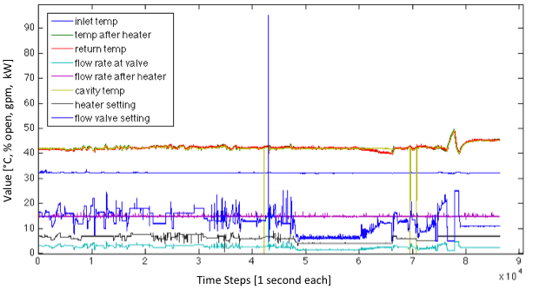
Data Obtained for the Initial Model Design
~24 hours of data total

Slide 27
Data Obtained for the Initial Model Design
~24 hours of data total
~14 hours of pseudo-random input (without regulation)

Slide 28
Data Obtained for the Initial Model Design
~24 hours of data total
~14 hours of pseudo-random input (without regulation)
~5 hours with changing RF power to the gun (with regulation) → cavity conditioning

Slide 29
Data Obtained for the Initial Model Design
~24 hours of data total
~14 hours of pseudo-random input (without regulation)
~5 hours with changing RF power to the gun (with regulation) → cavity conditioning
The rest is steady-state regulation with existing controller

Slide 30
Closer View of Cavity Temperature
Cavity Temperature [°C ]
Time Steps [2 seconds each]

Slide 31
Model Design: Input Parameter Selection
Choose parameters which make sense a priori
Get rid of redundant parameters
Where uncertain, investigate candidate models with 15-fold validation
Highly Correlated Parameters
Notes:
Can also use PCA and CCA to reduce dimensionality, but this adds computation time and isn’t always accurate depending on the system
Here, we have few enough variables that we can avoid it

Slide 32
Model Design: Input Parameter Selection
Chosen Parameters
  Flow Control Valve Setting
  Heater Setting
  LCW Temperature
  Cavity Temperature

Slide 33
Model Design: Input Parameter Selection
Chosen Parameters
  Flow Control Valve Setting
  Heater Setting
  LCW Temperature
  Cavity Temperature
Other candidate models examined
  Adding return temperature as an input (with appropriate delay)
  Excluding previous cavity temperatures as an input
  Reducing the number of previous cavity temperatures used as input

Slide 34
Model Design: Input Parameter Selection
Chosen Parameters
  Flow Control Valve Setting
  Heater Setting
  LCW Temperature
  Cavity Temperature
Other candidate models examined
  Adding return temperature as an input (with appropriate delay)
  Excluding previous cavity temperatures as an input
  Reducing the number of previous cavity temperatures used as input
  Did well, but not as well as the originally proposed model

Slide 35
Initial Training, Validation, and Testing Data
With more challenging
test data to follow

Slide 36
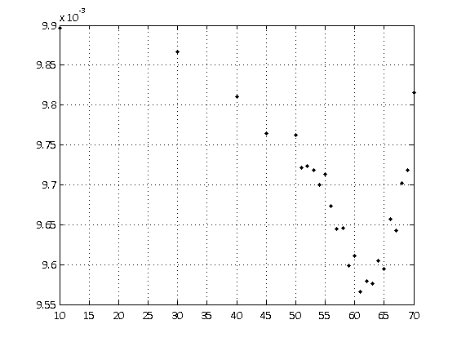
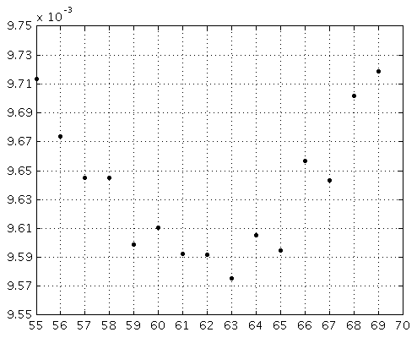
Model Design: Variable Dead-Time Removal
Measurements supply a starting point → but the delays vary
Empirical study with NN gives an optimal solution
25 candidates
15-fold validation
Rough Search
Refined Search
Root Mean Squared Error [°C ]
Time Removed [s]
Time Removed [s]
Notes:
Large system dead-time, can remove this, but what is the most appropriate shift to use?
Lots of ways to estimate this a priori if needed, especially for linear systems
However, we have the advantage of being able to just take a look at the system empirically
Can then zero-in on the appropriate value by looking at the error index
Note recursive process→ had found a good number of hidden layers to use, then did this study
60 seconds chosen→ better to have more information than less

Slide 37
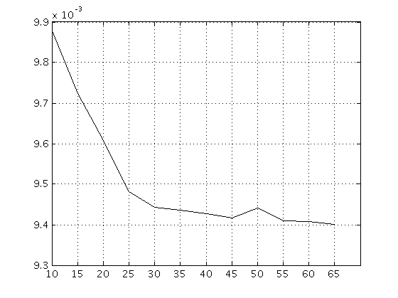
Model Design: Embedding Dimension
12 candidates
15-fold validation
Root Mean Squared Error [°C ]
Number of Previous Time Steps Used as Inputs
(each time step is now 2 seconds)

Slide 38
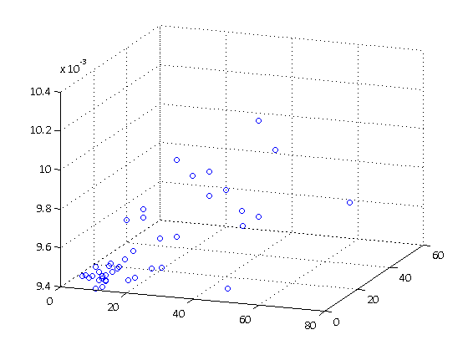
Number of Hidden Layers and Nodes
55 candidates for two-layer network
30 other candidates (not shown): recurrent, single-layer
Root Mean Squared Error [°C ]
Nodes in Hidden Layer 2
Nodes in Hidden Layer 1

Slide 39
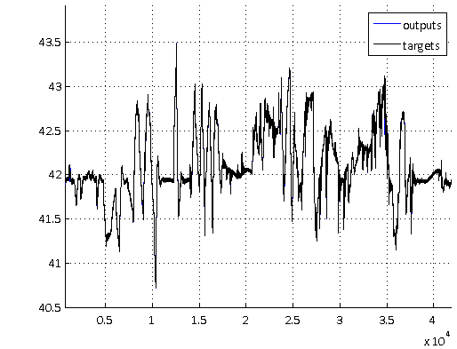
Performance Over Training and Validation Set
0.0094 RMSE validation set
0.0092 RMSE training set
Cavity Temperature [°C ]
Time Steps [2 seconds each]

Slide 40
Testing Regions

Slide 41
Testing Regions
Region 1: pseudo-random impulses

Slide 42
Testing Regions
Region 1: pseudo-random impulses
Region 2: steady-state with regulation

Slide 43
Testing Regions
Region 1: pseudo-random impulses
Region 2: steady-state with regulation
Region 3: cavity conditioning, slow change in RF power

Slide 44
Testing Regions
Region 1: pseudo-random impulses
Region 2: steady-state with regulation
Region 3: cavity conditioning, slow change in RF power
Region 4: cavity conditioning, faster change in RF power

Slide 45
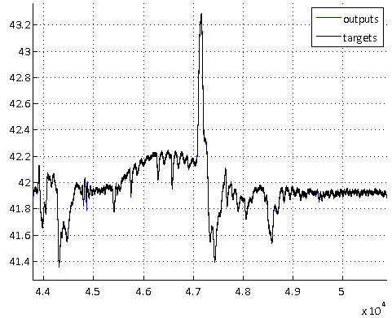
Performance in Testing Region 1
0.0100 RMSE
Cavity Temperature [°C ]
Time Steps [2 seconds each]

Slide 46
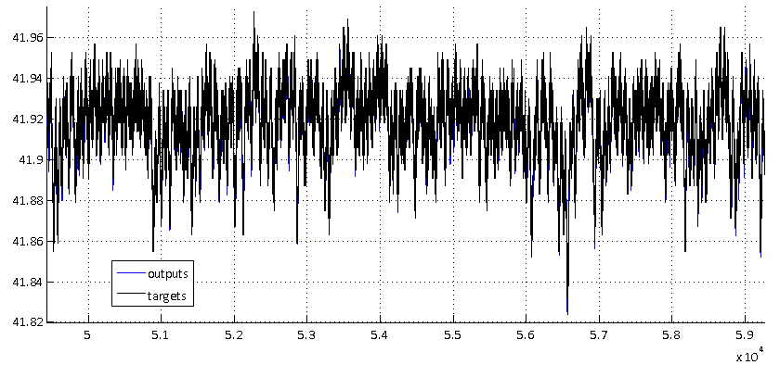
Performance in Testing Region 2
Cavity Temperature [°C ]
Time Steps [2 seconds each]
0.0096 RMSE

Slide 47
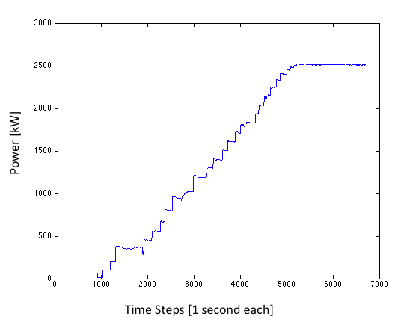
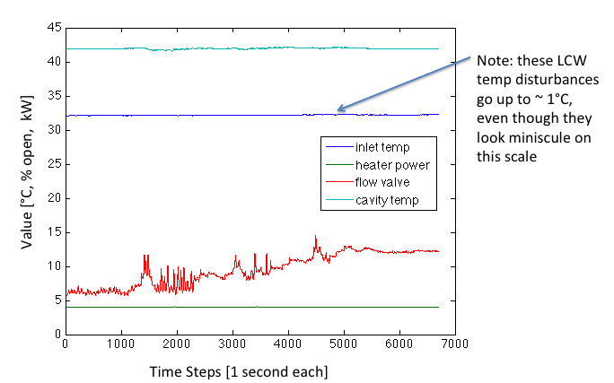
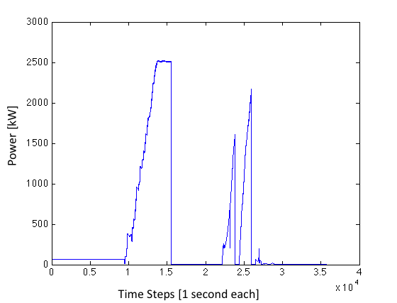
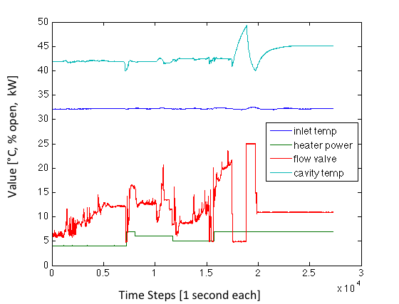
Testing Regions 3 and 4
Changes to RF Power
RF Power
(N:PMTR9)
Notes:
Note the 2nd image contains the 1st region also

Slide 48
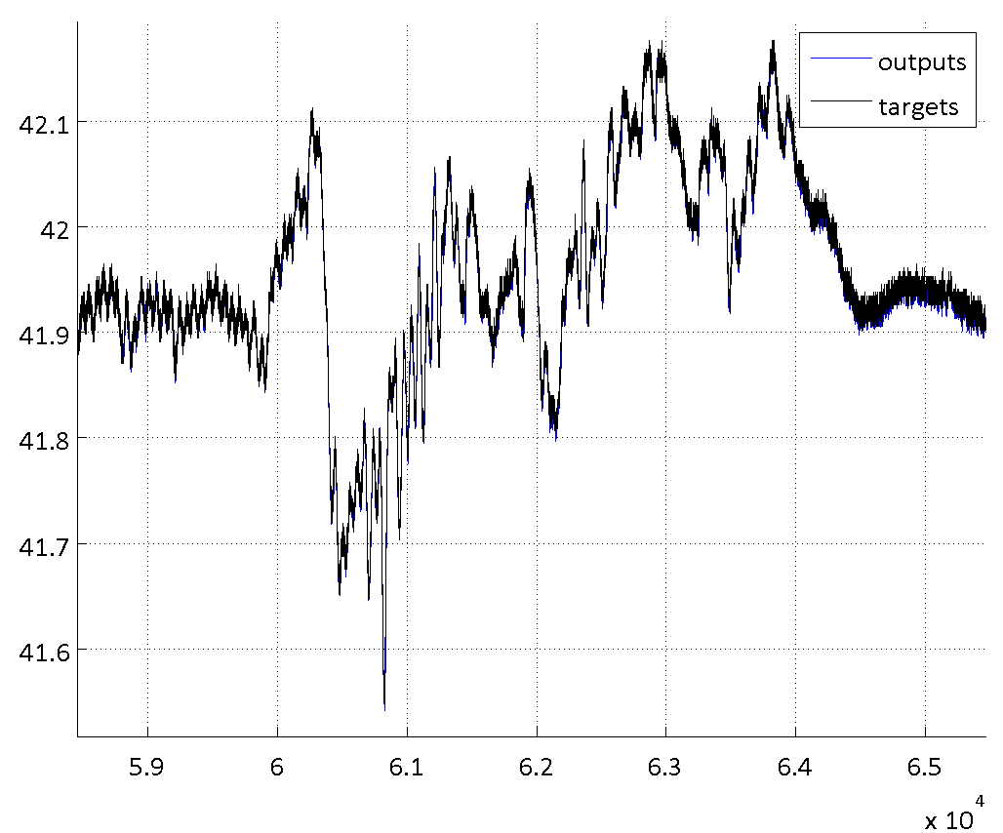
Performance on Testing Region 3
0.0156 RMSE
Cavity Temperature [°C ]
Time Steps [2 seconds each]

Slide 49
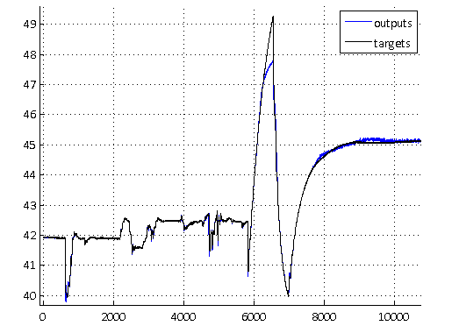
Performance on Testing Region 4
0.0549 RMSE
Cavity Temperature [°C ]
Time Steps [2 seconds each]

Slide 50
Performance on Testing Region 4
0.0549 RMSE
Cavity Temperature [°C ]
Time Steps [2 seconds each]

Slide 51
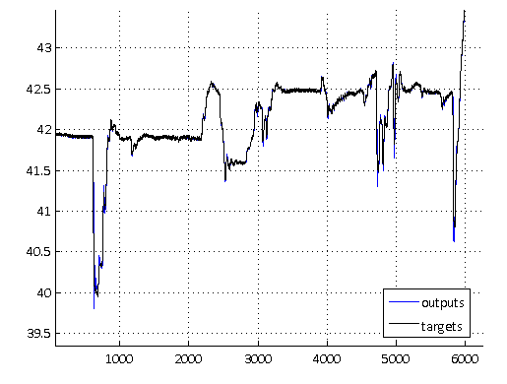
Performance on Testing Region 4
Cavity Temperature [°C ]
Time Steps [2 seconds each]

Slide 52
Performance on Testing Region 4 with Adaptation
0.0099 RMSE
Cavity Temperature [°C ]
Time Steps [2 seconds each]

Slide 53
What about large changes and different operating regimes?

Slide 54
What about large changes and different operating regimes?
Several options:
  Online adaptation
    Slow and potentially unstable for large, rapid changes
    Loss of previous learning

Slide 55
What about large changes and different operating regimes?
Several options:
  Online adaptation
    Slow and potentially unstable for large, rapid changes
    Loss of previous learning
  Use RF power as an input and train across the operating regimes
    Would need a lot of data for many transition types → time intensive + likely not feasible to capture adequately
    Likely would need to a more cumbersome NN structure

Slide 56
What about large changes and different operating regimes?
Several options:
  Online adaptation
    Slow and potentially unstable for large, rapid changes
    Loss of previous learning
  Use RF power as an input and train across the operating regimes
    Would need a lot of data for many transition types → time intensive + likely not feasible to capture adequately
    Likely would need to a more cumbersome NN structure
  Train several NNs with data gathered in different operating regimes
    Can switch models in control routines
    Can adapt online for small adjustments
    Many small models instead of one large, potentially problematic model

Slide 57
Current and Next Steps
Fully characterize model performance under challenging conditions
  If the model won’t perform well, a model-based controller certainly won’t
  Need to test in real-time while doing I-O though ACNET
  Need to test different updating schemes
  Need to test regime-switching schemes
Improve implementation of control script in Matlab
  Real-time execution of NN, I-O with ACNET, optimization procedure, data preprocessing
  Several computationally intensive processes
  → tested ACNET and NN I-O previously with a very limited direct inverse controller, but this did not involve any updating or optimization routines
Improve execution speed for Model Predictive Controller optimization
  Instantaneous linearization
  Different algorithm
Simulations of controller performance
Test controller output only
Test controller operation in training regime

