Slide 1
D30 SS Reconfigure
Final Design
Dean Still
4-17-2014

Slide 2
Outline
D30 SS Reconfigure Defined
Constraints – Mu2e In-tunnel shielding
Dealing with cables
Cable trays
Final D30 SS layout
Moving magnets
LCW
Bus work
Electrical / Lighting
Instrumentation
Vacuum
Trims
Service Building
Kicker power
M4 Power Cables
M3 Power Cables

Slide 3
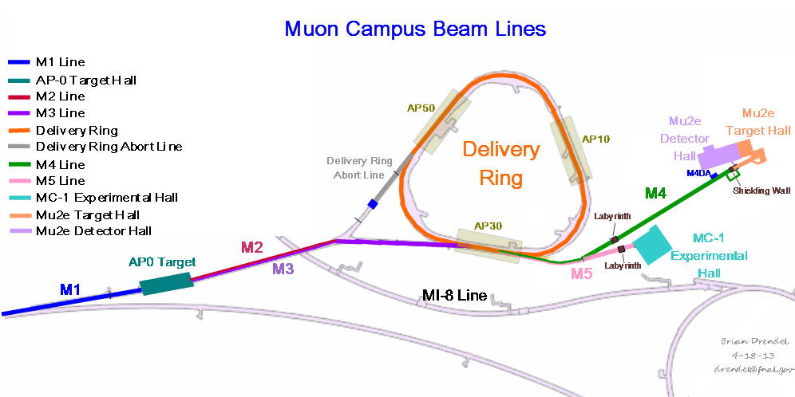
Muon Campus Overview
This the area that will be involved in the reconfiguration.
It is defined as the 30 straight section. (AP30 Service Building)

Slide 4
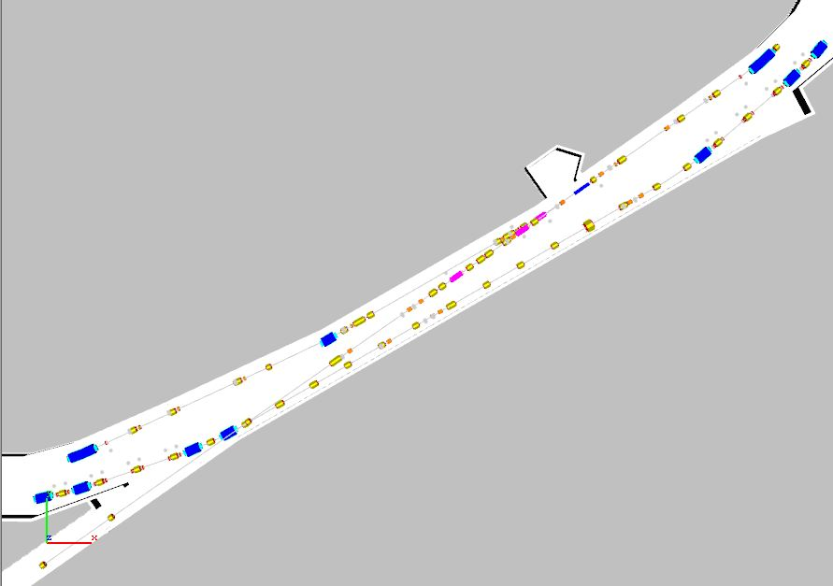
Current 30 Tunnel Section Layout
Overview of what needs to be reconfigured
Obsoleted AP3 Line
Obsoleted Accumulator
Remove the AP3 Line.
Store magnets in the tunnel
reuse.
Current Debuncher - Future Delivery Ring

Slide 5
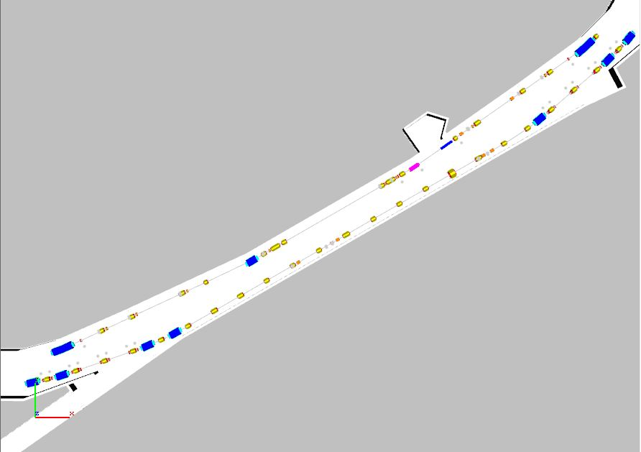
Remove the AP3 Line
Remove the Accumulator components
in the 30 straight section.
Note: Most AP3 Line components will be reused in the M2,M3,M4 and M5 beam lines.
Elements will need to be stored in the tunnel and categorized.

Slide 6
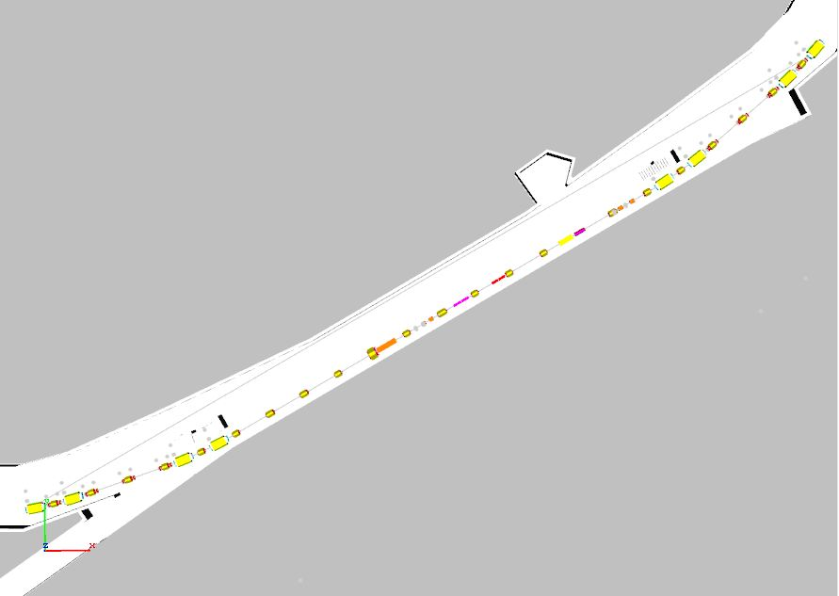
Prepare Room for M3 and M4 Installation
Remove and store all DR components
from D3Q11 to D3Q2.
Note: Most Accumulator magnet components will be reused in the M2, M3, M4 and M5 beam lines and stored in the tunnel until installed.
Collider equipment 10 stochastic cooling tanks will be removed from the tunnel.

Slide 7
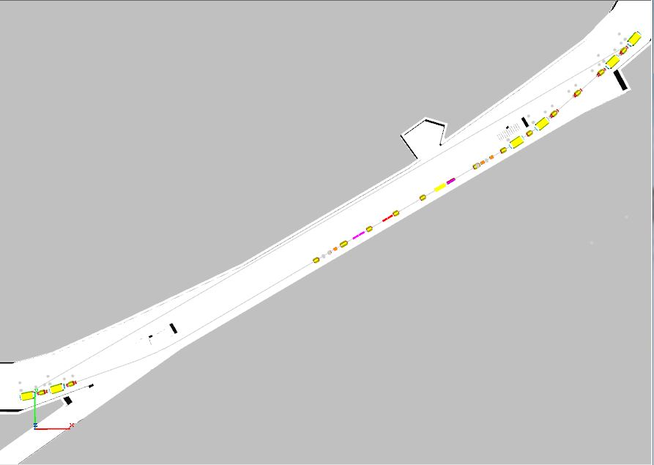
Remove the DR M3 Side
Remove and store all DR components
from D2Q4 to D2Q11.
Note: Collider equipment
8 stochastic cooling tanks and DRF3 will be removed from tunnel.

Slide 8
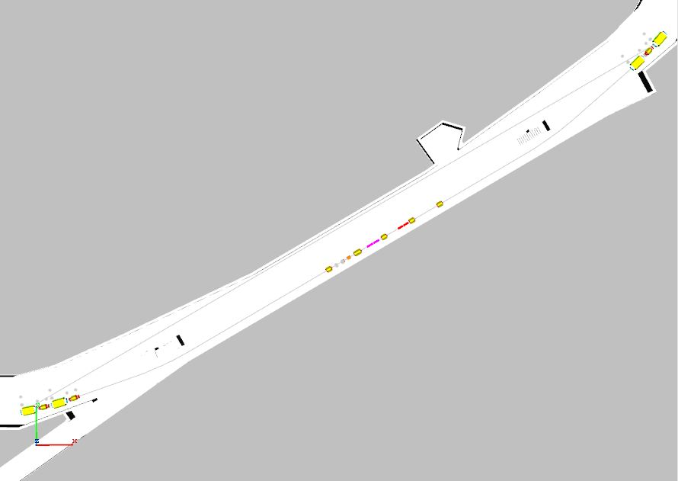
Remove DR on M4 Side
Install the DR Injection devices and the M3 Beam Line

Slide 9
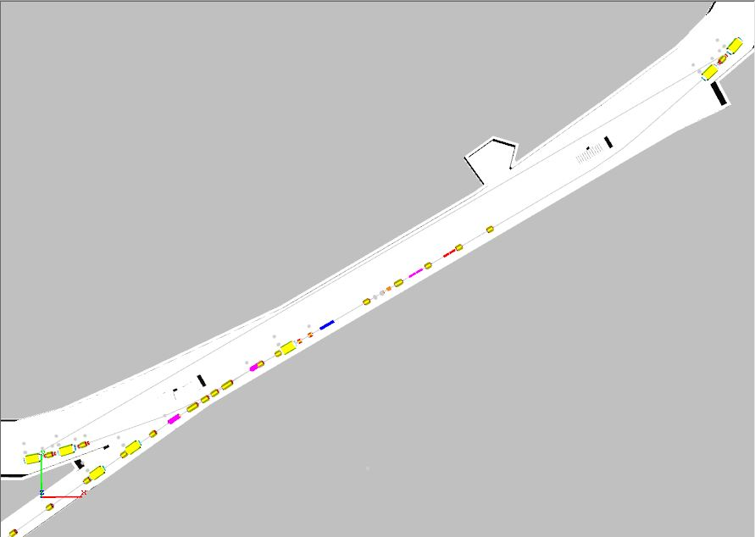
Install the M4 Beam Line
Install the DR extraction devices and the M4 Beam Line

Slide 10
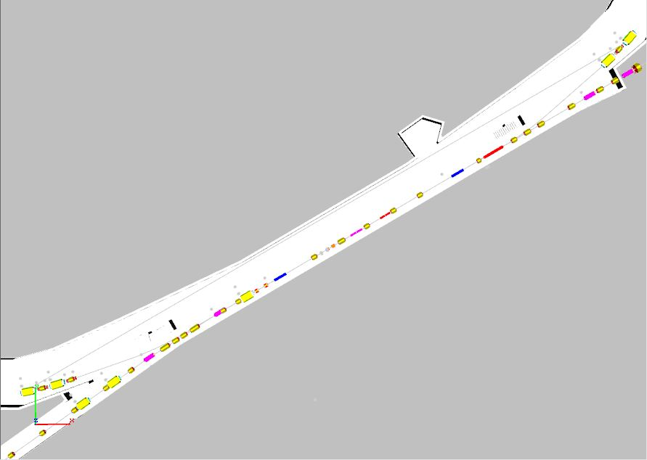
Install M4 Beam Line + DR Extraction Components
Reinstall the DR from D3Q11 to D3Q3
And D2Q4 to D2Q11

Slide 11
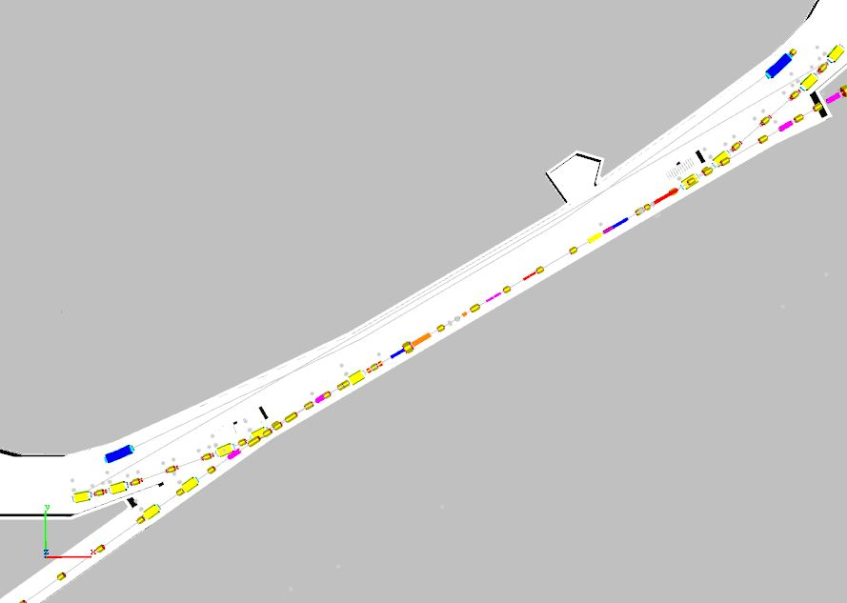
Completed Reconfiguration of 30 Straight Section
New M4
Beam Line
New Extraction Devices
New Injection Devices
Delivery Ring
New M3 Beam Line

Slide 12
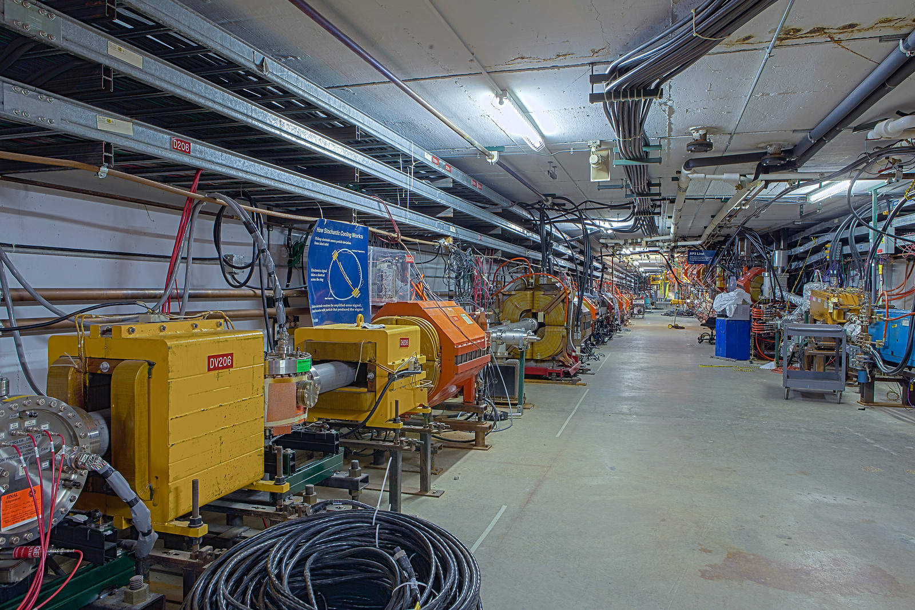
30 Straight Section Tunnel
AP3 Line
M4 Side of
Delivery Ring
Accumulator

Slide 13
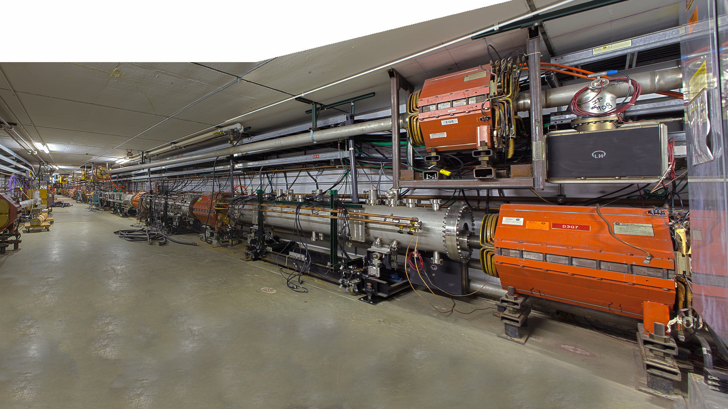
D30 Straight Section - Current

Slide 14
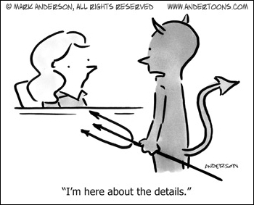
The Devil is in the ……….

Slide 15
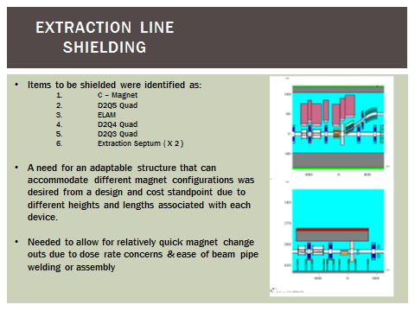
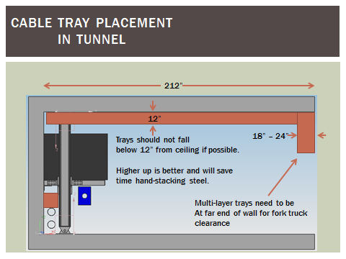
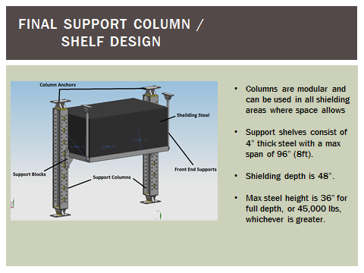
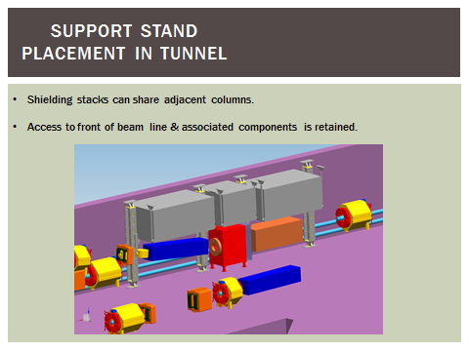
Mu2e In Tunnel Shielding Constraints
From C. Crowley: Mu2e-doc-3880

Slide 16
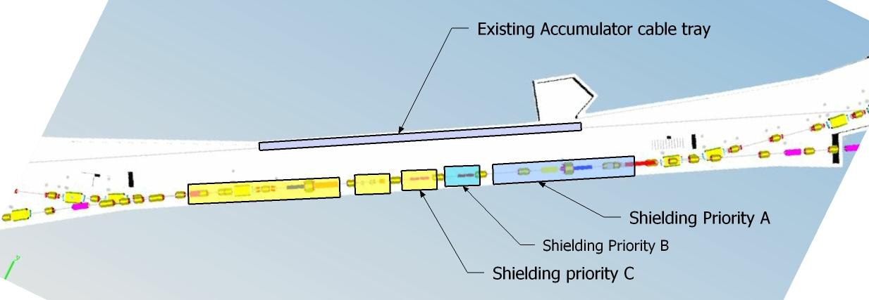
In-Tunnel Shielding Priority
Since there are so many possible shielding
Priorities in the D30 SS, should assume all
space above the beamline and 6.5’ from the wall to be reserved for shielding for ~ 180 ‘ of the SS.
(Mu2e-doc-1872)

Slide 17
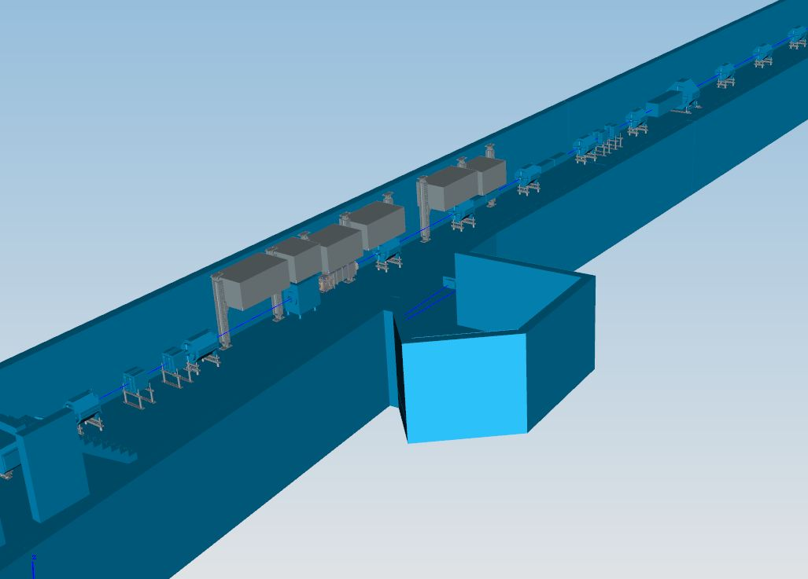
Mu2e In- Tunnel Shielding Incorporated Look

Slide 18
Cable Trays and Cables
The design criteria for the D30SS is:
  There can be NO cable trays on the DR side from D2Q11 to D3Q11. Reason: Interference of M3 and M4 beamlines on the top, interference of In-Tunnel shielding or potential shielding, egress areas for transporting magnets at D3Q9 and D2Q10.
  Since all DR cable trays must be removed, all DR penetrations must be clean out.
  All currently used DR penetration cables will need to move across to the Acc side penetrations in the service building.
  Some DR penetrations will be needed for M3 and M4 power cables.

Slide 19
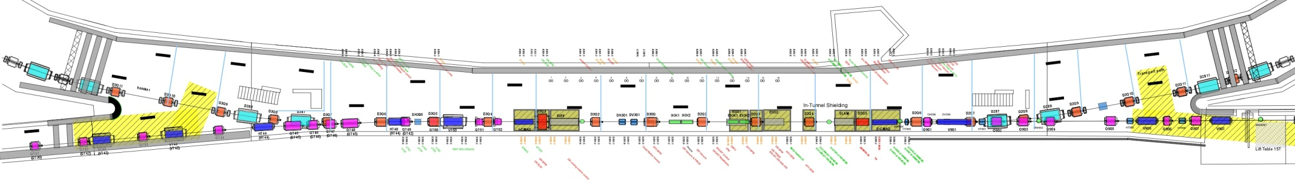
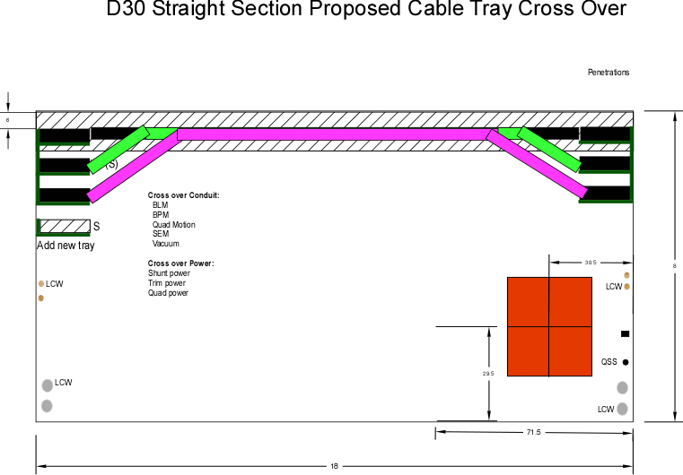
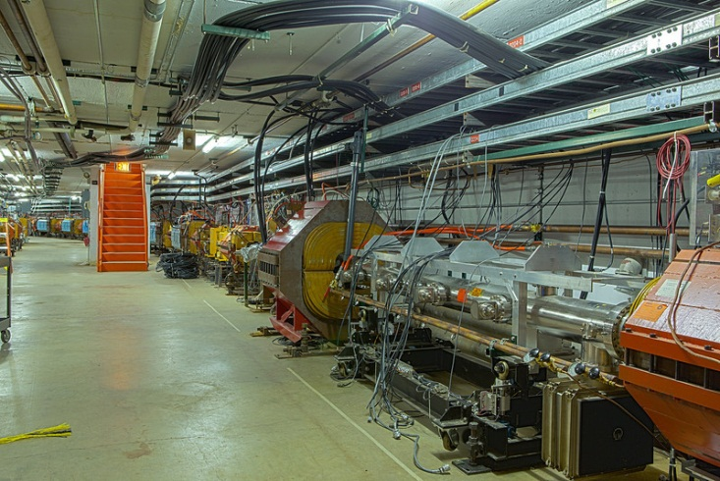
D30SS Applying Constraints
All DR cables tray (3 rows X 320ft must be removed)
All the cables that go down the DR side penetrations must be removed.
All DR side cables will go to the Acc side trays and cross over tunnel ceiling.

Slide 20
Cable Plan
Cables to Remove
- AP3 SEM
- AP3 BPM - AP3 Vacuum
- AP3 BLM - AP3 Trim magnet
Existing Cables to Deal with
- DR BLM (314 to 217) - Firus ( In DR tray to Ap10 & AP50)
- DR BPM Signal (4Q0-3Q0/ 3Q0-2Q0) - Phone ( to Ap30 tunnel & AP0)
- DR BPM preamp power (on wall) - CATV (In DR cable tray)
- Safety System (interlock to AP0) - Abort Link
- Quad Motion Control
- Network (From AP10 to AP0)
- DR vacuum (119,116,113,110,216,213,210,207,205,204,203,201,301,302,304,305,306,307)
- QF (350 MCM) -Klixon
- QD (350 MCM) -Trims (H301,V301,H305,H206,V206,H209)
- QSS (350 MCM) - Shunt DR 319 - 219 (Replace only 7 to 7 locations)
- IB (copper 2" bus)
- SF (350 MCM)
- SD (350 MCM)

Slide 21
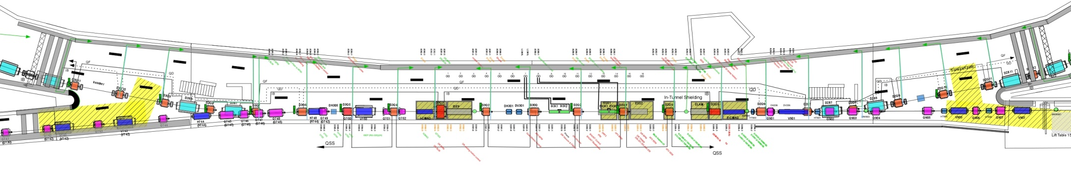
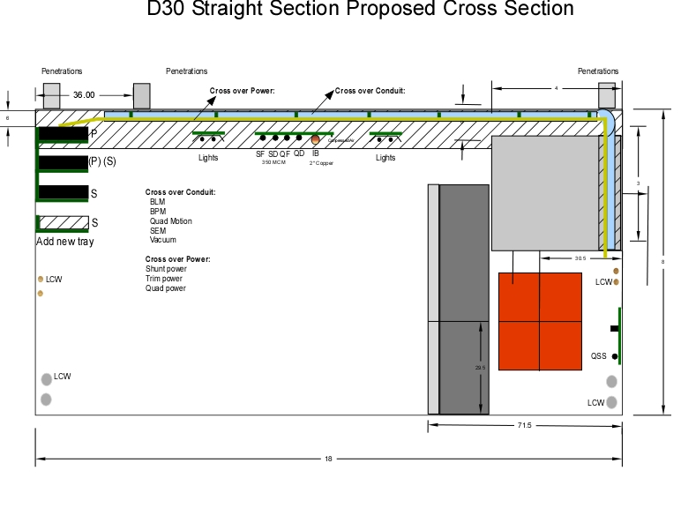
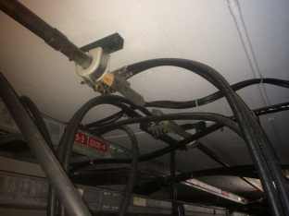
Powered Bus Solutions
Power Bus for
IB,QD,QF,SF,SD will move to overhead or in new cable tray
QSS bus and klixon will go on the wall between LCW header and sub header.

Slide 22
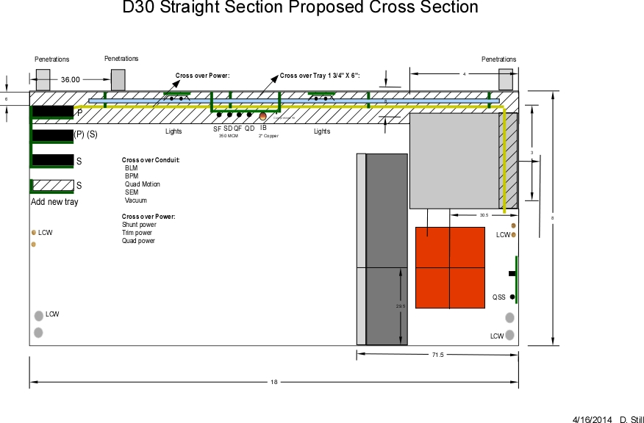
D30 SS Tunnel Cross Section

Slide 23
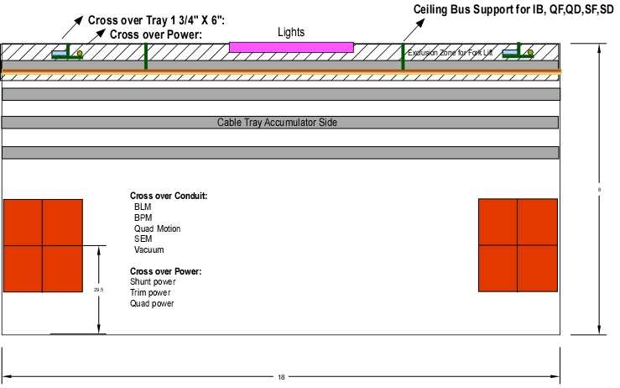
D30SS Proposed Long. Cross Section

Slide 24
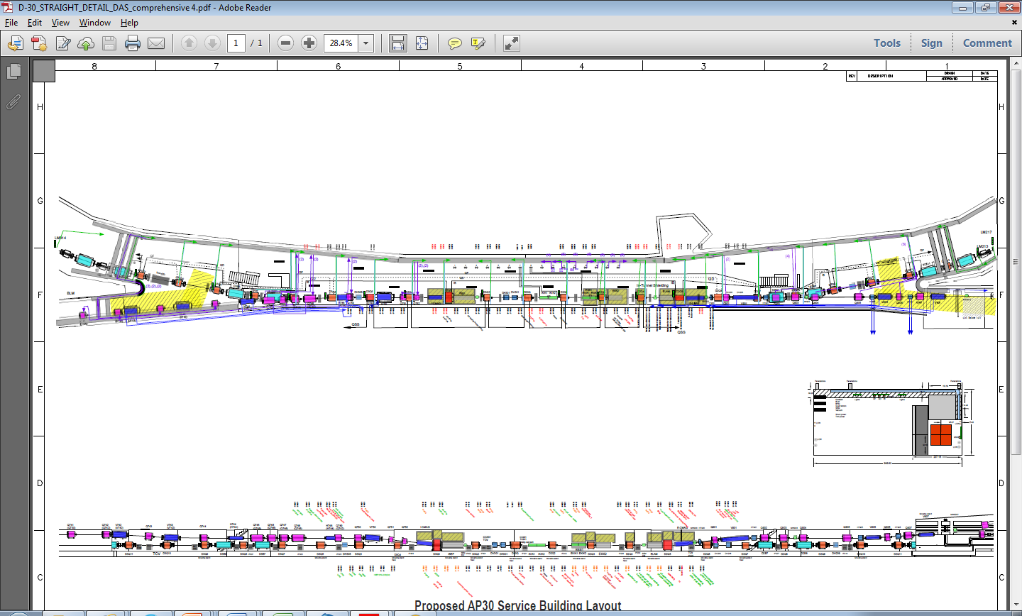
M3 & M4 Power Bus Route Plan
All M3 and M4 Quad cables will come down ACC mid penetrations and use cross over system to get to quad loads.
M3: Planning to use DR side penetrations for cables that power V742,H744,VT750,ICMAG & QT303
M4L Planning to use DR side penetrations for cables that power H910,V907,V905 &V901

Slide 25
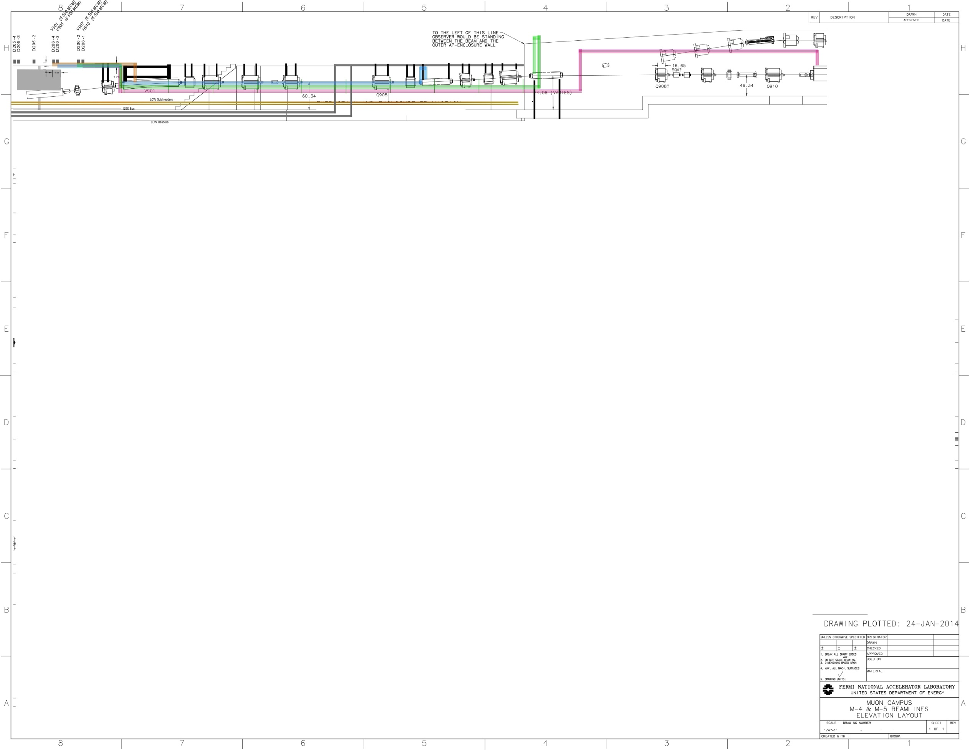
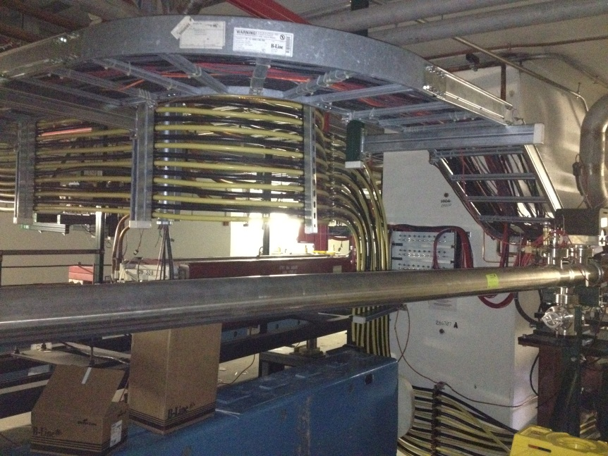

Routing M4 Dipole Magnet Cables (DR Side)
24 – 500 MCM

Slide 26
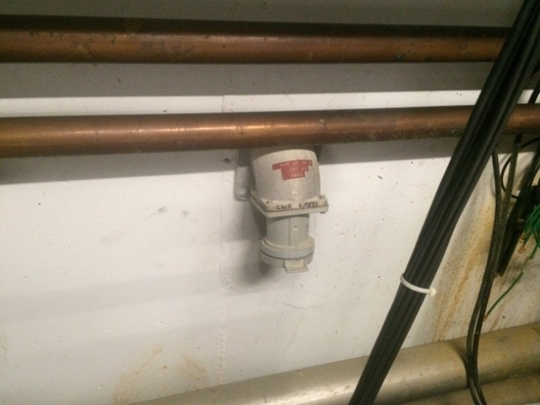
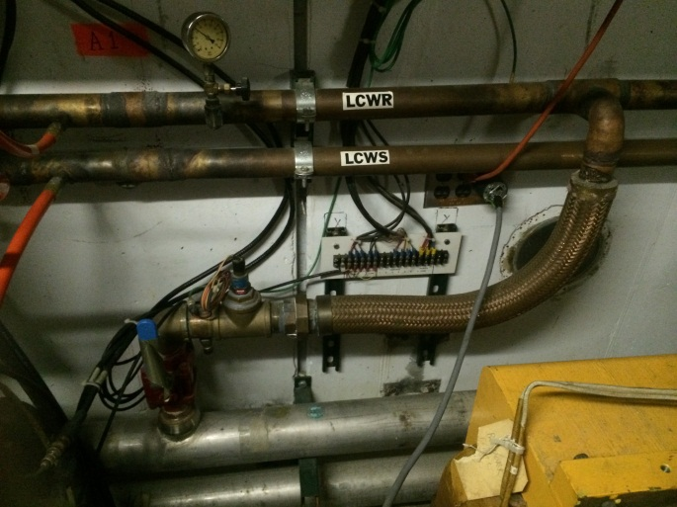
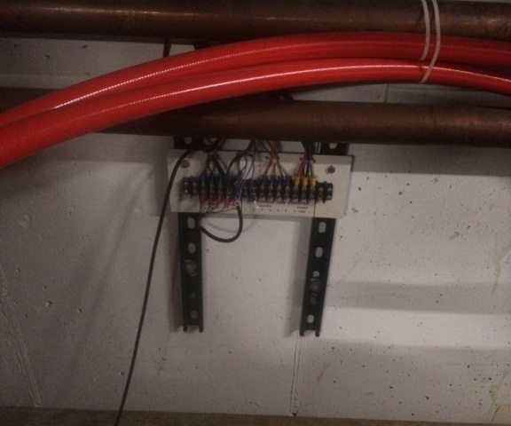
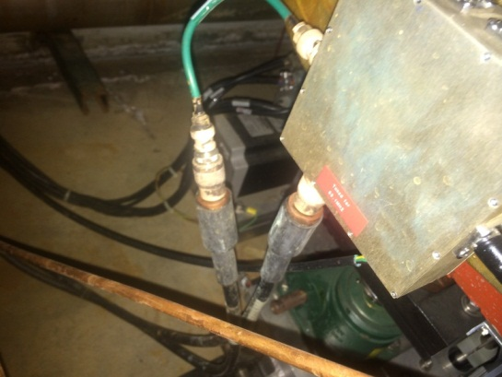
DR QSS Bus Interferences
QSS bus and klixon cables will mount on the DR wall between LCW pipes.
There are a number of
Items that interfere with the installation of the QSS bus
Welding outlet (decommission)
120 outlets (decommission)
LCW cross over ( work around)
BPM Amplifier Power (do no need for the DR BPM System)

Slide 27
Details for Cable Changes

Slide 28
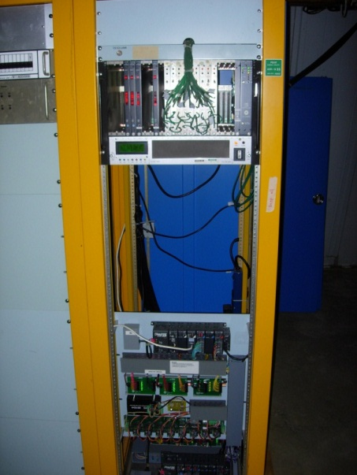
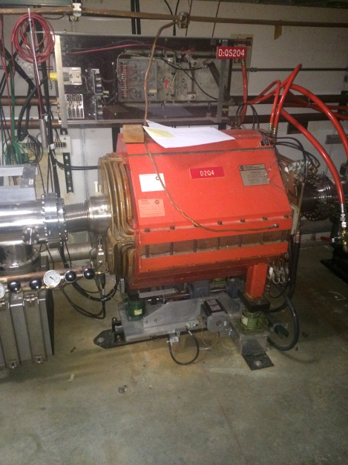
Quad Motion Control
Quad Motion Control – The quad motion control PLC hardware is found in A34R06. This crate provides motion control to quad movers for (TOP) 2Q2, 2Q10, 2Q14, 2Q17 (BOTTOM) 2Q20, 3Q6, 3Q9, 3Q12. These quad motion cables go through penetration D201-4. We will need to keep these cables. There will also be a need to add more quads with motion control in the D30SS. Quads 2Q4, 2Q6, 2Q7, 3Q0, 3Q2, 3Q4 will need to be added. There are Deb stochastic cooling motion control cables and motion hardware in rack A35R03 which use cable penetrations D302-1. These cables might be able to be reused for the additional quads with movers needed.

Slide 29
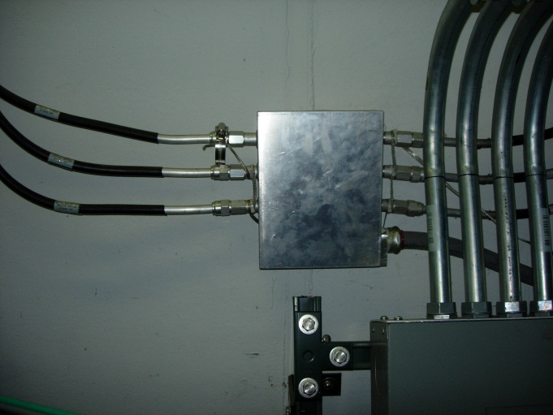
FIRUS - Solution
FIRUS - There are 2 FIRUS cables that goes down P# D204-6 and P# D305-6. These cables can be removed if the single mode fiber is pulled from AP30 to AP0. The fiber pull will be done under the AIP. A fiber will need to be pulled at each service building to the FIRUS box to get rid of the hardline.

Slide 30
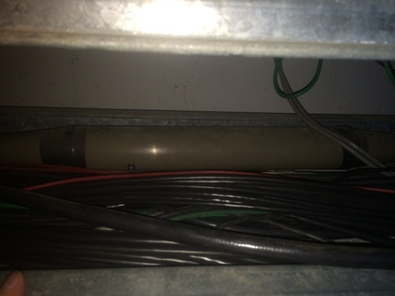
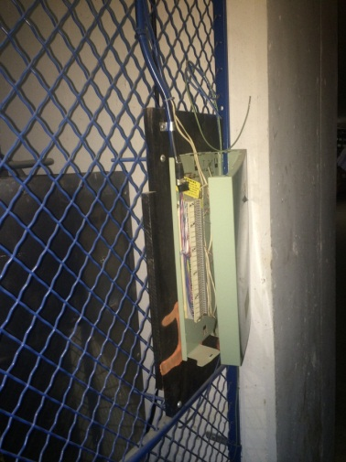
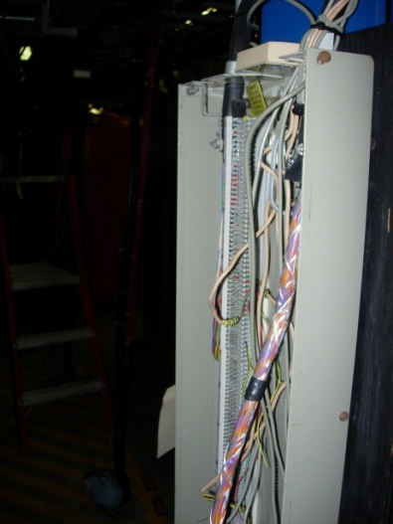
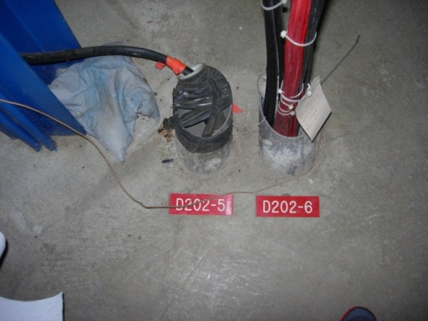
Telephone
Telephone – There is one cable that goes down Pen# D202-5 that services phone in the tunnel at AP and goes to AP10 and AP0. The cable from AP0 will cut at the splice upstream stairwell and brought to the ACC tray side and connected with the new cable in the trench. The AP10 side will cross over at the M4 cross over and spliced into the AP0 and trench cable.

Slide 31
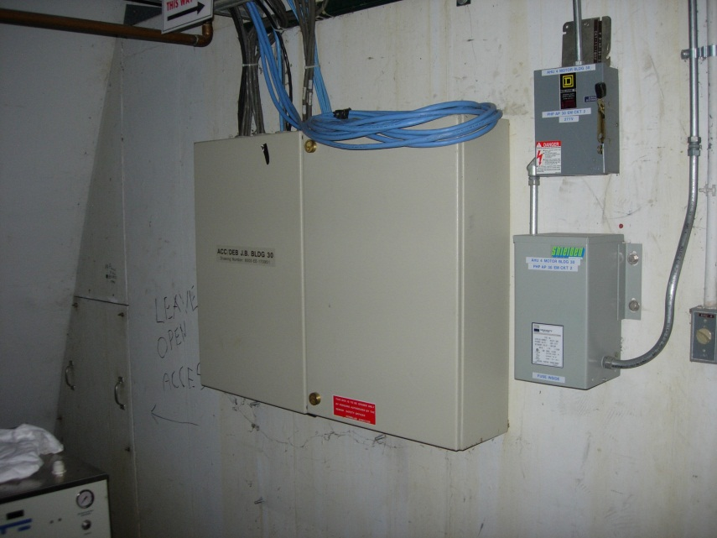
Safety System
There are 7 safety system (interlock cables) that go down Pen# D203-1.
2 cables go to AP10 on the DR side tray. These 2 cables we are going to pull back to D2B13 and then relocate them in the new cross over tray and into the ACC side tray and up Pen#A204-4.
There are also 2 cables that go to interlock boxes 19 and 20 (AP20 emergency hatch). They probably go across the ceiling in conduit. These can also be moved to the ACC side tray. Additional conduit will need to be installed by electricians for the system.
1 cable goes to interlock box 15 at the D30SS upstream stairwell. This cable can also be relocated to run in the ACC side tray. Some conduit work will be needed.
2 cables go down the DR tray side and goes to AP50. These might also be able to be pulled back and the installed in the ACC trays to Pen#204-4 once the cross over trays are installed.

Slide 32
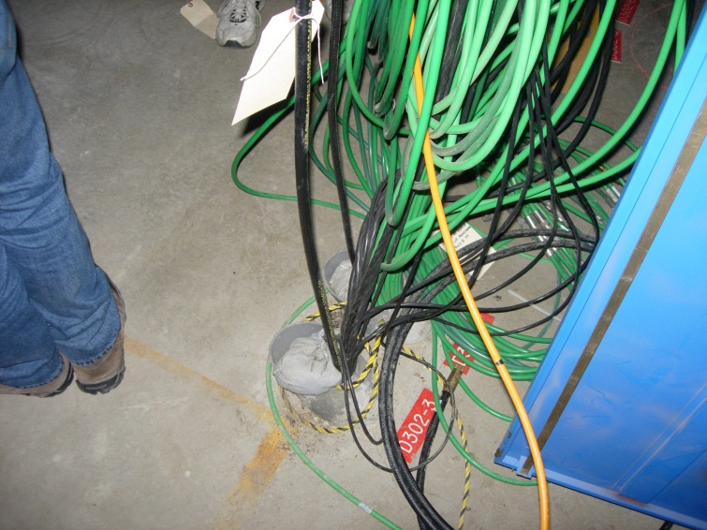
Abort Link
There is an abort line cable that goes through P# D302-3 and goes across the AP30 service building to rack B37R04.
In the tunnel this cable goes to F27 via the cable trays in the AP3 line. The cable has been located and labeled.
The plan for the cable is to roll it back to the AP3 line and bring it through the new cable trays on Acc side and through P# A304-5. There is also assumed a spare cable for this system. The spare should follow the same path.

Slide 33
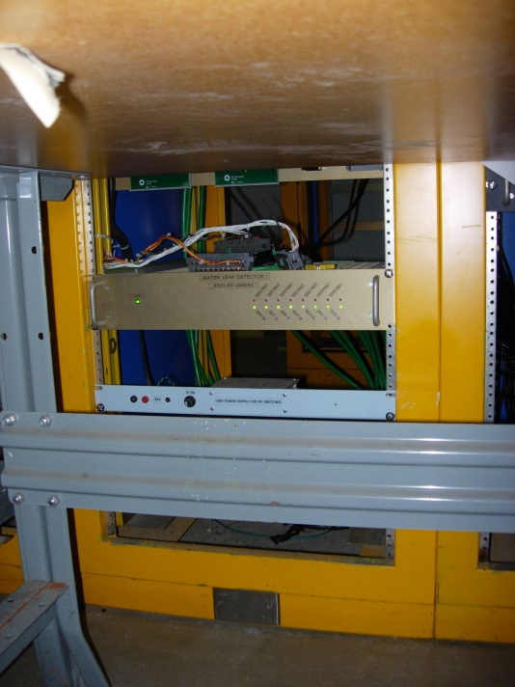
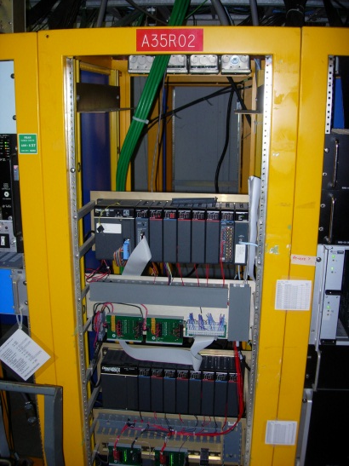
Transport Water leak System
Transport Water leak System - This system provide water floor leak indication for transport. This system needs to be maintained. Hardware is housed in rack A35R03 and cables (green) go down P# D302-4. These cables will need to move to the Acc side penetrations.

Slide 34
AP3 Cables – All cables removed
BLM 900 - 913
BPM 900 - 913
SEM 900, 906, 909,913
Toriod 910 cables to rack B37R03 (hardware is in the correct place)
Ion pump and vacuum cables from rack A34R02&R03 contains BV900, TC908, CC908, TC920,CC920 IP902,907,908,910,911,913,915,919,920,921,922,924,925 and BV 926 ( Move pumps with possible additional pump + need for CIA crate and CC interface box to
TRIM: All AP3 trim cables will need to be removed. The trim power supplies will be mounted in rack B37R01 to R03. Currently the trims that are in the these racks are B37R01 spare,V209,V206,H205,V204 B37R02 – V202,V302,V304,H305 B37R03 – HT910,V306,Vt306B,V309,VT309B B37R05 – H201,Ht201B,H204,Ht204B,HT901,HT901B,VT906,VT906B.

Slide 35
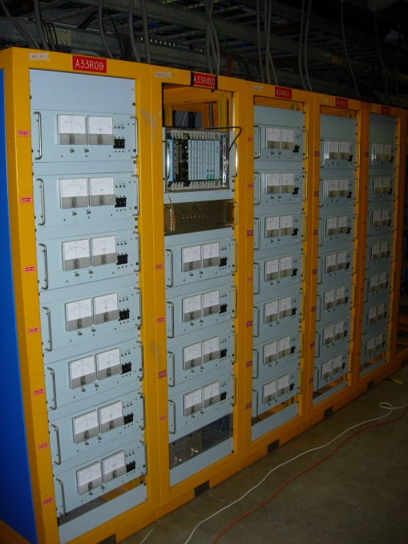
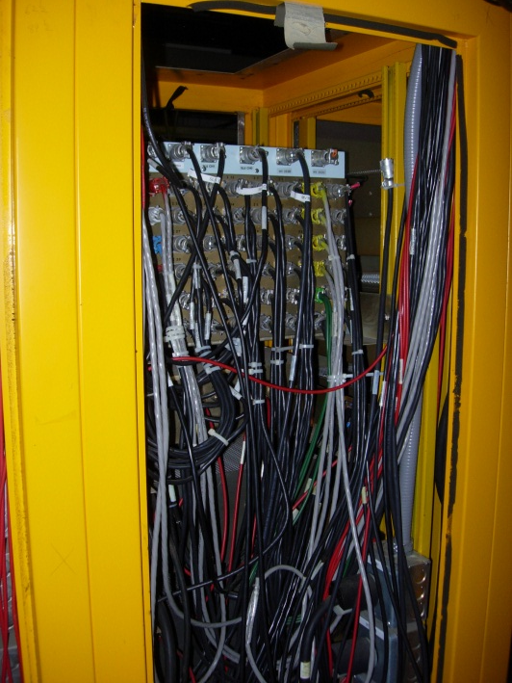
Vacuum
A34R01, A33R09 and A33R10 hold the entire D30SS vacuum.
Cables for the vacuum rack go through penetrationD201-2.
Ion pumps powered from these racks are 201, 202, 301, 302, 304, 305, 306, 307, 207, 205, 204, 203, 210, 213, 216, 119, 116, 113, 110. CC201, TC201, BV309, BV210.
All vacuum cables in the DR side penetrations will need to be removed and new cables pulled up the ACC side penetrations.
There are also permit cables that come from AP30 to AP50 and AP10 that will need to be replaced.
Cables will need to be terminated and incorporated into the CIA crate.

Slide 36
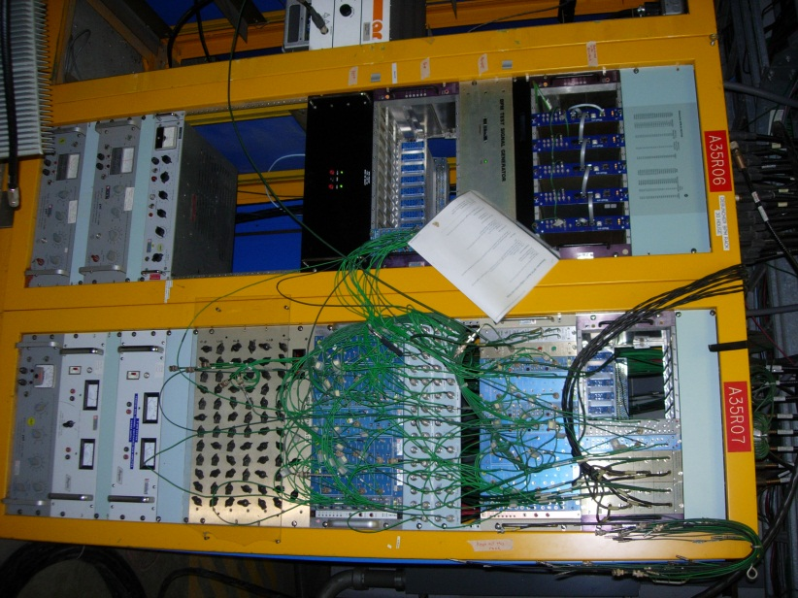
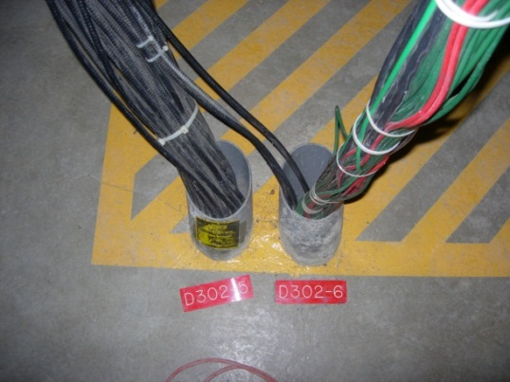
DR BLM
All BLM cables are sourced from rack A35R07 via penetration D302-6.
All Acc BLM’s will be removed. Cables and hardware.
All DR BLM signal and HV cables will be removed and pulled new and terminated and connected to the hardware.
The hardware is well labeled.
The new cables will drop the pen# A301-6 and cross in the tunnel using the cross over cable trays.
DR BLM’s that are sourced from this crate are 2Q17,2Q13,2Q10,2Q5,2Q4,2Q3,2Q2,3Q2,3Q4,3Q5,3Q6,3Q6P,3Q7,3Q8,3Q8P,3Q9,3Q11,3Q14,3Q17,3Q19

Slide 37
DR BPM
There are 2 houses of DR BPM in D30s one in rack AA35R06 and the one in A33R01.
One cables BPM’s from D3Q0 to D4Q0 and the other from D3Q0 to D2Q0. These BPM cables go through 2 penetrations.
The plan is to remove the BPM cables intact from both the DR and the Accumulator. There will need to be an increase in length for the DR cable since the cable tray will be removed that currently support the BPM cables. The DR cables will be run to the Accumulator side of the AP30 service building down the Accumulator side penetrations.
The Accumulator BPM that will be removed will be used to extend the lengths of the DR side BPM’s to account for the extra length needed.
The DR BPM systems and crates are going to move to racks B32R01 and B38R11. The ecotech cards for the new system will be installed in these crates. In the tunnel, the BPM amplifier and powered cable to the amp can be removed. The DR BPM’s in the arc’s will have their cables rolled back to the cross over cable points and then pulled to the accumulator side pen# A305-4 and A203-6.
The DR side heliax will be reused to match to the BPM system. These are phased matched cables.

Slide 38
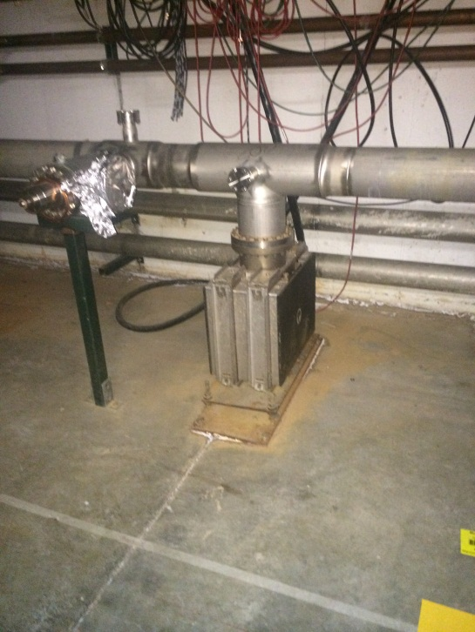
D30SS Vacuum Changes
All 8 Deb Stoch. Cooling Tanks will be removed in the straight section at 306,305,304,303 300,202,203,204.
The 270 l/s ion pumps will be removed from the cooling tanks and reused to in the these locations.
Full length spools will be needed at 306,305,304,303.
Partial length spools will be needed at 300,202,203,204 because injection of extraction devices share the section.
All Vacuum Controls will be reused with no additional hardware needed.
Ion pump stands will need to be reused from the Accumulator.
Ion pumps powered from the vacuum racks are 201, 202, 301, 302, 304, 305, 306, 307, 207, 205, 204, 203, 210, 213, 216, 119, 116, 113, 110. CC201, TC201, BV309, BV210.
Beam valve at 210 will move to 209.

Slide 39
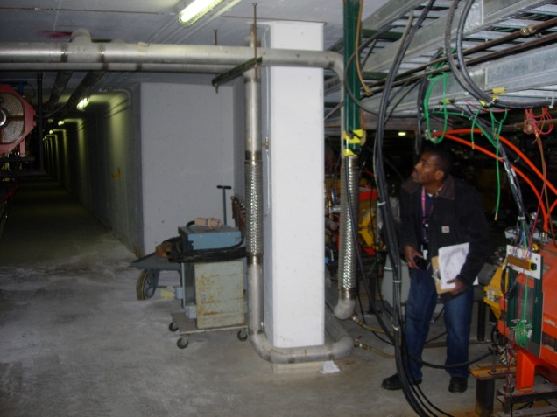


LCW Changes
M3 cross change - Cross over will move upstream ~ 25 ft to miss magnets and cable tray.
M4 cross over change – 4” header will enter new M4 enclousre and cross over where the M4 LCW comes in. Then transition back to Ring tunnel.
In Tunnel Shielding area change – LCW header to sub header changes from 19.5” to 12” from 2Q6 to 3Q0

Slide 40


Compressed Air Changes
The compressed air system has 2 pipes in the tunnel.
Use for Beam valves and air tools.
Used as a Ni let up system.
Would like to maintain both systems.
It will be mounted to ceiling bus support system. ( Might move to the bottom of the 4th Acc side cable tray)
Currently the compressed air system will tie into the Muon Campus system at MC-1.
Muon Campus compressed air system

Slide 41

Injection and Extraction Kicker

Slide 42

Removal of Shunts and Cables
Due to high radiation levels in the tunnel, shunt electronics are projected to fail and will need to be moved upstairs.
Shunts at 319,317,315,313,309,305,304,303,301,204,213,215 – since the shunt hardware is moving upstairs remove all cables and associated hardware. This should be a reading cable (crate 33) and a DAC cable provided by a C463 card crate 39. (Pen: D202-1 & D202-2)
The plan is to cable loads only from the 7 to 7 location. (cost on AIP). Removal cost on D30SS.
The new power cables will be sourced from the MI8 style shunts in rack (A35R02) and enter the tunnel through Acc side penetrations A200-5 cabled across tunnel ceiling.

Slide 43
AP30 Service Building
M3 Instrumentation
M4 Trim PS
M4 Vacuum
DR BPM
DR kickers
M4 Quad PS
DR BPM
M3 Quad PS
v
v
M3 Vacuum
DR BLM
DR Vacuum
M4 Bend PS
DR Quad Motion
DR Trim PS
M3 Dipole PS

Slide 44


Final D30 SS Configuration
Plan View
Elevation View
D30SS Over all changes:
Movable quads at 2Q7,2Q6,2Q4,2Q3,3Q0,3Q2,3Q4
Trims at H305,V301,H301,V206,H206,H209 (new, change place)
New SEM’s at 204 and 302
Q303 = LQE & Q205 = 8Q32
IKIK & EKIK (ESS1 & ESS2)
ISEP & ELAM
4 open spools – 303,304,305,306

Slide 45
Summary
The D30SS Reconfiguration is nearing a final design.
There are items that I may have missed. Please let me know if there are systems that were not explained.
Please let me know if your planned system is does not fit into the D30SS design.
Need better drawings.

Slide 46



Slide 47


Slide 48




