Slide 1
Muon Department Meeting
April 17, 2014

Slide 2
Schedule
Upcoming Review schedule very busy
  Both projects have Director Reviews in June
  June is also a budget replan period after P5 report comes out
  Both projects have DOE reviews in July/August

Slide 3
Long Shutdown Changes
LOTO for this shutdown has complications because we will be changing the loads in the tunnel.
Re-core tunnel door locks so we can issue long term shutdown keys (rings only).
Leave at least most of the shielding blocks off of the AP0 hatch.
Temporarily move interlocked gates to reduce the size of the transport enclosure. (Is this worth the trouble)

Slide 4
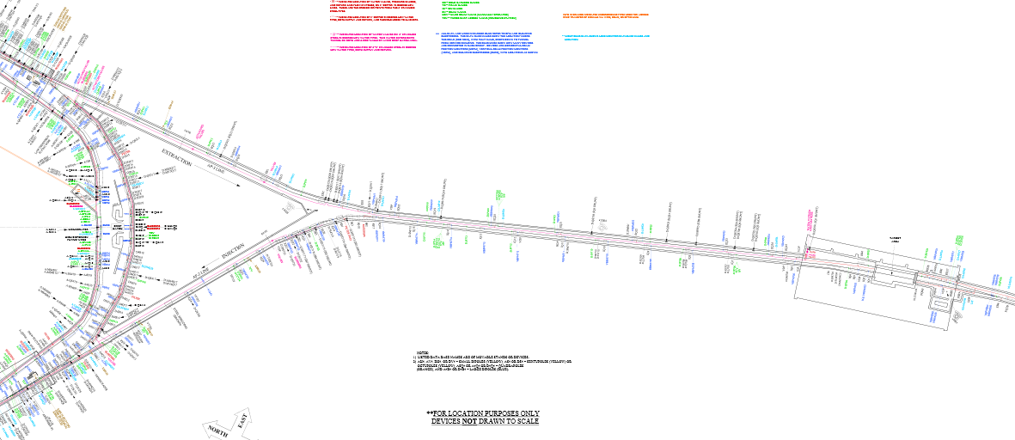
Transport Enclosure
8 GeV line
Gates

Slide 5
Safety
Transition to shutdown/construction mode.
  Many systems being moved and dismantled
  Many different types of jobs going on at once.
  Unusual configuration.
  Take some time to make sure we are working safe.
Remember that now that our shutdown begins, we have a big job to address the abandon cable issue.

Slide 8
Safety
Controlled Access violation a couple months ago
  This was an accident that could easily happen in our machine.
  Understand the importance of checking everyone’s key at the access point.
  If an unsafe condition is encountered, drop the interlocks and exit the enclosure.

