Slide 1
Slow Extraction to MTest
Michael Geelhoed
FTBF meeting - FNAL management
23 April 2014

Slide 2
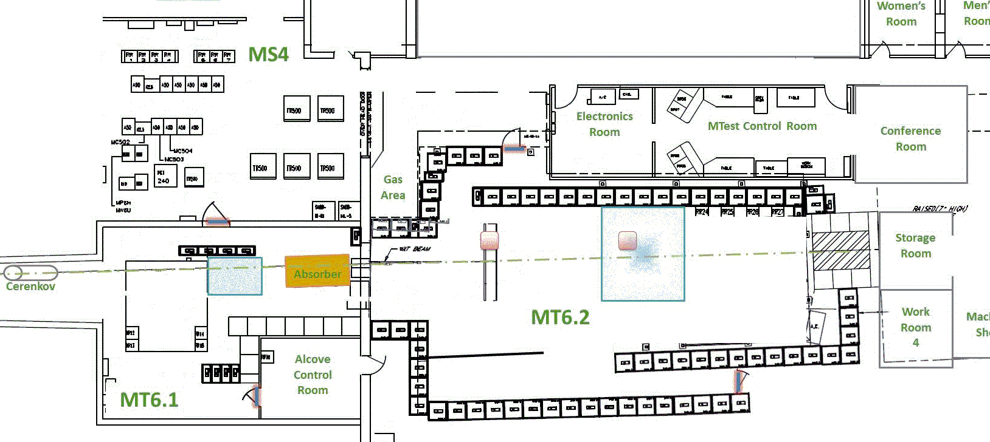
Slow Extraction to MTest
Items to be covered
General Beam Delivery
Beam Structure
Running Modes

Slide 3
Slow Extraction to MTest - General Beam Delivery
Source Linac & Booster
Beam is produced from AD’s Proton source which includes three machines. The Source, Linac and the Booster Ring. Depending on the request intensity Booster over laps beam from Linac. Each revolution in Booster is called a Turn.
Booster then delivers 8 GeV proton beam to Main Injector in bunches at a maximum of ~84 bunches at a time. This term is called a Batch.
Previous runs were partial batching*
Main Injector

Slide 4
Slow Extraction to MTest - General Beam Delivery
Source Linac & Booster
Even though physically Main Injector can hold 7 Batches, the maximum number is 6. This is because of the abort gap needed for operations.
Main Injector

Slide 5
Slow Extraction to MTest - General Beam Delivery
Source Linac & Booster
Beam is ramped from 8 to 120 Gev and held at the flattop value and resonantly extracted 4 seconds.
Main Injector

Slide 6
Slow Extraction to MTest - General Beam Delivery
Field Free Region
Field Region
2 Electrostatic Septa
Not to scale*

Slide 7
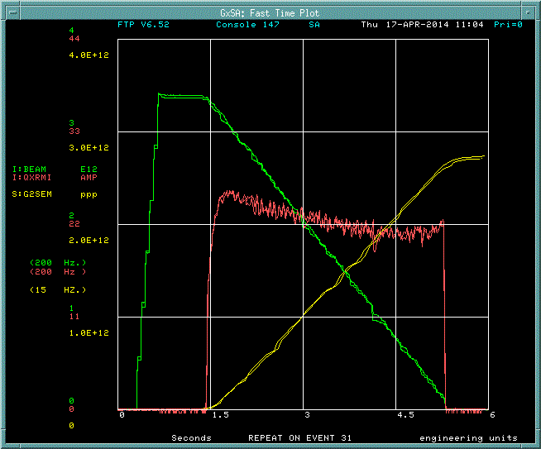
Slow Extraction to MTest - General Beam Delivery
QXR regulates Slow Extraction

Slide 8
Slow Extraction to MTest - General Beam Delivery
Source Linac & Booster
MTest
MCenter
Neutrino Muon
SeaQuest
P3
Beam is extracted from the MI52 area transported
through the P1 P2 and P3 (Main Ring remnant)
Beamlines to Switchyard. In Switchyard electrostatic
Septa split beam twice. First split beam to Neutrino Muon and Meson, the second splits the Meson beam between MTest and MCenter.
P2
Main Injector
P1

Slide 9
Slow Extraction to MTest - Beam Structure
1 RF Bucket (53 MHz) = 19 nanoseconds
Booster = 1.6 microsecond (84*19ns)
Main Injector = 11.2 microsecond (1.6*7)
Length of spill 4 seconds
4E6 / 11.2 microseconds = 357,143 revolutions
One slow spill event is equivalent to 175 million RF buckets of possible beam*
*That assumes 492 buckets in MI occupied

Slide 10
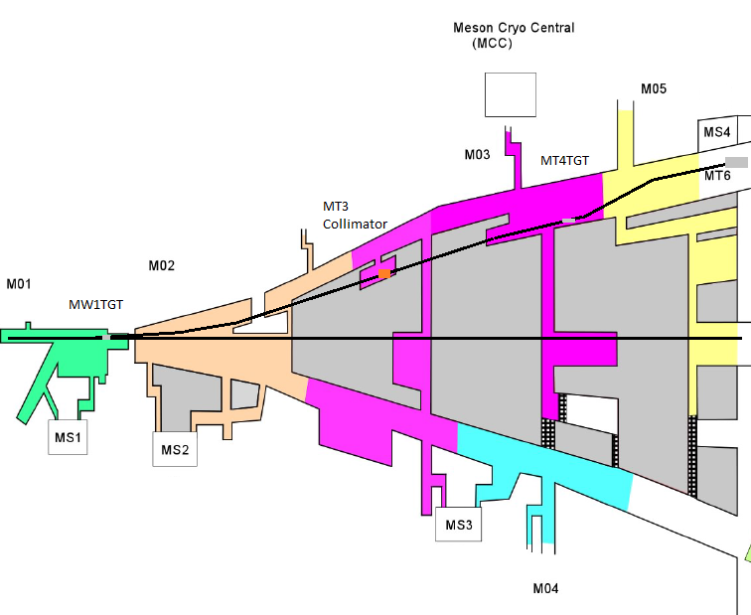
Slow Extraction to MTest – Running Modes

Slide 11
Slow Extraction to MTest – Running Modes
Three Modes
120 Gev Proton Mode
Low Energy Pion Mode
High Energy Pion Mode

Slide 12
Slow Extraction to MTest – Running Modes
Key Requirements
120 Gev Proton Mode
M01 target in place for attenuation
MT3 Pinhole Collimator for attenuation
Quadrupole magnets off for larger spot size
Low Energy Pion Mode
MT4 target in place for production
MT3 Pinhole Collimator out for transmission
Quadrupole magnets specific settings
High Energy Pion Mode
M01 target in place for production
MT3 Pinhole Collimator out for transmission
Quadrupole magnets specific settings

Slide 13
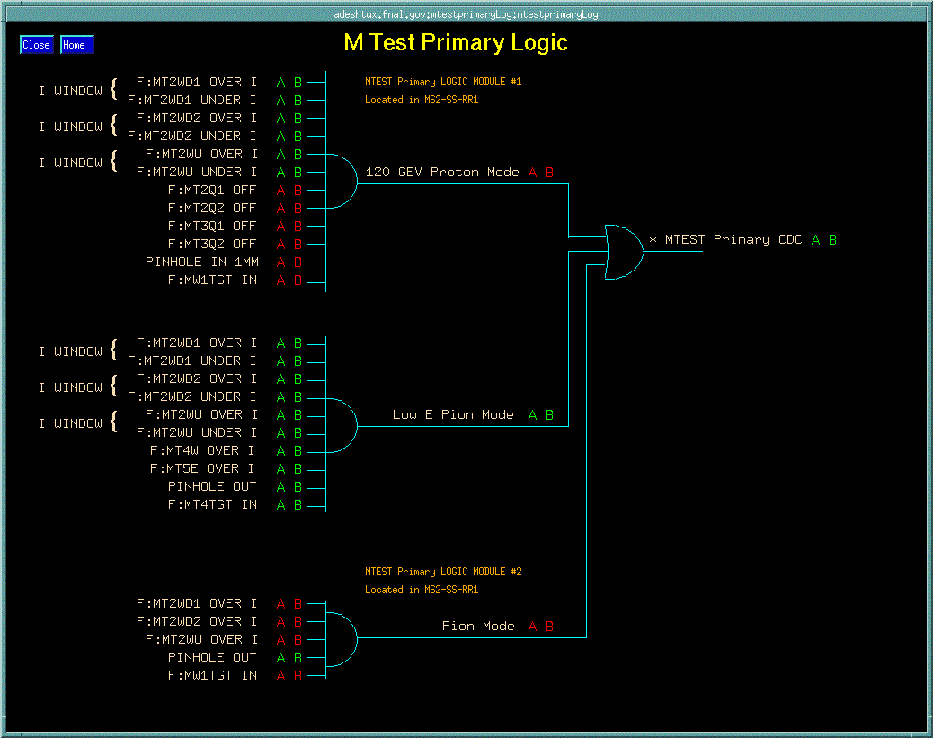
Slow Extraction to MTest – Running Modes

Slide 14
Slow Extraction to MTest – Running Modes
Low Energy Pion Mode
+/- 32
+/- 30
+/- 25
+/- 20
+/- 16
+/- 15
+/- 12
+/- 10
+/- 8
+/- 6
+/- 5
+/- 4
+/- 3.5
+/- 3
+/- 2.5
+/- 2
+/- 1.5
+/- 1
120 Gev Proton Mode
High Energy Pion Mode
+ 60
+ 50
+ 40
Muon Mode
Every LE or HE Pion Mode with additional absorbers in MT6-1.

Slide 15
Slow Extraction to MTest – Running Modes
Energy (GeV)
Counts normalized to 1E11 on F:MW1SEM

Slide 16
Slow Extraction to MTest – Running Modes
Momentum selectors
MT4W & MT5E

Slide 17
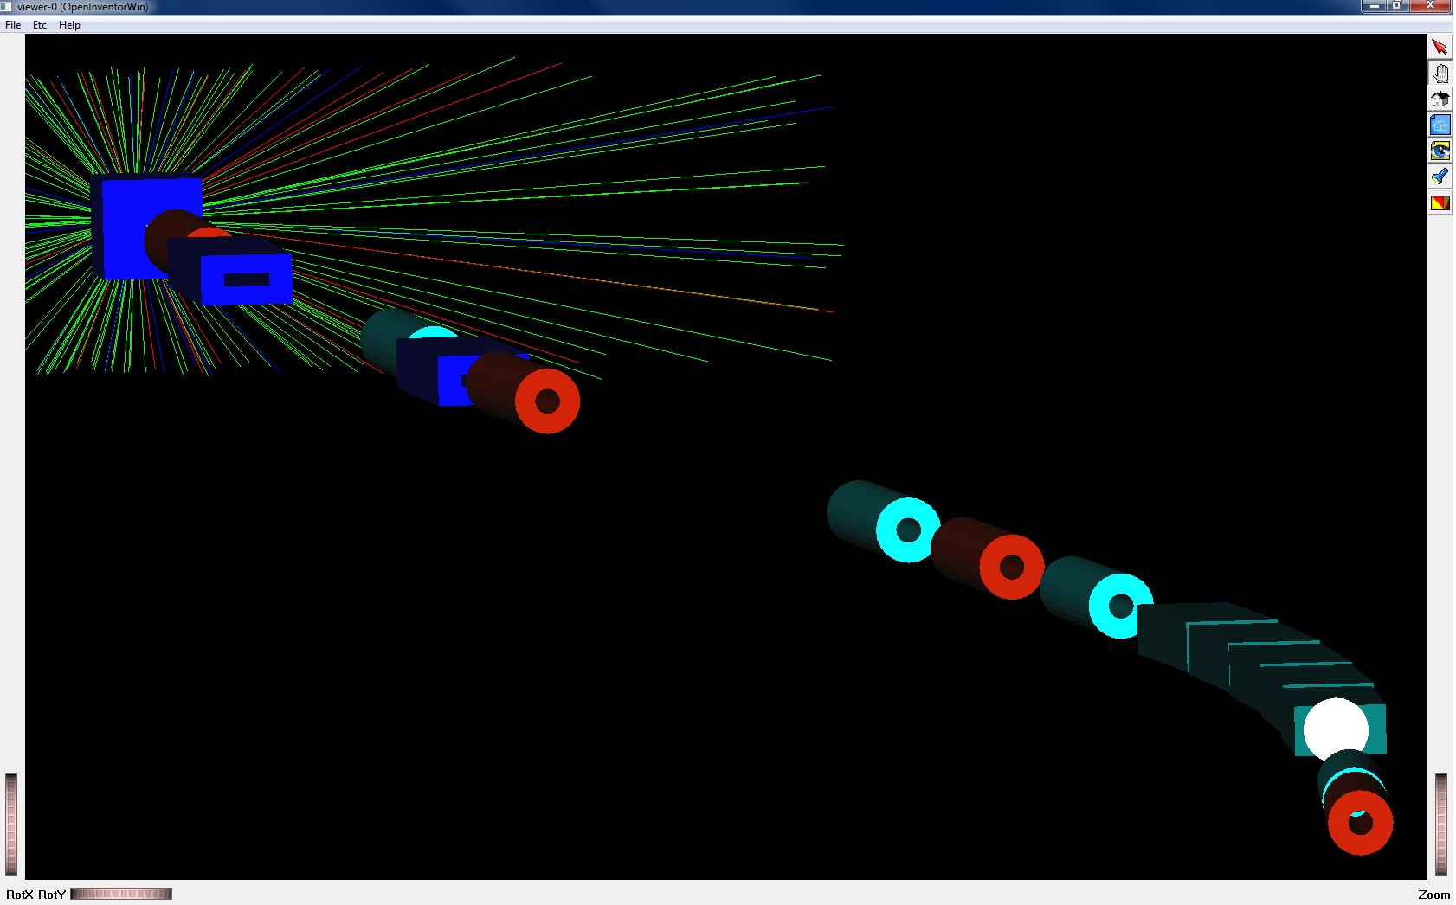
Slow Extraction to MTest – Running Modes

Slide 18
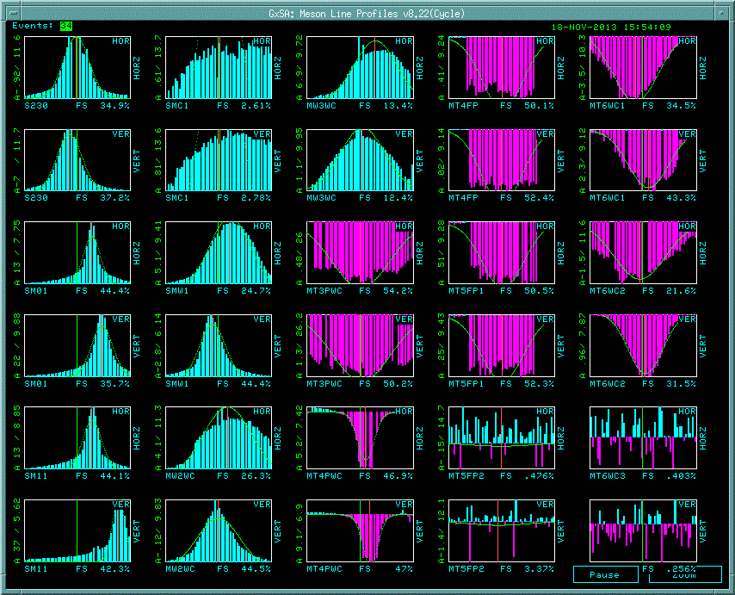
Slow Extraction to MTest – Running Modes
+32 GeV SWIC Profiles

Slide 19
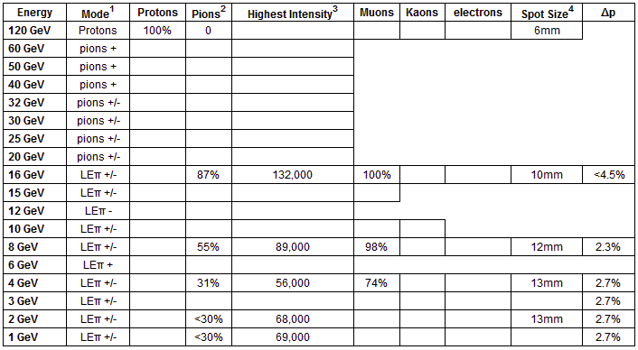
Slow Extraction to MTest – Running Modes
FTBF and AD EBD work in progress

Slide 20
Slow Extraction to MTest – Running Modes
From Feb 27th till Apr 18th

Slide 21
Slow Extraction to MTest
Items covered
General Beam Delivery
Beam Structure
Running Modes
Any Questions…?

Slide 22
Slow Extraction to MTest – Backup Slides
Backup Slides

Slide 23
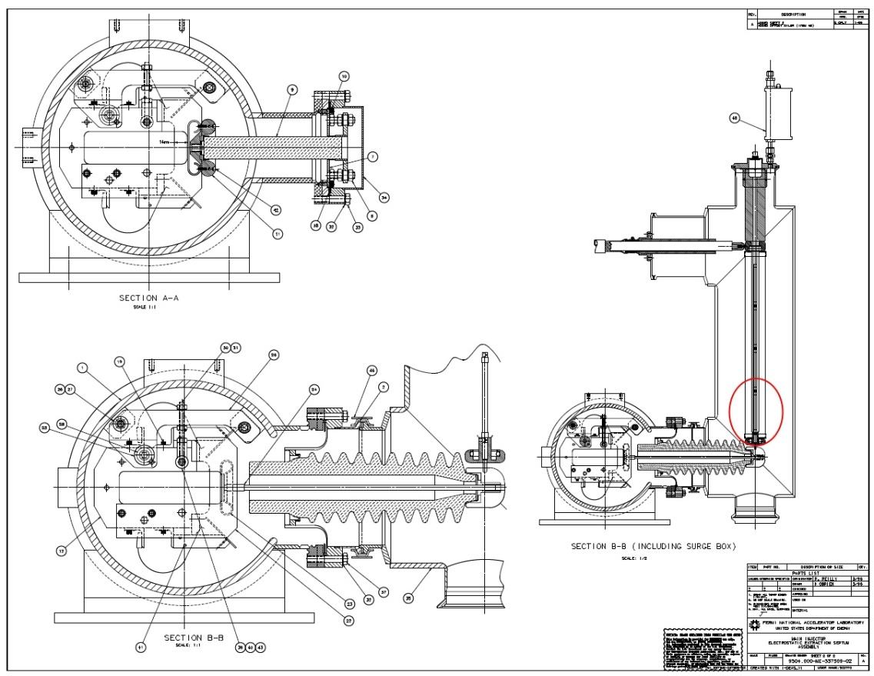
Slow Extraction to MTest - General Beam Delivery

Slide 24
Slow Extraction to MTest – Running Modes

Slide 25
Slow Extraction to MTest

