Slide 1
Fermilab Test Beam Facility
Aria Soha
April 23, 2014

Slide 2
Layout and Rooms
Beam Areas
Work Areas
Control Rooms

Slide 3
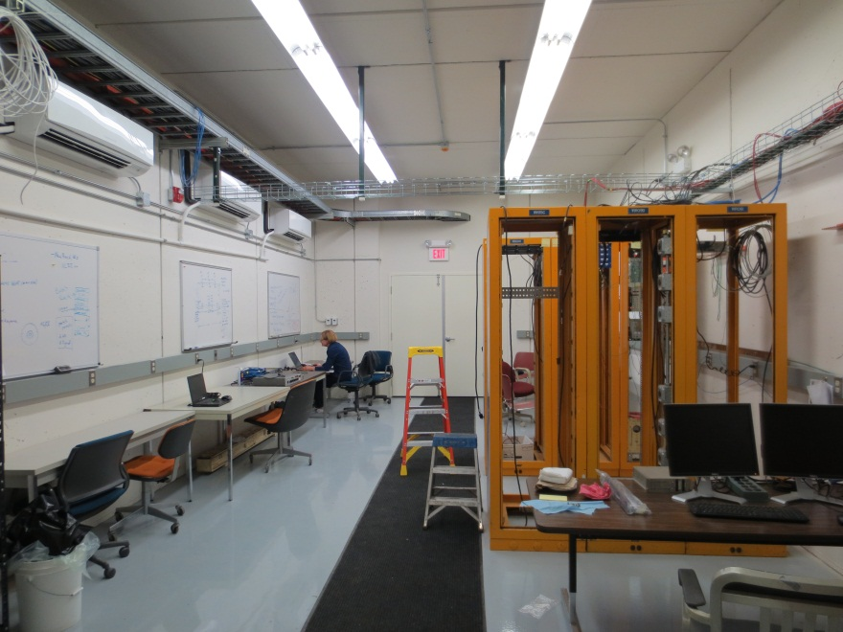
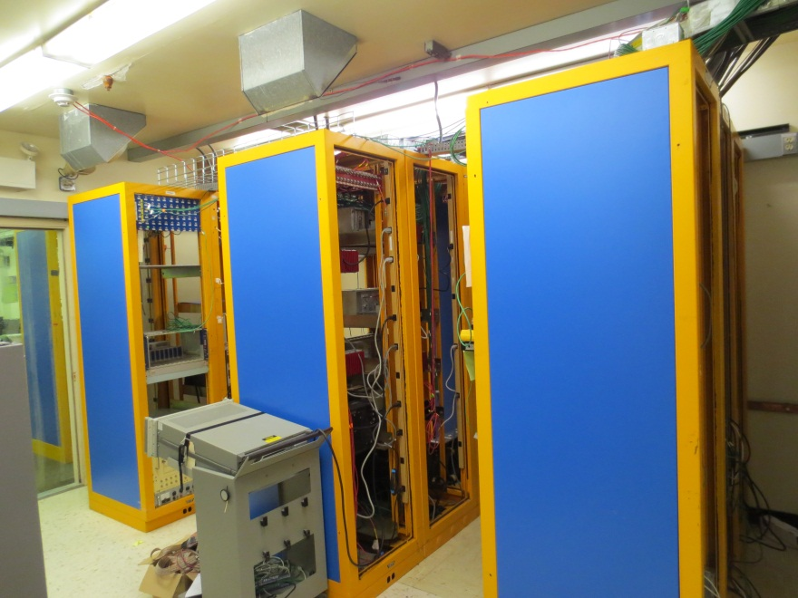
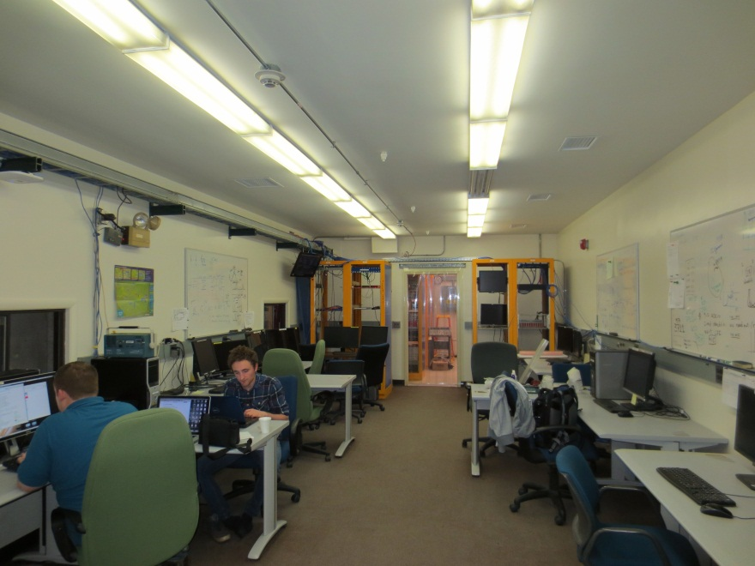
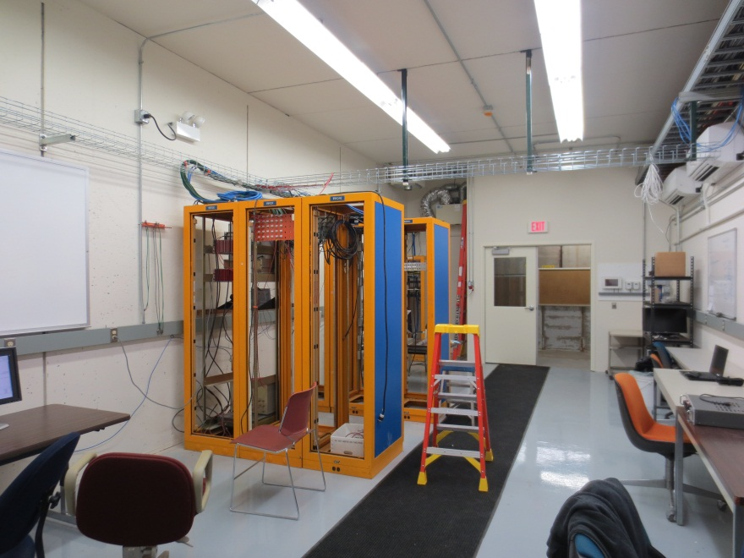
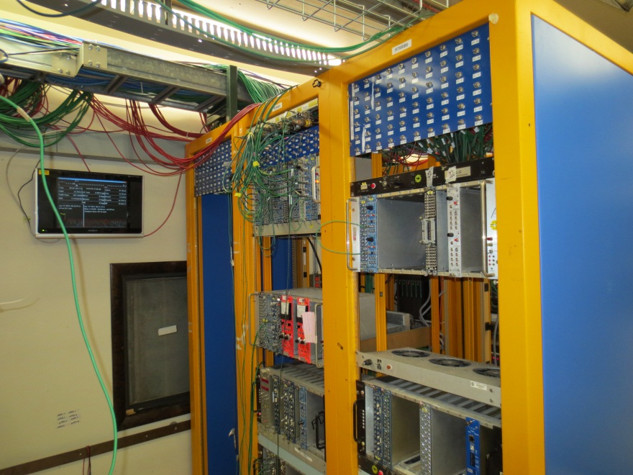
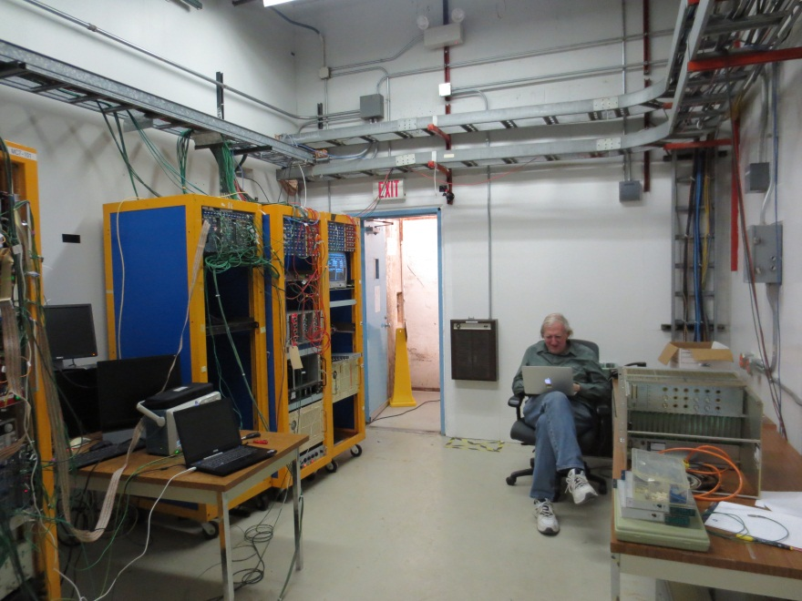
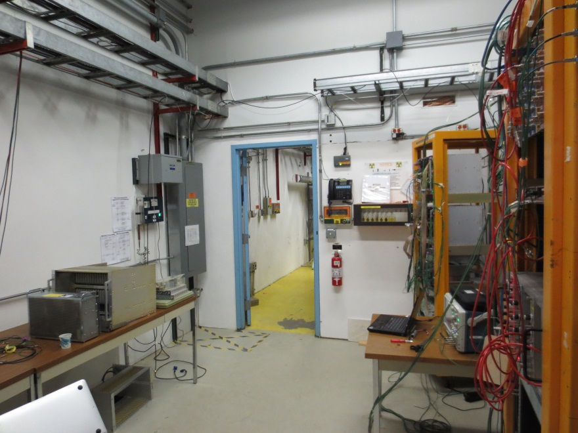
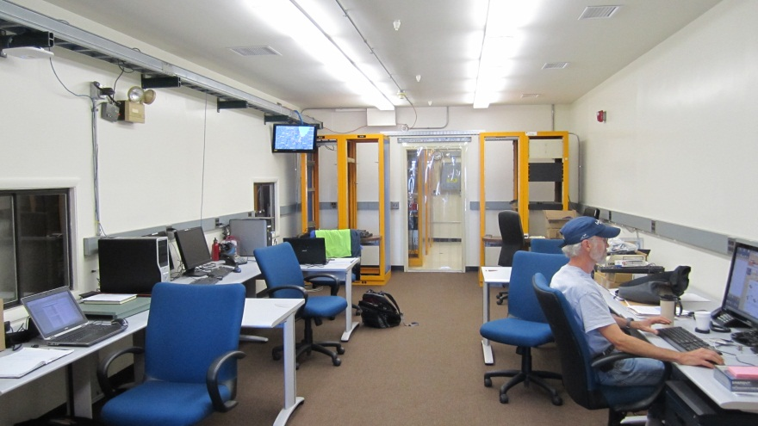
3 Control Rooms
Mtest Ctrl Rm
Electronics Rm
Alcove Ctrl Rm
MCntr Ctrl Rm

Slide 4
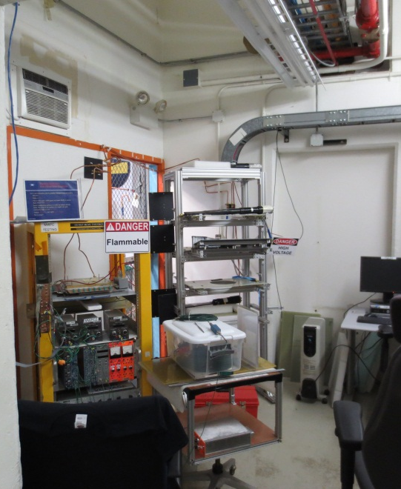
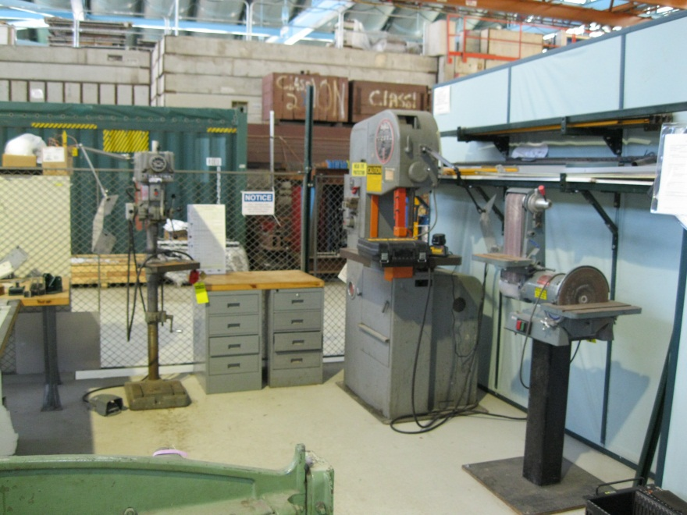
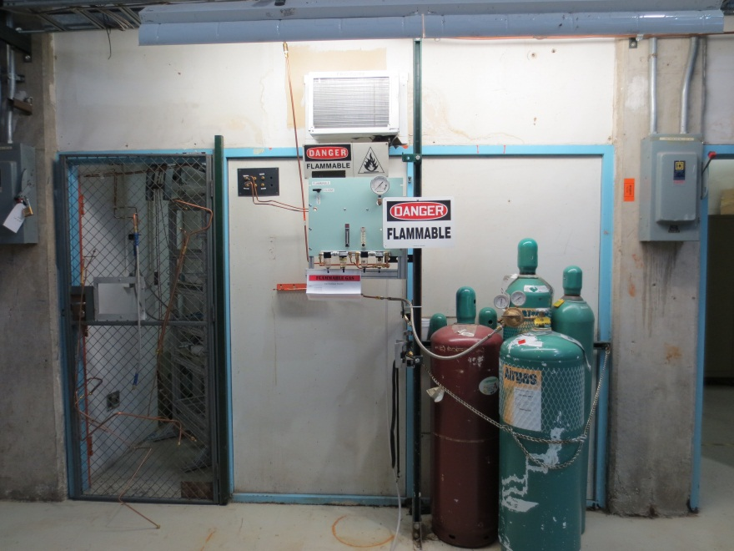
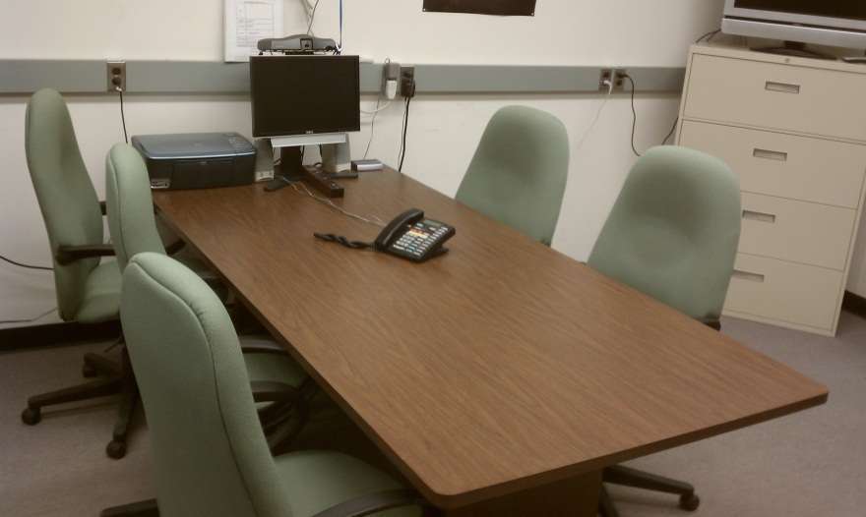
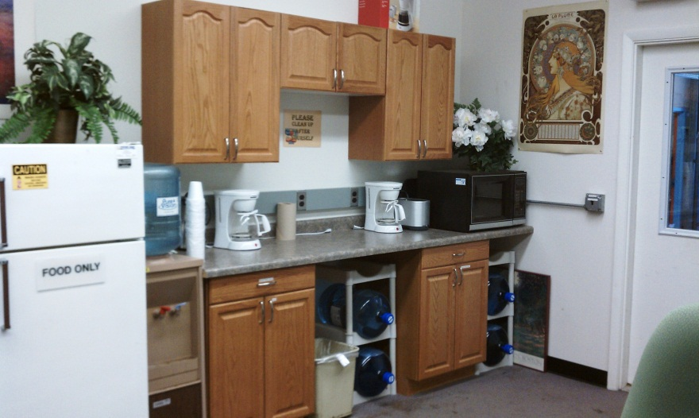
Work Areas
Tech Areas
Cosmic Telescope Rm
Conference Room
Video Conferencing
Kitchenette
Refrigerator
Microwave
Coffee maker
Bottled, hot & cold Drinking water
Counter tops and cabinets
Machine Tools

Slide 5
Beam Areas
6 MT6 Experiment Areas
2 MC7 Experiment Areas under development
2B
2C
2D
1A
1B
2A
3 Climate Controlled areas
3 areas with ACNET Controlled Motion Tables
2 areas with Crane access
(30 Tons)

Slide 6
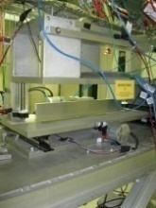
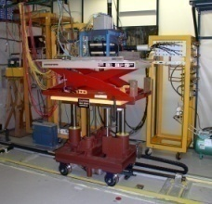
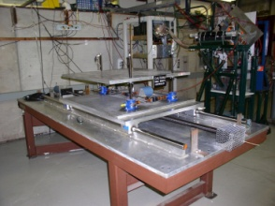
Motion Tables
ACNET Controlled to minimize accesses
1mm precision in X/Y
Rotation option now available!
Smaller stages with centimeters of travel available for small loads

Slide 7
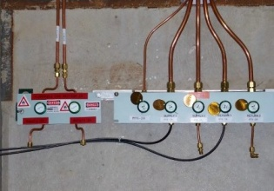
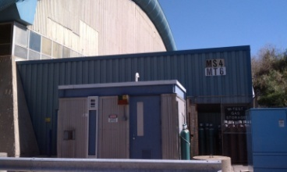
Gas
Gas Distribution system throughout facility
MT6.2 and MC7 have flammable capability
Some gasses provided

Slide 8
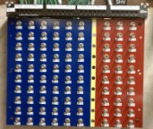
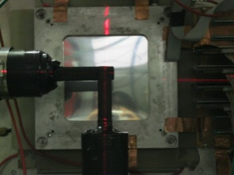
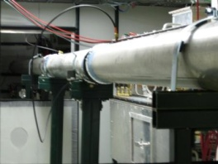
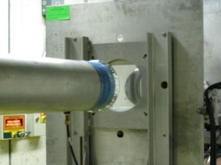
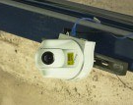
Other Equipment
Patch Panels
in enclosures and control rooms
Signal (lemo & BNC), SHV, Network (CAT5), Power, and other assorted cables are available to users in various lengths and quantities.
Including network controlled power strips
Lasers for Alignment (MT6 only right now)
Helium Tubes
Web-based Cameras (MT6 only right now)

Slide 9
Instrumentation

Slide 10
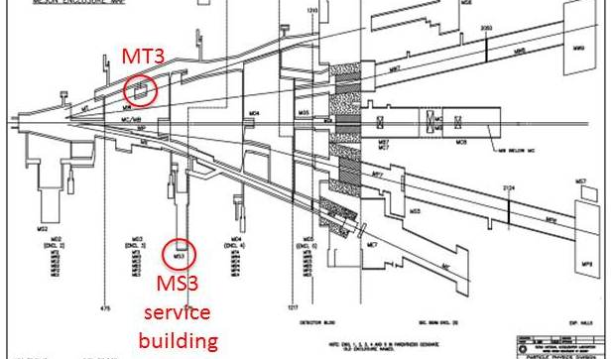
High Rate Tracking Area
Located in MTest beamline upstream of pinhole collimator (MT3 Alcove)
2.5 GHz/cm² Rates
Patch panel for signal, HV, and network links the enclosure alcove area with the MS3 service Building
Acnet controlled table

Slide 11
Additional Slides

Slide 12
Wishlist
Personnel!
Movable Table for 5 ton detector ($20k)
Roof & Lights over MC7 outside walkway
Improved Instrumentation for AD
rétractable MWPC
fiber profile monitors
Telescope around MT5 bend magnet for track by track momentum resolution
Laser Room?
Water Mist system for beam enclosures and control rooms ($100k)
Improved parking ($20k)
Card readers on doors ($30k)

