Slide 1
FTBF Operating Procedures
April 23, 2014

Slide 2
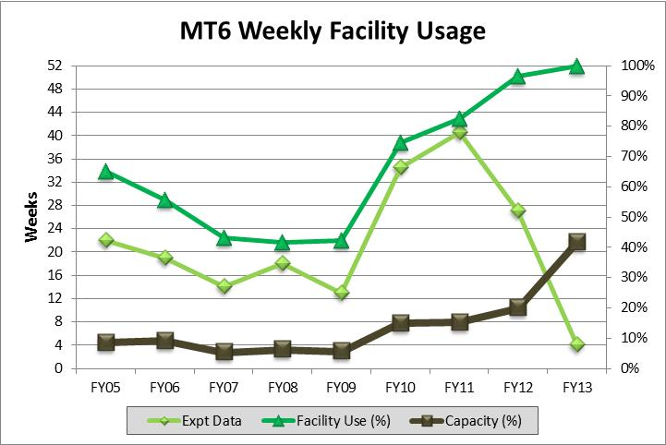
User Statistics
Since 2005 the Fermilab Test Beam Facility has served 45 experiments, consisting of 633 individual collaborators, from 139 institutions, in 24 countries!

Slide 3
Typical Users
Beam run of 1-4 weeks
Negligible install time
Return several times a year
Approximately 200 users a year (not double counting)
Beam is available 24 hrs/day, but not all experiments can make use of it because…
Control Room must be manned while beam is on

Slide 4
To Conduct an Experiment
Write (and get approved) a TSW
Get on the schedule
All Experimenters need Fermi ID numbers
Experimenters need training
Some online, ahead of time, or sign up for classes
Some special arrangements
Equipment gets shipped to Fermilab
Installation and Training completion happens
Operational Readiness Clearance
Users Oriented by Facility staff
Request Beam from MCR

Slide 5
Scheduling Guidelines
To make the most of your beam time it is a good idea to have a written set-up procedure, run-plan, and tear-down procedure.
Usually, Beam runs are Wednesday to Tuesday. This allows users to arrive on Monday, get required training on Tuesday, and get inspected on Wednesday. Exceptions can be made.
Fermilab can only guarantee 80% uptime, please make your request accordingly. (4032 pulses per week)
At this time, run requests in the MTest Beamline for 4-5 weeks must be conducted during the winter months of September - February (inclusive). Requests longer than 5 weeks are encouraged to look into use of the MCenter Beamline.
Any one experiment is limited to a total of 8 weeks of beam time per fiscal year, assuming 12 hour shifts. This is regardless of primary or secondary user status.
The first day of your beam requested time is usually devoted to installing and obtaining Operational Readiness Clearance (ORC)
If you have significant installation needs, please request additional time for installation when making a beam request.
Please include requests for facility equipment when making your beam request. Some equipment needs extra time to be calibrated, or installed.
Holidays and weekends have no effect on the beam, but can effect mechanical/electrical support, and safety inspectors.
Requests for extended hours can not be granted if the user did not take full advantage of the beam time available.
FTBF encourages coincident use of the six stations in the current MTest beam line, with thin-detector users upstream of thick-detectors.
Users should be familiar with the Policy for Beam Time Extensions

Slide 6
Initial Request
Experimenters write a Technical Scope of Work (TSW) which describes the test experiment in detail. For a template and instructions
The Spokesperson for the Test experiment will need to obtain a Fermilab ID number
The spokesperson submits the first draft TSW and their Fermi ID number to the Test Beam coordinator
Test Experiment number is assigned
Once the Test experiment number is assigned, the experiment can be 'penciled' into the schedule by submitting information to the FTBF Coordinator.
The TSW must be approved before the user will be allowed to install in the beam area.
All of the users on the experiment will need to obtain a Fermilab ID number

Slide 7
TSW Approval Process
Round 1: Typically takes 1 week
The Area Coordinator checks over the TSW and sends back to experimenter
Round 2: Typically takes 1 week Upon receiving the draft back from the experiment, the Area Coordinator will again check for formatting and other errors, and forward the draft to the rest of the Area Managers, and the head of Detector R&D.
Round 3+: Typically takes 2 - 4 weeks The Area Coordinator forwards the draft to significant people. These people forward the draft to their own relevant reviewers for feedback, all of which is collected by the FTBF Coordinator. This process often takes several rounds, with many drafts being re-submitted. At this point, if the experimenters continue to make significant changes to the TSW the approval process will be delayed. (Changes which effect the beam request, or Hazard Checklist are considered significant)
Round '4': Typically takes 2 weeks Once all the above parties are in agreement, the Area Coordinator will print out a hard copy and escort it to the following people to be signed. (As this is a rather important document, and these are extremely busy people, it can often take days before the document is read, signed and returned to the coordinator.)
Experiment Spokesperson
Particle Physics Division Head
Accelerator Division Head
Scientific Computing Division Head
ES&H Section Head
Associate Director for Research
Associate Director for Accelerators
Once signed, the Directorate Office of Program Planning Administrator, scans the document, files it, and distributes it to all relevant parties.

Slide 8
Operational Readiness Clearance
Each time an approved test beam experiment sets up in the beamline it must obtain an Operational Readiness Clearance (ORC) before the apparatus can be operated with beam.
This consists of an inspection of the equipment (in the beam enclosure) by the Particle Physics Division Safety Committee and an inspection of the enclosures by the Accelerator Division Radiation Safety Officer.

Slide 9
Orientation
For a smooth beam run Users should be shown/told about
How to Request beam from MCR
CAL’s/ Access Procedures
Beam Structure
Acnet
Logging into FTBF computers
Table Control
Instrumentation control
How to check on Beam status (Ch13/elogs)

Slide 10
Outreach
Working with a local community college for undergraduates to do beam studies
1 weeks of beam time
Each student would do 3 “shifts” plus orientation
Course credit
EDIT

Slide 11
Additional Slides

Slide 12
Experiments & TSWs

Slide 13
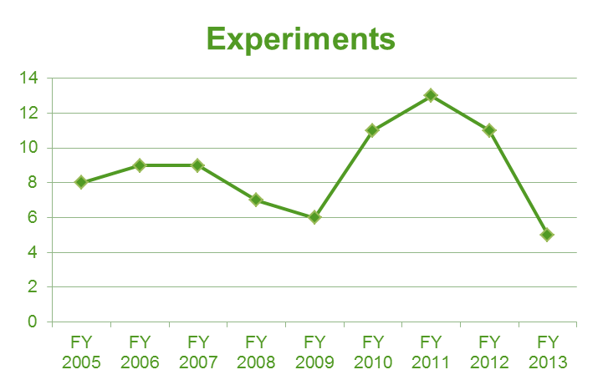
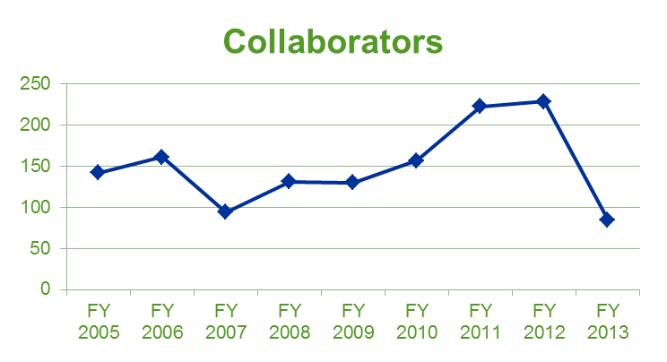
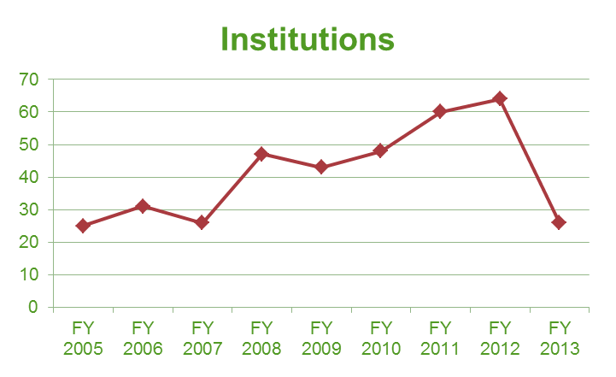
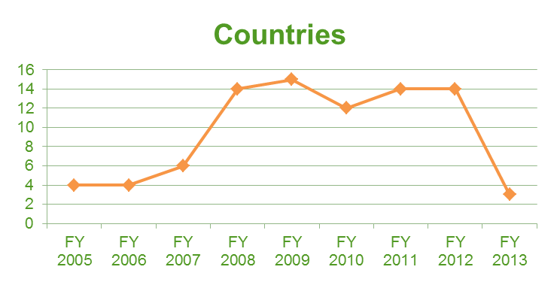
Facility Usage

