Slide 1
CERN Testbeam facilities
H. Wilkens

Slide 2
Overview
Injector complex
East Area:
  Testbeam facilities
  Irradiation facilities
North Area:
  Beam lines.
  Heavy Ions
  Experimental magnets.
  GIF++
  Next facilites.
Scheduling.

Slide 3
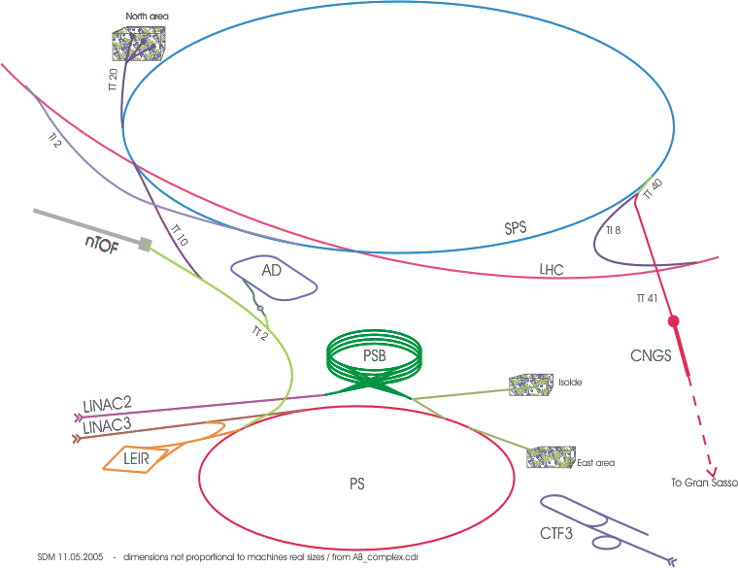
Test Beam Facilities at CERN
North Area
SPS Test Beams
East Area
PS Test Beams

Slide 4
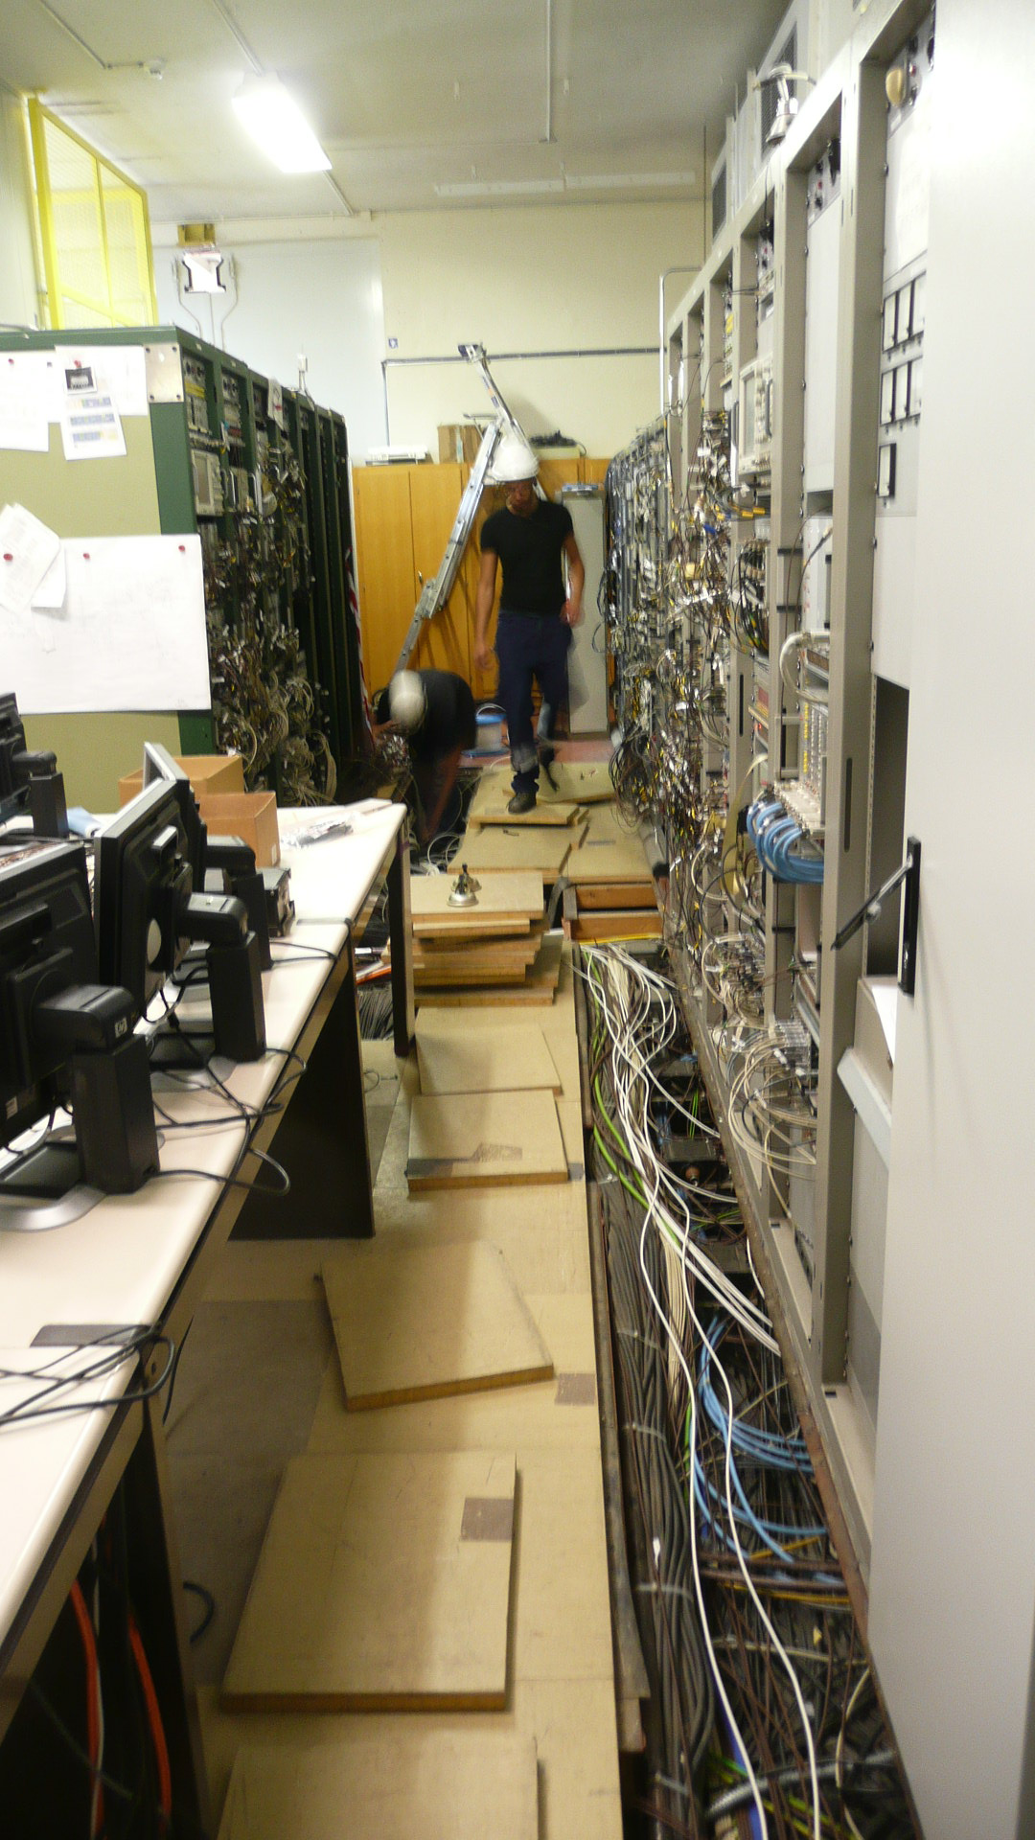
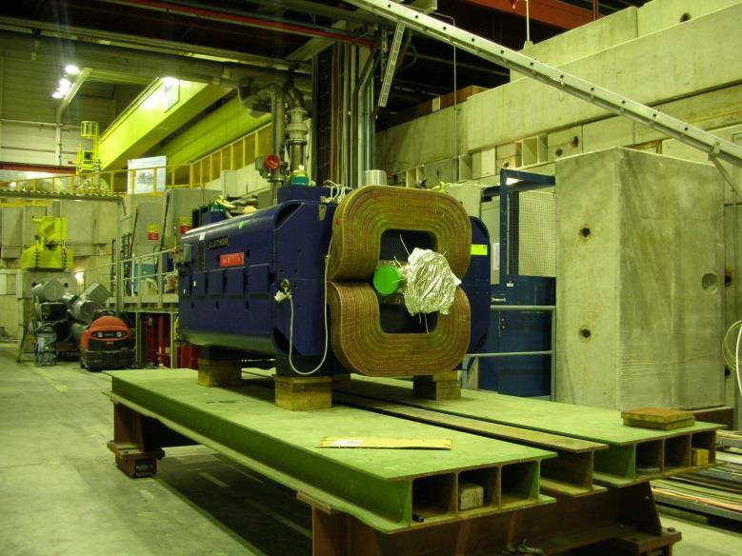
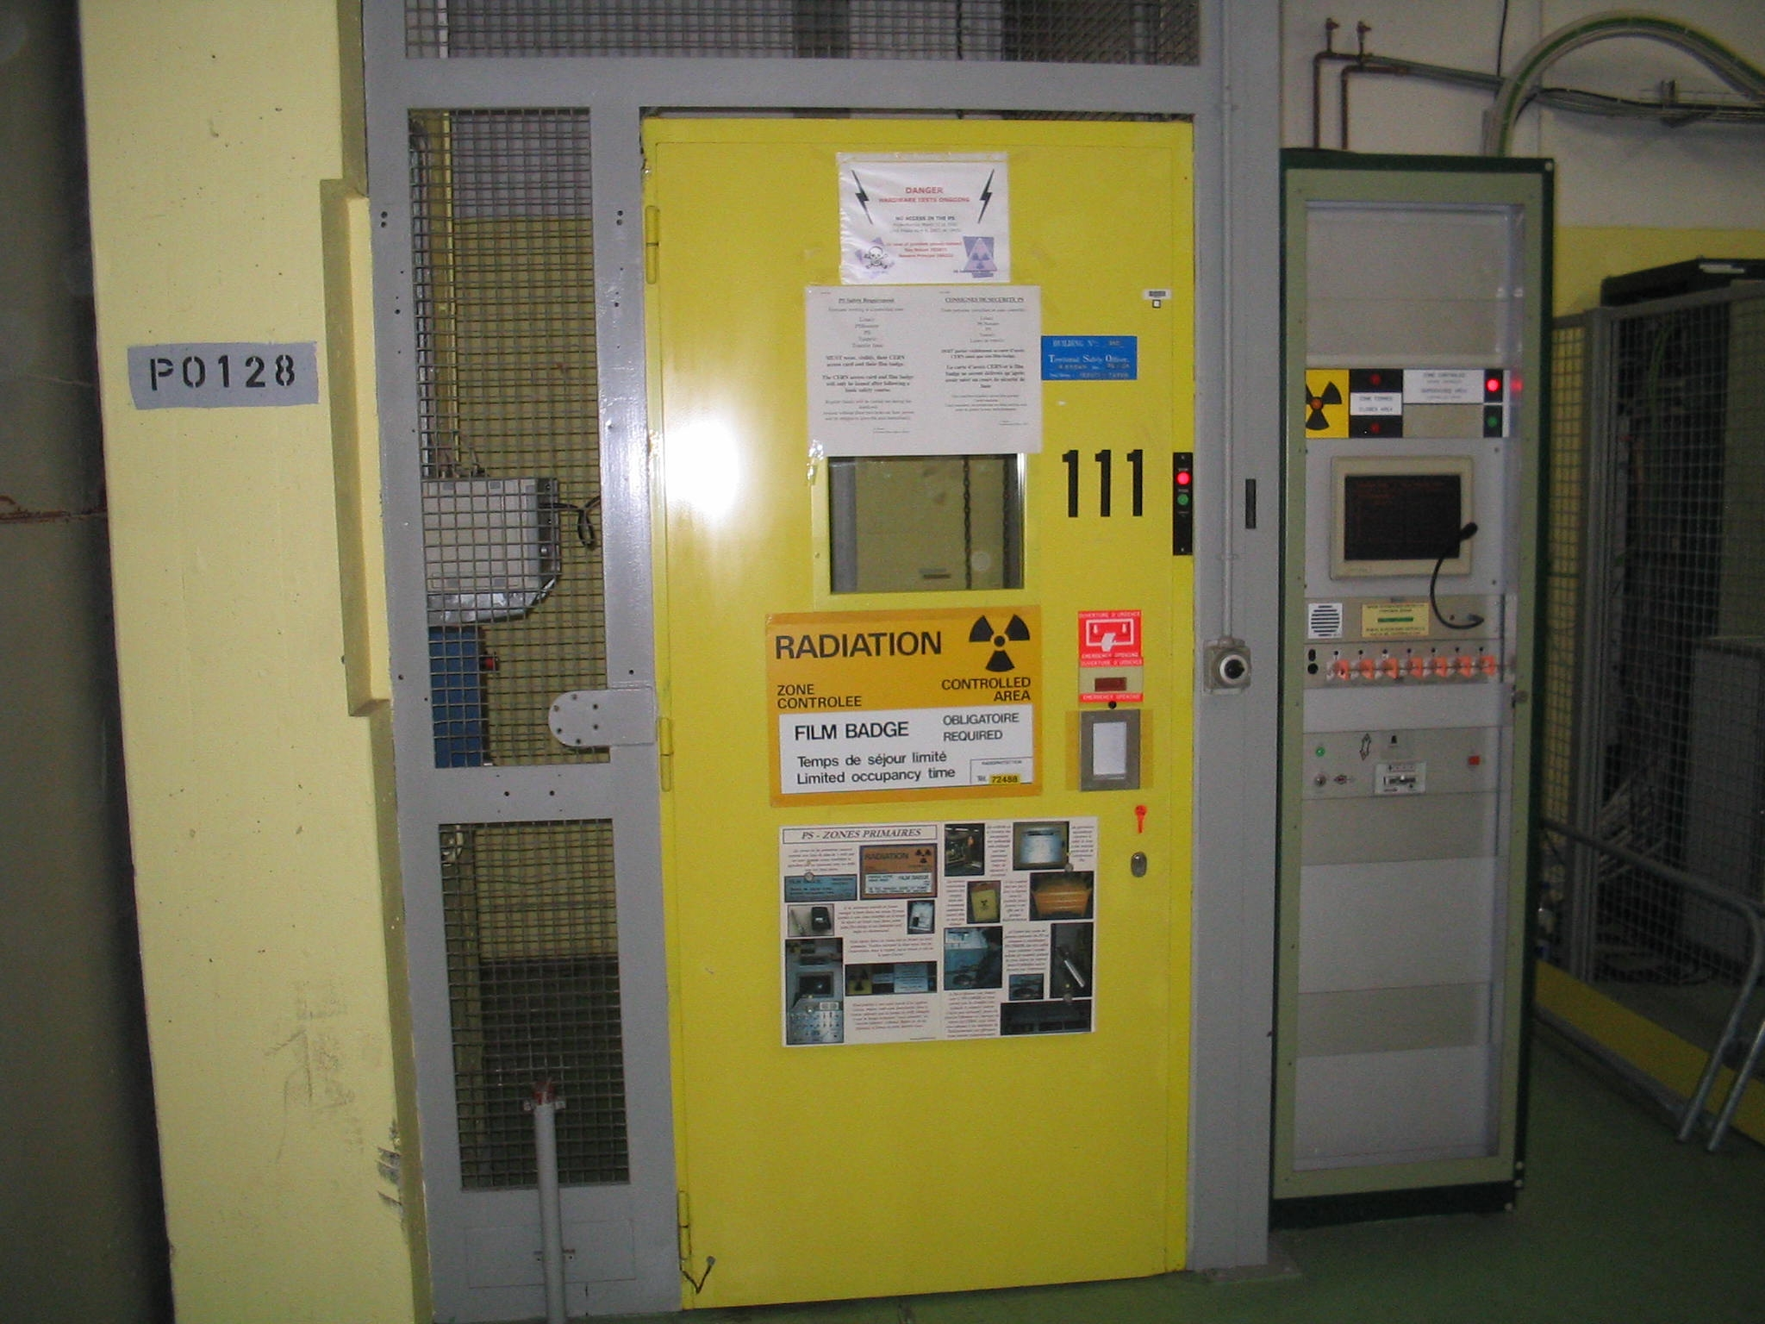
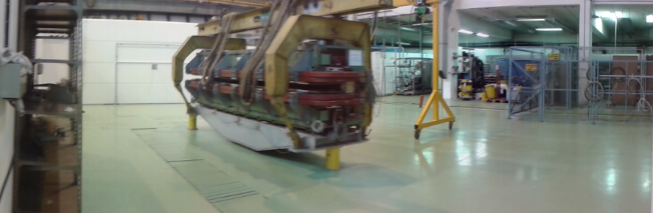
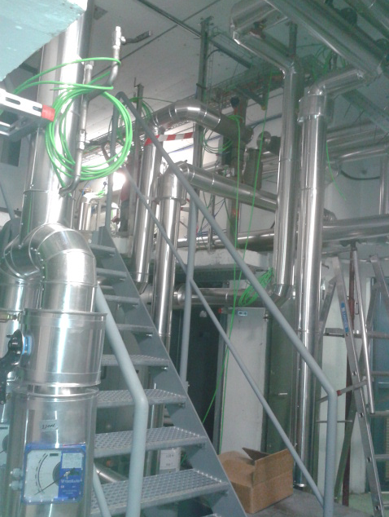
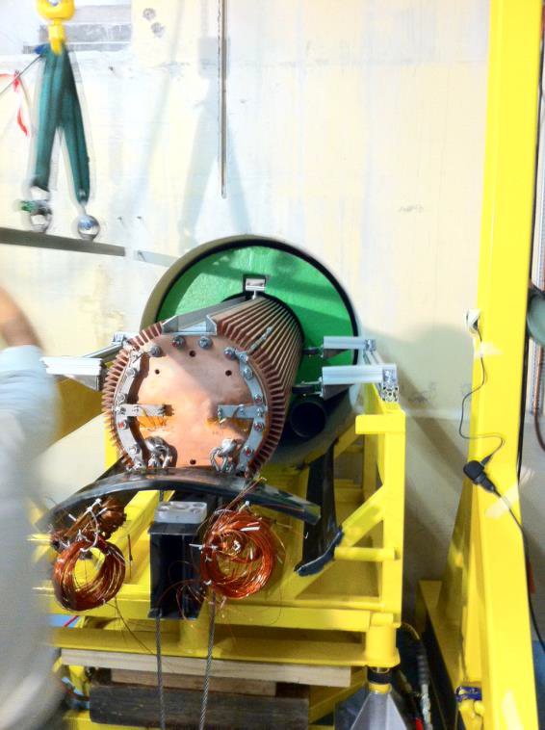
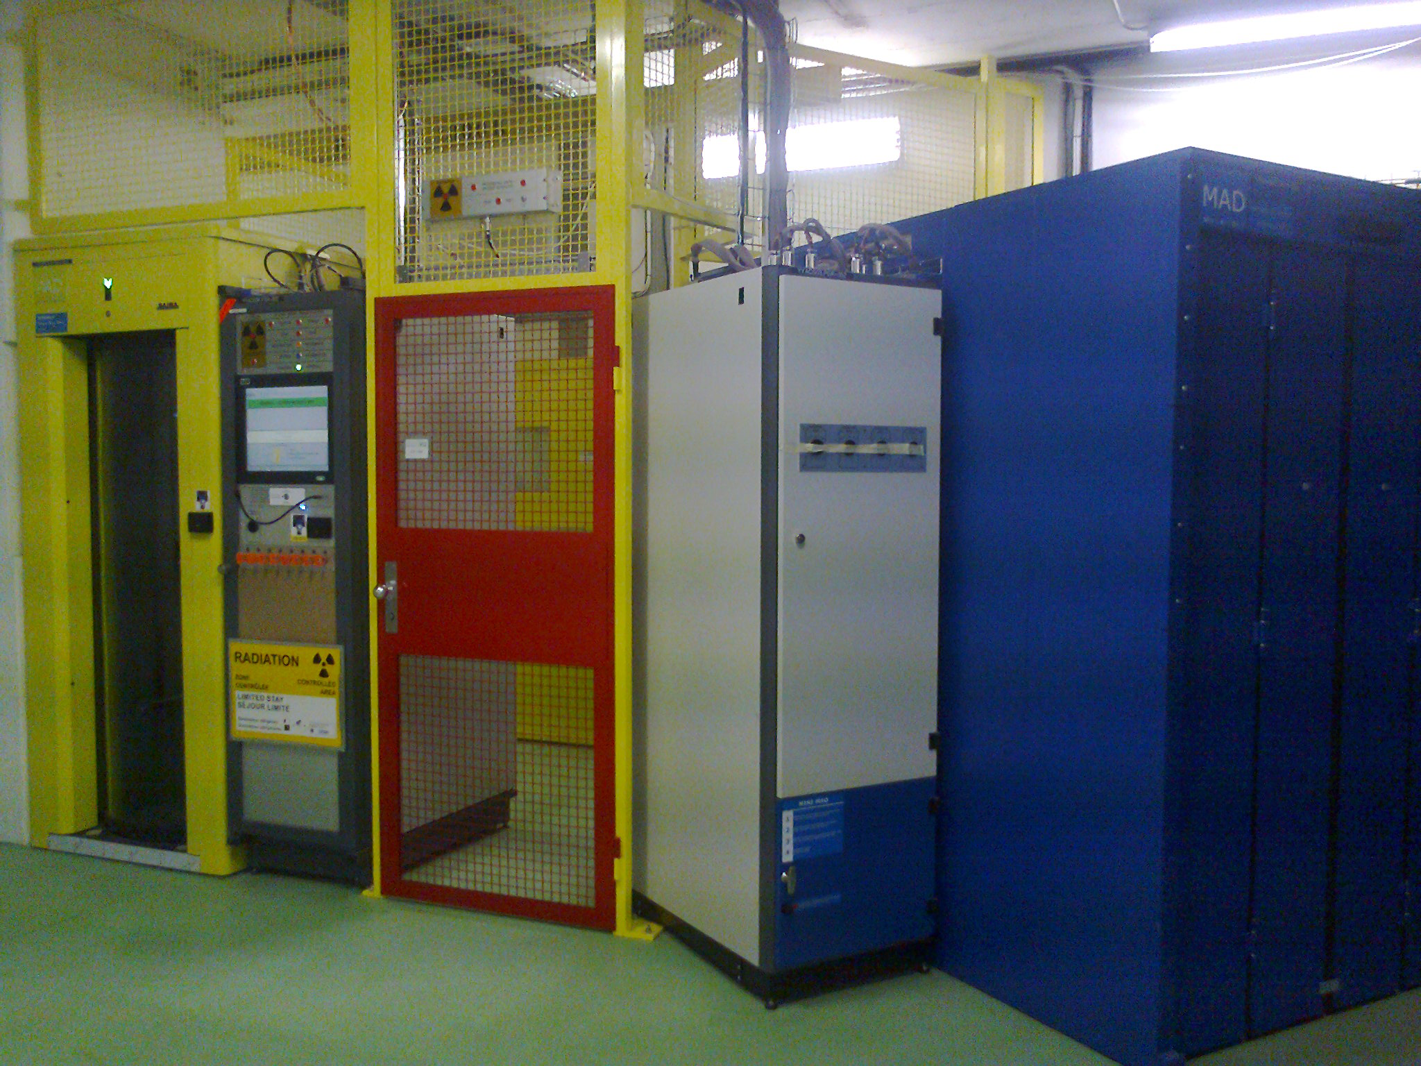
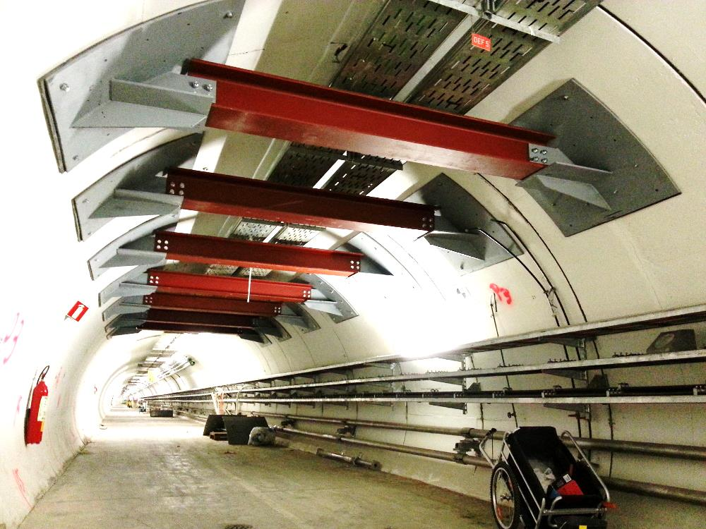
LS1: Some work in images
Re-cabling
Magnet changes
New PS Complex access
control and safety system
New PS ventilation
Tunnel consolidation
PSB Beam dump
exchange

Slide 5
The East Experimental Areas at the PS
T11
CLOUD
T10
Alice, COMPASS, CMS,ATLAS…
3.6GeV/c, 150mrad
7GeV/c, 60mrad
T9
Calice, ATLAS, CLICpix, CMS, LHCb, CBM, DAMPE,…
15GeV/c, 0mrad
Protons 24GeV/c
IRRAD
proton irradiation
CHARM
Mixed field irradiation
Mixed beams (h+e).
Equipped with Cerenkovs.
Max flux 10⁶p/spill.
5 spills / 30s supercycle (typ. 3 irrad, 2 testbeam)

Slide 6
East Area Beam Characteristics
Momentum range
  Secondary beam: 1GeV/c – 15 GeV/c
Particle type and intensity
  electrons, hadrons, muons
  max. 1-2*10⁶ particles per spill
  typically 10³ - 10⁴ used
Spill structure from PS
  400ms spill length
  Typically 2 spill every 30 s, more on request

Slide 7
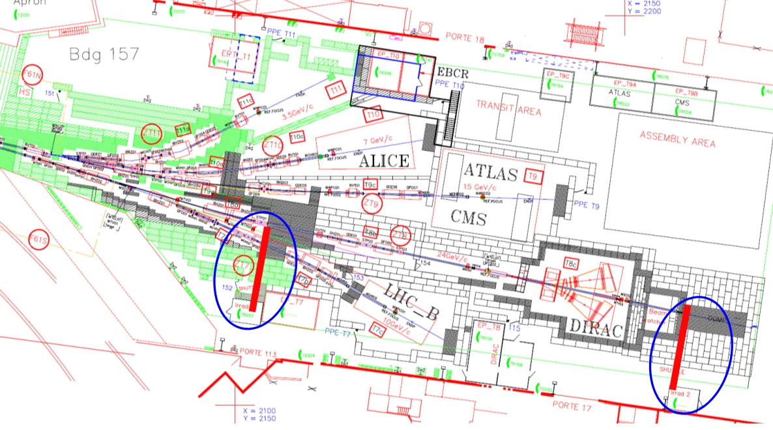
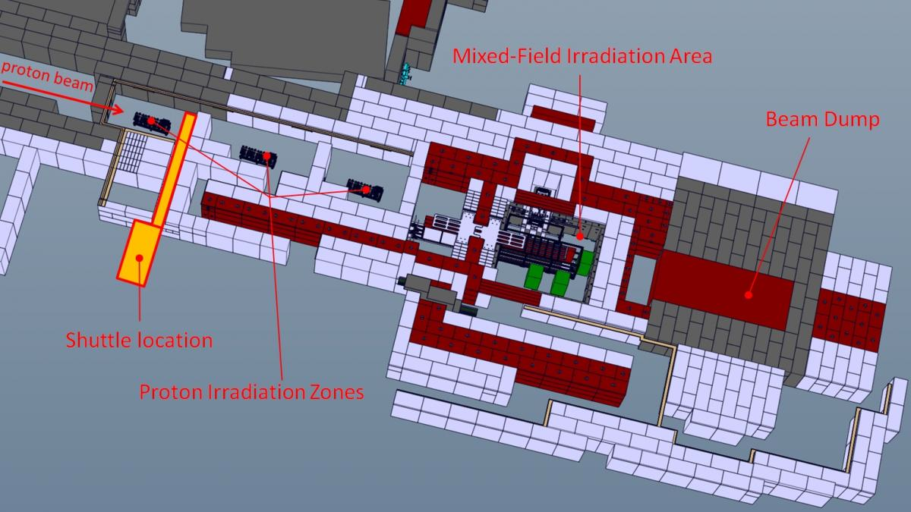
Changes in East Hall
The irradiation facility in T7 and the Dirac experiment in T8 have been dismounted.
A new Irradiation facility will be build on the T8 beam line:
3 areas for proton irradiation, with automated tables, cooling (-15ºC), and cryogenic (1.8K) facilities available.
Shuttle system.
Mixed field irradiation in the downstream area (CHARM)
Ready summer 2014.

Slide 8
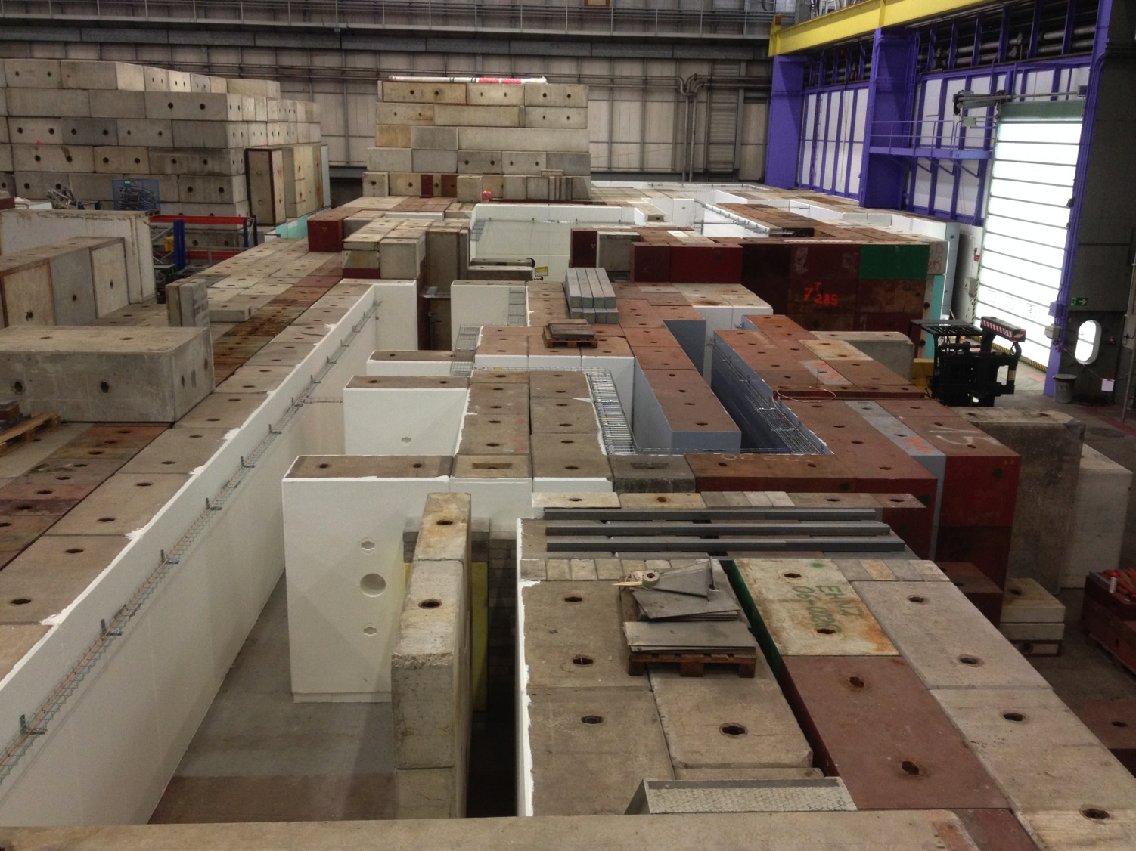
28 March 2014

Slide 9
The North Experimental Areas at the SPS
The SPS proton beam (400/450 GeV/c) slowly extracted to North Area
Directed towards the three North Area primary targets T2, T4 and T6
From the primary targets:
  T2 → H2 and H4 beam lines
  T4 → H6 and H8 beam lines
  and P42/K12 beam line (NA62)
  T6 → M2 beam line (NA58/COMPASS)
North Area
Test Beam Facilities
NA62
SPS beam
COMPASS

Slide 10
North Area Test Beams
NA61
H2
H4
ATLAS, EuDET, SILC…
H6
H8
Up to 4 user areas per beam line
  Possibility to take parasitic muons behind main user
  Some areas permanently occupied by LHC users (ATLAS, CMS, LHCb, TOTEM)

Slide 11
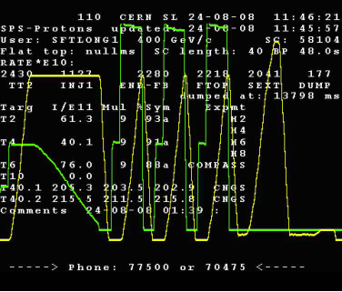
North Area Beam Characteristics
Momentum range
  H2, H4, H8:
    10 – 400 GeV/c (secondary beam)
    primary proton beam at 400 (450) GeV/c
  H6:
    5 – 205 GeV/c
Particle type
  electrons, hadrons, muons
  → secondary target→ tertiary beam
Particle intensity
  max. 2*10⁸ particles per spill
Spill structure from SPS
  4.8s – 9.6s spill length, debunched
  1 spill every 14s – ~48s
  spill length/repetition frequency depend on number of facilities which need SPS extraction (CNGS, LHC)
SFTPRO
3xCNGS
LHC
MD

Slide 12

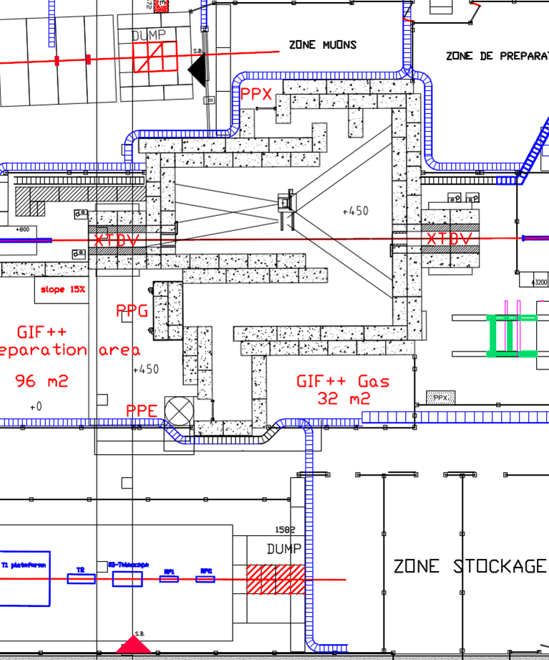
In the North Hall
A big clean-up campaign has be completed.
A new Gama irradiation facility,
GIF++ is being prepared in the EHN1 north hall:
Source foreseen ~16TBq, (old GIF had 740GBq in ‘97) +set of collimators for intensity modulation.
Located on H4 beam line, (old GIF had lost its beamline).
Will also have a set of cosmic triggers, for using outside of SPS running.
Source delivery Sept. ‘14, then commissioning. Available for users in ‘15.
Old GIF will be decommissioned

Slide 13
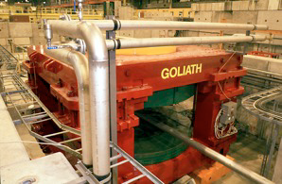
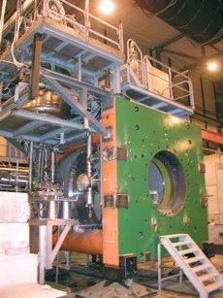
Magnets
Goliath
EHN1, H4 beam line
Large classical dipole
160x240x360cm
0.85T field
Morpurgo
EHN1, H8 beam line
superconducting dipole
1.6m diameter, 4m length
1.5T field
CMS M1 magnet
EHN1, H2 beam line
superconducting dipole
82 cm gap, 1.4m diameter
3.T field

Slide 14
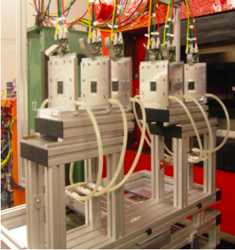
EUDET telescope copies
EUDET telescope was very successful, 5 built by DESY, sixth in the making:
EUDET, the original one, commuting between DESY and CERN SPS.
ANEMONE, copy for Bonn, used there.
ACONITE, copy for ATLAS used at CERN-SPS, DESY, going to SLAC.
DATURA, copy for DESY, at the TB21 area.
CALADIUM, copy for Carlton, used at FNAL.
DRYOPTERIS, copy being prepared for DESY.
All using AIDA projects:
  EUDAQ common DAQ software
  TLU trigger units
  EUTelescope analysis software
  Different sensors being prepared Mimosa, Timepix,
  FE-i4.
Costs ~ 75kEuro, +12kEuro for DCS.

Slide 15
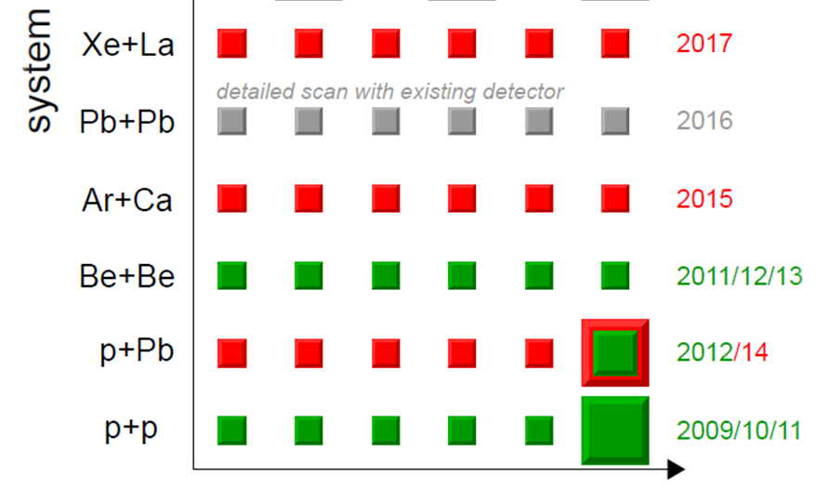
Ion beams
2013: Fragmented Ions, Pb in SPS, Be
extracted to NA61.
2015: Ar run in February/March
2016: Pb
2017: Xe
Ion beams available also in H8 and will
also be available in H4:
Interest for use as testbeam for experiments like CALET (ISS), Medipix/Timepix, Nucleon (satelite), ….
NA61 program

Slide 16
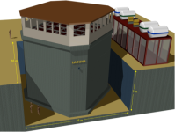
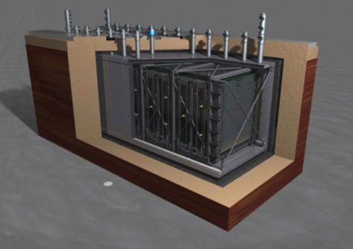
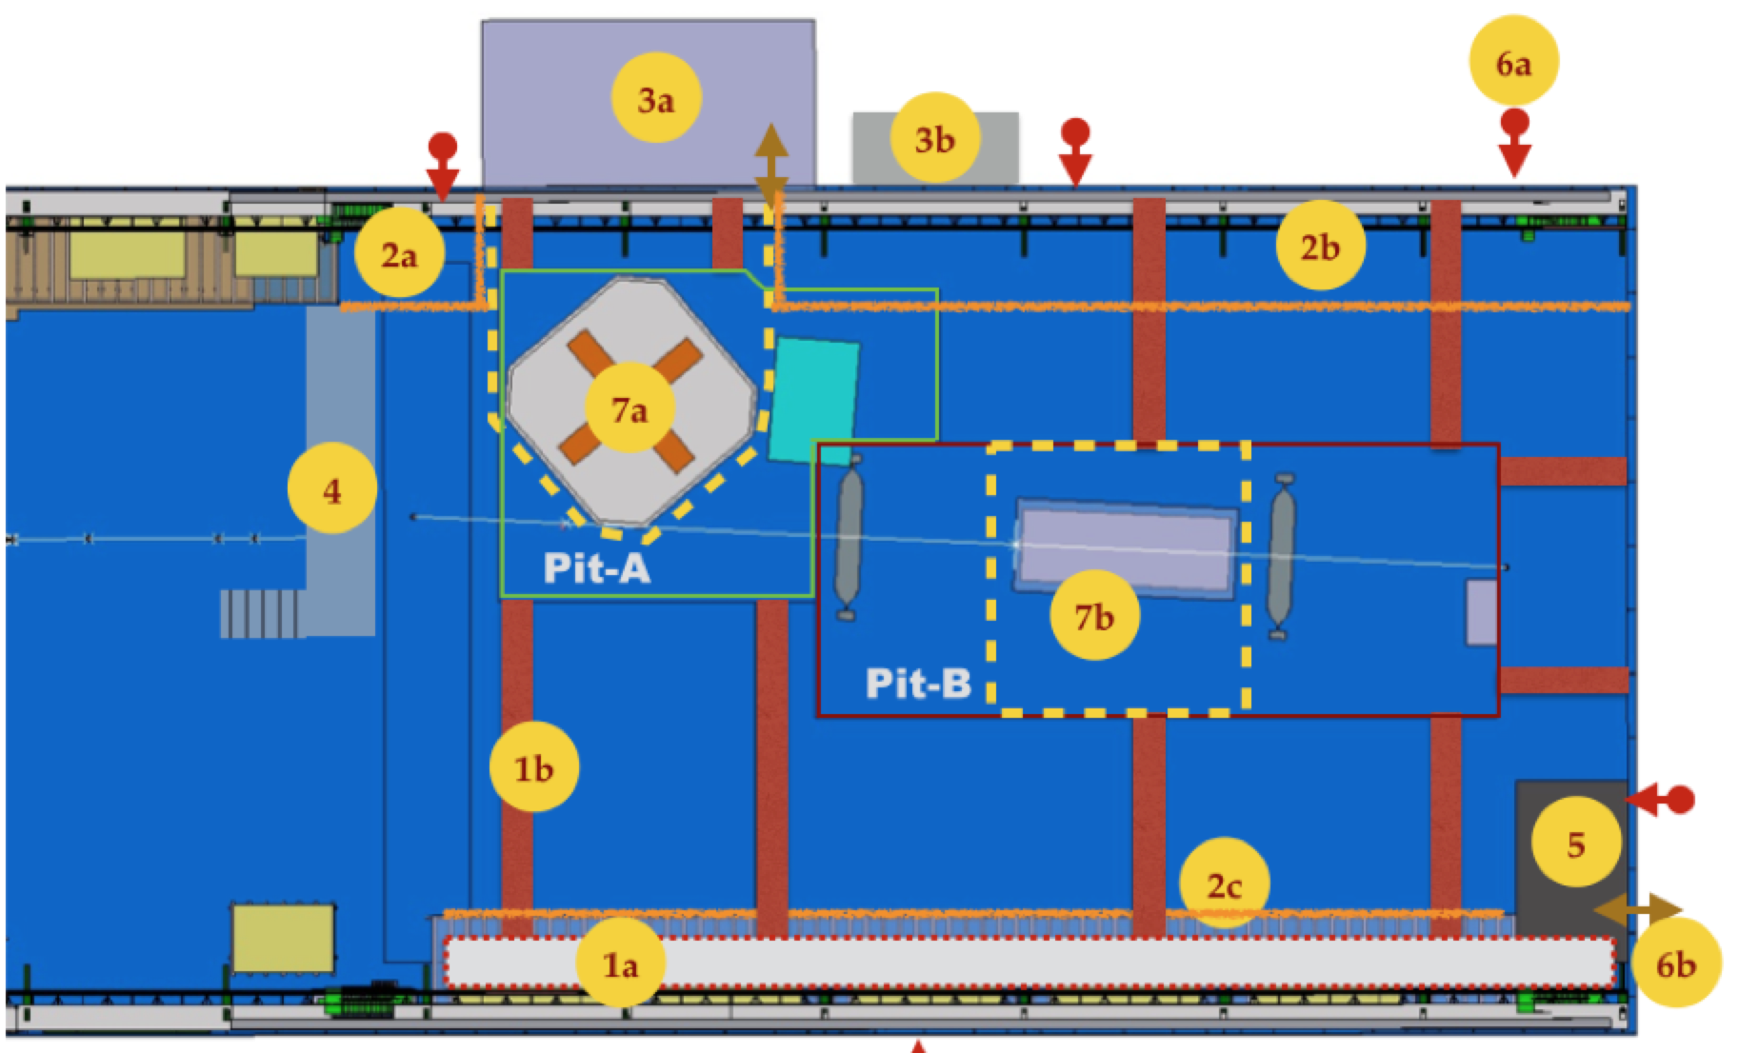
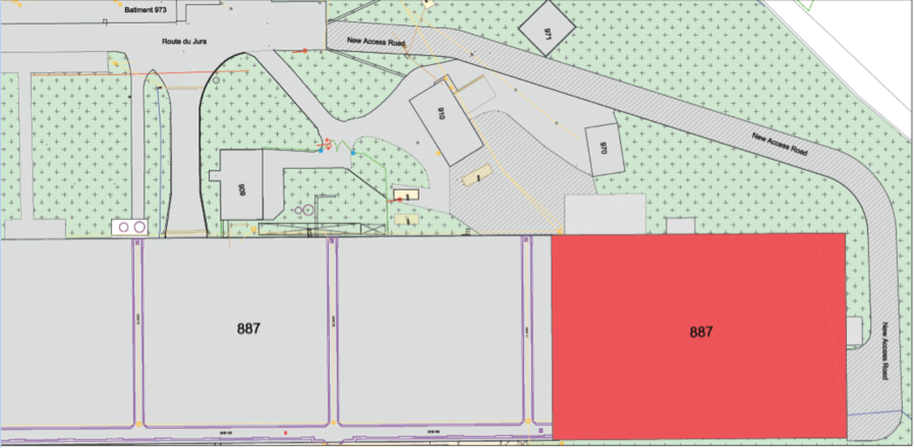
Testbeams for Neutrino experiments
EHN1 extension construction
~70m extension of the North Experimental Hall.
2 pools for prototype detectors.
extension of H2 and H4 beamlines.
Operational mid/fall 2016

Slide 17
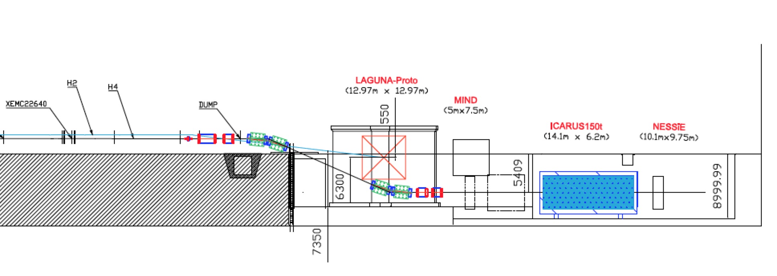
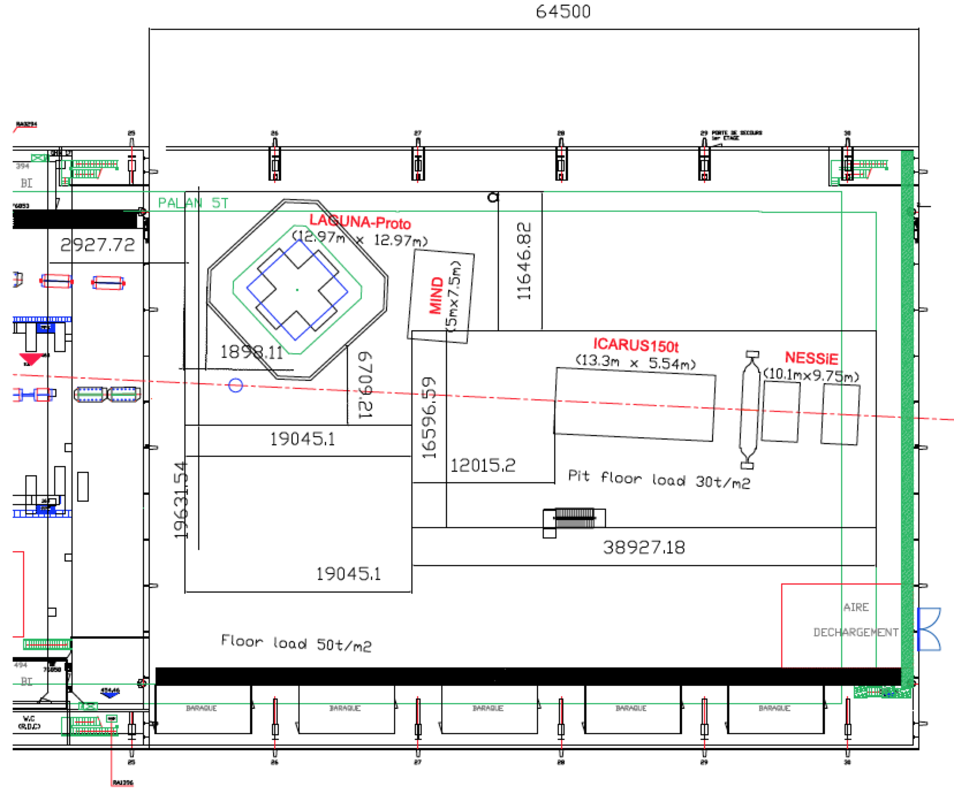
Testbeams for Neutrino experiements
EHN1 extension construction
charged beams layout
(~0.5-20 GeV/c)

Slide 18
CERN Transnational Access in AIDA
AIDA is a EU funding program for Detector R&D
In AIDA 43 applications for support for testbeams at CERN where accepted in 2011,2012.
Reimbursement : 138 CHF/day x person (Subsistence) + max 400 CHF/travel x person;
The total budget was 197900 CHF.
All the budget was used in 2 year, no beams were expected in 2013-2014.
64 users in 2011, 96 users in 2012.
We are preparing a new program for the coming 4 year (in AIDA2 H2020 funding)
 | User projects |  | Users supported | Units of access (8h shifts)
 | Eligible submission | Selected
Granted TA | 39 | 38 | 160 | 1720
Planed TA | 20 |  | 160 | 800

Slide 19
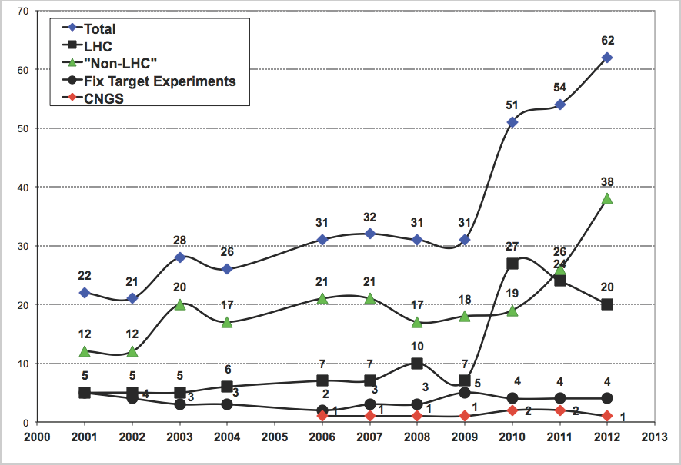
Beamtime scheduling
Request sent to PS/SPS physics coordinator:
Requests <1week at SPS or <2weeks at PS agreed by coordinator.
For more recommendation by cern committee needed (SPSC, LHCC, REC, RB).
Scheduling according to priorities discussed with committee’s chairs. Draft scheduled presented at Research Board for approval.
Evolution of the NA users.

Slide 20
PS User schedule 2014
This year the amount of requests = amount of available resources

Slide 21
PS User schedule 2014
In H2: user got 50-80% of requested time
In H4: 2 users volunteered to be postponed to next year, other user got ~50% of requested time.
In H6: mostly trackers, can use the 2 zones in parallel.
In H8: LHCb 70%, other users 50% of requested time.

Slide 22
Questions ?

