Slide 1
FACET and Test Facilities at SLAC
FNAL, Carsten Hast
April 23, 2014
Notes:
Amazing run period especially in the time of financial uncertainties. Thank you for support.

Slide 2
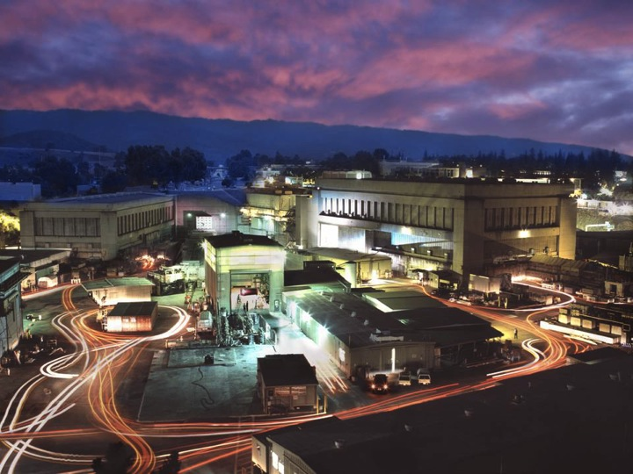
SLAC Electron Beam Test Facilities 5 MeV to 23 GeV
20-23 GeV e⁻ & e⁺
5 MeV
FACET
ASTA
2-15 GeV
& single e⁻
60-120 MeV
NLCTA
ESTB
Notes:
SLAC operates unique suite of facilities for advanced accelerator tests.

Slide 3
SLAC’s Test Facilities Layout
FACET
Sector 20
Sector 0
Sector 10
ESTB
ASTA
Decommissioned: PEPII, SLC

Slide 4
SLAC Beam Test Facilities Overview
Facility | Purpose | Parameters
FACET | Accelerator R&D, Material Science, THz | Very focused and short bunches at 20GeV e+/- 20x20x20 um^3
ESTB | Detector R&D, LC MDI, Radiation Tests | 2-16GeV primary LCLS beam or single e-
NLCTA | Accelerator R&D, Medical, Radiation Tests | 60 to 220 MeV, small emittance, very versatile infrastructure
ASTA | Gun and RF Testing, RF processing | <50MeV, X- and S-Band RF power
All supported by SLAC’s Test Facilities Department
https://portal.slac.stanford.edu/sites/ard_public/tfd/Pages/Default.aspx
http://facet.slac.stanford.edu and http://estb.slac.stanford.edu
e-mail: hast@slac.stanford.edu
Google: SLAC FACET or SLAC ESTB

Slide 5
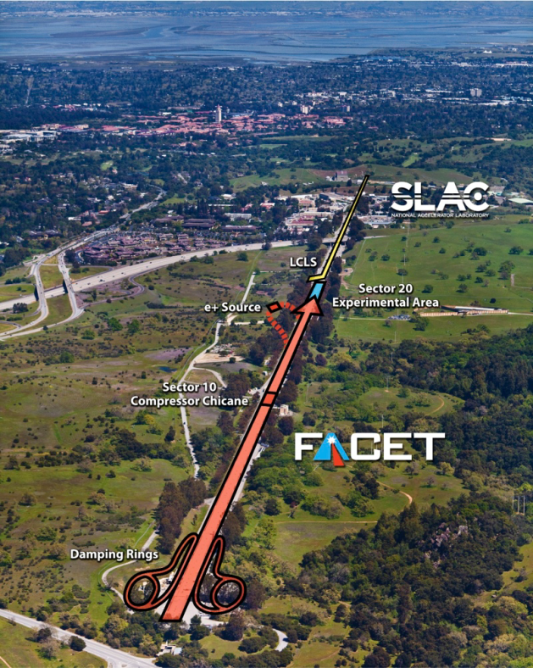
FACET Has a Multi-year Program to Study PWFA and Serves a Growing User Community
20GeV, 3nC, 20µm³
Primary Goal:
Demonstrate a single-stage high-energy plasma accelerator for electrons.
Meter scale
High gradient
Preserved emittance
Low energy spread
High efficiency
User Experiments:
Dielectric wake acceleration
Various ways of laser/plasma induced acceleration techniques.
Electromagnetic switching
THz generation and studies
Techniques for bunch length measurements
Notes:
Built by DOE, operates as a user facility but with primary purpose to study beam driven PWFA

Slide 6
FACET’s Experimental Area
Profile measurement experiment
Laser Insertion chamber
Plasma Experiment
Sample chamber

Slide 7
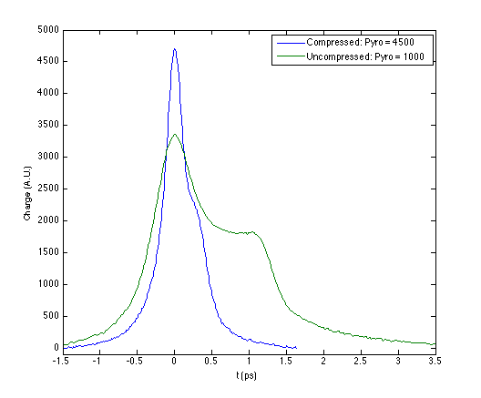
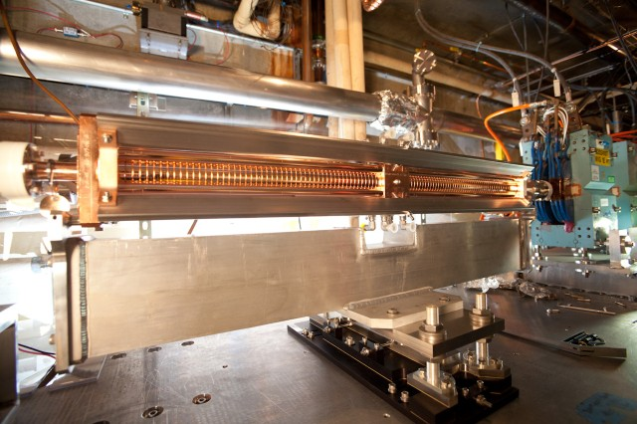
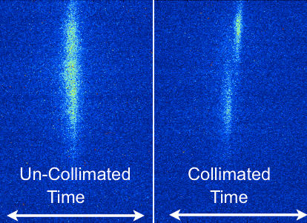
Bunch Length Measurements and Notch Collimator
Showing 2013 run examples, 2014 is ongoing
The time profile of the bunch is important to know at FACET
Notch Collimator provides drive and witness bunches for wakefield acceleration experiments
FACET longitudinal bunch profile:
Blue curve- fully compressed
Green curve - uncompressed

Slide 8
FACET FY14 2/3 through this year’s run, will end with positron acceleration and characterization
16 Planned Experiments
105 Users / 59 on-site
16 Institutions
Notes:
Just FACET, this run
Requires close coordination with every user group to make sure they are ready to use time efficiently
There are a number of interdependencies between the experimental programs
Makes programs more efficient but makes it tedious to coordinate

Slide 9
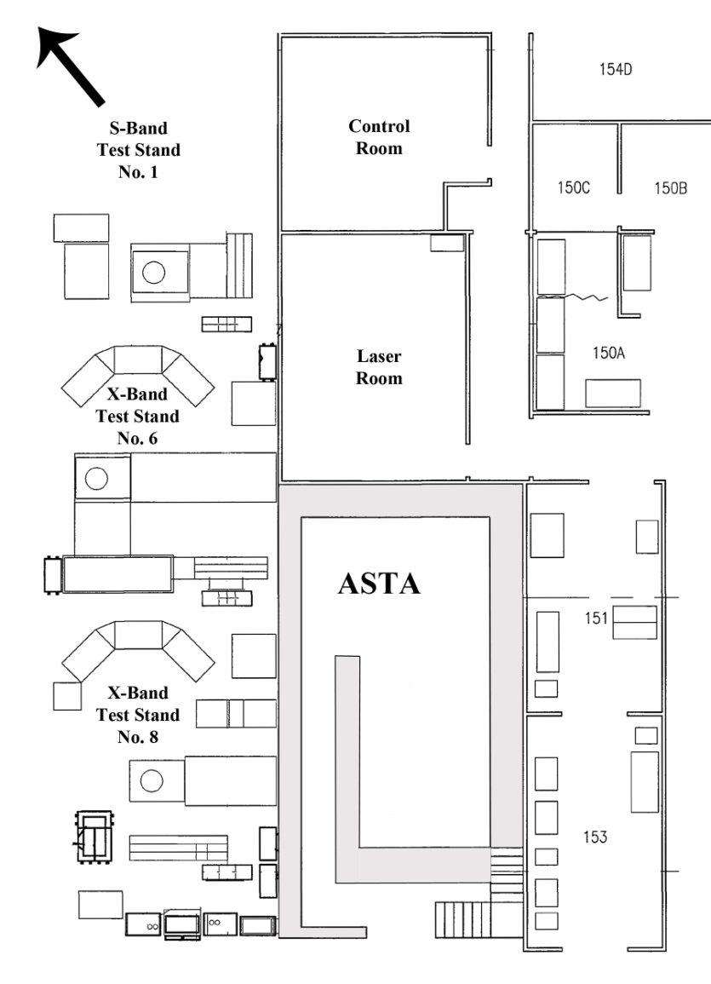
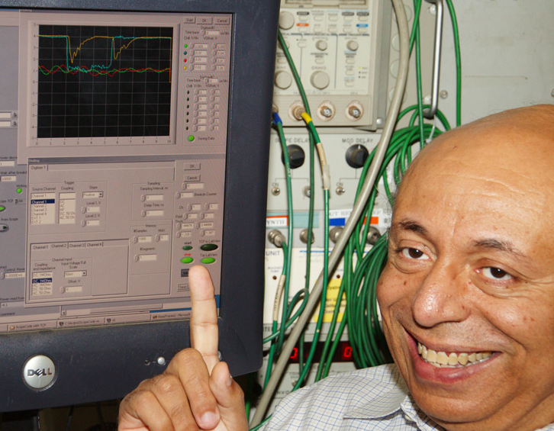
Accelerator Structure Test Area (ASTA)
Test facility with radiation bunker for up to 50MeV maximal beam energy with 24/7 unattended operations:
2 X-Band RF Stations, up to 500 MW (compressed, combined)
1 S-Band RF station
RF photoinjector testing, laser
Very flexible infrastructure allows combination of S-and X-Band into
one setup
Quick turnaround for a
variety of different
experiments and processing
of structures
ASTA is running 24/7 in a semi-industrial mode

Slide 10
NLCTA (Next Linear Collider Test Accelerator)
120 MeV high brightness e-beam facility
Synchronized 1 micron lasers for advanced beam manipulation
Two experimental halls
Two fully instrumented beam lines
10 month/year up to 24/7 beam operation
DLA
Direct Laser Acceleration
FEL Seeding
Advanced Beam Manipulation
High Gradient Development
X-Band photoinjector development
Over the past three years NLCTA has seen dramatic changes from focusing on DLA and modest effort in X-band RF structure testing to a multipurpose facility

Slide 11
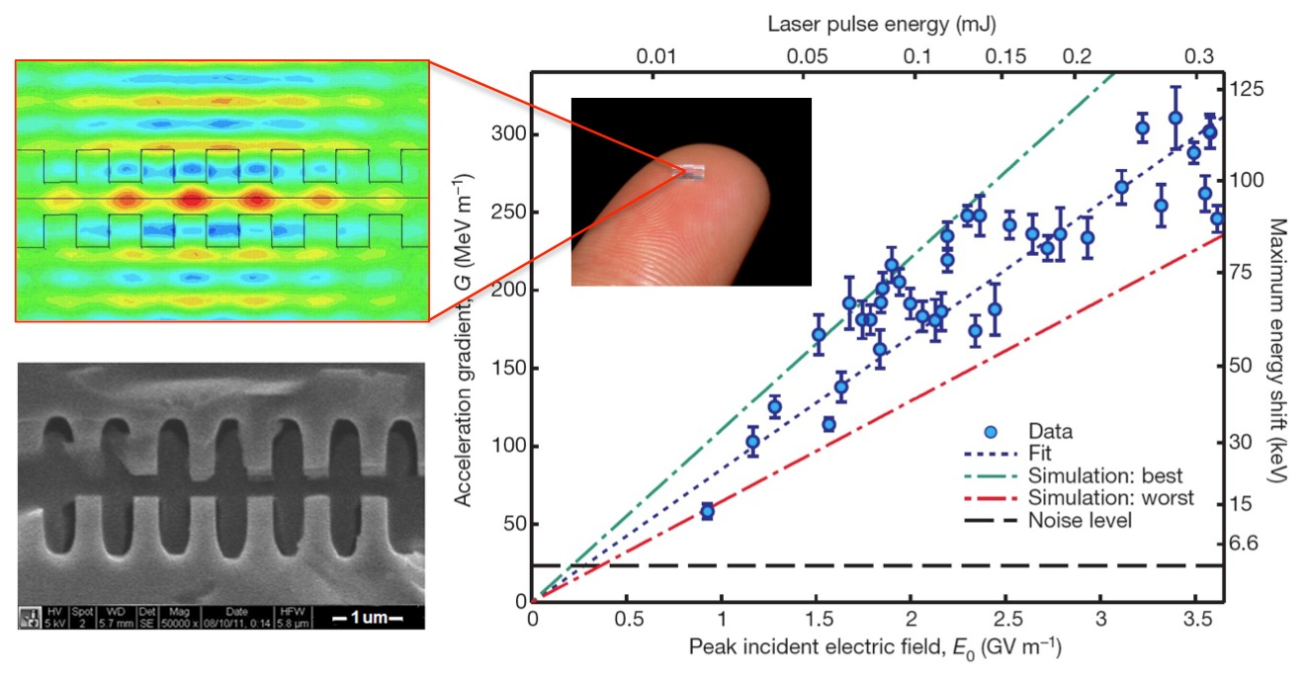
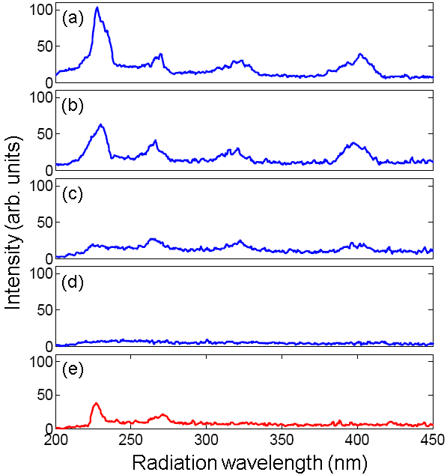
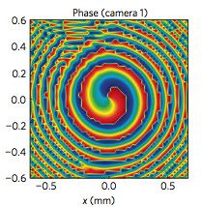
Science at NLCTA
Direct Laser Acceleration
E. A. Peralta, et al., Nature 503, 91-94 (2014).
>300 MV/m
Recent Developments:
300 MV/m measured gradients
Structures for 2-micron operation
FEL/ECHO program:
EEHG Harmonics
PRSTAB, 17, 010703 (2014)
PRL 110, 244801 (2013)
PRL 110, 264802 (2013)
PR-STAB 16, 010706 (2013)
PRL 110, 094802 (2013)
PRL 110, 064804 (2013)
PRL 109, 224801 (2012)
PRL 109, 074801 (2012)
PRL 108, 024802 (2012)
PR-STAB 15, 050707 (2012)
E. Hemsing, et al, Nature Physics, (2013)
Coherent optical vortices from e-beams
1590 nm only, V=0
7th
6th
5th
4th
1590 nm only, V=85 kV
1590 nm only, V=170 kV
1590 nm only, V=255 kV
795 nm +1590 nm, V=255 kV

Slide 12
NLCTA “Relativistic e-beam Radiation Therapy”
Purpose: To experimentally validate Monte Carlo (MC) simulations for dose calculations with e-beams in the presence of heterogeneities and to use MC simulations for treatment planning optimization of ultra-fast e-beam radiation therapy
MC calculated depth dose curves for heterogeneous phantoms in agreement with the experimental curves.
Stanford School of Medicine – Radiation Oncology
At 100 MeV integral dose to pediatric patient is 33 % lower than other leading therapies

Slide 13
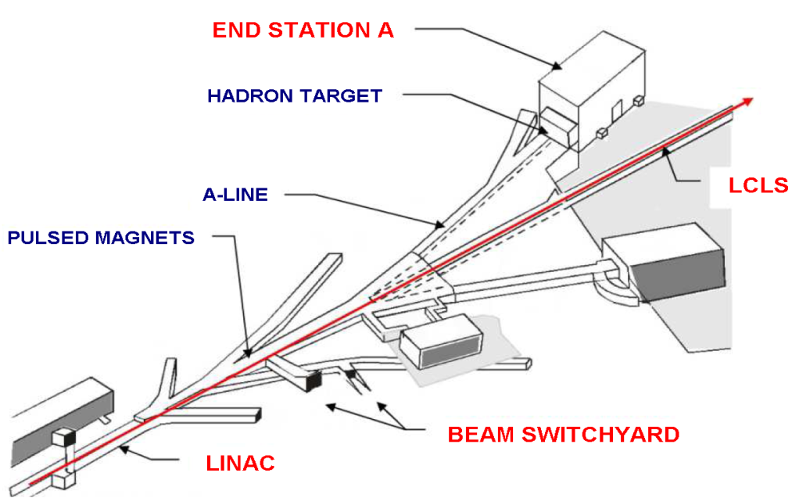
End Station Test Beam (ESTB)
Up to 10 GeV LCLS primary beam (16 GeV secondary particles) is deflected to ESTB at 5Hz
Exceptionally clean and well-defined primary and secondary electron beams for detector and accelerator R&D
FY13 (Construction completed in May)
4 experiments, 7 weeks, 32 (3 remote) Users
FY14 (October to March)
5 experiments, 9 weeks, 76 (27 remote) Users
Scheduled until summer 2014
6 experiments, 10 weeks
Wide user acceptance of ESTB within a short time

Slide 14
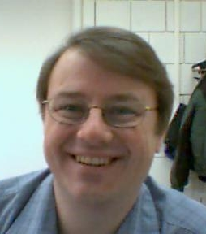
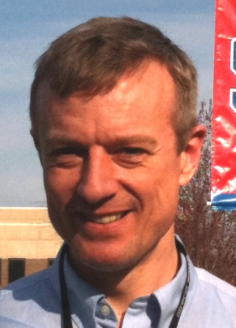
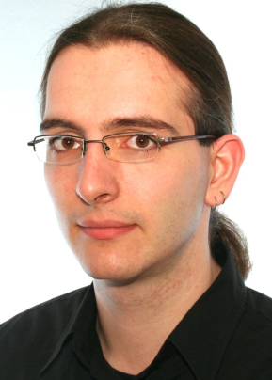
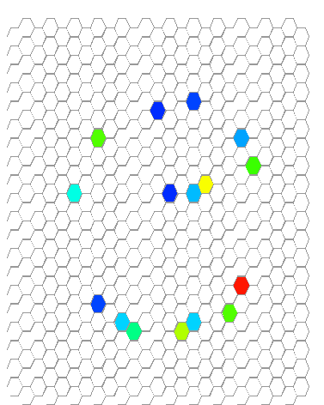
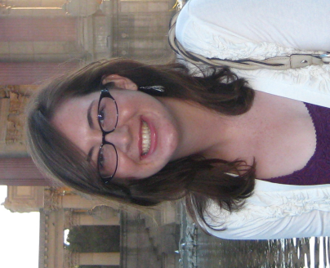
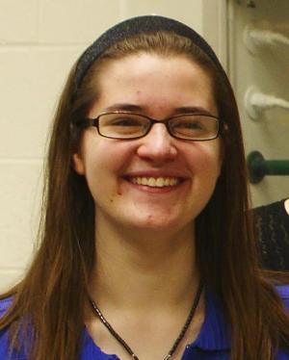
T-507: Test of a RICH-Prototype Based on CsI-GEMs for an Electron-Ion Collider
T. Hemmick, Stony Brook Uni.
Single electrons @ 5 Hz, 9 GeV
4 24h days from 5/31 to 6/03
Recorded 1.4 million triggers
Ran for 84% of wall clock time
13 hours total downtime in 4 days
Includes accesses
Tom
Hemmick
Abhay
Deshpande
Klaus
Dehmelt
Nils
Feege
Stephanie
Zajac
Marie
Blatnik
T.Hemmick is leading T-517 Phenix Calorimeter later this year
14

Slide 15
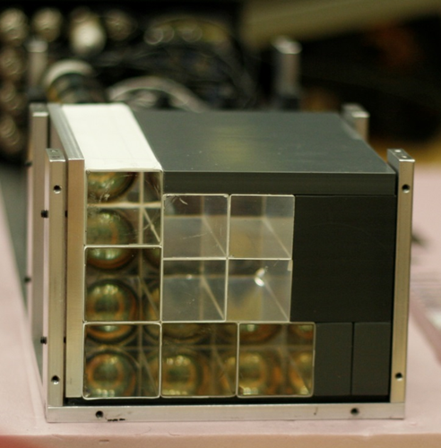
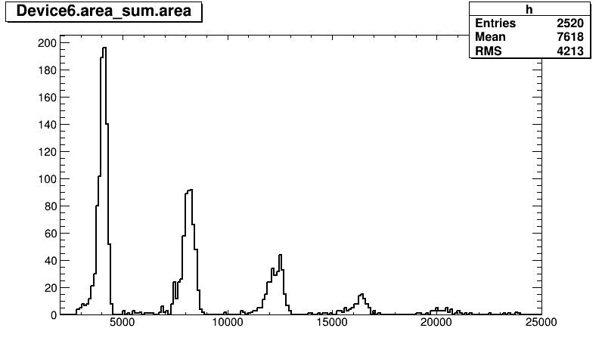
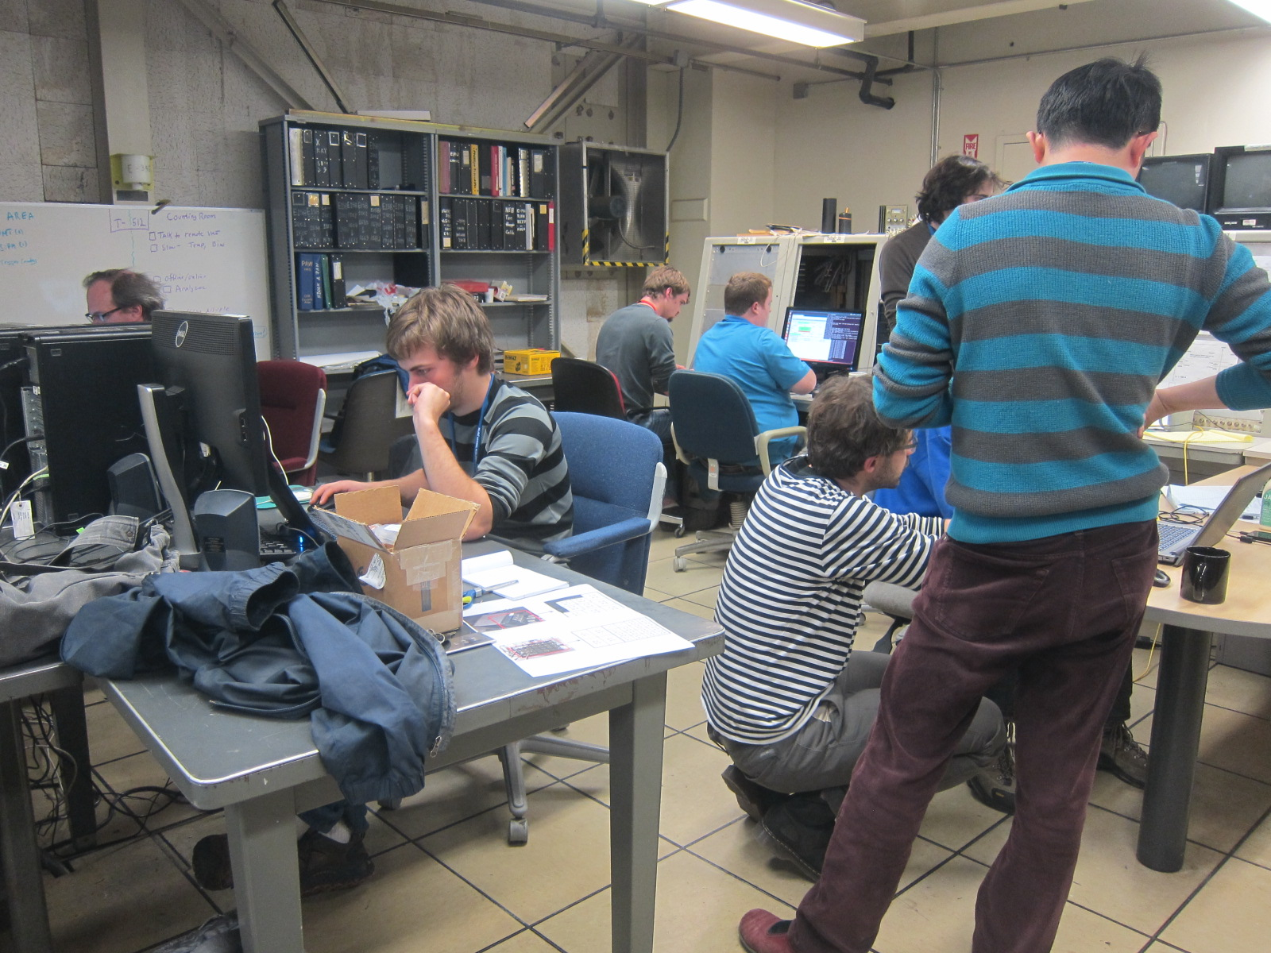
T-512: Test of FNAL g-2 Calorimeter
D.Hertzog, Univ. of Washington
8 collaborating institutions
Single electrons @ 5 Hz, 2-6 GeV
3 GeV in one of the blocks
1 e⁻
2 e⁻
3 e⁻
4 e⁻
5 e⁻
6 e⁻
T-512 back at ESTB for 2 weeks in July and October for calorimeter calibration

Slide 16
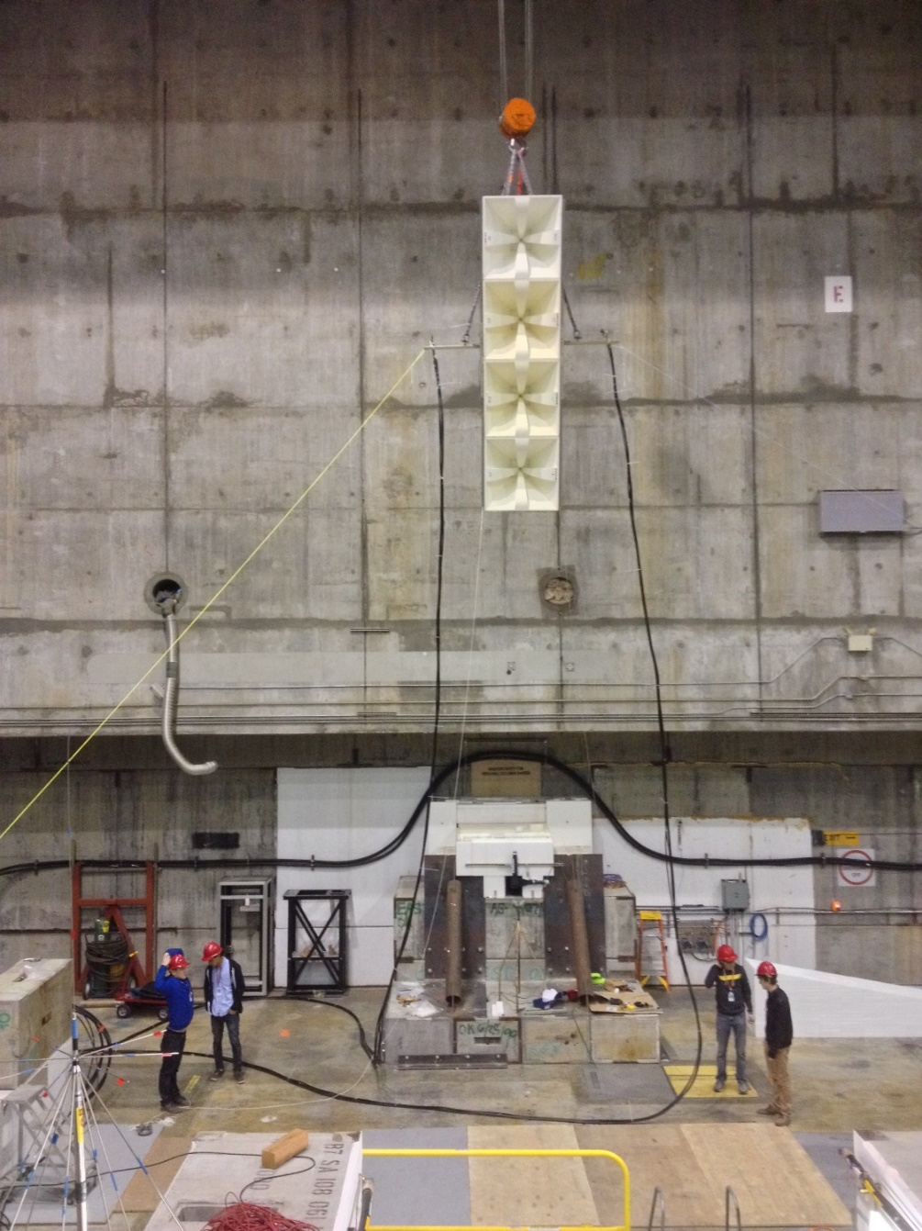
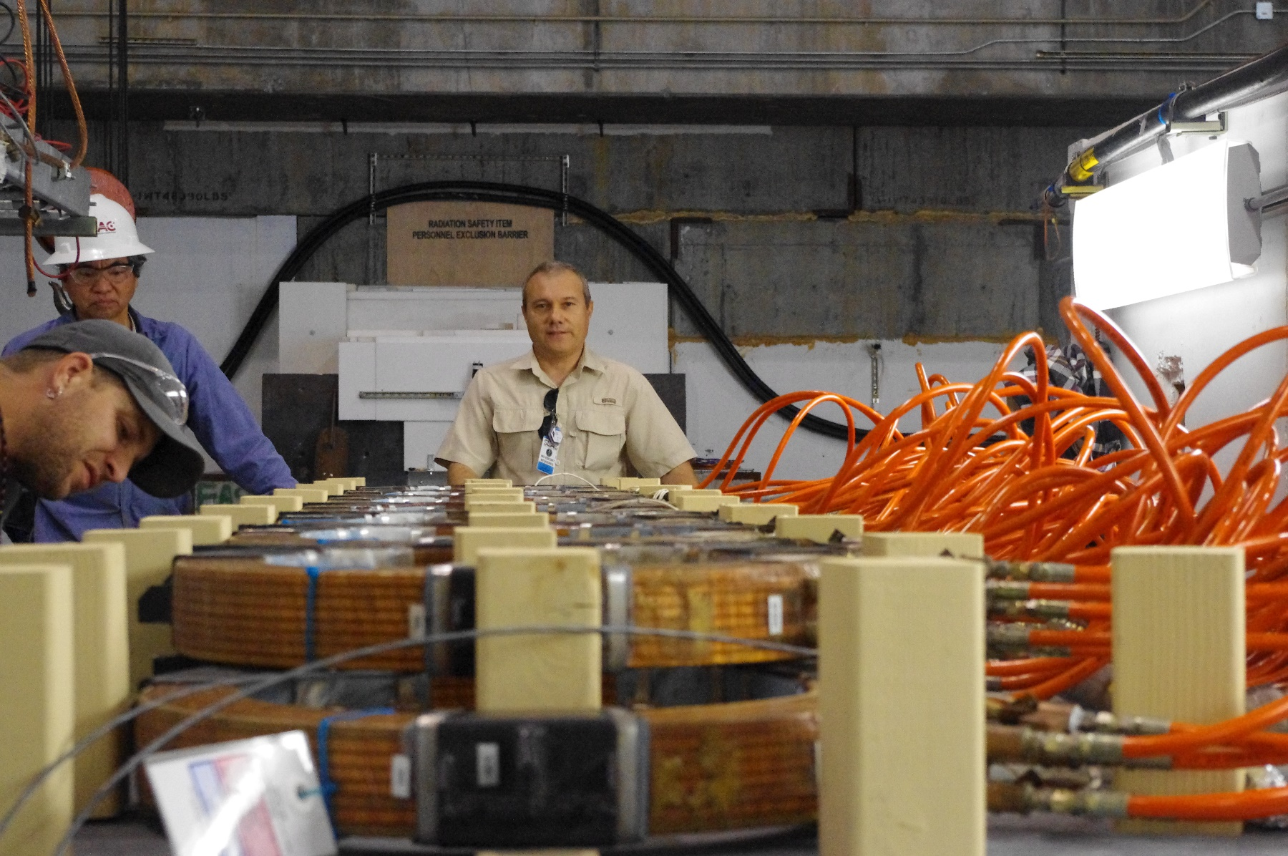
ESTB: “Geosynchrotron emission from extensive air showers” (T-510)
Anita is looking for UHECRs with a balloon at Antarctica
3rd mission planned for this year
It measured neutrons, air showers with RF antennas
Need to verify the shower model in a magnetic field to interpret data
T-510 Setup at ESTB
T-510 Goal: Reproduce atmosphere and earth magnetic field at ESTB and replace one ultra-high energetic particle with the LCLS electron beam

Slide 17
ESTB User Experiments FY2013 and FY2014
FY 2013
T-505: Tests of 3D silicon pixel sensors for ATLAS, P. Grenier, SLAC
T-506: EM Shower Damage to Si Diode Sensors, Bruce Schumm, UCSC
T-507:Test of a RICH-Prototype Based on CsI-GEMs for an Electron-Ion Collider, T. Hemmick, Stony Brook University
T-508: HERA-B ECal modules beam test in ESTB at SLAC for G_{Ep}(5) at Jefferson Lab, E. J. Brash, Christopher Newport University
T-511: Test of a Silicon-Tungsten Electromagnetic Calorimeter for the ILC SiD, R. Fry, Univ. of Oregon
FY 2014
T-505: Tests of 3D silicon pixel sensors for ATLAS, P. Grenier, SLAC
T-512: Calibration of the g-2 calorimeter, D. Hertzog, Univ. of Washington
T-513: Channeling and Volume-Reflection Studies of High-Energy Electrons in Crystals, U.Wienands, SLAC
T-510: Geosynchrotron radio emission from extensive air showers to detect ultra-high energetic neutrinos at Antarctica, K. Belov, UCLA
T-513: Channeling and Volume-Reflection Studies of High-Energy Electrons in Crystals, U.Wienands, SLAC
FY 2014 coming up
T-509: Develop a Neutron Beam Line for Calibration of Dark Matter Detectors, J. Va’Vra, SLAC
T-506: EM Shower Damage to Si Diode Sensors, Bruce Schumm, UCSC
T-516: ATLAS Inner Tracker (ITK) Upgrade, Test of several pixel sensor technologies, M. Bomben (Paris), P. Grenier (SLAC), S. Grinstein (Barcelona), D. Muenstermann (Geneva) and J. Weingarten (Gottingen), on behalf of the ATLAS-ITK Pixel Group
T-517: PHENIX MPX-EX Calorimeter, , T. Hemmick, Stony Brook University
T-518: Production Belle II iTOP module verification, G.Varner, Univ. of Hawaii
T-519: Calibration of the g-2 calorimeter, D. Hertzog, Univ. of Washington

Slide 18
ESTB User Statistics
2/28/2014
University groups need facilities to train their students in hands on experimental physics
US test beam facilities at National Labs play a critical role in training students in Detector R&D
Fermilab Test Beam Facility
ESTB at SLAC
In past 10 Months ESTB had
33 institutions from 13 countries
89 on site Users
120 Users total
46 Under/Post-Grad Students
12 PostDocs
33 Staff
29 Faculty

Slide 19
FACET and Test Facilities Users
2/28/2014
326 Users associated with the 43 active or planned experiments and beam tests at FACET and Test Facilities in FY14
Half of all users are on-site (badged and trained for experimental work)
All Users
On-site (badged and trained) Users

Slide 20
FACET and Test Facilities Users
2/28/2014
A third of all users are from outside the US
61 Institutions are represented in the User Community
Majority of Users come from universities
CA California | 121
NM New Mexico | 13
VA Virginia | 10
NY New York | 6
MD Maryland | 5
OR Oregon | 5
CT Connecticut | 4
WA Washington | 4
IL Illinois | 3
KS Kansas | 3
PA Pennsylvania | 3
CO Colorado | 2
DE Delaware | 2
FL Florida | 2
IN Indiana | 2
GA Georgia | 1
HI Hawaii | 1
NC North Carolina | 1

Slide 21
Proposal Evaluation: SAREC and TB
Users submit written proposals for review to SAREC
SLAC Accelerator Research Experimental program Committee
Evaluate the merit of proposed R&D in SLAC’s experimental accelerator research facilities for advancing world-class accelerator science or accelerator technology and rates each proposal (excellent to not suited)
Evaluate the feasibility of proposed R&D in SLAC’s accelerator research facilities
Review the progress of existing R&D in SLAC’s accelerator research facilities
Meets once per year, combined with Test Facilities User meeting
11 New Proposals presented for FACET (6), NLCTA (4) and ESTB (1)
SAREC ranked new proposals as Excellent (7), Very Good (2) and Good (2)
SLAC internal Committee to evaluate written Test Beam Proposals (a little less formal than SAREC)
Simply put: SAREC evaluates experiments, the internal committee evaluates test beam proposals

Slide 22
Beam Time Allocation
After experiments have been approved (E- or T-number issued) scheduling is done by the Facet and Test Facilities Division
FACET
Operation of 2/3 of the SLAC Linac is a complicated business
Experimental area is rather hard to reach: 30‘ underground, small and hot
1.5 consecutive days for access per week
Over the past 2 years we managed to train the user to be efficient in installation and usage of beam time
The accelerator state dictates which experiment is done when
Easier accelerator setup to more difficult one
Most experiments are done in 1-5 experimental shifts
A shift is between 8 and 12 hours followed by 12 hours of accelerator tuning to be ready for the next shift
ESTB
First come first serve (not running out of capacity yet)
Since beam energy is dictated by LCLS we negotiate with Users to get a good match
LCLS typically changes their user experiments at 9am/9pm therefore ESTB has 2 12h shifts per day, typically 5 days a week (2 days machine development and maintenance per week)

Slide 23
Peter’s Questions
* the capabilities of the facilities
* what kinds of beam particles electrons and positrons
* what beam energies 5MeV-20GeV in 4 different facilities
* luminosities 20-1000pC (10^8-2*10^10 particles)
* number of users serve 326 this fiscal year so far
* facilities for users fully developed experimental areas and control rooms and some office space
* the management of the user base
* how do users apply for beam time formal written proposal
* what is the approval procedure to get beam time formal review with external and/or internal experts
* what fraction of users get beam time, for how long currently nearly 100%
* shift policies (8,12, 24 hour shifts?) typically 12h, with days or 1-2 weeks of beam time
* installation of user devices help by Test Facilities Division
* what services does the lab provide to the users Safety training, computing, free usage of infrastructure
installation and operation support, purchase of gases
* the makeup of the user base
* what experimental community (LHC, neutrino, non-HEP, etc) LHC, B-factory, Neutrino, Dark Matter, g-2, Nuclear
Material Science, Accelerator Physics, Medical
* how many repeat customers most
* national composition 30% international, majority US
* process for evaluating the results of the test beam
* what do users have to do to show that they used the beam effectively, if anything? Long tradition of SLAC’s daily 8am meeting
Users show the result of the previous 24 hours
* reports/papers/talks at lab meetings? Yearly user meeting, where the bigger proposal
present their results and new ones
* any process for collecting results that use facility (conference papers, e.g., or other publications) Users agree to publish any
results with a SLAC publication number. In practice it is quite labor intensive to contact all Pis and request information
anything else Your turn for questions

Slide 24
Summary
FACET-ESTB-NLCTA-ASTA span a broad spectrum
e⁻ energy between a few MeV to 23 GeV
Focused Plasma Wakefield acceleration towards a future collider is the highlight of the program
There is also a broad spectrum of user research
Novel and better acceleration techniques
RF, X-Band, WFA, DLA, FEL, Seeding
Detector R&D at ESTB
Formal proposal review processes with external program advisory committee
User base and collaborating institutions are rapidly growing
Need electrons? Come to SLAC!

