Slide 1
LArSoft Project Status
Current Items – for further correction/discussion
Experiment responsibles for nightly builds monitoring/validation:
  LBNE – will meet with Tom and Mike K after Mike is back from vacation
  Uboone -?
Extended mrb functionality:
  Support for other shells was scheduled for completion today 4/3/14 – progress made; 4/29/14 Lynn joining the final testing effort.– no estimate for completion
  Support for multi-product dependencies schedule needed - ?6/1/14? – 4/29/14 not started
Workshop on LArSoft test suite ?6/26/14? 7/29-2/30?
Continuous integration
  Lots of progress on “CI@BuildService”
  Erica defining what else is needed – perhaps discuss
  Looking for help for writing tests: LBNE? Summer student?

Slide 2
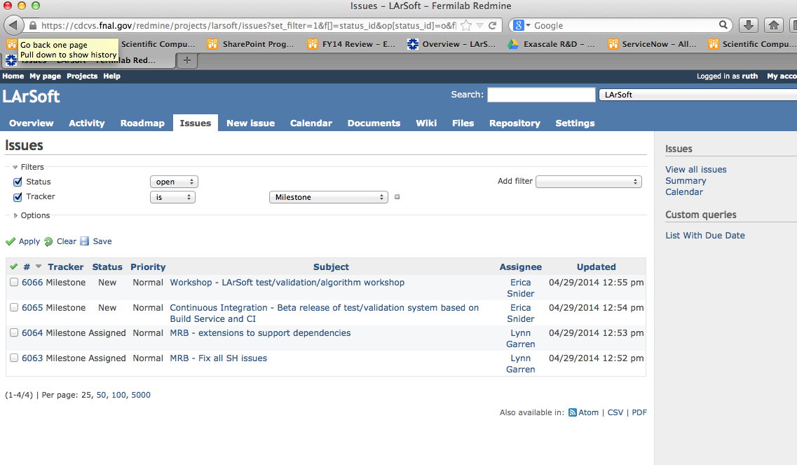
Building out Milestones in Redmine itself

