Slide 1
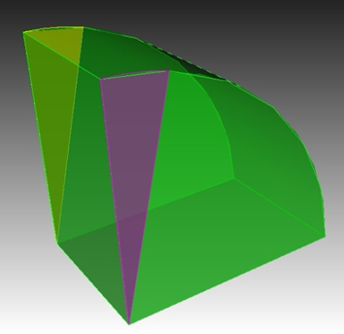
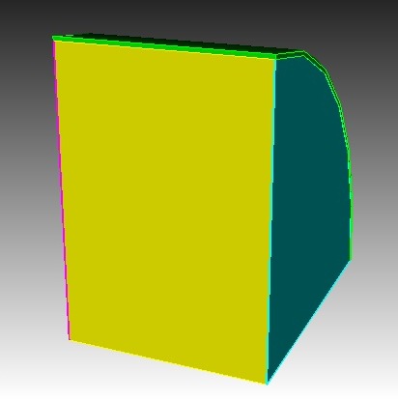
TEM3p for Be wall cavity
Thermal analysis: temperature calculation with T-dependent thermal and electric properties, cooling force estimation.
Mechanic: cavity deformation and frequency drift due to thermal stress and Lorentz force detuning.

Slide 2
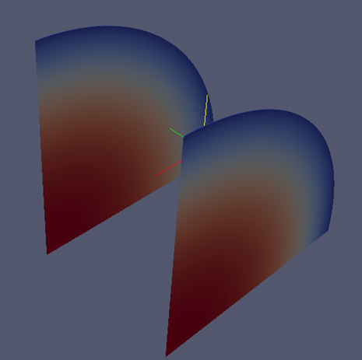
With constant thermal conductivity and electric resistivity
Blue line: TEM3P simulation
Red dashed: Analytical formula
The temperature distribution of the pillbox cavity with constant thermal conductivity and electric resistivity can be solved analytically.
Left figure is a simplified model for checking purpose: 1mm Be wall; thermal conductivity: 300 W/(mK); electrical conductivity: 9.3e7 S/m; peak E field 21.6 MV/m; duty factor: 0.92e-3; r=0.36 m where T is fixed at 80 K.
Right figure: the T along the Be wall radius, calculated by TEM3p (blue) and analytical formula (red).

Slide 3
With T-dependent thermal conductivity and electric resistivity
Electric resistivity
Blue: T-independent
Black: T-dependent
 | Bob’s Code | TEM3P
T_center(K) | 167.8 | 163.5
Thermal conductivity
TEM3p simulation result agrees well with Bob’s code.

Slide 4
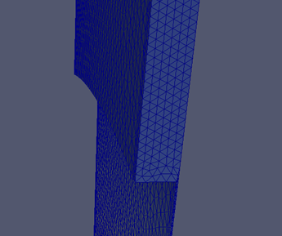

Stepped window and Tapered window
Stepped window
T (K) at the window edge
Tapered window
Red: tapered window
Blue: stepped window
Duty Factory (10^-4)

Slide 5
TEM3p outlook
Support the Be window design with reasonable RF heating: simulate the window temperature with arbitrary stepped/tapered shape and T-dependent material properties.
Preliminary cooling force estimation.
After the temperature is controlled within an acceptable range, move on to analyze the cavity deformation and frequency drift due to thermal stress and Lorentz force detuning.

