Slide 1
Mu2e Extinction
Steve Werkema
Muon Department Meeting
1 May 2014

Slide 2
Outline
Why Extinction is Needed
Implementation of Extinction
Predicted Performance

Slide 3
Why Extinction is needed
Mu2e Signal
Mu2e Beam Induced Backgrounds

Slide 4
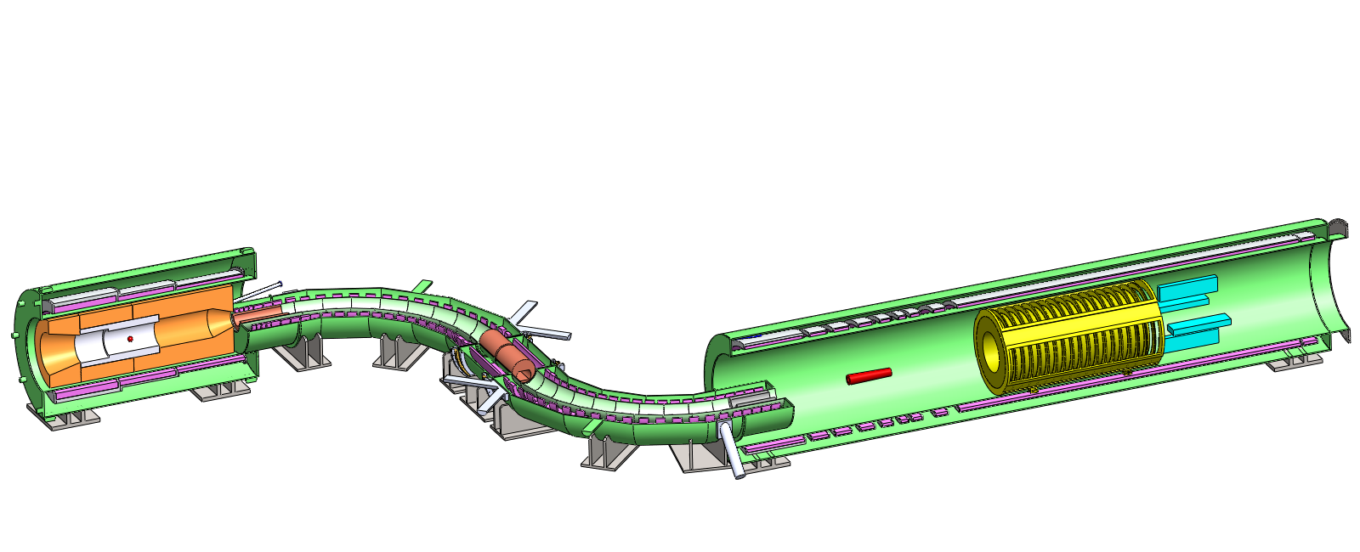
Mu2e on One Slide
Production Solenoid
  Production target
  Graded field
  π’s → μ’s
~ 0.0016 stopped μ⁻/POT
10¹⁰ Hz of stopped muons
Detector Solenoid
  Muon stopping target (Al)
  Tracker
  Calorimeter
  The signal is the response of the Tracker and the Calorimeter to the passage of the conversion electron.
Transport Solenoid
  Transport muons to stopping target
  Collimation system selects muon charge and momentum
  Pbar window in middle of central collimator
Proton Beam
Production Solenoid
Detector Solenoid
Transport Solenoid
Production Target
Calorimeter
Tracker
Stopping Target
Notes:
Modified from an animated slide originally put together by Ron Ray.

Slide 5
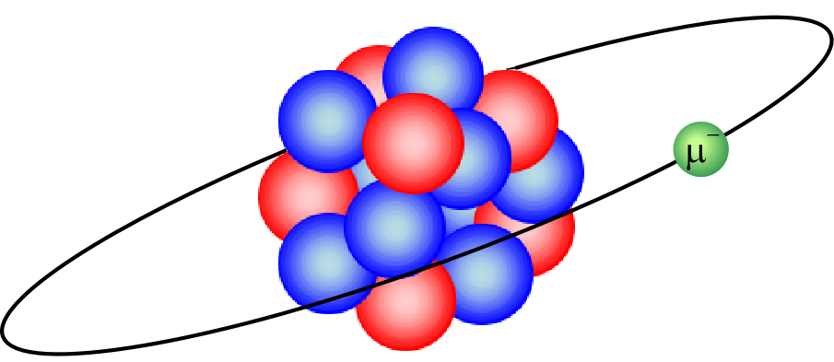
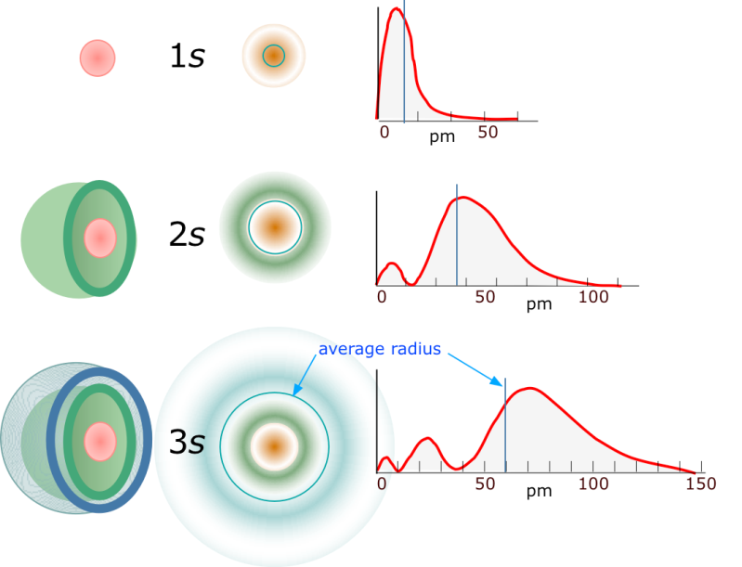
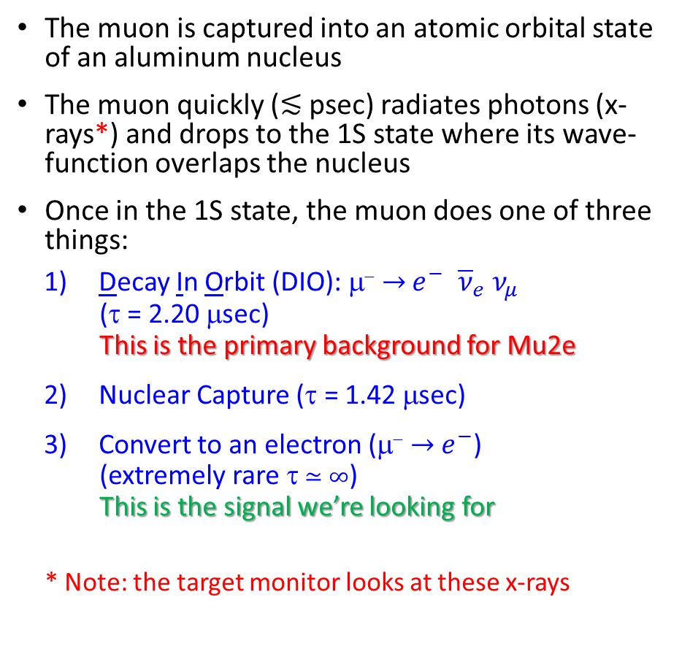
What Happens when a Muon Stops in the Stopping Target?
The muon is captured into an atomic orbital state of an aluminum nucleus
The muon quickly (≲ psec) radiates photons (x-rays*) and drops to the 1S state where its wave-function overlaps the nucleus
Once in the 1S state, the muon does one of three things:
  Decay In Orbit (DIO): μ⁻ → $e^{−} {\overline{ν}}_{e} ν_{μ}$
  (τ = 2.20 μsec)
  This is the primary background for Mu2e
  Nuclear Capture (τ = 1.42 μsec)
  Convert to an electron (μ⁻ → $e^{−}$)
  (extremely rare τ ≃ ∞)
  This is the signal we’re looking for
* Note: the target monitor looks at these x-rays
Al
Notes:
Hydrogen s-state image taken from: http://chemwiki.ucdavis.edu/Under_Construction/chem1/Atoms_and_the_Periodic_Table/The_Quantum_Atom

Slide 6
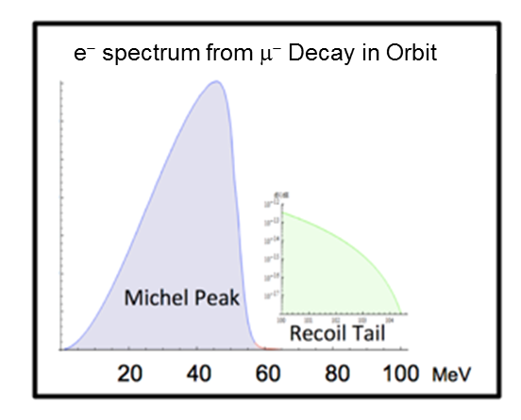
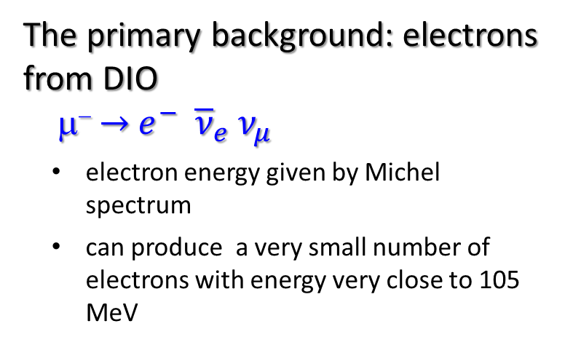
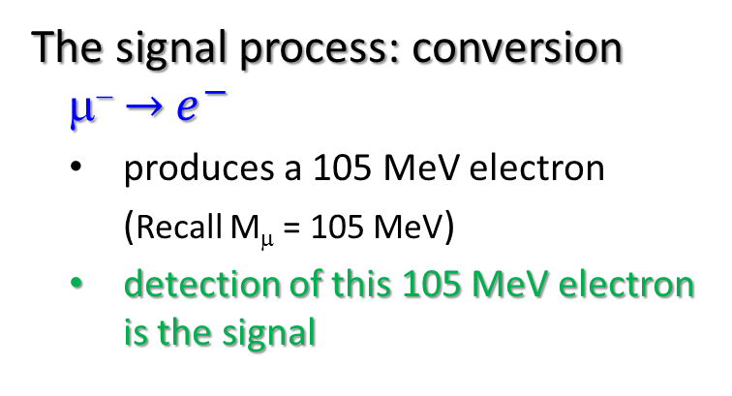
Excursus: Reducing the Primary Background
The signal process: conversion
μ⁻ → $e^{−}$
  produces a 105 MeV electron
  (Recall M_{μ} = 105 MeV)
  detection of this 105 MeV electron is the signal
~3 × 10⁻¹³ of the DIO electrons within 3 MeV of endpoint.
The primary background: electrons from DIO
μ⁻ → $e^{−} {\overline{ν}}_{e} ν_{μ}$
  electron energy given by Michel spectrum
  can produce a very small number of electrons with energy very close to 105 MeV
This background is reduced by a detector with very good energy resolution ~120 keV out of 105 MeV (0.1%).
Notes:
Since extinction is all about background reduction, it is appropriate to talk about the principle background for the Mu2e experiment.

Slide 7
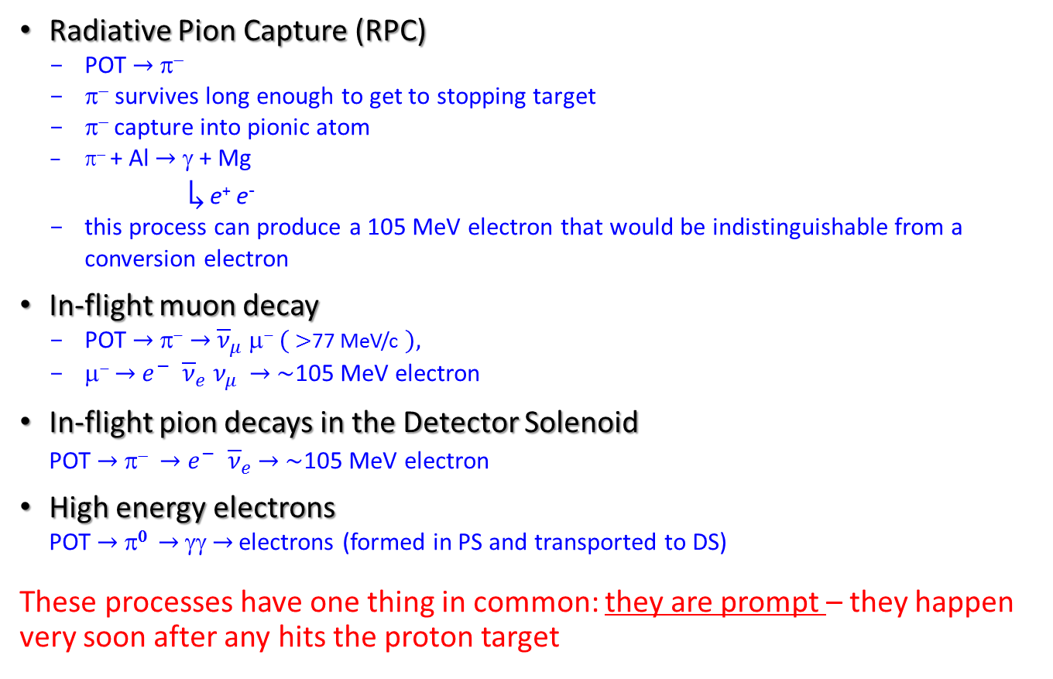
Other Processes that Produce 105 MeV electrons
Radiative Pion Capture (RPC)
POT → π⁻
π⁻ survives long enough to get to stopping target
π⁻ capture into pionic atom
  π⁻ + Al → γ + Mg
  ↳ e⁺ e⁻
this process can produce a 105 MeV electron that would be indistinguishable from a conversion electron
In-flight muon decay
POT → π⁻ → ${\overline{ν}}_{μ}$μ⁻ ( >77 MeV/c ),
μ⁻ → $e^{−} {\overline{ν}}_{e} ν_{μ}$ → ~105 MeV electron
In-flight pion decays in the Detector Solenoid
POT → π⁻ → $e^{−} {\overline{ν}}_{e}$ → ~105 MeV electron
High energy electrons
POT → π⁰ → γγ → electrons (formed in PS and transported to DS)
These processes have one thing in common: they are prompt – they happen very soon after any hits the proton target
Notes:
In order of increasing severity
POT = Proton on Target

Slide 8
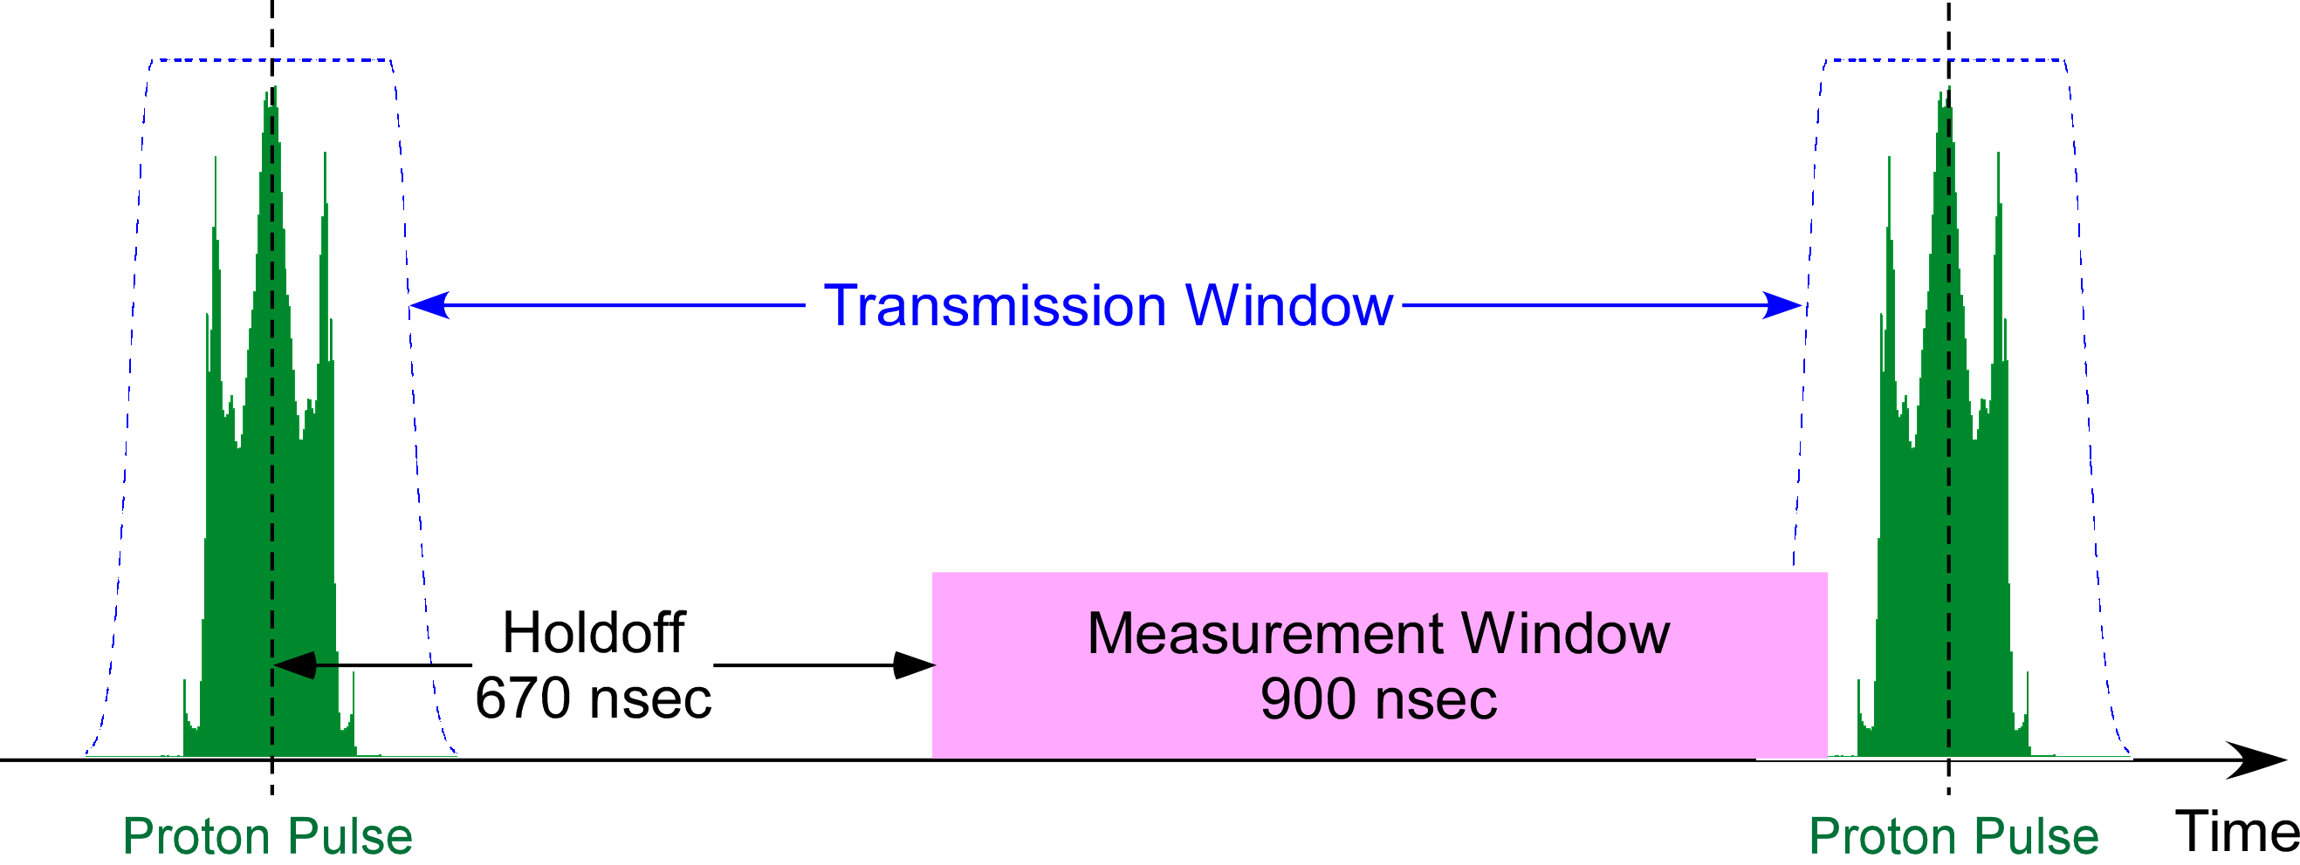
Reduction of Prompt Backgrounds
Prompt backgrounds are reduced by delaying when the Mu2e detector goes live.
t = 0
t = 1695 ns

Slide 9
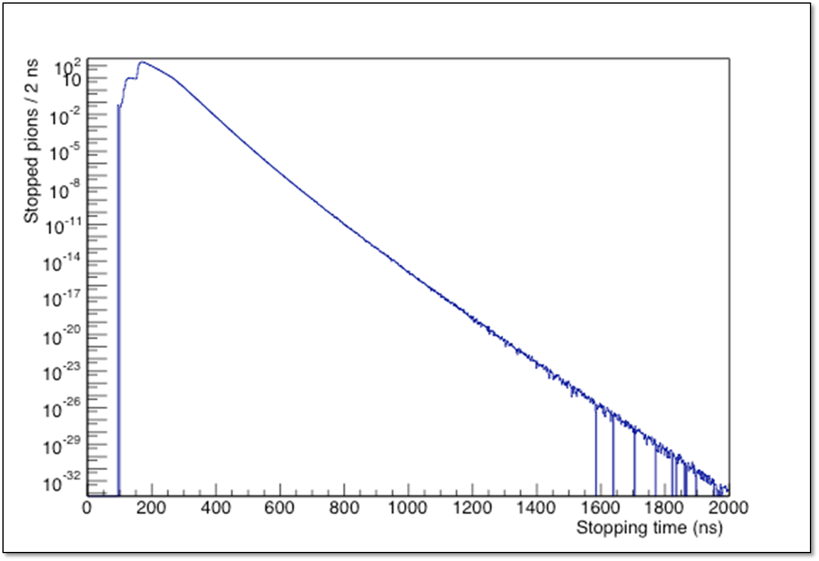
Pions in Stopping Target vs. Time
5×10⁹ POT
It takes >100 nsec for pions to start stopping in target
Pion stopping rate decays fast (τ ≃ 23 nsec)
Any proton beam hitting the proton target out-of-time will regenerate the rate of stopped pions
~e^{-t/(23 nsec)}
t = 0 is center of proton pulse
Beam FW = 250 nsec (±125 nsec)
Kyle Knoepfel

Slide 10
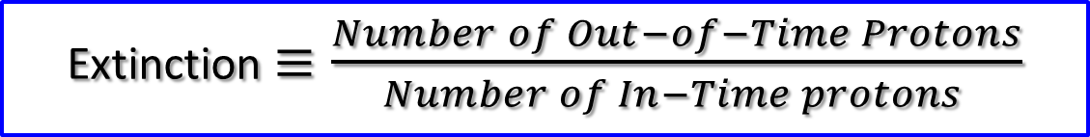
Extinction Requirement
Prompt backgrounds are reduced to an acceptable level in two ways:
Delaying the experiment’s live window until stopping pion rate has significantly decreased (670 nsec≃ 30 e-folding times)
Extinction requirement: limit on the number of out-of-time protons on the proton target
Extinction$≡\frac{Number of Out−of−Time Protons}{Number of In−Time protons }$
Extinction Requirement: Beam outside of ±125 nsec from the pulse center must be extinguished to an extinction level of 10⁻¹⁰.

Slide 11
Implementation of Extinction

Slide 12
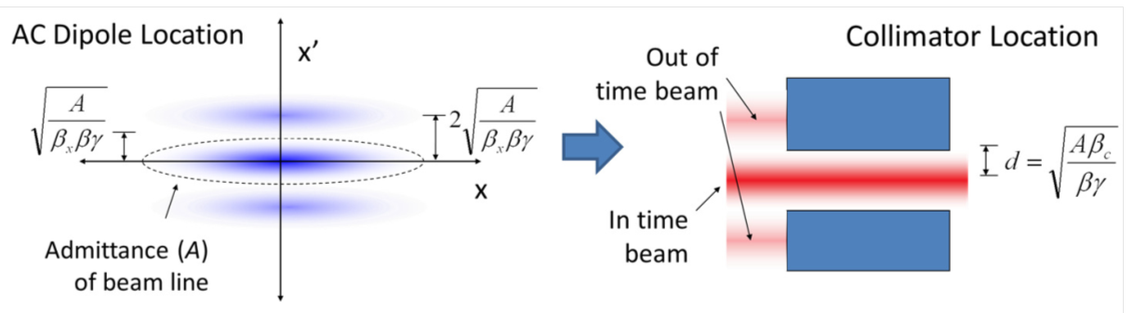
Principle of M4 Beamline Extinction Insert
Odd multiple of 90° horizontal betatron phase advance

Slide 13
Extinction Collimation Section
AC Dipole
5 collimators
C. Johnstone

Slide 14
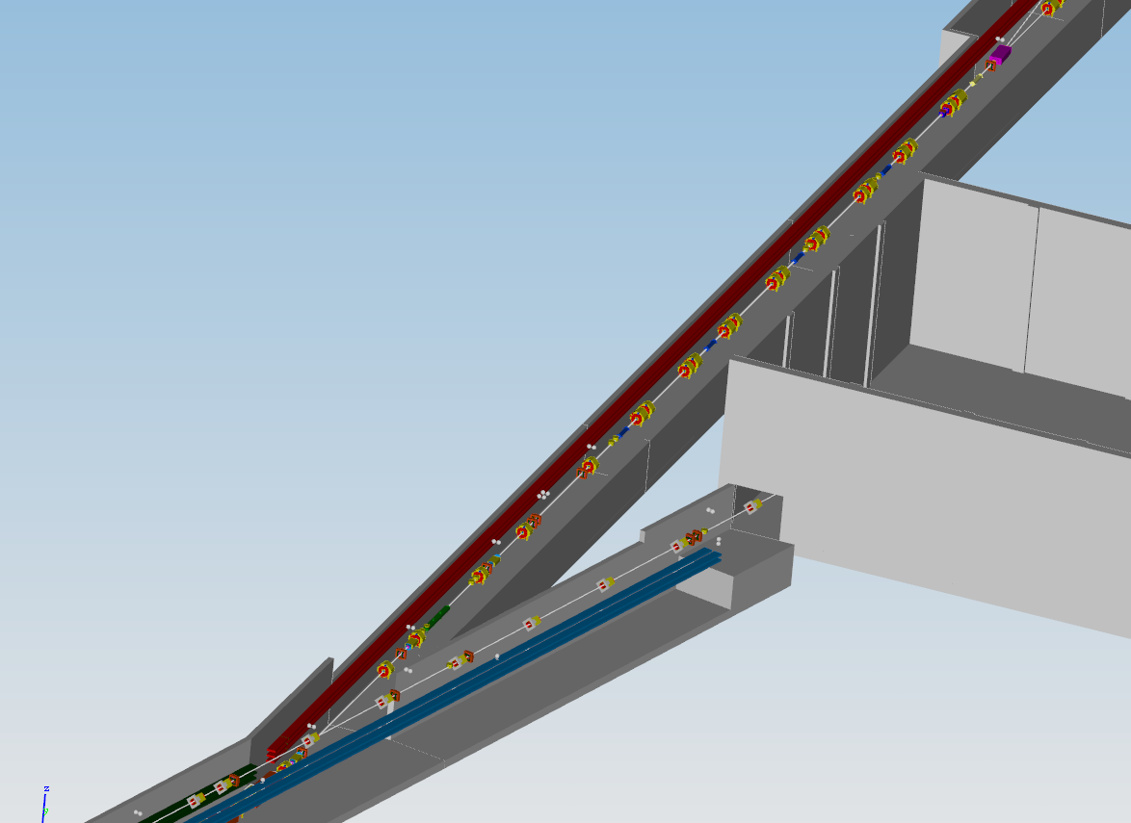
Extinction System Layout
Collimators
Note: we are presently considering the removal of one or more of these collimators
AC Dipole

Slide 15
AC Dipole Magnet
Copper tube Power Leads & Cooling channels
Ferrite plates
Beam direction
Al case (half shown)
Eric Prebys

Slide 16
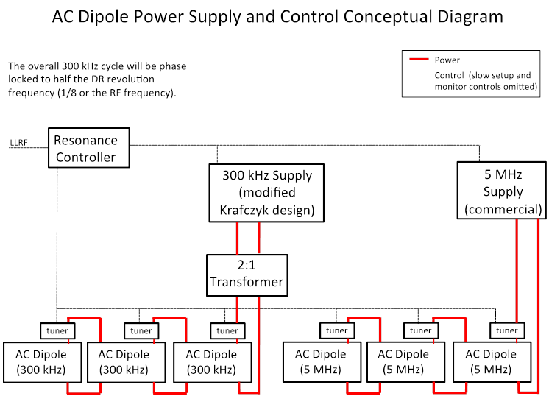
AC Dipole Power Supply
Note: A third harmonic (900 kHz) will likely be added to the design in the near future.
This addition does not add another magnet module – it will add one more power supply in the MC-1 building.
Eric Prebys

Slide 17
Final Waveform and Transmission Window
AC Dipole excitation waveform: superposition of 300 kHz and 5 MHz components
Transmission Window
Eric Prebys

Slide 18
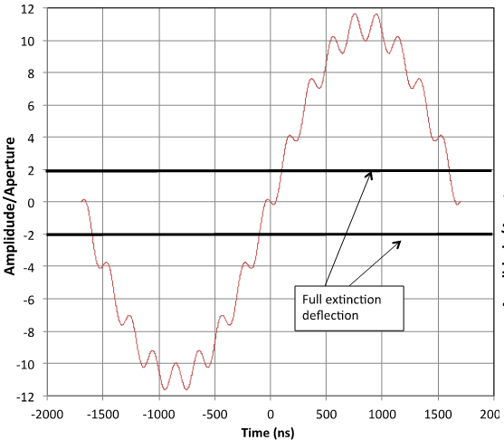
Problem
At peak fields in the AC dipole, beam will hit the beam pipe upstream of the collimator system, scattering particles into the beamline aperture.
Possible solutions:
Make beamline aperture bigger (replace SQ’s with LQ’s)
Add a third harmonic to AC dipole excitation

Slide 19
Modified AC- Dipole Waveform
Adding 900 kHz:
Lops off the peaks
Eric Prebys

Slide 20
Predicted Performance

Slide 21
Three Part Simulation
ESME longitudinal tracking model of Recycler Ring and Delivery Ring – Steve Werkema (Me)
G4Beamline Tracking model of beamline extinction section – AC Dipole + collimation – Eric Prebys
Mu2e muon beamline + detector Monte Carlo model to calculate rates of background events in the Mu2e detector. – Kyle Knoepfel

Slide 22
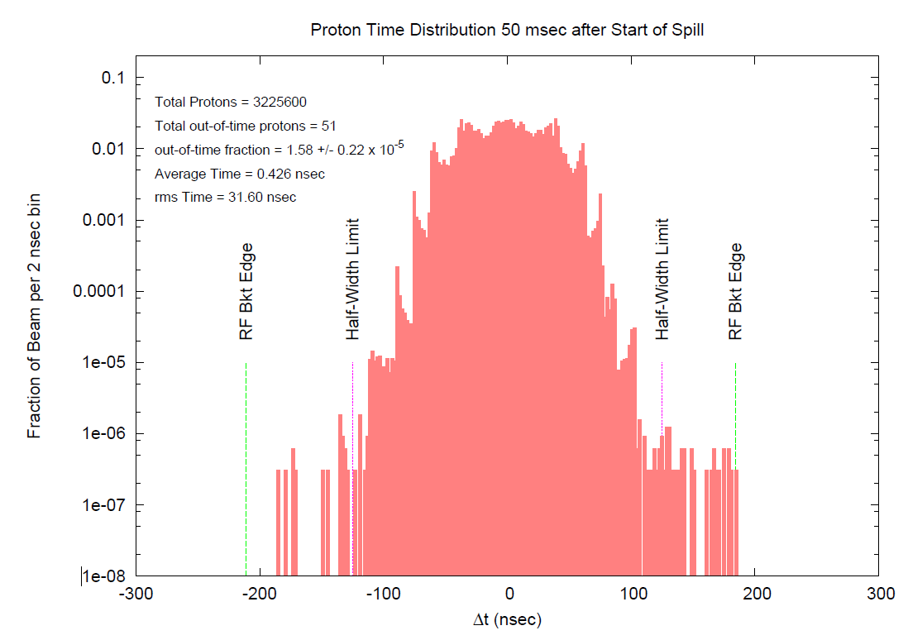
Output of ESME RR & DR Models
Beamline extinction system requires the out-of-time fraction to be <10⁻⁴ to achieve an overall extinction of 10⁻¹⁰

Slide 23
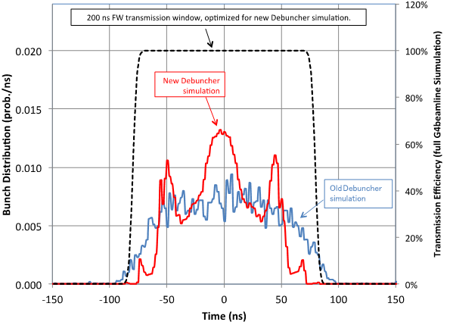
Extinction Model Result
Transmission window shown here is wrong. Eric used the wrong beamline admittance and beam emittance.
An updated transmission function will be published soon.
Eric Prebys

Slide 24
Extinction: Estimated Backgrounds for 10⁻¹⁰ Extinction
Estimated number of background events for the entire Mu2e run for an out-of-time extinction of 10⁻¹⁰
Background | Events
π⁻ Radiative Pion Capture | 0.033
μ⁻ Decay in Flight | 0.010
π⁻ Decay in Flight | 0.003
Beam Electrons | 0.0006
Total | 0.047
These numbers come from Table 1 in the Beam Extinction Requirement document
Mu2e-doc-1175 by Jim Miller
Note: this calculation used an older (more conservative) beam distribution and assumes 10⁻¹⁰ extinction of all out-of-time beam.

Slide 25
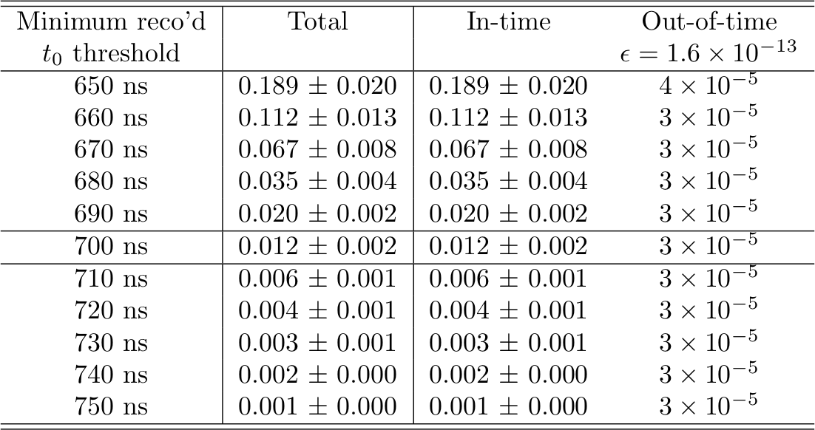
Mu2e Monte Carlo RPC Background
3 year Mu2e Run
New AC dipole transmission function/POT shape
Includes event mixing
Note: Kyle is using Eric’s defective transmission window.
(⬇40%)
TDR:
Kyle Knoepfel

