Slide 1
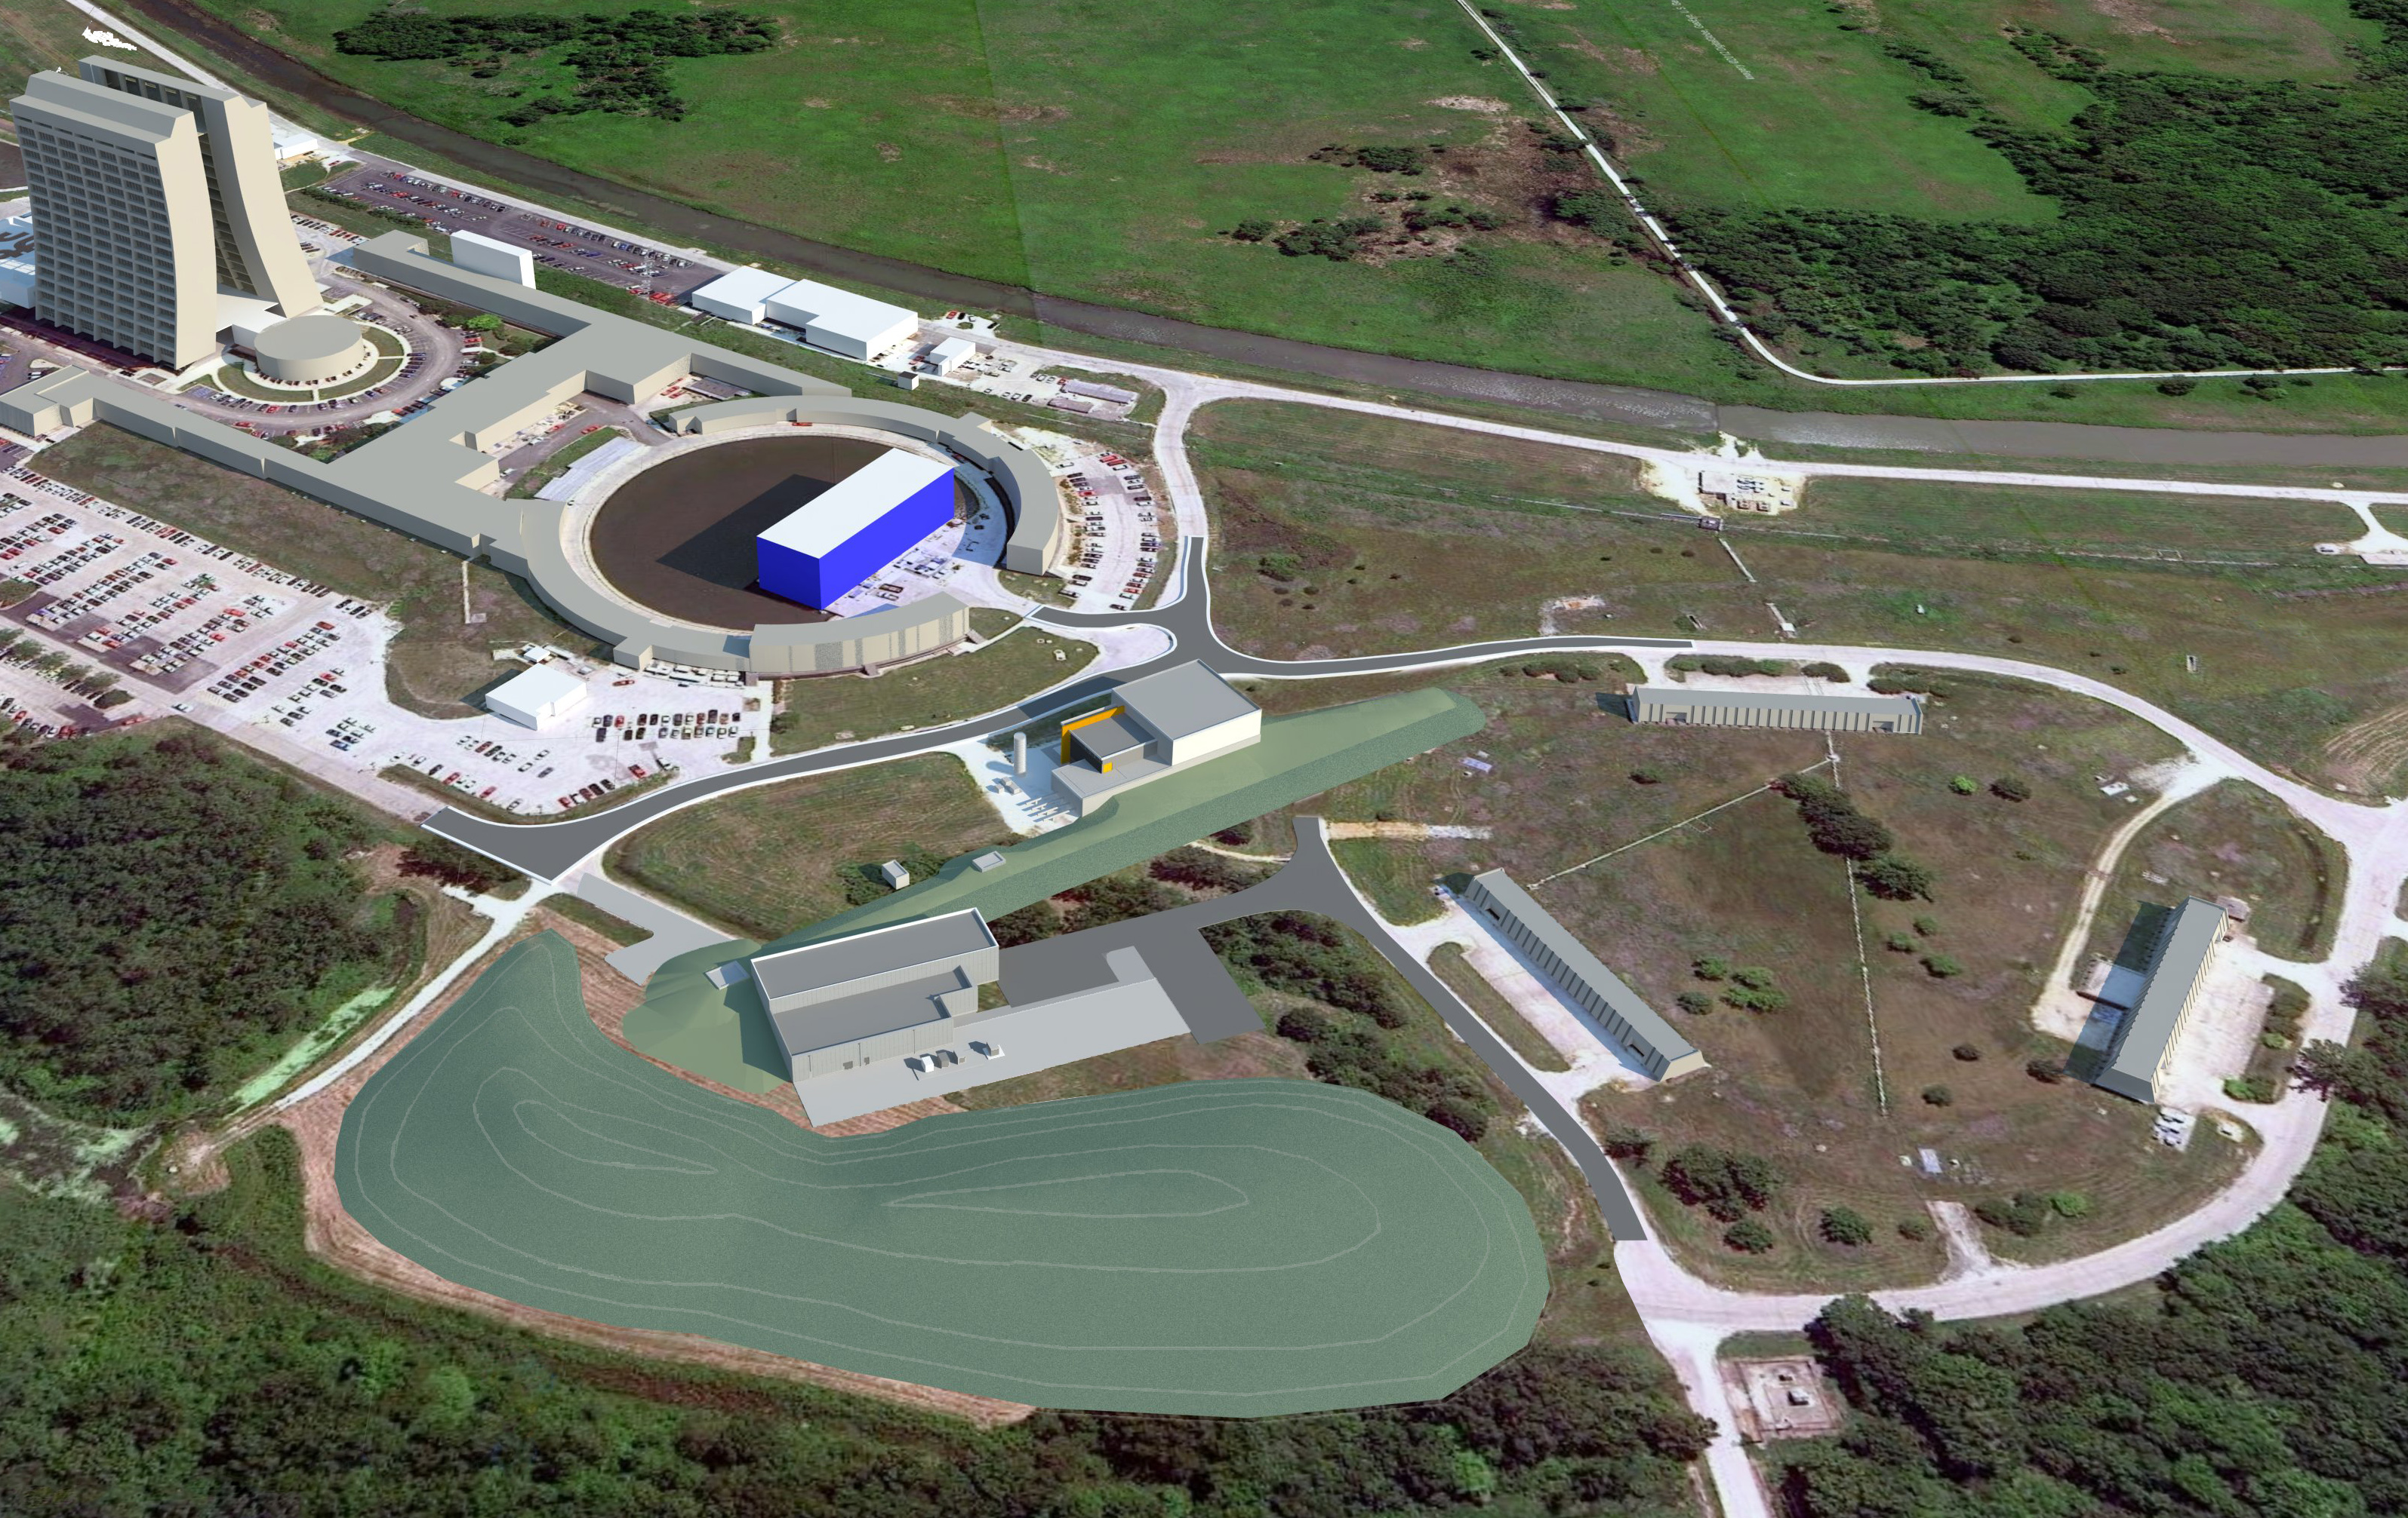
Muon Campus Shutdown Cons Gattuso 5/01/14

Slide 2
Tunnel Access Status
Supervised Access
Tunnel Key have been recored to Shutdown key set (Rings only)
Permenant key system has been set up
Items being worked
RWP
Currently your signature is required every 30 days
Trying to get this waved for 1/Shut down time frame (Rings only)
Human factor
Tunnel relamping
At the 10 and 30 Service buildings
Port-a-pods ($50/month/unit
Water stations
I have acquired 2 units will acquire bottle water in the same way

Slide 3
Tunnel work status
Alignment work
Network
Referencing
Other issues
Work areas
D/A
30 straight section
E760 Pit
50 straight section
Ring in general
Component tagging
Start the program next week
Need clear direction as to the final distances of some components

Slide 4
Alignment work
Network monuments are all in…
Rings/Transport to the Gates
Complete
Label control and painting done
Complete
Vertical network
Complete
Horizontal Network will follow
~35% Complete, On hold due to MC-1 Network installation
Refereeing and as founding ( ~1 hour per magnet)
D/A line
Complete
30 Straight section
Accumulator Ring 95% Complete
Delivery Ring 90% complete
~4-5 magnets have issue with Shuts that are in the way and can't be reference until they are removed.

Slide 6
Work areas
DR1-1 and DR-8
Removed and Spool piece put in there place
Area has been pump down and leak checked
E760 pit area
The 4-8 Ghz Core Momentum kicker tanks 1 and 2 next the AP50 pit should be ready to be moved to the 40 jump point.
This will give us access to the Crane within the pit to raise and lower components as needed.
Crane will most likely need service.
D/A line
Vacuum components between magnets have been removed
Power leads and Klixon cabling have been disconnected
Water lines will be valved out and capped
Magnets will be moved to jump point (40 hatch) starting today
Working on the process of moving magnets

Slide 7
Work areas
30 straight sections
ICW system removal
95% of the pipe is down from the ceiling
~350-400 Ft of piping will be cut to 4 FT lengths for disposal
Brown Rad box will be delivered to AP-30
Power Cable Disconnections/Removal/Booting
Accumulator Ring
Will start Monday
Delivery Ring
Will start Today
AP3 line
Will start Today
Delivery Ring
Vented
Cooling Tanks being prepped for removal
Shipped to B0 compressor building

Slide 8
Bumps In The Road
D3Q8 location in the 30 straight section

Slide 9
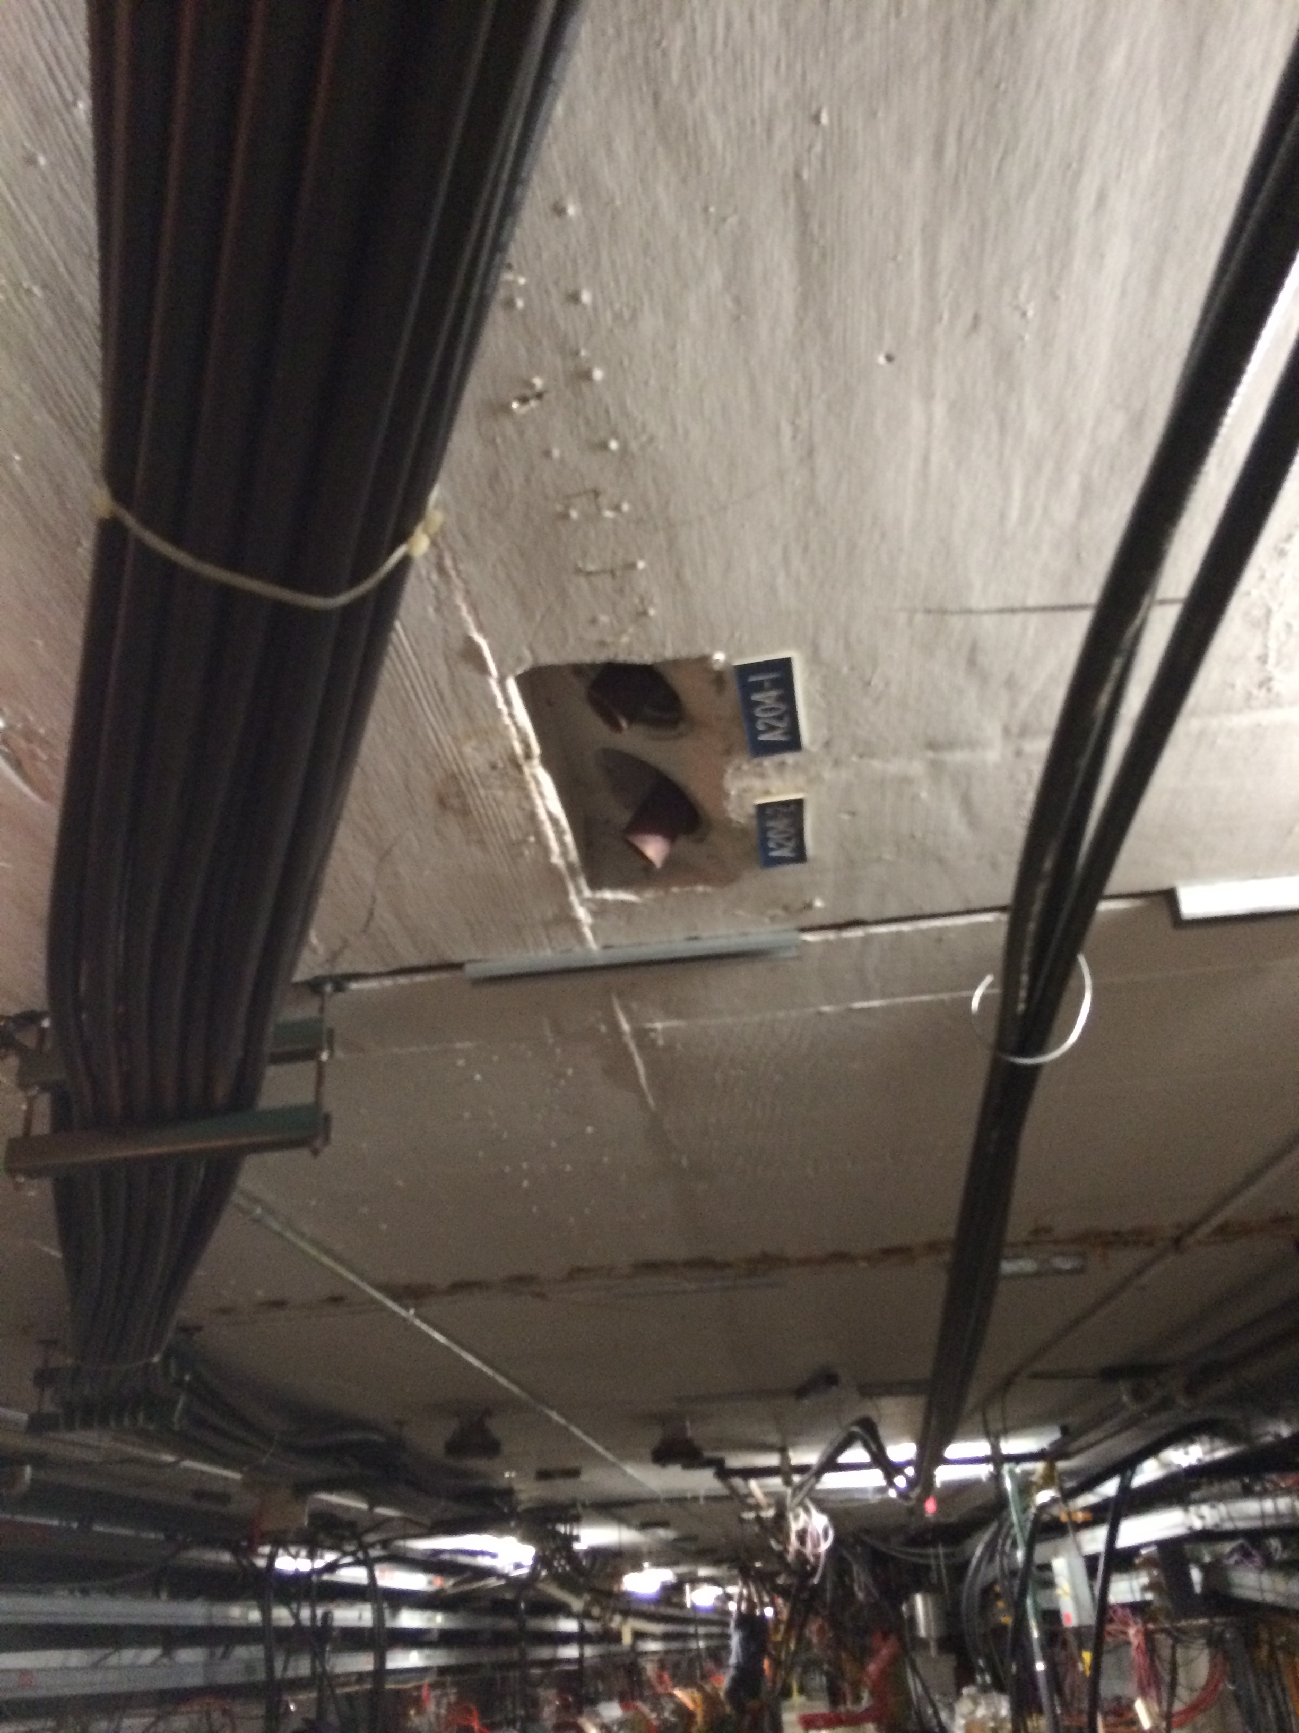
ICW removal

Slide 10
D/A Line Removal

Slide 11
Component Tagging
Three Classes
Red: Components to be removed from tunnel
Either Storage
Rad waste
Blue: Components to removed from current location and installed back to there original location.
Magnet in the Delivery ring 30 section for example
Green: Components to removed from current location and store at its jump point prior to being re installed else ware.
Magnet being moved the Accumulator to the M3/M4 or M5 lines
Overall Going Well Need to
remind Techs to do it.

Slide 12
Plan for the next few weeks
D/A
Complete removal and relocation of element
Review the removal process and look into additional hardware to move magnets
10 straight section
Remove cooling tanks and insert spool pieces.
Waiting 6-8 weeks for there fabrications
30 Straight section
Removal of the Delivery Ring Cooling tanks
Removal of the Accumulator Cooling tanks
Strip beam pipe and vacuum components in both machines
Disconnect cabling to magnets
Boot or Cut depending on type and magnet location

Slide 13
Plan for the next few weeks
Prepare for AP0 Pulling
Stage cooling tanks/RF tanks in AP3 line for pulling
Finalize how we will be keeping the AP0 hatch
One row of blocks
Fencing
Ok keep it just we have it, fully blocked
Prepare for Pulling the AP40 hatch
¾ inch plywood will be needed purchased and staged
Electric forklift will need to be readied
What ever equipment we have that still needs to be pulled staged
10 straight section
Pull tanks and replace with spools
Waiting fabrication

