Slide 1
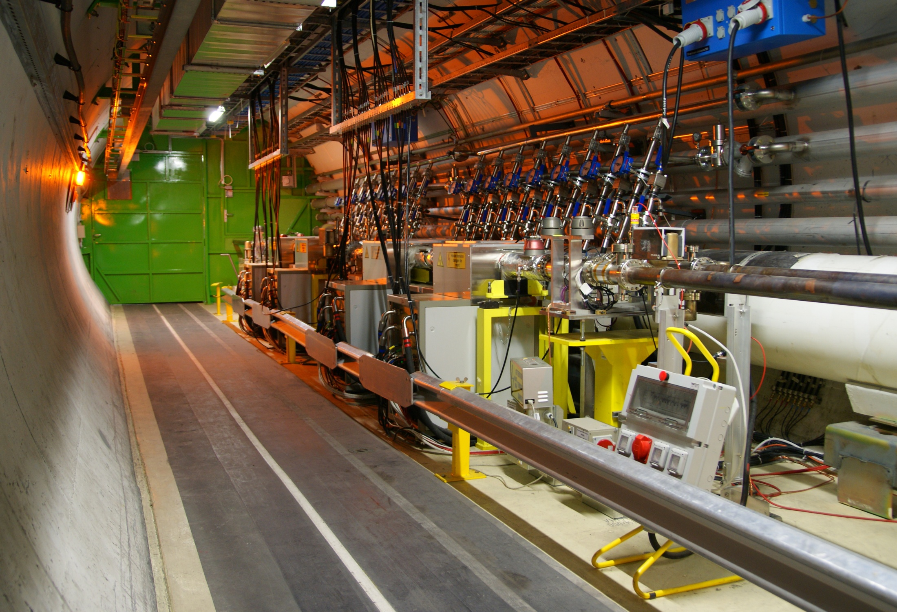
LHC Transverse Damper (ADT) operational experience and upgrade plans
ADT kickers and amplifiers in tunnel
point 4 of LHC, RB44 and RB46
Wolfgang Hofle

Slide 2
LHC Transverse Damper (ADT) operational experience and upgrade plans
W. Hofle
BE/RF/FB
Acknowledgement: L. Arnaudon, A. Butterworth,
F. Dubouchet, D. Jacquet, M. Jaussi, G. Kotzian,
E. Montesinos, D. Valuch

Slide 3
LHC Transverse Damper (ADT)
specifications and design
operational experience
impact on tune and Q’ measurement
damper as exciter
upgrades in LS1
conclusions

Slide 4
Specifications and Design

Slide 5
LHC Transverse Damper (ADT)
  initially designed for
    injection damping
    feedback during ramp (coupled bunch instabilities)
  today used for
    providing stability at all times in the cycle
    (including with colliding beams !)
    diagnostics tool to record bunch-by-bunch oscillation
    abort gap and injection cleaning
    blow-up for loss maps and aperture studies
    tool to produce losses for quench tests
    tune measurement (under development)

Slide 6
Principle
  4 systems
    2 beams
    2 planes (H/V)
  per system
    2 pick-ups
    4 kickers
  installed in LHC point 4
    tunnel
    UX45 (underground)
    SR4 (surface)

Slide 7
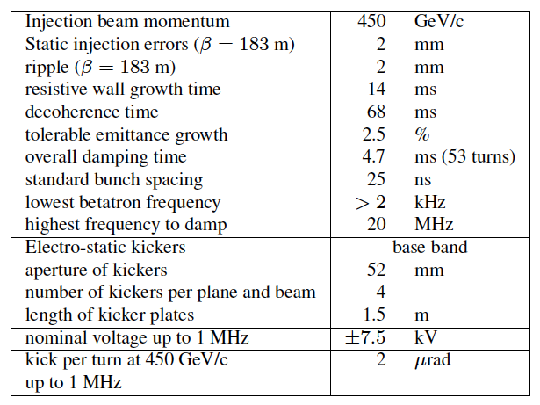
LHC Transverse Damper Specs

Slide 8
Layout in point 4 of LHC

Slide 9
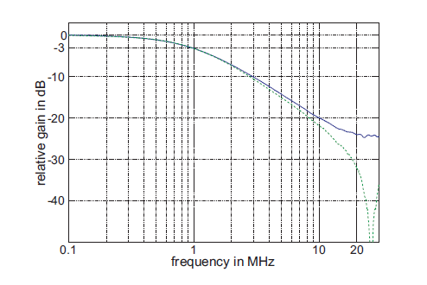
ADT power System
kicker length: each kicker 1.5 m
max voltage: 10.5 kV
2 μm kick to 450 GeV beam
kick at 10 MHz: 1 kV
gain up to beyond 20 MHz
16 kickers,
32x30 kW tetrode amplifiers
bandwidth up to 20 MHz
beam, kicked with electric field

Slide 10
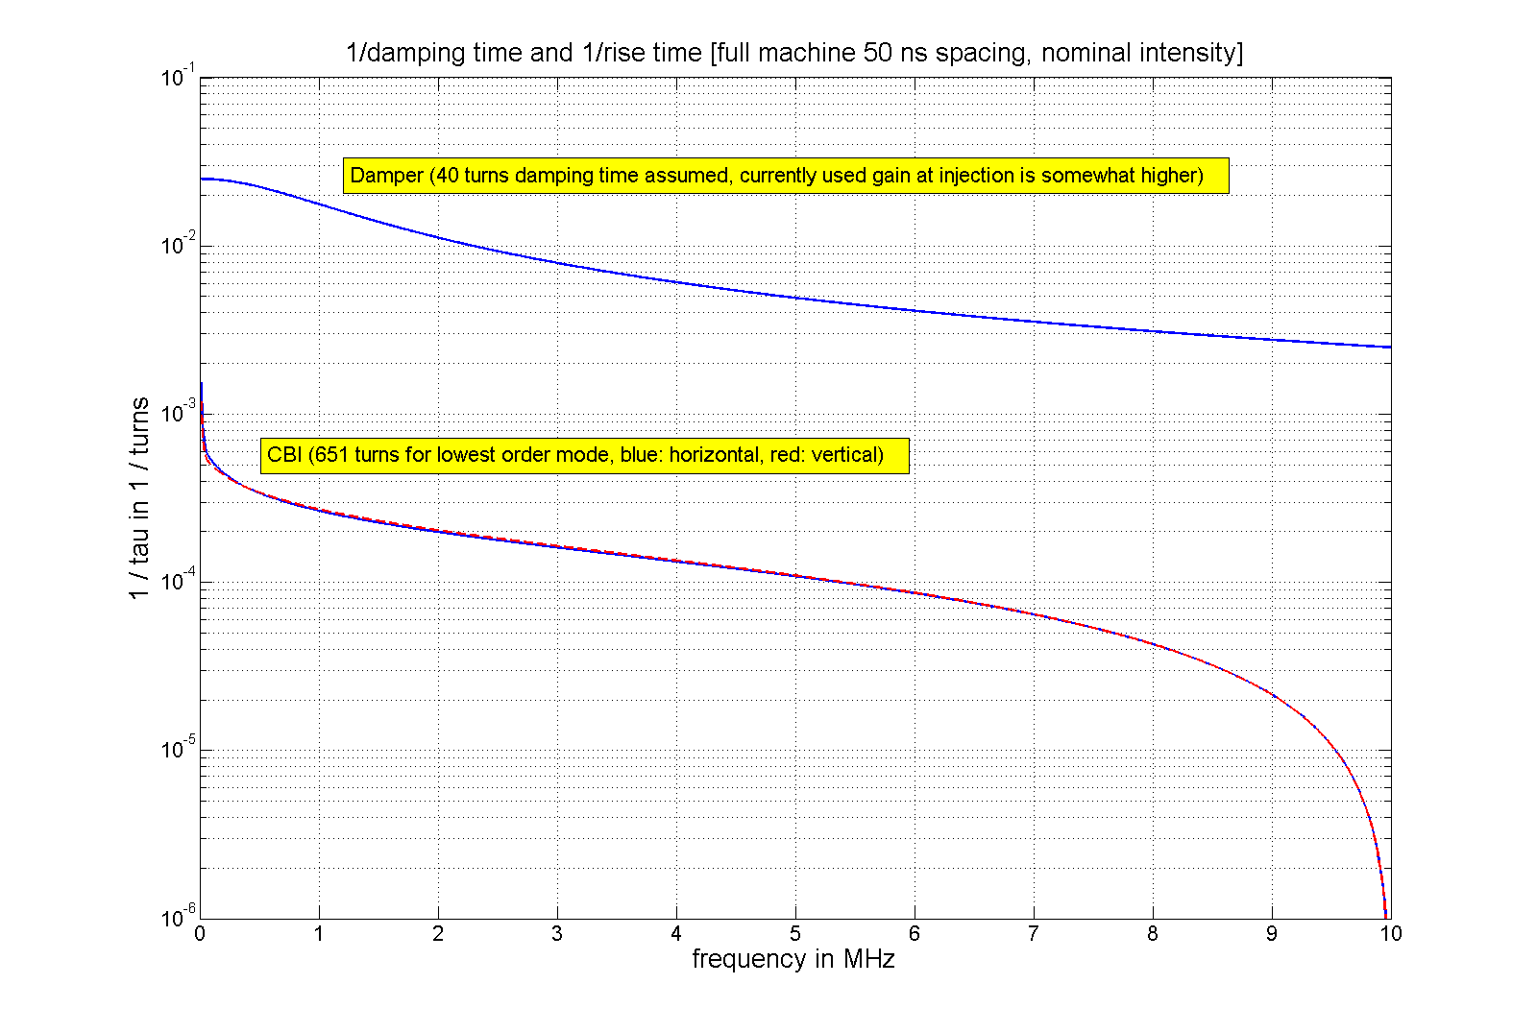
Instability Growth Rates versus Damping
50 ns bunch spacing
40 turns, 1/40 = 0.025
1.2x10¹¹ per bunch
50 ns spacing well
under control
with damper
Instability calculation by
N. Mounet (CERN BE-ABP)
LHC

Slide 11
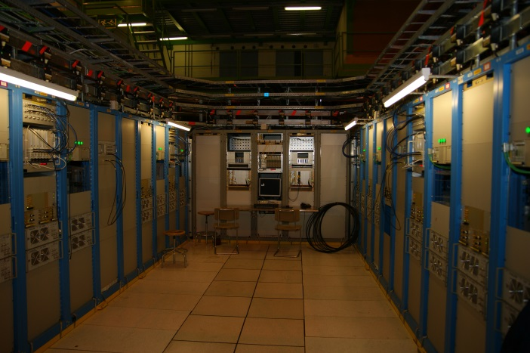
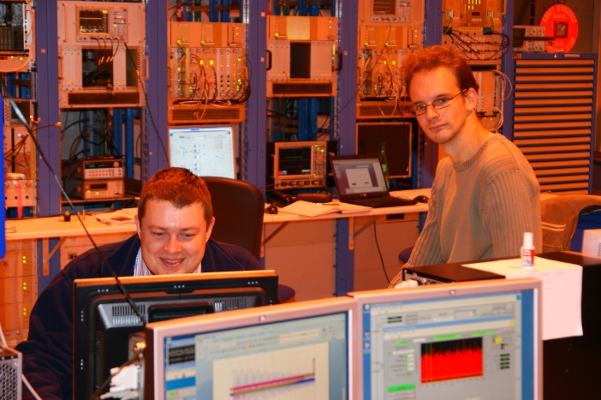
Drive signal generation
under ground cavern
  200 W driver amplifiers
  tetrode amplifier control
EMC
  carefully designed to minimize
perturbances by noise
  major EMC issue during commissioning:
    8 kHz switching frequency of UPS
electronics in surface building SR4
for easy access during commissioning
A/D conversion
all signal processing and D/A
computer controls

Slide 12
Overview of signal processing
beam position VME module
signal processing VME module
DSPU (“Damper Loop”)
based on 1T-FB module
intensity nomalised bunch position
digitised and synchronised (two pick-ups)
4 x i.e. one system per beam and plane

Slide 13
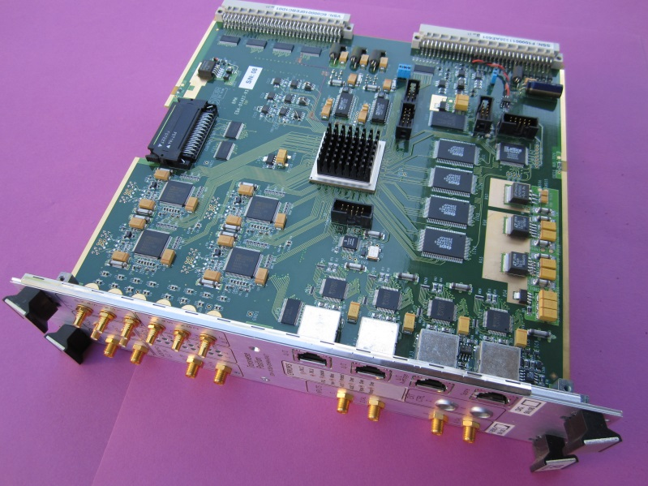
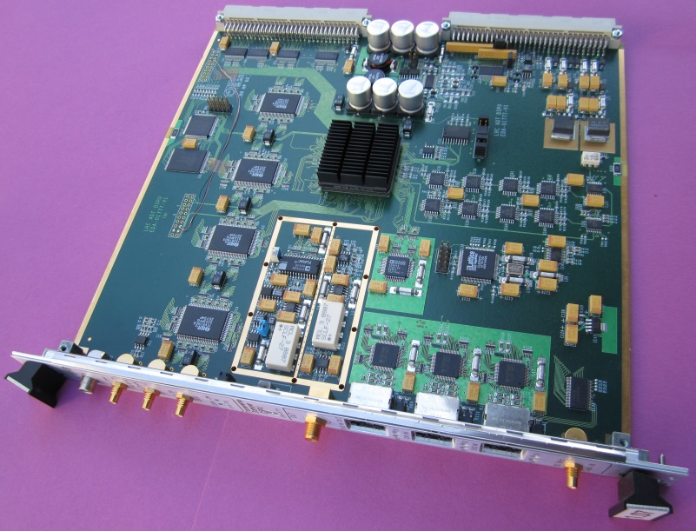
ADC / Signal Processing / DAC
Beam Position VME board
bunch spacing: 25 ns
bunch by bunch normalised position
16 bit ADCs
2 μm rms resolution
Gbit serial link to transmit data for
processing or storage
Processing VME board
80 MHz clock frequency
amplitude and phase correction by FIRs
adjustment of delay and feedback phase
generation of excitation signals
14 DAC

Slide 14
Operational Experience

Slide 15
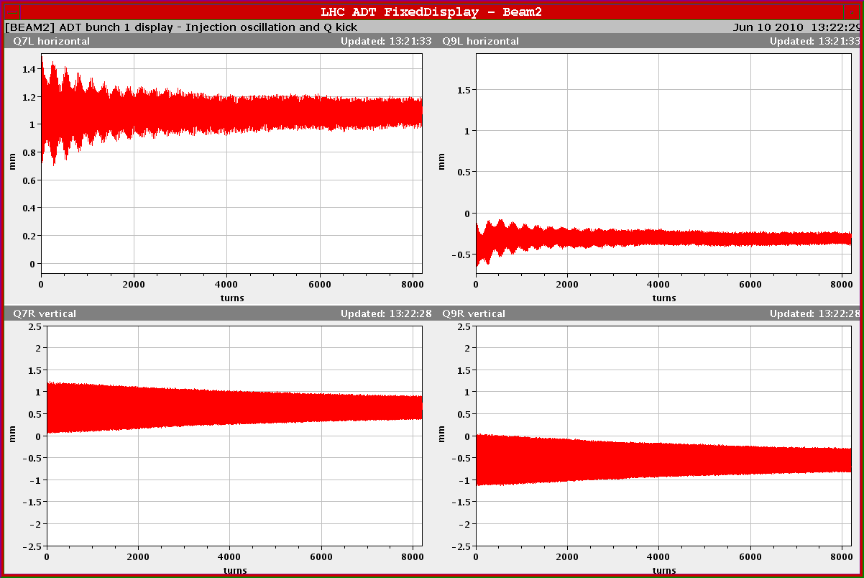
Diagnostics: the fixed display
Damper off
beam 1: transverse injection transient, pilot
H Q7, no dispersion
H Q9, dispersion 0.9 m
transient in energy of beam
high chromaticity
high chromaticity
V Q7
V Q9
low chromaticity
low chromaticity

Slide 16
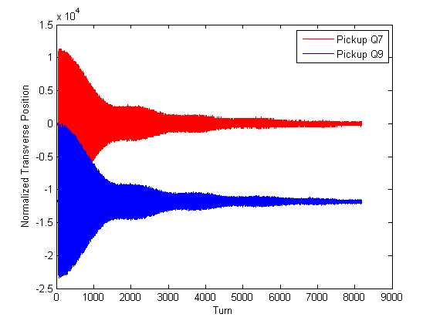
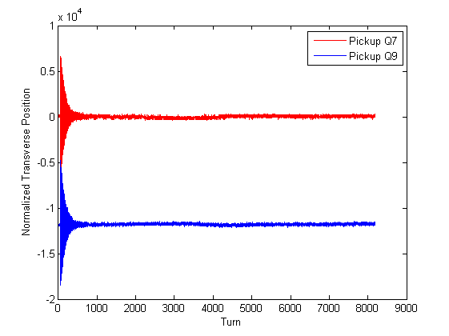
Initial commissioning
damper off
damper on
22.04.2010

Slide 17
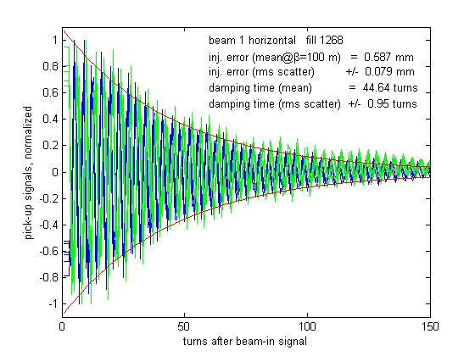
Injection oscillation logging
Injection damping fill 1268 (August 9, 2010)
horizontal plane beam 1
all injection oscillation data of the first bunch of every batch logged since Summer 2010
can retrieve performance at injection from logging
data also logged for post mortem when beam is dumped (all bunches 73 turns)

Slide 18
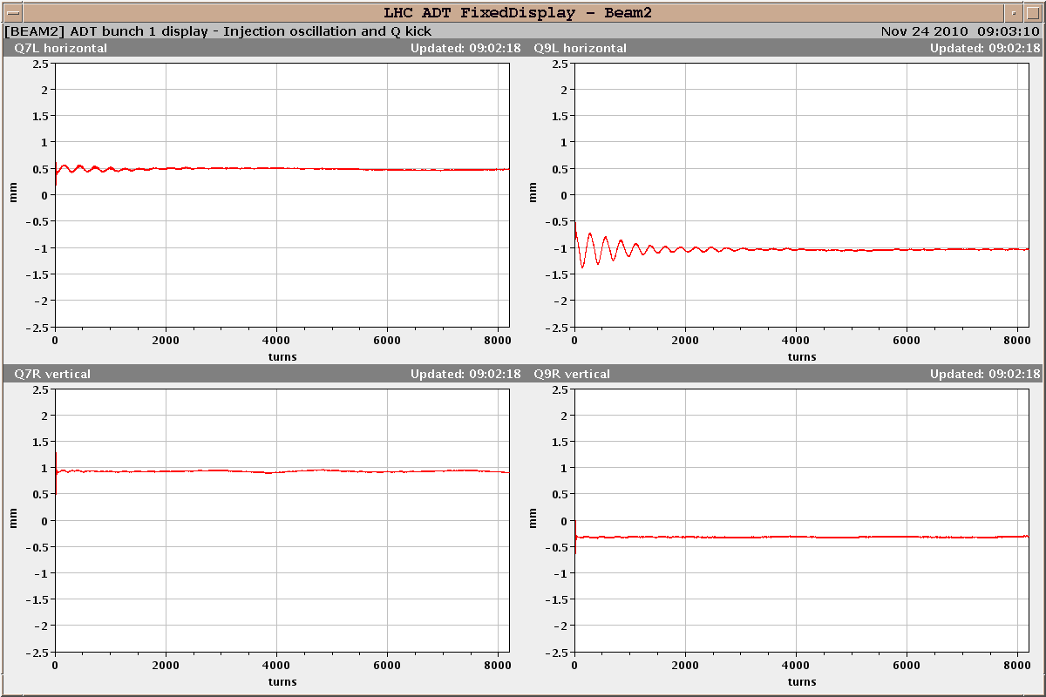
Damping with ions, few 10⁹ charges/bunch
energy / phase oscillations
H Q7
H Q9
V Q7
V Q9
Normal operational setting: less than 20 turns damping at injection energy

Slide 19
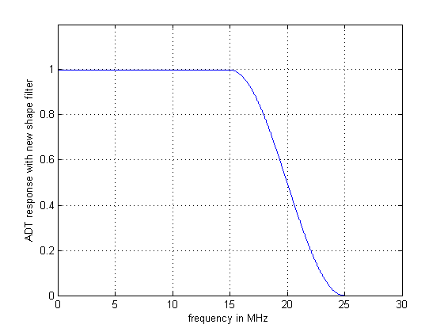
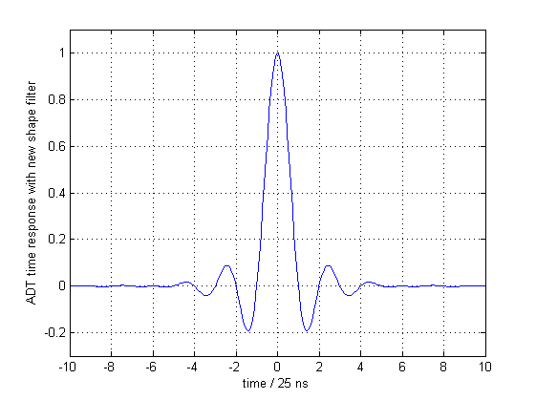
Bandwidth and bunch-by-bunch response
  single bunch operation with peak hold algorithm
  settings for 25 ns, 50 ns, 75 ns bunch spacings
  2012: proposed bunch-by-bunch mode
time domain
frequency domain
make flat to 15 MHz
roll-off symmetric to 20 MHz

Slide 20
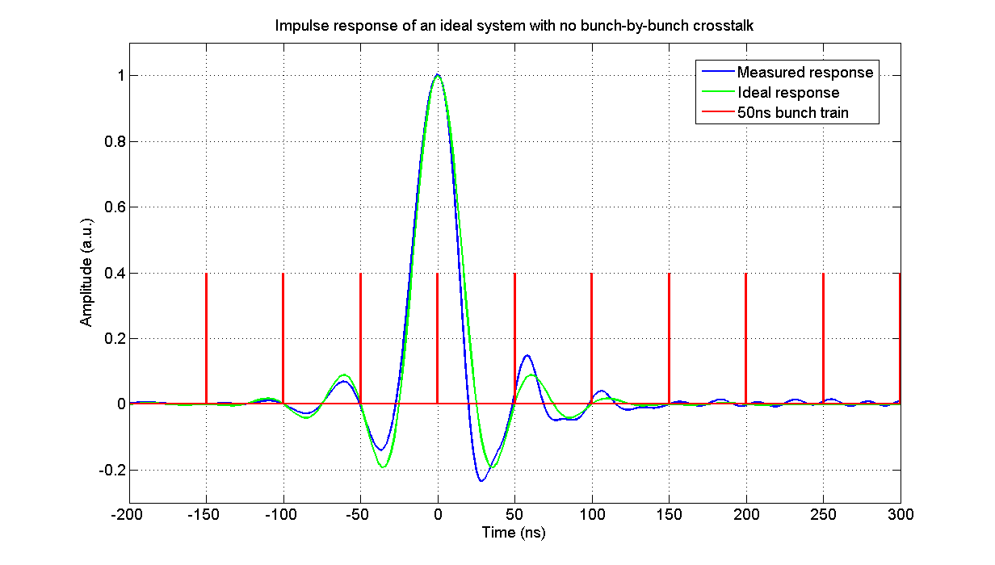
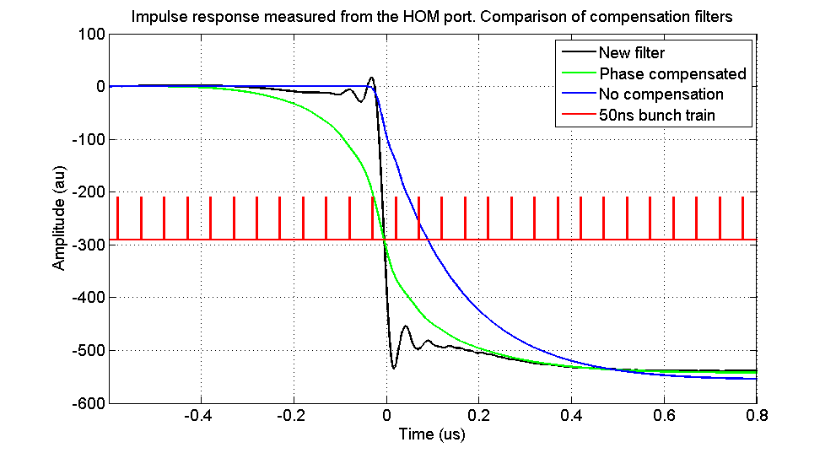
Bunch-by-bunch mode
measured response
  perfect for 50 ns spacing
  improvements planned
  for LS1 for 25 ns spacing
  zeros of response at adjacent
  bunches
  demand in power higher
  → reduction in peak kick
  bunch-by-bunch mode
  used in second half of 2012
  during the squeeze
  → introduces more noise
50 ns train
impulse response
step response

Slide 21
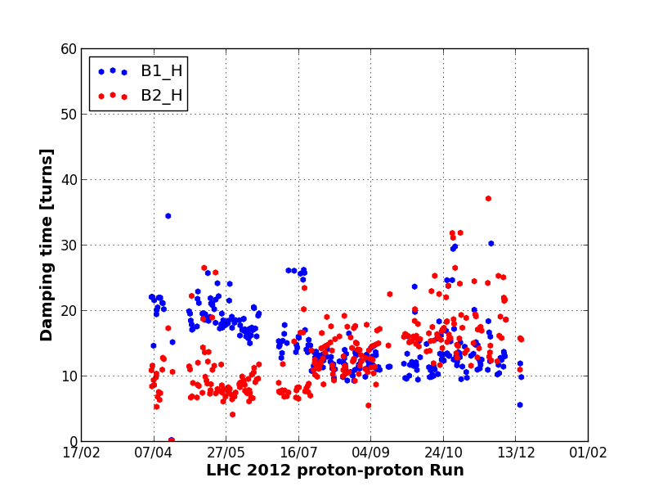
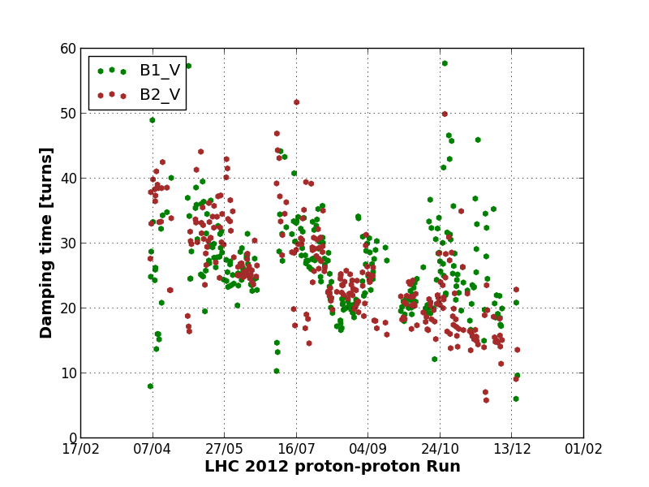
Automated Fill Analysis: Damping Time
2012 Proton Physics Run
Horizontal
Injection oscillations damping of first bunch in a train systematically logged
Fill analysis tool computes
damping time and tune
for every injected batch and fill
Data quality check challenging
Variations over time in part due to chromaticity settings (V-plane !)
Difference H/V: large V inj. error →
first bunch on edge of kicker pulse
2012 Proton Physics Run
Vertical
Macpherson
CERN BE-OP & BE-RF
LHC

Slide 22
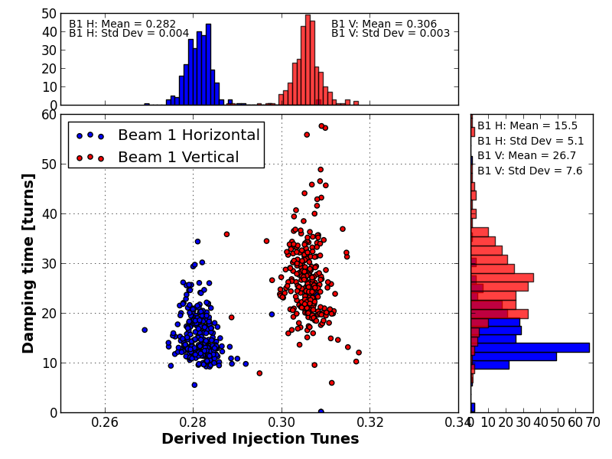
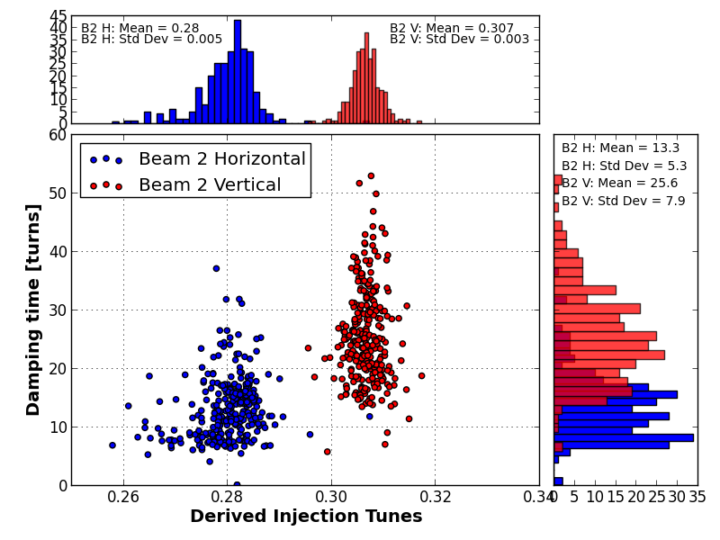
Automated Fill Analysis: Damping Time
Beam 2
H: 13 turns
V: 26 turns
V
H
V
H
Beam 1
H: 16 turns
V: 27 turns
Macpherson
CERN BE-OP & BE-RF
LHC

Slide 23
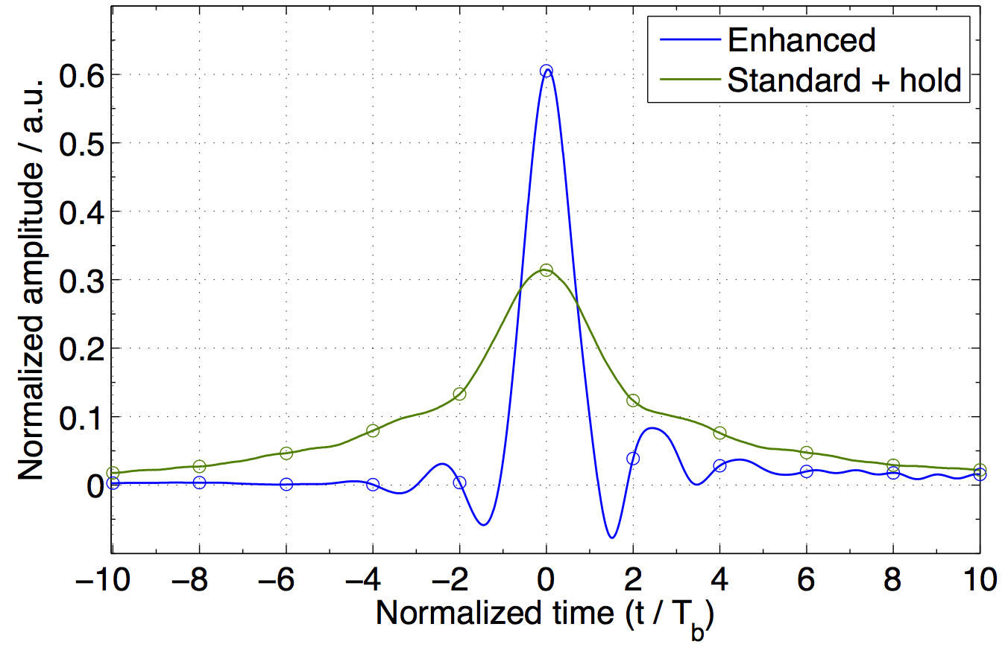
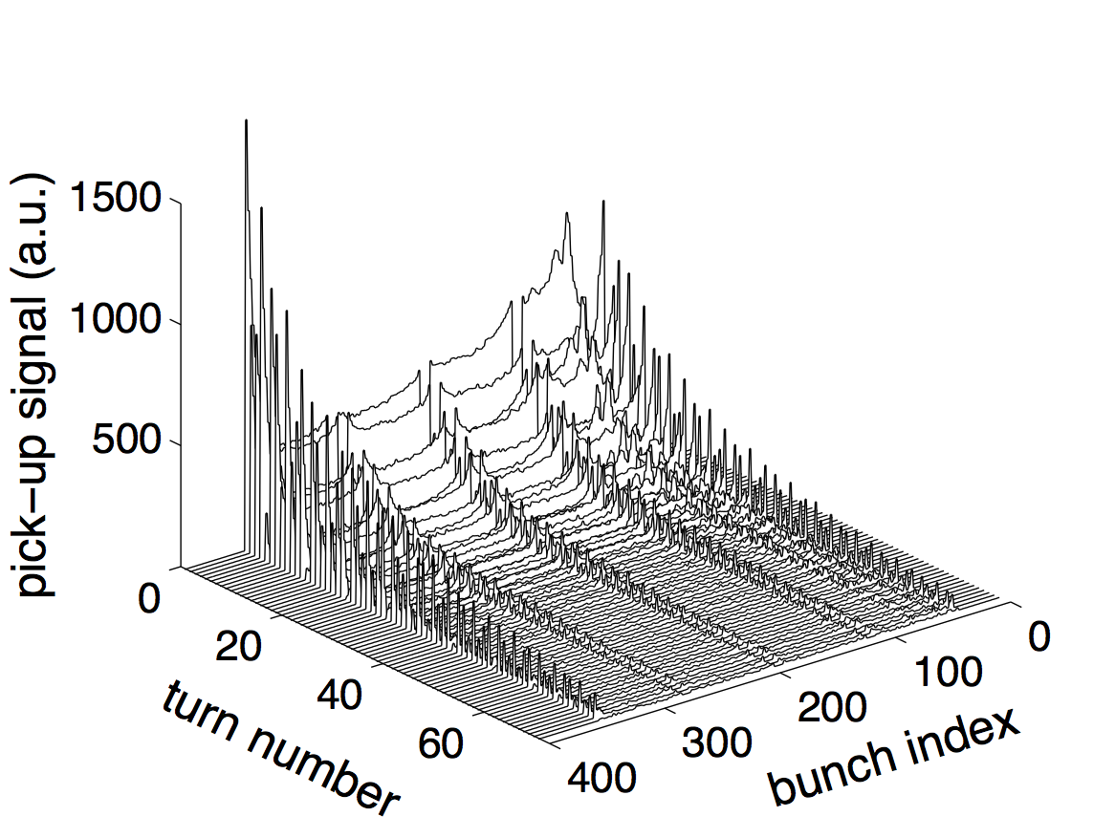
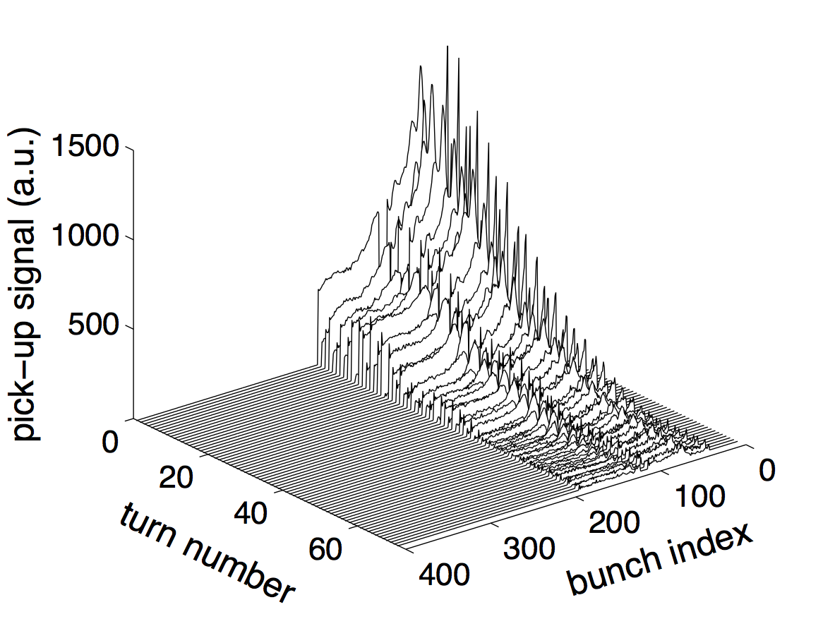
Performance with Bunch Trains in LHC 2012
50 ns bunch spacing
standard + hold
144 bunches (4x36)
25 ns bunch spacing
enhanced bandwidth
144 bunches (2x72)
Injection
oscillation
damping
W. Hofle et al., WEPME43
LHC

Slide 24
Impact on tune and Q’ Measurement

Slide 25
Operation through cycle

Slide 26
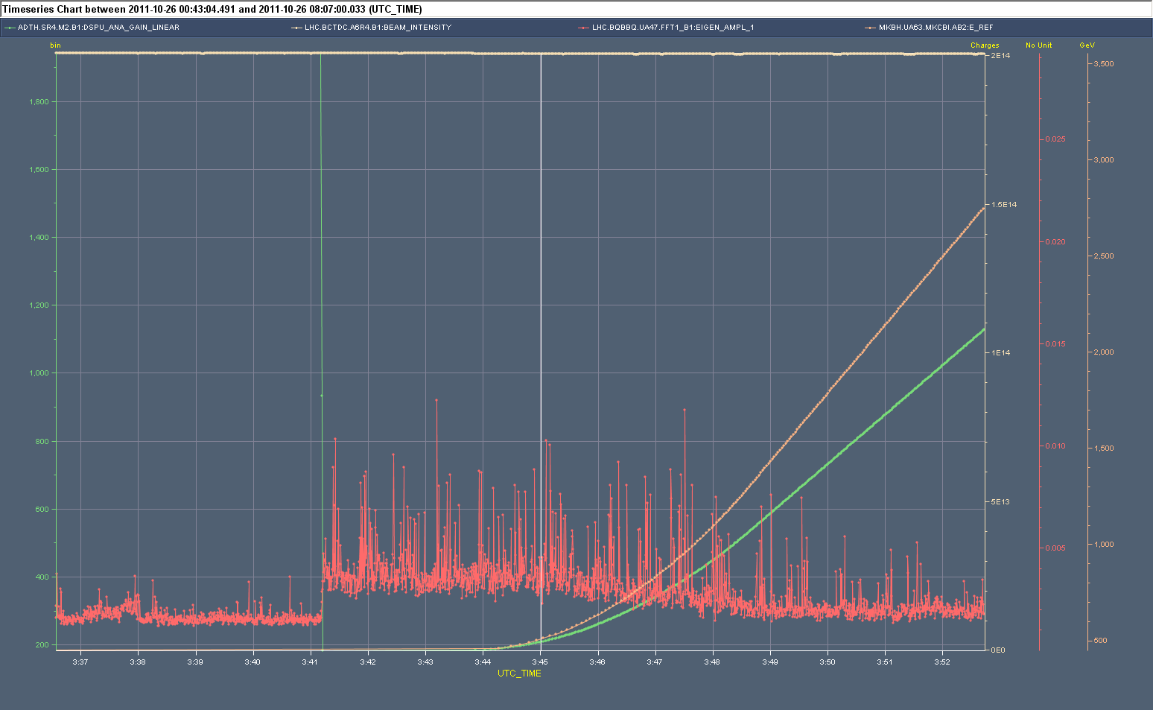
ramp with lower ADT gain
damper gain hor beam 1
(linear scale) HIGH @450 GeV
before prepare for ramp
increase of damper
(electronic) gain in ramp
to maintain approx.
same damping rate
ramp (energy)
drop of damper
gain
increased BBQ amplitude
= more residual beam oscillations
=> potentially leading to blow-up;
but signal needed for tune feedback
which is switched on here
BBQ hor Beam 1
amplitude
Injection plateau
prepare for
ramp
ramp

Slide 27
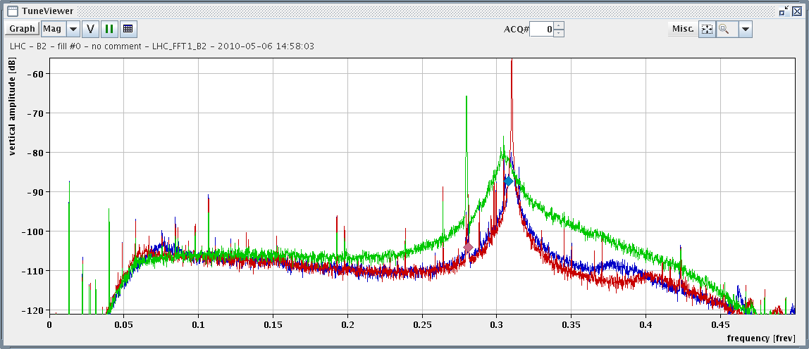
Impact on BBQ tune system
with damper, max gain, 2 kickers
less broadening with lower gain
reduction of tune peak, i.e.
residual oscillations by more than 20 dB
range were FB works well
(limits 45 degrees phase error)
solution deployed in 2012: ADT gain modulation within turn and gated BBQ
6 bunches are used for the BBQ, these have low ADT gain

Slide 28
Closed loop transfer function
beam
system input
system output
G(s)
perturbation
PU
F(s)
feedback
visible
to damper
open loop
output of closed loop
closed loop transfer function

Slide 29
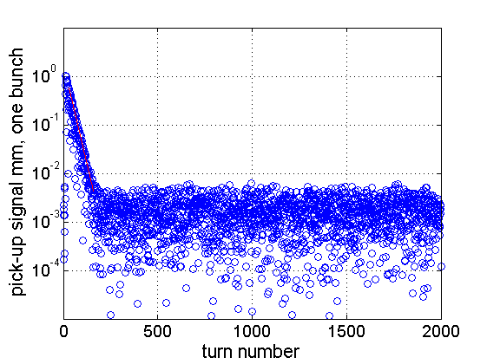
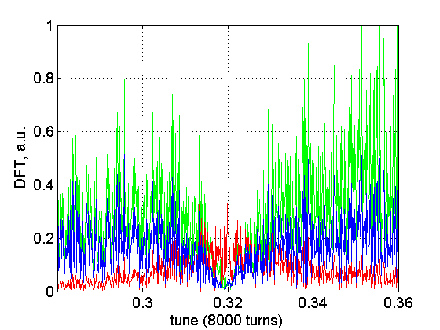
Simulation with noise
kicker signal
pick-up signal
beam oscillation (time domain)
with damping
noise level adjusted to
produce a 2 um rms observable
oscillation
beam oscillation (invisible to damper)

Slide 30
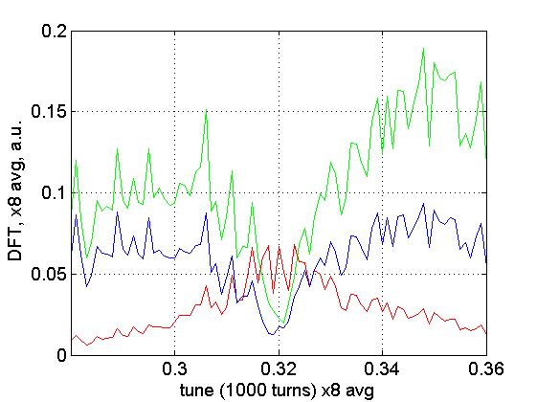
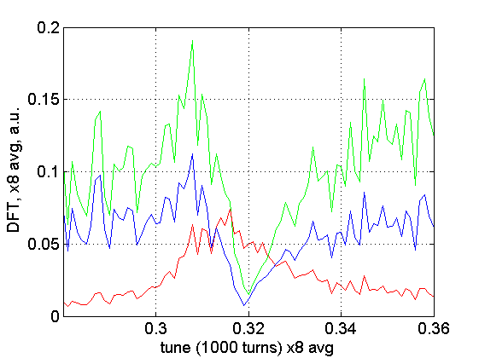
Tune shift by ADT in simulation
beam oscillation, pick-up and kicker signal
phase error in feedback → tune shifted
location of trench not shifted !

Slide 31
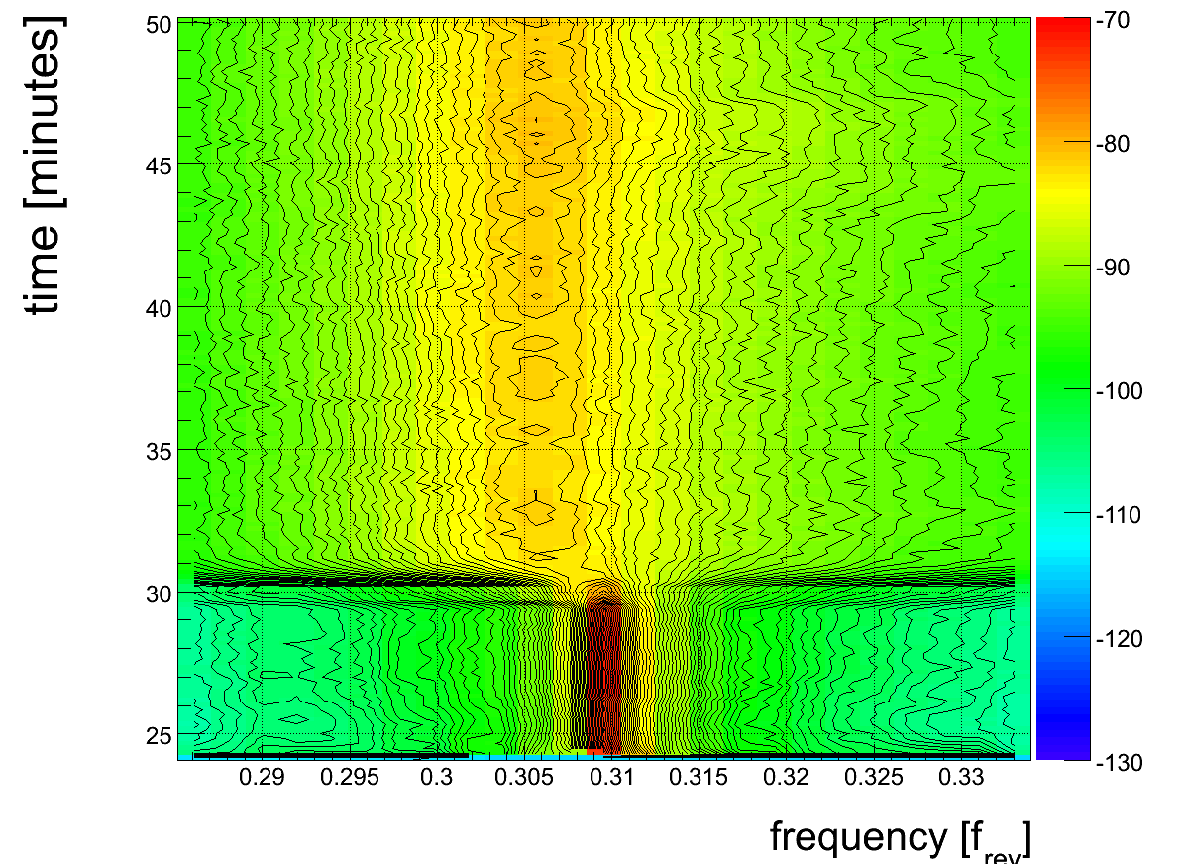
Tune shift (viewed by BBQ)
change in damper
gain → tune changes
ΔQ=0.0038
estimate that phase adjustment overall better than 30 degrees in 2010
(improvement in 2011, estimate: within 10 degrees)

Slide 32
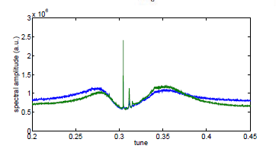
Measured spectrum with ADT
beam oscillating due to
external excitation
(not instability !)
reduced by feedback
(tune is trench)
measurements from a single bunch, two pick-ups
spectra averaged over 45 minutes (2010 data, V plane)

Slide 33
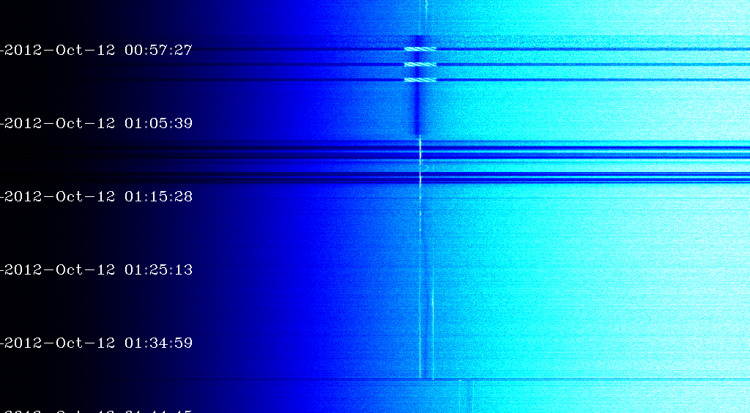
Tune Measurement with ADT
cleaning
(injection)
high gain
(trench @tune)
time
lower gain
(average over 6 bunches)
parasitic lines !
tune change at start
of squeeze
tune (H)
based on recording of 6 bunches
(optional: excitation with damper to enhance signal)

Slide 34
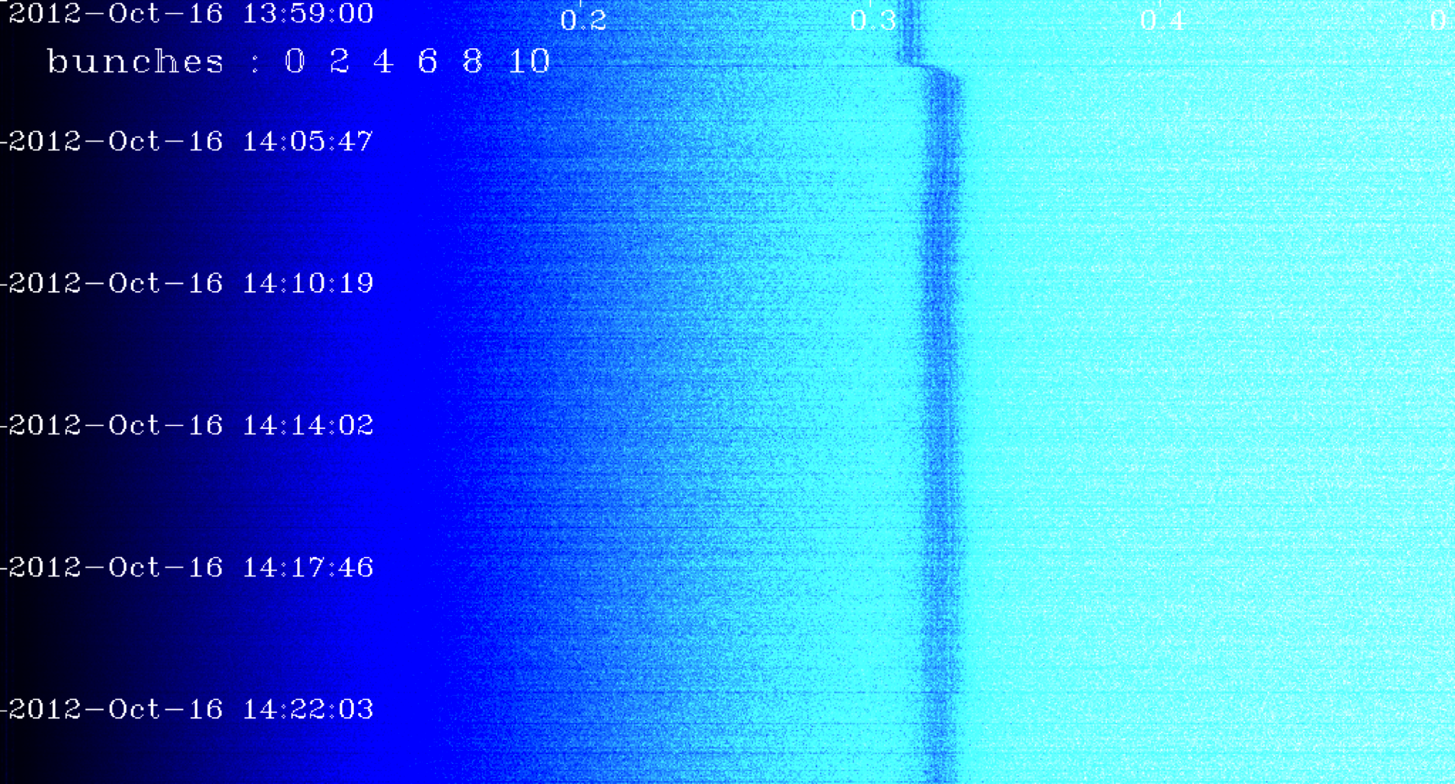
Tune Measurement with ADT
time
tune (V)
evolution of V tune in squeeze based on recording of 6 bunches

Slide 35
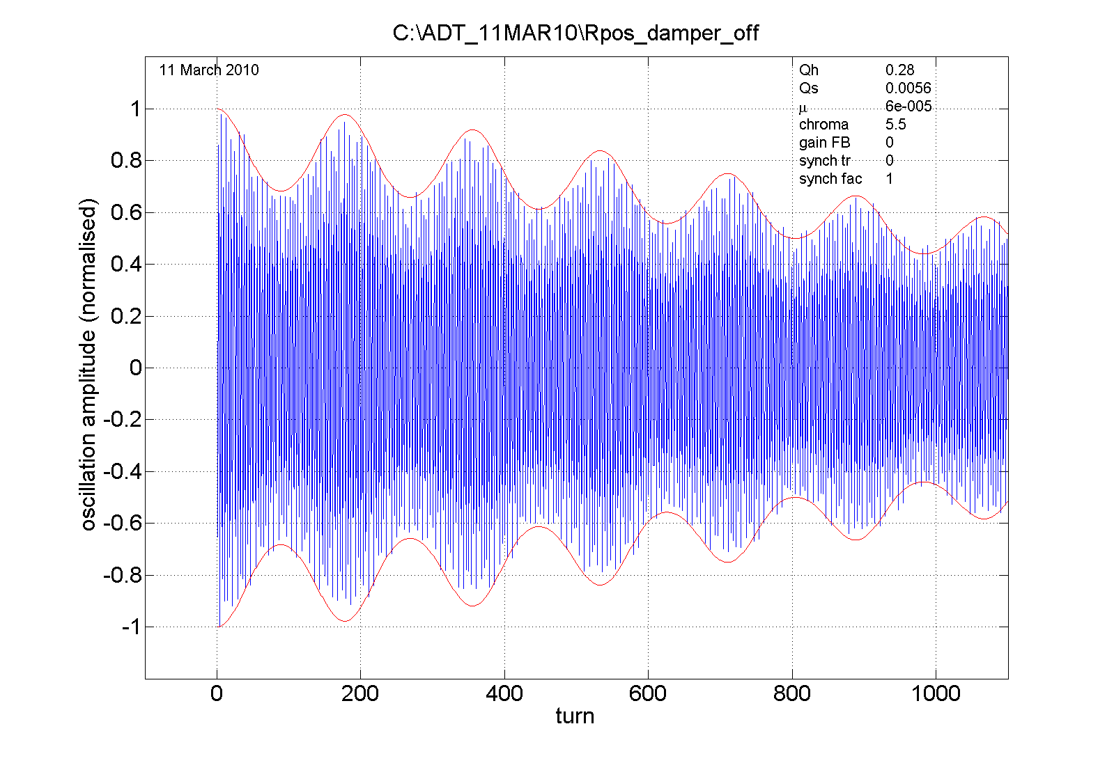
Q’ and ADT
Q’ measurement today
  uses pilot at few 10⁹ p
  special ramp needed
  energy modulation
Future use: ADT?
  record oscillations
  option 1: use pilots
  option 2: leading bunch train
    active excitation with ADT
    no need for energy modulation
    if natural filamentation exploited
Damper off
fit: Q’=5.5, μ = 0.6x10⁻⁴, Q_{H}=0.28, Q_{S}=5.6x10⁻³
potential for a tool for chromaticity estimation
(from pilot injection) at 450 GeV
or by kicking in ramp → need sacrificial bunches

Slide 36
Damper As an Exciter

Slide 37
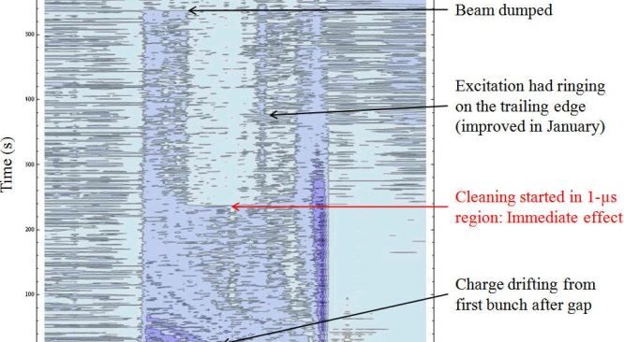
Abort Gap Cleaning
abort gap viewed by abort gap monitor with RF switched off,
cleaning by ADT (DDS) in V-plane
also used for injection gap cleaning prior to every injection (H-plane)

Slide 38
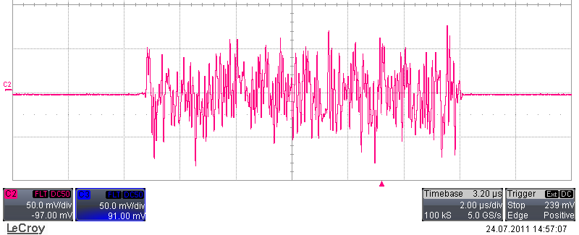
Gated excitation with noise
gate, 11 μs (example)
white noise generated on FPGA running at 40 MS/s
available since 2012 for all dampers
heavily used for tailoring emittance in MDs
aperture measurements by blow-up
loss maps for collimation set-up
any kind of excitation can be gated (also DDS produced narrow band)

Slide 39
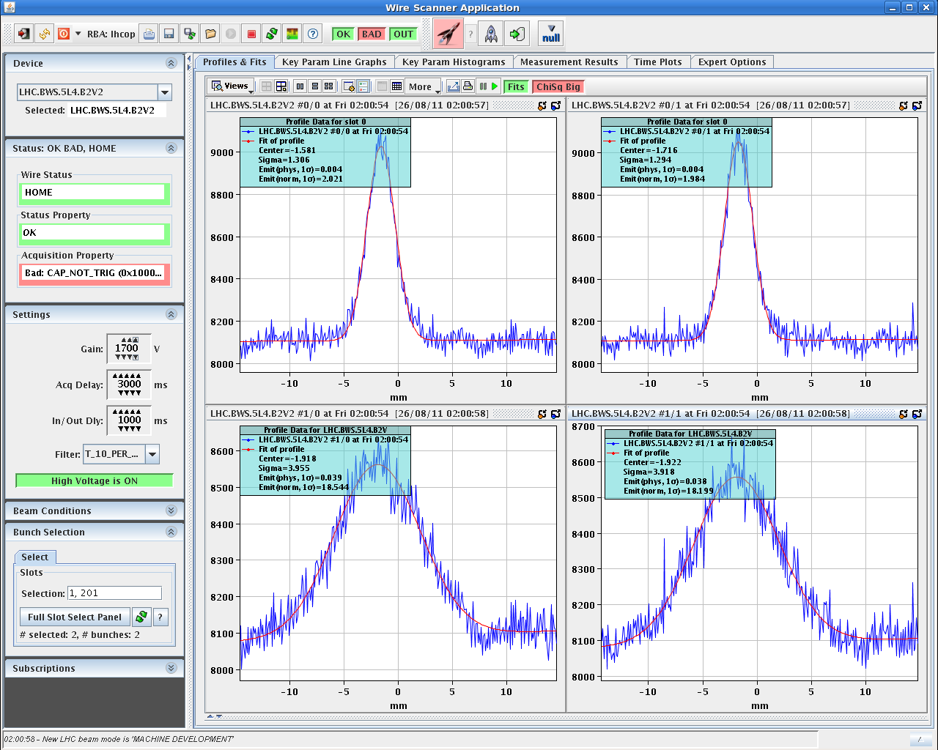
Selective blow-up (2 pilots)
2 μm
18 μm
stops at 18 μm
→ aperture
aperture measurement using ADT blow-up

Slide 40
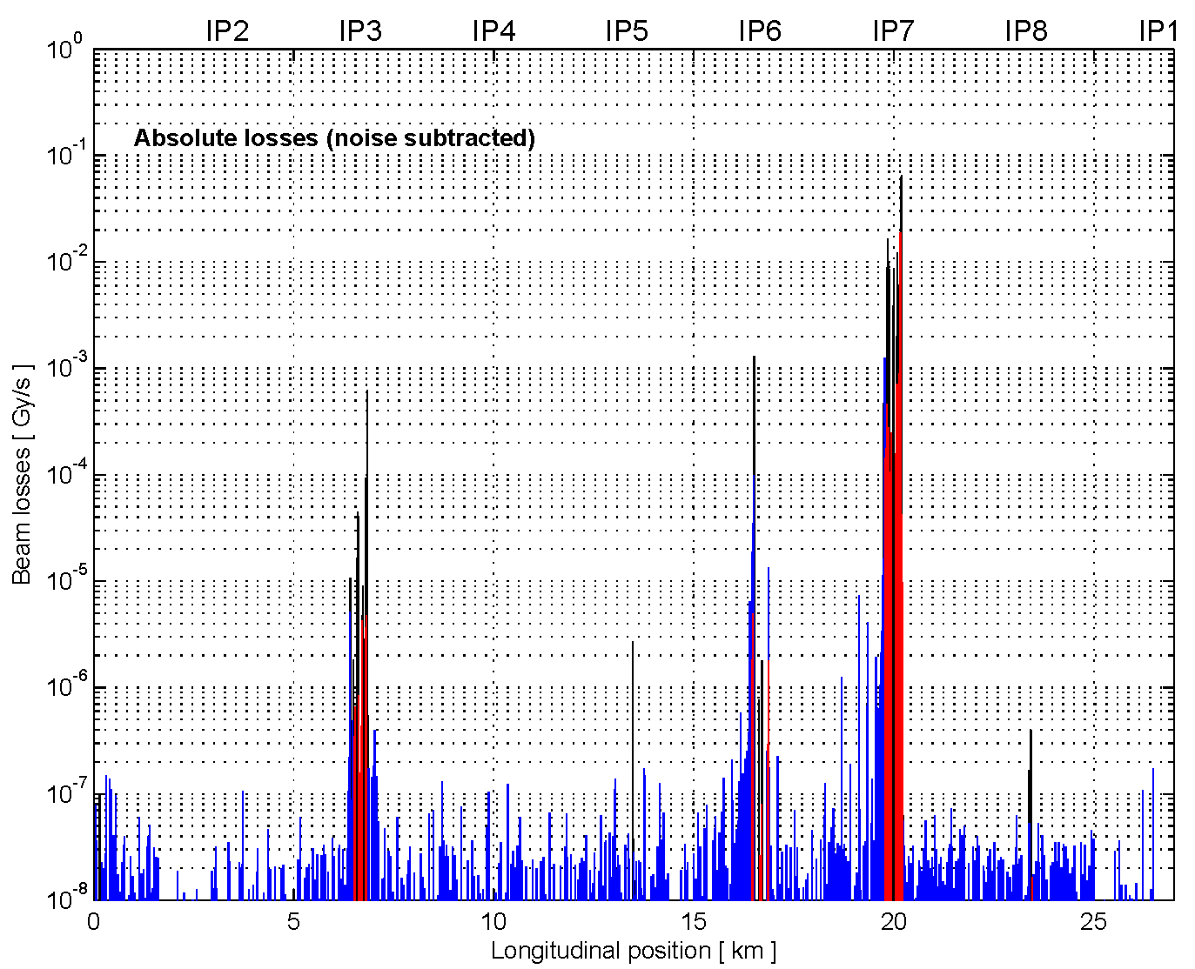
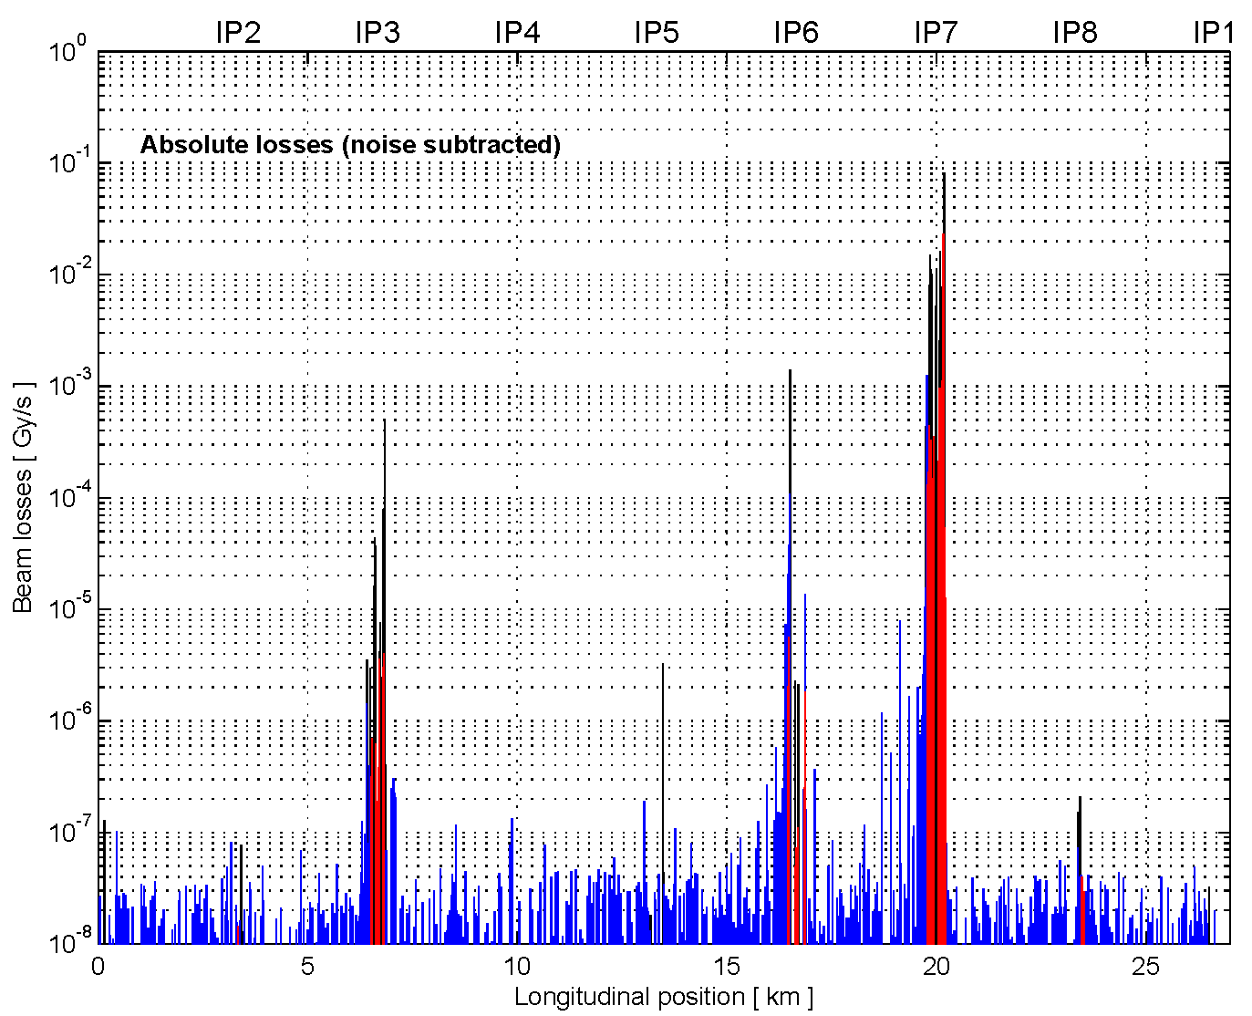
Comparison of loss maps
damper (ADT blow-up) loss map
3rd order resonance
excitation with noise
also used for collimation and
orbital bump quench test
S. Redaelli, R. Schmidt, D. Valuch,
D. Wollmann, M. Zerlauth et al.

Slide 41
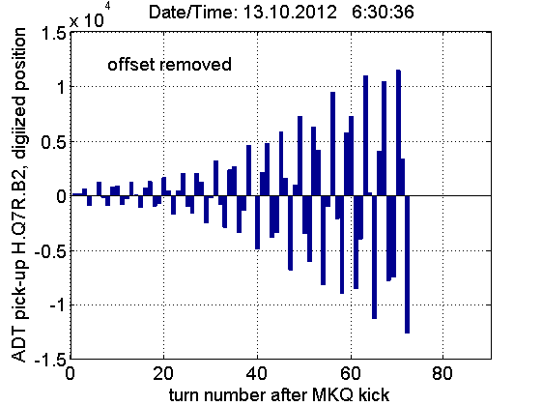
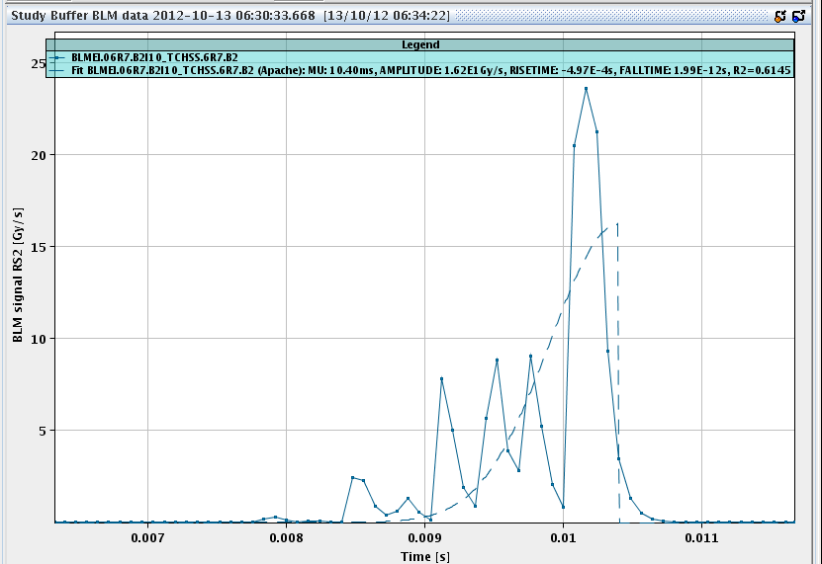
Fast losses with ADT simulating UFO type losses for quench test
evolution of beam oscillation amplitude
Fast losses (BLM signal)
1 ms

Slide 42
Upgrades in ls1

Slide 43
ADT - post LS1
Major upgrade in LS1
doubling # of pick-ups
complete re-cabling of PUs
new digital hardware
reduction of noise
flexibility for gain control
instability diagnostics (trigger !)
tune diagnostics (GPU)

Slide 44
ADT pick-ups after LS1
B1 horizontal | Q10L | Q9L | Q7L | Q7R | Q9R | Q10R
 | β = 28 m | β = 127 m | β = 112 m | β = 78 m | β = 16 m | β = 158 m
 |  | existing | existing | new |  | new
B1 vertical | Q10L | Q9L | Q7L | Q7R | Q9R | Q10R
 | β = 172 m | β = 25 m | β = 52 m | β = 127 m | β = 138 m | β = 38 m
 | new |  | new | existing | existing
Engineering change request being prepared to swap 4x Q7 PU with Q8 pick-ups
Optics under revision !
B2 horizontal | Q10L | Q9L | Q7L | Q7R | Q9R | Q10R
 | β = 164 m | β = 17 m | β = 60 m | β = 173 m | β = 106 m | β = 30 m
 | new |  | new | existing | existing
44
B2 vertical | Q10L | Q9L | Q7L | Q7R | Q9R | Q10R
 | β = 36 m | β = 140 m | β = 169 m | β = 23 m | β = 34 m | β = 181 m
 |  | existing | existing | new |  | new

Slide 45
Conclusions
ADT used since middle of 2010 for all Physics fills
injection damping in 10 turns achieved
feedback on during collisions thanks to good performance in terms of noise, preventing instabilities when beams not head-on
essential to keep emittance small and protect against instabilities
used to excite beam for multiple purposes: cleaning, blow-up, loss maps, quench tests → future potential for narrow band excitations
bunch-by-bunch mode (25 ns) achieved with signal processing
promising results to use ADT for instability, tune, and Q’ diagnostics
ongoing program to improve electronics and to make continuous streaming of data for observation purposes possible
major upgrade of electronics in LS1 to improve features for excitation and to reduce noise in system, more pick-ups

