Slide 1
Plans for RFCC Mechanical Assembly
MICE RF Workshop
June 2, 2014
Allan DeMello
Lawrence Berkeley National Laboratory

Slide 2
RFCC Assembly Steps Overview
Cryostating the coupling coil cold mass
Assemble and integrate the RF vacuum vessel to the coupling coil
Assemble vacuum vessel onto support stand
Install cavities
Notes:
2

Slide 3
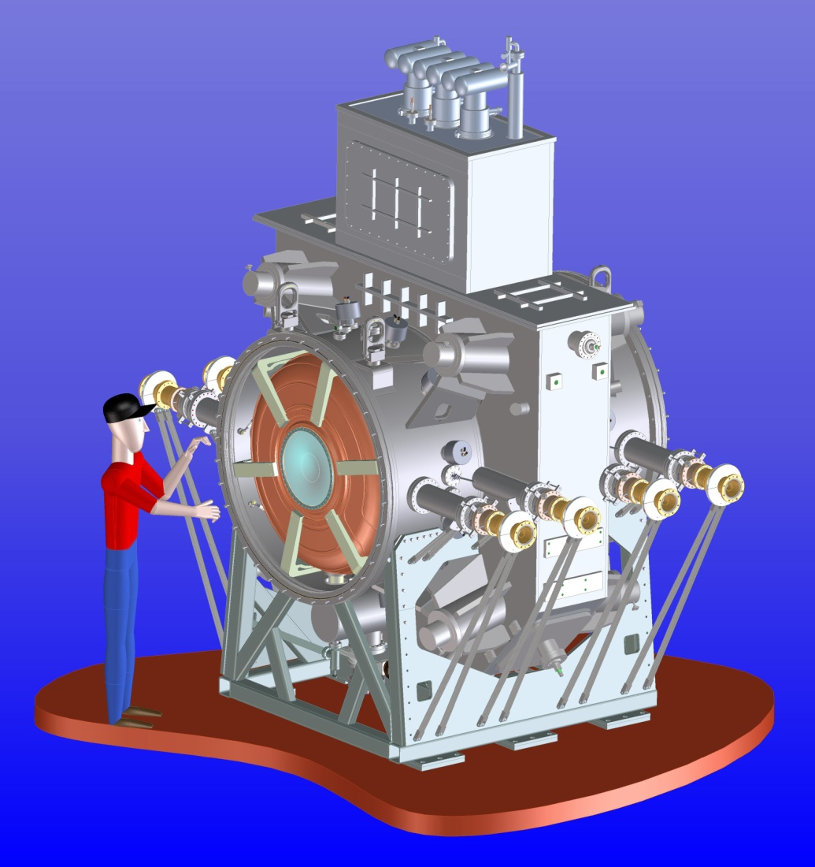
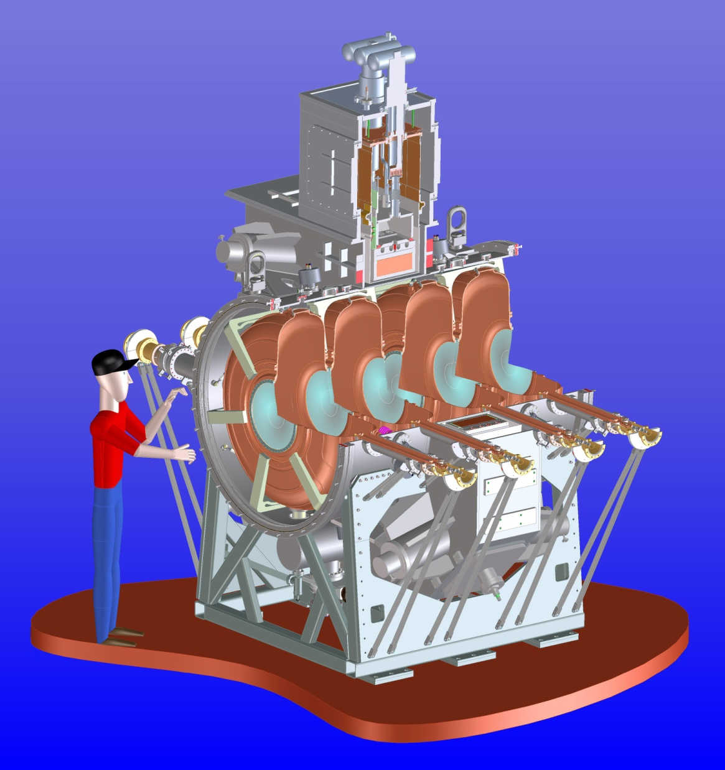
RFCC Module
Notes:
3

Slide 4
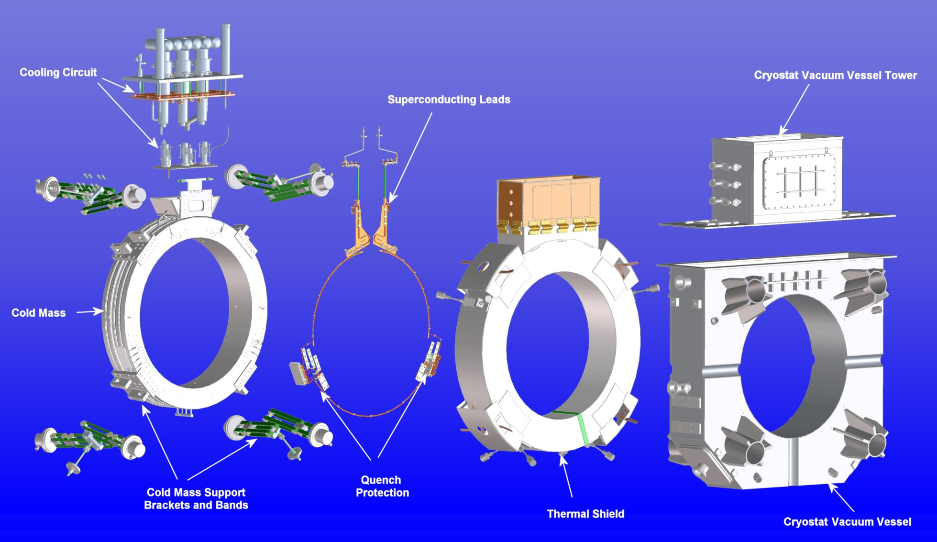
Intrgrate Coupling Coil Sub-assemblies
Notes:
4

Slide 5
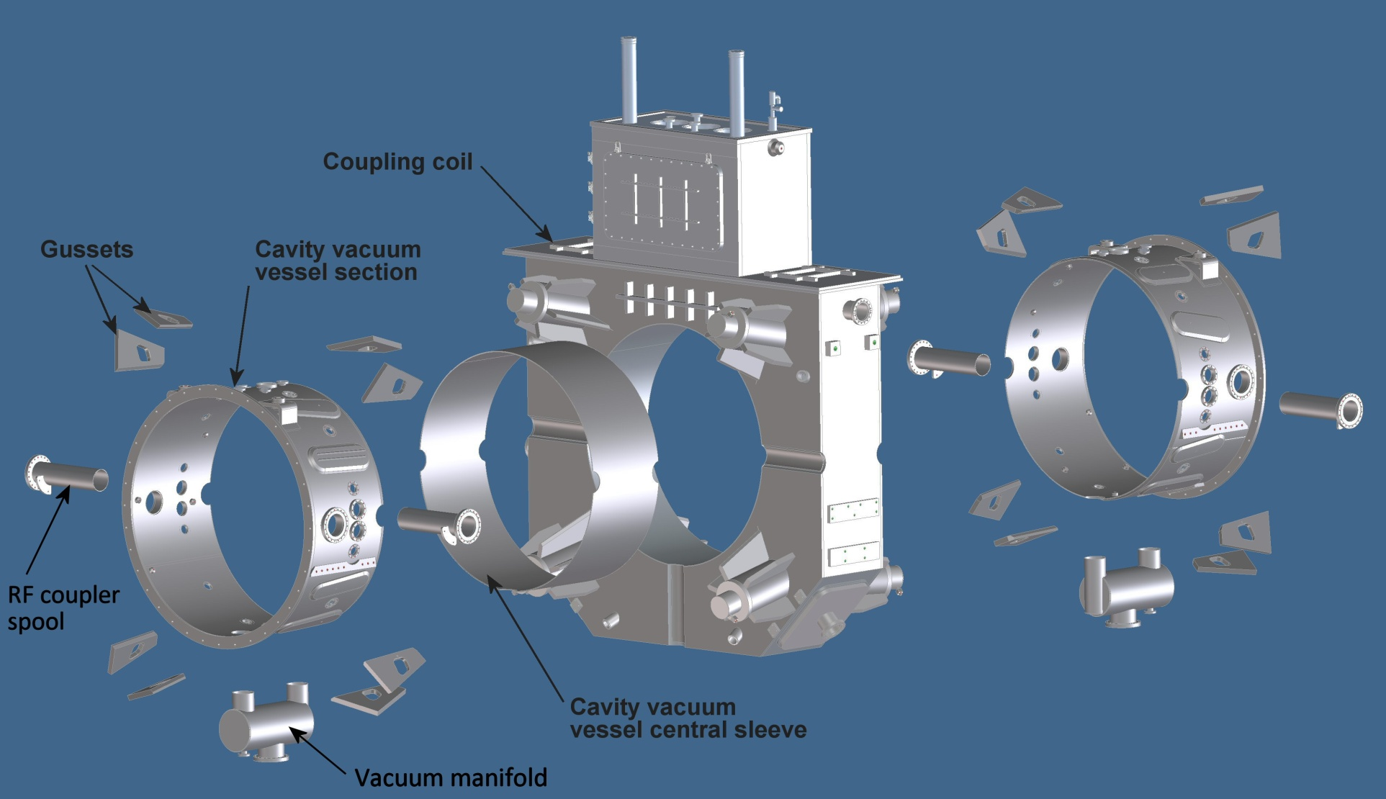
Assemble and integrate the RF vacuum vessel to the coupling coil

Slide 6
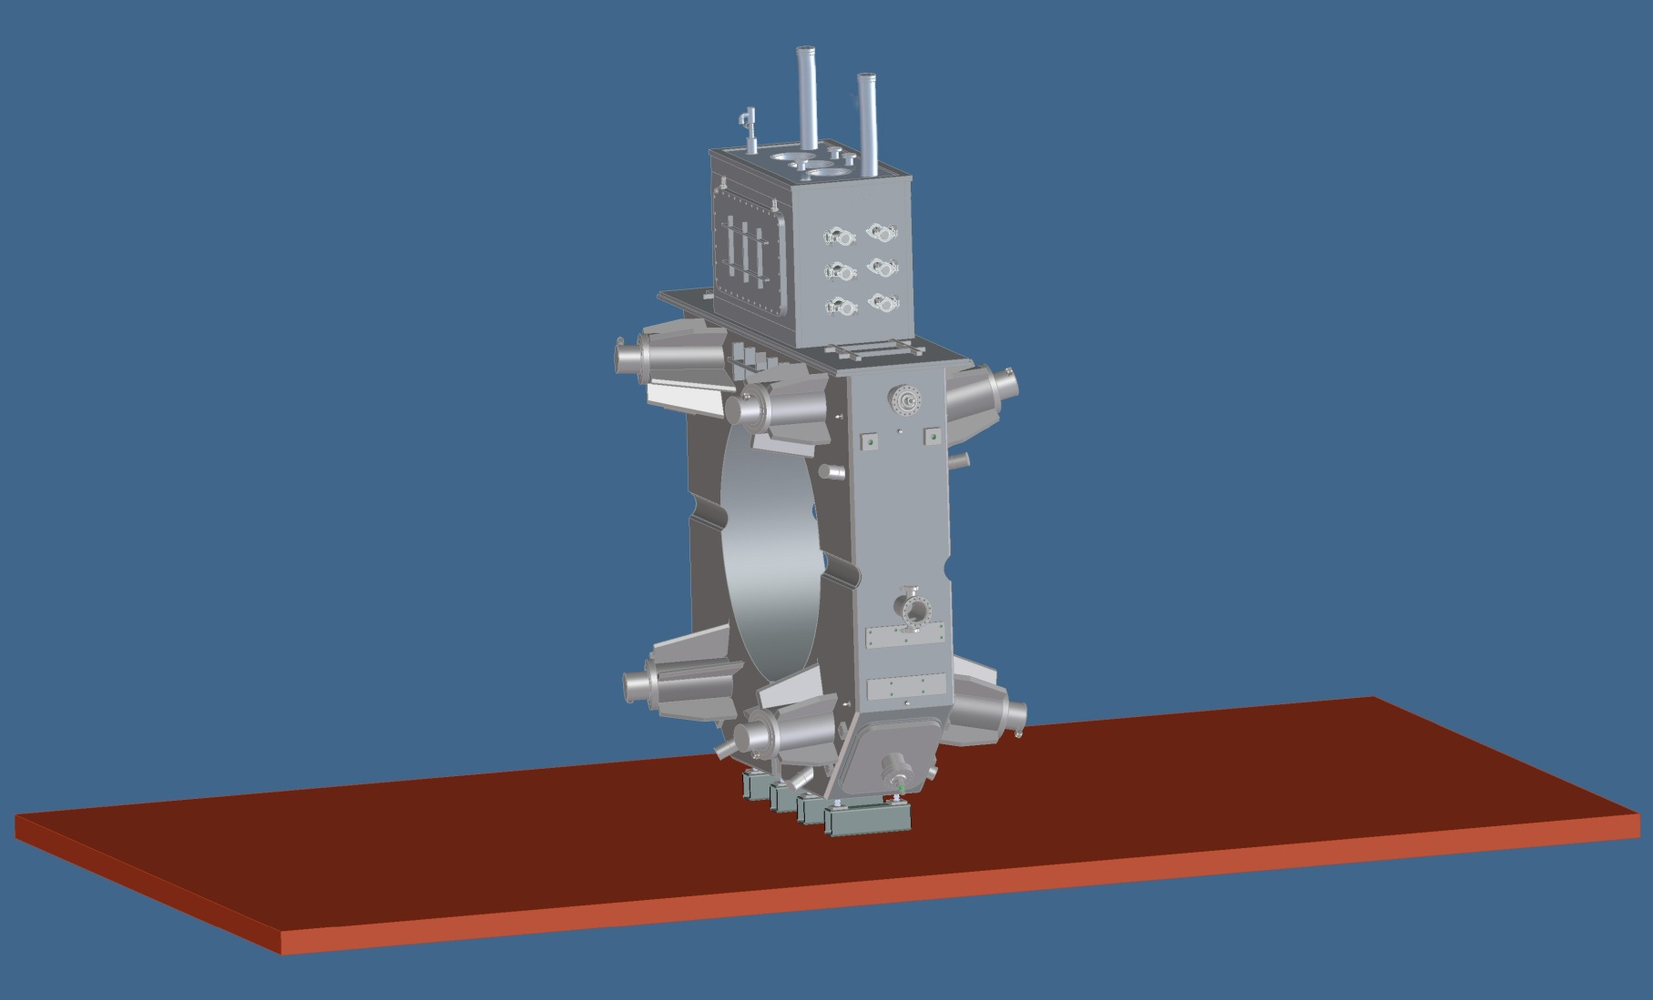
1. Stage Coupling Coil for Assembly
Coupling coil will need some support fixturing

Slide 7
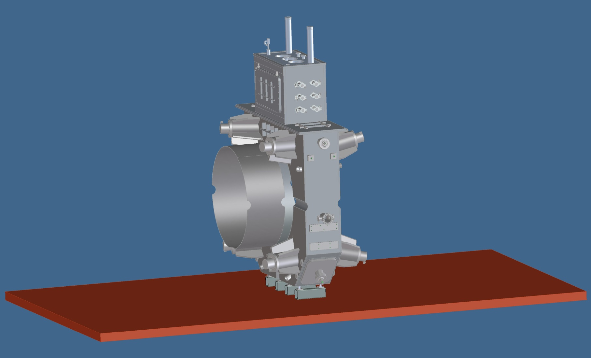
2. Stage Vacuum Vessel Central Sleeve
The central sleeve can be roughly aligned with shims between the O.D. and the I.D. of the coupling coil

Slide 8
3. Insert Vacuum Vessel Central Sleeve in Bore of Coupling Coil

Slide 9
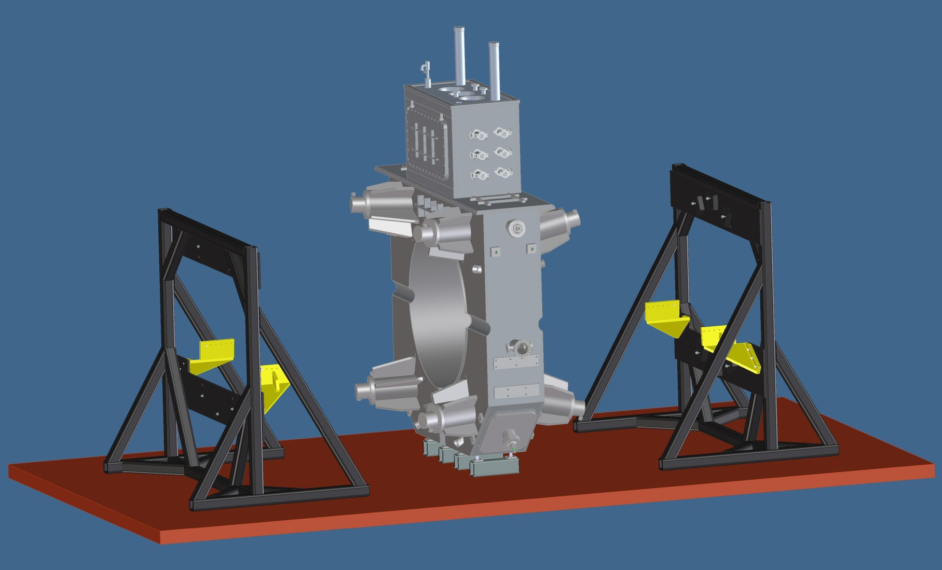
4. Stage Vacuum Vessel Assembly Fixtures

Slide 10
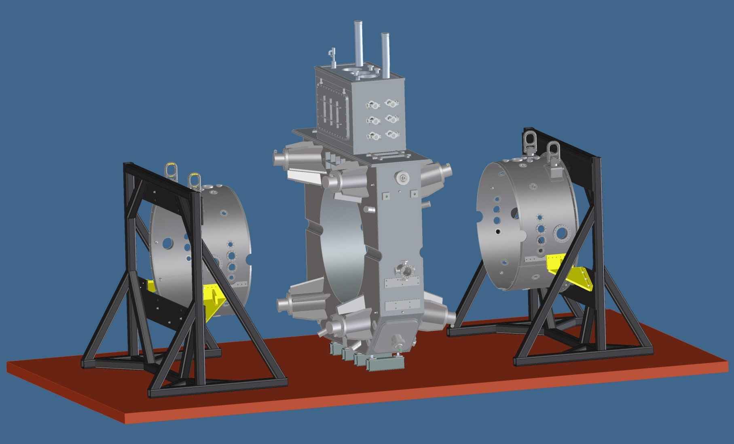
5. Assemble Vacuum Vessel Segments onto Fixtures
Vessel segments will need to be accurately aligned in the fixtures using the module mating flange

Slide 11
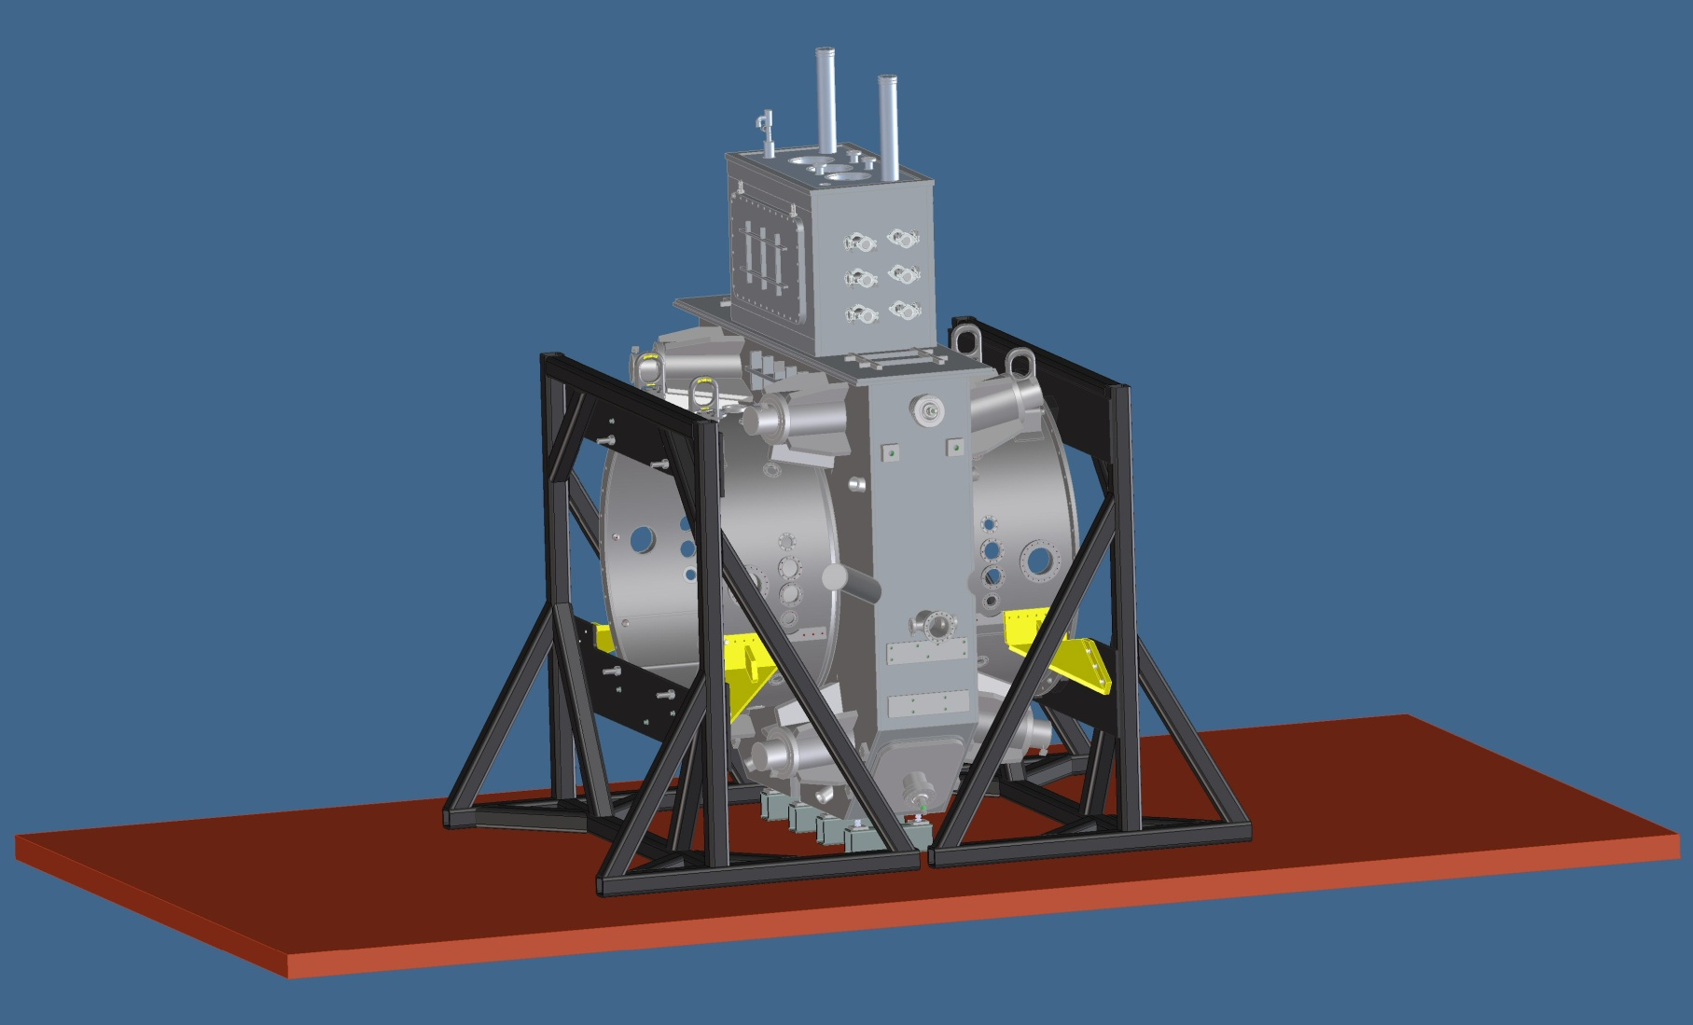
6. Bring Components Together - Align and Weld
Slide the segments up to the central sleeve
Alignment of the vessel segment and central sleeve RF ports to the scallops of the coupling coil vacuum vessel
After alignment is verified tack weld the segments to the central sleeve

Slide 12
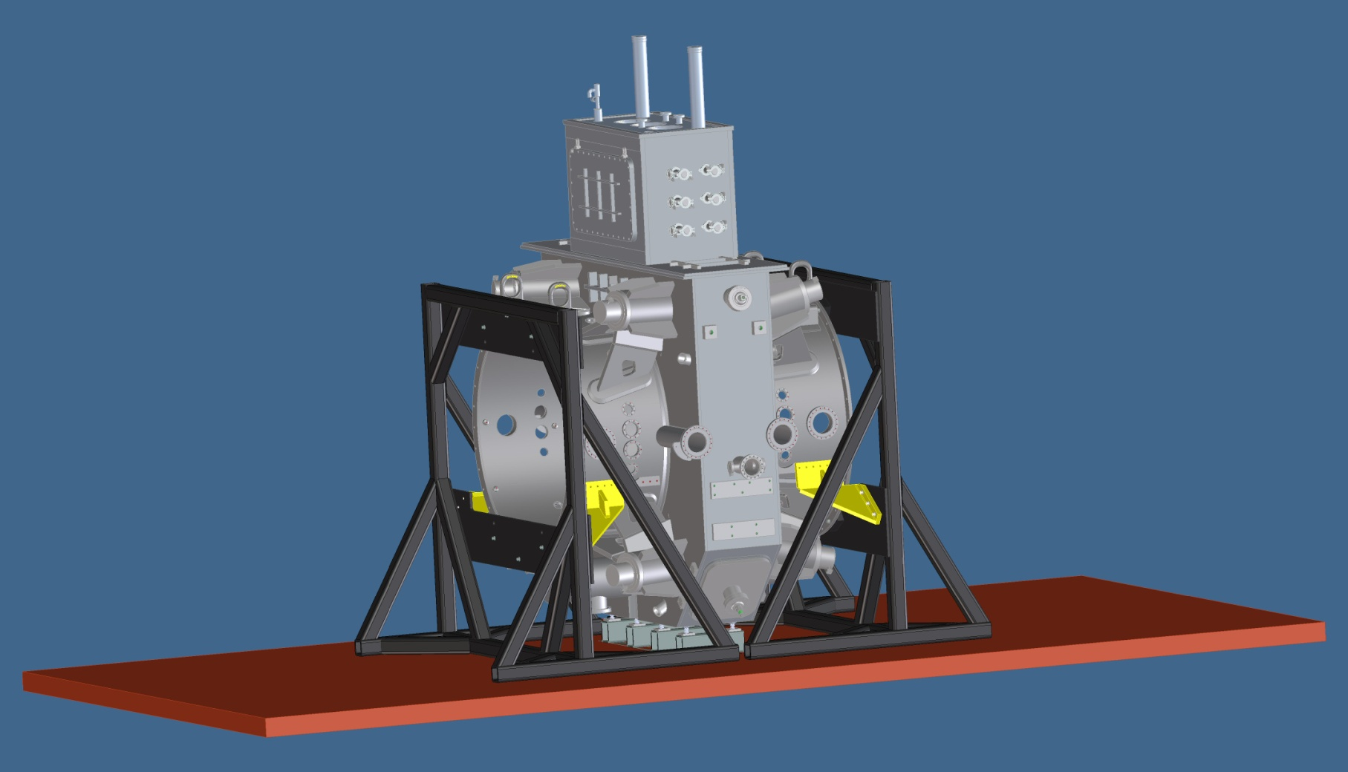
7. Weld Gussets Between Coupling Coil and Vacuum Vessel
Attach 16 gussets – 8 per side
Welding process needed to minimize distortion of RF vacuum vessel and coupling coil vacuum vessel
Alignment must be verified as welding is being carried out
Gussets

Slide 13
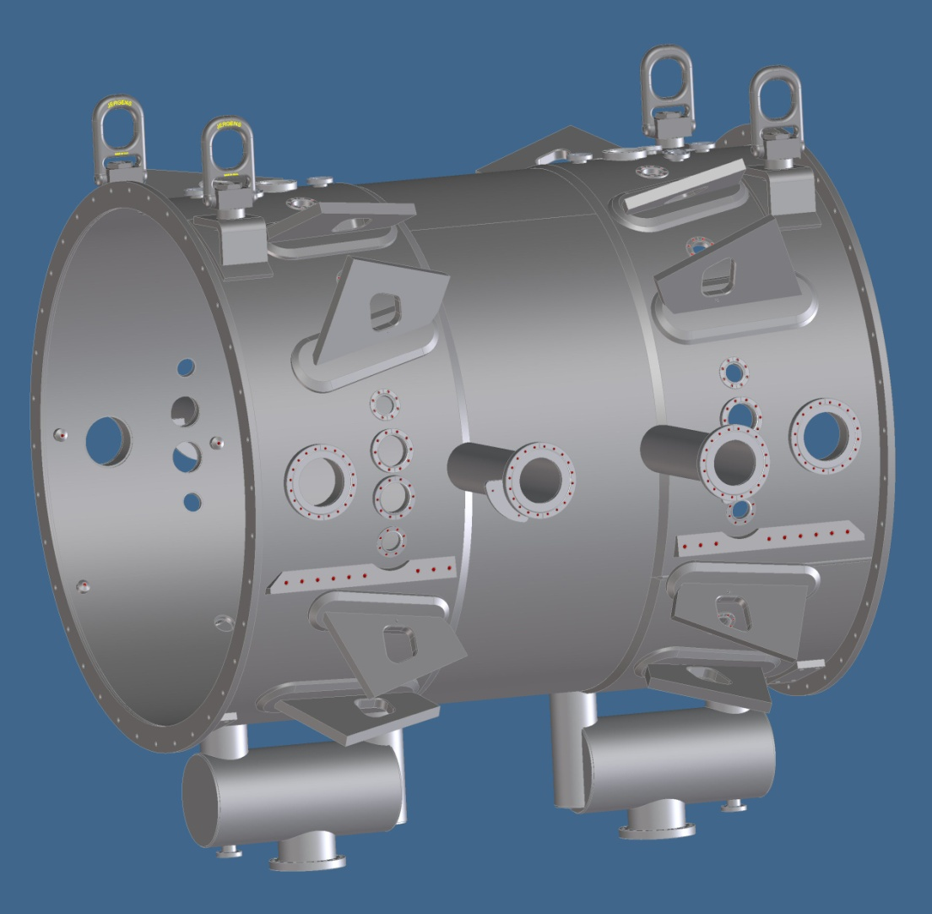
Integrate the RF Vacuum Manifolds and RF Spools
(coupling coil removed for clarity)
Weld on RF coupler spools
Weld on vacuum manifolds
4 RF coupler spools
2 Vacuum manifold

Slide 14
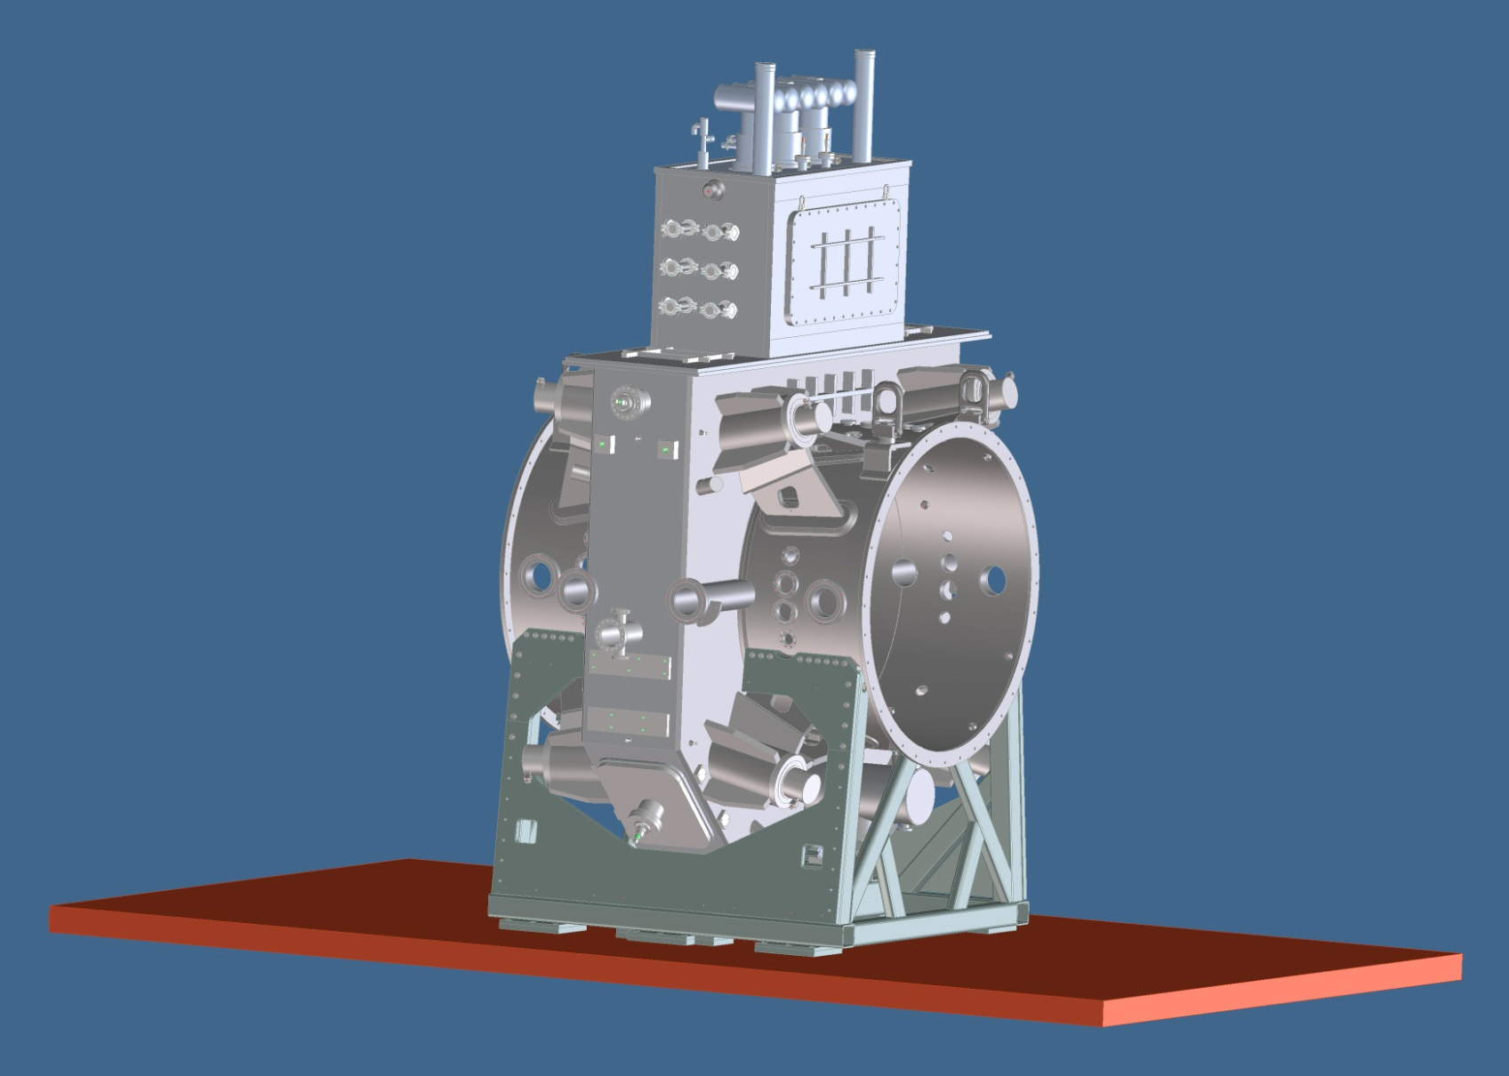
Mount the RF Vacuum Vessel/Coupling Coil to the Support Stand

Slide 15
Inserting Cavity Assemblies

Slide 16
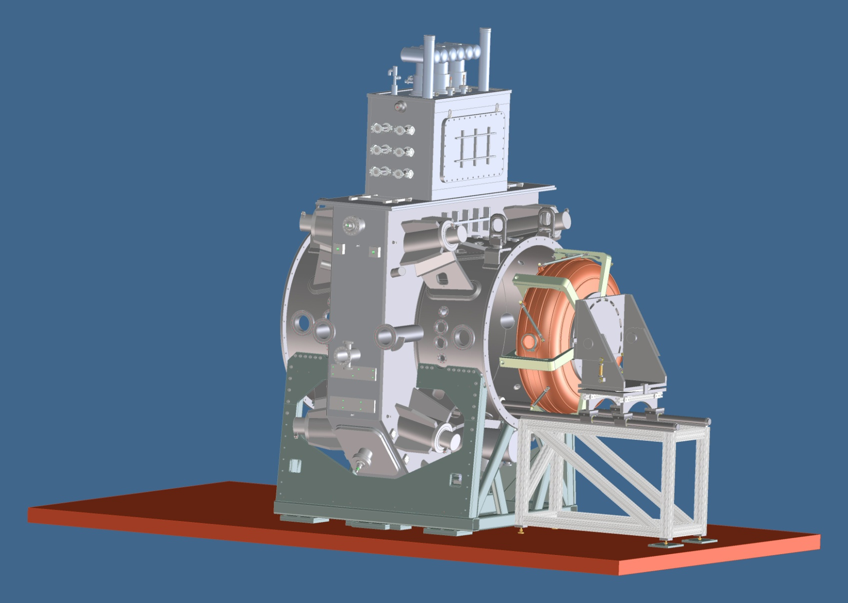
Inserting Cavity Assemblies

Slide 17
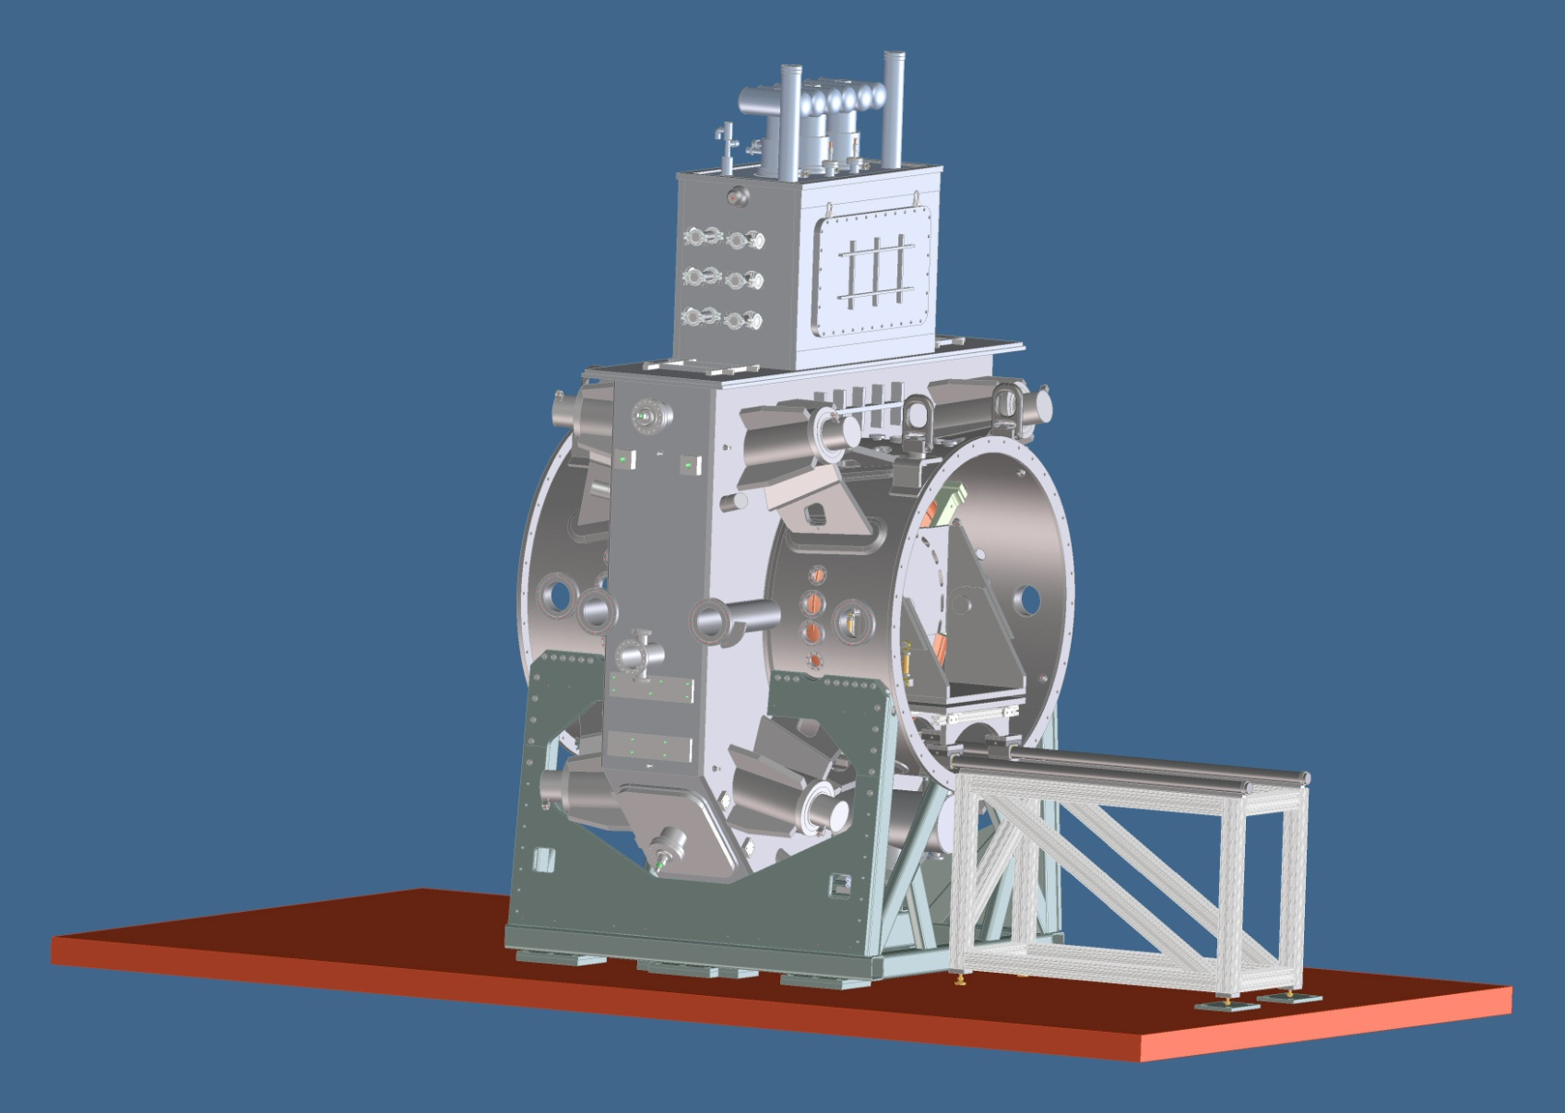
Inserting Cavity Assemblies

Slide 18
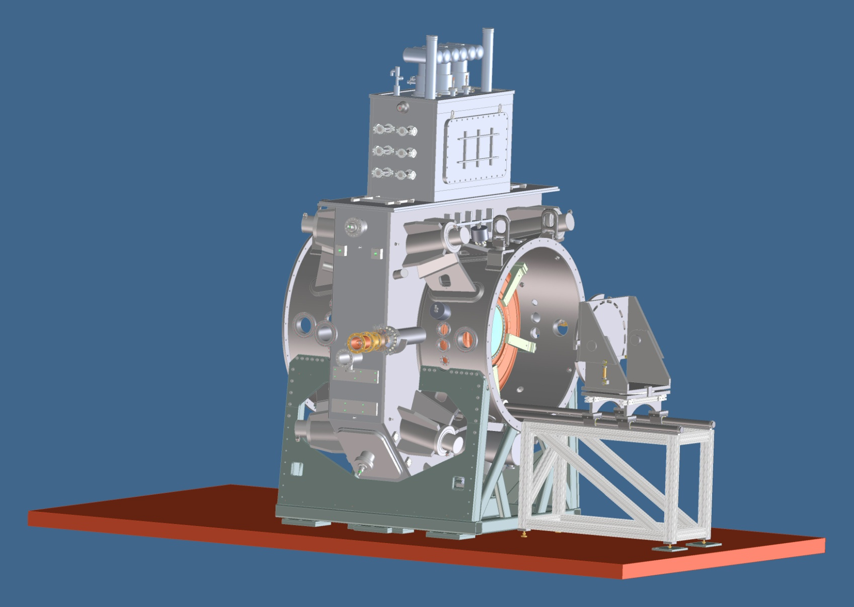
Inserting Cavity Assemblies

Slide 19
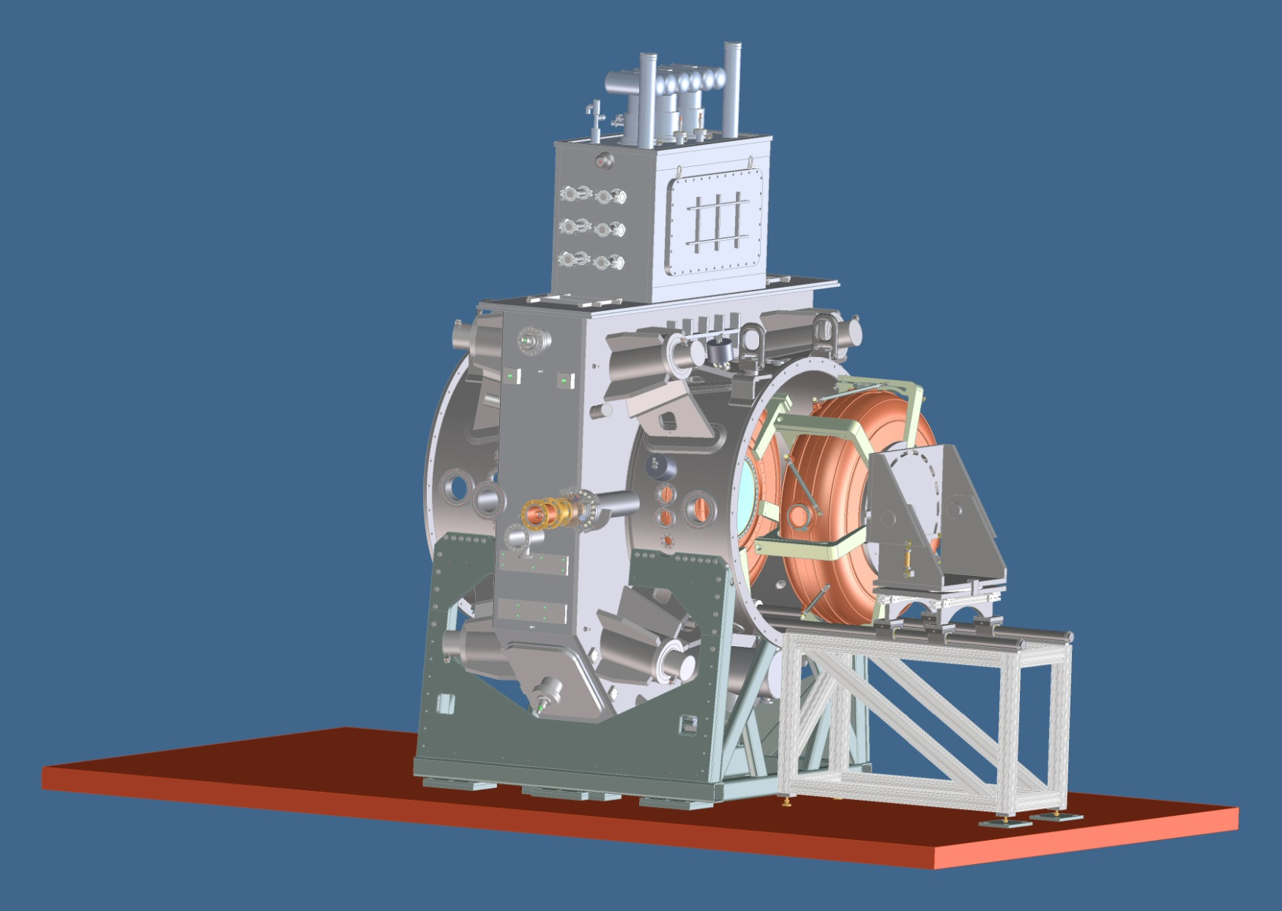
Inserting Cavity Assemblies

Slide 20
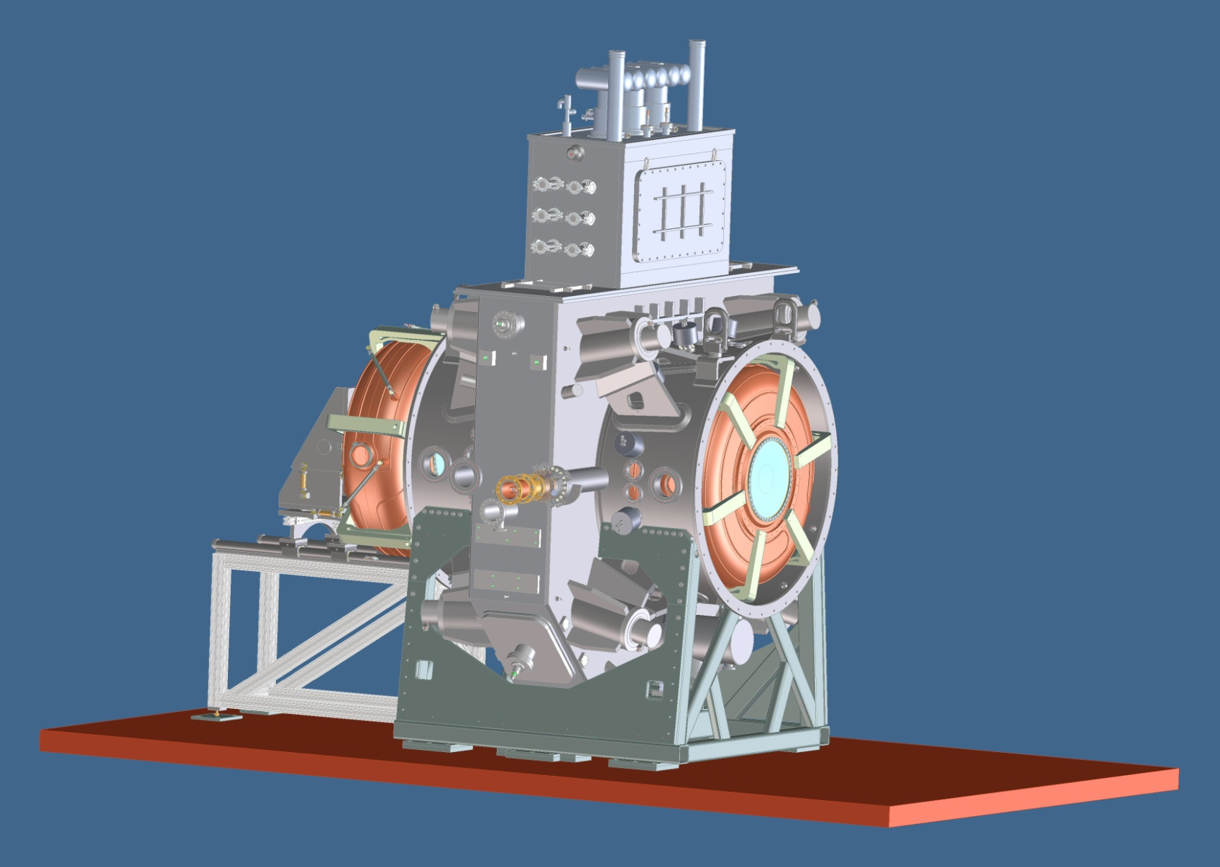
Inserting Cavity Assemblies

