Slide 1
MICE RFCC Vacuum System
MICE RF Workshop
June 2, 2014
Steve Virostek
Lawrence Berkeley National Laboratory

Slide 2
RFCC Vacuum System Overview
Preliminary plan is to use two SAES Capacitorr getter pumps for one 4-cavity module
Roughing system, pump isolation valves req’d
Manifolds connect one pump to two cavities
Pumps are connected to both inside and outside cavity vacuum space
Inside/outside vacuum regulated by a coaxial spool piece connected to cavity flange
Notes:
2

Slide 3
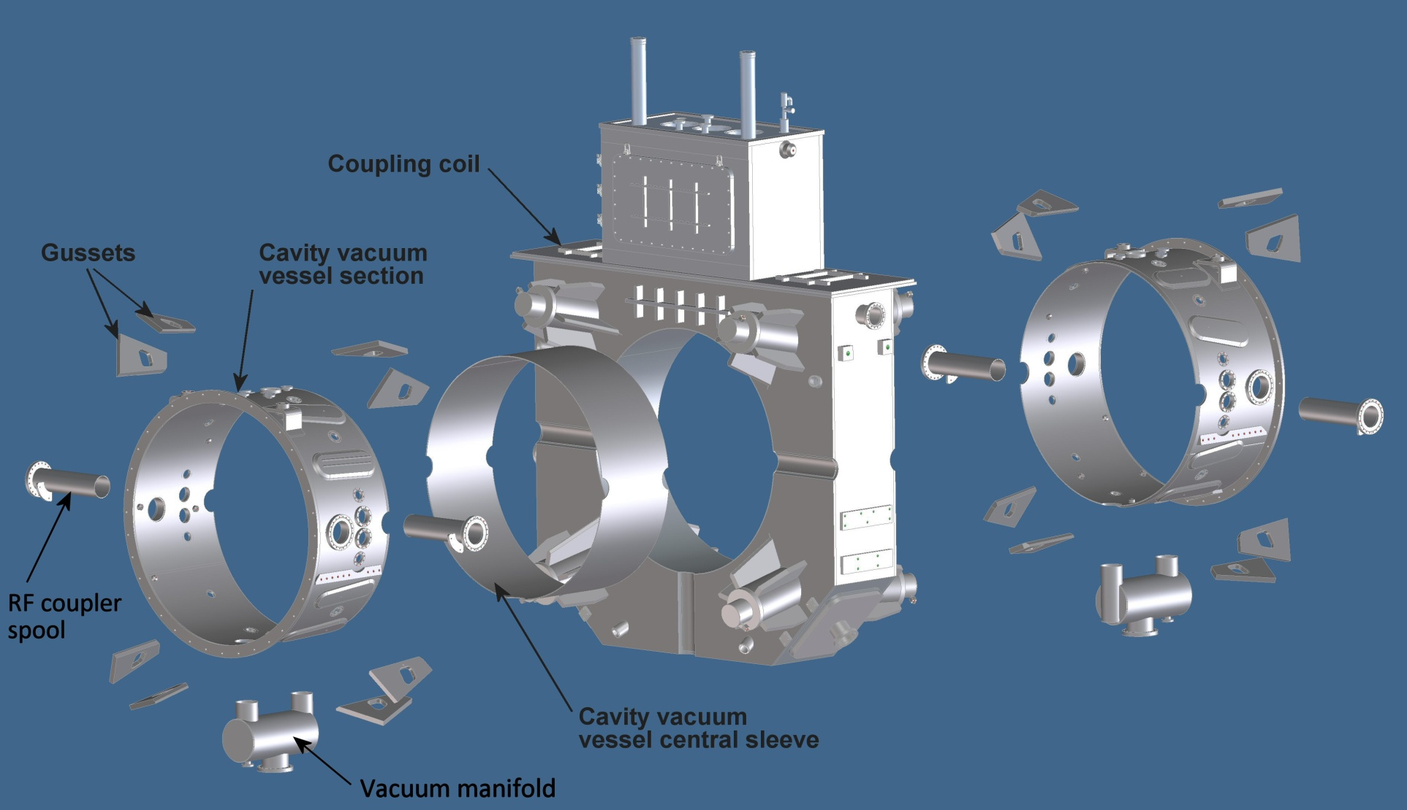
RFCC Exploded View
Vacuum manifolds

Slide 4
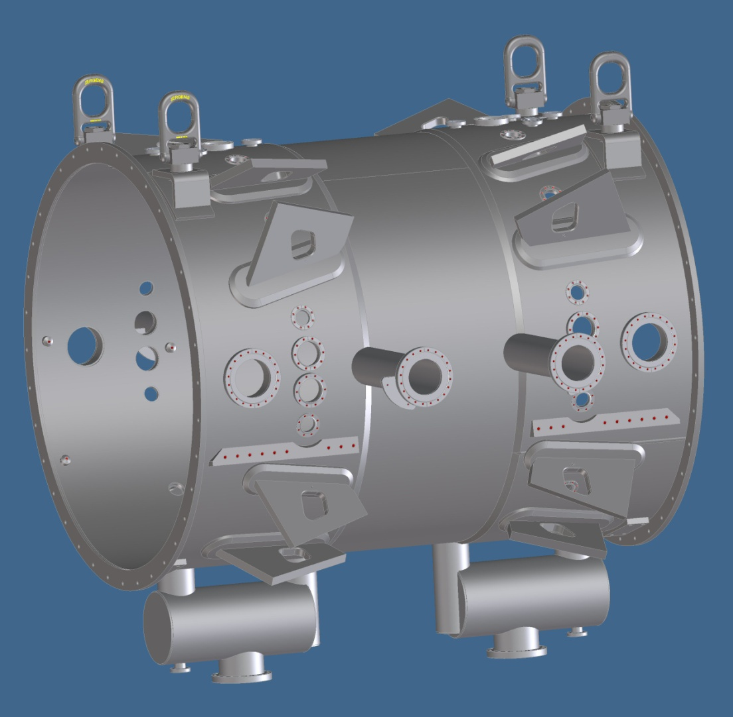
Manifolds Welded to Vacuum Vessel
2 Vacuum manifolds

Slide 5
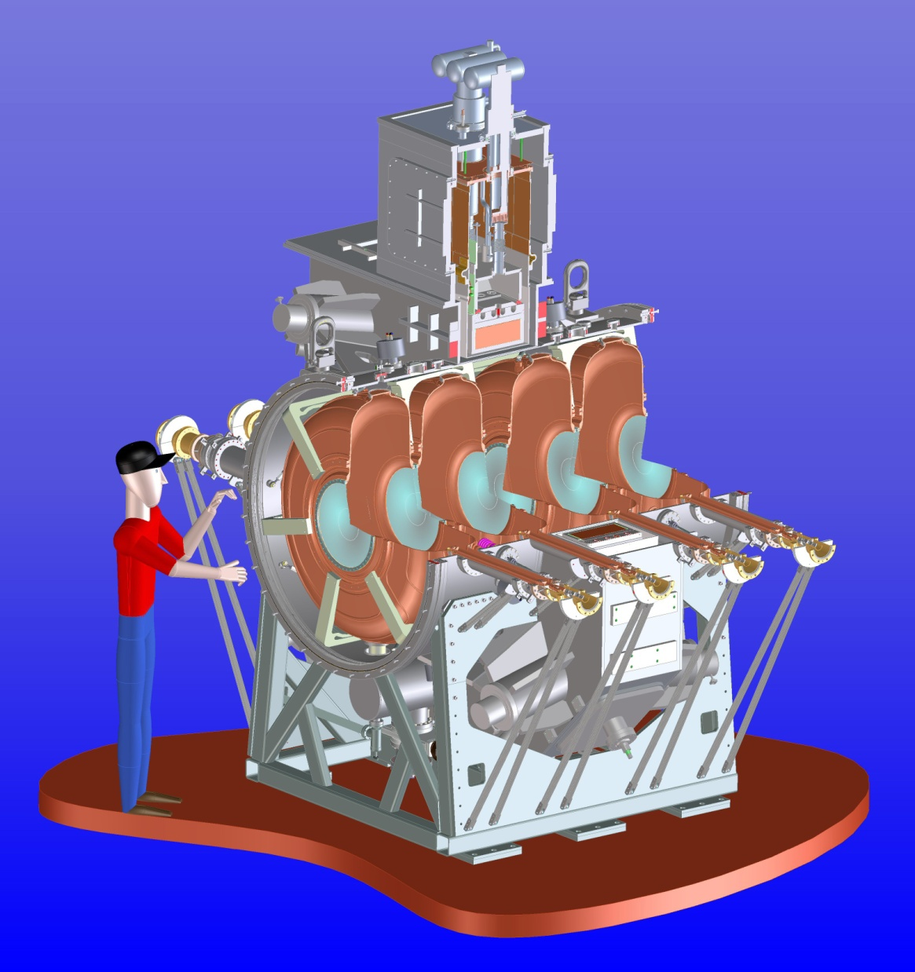
RFCC Module
Vacuum
manifold
Notes:
5

Slide 6
Plan Going Forward
Learn from experience on single cavity vessel
Possibilities:
Use 4 getter pumps
Separate inner/outer vacuum pumps
Modified spool connection to cavity
Notes:
6

