Slide 1
MICE RF – Installation at RAL
Tim Stanley,
MICE RF Engineer, RAL
2 June 2014

Slide 2
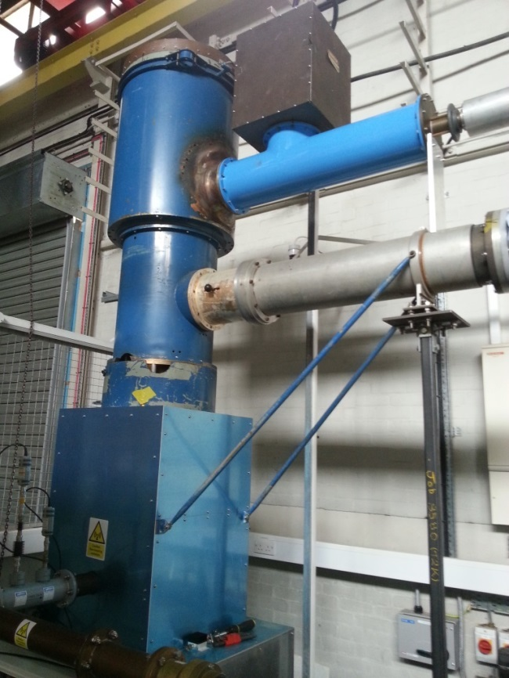
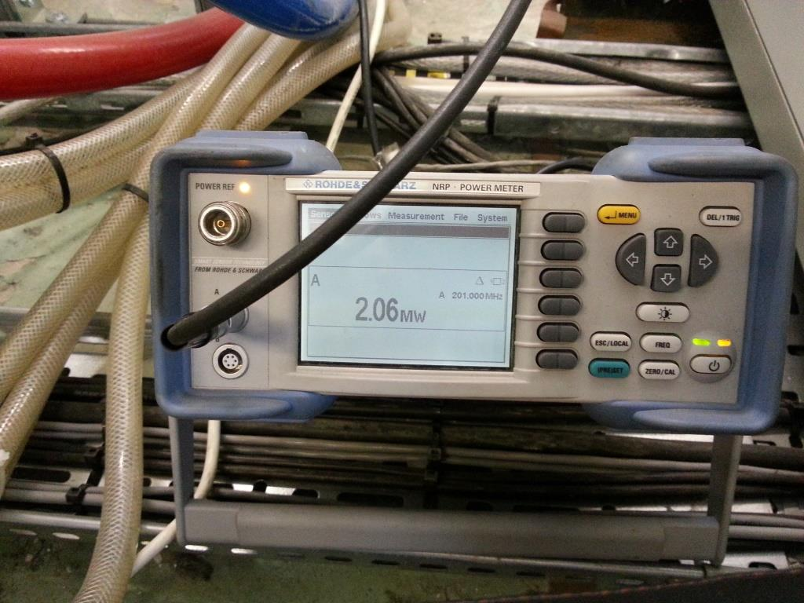
RF Amplifiers – Performance at DL

Slide 3
RF Amplifiers - Performance
2 MW RF output was achieved at Daresbury, in July 2013, on amplifier chain #1.
PSU trips were mitigated to allow high enough HT supply voltage (35 kV) to achieve the 2 MW RF
Amplifiers and PSU racks were dismantled and arrived at RAL MICE Hall mid-August.

Slide 4
TIARA System – Plan A

Slide 5
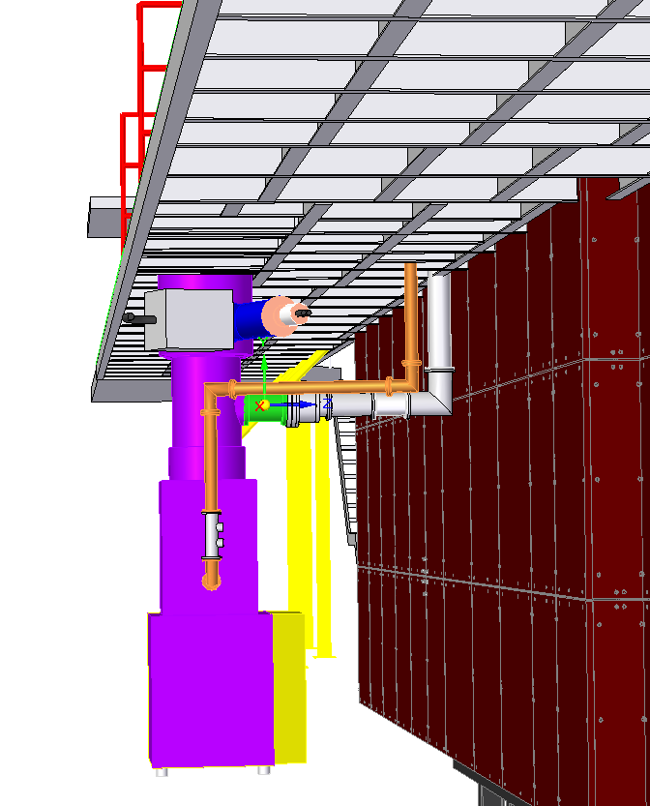
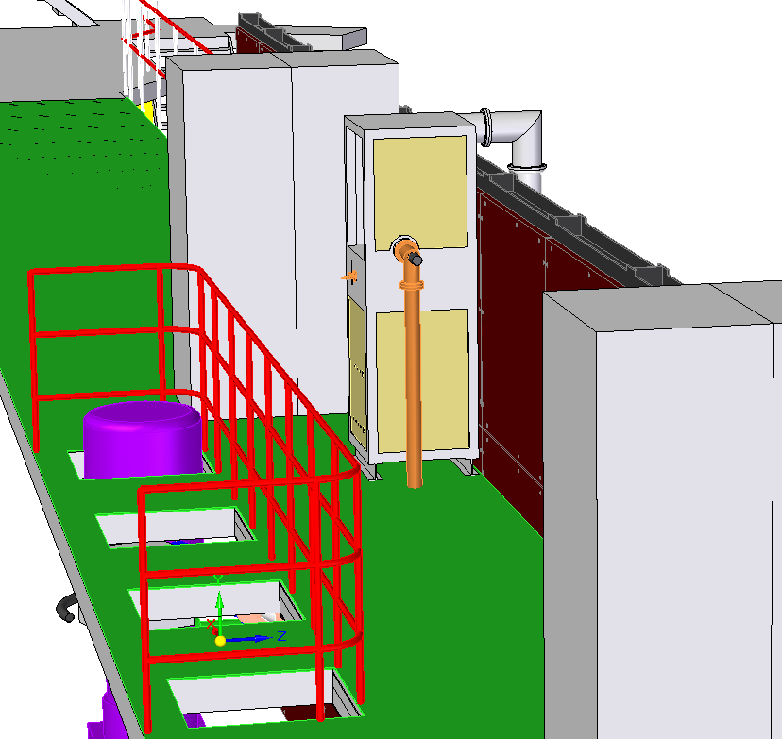
TIARA System – Plan A
End-stage, ground floor Driver stage and PSU racks

Slide 6
TIARA System – Plan B

Slide 7
Preparations for Installation
Alternative layout, of o/p co-ax, was implemented; avoided further delays in lead-time for upper floor mods. Limited demonstration, for TIARA milestone, to 500 kW
Safety Case document written by TS, and approved by ISIS-MICE Safety board.
Included Risk Assessment and Method Statement
Included HT, ionising and non-ionising radiation safety
Radiation monitoring schemes were developed in conjunction with RAL Radiation Protection Superviser
TS appointed EMF Protection Advisor. (RF and microwave fields).

Slide 8
Procurement of RF Components
MEGA, in the USA, fulfilled full order of parts for entire MICE RF (full Step VI)system. Importation, under MoU, via Univeristy of Mississippi, achieved late September 2013.
Many components of the RF system were procured by University of Mississippi under and MRI grant; thanks to Don Summers, and his colleagues.

Slide 9
Procurement of RF Components
Components included:
Co-ax RF transmission-lines for the whole project (a vast consignment!)
HT reservoir capacitors
HT charging PSUs
LLRF boards
3 new 4616 tubes and an amplifier i/p cavity

Slide 10
Procurement of RF Components
MoU allowed waiver of UK import taxes
Several components immediately used for build of amplifier system #1 for TIARA milestone

Slide 11
Arrival of a batch of TX lines at RAL

Slide 12
6” co-ax

Slide 13
6” co-ax – assembly practice

Slide 14
Mechanical Installation
PSU and Control racks (5) craned into position during August.
End-stage amplifier craned-in during September

Slide 15
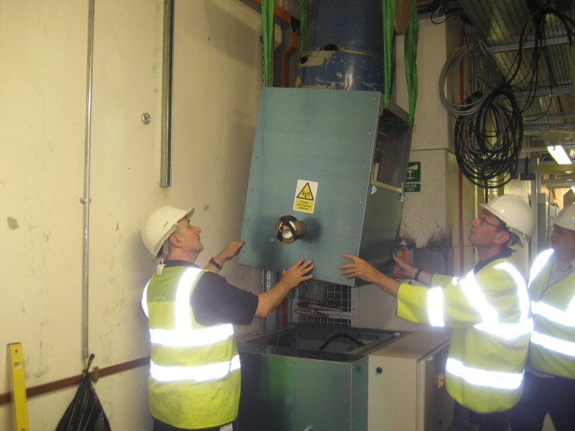
Mechanical Installation – End-stage

Slide 16
Mechanical Inst: HT PSU and SSPA

Slide 17
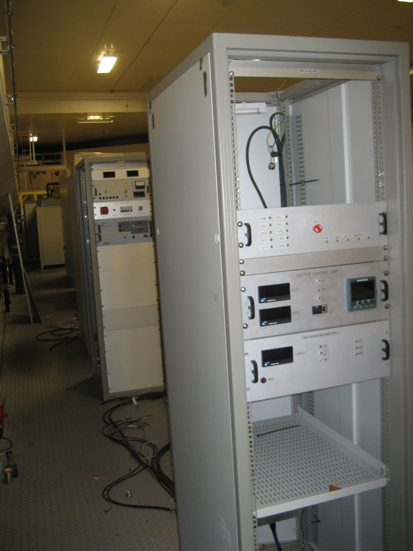
Mechanical Inst – HT PSU Rack 2

Slide 18
Mechanical Installation
Co-ax feeds from Driver stage to Endstage, and Endstage to Dummy-load, were fitted; co-ax is rigid piping. Careful, accurate siting of amplifiers required.
Laser-based survey imminent.
For full runs to cavities, considering some pre-assembly and fitting-checks in R9 lab at RAL in due course.

Slide 19
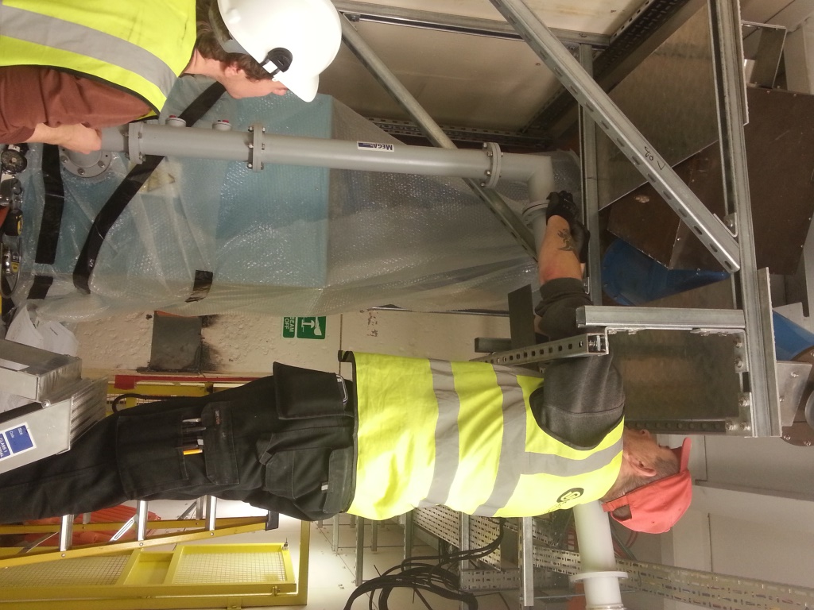
Mechanical Installation – 3” co-ax

Slide 20
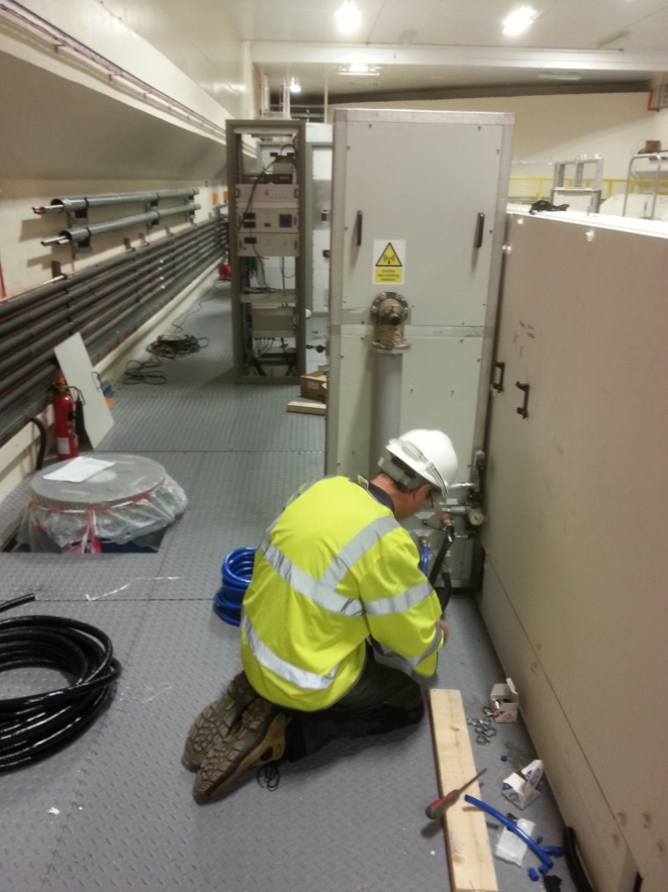
Mechanical installation
Driver stage accurately fixed in position

Slide 21
Electrical Installation
Done by DL engineers with local Elec technician at RAL
Some re-work required owing to config of End-stage HT port.

Slide 22
Services - Water
De-mineralised cooling water supply plumbed to MICE RF area. Dedicated closed-loop, but shares cooling with chilling system for magnets. Aimed for 21 to 24 degrees C at flow input. New system will be fully separate.
Flow-rates per water circuit, and conductivity at flow and return, were monitored and used for safety-trips. (Conductivity < 0.5 uS/m achieved)

Slide 23
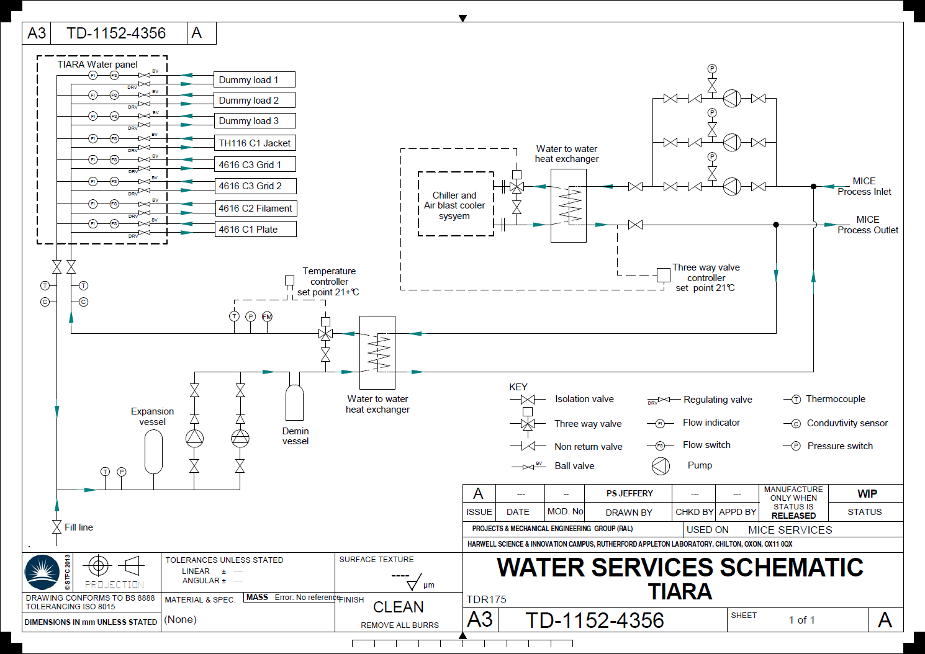

Slide 24
Services - Water
8-channel water distribution panel quickly designed by sub-contractor. Performed OK but RAL design review likely to improve fit in the confined space for RF plant in the MICE Hall
Bleeding-points, in 4616 amplifiers, to be fitted.

Slide 25
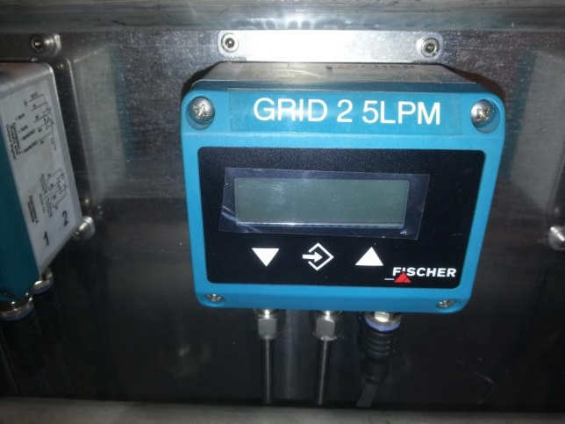
Services - Water

Slide 26
Services - Air
Supply, of dry and clean compressed air, provided to RF area in MICE Hall; local distribution and interlocks fitted.
STEP V system will need nitrogen pressurisation of co-ax TX lines (~ 2 Bar) to improve voltage stand-off.

Slide 27
Programme
Owing to protracted test-programme at DL to mid-2013, to resolve technical issues, RAL installation programme was very compressed.
However, teams, at RAL and DL, were able to bring a high level of commitment to the project, within the constraints of other high-priority work.
Avoiding the proposed mods., to mezzanine floor, won some time.
EMR Runs during October reduced hall-time by ~ two weeks.

Slide 28
Staff
MICE mechanical and electrical fitting work relied heavily on two RAL technician staff. Two more technicians now being hired for the project.

Slide 29
TIARA Milestone Success
Dec 12 2013
Amplifier chain functional; 531 kW RF power delivered to load; TIARA milestone achieved! Two weeks ahead of deadline.

Slide 30
Ready for Testing

Slide 31
RF Powers in MICE Hall

Slide 32
Rogues Gallery

Slide 33
2014
Amplifiers were further run for detailed operating familiarisation by Tim S and Pierrick H. Good preparation for generating protocols for design of remote-control system this year.
All 5 PSU racks, and 4616 amplifier, returned to DL in April, for re-assembly
RF testing, at DL, to resume ~ Summer 2014

Slide 34
Tentative Programme
RF amplifiers #2 aim to be ready and tested by end of FY 2014/15
Lock-out from MICE Hall, for STEP IV running, for one year from April 2015
PSU racks #2 aim to be ready by end of FY 2015/16
Installation of two amplifier systems at RAL for STEP V readiness during 2017

Slide 35
Tentative Programme
Perhaps introduce test cavity to pre-testing programme
Build of X-ray screening would be required

Slide 36
Enhancement of STEP V??
Perhaps option to increase E-field with amplifiers systems 3 and 4.
Would need some re-config. of co-ax layout and some new components.
Might invoke SF6 pressurisation of lines.

