Slide 1
FNAL Software School: Lecture 2 Hit Finding Performance
Matt Herndon,
University of Wisconsin – Madison

Slide 2
HitSet
You have produced a HitSet
Consider some of the features
typeDef std::vector<Hit> HitSetContainer
Makes code faster to write and look simpler
Allows us to change the underlying container to any other indexed type, std::list without effecting the user
Here we use the simplest variable size container, but for the TrackSet you may want to use a list to allow faster insertion and deletion
insertHit
two versions – one depreciated
The second uses “Perfect Forwarding”
&& gives a “R value” reference
You can then use std::move to move the internals of the object into the std::vector. Using move allows the compiler to avoid costly copies in the case where the original object is no longer needed. The Hit will now be in a not defined state

Slide 3
Hit and HitSet
Consider some of features
Data encapsulation and const correctness in Hit and Hitset
All the member data is private
Access to values only through “const” get functions
An accidental “hit._layer = 3” rather than hit._layer == 3” is not possible. This is a gift bug that can keeps on giving forever!
Only necessary non const member is insertHit
Initializer syntax
All Hit private member initialized in constructor via the initialization list
The user can’t forget to initialize something. Though the developer can forget to put something in the initialization list!
No non const functions needed to set the data members. Data can not be changed after it is created.
Faster. The constructor will default initialize anything not in the list. If you initialize it in the body of the constructor or later it gets initialized twice.

Slide 4
Event Framework
Event Framework features
Consider Event
A map of key ProductID, value std::shared_pointer
ProductID allows the objects to be indexed by name(C++ class type) for retrieval.
Pointers since the data objects are of highly variable size.
The “get” function to retrieve DataObjects gets a Handle: const T*
Template T since there are many objects
const means that you can’t alter the objects
Modular:
Each module has one purpose
The creation of the data happens separately from its use
Modules that consume data retrieve that data as const
Consider HitCompareModule
HitSet retrieved as a const “Handle”
If you included a line that tried to change the object it would not compile!
Try it!

Slide 5
Pointers
Typically we avoid pointers in favor of const references or only when necessary references
If you loos track of a pointer you can have a memory leak, at large on if it is an event DataObject
Unlike pointer data member references must be initialized.
No segmentation faults
std pointer types should be used if necessary
std::unique_ptr
Only one object can hold the poitner. Can be moved using std library methods. Automatically deleted when it goes out of scope
std::shared_ptr
Multiple objects can hold the pointer. Reference counted. Automatically deleted when last referenced instance goes out of scope
We only use these in the Event where we must use pointers
We only use bare pointer for root.
Root only understand bare pointers for histogram
It automatically deletes them when done
We use a shared pointer for the root file.

Slide 6
Your Role as a Developer
If you are developing objects
Declare all member data as private: Can’t be accessed and changed other than by the methods you write.
Make all methods to retrieve information const or const& if an object is retrieved
Don’t include any methods to alter the object if not necessary. In our case only the insertX method of the Set where we use Perfect Forwarding.
Construct the object completely using the constructor and if possible only using the initializer list. In can only be constructed using the method you control which is fast.
Now your object is fast and safe from being changed accidentally later on.
If you are developing Algorithms in modules.
If you need member data it should be const or const&. These are typically constants or objects like Detector Geometry that you need. Note that these constants have a single source like the configuration or the detector geometry file and can’t be changed later.
Make all functions const so they don’t accidentally change your constants.
Construct your objects using constructor calls. In some cases the object is so complex you might make and buildObject function to calculate all the values used by the constructor. Can’t be changed accidentally by you after being make
Use algorithm abstraction to write your code
Use algorithm abstraction to make your code well organized easy to understand
Now your code is fast and the objects in it safe from being changed

Slide 7
Why do all this
const correctness
Data safety
Initializer constructor calls
A user can’t incorrectly construct the object neglecting to fill in certain information
Data safety
Faster
Const references for access to all Objects instead of pointers
Data safety
Avoid segmentation faults and memory leaks
Algorithm abstraction
Better organized and readable code
Maintainability: Allows upgrades to underlying methods without effecting users

Slide 8
Course Goals: Data Objects
Goal
Learn how to write well designed and effective reconstruction software that integrates well into a large scale computing project
What does that mean?
Follows best practices
Many of the best practices are there to facilitate the elements of the goal.
Easy to read
A user or other developer can read and understand quickly what your code does.
Easy to maintain
Need to improve something? Well designed code will often let you do so with a change at a single point without effecting any of the classes and functions that use the code you’ve changed.
Simple
The simplest solution is used when various solutions are equally effective.
Safe
Data elements are safe from being altered when they should not be.
Fast and uses minimal memory
A fact of particle physics computing is that we deal with large data sets and are CPU and memory limited.
Effective
Defined in terms of the project goal. In reconstruction typically, efficient, accurate, and low fake rate (reconstruction of Hits, Tracks that don’t exist!) reconstruction of objects.
Data Encapsulation const correctness Event Framework
and Modules

Slide 9
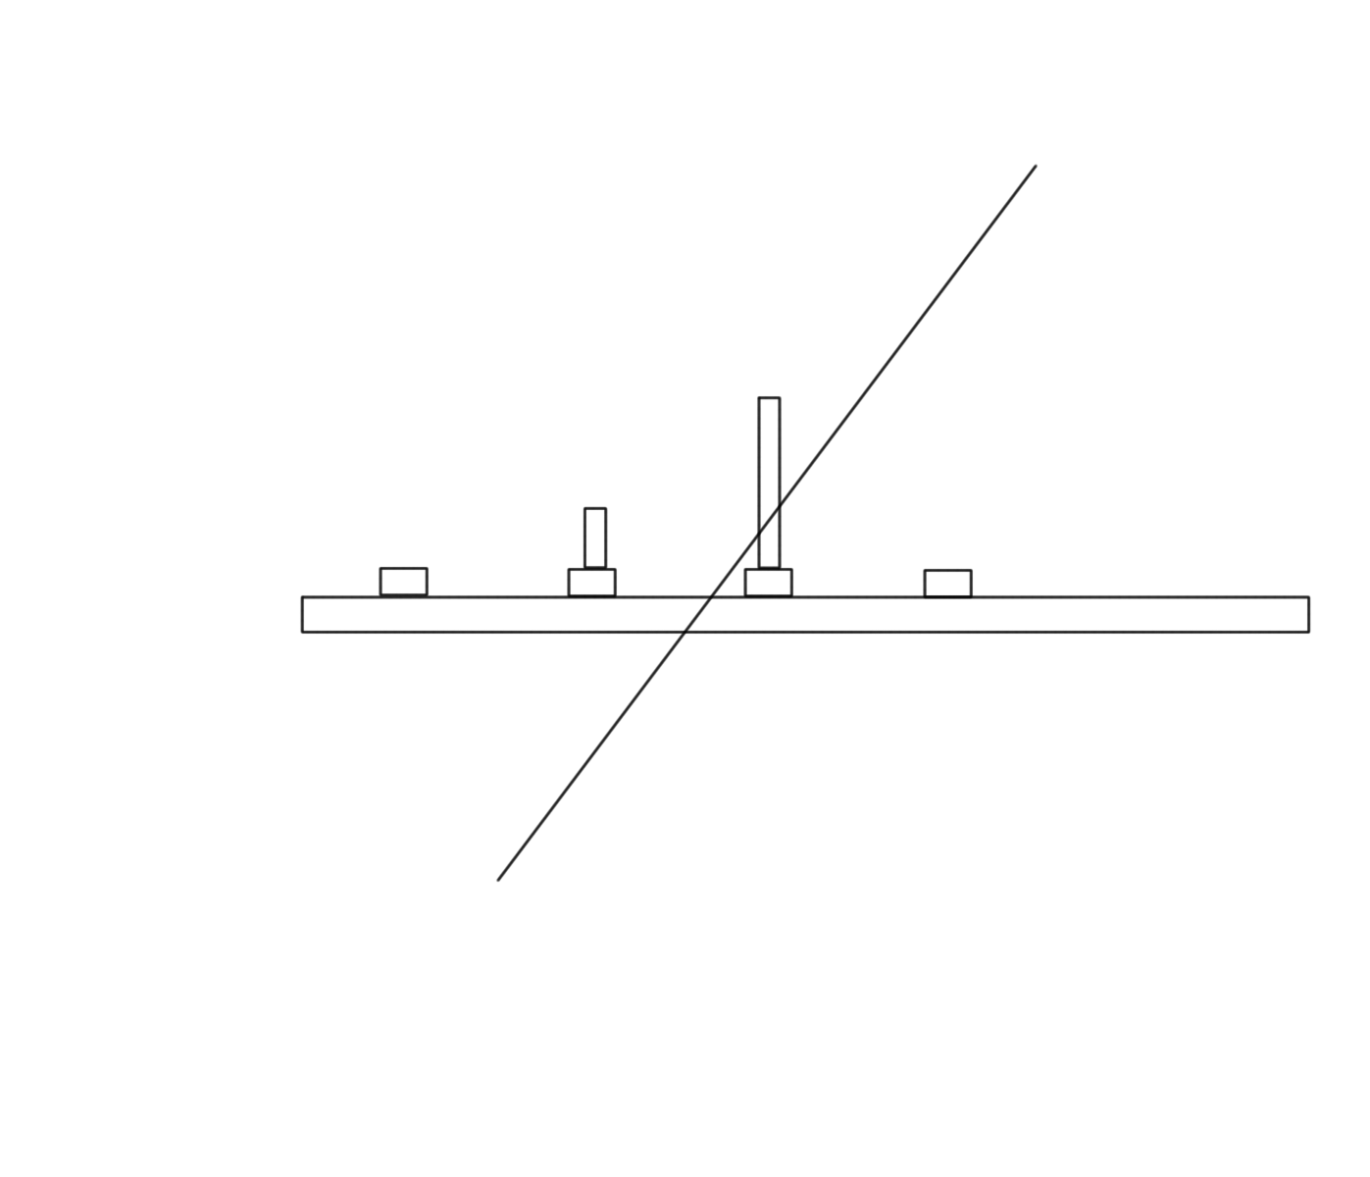
Cluster and Hit Finding
Cluster and hit finding goals:
Find the estimated position where a charged track traversed the detector
Find hit with high efficiency
In this case there is no reason the algorithm can not be perfect. Detector properties will result in inefficiency.
Do so with with understood resolution
Today assess efficiency and resolution(s)
Collected charge: ADC
strips

Slide 10
Track reconstruction and Hits
Hit resolution is a critical issue in track reconstruction
Typical track reconstruction
Find an initial candidate track helix
Three points define a circle in the plane orthogonal to the magnetic field: r-phi (x-y) view
Two points define a line in the r-z view
In our case five Hits 3X and 2 Z or SAS
Minimal set of information needed to define the helix trajectory
Use that helix to define the locations to look for hits in the other layers
Fit all hits to form the final track with both track parameters and estimated uncertainties.
Hit resolutions are needed to understand how big an area must be searched for hits on each layer.
Hit resolutions are needed to perform the final track fit
With poorly understood resolutions track fit will calculate incorrect uncertainties
You will search in an area that are too large or too small
Your physics analysis will not be reliable

Slide 11
Hit Resolutions
In a real detector
Resolution understood from first principles: Often principles applied in terms of a detailed simulation of the charge deposition and collection in the detector.
Measured in controlled situations like test beams
In our toy simulation
Resolution known: set in the DetectorGeometry.
Should work perfectly in most cases
However, two tracks can overlap where they intersect a layer resulting in
More than two strips
High charge
Poor resolution
Solution
Identify cases where this has happed and flag Hits as !goodHit
Directly measure the resolutions in those cases

Slide 12
Project Specifications
Efficiency sub project
Project Goal
Assess the efficiency which reconstructed hits were found on each layer.
Input: HitSet and GenHitSet
Output: Efficiency number assessed per layer
Using:
HitCompareModule
Loops over layers
Compares hit positions after matching closest Hit and GenHit
Project code
1: Currently always histograms nearest Hits no matter how far. There should be a tolerance to define a correct hit.
2: Assess efficiency and printout or graph

Slide 13
Project Specifications
Resolution sub project
Project Goal
Assess the resolution of hits per layer and for subclasses like good vs bad hits
Input: HitSet and GenHitSet
Output: List of resolutions
Using:
HitCompareModule
Project code
Note: HitRecoModule has been altered to categorize Hits as good or bad compared to the version you wrote
Include resolution histograms for two hit classes on each layer
goodHit
!goodHit
Measure resolutions and record

Slide 14
Project Specifications
Tracking sub project
Project Goal
Use the resolutions from the previous step to improve the tracking reconstruction.
Input: Resolution used to improve sensorgeometry.txt
Output: Tracks with improved estimated uncertainties.
Using:
Tracking modules and PerfectTrackingModule run by trackReco.cc
Comment out other tracking modules.
Project work
Run genData and trackReco with 10000 1 Track events
Look at pull distribution histograms. Track parameter uncertainties should be well estimated
Run with 1000 10 Track events.
Look at pull distribution histograms. Track parameter uncertainties will be poorly estimated
Update sensorgeometry.txt with badHit resolutions. detectorGeometry.pdf explains the format.
Run with 1000 10 Track events.
Look at pull distribution histograms. Are the estimated uncertainties improved?

Slide 15
Design Principals
HitCompareModule and this exercise
Follows const correctly guidelines
Initializes everything on the initializes line where possible
(can you find where this was not done)
Applies algorithm abstraction
Constants are from a single source and can’t be altered by the program when running
Uses best practices in treating the data
auto const& loops …
Show the need for careful planning
Hooks already in the design for good vs bad hits and using the different resolutions.

Slide 16
Course Goal Revisited
Goal
Learn how to write well designed and effective reconstruction software that integrates well into a large scale computing project
What does that mean?
Follows best practices
Many of the best practices are there to facilitate the elements of the goal.
Easy to read
A user or other developer can read and understand quickly what your code does.
Easy to maintain
Need to improve something? Well designed code will often let you do so with a change at a single point without effecting any of the classes and functions that use the code you’ve changed.
Simple
The simplest solution is used when various solutions are equally effective.
Safe
Data elements are safe from being altered when they should not be.
Fast uses minimal memory
A fact of particle physics computing is that we deal with large data sets and are CPU and memory limited.
Effective
Defined in terms of the project goal. In reconstruction typically, efficient, accurate, and low fake rate (reconstruction of Hits, Tracks that don’t exist!) reconstruction of objects.
Careful project planning.
Hit and DetectorGeometry designed to account for this issue and modules were designed to measure the resolutions and test the results

