Slide 1
FNAL Software School: Lecture 1 Course Code Infrastructure Cluster and Hit Reconstruction
Matt Herndon,
University of Wisconsin – Madison

Slide 2
Course Code Base
Location
https://github.com/herndon/FNALComp/tree/production
Organization
Framework: Event processing framework
Modules: Produce or consume data objects each event
DataObjects: Class definitions of basic data objects
Geometry: Definition of the detector geometry and properties
Algorithms: Algorithms that run on the data objects to perform operations like IO, fitting, …
Tracking: High level tracking classes with algorithms and supporting functions
Services: Services such as Errorlogger, Random number generation …

Slide 3
Code Structure
Main program and Event processor: dataRead.cc
Initializes persistent objects used throughout the program
EventProcesser: process “Events”, runs the processEvent function of Modules once per event
Other persistent objects: Config, DetectorGeoemtry, Random, Iostreams, Root file… persistent objects over the scope of the whole program
The Event: Event
Particle physics takes place in short time scale interactions or “Events”
This informs us on how to structure our code
Event: Contains DataObjects persistent for the scope of one Event
Modules can read (consume) and/or write (produce) data objects from/to the event
Modules: HitRecoModule
A class that performs a specific task producing or consuming (frequently both in reconstruction) data objects
Specific instances of Modules are derived classes inherited from the Module class to give a common class type and interface that EventProcessor can control.
Special cases are CountEventsSource, starts generation of data, and DataSource, reads data from disk.

Slide 4
Code Developers
Your role
As a code developer performing reconstruction:
Develop Modules for performing a single specific task. Today you are using the premade module template HitRecoModule
Develop algorithms to process data within a Module. Today you are performing cluster finding and hit reconstruction in HitRecoModule.
You will consume as input a StripSet and produce as output a HitSet

Slide 5
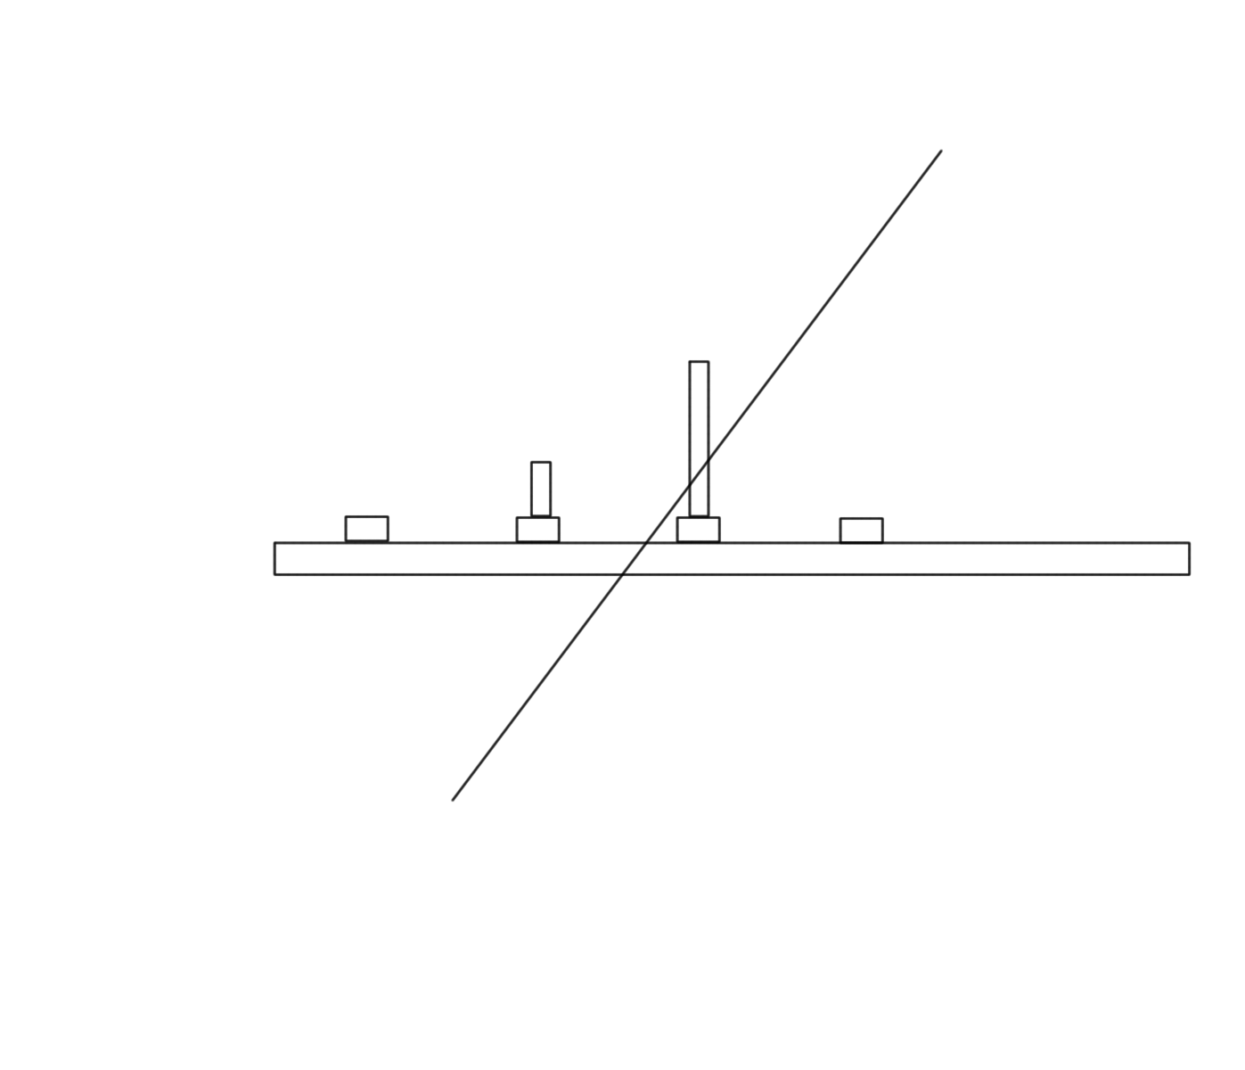
Cluster and Hit Finding
Cluster and hit finding
Goal: Efficiently find the estimated position where a charged track traversed the detector
Strip detector
Silicon strip detector, calorimeter strip chambers, muon detector.
In our case charge is deposited relatively on the adjacent strips in inverse proportion to the distance to the strips.
Location found from charge weighted sum
Collected charge: ADC
strips
Final result, Hit: 1D measurement with known position (and resolution)

Slide 6
Strip Detector
10 Layer of strip planes arranged in 5 closely spaced pairs (200um)
Three pairs with X and Z measurements
2 pairs with X and SAS (small angle stereo, 1º rotated from X)
Intersection of X and SAS strips allows effective measurement in Z
Sufficient determine helical trajectories of a track in magnetic field.

Slide 7
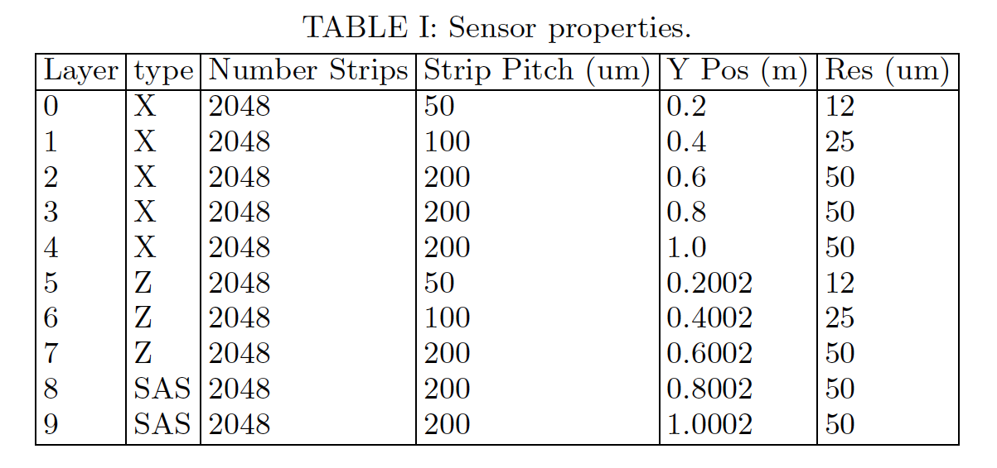
Strip Detector
Detailed properties
Described in sensonsorgemetry.txt

Slide 8
Strip Detector
Why SAS?
Intersection of X and SAS strips gives effective measurement in Z
Ambiguity
Less ambiguity from SAS layers.
If you had only SAS (or worse Z) layer the same pattern would repeat at every layer and all the false pairings would look real!
Different types of layers breaks the ambiguity.
Why Z:?
More accurate Z measurements
X,SAS
X,Z
Angular resolution
This detector has the good angular resolution in the outer layers
Makes sense to start tracking there

Slide 9
Programming Project
Cluster and Hit Finding applying algorithm abstraction
Project goal summary
Given raw data of strip number and ADC counts from a strip detector determine location where the tracks traversed the detector layers.
Two primary logical steps
Cluster finding: Find all adjacent sets of above threshold strips that may be due to one or more tracks traversing the sensor at that location.
Hit construction: Convert that information into a location in a global coordinate system
Software engineering concept:
Algorithm abstraction: Determine the logical steps of your problem and map them to abstractions
The abstractions are the names of the functions that will accomplish each step.
Our problem, though not complex, is complicated enough that we will create a hierarchy of abstractions to represent our problem.

Slide 10
Abstractions
The DataObjects in our code represent a hierarchy of abstractions as well.
Tracks (class)
Helix (class)
Covariance Matrix (TMatrixD)
Hits (Vector of indices)
Helix Parameters(TVectorD)
Uncertainties, Covariance's
Hit
Hit
Hit
In general you just see clearly named functions that get the various classes or values. To just read the data what classes and types of containers hold the data should be largely irrelevant and can be abstracted away from the user.
N Strips, Positions(TVector3)

Slide 11
You as the Developer
Your job as the code developer
Develop the abstractions
Your cluster finding code should read like
ReconstructsHits
(loop over layers)
findClustersOnLayer
(Loop over clusters)
…
Note there are often multiple reasonable algorithm choices
Find all clusters on layer. Process all clusters on a layer to make Hits
For each Layer
Create a vector of all the cluster acd information where the cluster acd information consists of multiple strips and can also be represented by a vector. A vector of vectors. Create a second vector of initialStrips
Or you could make a vector of indices, strip numbers, into the StripSet representing the start of each cluster.
Find one cluster. Process that cluster to make a Hit. Look for the next cluster.
Have to keep track of position in the StripSet
I did this (we should compare!)

Slide 12
Me as the DataObject Developer
Also make optimal decisions about what underlies the abstractions, Consider the StripSet
StripSet: vectors of maps (key int strip number, value int acd)
Data is sparse. In the map not every strip number needs to be there
Container is ordered, indexed by key and keys are unique.
When filling we can insert strips into the order. If the key already exists we should add the additional ACD counts.
The strips we insert may go anywhere since they are at the locations of track intersection. Maps support fast insertion into the map order.
We can insert or retrieve a strip ADC value by stripNumber index.
The ordering is needed for cluster finding
Note the insertStrip function is an abstraction. I can(should now!) change it whenever I want without effecting the user of the interface.

Slide 13
Look for help
Cluster and hit finding is the inverse of what was done to generate the data.
There we found the position where the tracks intersected layers and converting those hits to clusters of strips
HitStripGenModule
Look at storeStripInfo
calclateLocalFromGlobalPostion
calculateStripFromLocalPosition
generateClusterFromStripHitPosition
The calculate functions are free functions.
Looking at the file with the functions we see the inverse calculation functions have already been written!

Slide 14
Project Specifications
Input: StripSet, raw data from the strip detector
vector of 10 maps with pairs of key int strip,value int acd information
Access: retrieve each map and iterate over the elements
Output
Intermediate: clusters per layer: vector of vectors of acd values, vector of initial strip numbers
Intermediate: Hits with TVector3 position, number of strips, charge
Final: HitSet, vector of Hits
Given the specifications there is only one correct solution to the HitReconstuction problem
After adding a print method similar to those for the other DataObjects the output should be identical to the “make test” output

Slide 15
Project Specifications
Algorithm
reconstructsHits
(loop over layers)
findClustersOnLayer
(loop over strips)
test if adjacent
add to single cluster adc vector if adjacent
add single cluster adc vector to vector of clusters if not adjacent
(end loop over strips)
(Loop over clusters)
buildHit
calculateStripHitPositionFromCluster
… coordinate transformations
make the Hit
storeHitInSet
(end loop over clusters)
(end loop over layers)

Slide 16
Course Goal Revisited
Goal
Learn how to write well designed and effective reconstruction software that integrates well into a large scale computing project
What does that mean?
Follows best practices
Many of the best practices are there to facilitate the elements of the goal.
Easy to read
A user or other developer can read and understand quickly what your code does.
Easy to maintain
Need to improve something? Well designed code will often let you do so with a change at a single point without effecting any of the classes and functions that use the code you’ve changed.
Simple
The simplest solution is used when various solutions are equally effective.
Safe
Data elements are safe from being altered when they should not be.
Fast uses minimal memory
A fact of particle physics computing is that we deal with large data sets and are CPU and memory limited.
Effective
Defined in terms of the project goal. In reconstruction typically, efficient, accurate, and low fake rate (reconstruction of Hits, Tracks that don’t exist!) reconstruction of objects.
Algorithm
Abstraction

