Slide 1
FNAL Software School Day 3
Matt Herndon,
University of Wisconsin – Madison

Slide 2
Today’s Activities
Introductory slides
Review Day 2
Investigate candidate finding
Demonstrate the positive effect of a better resolution model on the track fit
Lecture
The tracking reconstruction problem: Candidate finding
Organization of a complex set of algorithms
Daily project:
Candidate finding Algorithm

Slide 3
Today’s Activities
New coding project schedule
Detailed instructions for project after lecture(10:30)
Simultaneous
Remedial work to tie up loose ends of previous days project with instructor
Start new project with instructor
Lunch, please finish by 1PM
Meet with TAs to assess progress on project: 1PM
Programming in consultation with TAs
Primarily to allow the TAs time to do their work

Slide 4
Day 2 exercise review
Day 2 exercise
Evaluating hit finding performance
Applying the results to tracking reconstruction
Project goals
Does the hit reconstruction code efficiently reconstruct hits
Should be no inefficiency. A detector inefficiency is programmed into the simulation, but is applied before GenHits are written.
Were the hits reconstructed accurately and with well understood resolutions
If cases where it was not, are they understood, and if so apply the results to the resolution model used for track fitting.
Does the track fit perform well after this work?

Slide 5
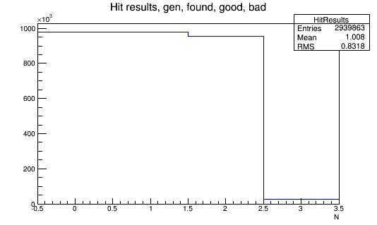
Hit Efficiency
Gen Hits
that matched
to reco Hits
used 10σ
To pick up
Bad hits
100% Eff
Gen Hits
98% Eff
98%
2-3%

Slide 6
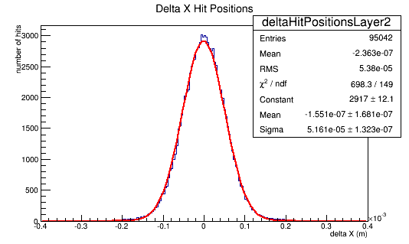
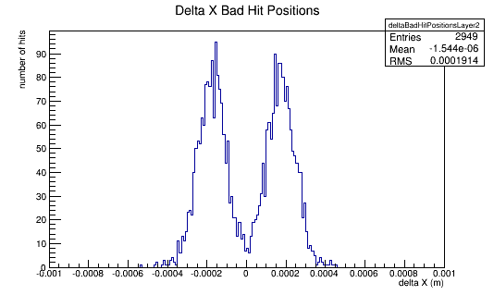
Hit Resolution
Will better bad hit resolutions do the job?
Expected ~50um
There is digitization noise. Should adjust
sensorgeometry.txt

Slide 7
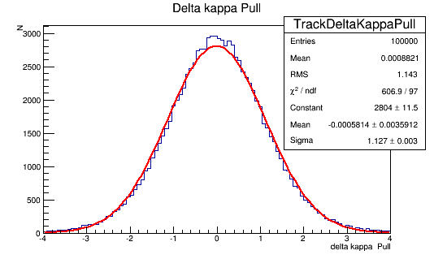
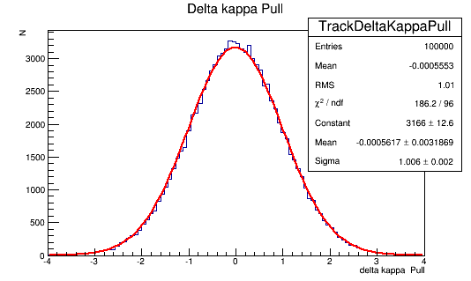
Perfect Tracking
Results use perfect tracking. Matches reconstructed Hits to GenHits to find best set of reconstructed hits
Track parameters were misestimated by 12%-17% and slightly non Gaussian
After applying the new resolution the fit results are unbiased and well estimated.

Slide 8
Perfect Tracking
Results use perfect tracking. Matches reconstructed Hits to GenHits to find best set of reconstructed hits
Track parameters were misestimated by 12%-17% and slightly non Gaussian
After applying the new resolution the fit results are unbiased and well estimated.

Slide 9
Is the the best solution?
Track reconstruction often involves interactively searching through all the layers.
The search is performed in windows based intersection of the helix with the next layer and the estimated uncertainties on that intersection location.
Bad hits will lead to larger windows and biased positions
A solution is to record that you found a hit so you can keep track of whether you have found all the expected hits, but to not add the hits to track fit.
The Hits has a goodHit flag so it is easy to implement this solution.

Slide 10
FNAL Software School: Lecture 3 Track Candidate Finding
Matt Herndon,
University of Wisconsin – Madison

Slide 11
Track reconstruction Problem
Typical track reconstruction
Find an initial candidate track helix
Three points define a circle in the plane orthogonal to the magnetic field: r-phi (x-y) view
Two points define a line in the r-z view
In our case five Hits 3X and 2 Z or SAS
Minimal set of information needed to define the helix trajectory
Use that helix to define the locations to look for hits in the other layers
Iterate through all the layers.
Fit all hits to form the final track

Slide 12
Track Candidates
X-Y view:
Looking down the Z axis, the axis of the magnetic Field
Y-Z view:
Straight line
F = qv x B
No effect on z momentum
4
3
2
1
0
9
8
7
6
Which layers to use for cands?:
4, outer layer has best angular resolution
0,1,3 equal, 2 is the worst
SAS 8,9 are have less ambiguity when combined with 4,3
Many combinations would have to be searched to allow for inefficiency on any one layer.
5

Slide 13
Detector design
Detector design and tracking
For this detector pairs of layers with SAS strips will drive the initial tracking phase
If there are hits on both layers of an X,SAS pair you can check whether the strips intersect.
At 1 degree you an SAS strip only overlaps 1.1% of the X strips
X,SAS
X,Z
With 10 track all the pairing are likely to be unique. Even with more there wont be many ambiguous pairing unless you have 100
Without the overlap you would have to test 100 pairings instead of one or two.

Slide 14
Track Candidates
Another solution using 3 hits
Using the primary vertex
Good: no inefficiency to find PV
Bad: what if the particles did not come from a primary vertex
Long lived particle decay products
No primary vertex – neutrino physics
2X1SAS algorithm
Use PV
Search 4, 3 and 9
Combination of 4+9 reduces conbinatorics and gives a Z position
Does not allow for inefficiency!
Should be interesting to compare and test for:
Inefficiency: overall and vs dR or dZ
execution speed

Slide 15
The Helix
The track candidate will allow us to generate an initial Helix
There are many ways to parameterize a helix
An initial starting point, the momentum, and the magnetic field.
We want a parameterization that will be optimal for track fitting
Helix parameterization: follows physics/1305.7300
Relative to a reference point a helical trajectory can be described by five parameters
dr, impact parameter in x-y. Distance of closest approach to the reference point (0,0,0) in x-y
Phi0, angle from the reference point to the point of closest approach in x.y
kappa, inverse of pT, singed to indicate handedness, + right-handed negative charge, - left-handed positive charge.
dz distance of closest approach to the reference point in z
tanLambda= cot(theta) pz/PT where theta is the angle to the positive z axis
These choices avoid several issues: Example: kappa goes to zero for very high pT tracks and changes sign smoothly
κ,1/R
φ₀
dr

Slide 16
Track reconstruction and Hits
Hit resolution is a critical issue in track reconstruction
Hit resolutions are needed to understand how big an area must be searched for hits on each layer.
Hit resolutions are needed to perform the final track fit
With poorly understood resolutions track fit will calculate incorrect uncertainties
You will search for hits in an area that is too large or too small
Your physics analysis will not be reliable

Slide 17
The TrackFit
A conceptually simple Chi2 fit
Input: Hit position and hit resolutions (and an initial helix)
The fit
Given a helix determine residuals between the helix and the hits on each layer
Determine a chi2 based on the resolution of the hits
Determine what changes in all 5 helix parameters change the chi2 by one unit. Essentially the derivatives of the helix parameters. An analytically solvable problem using matrix math.
Alter the all 5 track parameters to improve the chi2 and recalculate. The change to apply analytically calculable using the derivative matrices above.
Iterate progressively reducing the size of the alteration each time.
Typically converges in 10 iterations in our code!
Output: A Track
Final helix parameters
Covariance matrix – diagonal elements give the 1σ uncertainties on the parameters based on the matrix calculations above
Chi2 and nDof
Also can calculate uncertainties at any point along the helix
The input that directly effects the uncertainties is the hit resolutions

Slide 18
The Objects and Algorithms
chooseHitsForIntialization
Input: Hits(TVector3)
and resolutions
initializeHelix
Helix(TVectorD)
TrackFit:
fitToHelix
Helix(TVectorD),covMatrix(TMatrixD)
buildTrack
controls the process
Output: Track

Slide 19
Algorithm Abstraction ☺
Input: Hits
Full Track needed to calculate uncertainties and define windows to look for more hits
What you do:
Give candidate Hits to BuildTrack and it makes a Track
Output: Track

Slide 20
Design Choices
Design choices
Use of TVector and TMatrix allows a large part of the math be reduced to Matrix multiplication
The internal functions of the objects perform the multiplication, transpose and inversion operations
The track fit follows physics/1305.7300
The article explains the fit in terms of matrices that must be constructed and then transposed, inverted and multiplied
The code reads exactly that way
Algorithm abstraction
Allows the code to structured to follow the logical steps outlined in the article

Slide 21
Design Choices
Design choicesL Free functions
Most of the parts of the trackFit are free functions
InitializeHelix can by used to make a helix for the TrackCandidateStrategy
Derivative calculations are used to find uncertainties on the intersection with a layer
intersectWithPlane used to place hits in the simulation Modules
Two above used to calculate residuals between the track and hit on layers and test that track parameter uncertainties are well measured.
Coordinate transformations are used in many places.
Free functions are used extensively where even compact calculation has to done that has utility in many places.
The std library is primarily composed of free functions

Slide 22
Course Goal Revisited
Goal
Learn how to write well designed and effective reconstruction software that integrates well into a large scale computing project
What does that mean?
Follows best practices
Many of the best practices are there to facilitate the elements of the goal.
Easy to read
A user or other developer can read and understand quickly what your code does.
Easy to maintain
Need to improve something? Well designed code will often let you do so with a change at a single point without effecting any of the classes and functions that use the code you’ve changed.
Simple
The simplest solution is used when various solutions are equally effective.
Safe
Data elements are safe from being altered when they should not be.
Fast uses minimal memory, Not really
A fact of particle physics computing is that we deal with large data sets and are CPU and memory limited.
Effective
Defined in terms of the project goal. In reconstruction typically, efficient, accurate, and low fake rate (reconstruction of Hits, Tracks that don’t exist!) reconstruction of objects.
Track
Fitting

Slide 23
Tracking
A complex reconstruction task
Design considerations
Identify the primary logical steps
Simplifies our understanding of the problems
These will likely be at the Module level
Allows assessment of the performance of each step since we can write the results to objects and use them in a histogramming module
Identify subtasks
Is the problem complex enough that we need a hierarchy of task(yes)
Are task unique? One member function.
Are they performed in several places. Free functions.
Do they have similar structure.

Slide 24
Tracking Hierarchy
Candidate reconstruction: TrackCandidateModule
Find the initial helix used to search for hits.
Module level since we need to evaluate the success of this task, without the candidate we can’t proceed to find the track.
Specific candidate strategies: TrackCandidateStrategy
A class used in TrackCandidateModule since it is complex
Probably several versions, but all with the same general structure.
Find the hits to build the candidate: findHitCandidates
Calls goodCandidate that evaluates the quality: free function
Build track given the Hits
Needed to estimate uncertainties for the next step.
Calls goodCandidate since more information is available to evaluate the candidate.

Slide 25
Candidate Finding
Module: TrackCandidateModule
Input: reconstructed HitSet
Ouput: TrackSet of track candidates
A full TrackSet so we can examine it to access performance
Algorithm
Class: TrackCanidateStrategy2X1SAS
findHitCanidates
Loops over layers over the HitSet and forms all combinations of Hits on layers 4,3,9
calls intersectStrips to determine if an SAS hit is consistent with an X Hit
The overlap is 1.1% of the detector. Removes many candidates
Calls initializHelix to make a Helix
Calls goodCandidate based on a TrackingSelector to decide whether to keep the candidate
Builds candidates using buildTrack

Slide 26
Project Specifications
Track Candidate Finding
Project Goal
1) Improve TrackCandidateStragegy2X1SAS to search additional layers in case of detector inefficiency.
Input: HitSet
Output: TrackSet of track candidates
Using
TrackCandidateStrategy2X1SAS??
Make a copy of the other strategy renamed
Account for hit finding inefficiency. i.e. make candidates using at least one more layer 4,3 , 4,1 and 3,1. Try more than one SAS layers as well 9 and 8 as appropriate. Make all combinations that include an X, SAS pair.
Code
You will produce a findHitCanidates function with appropriate use of
intersectStrips, initializHelix, goodCandidate
Simple performance evaluations
Size of the candidate list (in printout)
Run gprof to profile and get execution time of various modules. Compare TrackCandidateStrategy2X1SAS and new strategy

Slide 27
Backup

Slide 28
Tracking Hierarchy
Track reconstruction: TrackRecoModule
Module level since we need to evaluate the success of this task
Search for hits on each layer in turn: Layerfinder
A class because of the complexity.
Find all candidate hits for one track on one layer: findHits
Build the tracks: buildTracks
Call goodCandidate to evaluate quality.
Call contentionFilter that chooses best possibilities
Call goodCandidate to evaluate quality
Call contentionFiler that chooses best posibillities.

