Slide 1
FNAL Software School Day 5
Matt Herndon,
University of Wisconsin – Madison

Slide 2
Today’s Activities
Review Day 4 exercise
Performance of TrackCandidateStrategy2X1SASML
ML searches multiple combinations of layers
Lecture
Tracking performance
Review of software engineering principles
Daily project:
Time to run track reconstruction!
Profiler demonstration at 1PM
Should not be a long day

Slide 3
Track Candidates
ML searches multiple combinations of layers
Add redundancy so that at least one candidate is found for each real track
However, 4 candidates can be found for each real track. They will be eliminated later during track reconstruction.

Slide 4
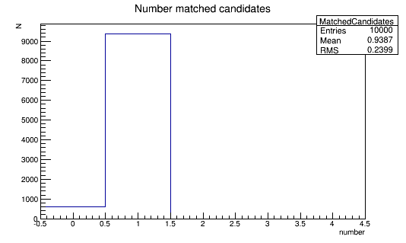
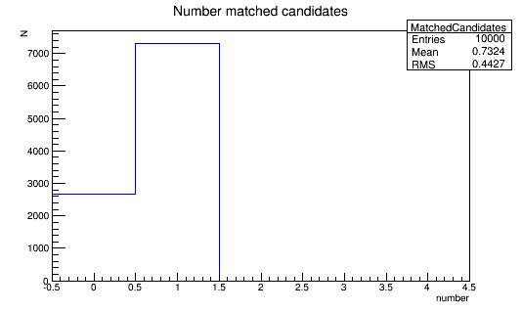
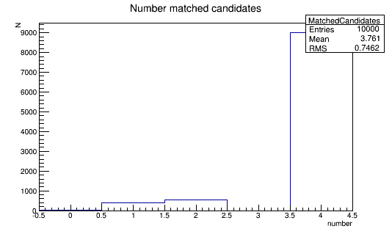
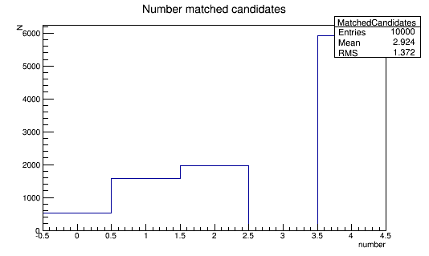
Track Candidates
98%
6% complete
Failure rate
90%,
30% complete
failure rate
ML 90%,
Only 5%
failures
ML 98%,
Almost 0
failures

Slide 5
FNAL Software School: Lecture 5 Track Reconstruction and Software Engineering
Matt Herndon,
University of Wisconsin – Madison

Slide 6
Data and Algorithm Abstractions
The DataObjects in our code represent a hierarchy of abstractions.
Tracks (class)
Helix (class)
Covariance Matrix (TMatrixD)
Hits (Vector of indices)
Helix Parameters(TVectorD)
Uncertainties, Covariance's
Hit
Hit
Hit
A user just sees clearly named functions that get the various classes or values. As the developer you can then choose the underlying containers and classes and even change them
Requires developers and users to follow best practices like using auto const & loops
N Strips, Positions(TVector3)

Slide 7
Algorithm Abstraction
Consider our clustering algorithm
constructsHits
(loop over layers)
findClustersOnLayer
(loop over strips)
test if adjacent
add to single cluster adc vector if adjacent
add single cluster adc vector to vector of clusters if not adjacent
buildHit
calculateStripPositionFromCluster
calculateLocalFromStripPosition
calculateGlobalFromLocalPosition
make the Hit using Hit constructor
(end loop over strips)
(end loop over layers)
Operations like those in buildHit are encapsulated and abstracted away from the user. buildHit then serves as the single correct way to make a hits.
The top level of algorithm abstraction are the Modules which are designed for a single task.

Slide 8
Data Safety
Consider the HitSet
Data encapsulation and const correctness in Hit and Hitset
All the member data is private
Access to values only through “const” get functions. const reference if a larger object – not a pointer!
An accidental “hit._layer = 3” rather than hit._layer == 3” is not possible.
Only necessary non const member is insertHit
Initializer syntax
All Hit private member initialized in constructor via the initialization list
The user can’t forget to initialize something
No non const functions needed to set the data members. Data can not be changed after it is created.
Faster. The constructor will default initialize anything not in the list. If you initialize it in the body of the constructor or later it gets initialized twice.
Enforced by the event framework which returns all event data objects as const
Also use for algorithm code and module classes that produce and consume data.
In your own code you don’t want to accidently alter the data objects your are creating and using

Slide 9
Integrated Design
Performance assessment has to be built into the system from the beginning.
Required correct choices in data object design and a full set of performance assessment Modules designed to work with the reconstruction modules
In reconstruction the elements of performance assessment are the core of your project goals
You want to achieve excellent efficiency, accuracy of both parameters and uncertainties, low fake rate, and fast execution speed with low memory use
Also you have to design for issues like
Input and output of data
Calibration and application of calibrations
Automated testing of the code

Slide 10
Why do all this
const correctness
Data safety
Initializer constructor calls
A user can’t incorrectly construct the object neglecting to fill in certain information
Data safety
Faster
Const references for access to all Objects instead of pointers
Data safety
Avoid segmentation faults and memory leaks
Algorithm abstraction
Better organized and readable code
Maintainability: Allows upgrades to underlying methods without effecting users
Integrated design
Plan and design in advance so that your software includes methods both meet and to test/demonstrate the project goals are met. Typically requires infrastructure that spans the dataObjects and algorithm code

Slide 11
Course Goal Revisited
Goal
Learn how to write well designed and effective reconstruction software that integrates well into a large scale computing project
What does that mean?
Follows best practices
Many of the best practices are there to facilitate the elements of the goal.
Easy to read
A user or other developer can read and understand quickly what your code does.
Easy to maintain
Need to improve something? Well designed code will often let you do so with a change at a single point without effecting any of the classes and functions that use the code you’ve changed.
Simple
The simplest solution is used when various solutions are equally effective.
Safe
Data elements are safe from being altered when they should not be.
Fast uses minimal memory
A fact of particle physics computing is that we deal with large data sets and are CPU and memory limited.
Effective
Defined in terms of the project goal. In reconstruction typically, efficient, accurate, and low fake rate (reconstruction of Hits, Tracks that don’t exist!) reconstruction of objects
✓
✓
✓
✓
✓
✓
✓

Slide 12
Tracking
We now have an initial seed track
Iterate searching for hits in each layers
The track parameters are used to predict where to look for hits
9
4
8
3
7
2
6
1
5
0
The estimated uncertainties determine how wide a region to search
Refit adding each hit
Improves the estimation of parameters when looking for the next hit
Apply quality criteria at each step to remove fake tracks
Compare all tracks at the end to select the best ones

Slide 13
Tracking Hierarchy
Track reconstruction: TrackRecoModule
Module level since we need to evaluate the success of this task
TrackRecoModule
TrackRecoStrategy2X1SAS (recoTracks)
1 LayerFinder (findTracks)
2 contentionTrackSetFilter
a findTrack
b simpleTrackSetFilter
once
i findHits
c duplicateTrackSetFilter
ii buildTracks
a-c For 10 layers
i-iv
For n
tracks
iii goodTrack (Selector)
iv bestTracks (Filter)

Slide 14
Controlling Tracking
Several places you can tune the tracking to improve performance
Order that layers are called
TrackRecoStrategy2X1SAS (findTracks)
Whether to call the contentionFilter after each or specific layers
TrackRecoStrategy2X1SAS (findTracks)
chi2NDof and minPt cuts used in goodTrack selectors
configurereco.txt

Slide 15
Controlling Tracking
Some general ideas
Order of layer search is important
Once the layers used in Candidate construction are searched the duplicateFilter will remove most of the the multiple patterns searched.
Search windows are determined by using the helix parameter uncertainties to calculate an uncertainty window on the next layer. You should avoid extrapolating over many layers.
The resolutions of candidates are different in X and Z. Large uncertainties will mean large search windows. You could search the layers with small uncertainties first.
Cutting very tightly on chi2NDof or using the contentionFilter early can reduce efficiency, but may boost performance

Slide 16
Performance Assessment
Assess
Efficiency
Accuracy of parameters and uncertainties
Fake object rate
Execution speed and memory usage
A General principal
Need a mechanism of unambiguously associating reconstructed objects to generated ones to assess efficiency, resolution and fake rate.
Helix matching works well with reconstructed tracks.
Δ(gen-reco)/σ for all five track parameters
Efficiency and fake rate
Select on Δ(gen-reco)/σ for all 5 track parameters
Eff: = (matched Reco)/(Gen)
Fake = (unmatched Reco)/Reco

Slide 17
Todays Project
Performance assessment of tracking
Update youe FNALComp project
Edit TrackCompareWithGenModule
Insert counter to keep track of, genTracks, recoTracks, recoTracks matched to gen
Print out efficiency and fake rate in endjob
Consider the tolerance used for matching tracks. Remember you are matching 5 parameters, so 3sigma would have a noticeable effect when repeated 5 times.
Performance assessment
Determine execution speed – run by typing: time ./trackReco > logfile
Determine how many 10 track events you can run in order 1 minute (~100 on my computer)
Measure eff and fake rate
Look at histograms from TrackCompareWithGenModule
Start adjusting the tracking parameters. You should be able to get a factor of 2 in speed. Eff, fake rate, speed should be your three metrics

