Slide 1
LArSoft Project Status Current Items – for further correction/discussion
Experiment responsibles for nightly builds monitoring/validation:
LBNE – Still in progress
Uboone – Herb, Eric
Milestones

Slide 2
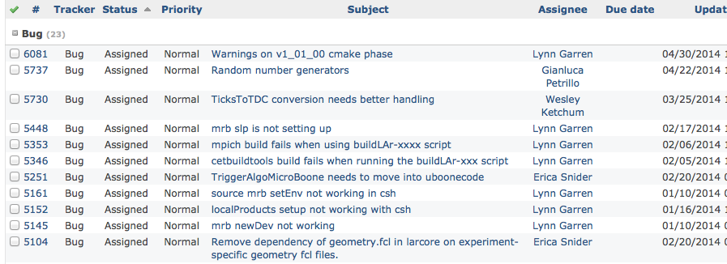
Current “un-resolved” Issue Status
Will start to add Due Date to the Redmine list

Slide 3
Feature Requests

Slide 4
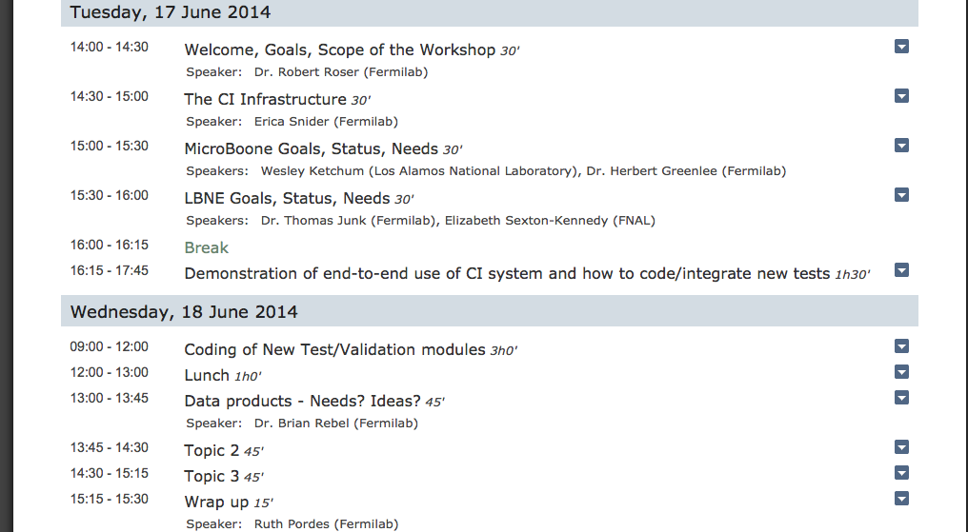
DRAFT agenda for Workshop?

