Slide 1
Status update for the Mu2e Resonant Extraction
V. Nagaslaev
Muon department meeting
05/29/2014

Slide 2
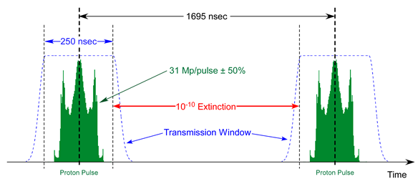
Introduction
Slow spill extraction is a fundamental part of the Mu2e beam delivery scheme as it uniquely provides the needed time structure of pulses
On the flip side this brings a challenge for the high intensity proton machine, due to its inherent beam losses and radiation protection issues
Third integer resonance extraction is chosen because it provides the opportunity to minimize losses

Slide 3
RE main parameters

Slide 4
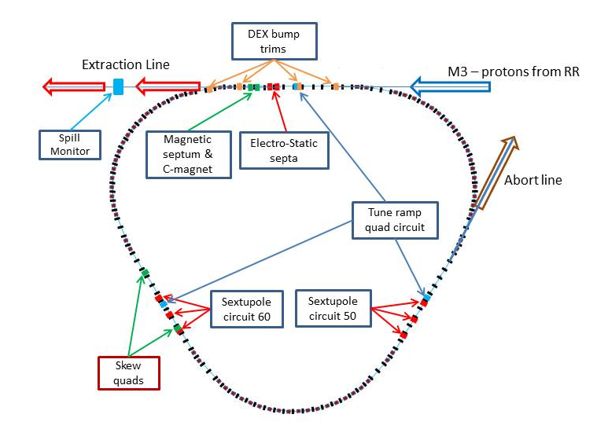
RE main elements
The map of slow extraction in the DR
Tune ramp quads (3)
Sextupoles (2x3)
ES septa (2)
DEX bump trims (4)
RFKO kicker (1)
Spill Monitor (1)
Spill Regulation (NS)
Skew quads (2)
Slow extraction is achieved by : “…creating a resonance condition that destabilizes part of the beam in a controlled way.” (Mu2e TDR)
The challenge is to “dribble the spill to the experiment with minimum spills in the ring enclosure”.

Slide 5
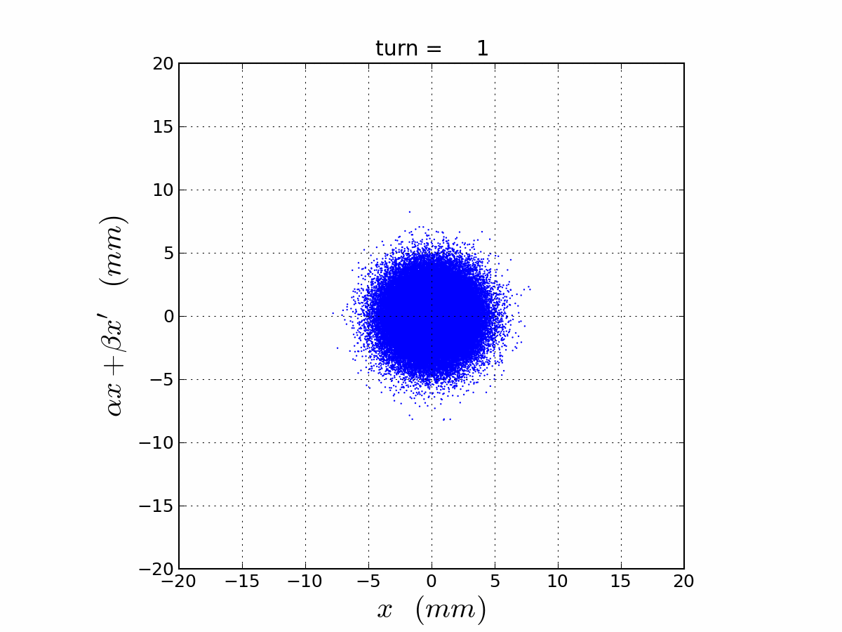
Onset of the sextupole dynamic aperture
Transition of the normalized beam phase space to resonant conditions
Important term: the separatrix

Slide 6
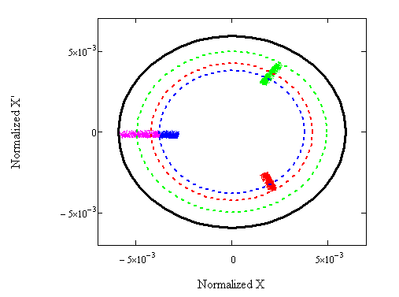
Other essential terms of spill control
Separatrix orientation
Offset at the septum
  Dynamic bump
Step size
Losses in the ring
Normalized X’
Septum

Slide 7
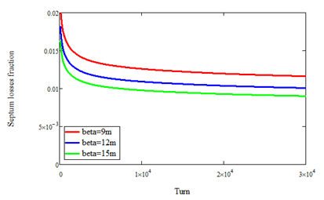
Step size and efficiency
Intuitively:
More accurately:
Obviously, efficiency strongly depends on the beam X-dimension, especially in the beginning of the spill.
It is important to preserve low beam emittance at injection to the Delivery Ring. (1st reason)

Slide 8
Magnets for Resonant Extraction: ramped quads
Best choice of quad locations – in points of symmetry, in the middle of straight sections. This ensures low harmonic content, although it is not clear how much that is important.
For 3 magnets the max strength, current and the dependence on time can be calculated, full specs shown here:
Magnet | Quantity | Base* Integrated gradient | Integrated gradient excursion | Base* Current, [A] | Max Current Excursion, [A] | Max supply Current [A] | Max dI/dt [A/sec]
Tune Quad | 3 | 0 | 0.2 T | 0 | 80 | 100 | 16,000
Magnet | N | Imax, [A] | I_base, [A] | DI, [A] | Max dI/dt [A/sec] | Regulation accuracy, % | Regulation stability | Curve accuracy | Ripple, %
Tune Quad (CQA) | 3 | 100 | 0 | 80 | 16,000 | <0.5% | <0.5% | <0.5% | <0.05%

Slide 9
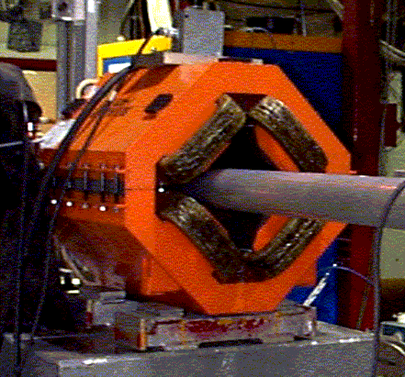
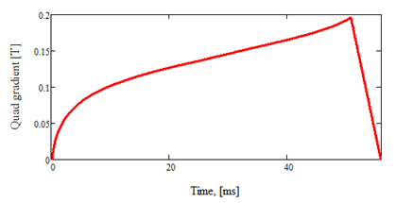
Magnets for Resonant Extraction: ramped quads
These specs are satisfied by using the CQA type quad magnets. These magnets exist in abundance in the lab storage and can be brought up with minimum preparation cost. The model AC stability analysis yielded positive conclusion. Nevertheless, AC tests will be performed upon readiness of the PS prototype.
PS is based on the Booster switching mode units, no technical challenges expected.
AC tests will complete the final design on magnets and PS.

Slide 10
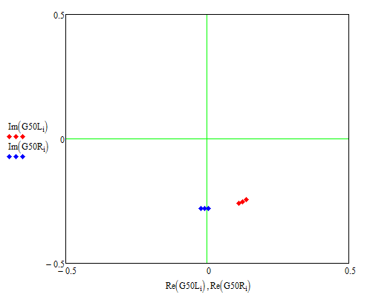
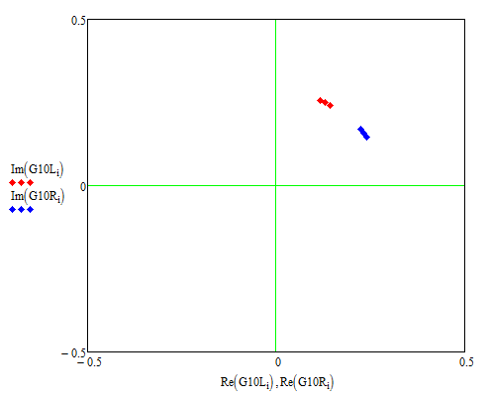
Magnets for Resonant Extraction: sextupoles
Figure of merit - sextupole resonance coupling strength:
2 orthogonal circuits for best control
Must be in D-free region.
Straight sectors 10,60,50 are the only available
Due to 60° lattice feature any location at focusing quads is suitable. Locations at 1-3-5 considered
Closer to the end (ESS) is desirable
SS-10 is equivalent to SS-60
Ideal lattice assumed
Preferred configuration: 50L and 60R

Slide 11
Sextupole magnets and PS specs
Main magnet and PS parameters
Magnet | Quantity | Base* Integrated gradient | Integrated gradient excursion | Base* Current, [A] | Max Current Excursion, [A] | Max supply Current [A] | Max dI/dt [A/sec]
Sextupole | 6 | 80 T/m | 32 T/m | 200 | +-80 | 300 | 16,000
Magnet | N | Imax, [A] | I_base, [A] | DI, [A] | Max dI/dt [A/sec] | Regulation accuracy, % | Regulation stability | Curve accuracy | Ripple, %
Sextupole (ISA) | 6 | 300 | 200 | +/-80 | 16,000 | <0.5% | <0.5% | <0.5% | <1%

Slide 12
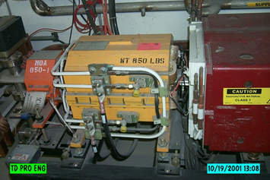
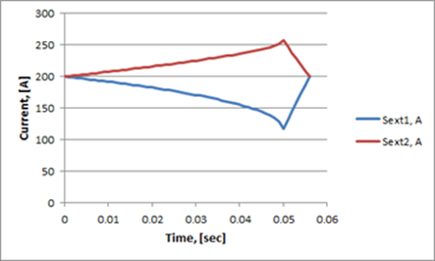
Sextupole magnet and PS design
Specs satisfied with ISA type
Will have to fabricate new
Baseline design of RE has no sextupole ramp, however want to have ramping capability available
Cost impact of AC version is low
One possible scenario where ramp is needed is if Dynamic bump is not feasible
S-ramp would be used to rotate the separatrix and keep its X’ constant at the septum.
PS design is based on Booster switchers and satisfies this representative ramp
PS prototype will be built for the magnet AC tests. This will complete the final design on magnets and PS.

Slide 13
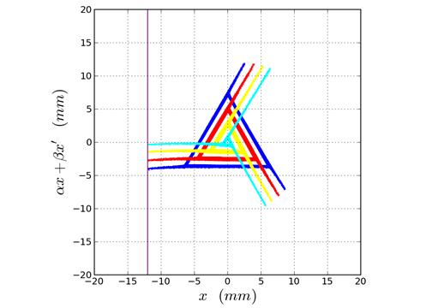
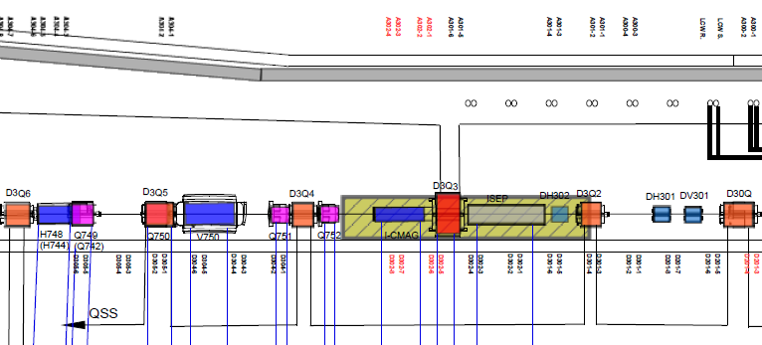
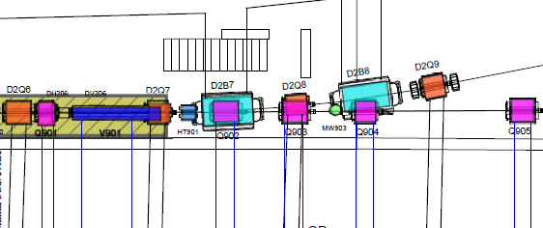
Magnets for Resonant Extraction: DEX bump
Angle bump at ESS1 location
Bump dynamic ramping is necessary to compensate for extracted beam angle change → DEX bump
4-bump as much as possible local
Very tight space constraints in DSS-30
Bump is realized with existing Debuncher NDB magnets D:H301; D:H302 moved to 305; D:H206 and a new D:H209
All designated magnets are operational
Septum
H209
H206
H305
H301

Slide 14
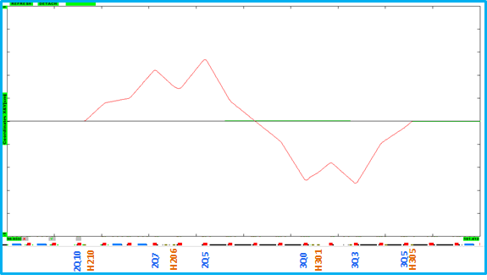
Magnets for Resonant Extraction: DEX bump
Magnet | Quantity | Base* Integrated gradient | Integrated gradient excursion | Base* Current, [A] | Max Current Excursion, [A] | Max supply Current [A] | Max dI/dt [A/sec]
DEX Trim (NDB) | 4 | ND | 0.014 Tm | ND | 14 | +-40 | 1,400
Magnet | N | Imax, [A] | I_base, [A] | DI, [A] | Max dI/dt [A/sec] | Regulation accuracy, % | Regulation stability | Curve accuracy | Ripple, %
DEX Trim (NDB) | 4 | +/-40 | ND | +/-14 | 2,800 | <1% | <1% | <1% | <1%
Angle bump at Q203 causes substantial orbit deviations up to ~5mm at focusing quads within its length. This may become an aperture issue in case of a poor orbit control.

Slide 15
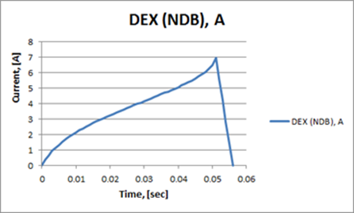
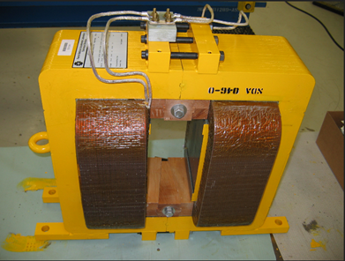
Magnets for Resonant Extraction: DEX bump
dI/dt determined by reset time
Very high driving voltage (700V)
Power supply solution – Booster switchers upgraded with higher voltage FETs and filter, capable to output 350V; 2 magnet coils powered in parallel
Prototyping needed to verify this solution
Possible magnet issues if lamination is not good enough
Magnets will be tested with the prototype PS
This will complete the final design on DEX bump correctors

Slide 16
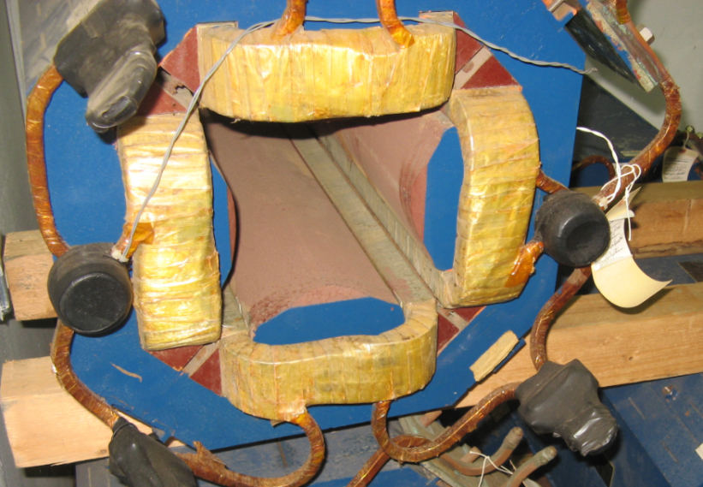
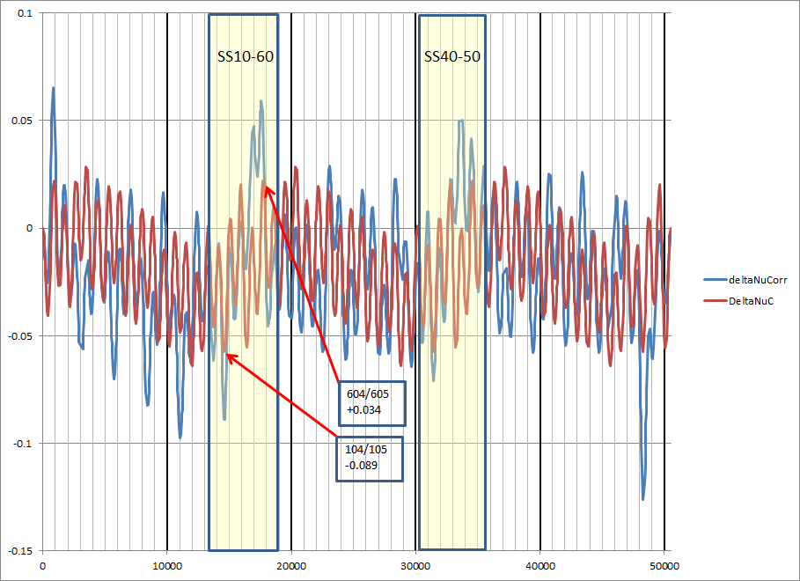
Magnets for Resonant Extraction: skew quads
Want to have coupling control in the DR
No other Mu2e scope to put in
Locations: need phase advance Ψx-Ψy=π/2 +k*π
Harder choice in DR vs ACC - suggested sQ104, sQ604
Free operational SQs from Accumulator
Existing PS
Only relocation cost to pay

Slide 17
Side note on corrector magnets
Trim magnets can be used for orbit control, aperture studies and lattice measurements
Historically Debuncher used to have a few trims, especially in vertical plane, due to the lack of available space
Both g-2 and Mu2e will benefit from more trims, and there is space available
In my opinion, g-2 absolutely needs more correctors…

Slide 18
Septum program
Experience at Fermilab
  Wires
  HV up to 100kV
  Low beam intensities
  Last septum built in 19.., since then all the tooling and handling expertise lost
New experience to be built:
  Foils –
    More stable mechanically
    Higher HV achievable
  High beam intensity
    Ion density is critical for the spark rate control
    Improve vacuum
    Reduce ion drift from the circulating beam area
  Handling experience
New design solutions:
  Foil spacing, clamping, stretching; foil removal
  Asymmetric ESS1/ESS2 length
  Diffuser plane

Slide 19
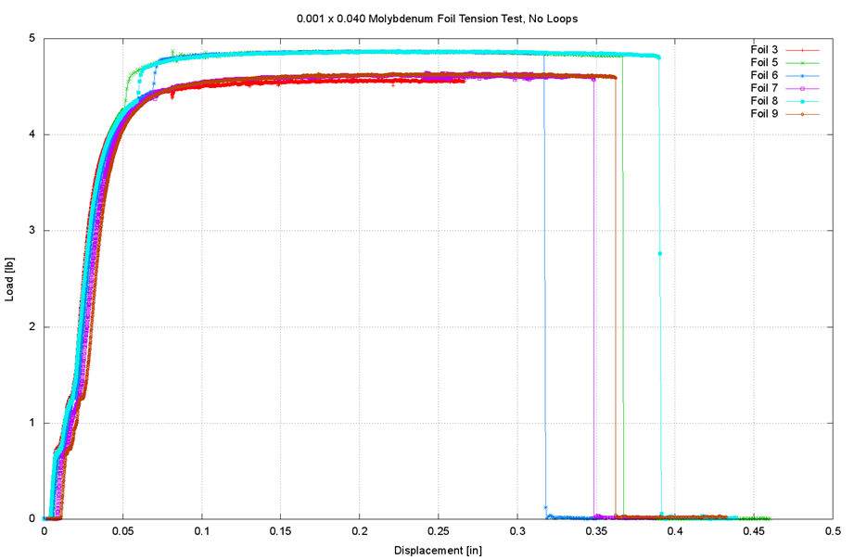
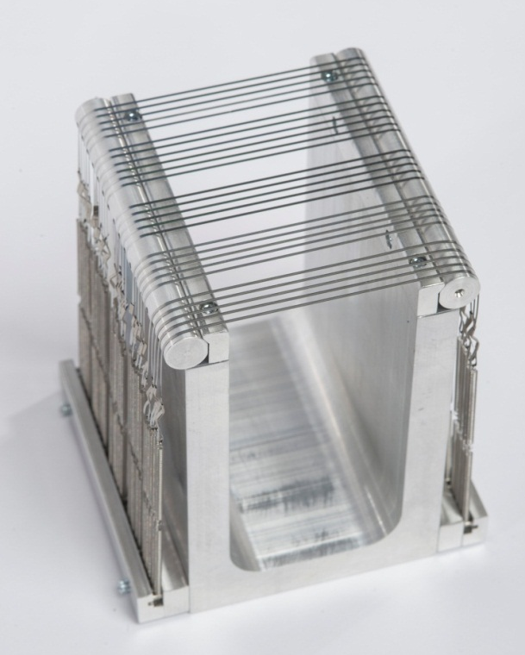
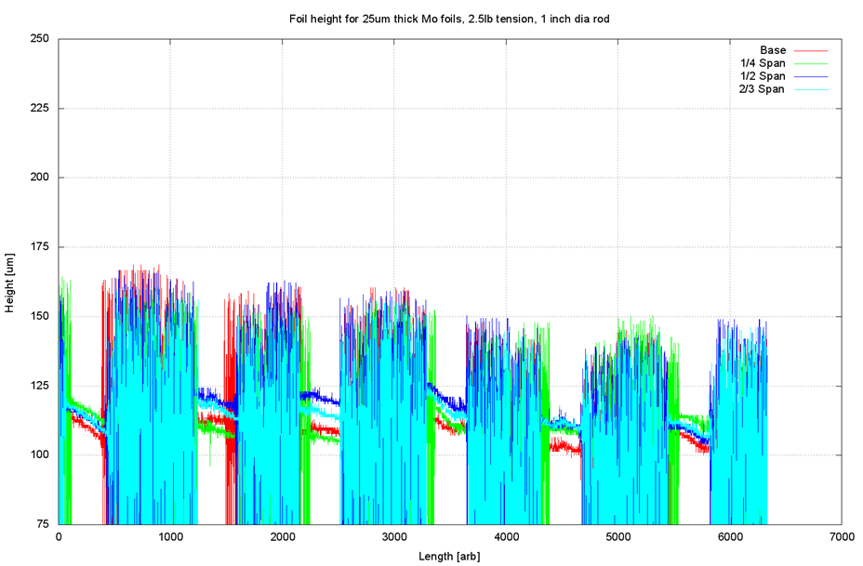
Septum R&D - Foils (Prototype-I)
Variety of foils available on market
Built a prototype to study mechanical properties, techniques for clamping, stretching, measuring.
Successful results after making 2 modifications to the scheme (B.Hartsell)

Slide 20
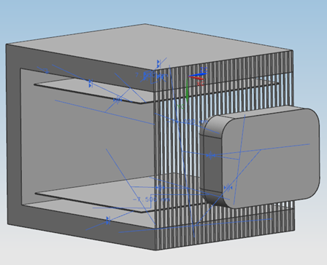
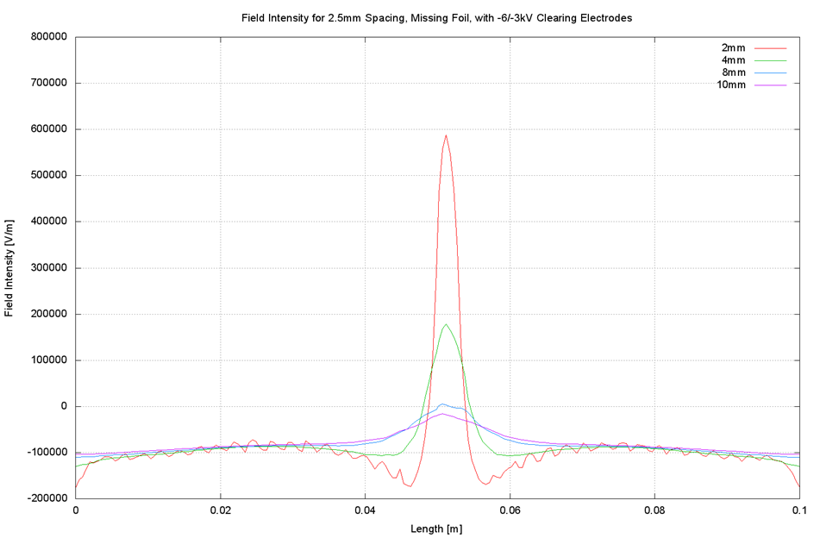
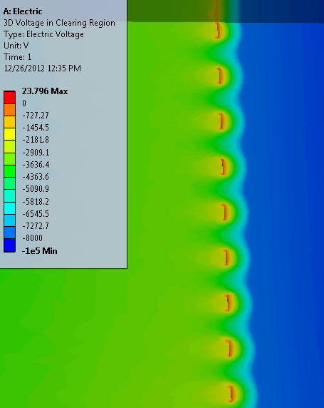
Septum R&D: FEA field calculations
ANSYS 2D and 3D E-field calculations
  Edge effects
  Clearing electrodes configuration
  Field penetration in to the circulating beam area
  Choice of an acceptable foil spacing
  Effect of a missing foil
Allowed spacing = 2.6 mm
This results in some 1200 foils in two septa

Slide 21
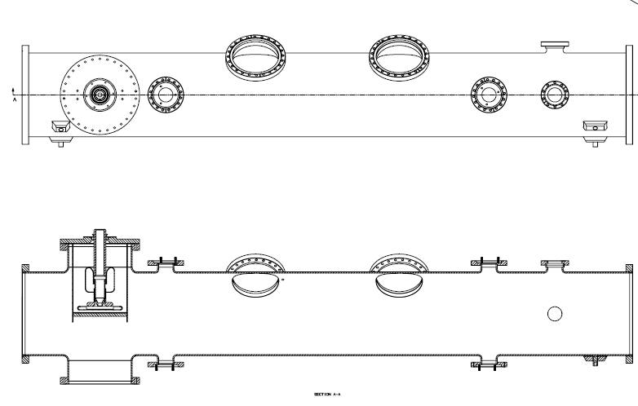
Septum R&D - Prototype-II
Prototype-II
  HV tests with foils in vacuum
  Reusing a TeV separator tank and PS
  Setting up a facility at NWA
  Step 1 – simplest configuration
  Expected to be ready for fabrication beg. June

Slide 22
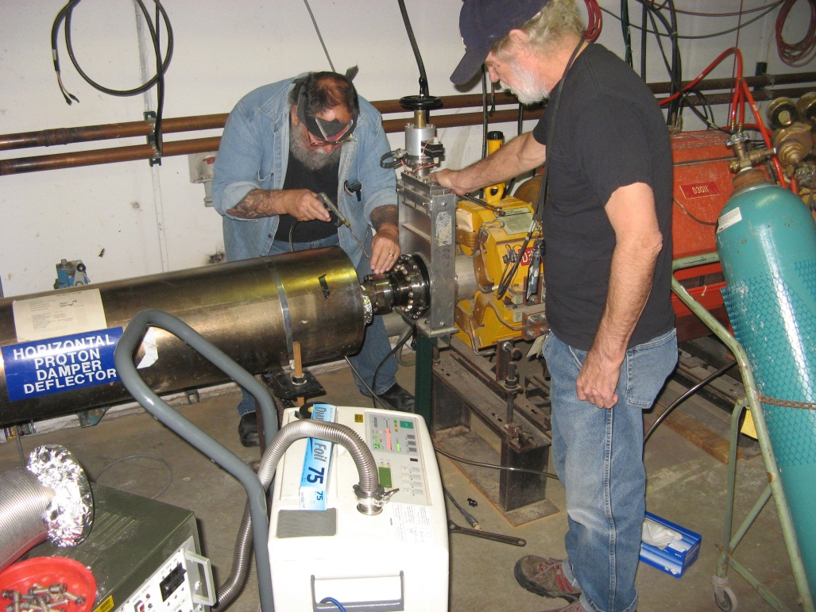
RFKO design
RFKO is the transverse heating of the beam by means of excitation of coherent beam oscillations. It was realized in the simulation studies that only chromatic tune spread can help effectively transfer coherent motion into incoherent beam heating. Therefore, non-zero chromaticity must be part of RFKO.
Kicker: suggested by D.Wildman to reuse the former TeV damper kicker
Kicker location: we used initially the 310 location for the beam studies with the RFKO kicker. There is no any physics reason why it would have to change that location.
RFKO EGR measurement: see below

Slide 23
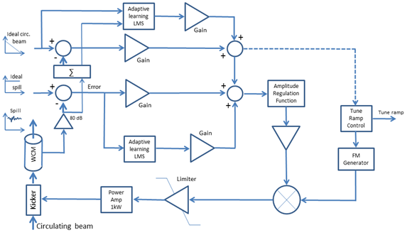
RFKO regulation design
RFKO regulation logic will potentially be using proportional, integral and derivative data from the Spill monitor and DR DCCT to form the feedback regulation signal to the kicker
Spill regulation will also use the learning algorithm to develop a feedforward curve for the tune ramping quad circuit
Bulk of the logic programming will take place after the mini-review
The only remaining in Final Design task is to prototype and test the timing module
We do have an engineer assigned to help with programming work (A.Ibrahim)

Slide 24
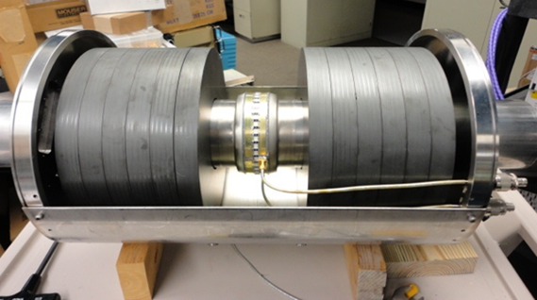
Spill monitoring
Need spill rate signal to reflect variations faster than 1 msec
Two sources of spill monitoring:
  WCM
    Designed and built by P.Prieto &Co as Mu2e R&D
    Tested with the Debuncher Rev.P. beam
    Will be given to g-2 for their intensity monitoring in DR
  UEM
    An alternative device
    UEM specs need to be enhanced to satisfy SM needs
    Design work is in a very early stage

Slide 25
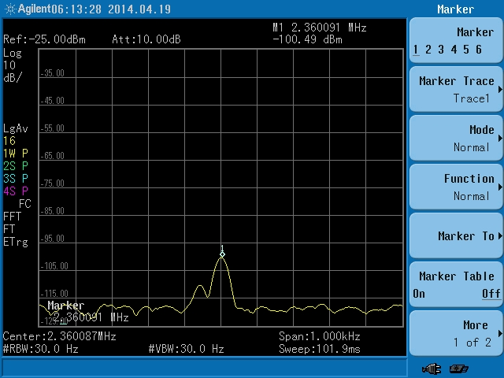
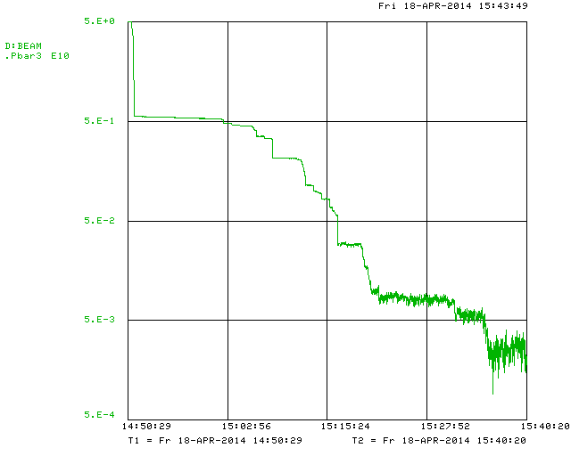
Spill monitoring: beam studies
Used a single pulse – very last RP beam in the Debuncher history
Scraped down 3 orders of magnitude: 5e10 → 5e7 protons
That’s 1.3e7 protons/bunch, 2.5MHz frequency
Observed S/N 20dB with narrow RBW and VBW
Probably doable, but -
Needs smart filtering and >100dB low noise amp
Will be challenging

Slide 26
Tracking simulations of the RE
Long ongoing effort of RE tracking simulations with Synergia. Orbit simulations have been discontinued since the CD-1 review.
Synergia claims to provide symplectic tracking of particles taking into account:
  Nonlinear fields
  Longitudinal RF fields
  Space charge
  RFKO fields
  Tune ramping
  DEX bump ramping
It also has a set of optimization tools, runs in parallel jobs on a ~1000 CPU processor farm. It’s main disadvantage against ORBIT used to be the processing time, but that has been substantially improved since CD-1.
Main outcome:
  No known physics phenomena observed to impact extraction performance
  Observed performance is consistent with earlier ORBIT results and results of analytical model
  RFKO beam heating rates are consistent with expectations
  Linear spill demonstrated with appropriate tune quad ramp
  Extracted beam full footprint
  DEX bump magnet position optimization

Slide 27
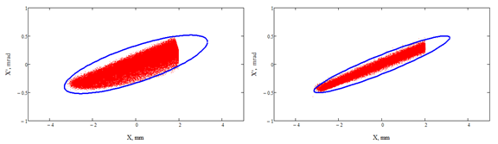
Tracking simulations of the RE
DEX bump off
ε(99.9%)=1.1 π mm-mrad
β=10m
DEX bump on
ε(99.9%)=0.6 π mm-mrad
β=18m
Tracking simulations are expected to be completed and task closed by the end of FY14

Slide 28
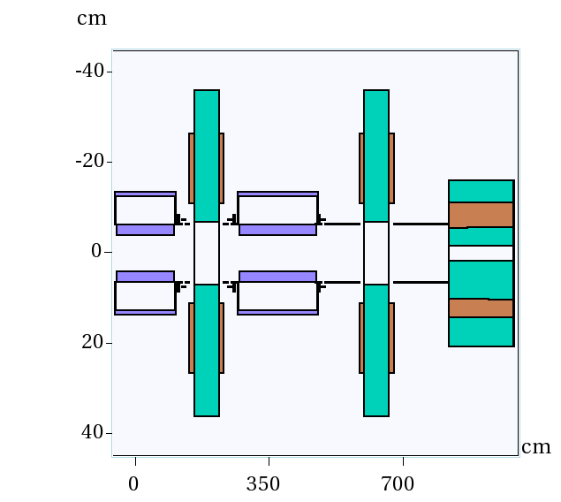
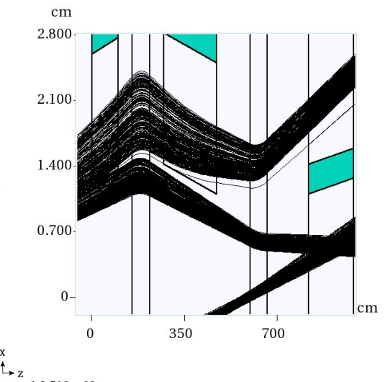
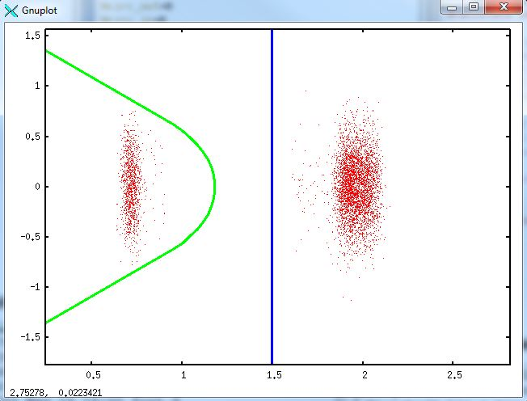
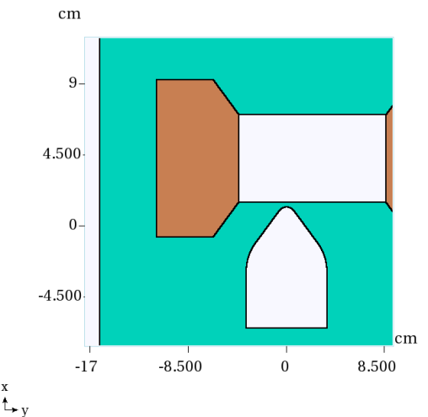
MARS simulations of the RE
Tracking particles in media and magnetic fields
Detailed calculation of interaction with materials
Radiation levels, Residual activation, Energy deposition, etc
Essential for beam loss calculations and geometry optimization
Extraction channel geometry
Tracks separation
Tight vertically!
Tracking samples
New LAM geometry

Slide 29
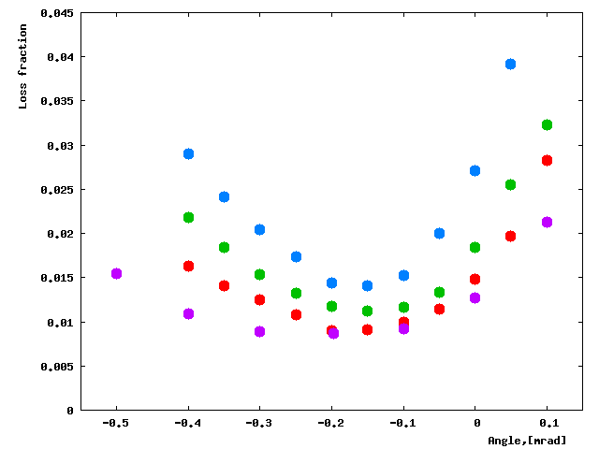
Lessons from MARS simulations
Lesson 1: Wires do not have apparent advantage over foils
Red- 50u W foils strip plane (2mm/4mm);
Green- 50u W whole foil plane;
Blue- 50u “black hole” plane;
Purple- 100u W wire plane, 2mm spacing;
Lesson 2: Optimal alignment is different from zero.
Lesson 3: Septum alignment better than 0.1mrad is required.

Slide 30
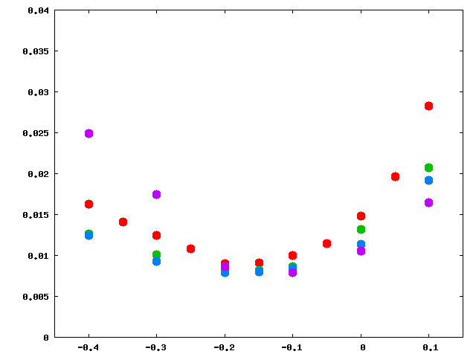
Lessons from MARS simulations
Red- 1.5m + 1.5m
Green- 1.0m + 2.0m
Blue- 0.7m + 2.3m
Purple- 0.5m + 2.5m
300u separation with L1=0.5m
No angle adjustment of ESS2 during angle scan
Assumed 1mR kick at 1.5m ESS
Lesson 4: It helps making ESS1 shorter than ESS2. Optimal ratio is 1:2

Slide 31
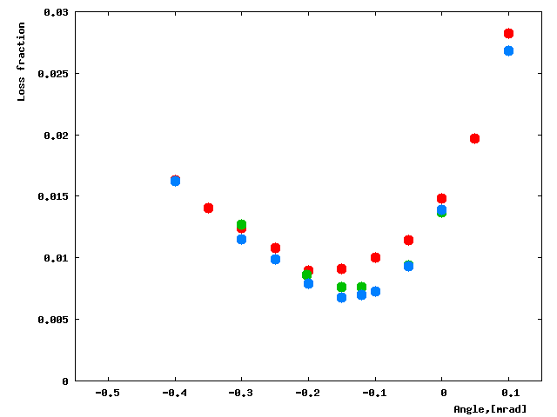
Lessons from MARS simulations
Red- 50u W foils strip plane (2mm/4mm);
Green- 6mm Carbon diffusor 250mm upstream of septum plane;
Blue- Carbon diffusor 200mm long (0.4mm/1mm)
Lesson 5: Losses do improve with use of a pre-scattering diffuser.

Slide 32
MARS simulations of the RE
The new series of MARS simulations have started. That includes updated LAM geometry and new foil geometry. It is scheduled to be finished this summer.

Slide 33
Short summary on the beam studies

Slide 34
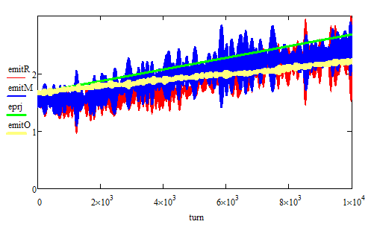
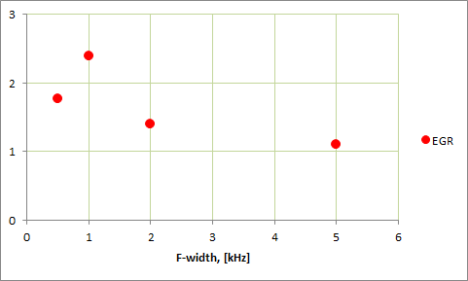
Results of the 2012 vintage studies
EGR(Calc)= 60π mm-mr/sec
EGR(Orbit)=33π mm-mr/sec
EGR(Meas) ~1.5π mm-mr/sec !!!

Slide 35
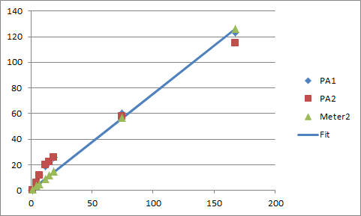
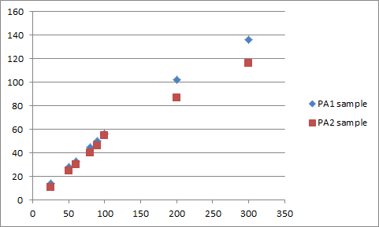
Hardware homework and lessons
Verified proper signal passage/termination beyond the kicker plates
Problems with model 250/100 → replace for a twin 250/250
Nonlinear, inconsistent gain variation control – best to set at 100%
Nonlinear internal power meter, especially at low power
Performed direct power measurement at the PA output
Some non-linearity at higher power level
RF switch has a DC input offset – requires careful matching to Gen output
Measured power vs Expected
PA control mVpp vs Gen. output
Set PAs to 100% and control the LL power; use the ext. calibration
With this recalibration, results of 2012 could be rescaled up 4-8 times

Slide 36
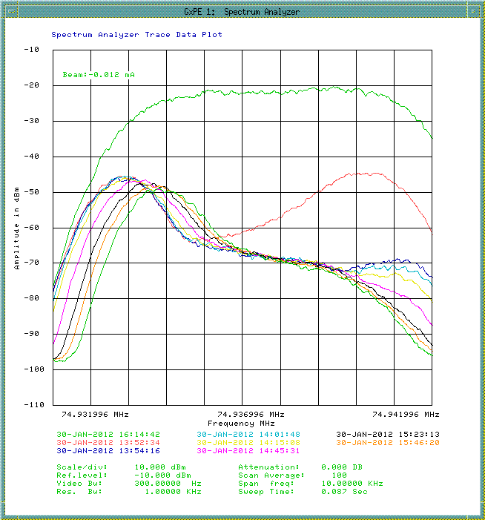
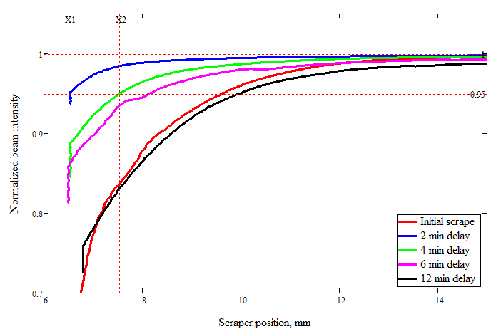
Beam quality factor
Design DR acceptance= 35 πμ
Expected beam ε₉₅= 1.6 πμ
Actual Debuncher Acceptance=20 πμ
Actual Injected beam ε₉₅= 7.5 πμ
Impedances and resonances do affect the lifetime – important! Not studied…
Substantial diffusion
Measured lifetime = 0.5-4 hr
Diffusion > 1 π−mm-mr / 2min
Slow scraper in-out time is 2 min

Slide 37
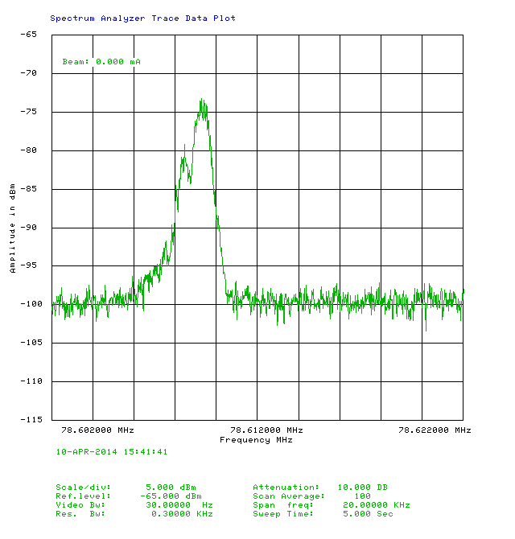
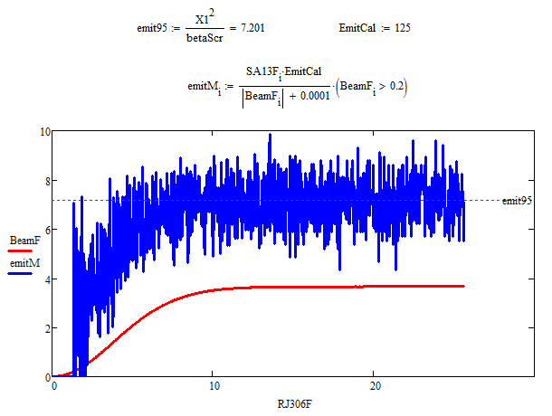
Emittance monitoring: Schottky
Total power of the Schottky sideband is proportional to beam emittance*Ibeam
SA #5 has been set to RBW=20kHz, CF=(134-Qx)*Frev, FS=0
SA5 output is read out into the ACNET and datalogged

Slide 38
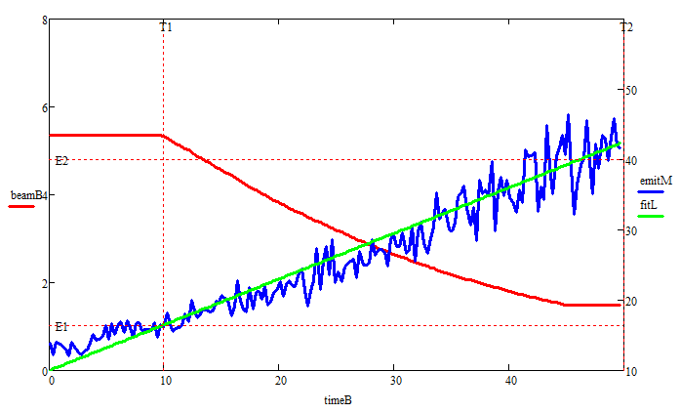
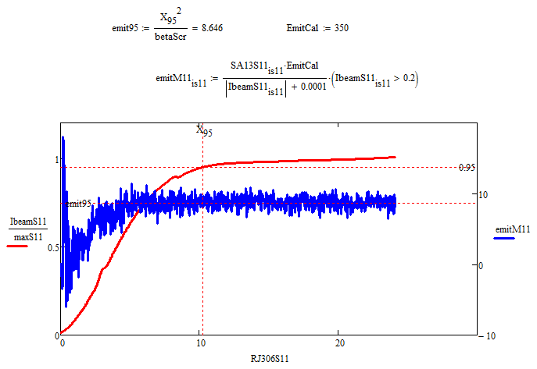
Issues with Schottky emittance monitoring
  Inconsistent calibration
  Unrealistic response
  Hard to trust

Slide 39
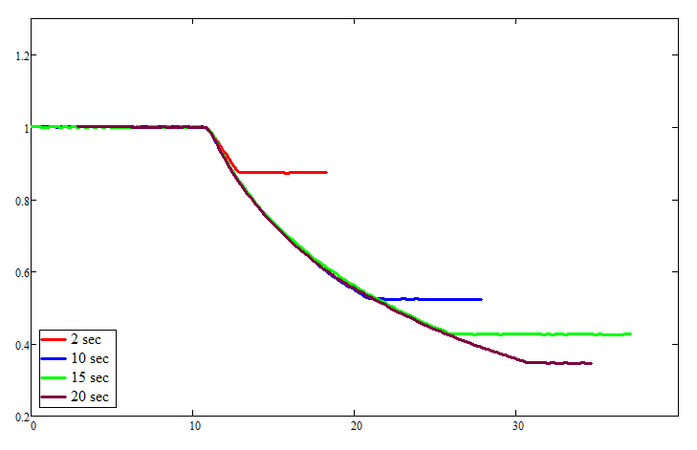

Checking profile development with scraper
Normalized beam intensity vs time
Running RFKO power with same configuration, varying duration
Pre-scraping before each shot to create similar initial state
Scraping beam down after each shot to see the profile
After some significant heating profile stops changing much
This does not support the steady emittance growth observed with the Schottly monitor
Normalized beam intensity vs scaper position

Slide 40
So how do we measure emittance growth rates?
Main issue of so far measured growth rates is that they do not nearly explain rapid beam loss rates: they’ve got to be much faster!
Intensity curves is the next thing to look at – can we derive beam profile from the intensity curves?
Turns out – that this problem has been solved analytically!

Slide 41
Beam horizontal distribution change with diffusion
Let’s assume that beam loss occurs only due to horizontal beam size growing and running on the machine aperture.
We also assume that the beam diffusion due to RFKO heating is uniform in action and tunes.
The Fokker-Planck equation in this case is
In case of free beam with no bounds this has a simple thermo-conductivity-like solution with
Machine acceptance introduces a boundary condition at I=I_{a}, where f(I_{a})=0. In this case solution is presented by the sum of Bessel function J0 harmonics:

Slide 42

Beam horizontal distribution change with diffusion
Where the time decrement for k-th harmonic is attenuated by a squared value of the k-th node.
Normally all higher harmonics should decay very fast with only the 0-th one remaining. From single exponential fit of the later curve part we determine:
This is the same run we’ve seen before, with added exponent fit. Apparently, the 0th harmonic dominates here from the beginning. Measured EGR is 3.1 μ/sec; whereas linear fit to EmitMon gives 0.65μ/sec.

Slide 43


Examples of the Intensity curve fit
04/10/2014
Δf=6kHz
04/11/2014
Δf=4kHz

Slide 44


Examples of the Intensity curve fit
04/09/2014
Δf=2kHz
Impossible to find a fit
04/09/2014
Δf=2kHz
Best fit, but there is variability
At low frequency modulation width part of the beam is not affected by RFKO, this part is not heated. This results in ambiguity in interpretation of the curve.

Slide 45

EGR from the Intensity curve fit
Note: Again, in order to compare with earlier simulation plots, measurements are rescaled to 25W of RFKO power on a single PA. Measurements were made at 3.5 and 7W power.
Orbit
EGR, pimm/sec
FM width, kHz

Slide 46
Conclusions to the RFKO studies
Recalibration of the HL revealed substantial underestimation of output power in previous studies
Attempts to make use of Schottky Emittance Monitor were not successful. The reasons of this need to be investigated.
A new method of EGR evaluation has been implemented. In general, this method gives a conservative measurement, but its applicability is limited for narrow bandwidths.
Obtained results are consistent with expectations

Slide 47
Conclusions to status update

