Slide 1
Job Management Overlays – from a Concept to Production August 19, 2014 Miron Livny PI and Technical Director

Slide 2
The Technology Gate Keeper
We use the OSG Blueprint (evolving principles) that follows the OSG DHTC (underling) principles to guide our technology roadmap – adoption and promotion.
My role is to manage the formulation of the underling principles and the development of the blueprint. What we have today is based on almost 35 years of work in the area of distributed computing and the operation of production computing systems at all scales.
We do use technologies that do not follow our blueprint.
We promote and help advance technologies that follow our blueprint.
We do not develop new technologies.

Slide 3
1978 | 1983 | 1985 | 1992 | 1993
Condor Deployed
My
PhD
Enslow’s DPS paper

Slide 4
2014 Marks 20th Anniversary of Gartner Hype Cycle

Slide 5
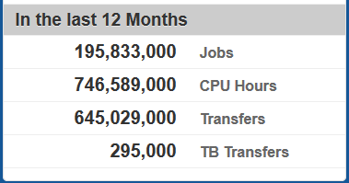
Deliver while leading
This (unique) approach to the adoption and promotion of DHTC technologies enables the OSG to deliver effective
HTC capabilities while
serving as a DHTC
technology leader.
BNL (US-ATLAS T1) and FNAL (US-CMS T1) adopted Condor in the early days of PPDG (~2000).
CDF CAF adopted Condor in 2004

Slide 6
Rutherford Appleton Laboratory (UK T1) adopted HTCondor in 2013

Slide 7
CERN (T0) Adopted HTCondor in 2014

Slide 8
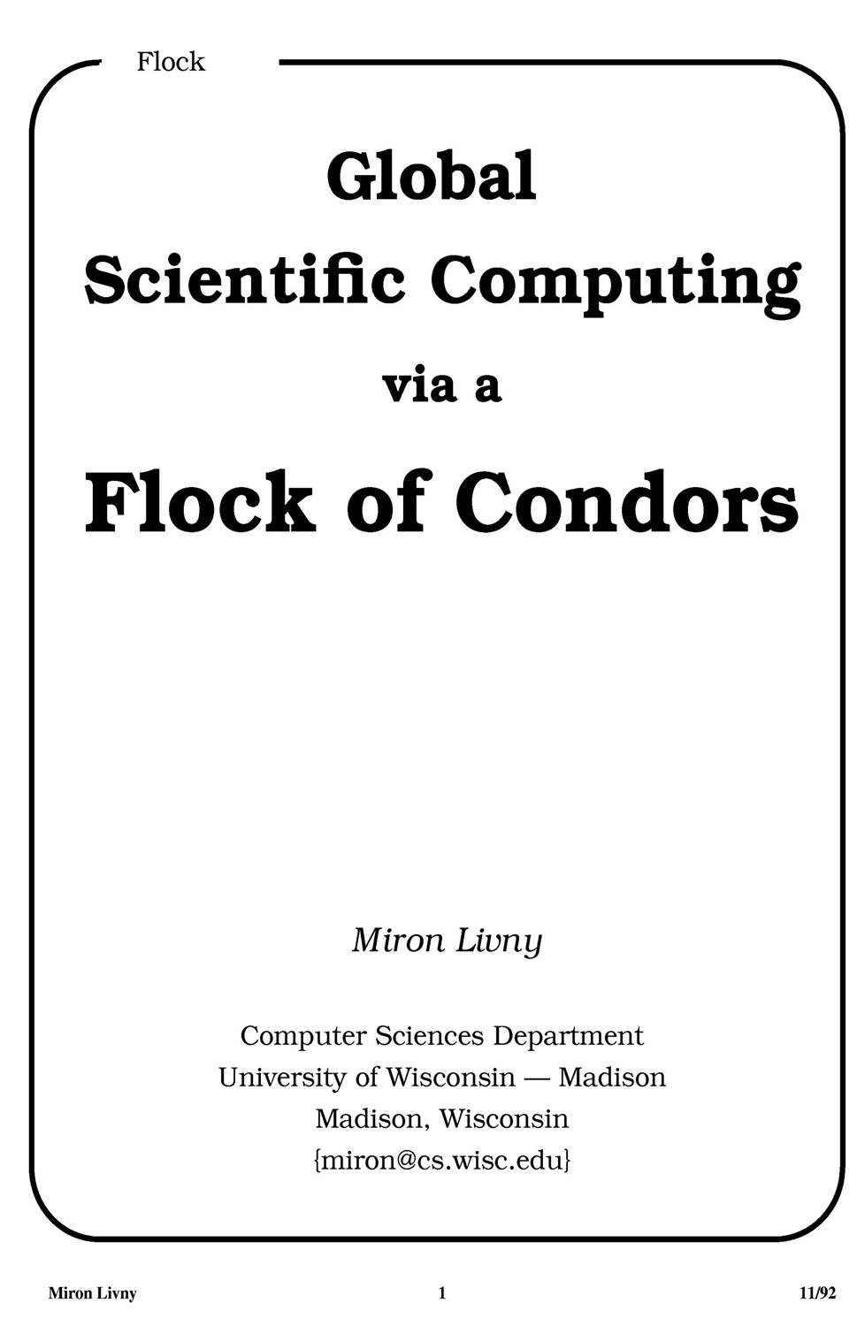
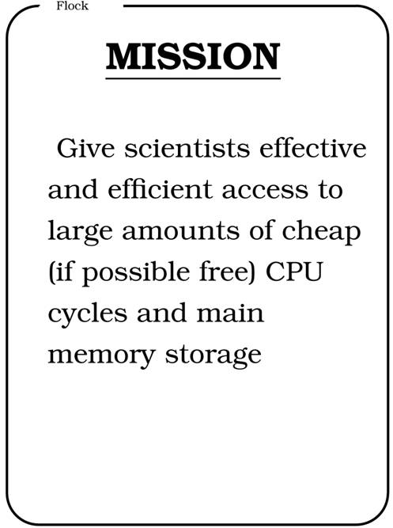
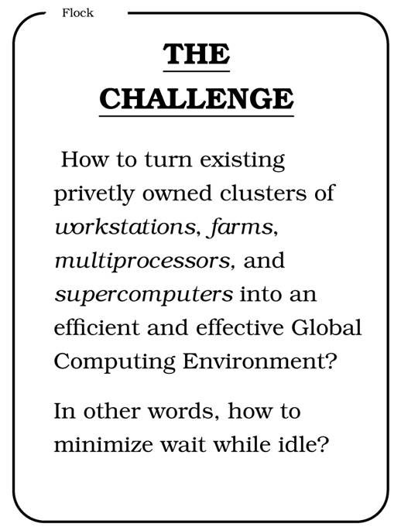
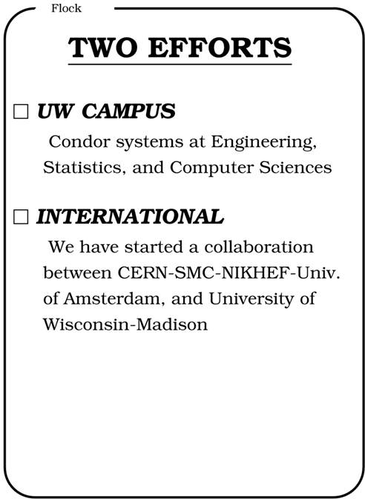
CERN 92

Slide 9
Our underlying Principles
The OSG addresses these challenges by following a framework that is based on four underlying principles: Resource Diversity: Maximizing throughput requires flexibility to accept many types of resources and the integration of multiple layers of software and services. Dependability: Throughput must be tolerant to faults since the scale and distributed nature of high throughput environments means some service or resource will always be unavailable. Autonomy: Enable users and resource providers from different domains and organizations to pool and share resources while preserving their local autonomy to set policies and select technologies. Mutual Trust: The formulation and delivery of a common goal through sharing requires a web of trust relationships that crosses the boundaries of organizations as well as software tools.

Slide 10
The OSG User School (2012-14)
Goal: To train scholars in the fundamentals of high throughput computing so that they can use it to transform their work and make new discoveries
Main Objectives:
Describe the basic elements and architecture of a distributed computing system
Use basic distributed computing tools to run jobs and manage data
Select good tools and methods to solve problems with distributed computing
Outline the role of distributed computing, its history, current state, and future hopes
Identify resources for support, further study, and development opportunities
Method: Participants learn through hands-on experience with tools, resources, and methods that are available locally and in the OSG, so that they can apply and share their new abilities immediately back at their home institutions.

Slide 11
Five days of hands-on experience
Ongoing Mentoring : At the end of the program, each participant is assigned a mentor, who is one of the instructors at the School. Mentors check in on their students and are available as the primary contact point in case of questions, requests, comments, resource needs, etc.
Final Assignments : Each participant is asked to complete a final assignment, in which they describe a scholarly challenge that requires significant computation and how they would apply their new knowledge to address that challenge.
Year | Applications | Attendance
2012 | 46 | 31
2013 | 45 | 26
2014 | 34 | 24

Slide 12
Success!!
A physics students from the University of Puerto Rico attended the 2013 School. Afterward, he showed great interest in pursuing his work on OSG resources, because his home institution had only a small site (we were able to get him ample time at Madison). Then, in 2014 his advisor applied to and attended the School, because of its usefulness to his student and because of the potential for using high throughput computing in his whole group. After the School, the faculty member wrote: “I discussed with my CoPIs on our cyberinfrastructure grant and we would like our site to join the OSG”. All because of contact via the School!

Slide 13
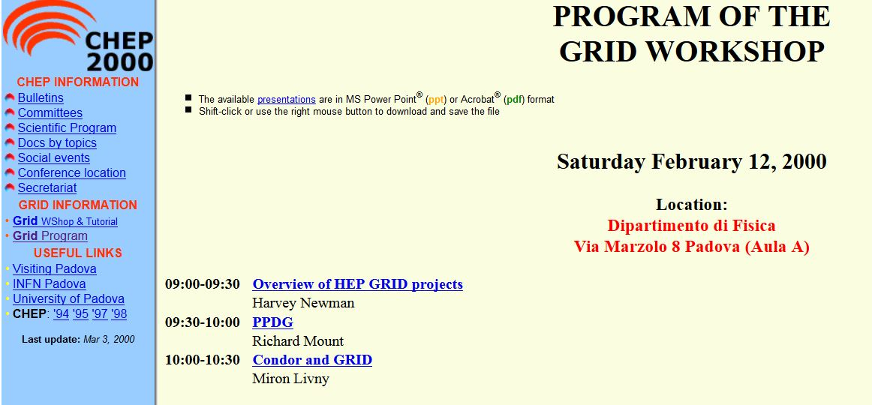
Overlays are the (only) way to go!
Following the OSG blueprint we have been promoting Job Management (JM) overlays as effective means for managing HTC workloads in a distributed (grid) environment.
I introduced JM
overlays for
grid
infrastructure
at the (first) Grid
Workshop
at CHEP 2000.

Slide 14
Condor and (the) Grid (one of the CS X in PPDG)

Slide 15
Step IV - Think big!
Get access (account(s) + certificate(s)) to Globus managed Grid resources
Submit 599 “To Globus” Condor glide-in jobs to your personal Condor
When all your jobs are done, remove any pending glide-in jobs
Take the rest of the afternoon off ...

Slide 16
A “To-Globus” glide-in job will ...
… transform itself into a Globus job,
submit itself to Globus managed Grid resource,
be monitored by your personal Condor,
once the Globus job is allocated a resource, it will use a GSIFTP server to fetch Condor agents, start them, and add the resource to your personal Condor,
vacate the resource before it is revoked by the remote scheduler

Slide 17
More than 10 years later
JM overlays are now fully embraced by the LHC experiments.
All OSG cycles are now delivered via JM overlays
OSG provides services for VOs to manage and operate their JM overlays.
JM overlays are used to run HTC workloads on clouds (commercial and private) and HPC resources

Slide 18
Local
User Code/
DAGMan
HTCondor
MM
C-app
MM
Factory
Front End
SchedD
OSG
Factory
Grid CE
SSH
CondorC
HTCondor
MM
HTCondor
C-app
MM
LSF
PBS
HTCondor
SchedD
G-app
G-app
G-app
StartD
StartD
StartD
Remote
C-app
C-app
C-app

Slide 19
Resource Provisioning
The OSG GildeIn factory uses the Condor SchedD as a resource provisioning agent on behalf of the (local) SchedD. The factory decides when, from where and for how long to keep an acquired resource.

Slide 20
Local
User Code/
DAGMan
HTCondor
MM
C-app
MM
Factory
Front End
SchedD
OSG
Cloud
Factory
EC2
OpSt
Spot
HTCondor
HTCondor
MM
C-app
VM
VM
VM
SchedD
StartD
StartD
StartD
Remote
C-app
C-app
C-app

Slide 21
Impact on the UW-Campus and beyond
When assistant professor N. Roys and his students from the Economics department at UW-Madison submit their jobs to the campus HTC facility they are not aware that some of these jobs may be executed by the OSG. By leveraging the JM overlay services of the OSG, more than 50% of the 200K core hours that they consumed on 08/13/14 were provided by opportunistic cycles from other OSG sites.
Over the past year more than 90 UW-Madison researchers benefited from more than 10M core hours provided by OSG sites when submitting their jobs to the campus HTC facility.
We share our experience and methodologies with other campuses through the recently funded ACI-REF network.

Slide 22
Submit locally and run globally
(Here is my work and here are my resources)

