Slide 1
OSG Council
Ruth Pordes
Mar 25th 2015
Mar 25th 2015

Slide 2
Why a Council?
Mar 25th 2015

Slide 3
The Most Committed Stakeholders
And the broader Community that is Not being directly Funded
Mar 25th 2015

Slide 4
Cares for the Consortium
Vision
Mission
By-Laws
Oversees the Eco-System and Project
Mar 25th 2015

Slide 5
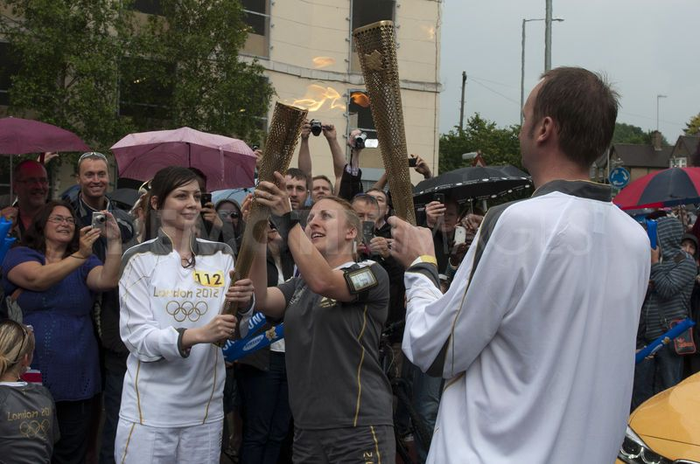
Mar 25th 2015

Slide 6
What does the Council Talk about and Why is it useful…
Mar 25th 2015

Slide 7
Review/Comment/Guide Current Project Work e.g.
Reports on usage through the XD Allocation system
Feedback on quality/success of User Requirements Engagement

Slide 8
Sponsor tomorrows Panel session
The Future of Campus Computing
Jim Bottom
Miron Livny
Joseph Paris
Pascal Paschos
Birali Ranesha
Get your questions in ahead of time Please!

Slide 9
2015
A year for Anniversaries
Mar 25th 2015

Slide 10
June: 10 years since the OSG Ribbon Cutting
OSG ribbon cutting – Univ. Wisconsin-Milwaukee 2005
OSG vision was fashioned back then and recorded in the bylaws that guide our program today. Only one change – recently - to add the phrase on Sharing.
.. Membership occurs through completed registration of a resource, VO, or other organization with the ..Consortium Members contribute to and/or benefit directly from the resources, use, operations and/ or other activities.
Consortium members recognize that the OSG is a sharing eco-system and strive to maximize the sharing of computing resources, software, and other assets to enable science.
…

Slide 11
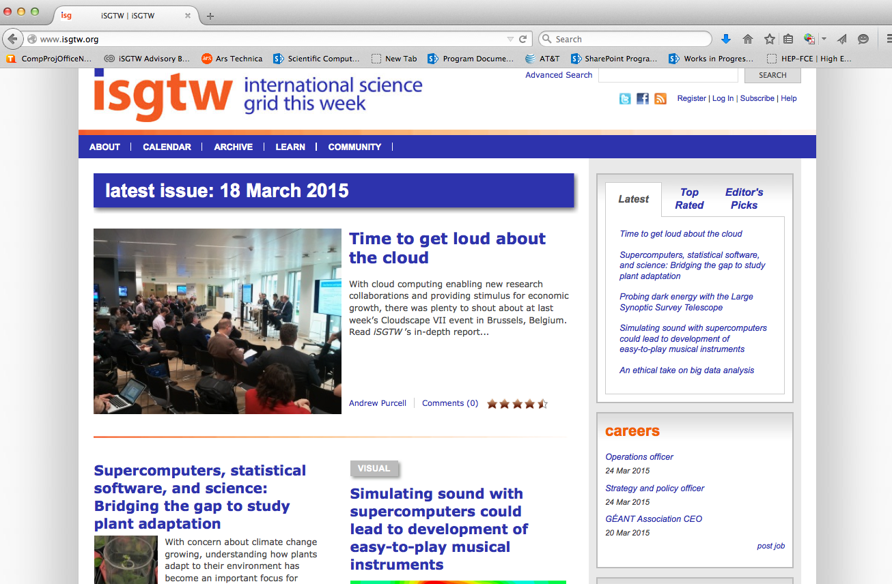
End of April: 10 years of (i)SGTW

Slide 12
Changes in the Council in past 12 months
Mar 25th 2015

Slide 13
Added: Don Krieger, of Pittsburgh Medical Center, a very heavy user of the OSG XD allocation.
Subtracted: Tevatron Run II representative stepped down from being a member of the Council due to the ramp down of their computing needs and analysis.
Changes: US CMS alternate transitioned to Greg Snow, UNL

Slide 14
The OSG Eco-system
Mar 25th 2015

Slide 15
OSG User School
27–31 July 2015 at UW–Madison
• Who?
– Graduate students at U.S. institutions
– In any domain field (STEM + others!)
– With large-scale computations, now or planned
• Travel expenses are paid
• Applications will open very soon
Help ! Bring Us Qualified Applicants!
• In 2014: 13 apps from UNL, due in part to David Swanson
• Enlist direct help from campus VIPs
– HTC champion, research computing, CIO
– Graduate research office or equivalent
– Faculty with HTC success stories
• We will work with ACI REF, XSEDE, …
• Any other ideas?

Slide 16
Effective Contributor to XD Allocations
Delivering ever more cycles to User Allocations and extending usage into Opportunistic

Slide 17
Satellite Projects
Existing satellite projects continued to work in collaboration with individual members of OSG Staff and Executive Team”
Any Data, Any Time, Any Where – which has developed XROOTD based data distribution federation solutions, which can now start to be deployed in the OSG facility
dV/DT – computer science research on monitoring and resource management.
Lark - CS research into network resource management
DASPOS – data preservation for LHC and other sciences
Extreme-Scale Identity Management (XSIM) / NSF Security Institute

Slide 18
New Satellite Project: PunDit
Type-2 OSG satellite project (both working with OSG during development and intending to deploy a successful implementation within OSG).
Develop an automated network diagnostic capability and collaborate with OSG on its testing in "real-world" situations.
OSG
working with the PuNDIT team to deploy and evaluate its usefulness and effectiveness for OSG needs.
providing access to its perfSONAR data and end-sites to PuNDIT to support its development work.

Slide 19
And..
Communications
Mar 25th 2015

Slide 20
Monthly Research Highlights
Bi-monthly newsletter
Support continued for the various web sites including www.openscienceigrd.org.
Catching up with GlueX (2/3/2015) – but work done in 2014
IceCube is providing a unique view into the universe (12/2/2014)
Changing society one math problem at a time (10/28/2014)
Using high-throughput computing to evaluate post-Katrina rebuilding grants (10/6/2014)
Computational modeling of bank networks and interbank transactions (8/5/2014)
Accelerating the discovery of treatment effects in the social sciences using the OSG (6/24/2014)
Using the OSG to plan for an electron-ion collider at Brookhaven (6/3/2014)
Using the OSG to test theories of nature at the LHC (5/2/2014)
2014 GridUNESP upgrade offers more potential for OSG partnership (3/31/2014)
Nuclear physics and computer science meet on the OSG (2/24/2014)
BLAST on OSG provides a timesaving alternative for large-scale analysis (1/31/2014)
Six 2014 OSG newsletters at http://www.opensciencegrid.org/news/previous-newsletters/

Slide 21
Future Depends on
Each of Us
Mar 25th 2015

