Slide 1
Running User Jobs In the Grid without End User Certificates - Assessing Traceability
Anand Padmanabhan
CyberGIS Center for Advanced Digital and Spatial Studies
National Center for Supercomputing Applications
University of Illinois at Urbana-Champaign
OSG Security Team
OSG AHM 2015

Slide 2
Motivation
X.509 user certificates expose users to complexities of authN/authZ systems
First hurdle for every new Grid user
Represents a significant barrier to promoting ease of use and discourages potential users
End user certificates are however the primary way to authenticate on Grids

Slide 3
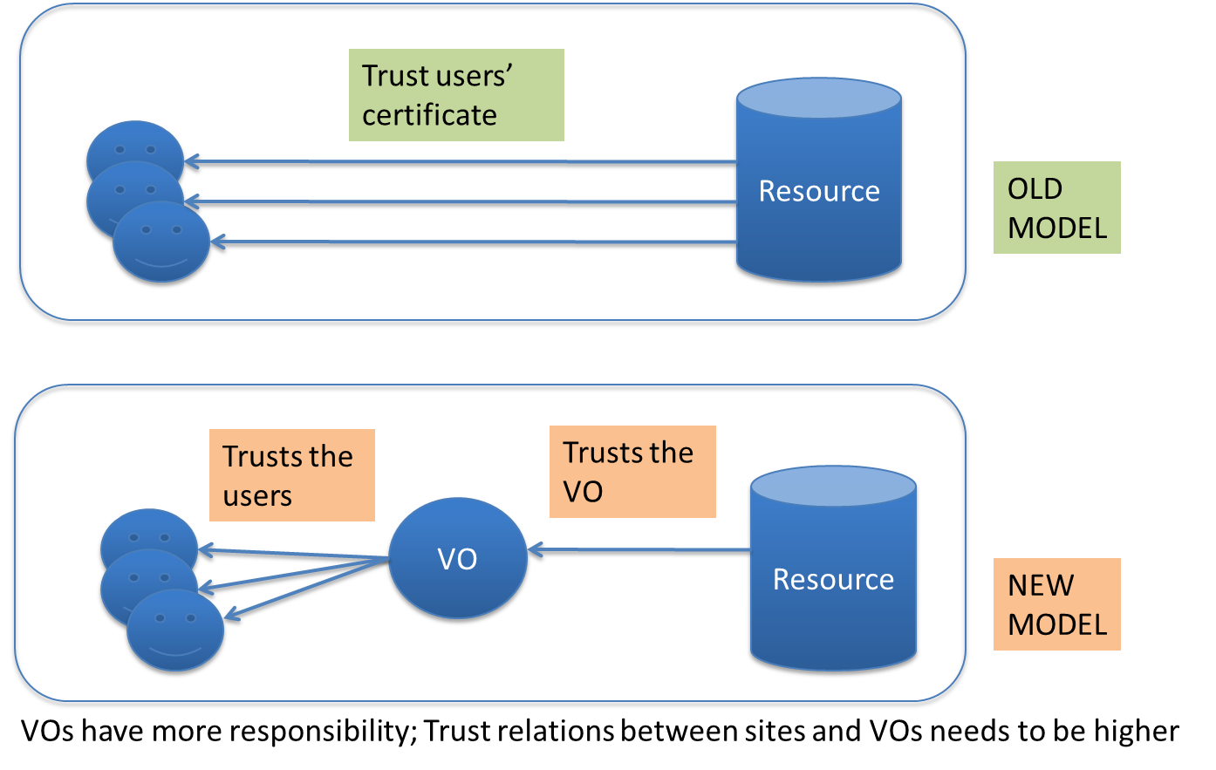
Changing Trust Paradigm

Slide 4
Changing Trust Paradigm
OLD TRUST model
Sites only trust user’s with a certificate
VOs do not play a role in this trust relationship
This is inefficient
NEW TRUST model
Sites trust VOs to provide the users’ information when needed
Sites only know which VO the user belongs to
VO trusts its user to behave properly and takes responsibility for its user’s actions
Sites don’t know the identity of the user upfront
If a problem is noticed with a user job, sites will
contact the responsible VO
expect VOs to identify and ban the problem user
If a problem persists, the site can ban the entire VO

Slide 5
Why we needed the New Trust Model? What was wrong with the Old Model
The old model did not recognize the important role a VO played in trust relationships.
It puts the burden of proving identities on the users.
VO already knows its users’ identities and could provide it to sites.
Biggest beneficiary of the new model is the end user.
If site did not need to establish trust with each user, then user did not need to deal with proving its identity and role.
Users do not need to obtain certs, create proxies, etc
Hides complexities of authN/authZ systems
Promotes ease of use

Slide 6
Does the New Trust Model Meet Our Security Needs?
Needs for knowing a user’s identity or distinguishing a user from one another with access tokens
Fine-grain access privileges: Alice needs a different execution environment than Bob
Accountability: Holding users responsible for their actions on the grid
Most VO members (limited exceptions like software installers exist) need the same access privileges
We do not hence need fine-grain privileges for most jobs
Accountability – tracing a malicious job to its owner is the main reason for using certificates
Sites typically do not care who a user is unless a problem occurs
We hence evaluate glideinWMS for traceability

Slide 7
Hypothesis
Pilot job framework (e.g. GlideinWMS) already collect sufficient amount of data about users and jobs. So, it already has traceability information.
This will lead to improved usability
Existing pilot job framework are well positioned to support this model
Goals
Research: Can traceability be achieved through different technical means?
If so, what are the security risks of using these means?

Slide 8
GlideinWMS Architecture

Slide 9
GlideinWMS Workflow
GlideinWMS acts as a shield to protect users form complexities of the job submission on the Grid
User accesses the Frontend and submits a job
Frontend communicates with the Factory and requests Glideins (i.e. Pilot jobs)
Glideins checks if the worker node suitable for the user job and then starts the user job
Glidein job is a parent process to the actual user job and watches over the user job throughout its lifetime
GlideinWMS framework is documented at http://www.uscms.org/SoftwareComputing/Grid/WMS/glideinWMS/doc.prd/index.html

Slide 10
GlideinWMS Details
A worker node can run multiple Glideins and user jobs simultaneously
An individual Glidein only starts a single job at a time
A Glidein can however run a sequence of jobs one after the other
Jobs may belong to different users
All HTCondor logs associated with the Glidein are written on the worker nodes and are transferred back to the Glidein factory after the Glidein completes execution
Glideins typically run for 24-48 hours

Slide 11
Experiment Setup
The security team submitted jobs on OSG sites without end user certificates and evaluated if the jobs can be traced back to the submitter
Our exercises labeled a random (non-malicious) job as malicious
Conducted searches in both directions
Tracing a malicious job back to a user
Tracing a user to find all of her jobs
We paid special focus to additional risks from the lack of certificates

Slide 12
Tracing Jobs
Site admin identifies a problem job on a worker node at the site
Identify the Glidein process that started the problem job
Use the standard error and out, Starter and Startd logs associated with Glidein
Search associated timelines
Identify the VO that owns the Glidein and the problem job
Use Glidein DN and contact Factory operator
With the HTCondor job id of the Glidein, look at the StartdLogs belonging to that Glidein instance
Find frontend where the job originated
HTCondor jobid at frontend
Contact VO operating frontend to check frontend log, history files, node login logs, etc to determine user

Slide 13
Challenges against Traceability
Attacker overwrites the Glidein log files
The user job runs in the same user account as the Glidein job, so a malicious user could hijack the Glidein infrastructure, overwrite the log files, and no useful info returned to the factory (i.e. fake logs).
Likelihood: Moderate. Requires some insider information
Mitigation: Two potential venues: 1) getting more information back to the Schedd/Frontend; and 2) making sure we always do the UID switch.
Currently investigating solutions

Slide 14
Results
Traceability study was carefully conducted on three frontend/VOs and access to Fermilab (FNAL) resources (which previously required certificates) was enabled
OSG-XSEDE frontend (OSG VO)
CHTC frontends (GLOW VO)
Will present experiences today
HCC frontends (HCC VO)
Careful drills were conducted and recommendations presented to FNAL security team
Recommendations were accepted and implemented
Successfully opened up the use of opportunistic resources from FNAL to a number of users
Process we went through is documented on twiki
E.g. https://twiki.grid.iu.edu/bin/view/Security/HCCJobTraceability

Slide 15
Findings
GlideinWMS has shown to possess significant tracing capabilities
System can identify a unique owner for a grid job at a worker node for a given timeframe
Some corner cases could make tracing more challenging
Likelihood is however low and mitigations have been recommended
Has profound affects on trust relationships
Site trusts VO and VO trusts its users

Slide 16
What to do if my VO is Interested
Defined a process for VOs to submit jobs under the new trust model
Prospective VO applies to the Security Team
Security Team evaluates them against a criteria https://twiki.grid.iu.edu/bin/view/Security/JobTraceabilityWithoutCerts
Example Questions
How do you manage your users; how do you vet their identity, give permissions and assign roles to users. How do you document and log your users activities.
What access control mechanisms do you employ to ensure only authorized VO members can access VO services?
What is the architecture of the glidein setup at your VO?
Does your VO operate more than one submit node (e.g. PI controlled submit node) and use flocking, if so how do you trace users between these systems
Do you have a centralized system for collecting logs?
Do you have a policy of how access is revoked?
If a VO demonstrates that they can manage their users effectively and take responsibility for them, they switch to operate under new trust model

Slide 17
OSG Procedures and Policies
Old and new model co-exist
Many VOs prefer to switch to the new model
Easier on new users
Some VOs will continue to use the old model
OSG leaves the decision up to the VOs
OSG provides the infrastructure and services to enable both models

Slide 18
Questions?
Thank you

