Slide 1
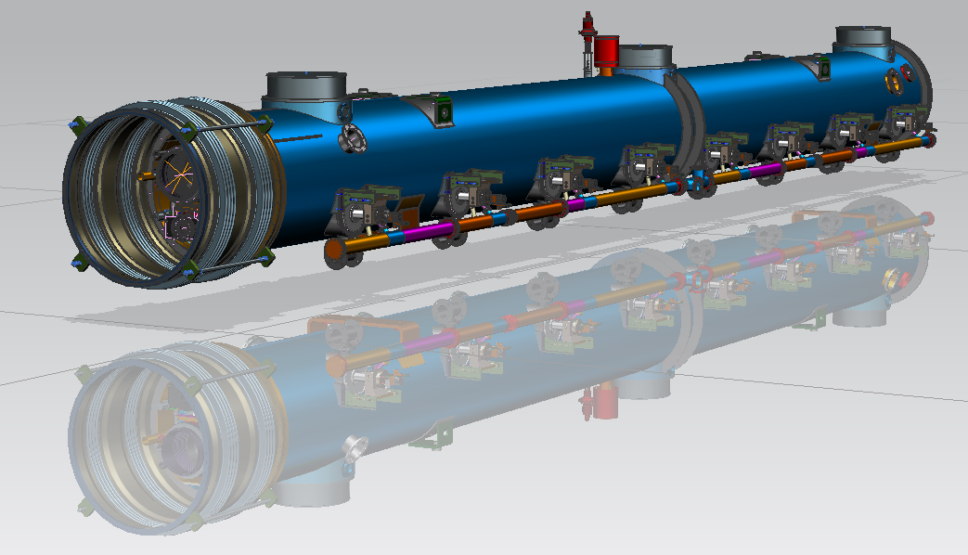
LCLS-II Cryomodule – Upcoming Work
Tom Peterson
6 June 2014

Slide 2
Schedule – upcoming milestones from Draft Schedule for LCLS-II Preproduction Module-v11.pdf
Prototype cryomodule final design review
November 3, 2014
Prototype fabrication readiness review
December 1, 2014
Assembly of string into cryomodule outside of the cleanroom starts
end of May, 2015
Cryomodule assembly complete
October 15, 2015

Slide 3
Cryomodule procurements (in addition to dressed cavity with tuner, input and HOM couplers)
HGR Pipe Weldment and Machining
Vacuum Vessel
2K Forward Pipe Weldment
Warm-Up-Cool-down Pipe
5K Forward Pipe Weldment
8K Return Pipe
40K Pipe Assy
40K Upper Shield (AL)
40K Lower Shield (AL)
40K Extr. Pipe-Mach
Magnet package
Current leads
VacuumBellows_850mm
Pipe interconnect Bellows
Bellows Weldment 2-Phase
Support Posts
Base Support Assembly
Pump Line Coupling Assy
CM Support Fixed Assy
CM Support Sliding Assy
Bimetallic Couplers -- chimney
Cavity Magnetic Shield
RF Gate Valve (VAT)
HOM absorber
BPM

Slide 4
Cryomodule components
Previous shopping list totals ~ $1M
Does not include dressed cavity, tuner, input coupler costs, and various fixtures and tooling

Slide 5
Long lead procurements
Aside from dressed cavities and input couplers, these items are among the longest lead procurements
300 mm helium gas return pipe assembly
4-5 month procurement
~$60 K
Vacuum vessel
6 month procurement
~$140 K
Magnetic shielding
4 month procurement
~$60 K per cryomodule

Slide 6
LCLS-II, 1.3GHz Cryomodule 3D model and Drawings status & plan (Yuriy O.)
1.3 GHz Cryomodule 3D model, F10009945
(ready for drafting-70%)
DWG’s for Cavity He Vessel, End Lever Tuner,
-done
Try to use (with small update) ~30% of existing drawings of Cryomodule #3
This month plan to start to create drawings for:
-1.3 cavity string Assembly (~30 DWG’s)
-Vacuum Vessel (~40 DWG’s)
-HGR Pipe (~30 DWG’s)
(?)-50K aluminum shielding (~50 DWG’s)

Slide 7
Effort and resources
We are tracking personnel hours and updating estimated resource requirements
Estimate about 40 months of engineering and design labor needed for rest of FY14
With 4 months left, so ~10 FTE
This includes full CM effort – cryostat plus dressed cavity, tuner, magnetic shielding, etc.
Need some additional engineering and designer help, but should be able to establish that, especially for
Structural analysis
Drafting for drawings
Effort continues into FY15 at approximately the same level
Remaining design tasks, especially final engineering documentation, engineering notes
Procurement and assembly always involves continuing designer involvement

