Slide 1
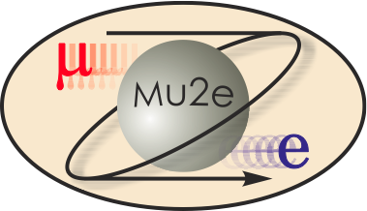
Mu2e Tracker Straws
U.S. DEPARTMENT OF
ENEGY
Office of
Science
Chiho Wang
Straws L3 Manager
7/9/2014

Slide 2
Outline
Straw requirements
Straw property measurements
Straw assembly components and procedures
Cost

Slide 3
Straw requirements
5mm ID metalized Mylar tube cathode.
Minimal material
6 μm Mylar + 3 μm adhesive + 6 μm Mylar double helical wrap
Inner wall coating: 500Å Al + 200Å Au
Outer wall coating: 500Å Al
Operates in vacuum
Sustains > 1 atm pressure difference
Leak rate < 7 ccm / detector volume
Stability
Straw straightness: max. transverse deviation/sagging < 300 μm for HV stability.
Longitudinal tension is applied to keep straw straight.
Initial tension need to be higher to counter for material relaxation over time (creep).
Sustains radiation over the life time of operation.

Slide 4
Straw properties
Destructive tests:
Pressure: sustained 60 psi (10 min.). Destroyed ≥ 70 psi
Stretch: sustained 1.6 kg (2 yrs.). Destroyed ≥ 2.9kg
Mechanical:
Linear density: 0.34±0.01 g/100cm
Wall thickness: 15μm
Derived from linear density, assuming Mylar density 1.39g/cm³, and same for the polyester based adhesive.
Spring constant: 0.891cm/kg/100cm
Electrical:
Cathode resistance: 120Ω/100cm

Slide 5
Straw leak measurement 1
Pressurize to ~ 1 atm and measure the pressure drop

Slide 6
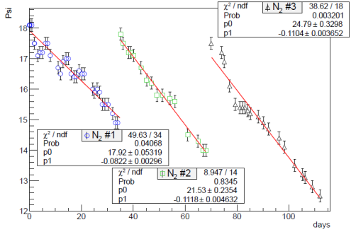
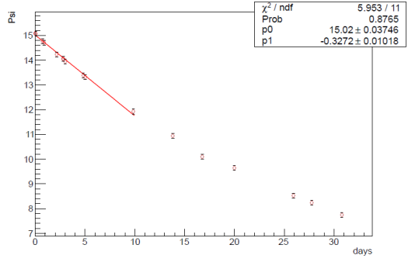
Straw leak measurement 1
N₂
CO₂
N₂ leak rate =0.095±0.026 psi/day
CO₂ leak rate =0.36±0.06 psi/day
Assume Ar leak rate similar to N₂ , and straw volume ~ 0.3 m³, estimated Ar(80%)CO(20%) leak rate ~ 2ccm / tracker volume

Slide 7
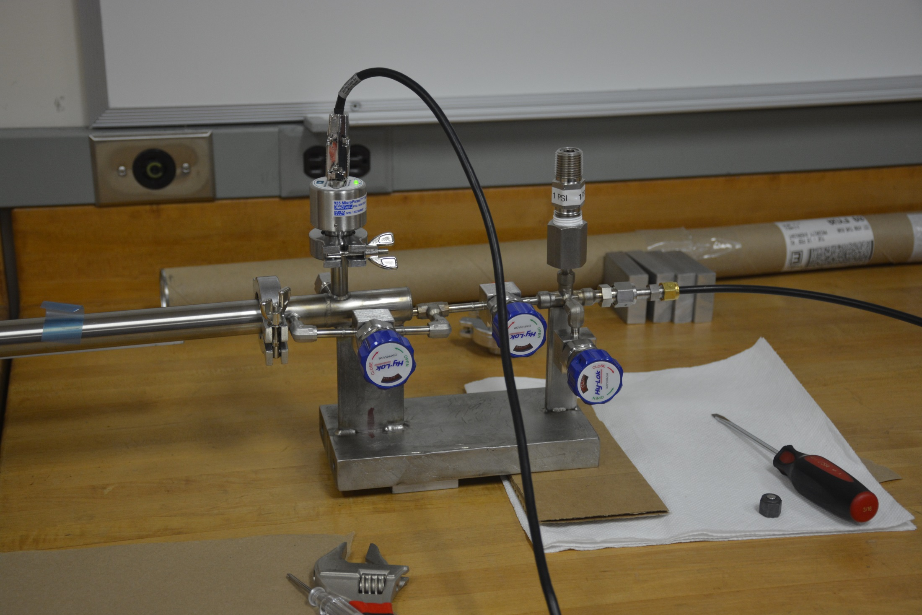
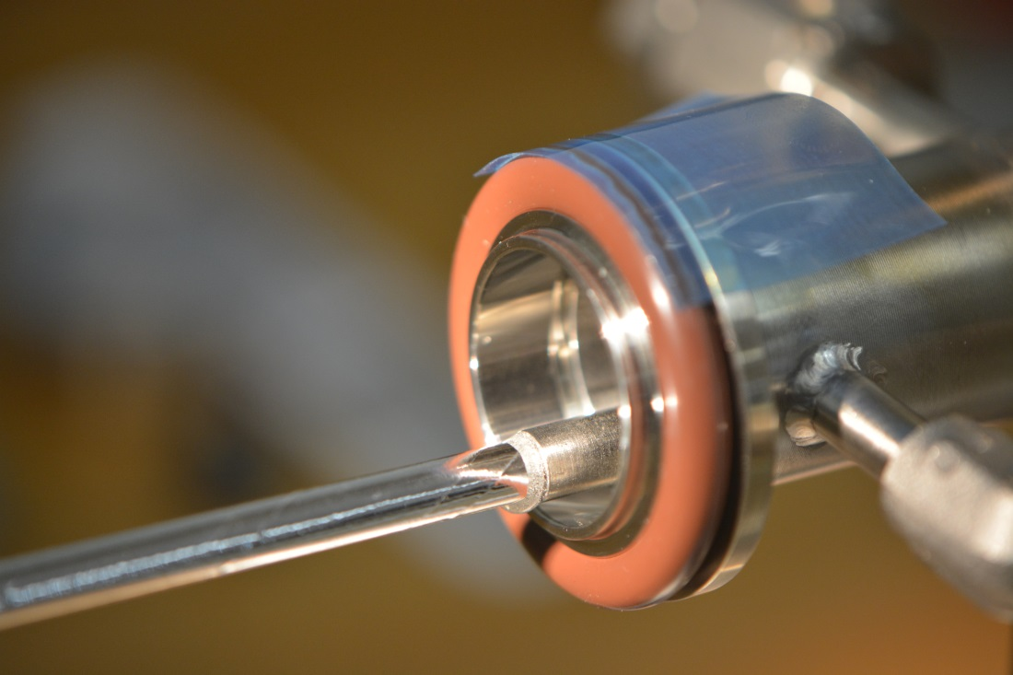
Straw leak measurement 2
Fill straw with ArCO₂ and place in vacuum,
Measure pressure rise
Gas inlet
To straw
Straw
1 psi
Pressure relief
Vacuum
gauge
Feed through
Tested 10x 129cm straws
Averaged leak rate = 3.6x10⁻⁴ccm/straw
~ 4 ccm / tracker volume
Vacuum pump

Slide 8
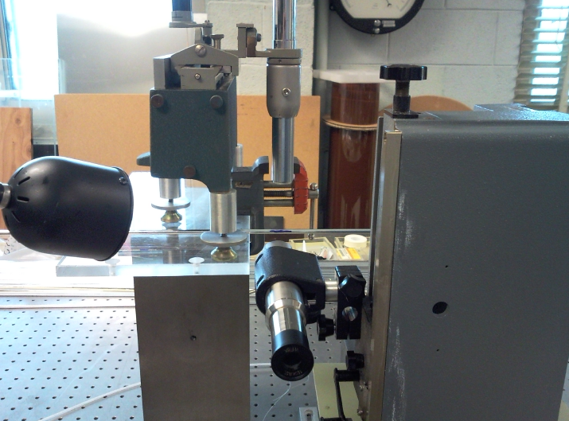
Straw straightness measurement To determine the required straw tension
Horizontal Traveling Microscope (X)
Straw
Straw deviation measured for different straw length and tension.
Vertical Traveling Microscope (Y)

Slide 9
Straw straightness measurement
ΔR=Sqrt(Δx²+Δy²)
ΔR (cm)
gm
Mid point deviation, relative to the highest tension (500g)

Slide 10
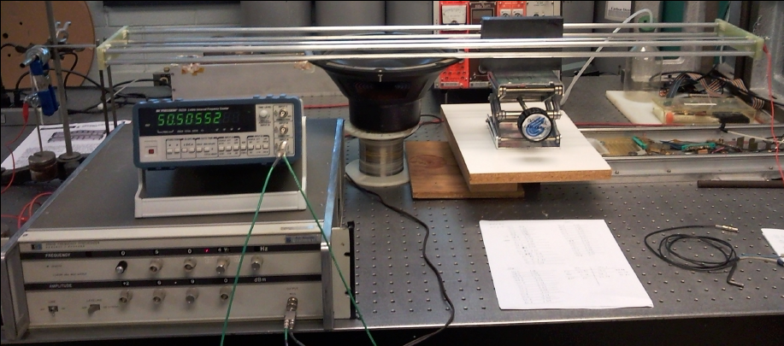
Straw creep measurement
Glue straws on a support frame (120cm) with tensions:
300gm, 400gm, 500gm, 600gm.
Measure straw tension by resonant frequency as a function of time.
Support Frame
Frequency
Counter
Magnet
Speaker
Straw
Weight
Precision
Function
generator
5/10/12
Chiho Wang, Seog Oh, Wes Johnson
10

Slide 11
Straw creep measurement
300gm
400gm
500gm
600gm
(corrected for temperature & humidity variation)

Slide 12
Straw creep measurement
Fractional tension shows scaling effect, giving prediction power to other initial tensions.
Assume T(t)/T(0)=(c0*e^{-c1*t}+c2), with c2=0
6-year extrapolation → T(t)/T(0) ~ 43%
700 gm initial tension is sufficient to keep tension > 250 gm after 6 years.

Slide 13
Radiation aging study
A single straw detector, constructed with relevant components, was operated under Sr-90 irradiation.
Expected total dose (including beam flash) of 0.9 C/cm was irradiated.
Gain change monitored by Fe55 peak amplitude.
Observed no measurable degradation in gain or cathode resistivity
Fractional gain change over 3 irradiation periods. Measured at 3 locations from downstream. Referenced to un-irradiated point at 110cm:
Gas flow rate = 2 vol/hr/m
20±0.02% CO₂ with balanced Ar
Airgas “primary standard” grade. Purity 99.99% with individual impurities below:
Period | Charge (mC/cm) | Current (nA/cm) | Gain(x)/Gain(110cm)
 |  |  | p1 (7cm) | p2 (37cm) | p3 (67cm)
1 | 120 | 18 | 0.979 | 0.982 | 0.994
2 | 120 | 36 | 1.010 | 1.009 | 1.002
3 | 670 | 70 | 0.994 | 0.990 | 0.983
Total | 910 |  | ±2%

Slide 14
Straw property summary
Straw is robust and has no problem operating in vacuum. The burst pressure exceeds 60 psi and is well above 14psi.
Straw leak rate of ~<4ccm is within acceptable range of 7ccm
700 gm initial tension is needed to keep straw tension above 250 gm after 6 years, which is needed to keep straw straightness within ±0.3mm for HV stability.
Straw can sustain tension > 1.6Kg and is well above the needed 700 gm initial tension.
No measurable degradation in gain after expected dosage of radiation.

Slide 15
Straw assembly
After a straw is received from manufacturer it needs to go through QC procedures and get assembled into a straw sub-assembly. These procedures include:
Visual inspection
Continuity check (measure resistance)
Leak test
Cut to length
Assemble/Attach end pieces
A QA/QC data base is being developed to track/link component data.

Slide 16
Straw cutter

Slide 17
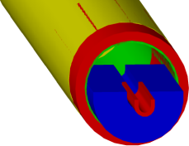
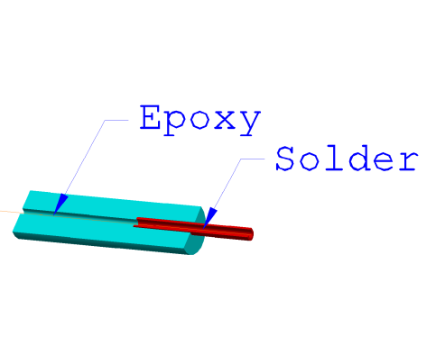
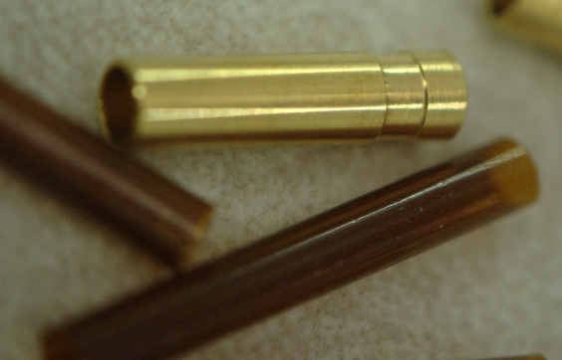
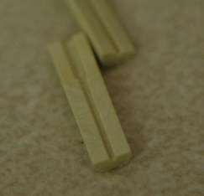
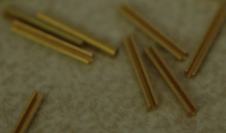
Straw sub-assembly
Wire fixation
Sense wire is aligned by external precision fixture (PAAS), not by straw components)

Slide 18
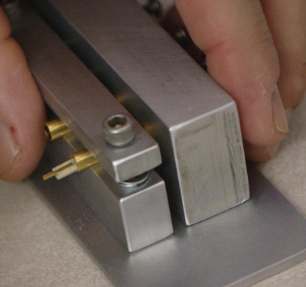
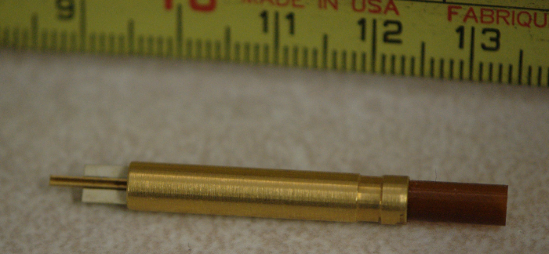
Assembly jigs for assembling end pieces

Slide 19
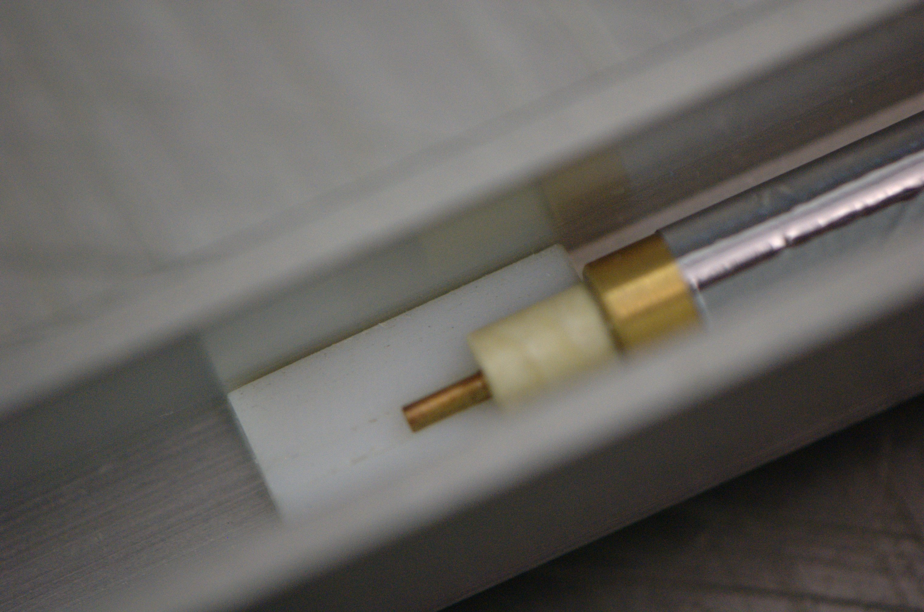
Assembly jigs for gluing end pieces to straw
Orient end pieces on both end of the straw to the same direction
and glue to straw with conductive glue.

Slide 20
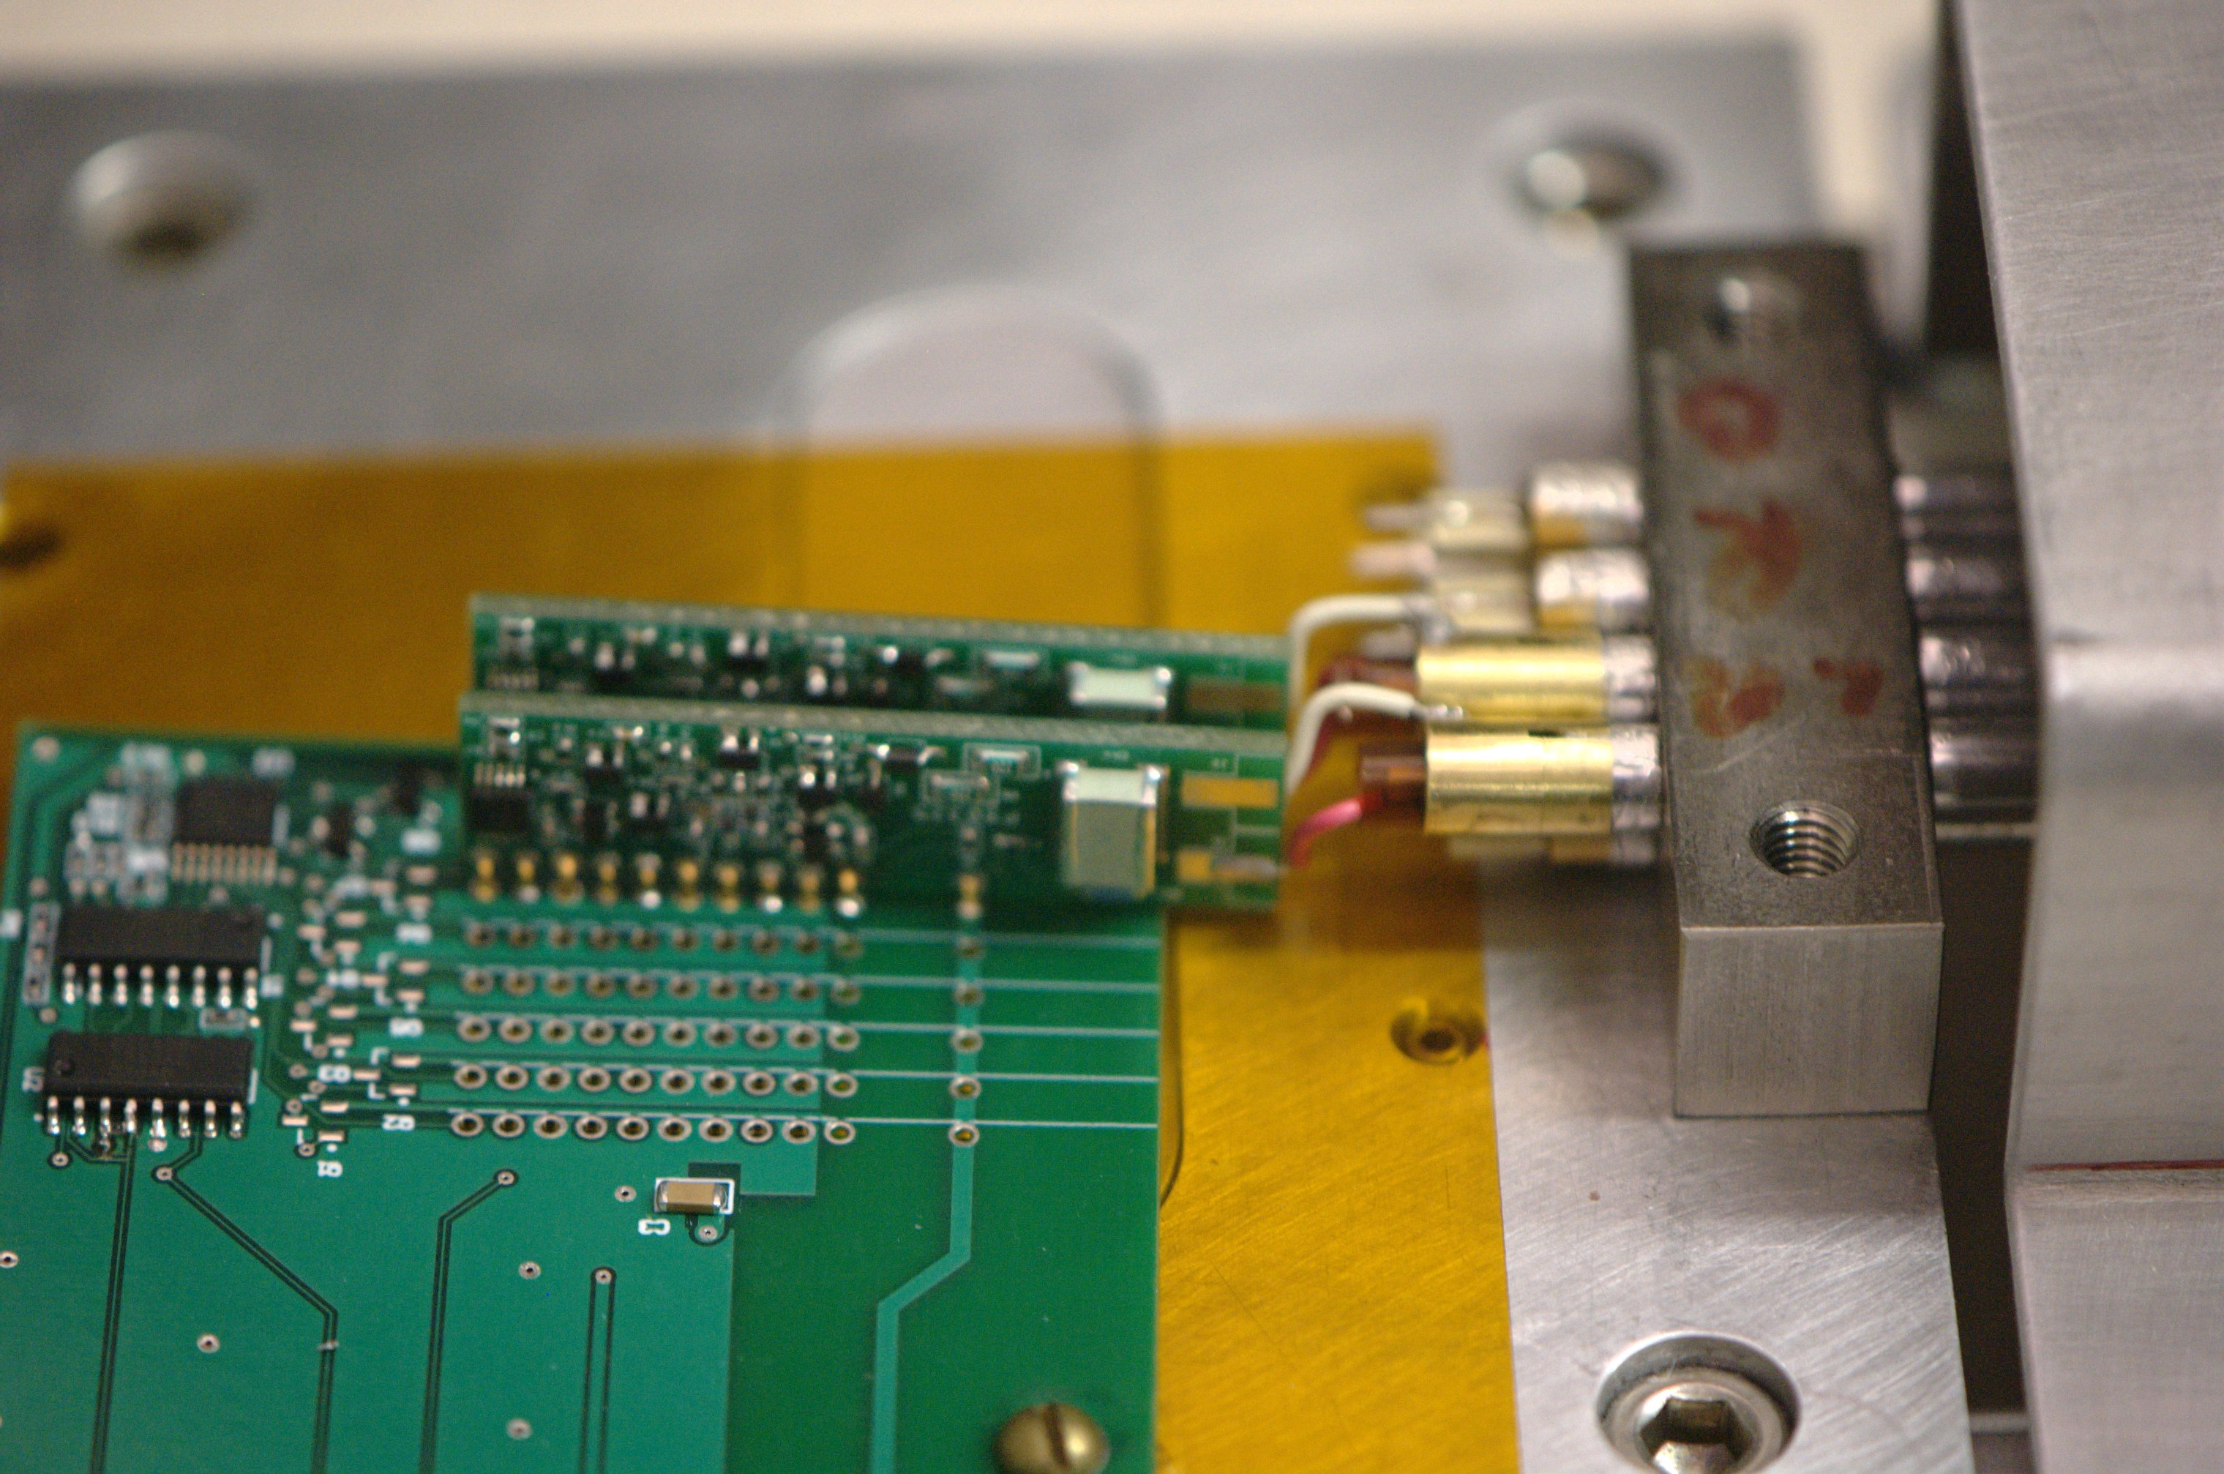
A 2x4 prototype
Front end electronics attached

Slide 21
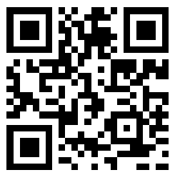
QA/QC data base
RDBMS
Open source
Multimaster replication
Input programming language independence
→MariaDB (formerly MySQL)
GUI

Slide 22
Straw assembly summary
Straw end components had been manufactured and tested.
Assembly tools and test equipment for straw assembly procedures were developed and functional.
Using the material and tools developed, a 2x4 prototype is completed with front end electronics attached.
A QA/QC data base is being implemented for production process.

Slide 23
Cost Distribution by L4
Base Cost by L4 (AY $k)

Slide 24
Cost Distribution by Resource Type
Base Cost (AY $k)

Slide 25
Quality of Estimate
Base Cost by Estimate Type (AY$k)

Slide 26
Labor Resources
FTEs by Discipline

Slide 27
Cost Table
Costs are fully burdened in AY $k
 | Base Cost (AY $)
 | M&S | Labor | Total | Estimate Uncertainty (on remaining costs) | % Contingency on ETC | Total Cost
475.06 Tracker
475.06.02 Straws
475.06.02 Straws | 75 | 49 | 124 |  |  | 124
475.06.02.01 Straw Tubes | 1,262 | 16 | 1,277 | 486 | 38% | 1,763
475.06.02.03 Wire Stringing | 18 |  | 18 | 3 | 15% | 20
Grand Total | 1,354 | 65 | 1,419 | 488 | 38% | 1,908

Slide 28
Conclusion
Detecting elements of the tracker: straws and straw-end components are manufactured and tested.
Straw tube is robust and leak tight, and exceeds the requirements to operate in vacuum for 6 years.
Assembly procedures and assembly tooling are realized and exercised.
A QA/QC data base is being implemented.
Cost is better estimated.

