Slide 1
Mu2e CD-2 Life Safety Review
U.S. DEPARTMENT OF
ENEGY
Office of
Science
Jim Niehoff
ES&H (Fire Protection) Safety Specialist
7/8/2014

Slide 2
Requirements (Objectives)
Provide successful evacuation
Provide effective fire fighting and rescue operation
Limit spread of fire and smoke
Fire suppression systems
Fire alarm systems
Smoke abatement

Slide 3
Requirements (Determined)
AON’s recommendations are based on codes/orders/standards:
DOE Order 420.2C Safety of Accelerator Facilities
IBC (International Building Code)
IFC (International Fire Code)
NFPA (National Fire Protection Association)
Aim of Life Safety
Get the occupants out (egress)
Get the fire fighters personnel in (ingress)
Fire Protection approach is based on experience from previous projects at the laboratory

Slide 4
Design
Less than 30 feet below level of exit discharge, omitting the requirements for smoke control and stairway pressurization
Two Exit stairways enclosed by 2 hour fire rated construction
Means to separate Enclosure from Detector Hall
Maximum travel distance 300 feet
Minimum aisle width 36 inches
Automatic fire sprinkler system, preaction type (Detector Hall)
Linear heat type detection
Beam Type Smoke Detection & Spot Type Detection
Air sampling smoke detection
Manual pull stations

Slide 5
Design Continued
Fire Alarm will have Emergency Voice Alarm system enable to interface with Fermilab’s Site-wide Emergency Warning System
Emergency and exit signage
Emergency/Standby power systems
Fire alarm system
Exit signs
Emergency Lighting
Elevator
Sump System

Slide 6
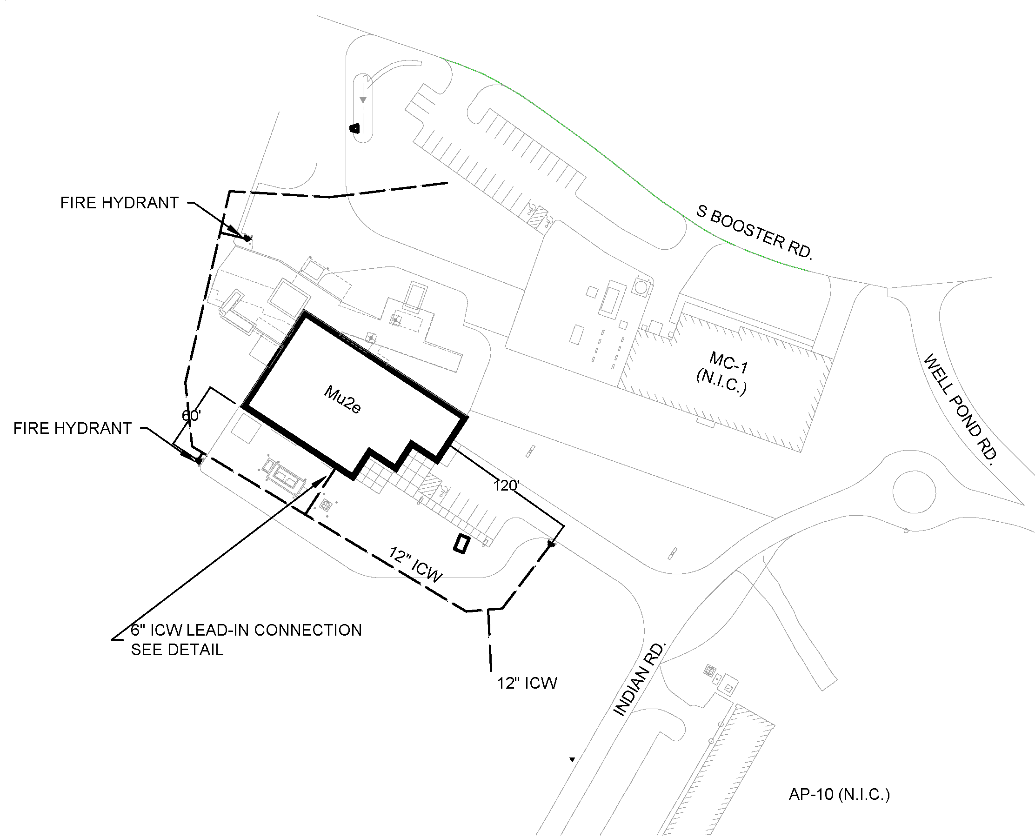
DESIGN (Site Plan)

Slide 7
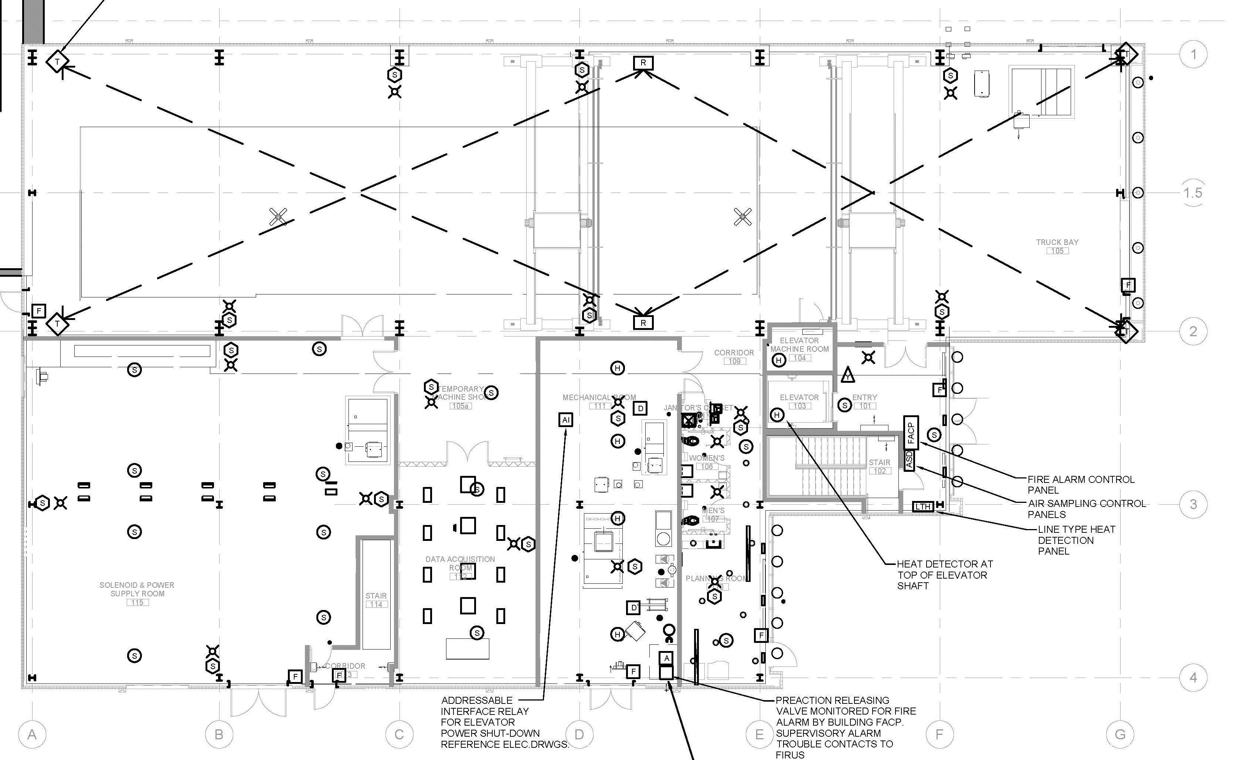
Fire Detection – Main Level

Slide 8
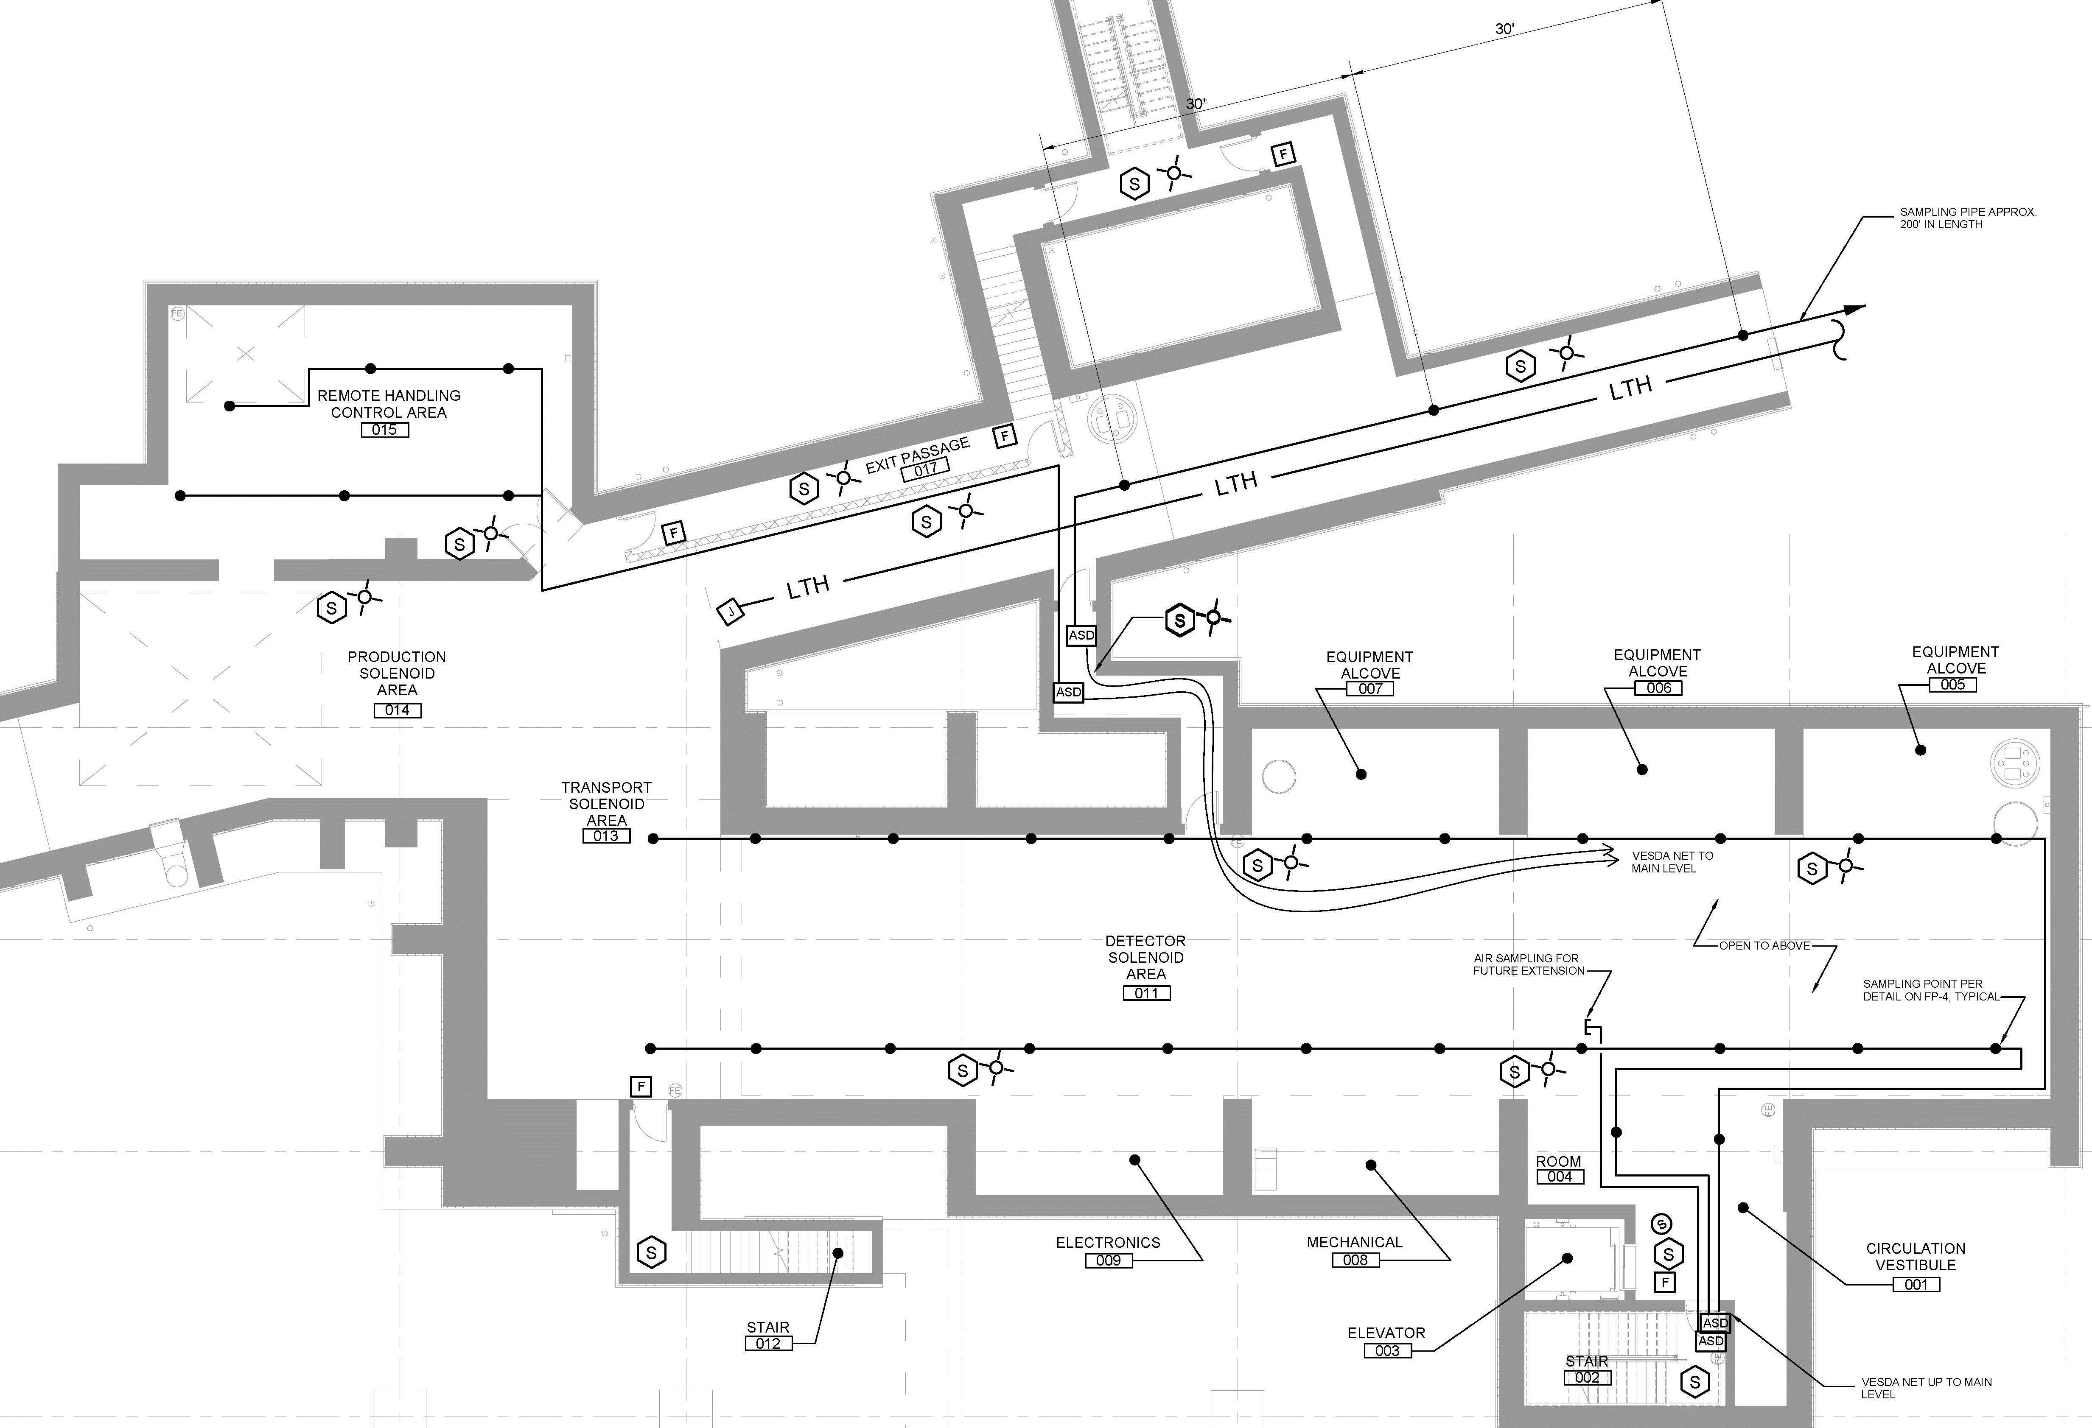
Fire Detection – Lower Level

Slide 9
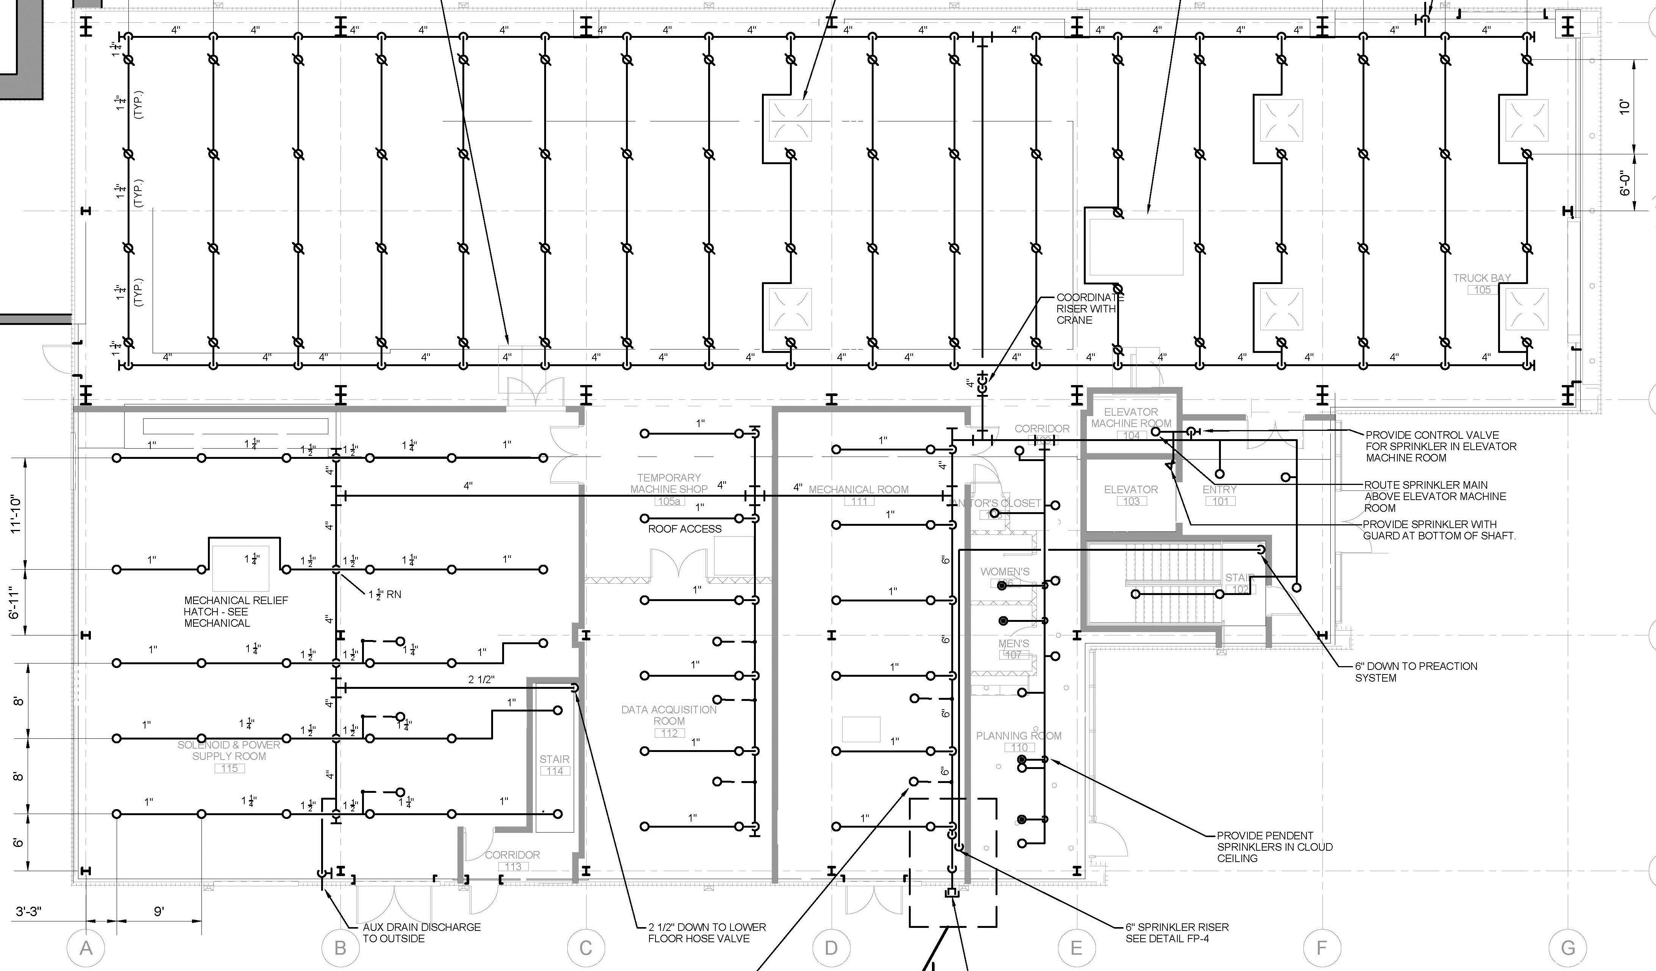
Fire Suppression – Main Level

Slide 10
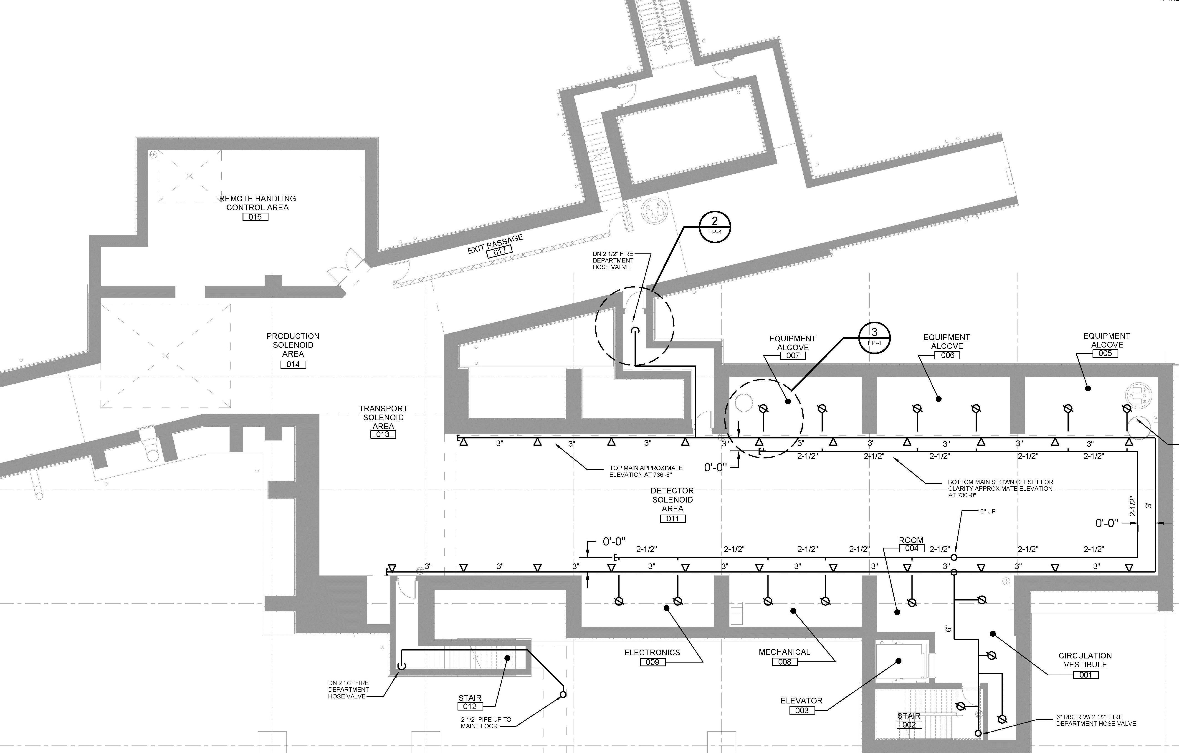
Fire Suppression – Main Level

Slide 11
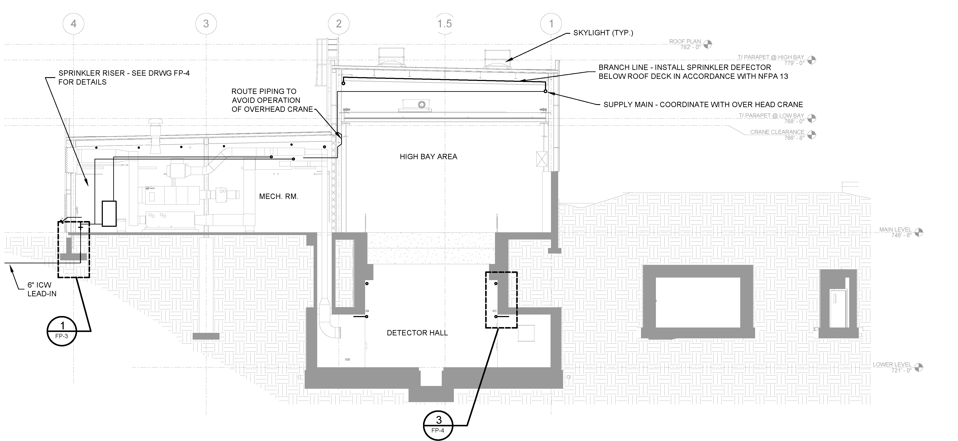
Design (Section View)

Slide 12
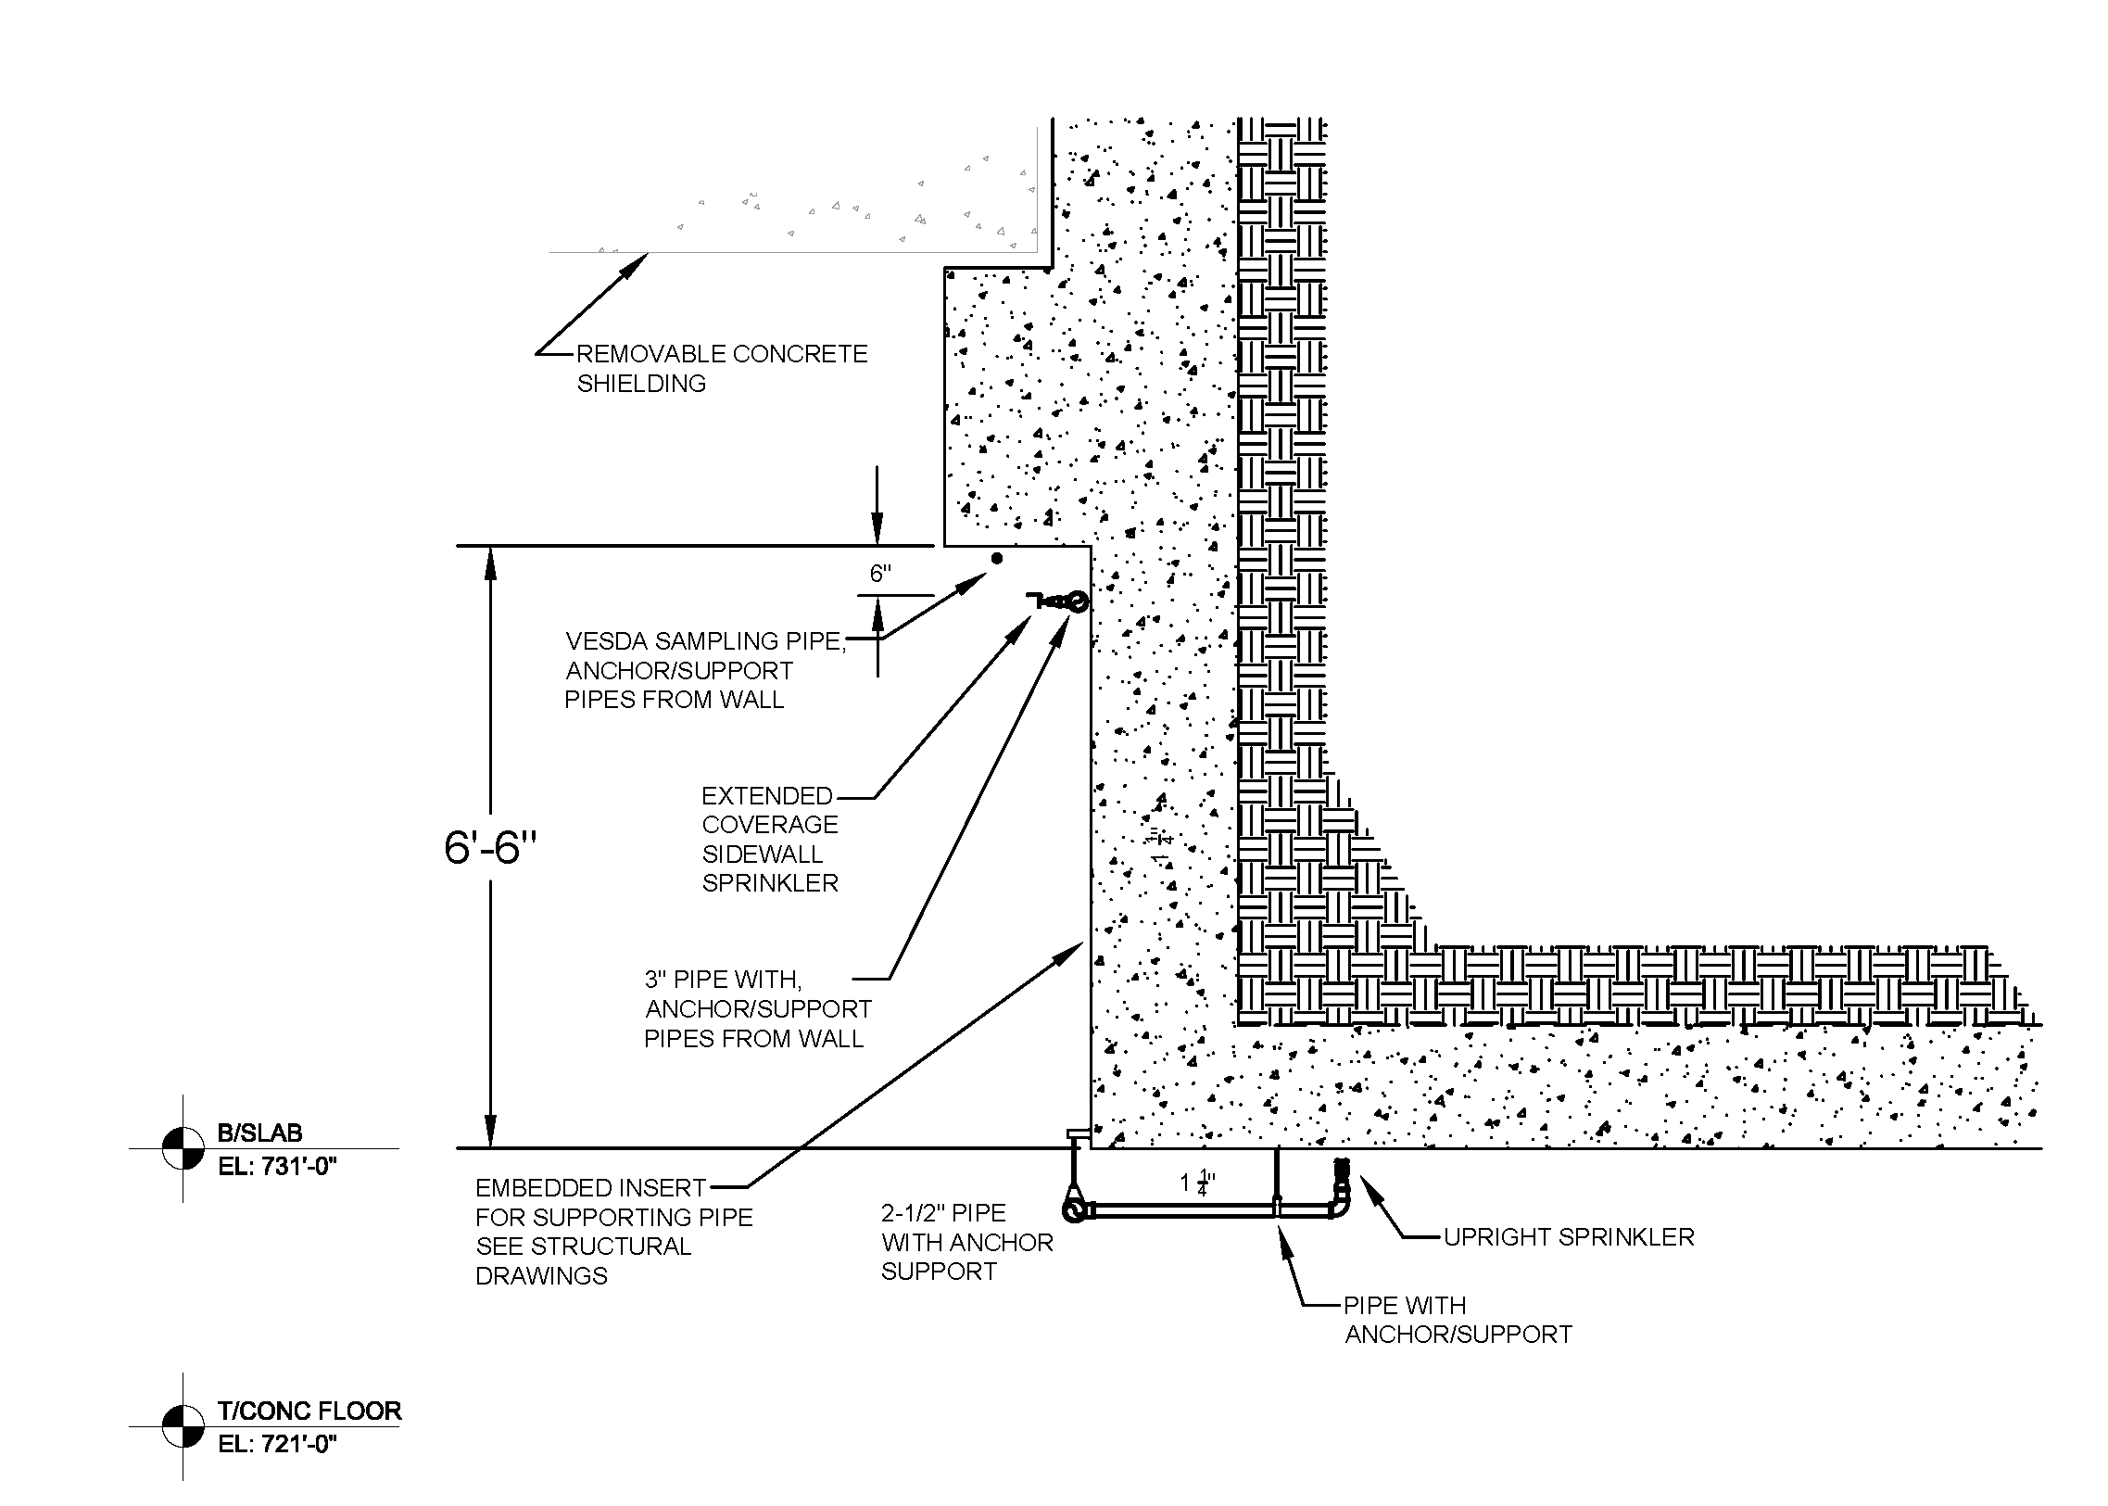
Design (Detector Hall Detail)

