Slide 1
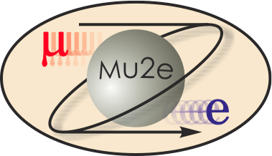
Reference Design of the Mu2e Production Solenoid
Vadim Kashikhin
11-MAY-2015

Slide 2
Role of Production Solenoid
The Mu2e magnet system consists of three large superconducting solenoids. Production Solenoid (PS) is the first magnet in the chain, which collects and focuses pions and muons generated in interactions of an 8-GeV proton beam with a tilted high-Z target and directs them towards Transport Solenoid (TS).
PS performs the following functions in the mu2e:
Maximizes muon yield by efficiently focusing secondary pions and subsequent secondary muons towards the Transport Solenoid (TS) system, in the momentum range to be stopped in the stopping target;
Provides a clear bore for beam line elements such as the primary production target and secondary particle Heat and Radiation Shield (HRS);
Allows the primary proton beam to be steered into primary target; allows outgoing proton beam to exit without striking PS magnet shield.

Slide 3
General requirements
Magnetic:
  Nominal peak field on the axis 4.6 T;
  Maximum peak field on axis 5.0 T;
  Axial gradient -1 T/m;
  Gradient uniformity ±5 %.
Electrical:
  Operating margins: ≥ 30 % in I_{c}, ≥ 1.5 K in T_{c};
  Operating current 9÷10 kA;
  Peak quench temperature ≤ 130 K;
  Voltage across terminals ≤ 600 V.
Structural:
  Withstand forces at all conditions while part of the system or stand-alone;
  Cryostated magnet weight ≤ 60 tons;
  Compliance with applicable structural codes.
Cryogenic:
  Cooling agent: LHe at 4.7 K;
  Total heat flow to LHe ≤ 100 W;
  Cryostat ID 1.5 m;
  Conduction cooling.
Radiation:
  Absorbed dose ≤ 7 MGy total;
  Minimum RRR of Al stabilizer in the operating cycle ≥ 100.
Color coding:
Hard requirements
Changes vs. RDR

Slide 4
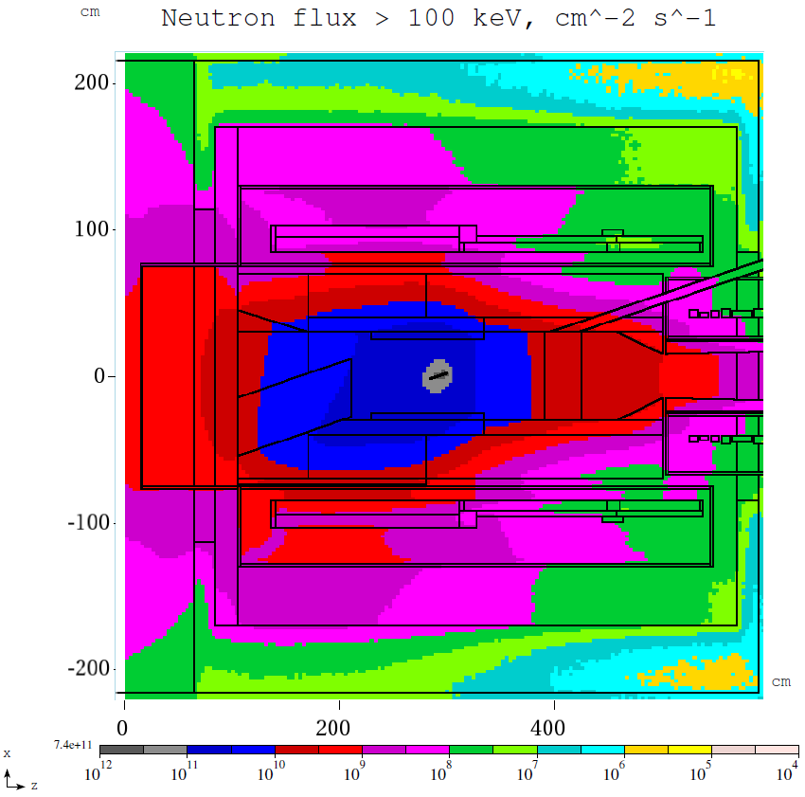
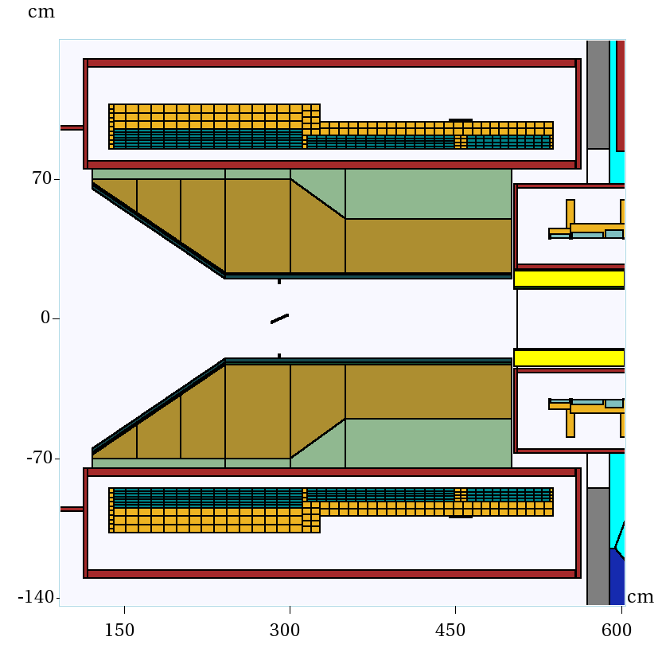
Unique feature: radiation environment
It is expected that RRR will degrade after one year of operation as follows:
  Al RRR 500 → 100;
  Cu RRR 100 → 50;
Once the critical degradation is detected, the magnet will be thermo-cycled to recover the resistivity.

Slide 5
Cold mass design

Slide 6
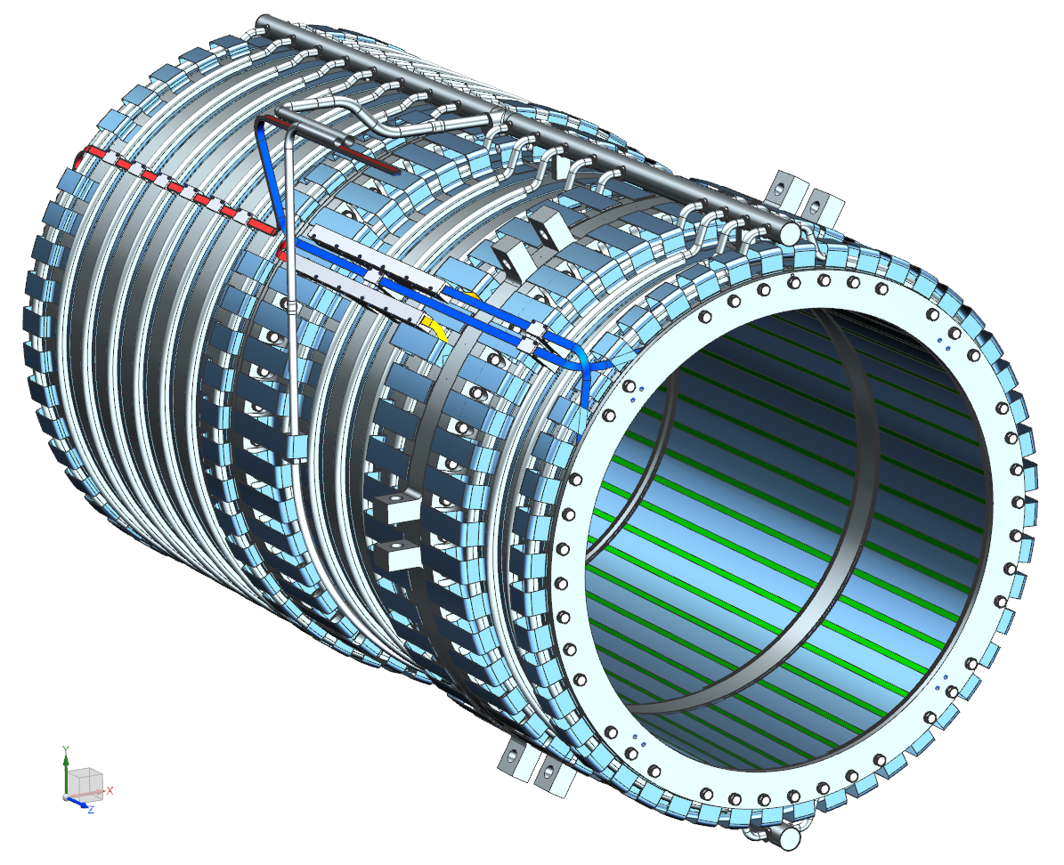
Main features
PS consists of three coil modules with 3-2-2 layers of the same Al-stabilized cable wound in the “hard way”;
Each module has an outer support structure made of Al 5083-O to manage the forces;
The shells are bolted together to form a single cold mass assembly.
The coil modules are installed inside of cryostat using axial and transverse supports.

Slide 7
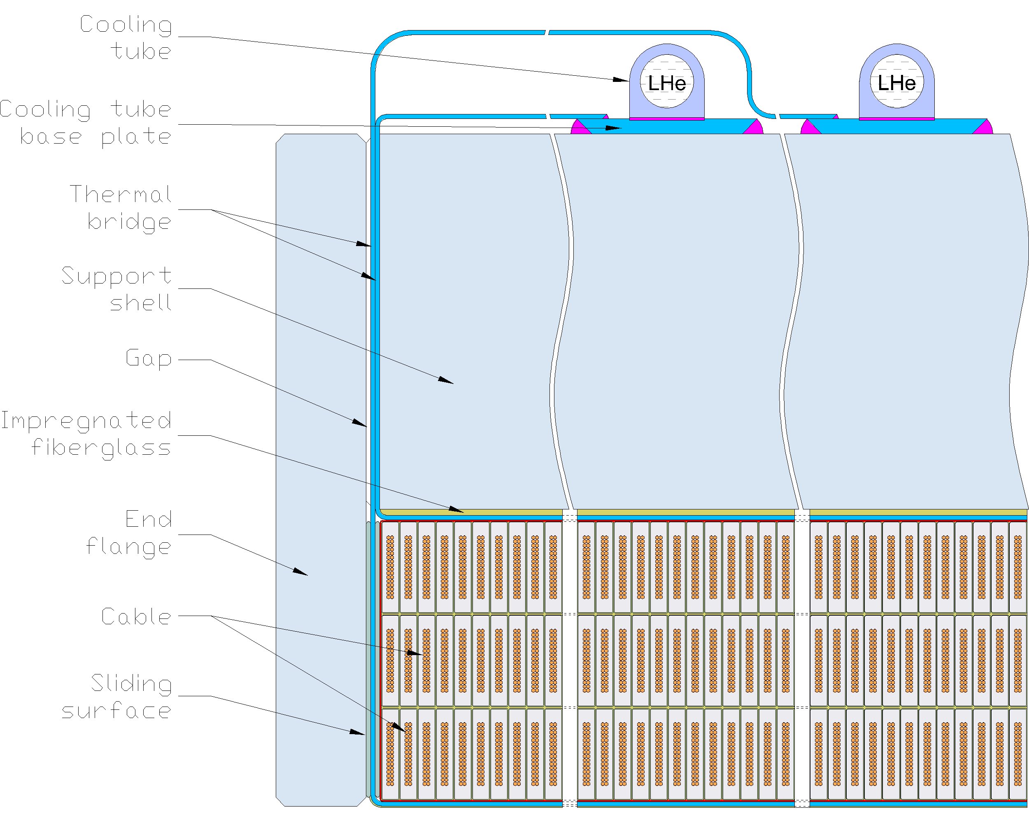
Components
Cables;
Cable insulation;
Ground insulation;
Thermal bridges;
Coil-shell buffer;
Washer plates;
Support shells;
End flanges;
Sliding layers;
Cooling tubes.

Slide 8
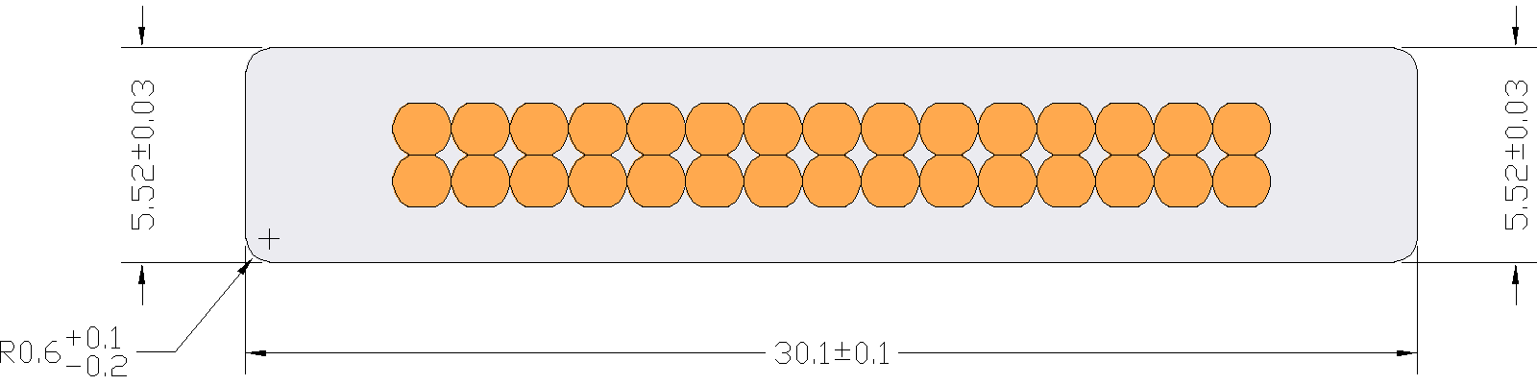
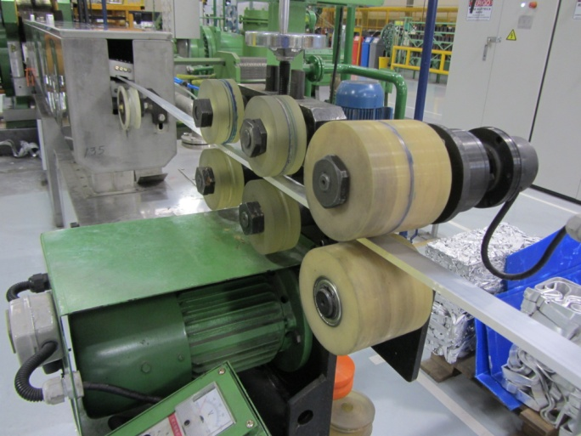
Al-stabilized NbTi cable
No keystoning
Smoother corners
Lower Al RRR
Higher I_{c}
Increased unit length
Extra spares

Slide 9
Insulation
It is the requirement to include polyimide (Kapton) layers into the cable and ground insulation;
Cable insulation: composite “UG” tape similar to the one used in ATLAS CS;
Interlayer insulation: dry E-glass, creates channel for epoxy penetration;
Ground insulation: dry E-glass and polyamide or “GUG” ATLAS CS type insulation.

Slide 10
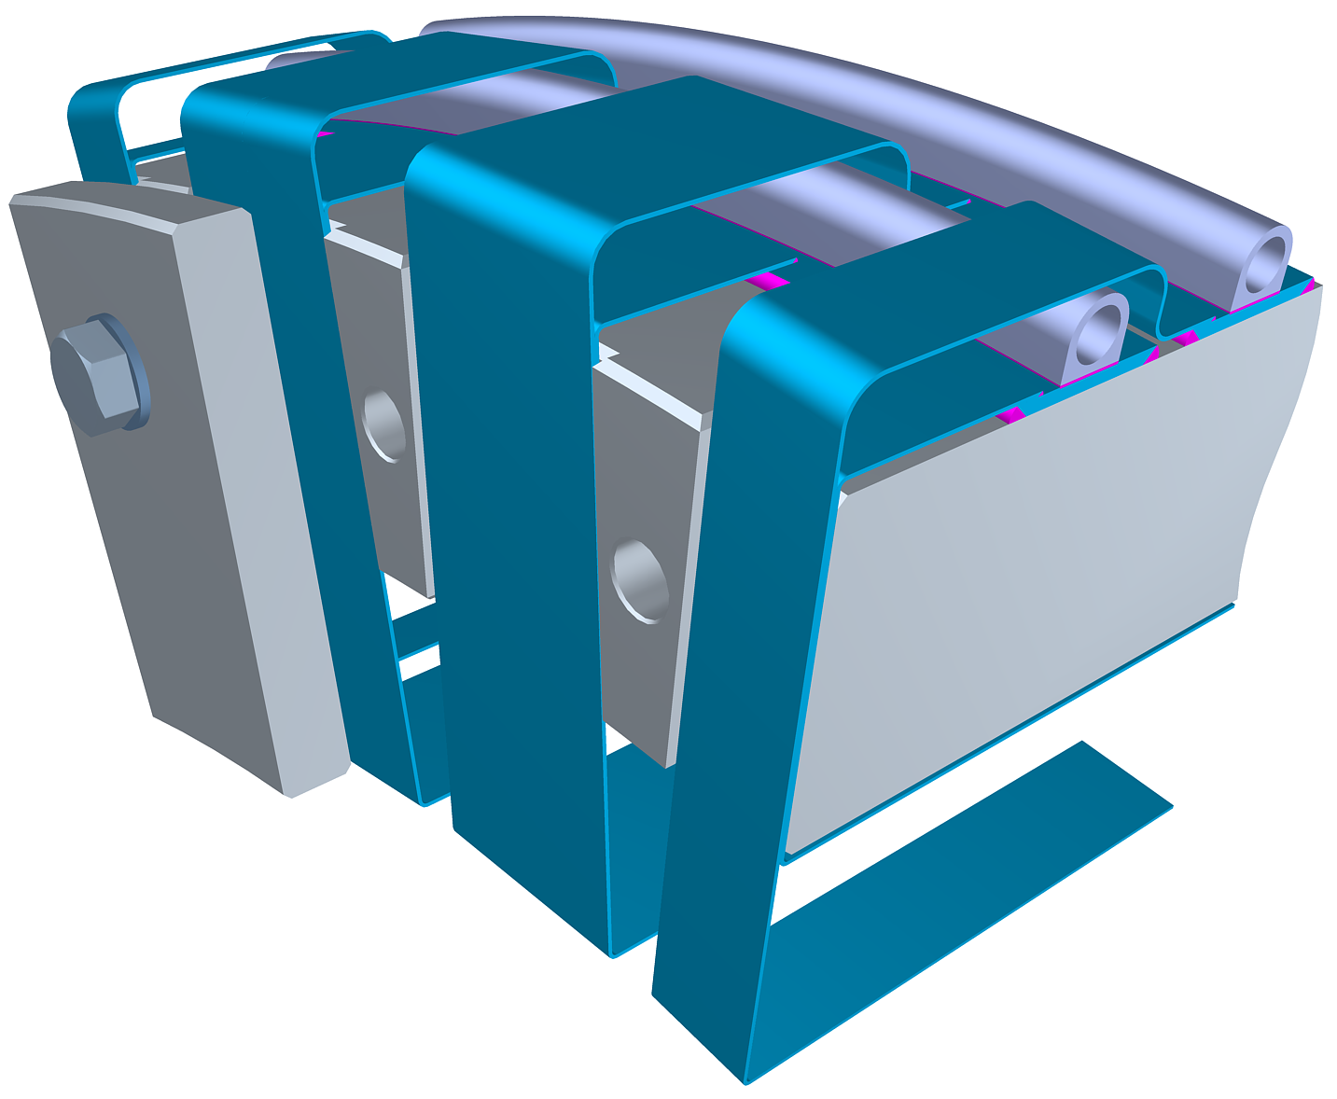
Thermal bridges
The cold mass is to be cooled via the heat conduction to the thermosiphon system.
In order to facilitate the static and dynamic heat extraction and reduce the temperature increment in the coil, the cold mass is equipped with thermal bridges bonded to the inner and outer coil surfaces.
The thermal bridges are strips of 5N high purity Al with a minimum residual resistivity ratio (RRR) of 1500 and 1.5±0.1 mm thickness.
The coil is not shown

Slide 11
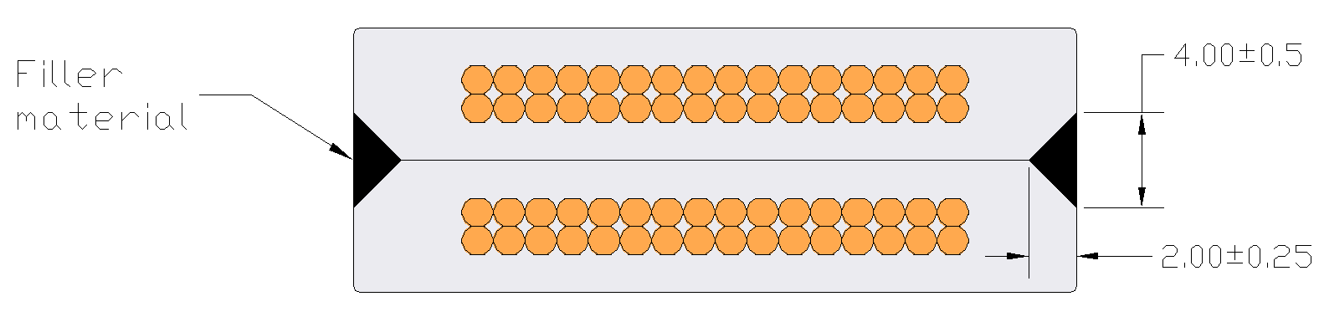
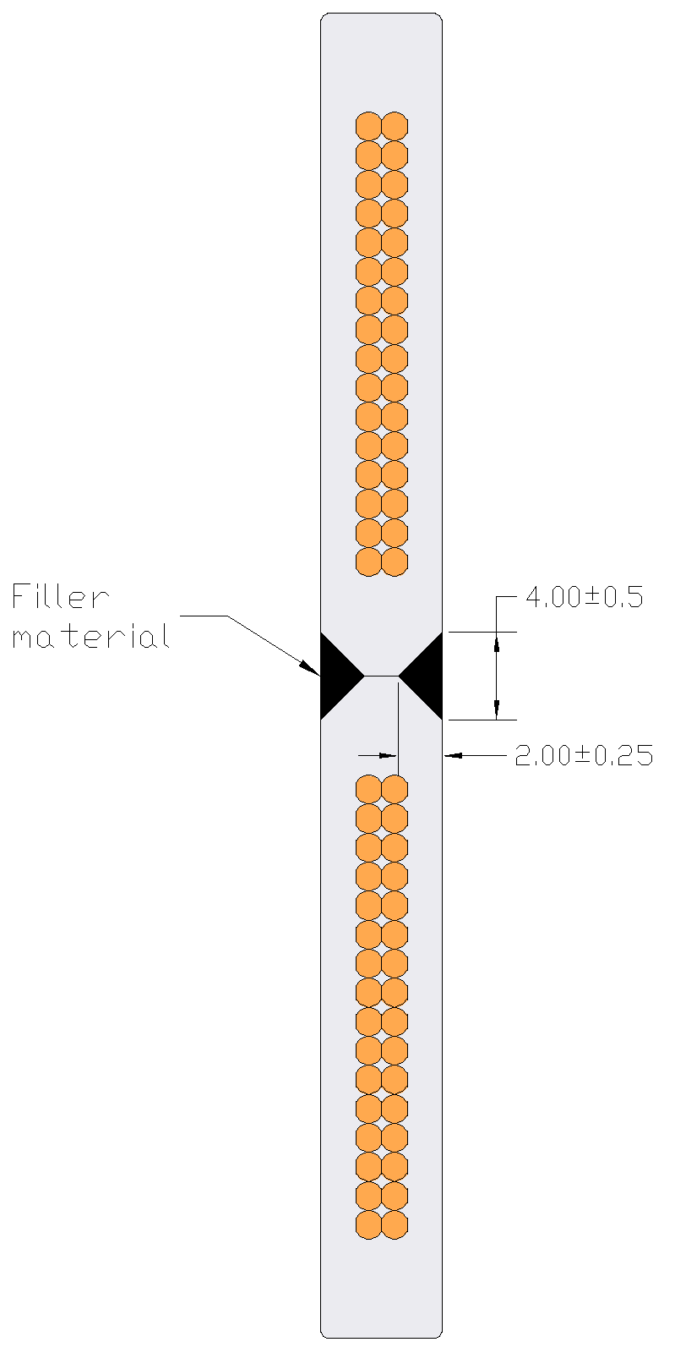
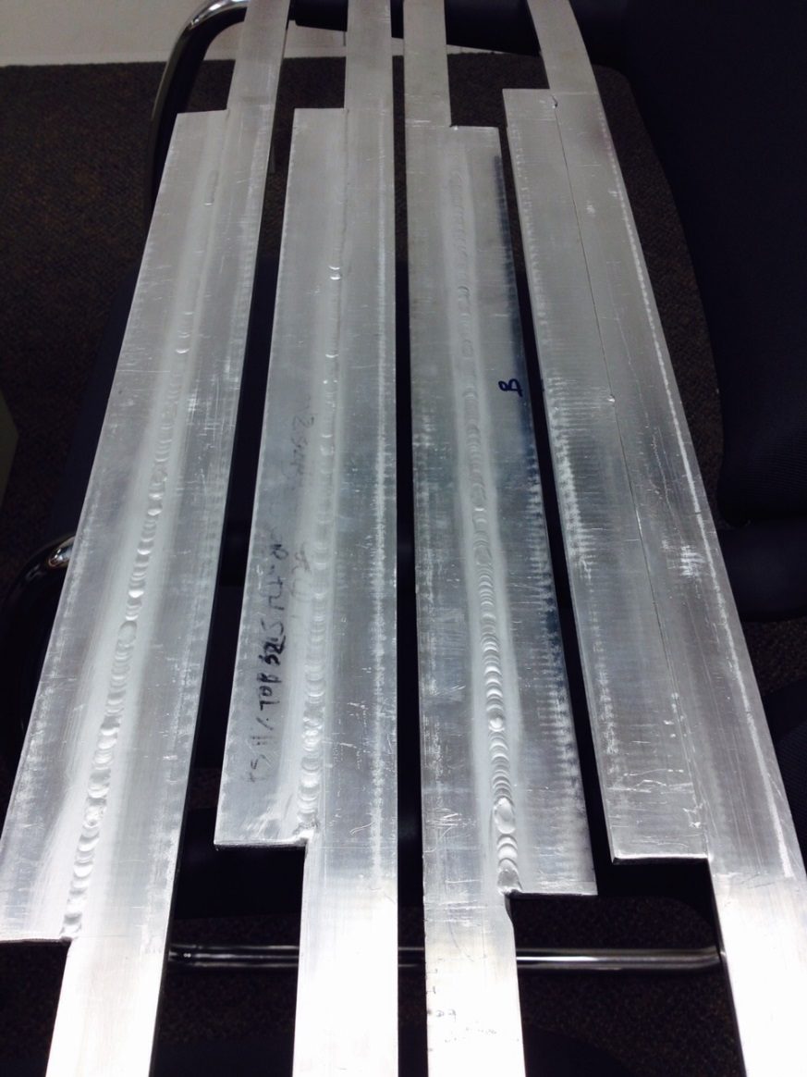
Electrical joints
Layer-to-layer joint
Coil-to-coil joint
Ongoing splice R&D at FNAL:
  Several splices of both designs were TIG welded using 1199 filler;
  The cables are being etched to extract and test strand Ic;
  Next steps will include more samples for I_{c} measurements (different weld prep) and for RRR measurements.
Target parameters: <20% degradation in I_{c} and <1nΩ resistance at 4.2 K.
A detailed splicing procedure will be provided by FNAL.
No extra trim lead.

Slide 12
Cryostat

Slide 13
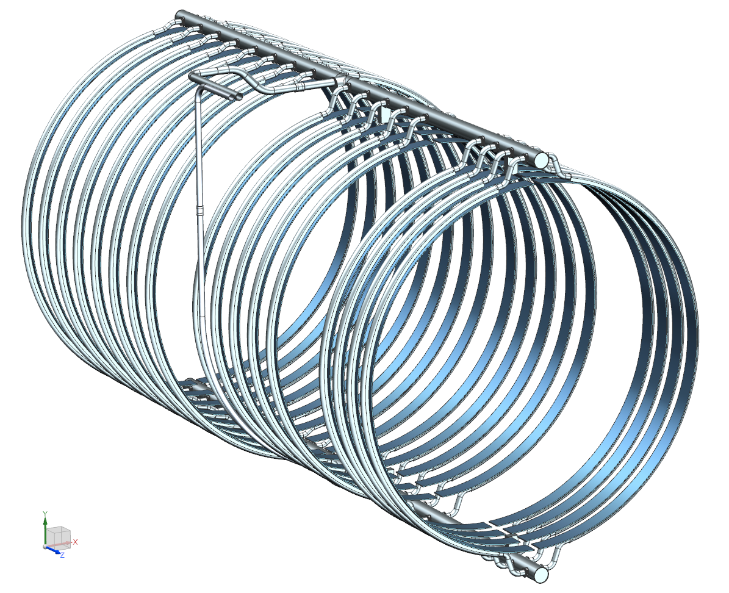
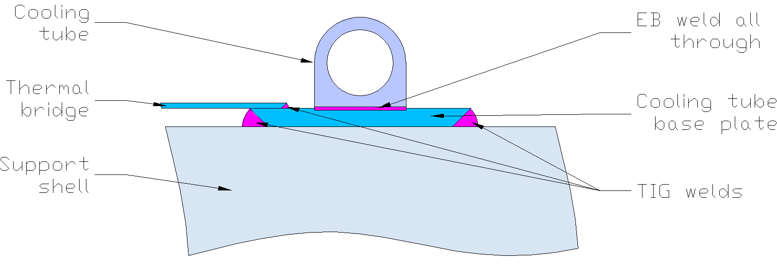
Thermosiphon System
2-phase He return
LHe supply
Return manifold
Thermal bridges are the main elements of the coil heat extraction. The bridge connection to the cooling system is an important design detail;
The D-shaped cooling tubes are EB-welded to the base plates made of 5N Al;
The baseplate connection to the shells is being analyzed:
  ~0.1% strain from Lorentz forces adds to the tube stress;
  For seamless extrusions, Al 6061-T6 has a sufficient allowable stress (87 MPa) to handle the extra load (Process Piping code B31.3-2014) and Al 6063-T6 has insufficient allowable stress (69 MPa);
  For welded constructions, neither alloy has a sufficient allowable strength (55 MPa and 39 MPa).
Transition tubes
Supply manifold

Slide 14
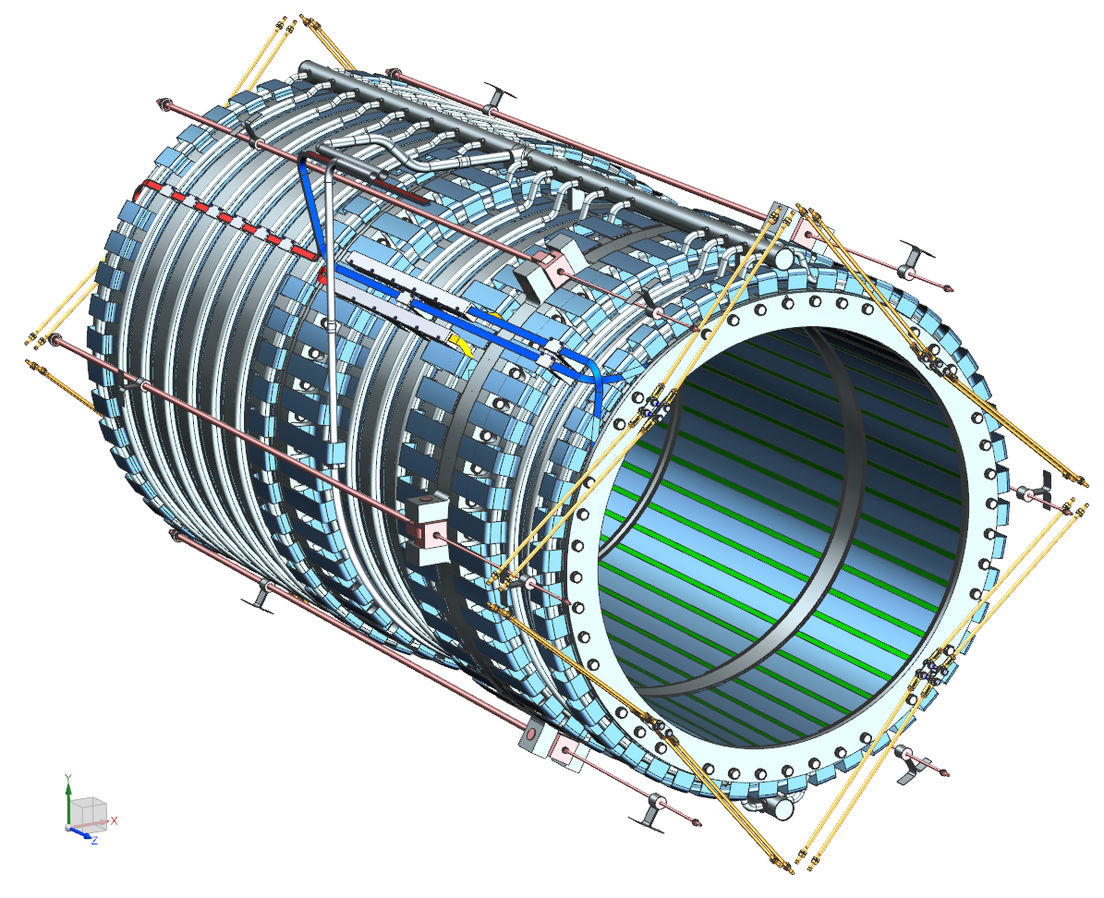
Cold mass suspension system
Axial anchor system consists of 12 Inconel-718 rods - 6 running from each end of the vacuum vessel and attaching to the spacer ring between the coils.
  Each rod connects to the vacuum vessel through the Belleville springs to compensate the thermal contraction.
Radial suspension system consists of 4 pairs of Inconel-718 rods connecting each end flange to the outer shell of the vacuum vessel.
  Half of the rods is loaded through the Belleville springs.

Slide 15
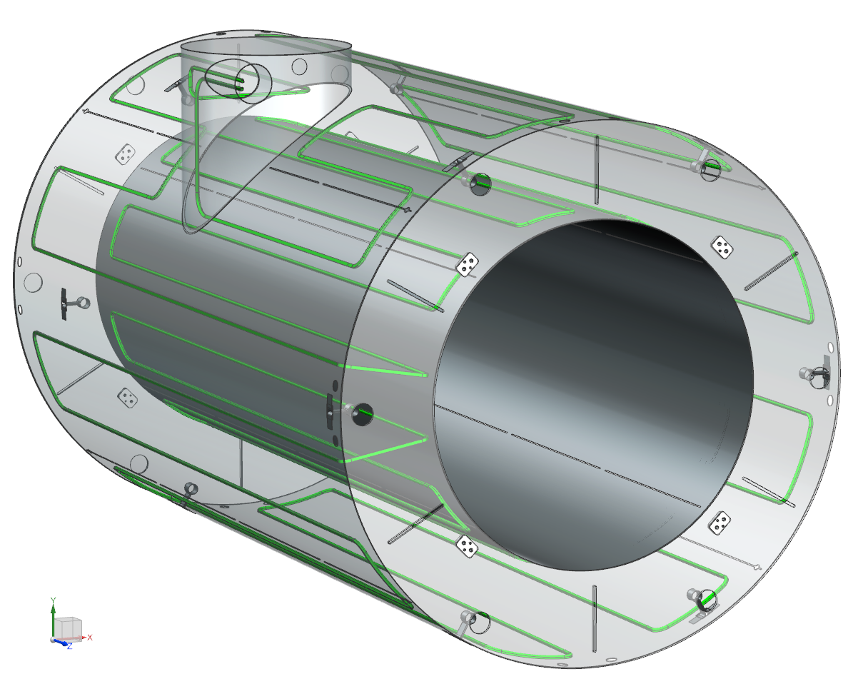
Thermal shield
Inner and outer shells are made of Al 6061-T6;
The LN₂ cooling tubes are attached to the cold mass side of the shield;
Two LN₂ circuits vs. one in the RDR;
There are axial slits to cut eddy currents and forces during quench.

Slide 16
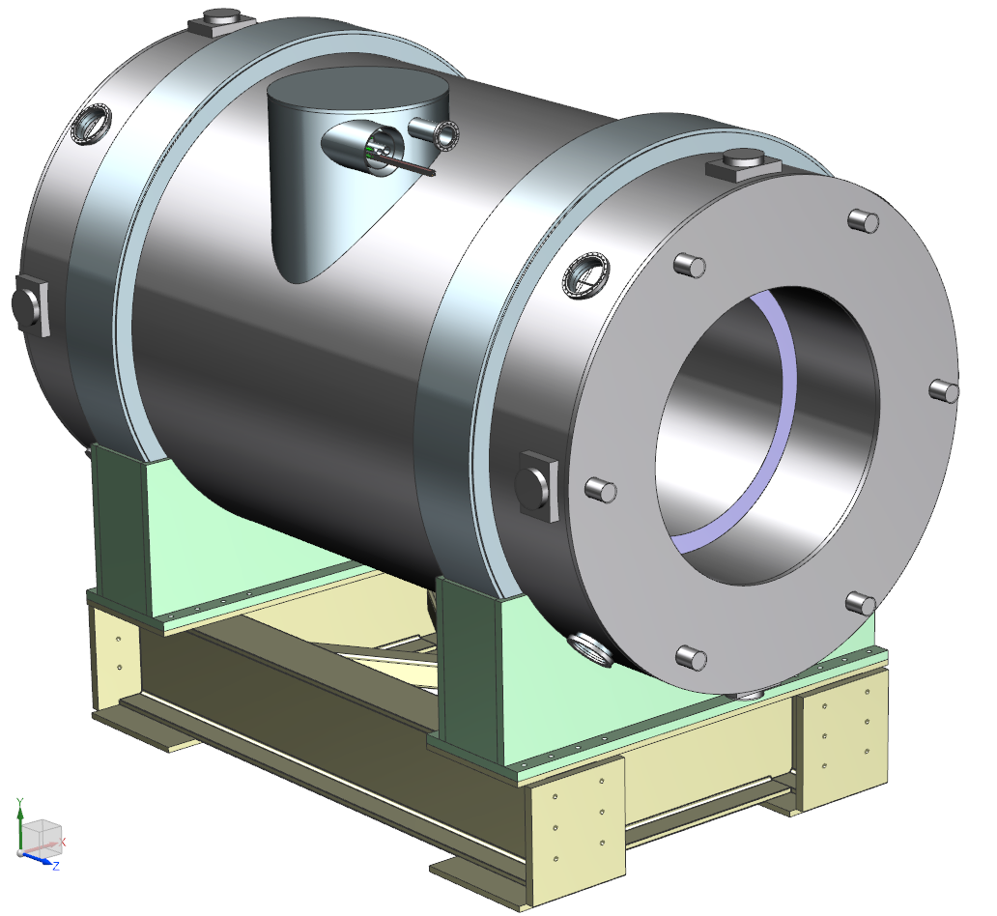
Vacuum vessel
Operating conditions:
  Up to 1 atm pressure in the magnet vacuum space while the inner bore is evacuated;
  Up to 1.34 atm pressure in the inner bore while the magnet vacuum space is evacuated;
  The magnet vacuum space and the inner bore evacuated at the same time;
  Up to 55 tonnes of the gravity load from the HRS on the inner shell.

Slide 17
Instrumentation

Slide 18
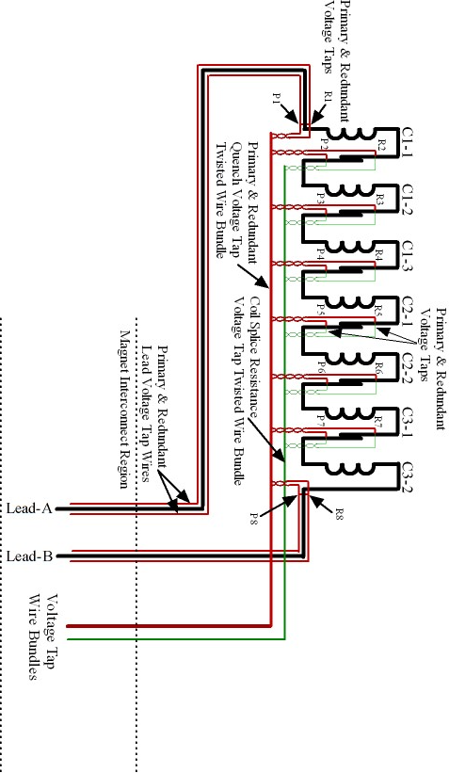
Instrumentation summary
No trim lead instrumentation
All the gauges/wires will be provided by FNAL

Slide 19
Magnetic analysis

Slide 20
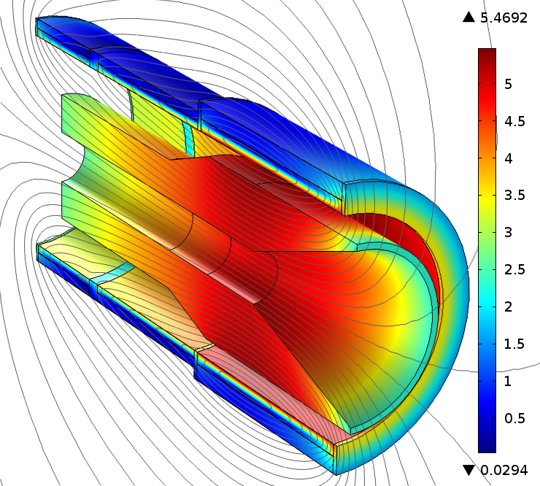
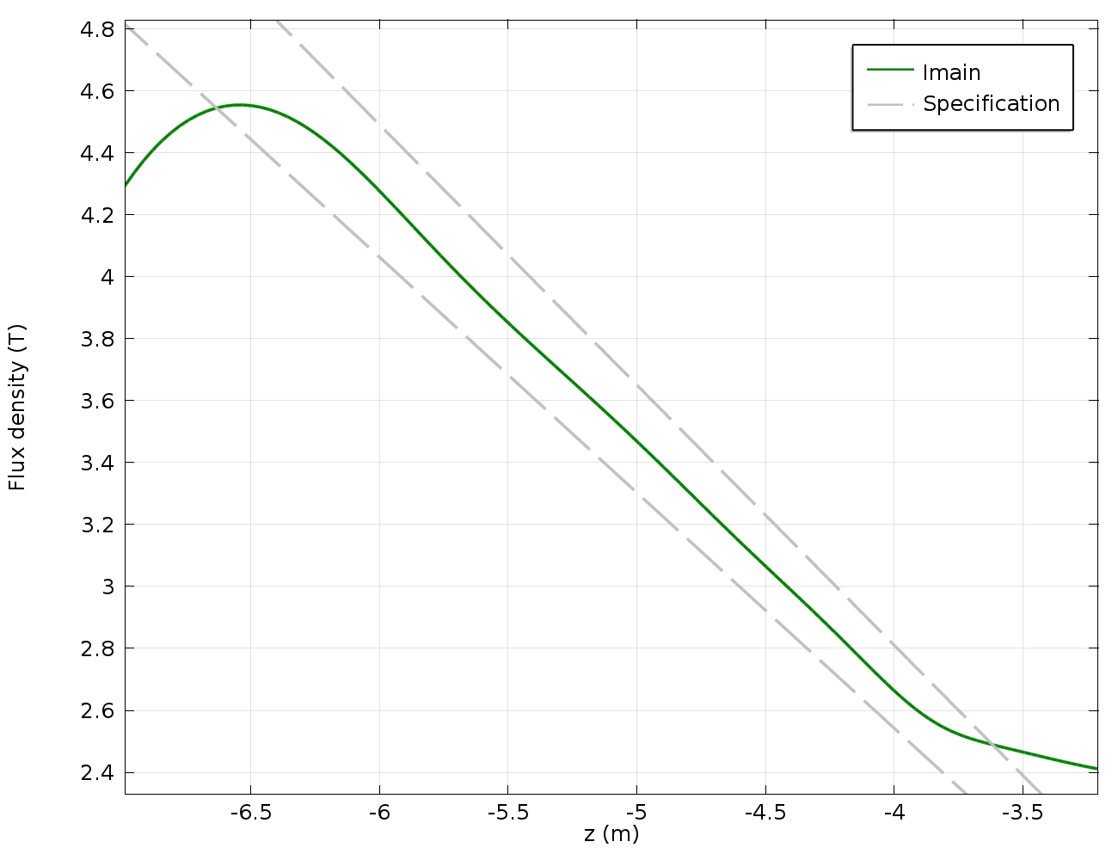
Magnetic field
No trim current variation;
Radiation shield (shown) is made of high-resistivity bronze (magnetic permeability of ≤1.10).

Slide 21
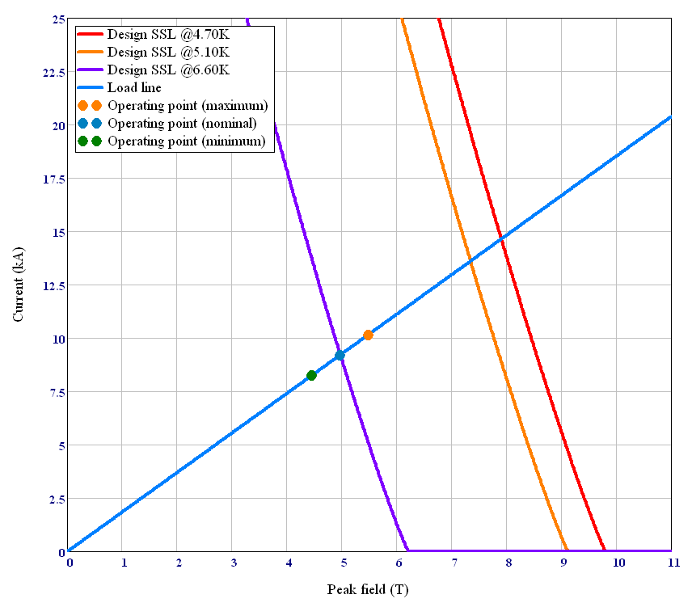
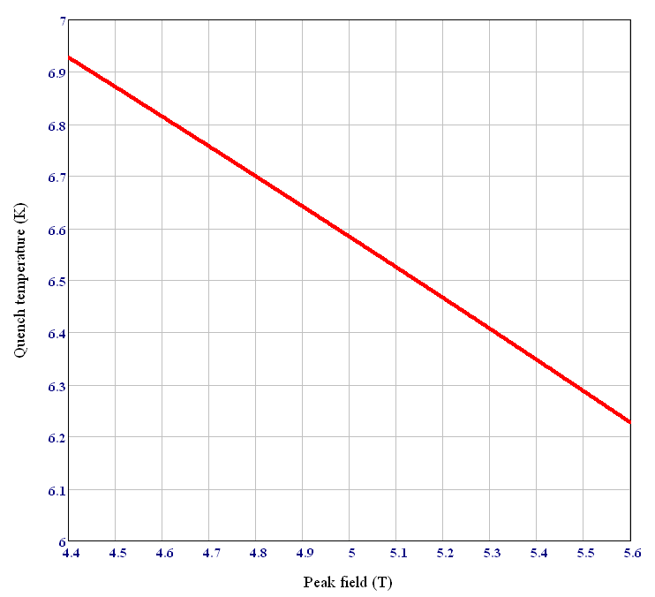
Load line
Maximum current
Nominal current
The 1.50 K thermal margin must be maintained during the nominal operation per the magnet requirements;
It defines the maximum allowed coil temperature of 5.10 K (at the nominal current).

Slide 22
Forces

Slide 23
Magnet parameters
The magnet shall be designed for 5.0 T on axis;
  May be tested up to this field.
Will operate at 4.6 T on axis.

Slide 24
Stability

Slide 25
Magnet stability
Ability of the magnet to recover from a short-term transition from superconducting to normal state;
Characterized by the minimum quench energy (MQE) – the minimum energy deposited in the coil causing the irreversible transition to normal state (quench);
3D thermal model of the cable:
    Actual cable geometry and all properties are taken into account;
    Heat pulse is delivered to a short section of the cable within a small time frame;
    MQE = minimum heat pulse energy that starts the quench;
  Coupled to 2D current sharing model:
    Simulates the current sharing between the Rutherford type cable and Al stabilizer;
    3D is not feasible because of the element size restriction (~microns);
  Fully parametric;
  Benchmarked using the CMS cable tests.

Slide 26
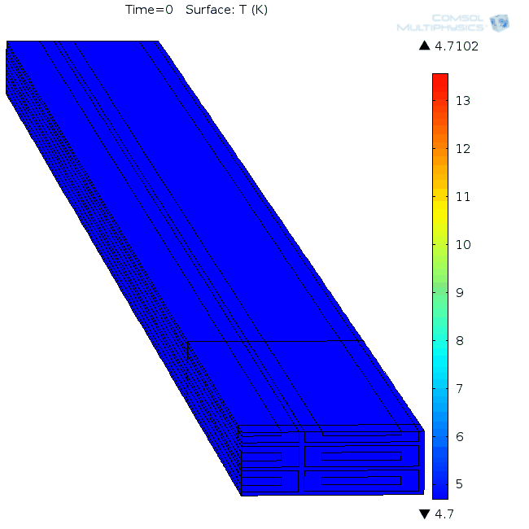
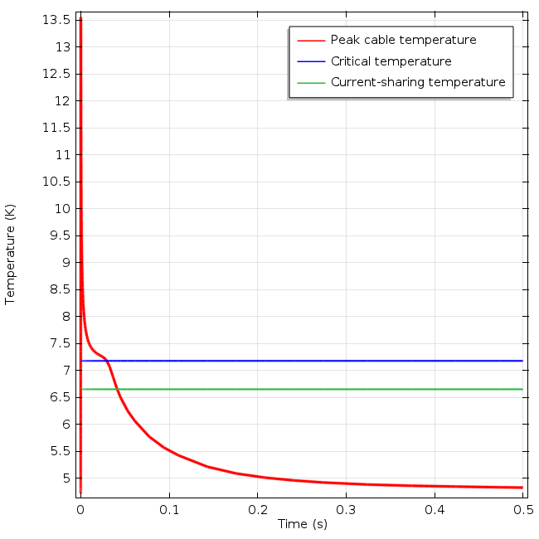
Magnet stability
T = 4.7 K, RRR_{Al} = 600, RRR_{Cu} = 80, Q = 168 mJ

Slide 27

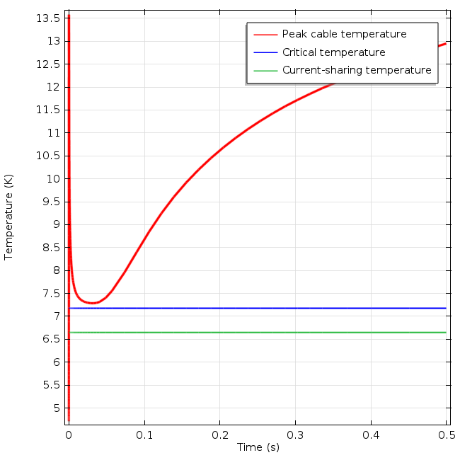
Magnet stability
T = 4.7 K, RRR_{Al} = 600, RRR_{Cu} = 80, Q = 169 mJ

Slide 28
MQE vs. RRR and T

Slide 29
Quench protection

Slide 30
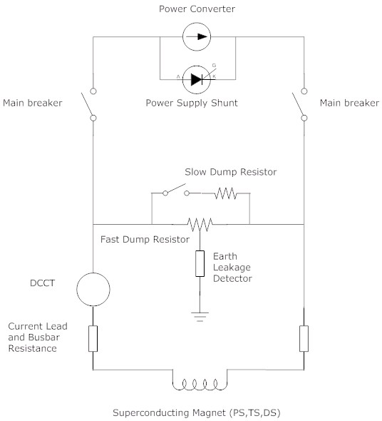
Quench protection system
The quench protection system continuously monitors the voltages during the magnet operation;
The quench event occurs when the resistive voltage exceeds the detection threshold of 0.5 V;
  the system waits for 1 s to give the magnet a chance to recover;
If the voltage does not drop below the detection threshold after the delay, the main breaker is disconnected and the magnet discharges through the fast dump resistor.

Slide 31
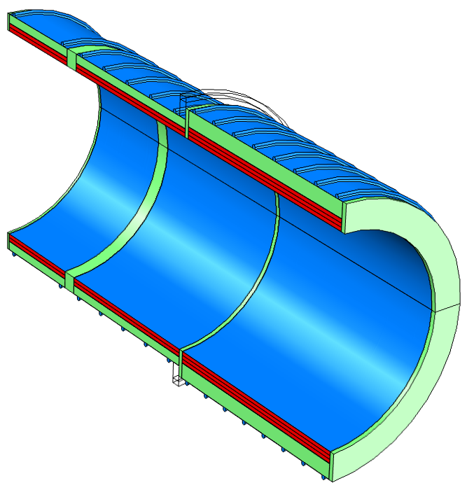
FEM quench model
The goal of the quench analysis was to determine the peak temperatures and voltages in the magnet at different operating conditions;
Primary tool - COMSOL Multiphysics code, benchmarked against QLASA code;
Included all the relevant features, including the individual coil layers, interlayer and ground insulation, thermal bridges on the inner and outer surfaces of the coils, coil support structures and the HRS;
Two strategic quench locations considered: high-field (HF) region in the inner layer of the 3-layer coil and the low-field (LF) region at the magnet end adjacent to the TS.
Low field location
Thermal bridges
High field location

Slide 32
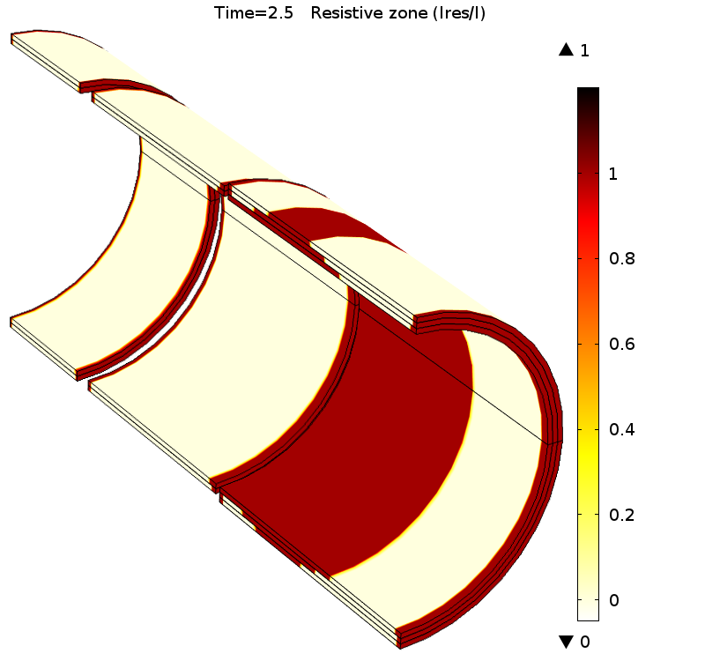
Beginning of the quench
Initial quench location

Slide 33
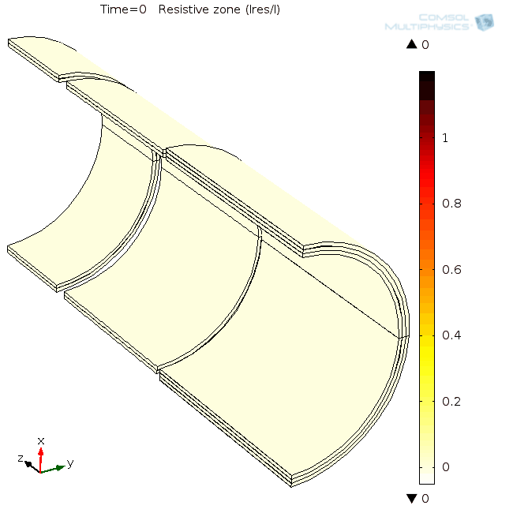
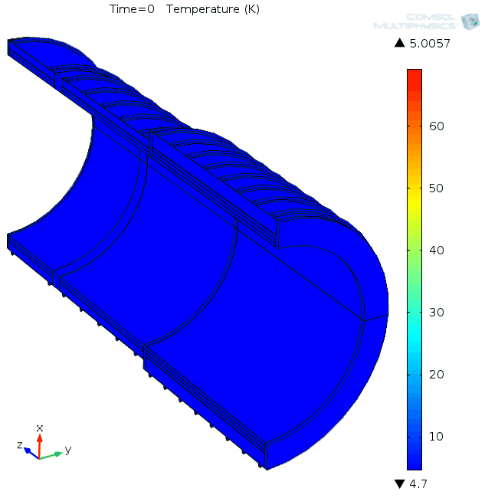
Resistive zone and temperature
RRR_{Al} = 600, with TB and EC, no HRS

Slide 34
Normal operation
RRR_{Al} = 100, with the HRS
The RRR of Al degrades from 500 to 100 in ~1 year of operation.
The peak temperature goes up to only ~80 K, but the peak resistive voltage goes up to 300 V.

Slide 35
Quench protection failure
A catastrophic failure of QPS was considered as part of the risk assessment:
  The extraction circuit fails (both dump switches or a bus-bus short), all stored energy dissipates in the cold mass.
The highest temperature is for the LF quench at the maximum RRR. Still well below the room temperature.
The highest resistive voltage is 800 V at the HF quench and the minimum RRR.

Slide 36
Quench forces
The HRS is made of a high-resistivity bronze to minimize quench eddy currents;
The peak dynamic axial force on the cold mass due to interaction with the HRS is 115kN, in the direction opposite to the static PS-TS force;
The 2-way axial support system shall be designed to intercept forces in both directions.

Slide 37
Structural design

Slide 38
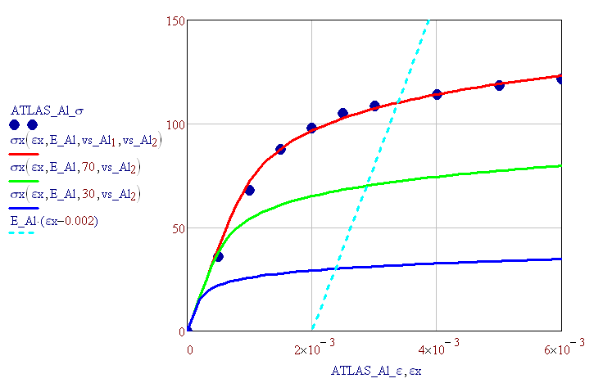

Elasto-plastic analysis
Stress-strain curves were measured on NbTi/Cu strands and Al stabilizer;
The Ramberg–Osgood equation was fitted on the experimental data to extrapolate for larger strains;
Each cable (1549 total) was individually modeled with the Rutherford cable, stabilizer and insulation.

Slide 39
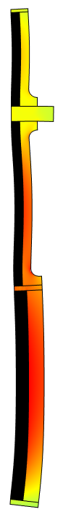
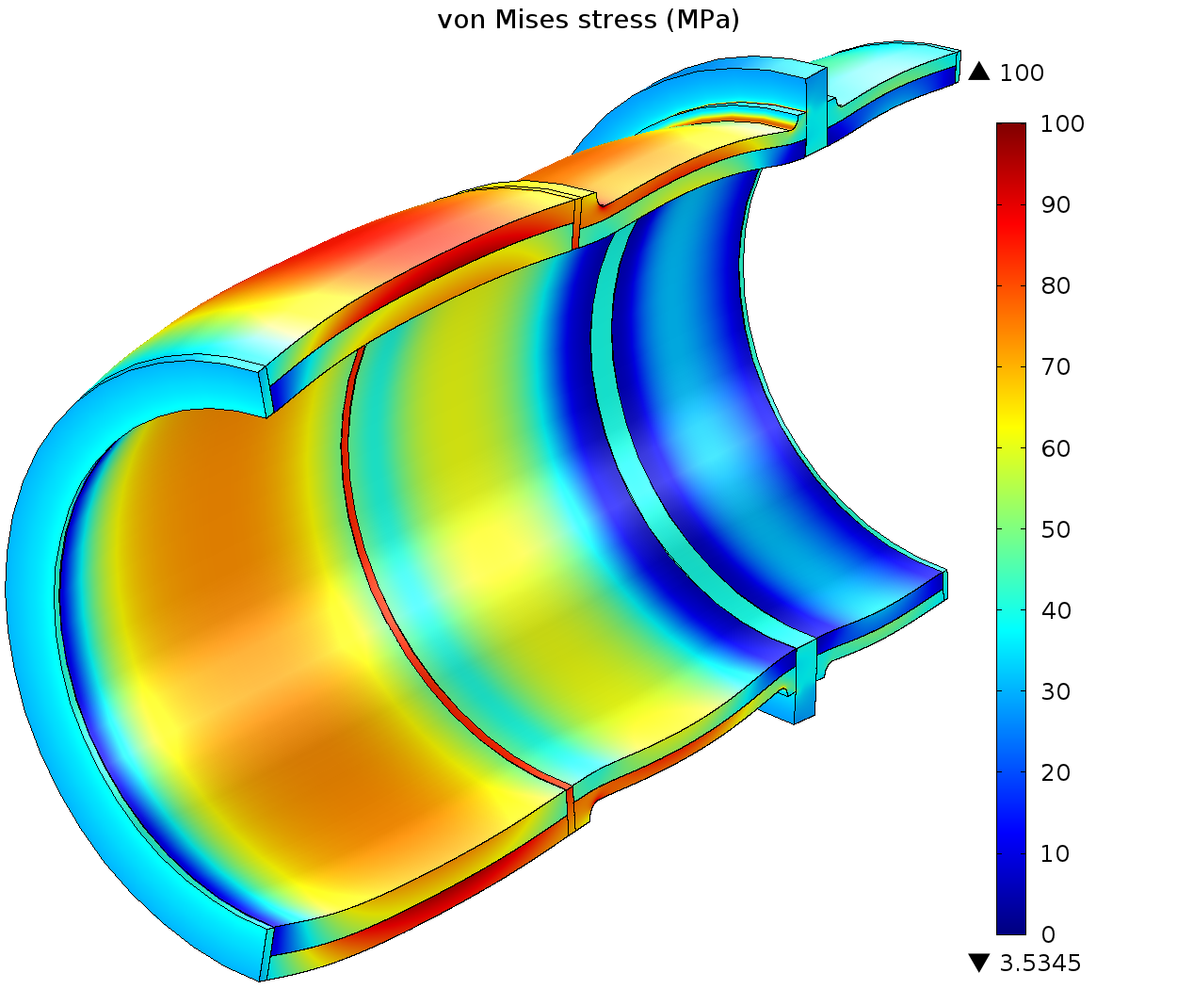
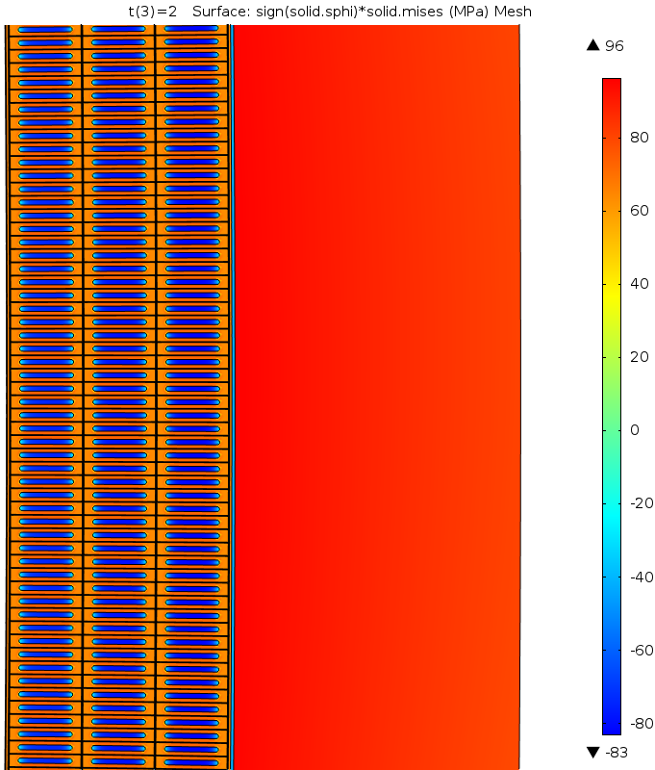
Shell thicknesses: Al Y.S. = 80MPa (cold)
T = 5 K, I = I_{max}
96 MPa
Shell thicknesses (elastic → elastoplastic):
  Non-TS end: 83 mm → 125 mm;
  Middle: 50 mm → 70 mm;
  TS-end: 50 mm → 70 mm;
Shell stresses are within the maximum allowable values.

Slide 40
Thermal analysis

Slide 41
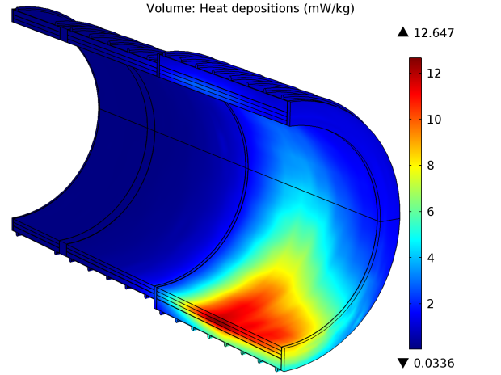
Heat loads

Slide 42
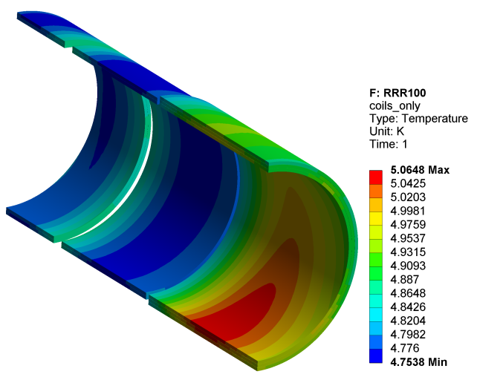
T₀=4.7 K, static+dynamic heat load

Slide 43
Radiation impact on RRR

Slide 44
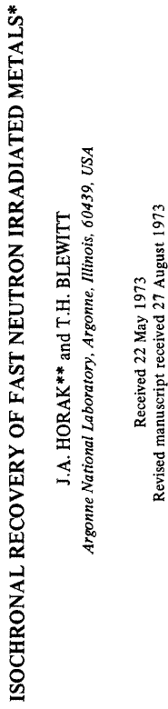
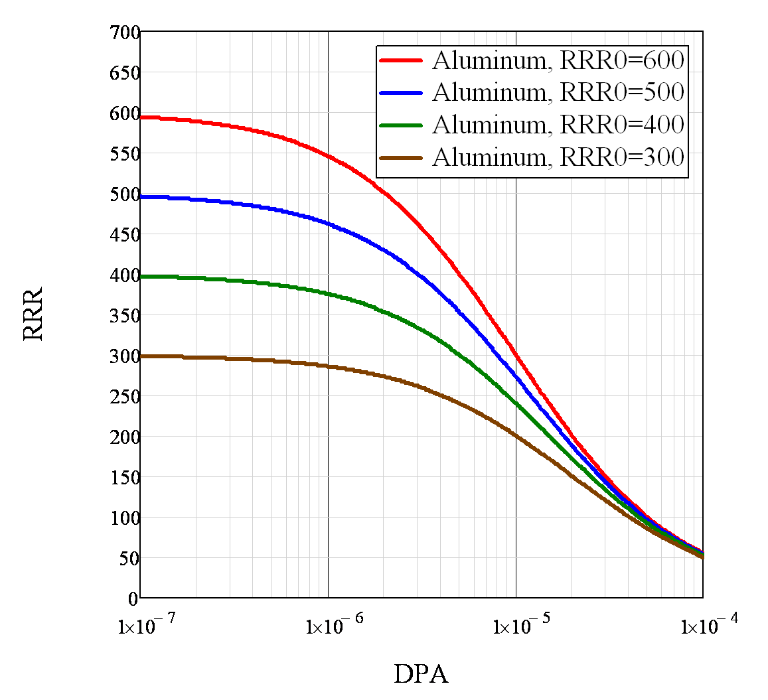
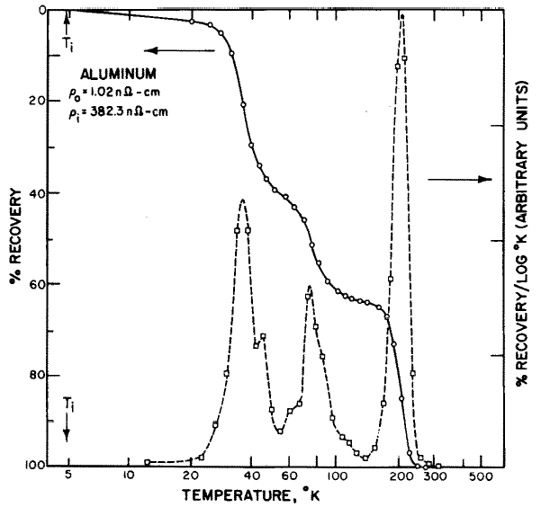
Impact of radiation on stabilizer properties
1 year of operation
(factor of 2 uncertainty)

Slide 45
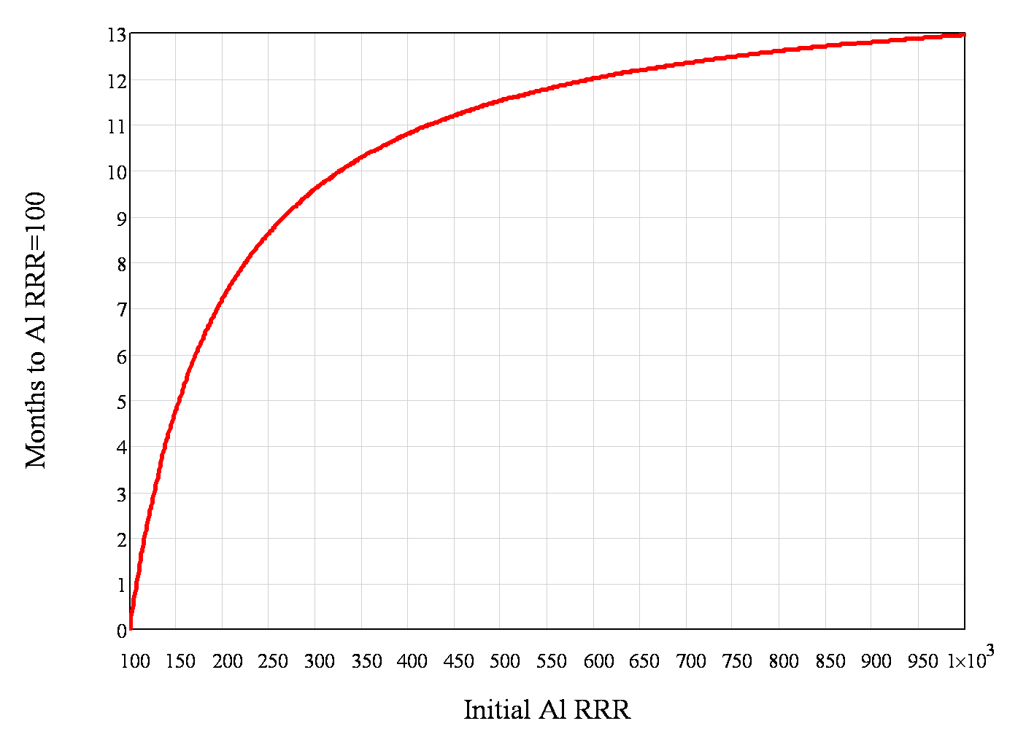
Irradiation time to degrade aluminum RRR to 100

