Slide 1
Measurement of damage rate of copper irradiated with 125 MeV protons at 12 K and comparison with PHITS results
Radiation Effects in Superconducting Magnet Materials 2015, 11-14th May, 2015 in FRIB/MSU
Y. Iwamoto^{*,a}, T. Yoshiie^{b}, M. Yoshida^{c}, T. Nakamoto^{c}, M. Sakamoto^{b}, Y. Kuriyama^{b}, T. Uesugi^{b}, Y. Ishi^{b}, Q. Xu^{b}, H. Yashima^{b},
F. Takahashiª, Y. Mori^{b}, T. Ogitsu^{c}
ªJAEA ^{b}KURRI/Kyoto Univ. ^{c}KEK

Slide 2
Outline
Introduction
Development of cryogen-free cooling system
Measurement of damage rate of the copper sample with 125 MeV proton irradiation at 12 K
Comparison of displacement cross section with PHITS results

Slide 3
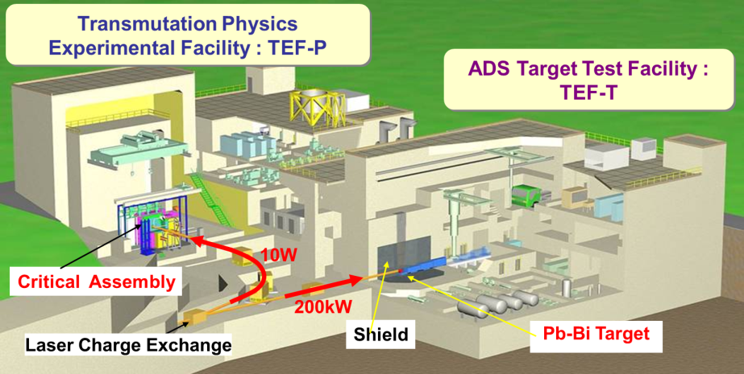
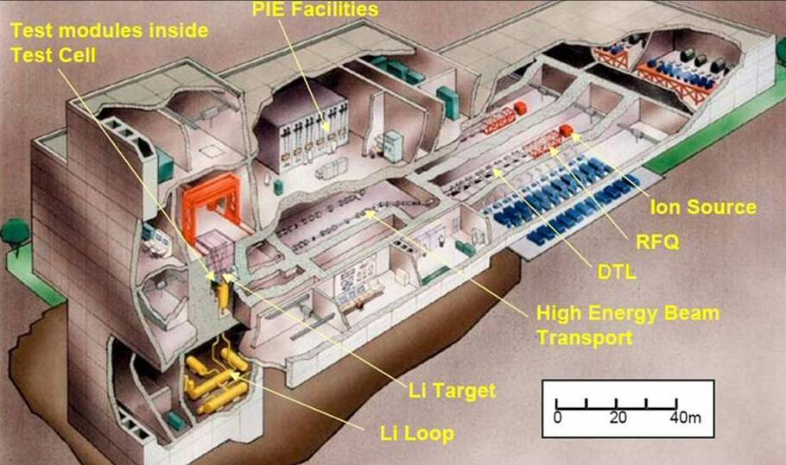
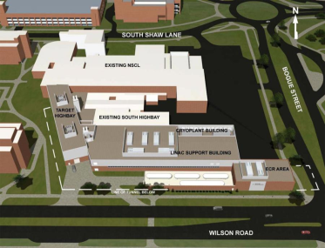
Introduction
Prediction of structural damage to materials under irradiation is essential for the design.
ADS Target Test Facility (TEF-T)
International Fusion Materials Irradiation Facility
Heavy ion facility
FRIB,RIBF,GSI
J-PARC
FRIB
proton, neutron
– 400MeV
deuteron, neutron
- 40MeV
proton, heavy-ion, neutron
~GeV/nucleon
To evaluate radiation damage, a fundamental parameter that characterizes lattice displacement events is required.
Displacement per atom (DPA) value is used as a damage-based exposure unit.
Notes:
As the power of accelerators is increasing,
the prediction of the structural damage to materials under irradiation is essential for the design.
There are new high-power materials irradiation facilities for ADS and fusion reactor currently in design.
Important particles are protons, neutrons and heavy ions with energy ranges from thermal to GeV/nucleon.
To evaluate radiation damage, a fundamental parameter that characterizes lattice displacement events is required.
Historically, displacement per atom (DPA) is used as unit of displacement damage intensity.

Slide 4
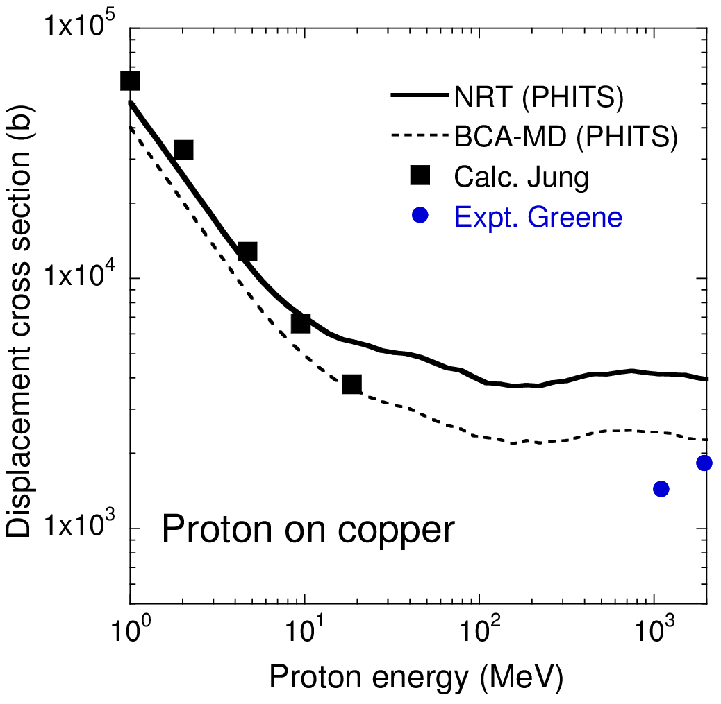
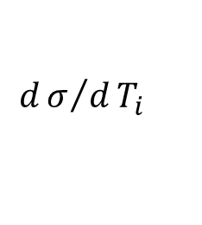
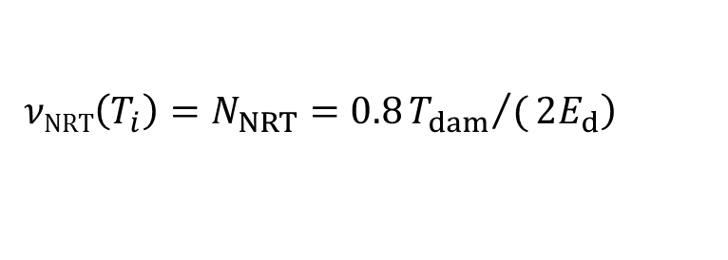
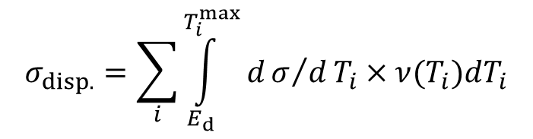


Lack of experimental data for high-energy proton irradiation
The average number of displaced atoms per atom of a material
DPA (displacement per atom) =
the number of Frenkel pairs
Displacement cross section
$$σ_{disp.}=\sum_{i}{\int_{E_{d}}^{T_{i}^{max}}{dσ/dT_{i}}}×ν(T_{i})dT_{i}$$
$$dσ/dT_{i}$$
:recoil atom energy distribution
$$\left.νNRT\left(T_{i}\right)=N_{NRT}=0.8{T_{dam}}/(2E_{d}\right)$$
Proceedings of AccApp’03,
2004, p.881–892.
:number of defects
$$T_{dam}$$
: Damage energy
Ed : threshold displacement energy
$$νBCAMD\left(T_{i}\right)=NBCAMD={ηN}_{NRT}$$
Y. Iwamoto, et al., JNST, 2014, p.881–892.
Defect production efficiency by BCA-MD
C.H.M. Broeders, A.Yu. Konobeyev, J. Nucl. Mater. 328 (2004) 197–214.
No experimental data except for 1.1 and 1.94 GeV proton in BNL
Notes:
DPA refers to the average number of displaced atoms per atom of a material.
DPA is defined by the integral of displacement cross section times irradiation fluence.
It is also related the number of Frenkel pairs.
In calculation, displacement cross section is expressed by the integral of recoil atom energy distribution and number of defects.
Number of defect is obtained by NRT model with damage energy to lattice atom and threshold displacement energy.
Or number of defect is obtained with defect production efficiency by MD-BCA.
This shows displacement cross section for proton irradiation on Cu.
Solid line shows calculated results by PHITS with this equation and this equation with defect production efficiency.
Black points shows calculated results by Jung.
On the other hands, there is no experimental data except for 1.1 and 1.94 GeV protons.

Slide 5
How to measure displacement cross section?
Irradiation on metal at cryogenic temperature
Recombination of Frenkel pairs by thermal motion is well suppressed.
Damage rate
Δρ_{metal}: Electrical resistivity change(Ωm)
Φ: Beam fluence(1/m²)
ρ_{FP}: Frenkel-pair resistivity (Ωm)
J. Nucl. Mater. 49 (1973/74) 161.
Resistivity increase is the sum of resistivity per Frenkel pair
BNL data: Cryostat assembly for sample irradiation consisted of
complicated system to deliver a flow of liquid cryogen.
Hard to measure systematic data at other facilities with same device.
Development of cryogen-free cooling system
Measurements of damage rate of Cu under cryogenic irradiation
Notes:
Here we can see how to measure displacement cross section.
In experiments, we can not measure DPA directly.
Displacement cross section could be experimentally validated in Irradiation at cryogenic temperature
when Recombination of Frenkel pairs by thermal motion is well suppressed.
Experimental cross section is expressed by damage rate defined as the ratio of electrical resistivity change to beam fluence.
Frenkel-pair resistivity is given by other researchers.
In this equation, It is assumed that Resistivity increase is the sum of resistivity per Frenkel pair
In BNL experiments, cryostat assembly for sample irradiation consisted of
complicated system to deliver a flow of liquid cryogen.
Therefore, it is hard to measure systematic data at other facilities with same device.
The purpose of this work is
Development of cryogen-free cooling system
Measurements of damage rate of Cu under cryogenic irradiation.
Useful information for degradation of the stabilizer of superconductor
.
This graph shows the calculated results by PHITS and calculated data by Jung and experimental data.
We can see that there is no experimental data except for 1.1 and 1.94 GeV proton
In the BNL experiments [9], the cryostat assembly for sample
irradiation consisted of a complicated cryogenics system to deliver
a metered flow of liquid cryogen (mixture of liquid nitrogen and
liquid helium) for controlling the sample temperature.
In such case, It is hard to measure damage rate at other accelerator facilities with same device.
Therefore, We have developed cryogen-free cooling system and measured damage rate of copper sample under cryogenic irradiation.
.

Slide 6
Outline
Introduction
Development of cryogen-free cooling system
Measurement of damage rate of the copper sample with 125 MeV proton irradiation at 12 K
Comparison of displacement cross section with PHITS results

Slide 7
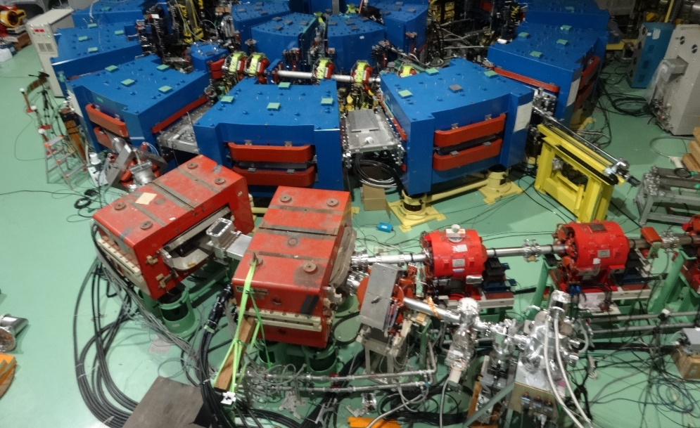
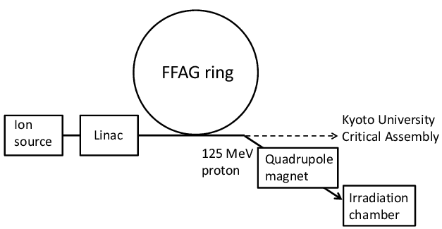
Beam line of FFAG accelerator facility
Fixed-Field Alternating Gradient (FFAG) accelerator facility
at Kyoto University Research Reactor Institute (KURRI)
Irradiation chamber
Quadrupole magnet
Proton energy: 125 MeV, 1 nA
Next slide: Irradiation chamber
Notes:
We developed irradiation sysytem in the beam line of the Fixed-Field
Alternating Gradient (FFAG) accelerator facility [16] at Kyoto University
Research Reactor Institute (KURRI).
Protons with energies of 125 MeV were incident on the irradiation chamber through a quadrupole magnet.
The full width at half maximum (FWHM) of the beam was 2.3 cm.
Next slide shows irradiation chamber.

Slide 8
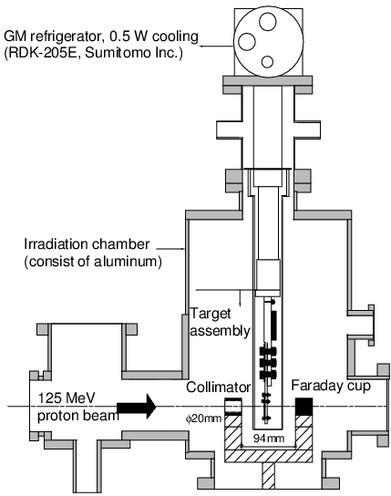
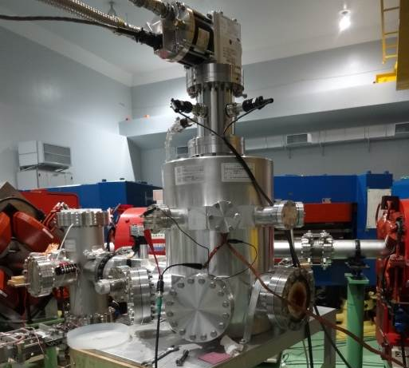
Irradiation chamber with GM cryocooler
GM cryocooler 500 mW cooling capacity at 4 K
(RDK-205E, Sumitomo inc.)
He gas lines
to compressor
Signal cable
Irradiation chamber
(consist of aluminum)
Cold head
proton
Next slide: Target assembly
rotary pump and
turbomolecular pump
Vacuum of 10⁻⁵ Pa
Notes:
This slide shows the irradiation chamber with the GM cryocooler with 500 mW cooling capacity at 4 K..
This is He gas lines to compressor, signal cable and irradiation chamber consist of aluminum.
Cold head was connected with target assembly.
A collimator was set in front of the target assembly and the beam current was measured by a Faraday cup.
The irradiation chamber was maintained under vacuum of about 1 105 Pa
using a rotary pump and a turbomolecular pump.
In next slide, I will show you detail about target assembly.
1 min

Slide 9
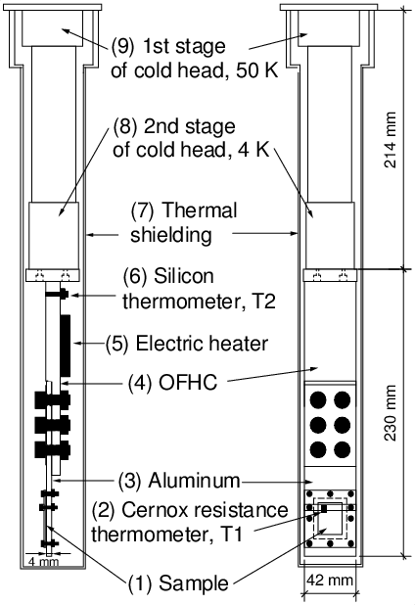
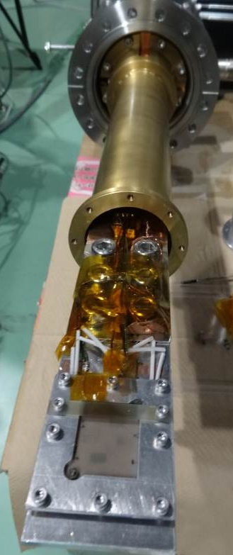
Target assembly
Sample was cooled by conduction coolant via Al (3) and oxygen-free high-conductivity copper (OFHC) (4).
Cylindrical pipe: intercept thermal radiation from ambient irradiation chamber.
Cold head of GM cryocooler
Target assembly
Electric heater:
Measurement of recovery of defects through annealing
300W/(m K) at 300K
220W/(m K) at 300K
Next slide: Sample
Notes:
Here we can see a picture and an illustration of the target assembly
and the cold head of the GM cryocooler.
Sample was cooled by conduction coolant via Al (3) and oxygen-free high-conductivity copper (OFHC) (4).
with high thermal conductivities (e.g., 220 W/(m K) for aluminum at 300 K and
300 W/(m K) for OFHC at 300 K).
An aluminum cylindrical pipe covered the whole target assembly
to intercept the radiation from the ambient irradiation chamber
To measure the temperature on materials,
Cernox resistance thermometer was set on the sample and Silicon thermometer was set on near Cold head.
Electric heater was use to measure recovery of defects through annealing.
Next, I will show you the sample.
1 min.

Slide 10
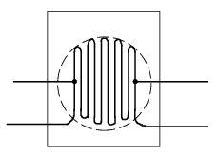
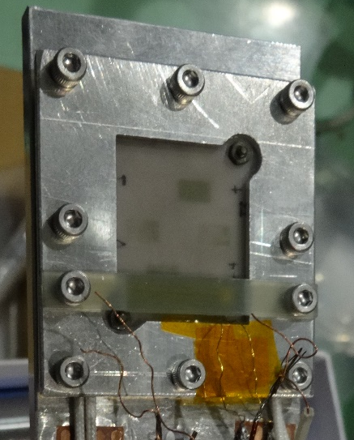
Sample and its retention
Copper wire
Spot welding
V+
V-
GFRP
I+
I-
Irradiation area, φ20 mm
1.5-mm-thick AlN ceramic sheet
Electrical insulation and high thermal conductivity
CX1050-SD Cernox
resistance thermometer
Excellent resistance to ionizing radiation
Material | Copper
Diameter (µm) | 250
Purity (%) | 99.999
Shape | Serpentine-shaped line Annealed for 1 h at 1000℃
Length between two potential points (mm) | 152
Al plate
Wire was carefully sandwiched between two 1.5-mm-thick AlN.
Next: Electrical resistance measurement
Notes:
A copper wire with a 250-μm diameter and 99.999% purity was set on the AlN sheet with a serpentine-shaped line.
The AlN Aluminium Nitride sheet was selected because of its
electric insulation and high thermal conductivity (21 W/m K at 4 K) [18].
The sample was annealed for 1 h at 1000 C before irradiation.
Two copper potential leads were connected to the sample
by spot welding. The length between the two potential points was 152 mm.
The wire was carefully sandwiched between two 1.5-
mm-thick AlN sheets by bolts to provide good thermal contact,
and precisely set within the irradiation area.
A glass-reinforced plastic (GFRP) beam was used
to fix the CX1050-SD Cernox resistance thermometer .
It was selected because of Excellent resistance to ionizing radiation.

Slide 11

Electrical resistance of copper wire
V+
Nano-voltmeter
V-
2182A Keithley Inc.
A current of ±100 mA was fed into copper wire with polarity changing at a frequency of 10 Hz.
TRIG link
RS232
I+
PC
Labview
Source:6221
I-
±100 mA
Cancel effects of thermal electromotive force
Precision of this resistance measurement was ±0.01 μΩ,
Corresponding to a resistivity of ±3 fΩ m.
$$ρ_{Cu}=R L/A$$
Electrical resistivity
V+
V-
R: Measured electrical resistance
L: Length between two potential points (152 mm fixed)
A : Area of the sample (4.91x10⁻² mm² fixed).
I+
I-
Next: Cooling test
Notes:
The electrical resistance of the copper wire was measured using
a combination of a current source and a nano-voltmeter .
A current of ±100 mA was fed into the copper wire with the polarity changing at a frequency of 10 Hz.
It is known that this method Cancel effects of thermal electromotive force.
The precision of this resistance measurement was ±0.01 lX, corresponding to a resistivity of ±3 fX m.
Electrical resistivity was defined as this equation using ….
As Length and area of the sample were fixed, electrical resistivity was obtained by R, easily.
Next slide shows cooling test.

Slide 12
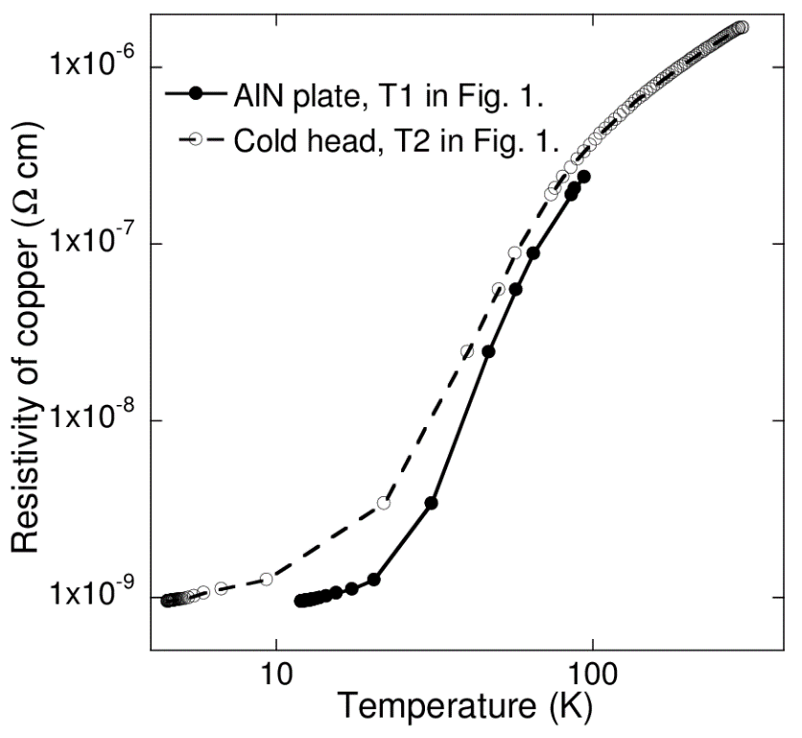
Cooling test for sample
Estimated heat entering the sample
through signal cable and thermal radiation
14 mW: much less than 500 mW power .
T2
4.6K@T2
Insufficient thermal contact between the aluminum columns and AlN sheets.
12K@T1
T1
Material | Copper
Resistivity at 298 K (Ω m) | 1.67 × 10⁻⁸ (52.0 mΩ)
Resistivity at 12 K (Ω m) | 9.44 × 10⁻¹² (29.4 μΩ)
Residual resistivity ratio (RRR) | 1769
Next slide: How to measure beam fluence on sample
Notes:
This graph shows the results of cooling test for sample.
X axis shows the temperature of thermometer at Ti and T2,
And y axis shows the resistivity of copper.
We can see that the minimum temperature of T1 was 12.0 K, although the temperature of T2 near the cold head was 4.6 K.
The estimated heat entering the target assembly was 14 mW which is much less than 500 mW cooling power.
The main reason for the different may be insufficient thermal contact
between the aluminum columns and the AlN sheets.
This table summarizes and Residual resistivity ratio of room temperature to 12 K.
In this work, 29.4 uW was measured at 12 K.

Slide 13
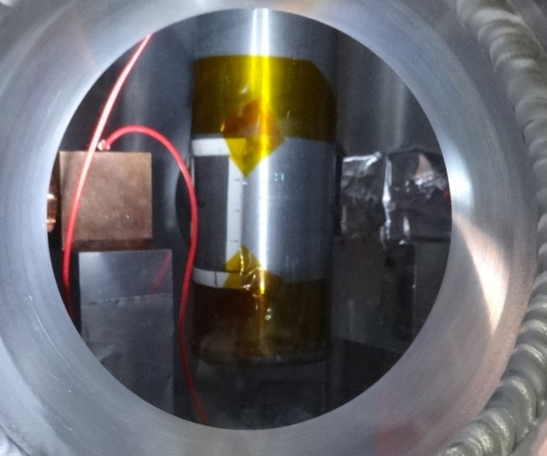
How to measure beam fluence(protons/m²) ?
The number of protons on the sample during irradiation was
measured in situ by the Faraday cup.
125 MeV Proton
Copper collimator with φ2 cm hole
Faraday cup, 3 cm thick Cu block
Reduce halo of proton striking the thermometer on the sample.
Cu block was insulated by Kapton polyimide tape
to ensure secondary electrons do not escape from Cu block.
Notes:
The number of protons on the sample during irradiation was measured in situ by the Faraday cup.
Once the beam passed through the copper collimator with a
2.0-cm diameter hole inside the irradiation chamber,
the beam entered into the sample and the 3-cm-thick Faraday cup.
The collimator was necessary to reduce the halo of protons striking the thermometer on the sample.
The Faraday cup was designed so that 125 MeV protons
were completely stopped in the copper block insulated by
Kapton polyimide tape to ensure that secondary electrons do not
escape from the copper block.

Slide 14
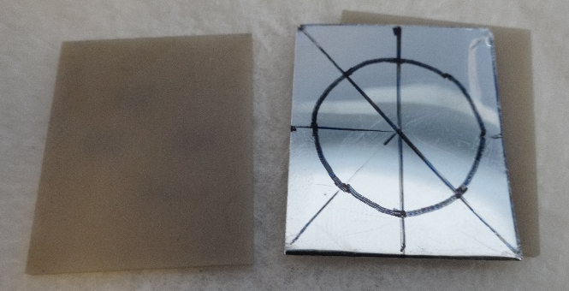
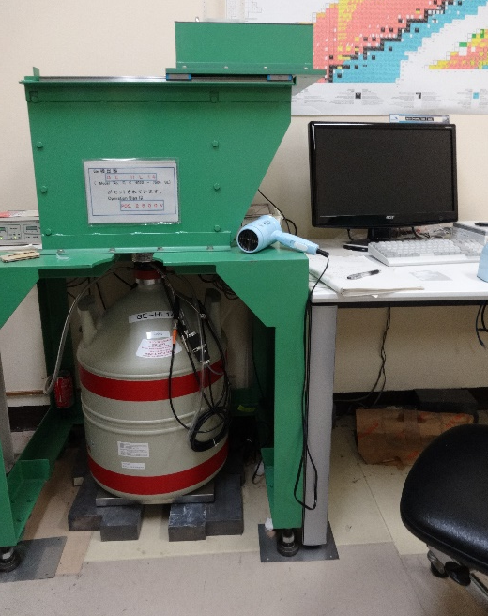
Calibration of Faraday cup using activation method
To quantify the number of protons in the sample region (φ2.0-cm)
1. Before cryogenic irradiation on the sample,
aluminum foil with 100-μm thickness was set in-between AlN sheets instead of Cu wire.
2. A 125 MeVproton beam with about 0.6 nA current irradiated
the activation foil for 5 h at room temperature.
3. After irradiation, the activation foil was analyzed for the ²⁷Al(p,x)²⁴Na reaction.
Notes:
For calibration of the Faraday
cup, an activation measurement was carried out to quantify the
number of protons in the sample region (2.0-cm diameter) using
aluminum foil with 100-lm thickness and a 2.0-cm diameter
before cryogenic irradiation on the sample. The activation foil
was set in-between AlN sheets instead of the sample. A 125 MeV
proton beam with about 0.6 nA current irradiated the activation
foil for 5 h at room temperature. After irradiation, the activation
foil was analyzed for the 27Al(p,x)24Na reaction using a germanium
detector at KURRI. The image of the beam spot in the 2-cm diameter
on the AlN sheet was also observed after irradiation. Table 2
lists the number of protons measured by the activation measurement.
For comparison, the Faraday cup measurement is also
shown.
The total number of protons measured by activation analysis is
less than that measured by the Faraday cup, because the activation
foil only counts protons within a 2.0-cm diameter while the Faraday
cup covers all beam spot including particles scattered by materials.
We assumed that this relationship is preserved for cryogenic
irradiation. The beam fluence /F (protons/m2) on the copper wire
for cryogenic irradiation can be expressed by the following
expression:
/F . d1:45 1017 CF T=d5:34 1013T . 2:72 103 CF d2T
where CF is the number of protons measured by the Faraday cup for
cryogenic irradiation. Note that a 125 MeV proton beam has a
Gaussian-like intensity distribution. Because the beam distribution
was not uniform within the diameter of 2.0 cm, we calculated the
proton fluence integrated over the copper sample using the Monte
Carlo particle transport code PHITS. The difference of the beam fluence
between the circle with the 2.0-cm diameter and the actual
serpentine shape was 6%.

Slide 15
Beam fluence on sample
 | ²⁴Na activity on aluminum foil with 100μm thick 2-cm diameter | Faraday cup
Number of protons with 0.6 nA and 5 h irradiation | 4.56×10¹³ (1.45 × 10¹⁷ protons/m²) | 5.34 × 10¹³
Activation foil only counts protons within a 2.0-cm φ while Faraday cup covers all spot including particles scattered by materials.
During cryogenic irradiation on sample,
beam fluence was obtained by this relationship.
Notes:
For calibration of the Faraday cup, an activation measurement was carried out to quantify the
number of protons in the sample region (2.0-cm diameter) using aluminum foil with 100-lm thickness and a 2.0-cm diameter
before cryogenic irradiation on the sample.
Table lists the number of protons measured by the activation measurement and Faraday cup.
The total number of protons measured by activation analysis is less than that measured by the Faraday cup,
because the activation foil only counts protons within a 2.0-cm diameter while the Faraday
cup covers all beam spot including particles scattered by materials.
We assumed that this relationship is preserved for cryogenic irradiation.
The beam fluence /F (protons/m2) on the copper wire
for cryogenic irradiation can be expressed by the following
expression:
/F . d1:45 1017 CF T=d5:34 1013T . 2:72 103 CF d2T
where CF is the number of protons measured by the Faraday cup.
During cryogenic irradiation on sample,
beam fluence was obtained by this relationship.

Slide 16
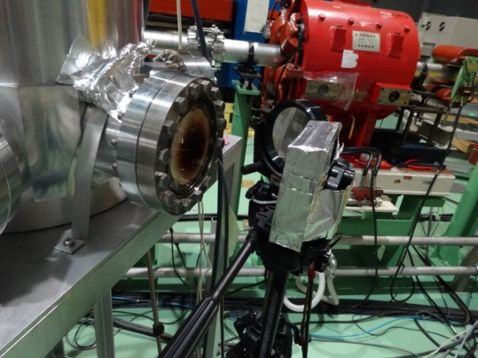
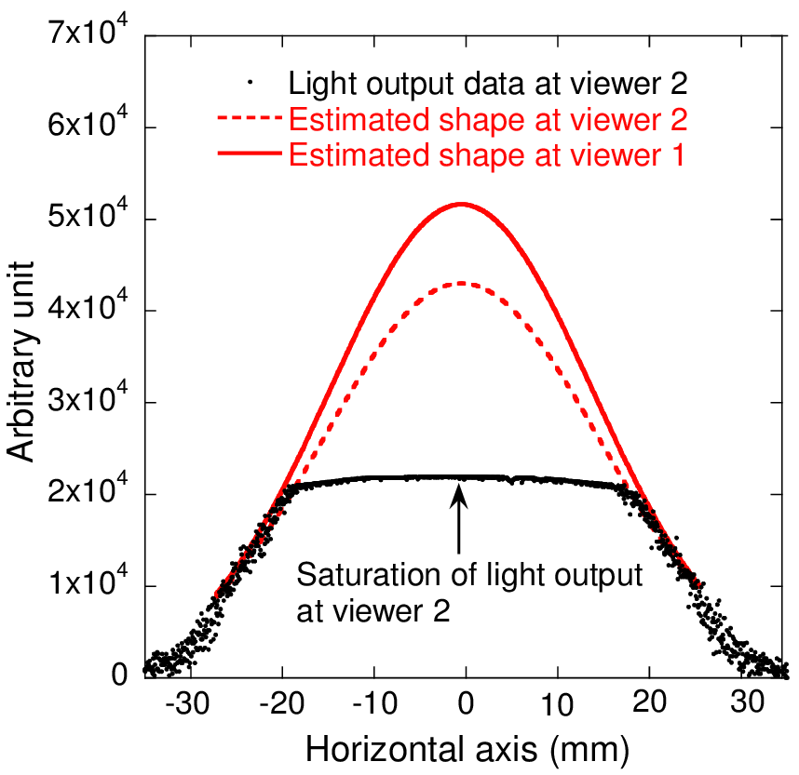
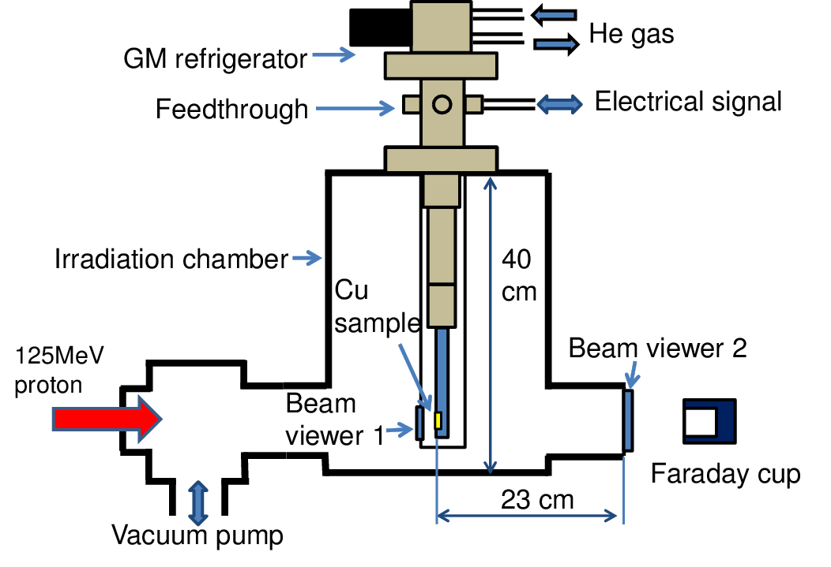
Estimation of beam shape
Beam viewer 2
1. Data of beam image on viewer 2 was sent to a PC and analyzed.
2. As the light output is saturated around peak area,
data is fitted by Gaussian equation to estimate the shape at around peak.
3. Beam transport simulation between the sample and the viewer 2 was carried out using PHITS
Full width at half maximum of the beam: 2.3 cm
Notes:
This slide shows estimation of beam shape.
Estimation procedure was as followings.
First, Data of beam image on viewer 2 was sent to a PC and analyzed.
Then, As the light output is saturated around peak area,
data is fitted by Gaussian equation to estimate the shape at around peak.
Finally, Beam transport simulation between the sample and the viewer 2 was carried out using PHITS
As a results, we estimated Full width at half maximum of the beam to be 2.3 cm.

Slide 17
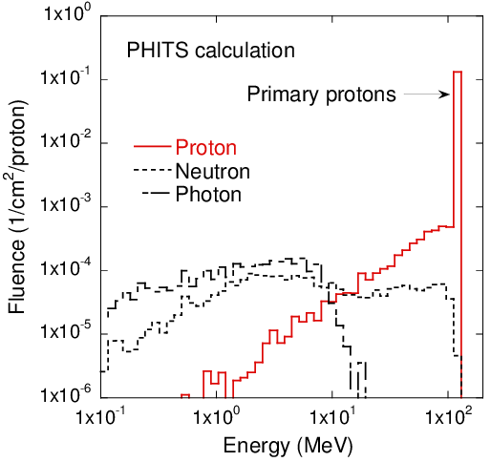
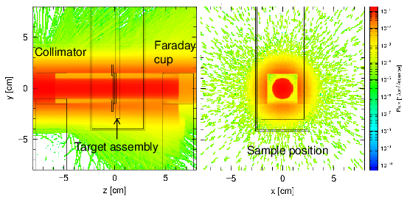
Estimation of background effects on the sample using PHITS
protons
sample
Because ratio of the number of protons with E >120 MeV to total was 97%, structural materials did not introduce an undesirable heat deposition.
Predicted heat generation in sample: 5 mW at 1 nA
To investigate effects on resistivity change, calculated displacement cross-sections were multiplied by fluence calculated by PHITS with E <120 MeV.
Resistivity changes <120 MeV / Total resistivity changes
6 % for proton, 0.5 % for neutron
Notes:
Estimation of background effects on the sample was performed using PHITS
This figure shows the two-dimensional distribution of protons and particle distribution on sample.
Because the ratio of the number of protons with energies >120 MeV
to the total number of protons was 97%, we assumed that the structural materials did not introduce
an undesirable heat deposition as a background into the sample.
The calculation predicted heat generation of 5 mW in the sample produced by 125 MeV proton irradiation at 1 nA beam current.
On the other hands, to investigate effects on resistivity change, calculated displacement cross-sections were multiplied
by fluence calculated by PHITS with E <120 MeV.
As a results, the ratio of Resistivity changes <120 MeV / Total resistivity changes
was 6 % for proton and 0.5 % for neutron.
In the case of resisitivity change, we can see that background effects are small.

Slide 18
Outline
Introduction
Development of cryogen-free cooling system
Measurement of damage rate of the copper sample with 125 MeV proton irradiation at 12 K
Comparison of displacement cross section with PHITS results

Slide 19
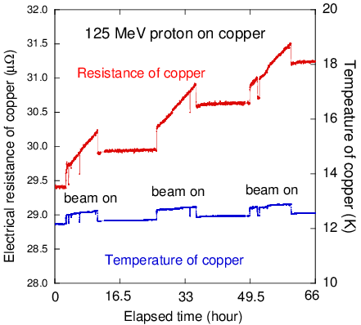
Electrical resistivity changes of copper during irradiation
Mainly resulted from temperature increase by beam heating.
Total electrical resistance increase:
1.81 μΩ
1 nA
Electrical resistance increase due to 0.4 K increase: 0.28 μΩ
Electrical resistance increase
due to irradiation: 1.53 μΩ
φ (protons/m²) | Resistivity increase Δρ_{Cu} (Ω m) | Damage rate (Ω m³/proton)
1.45×10¹⁸ | 4.94×10⁻¹³ | 3.41×10⁻³¹
Notes:
Figure shows copper resistance and temperature on sample
during proton irradiation for three beam runs with an 1 nA.
The jump in the resistance at the beam-on and beam-off times mainly resulted
from the temperature increase by beam heating.
Total electrical resistance increase:1.81 μΩ
Electrical resistance increase due to 0.4 K increase: 0.28 μΩ
Τηερεφορε, Electrical resistance increase due to irradiation: 1.53 μΩ
Φιναλψ ωε οβταινεδ 3.41×10⁻³¹ Ω m³/proton damage rate.
Table 3 summarizes the obtained data of the integrated proton fluence,
electrical resistivity change of copper, and damage rate, which is
the ratio of resistivity change to proton fluence. The total beam fluence
on the sample was 1.45 1018 protons/m2.
The jump in the resistance at the beam-on and beam-off times mainly resulted
from the temperature increase by beam heating.
The total resistance increase of copper was 1.81 lX.
The electrical resistance increase due to the 0.4 K temperature increase was estimated to be 0.28 lX
(using the RRR measurement data at sample temperatures from 11 to 13 K).
From this result, the electrical resistance increase by irradiation was determined to be 1.53 lX, that is,
4.94 1013 X m resistivity.
Finally we obtaine 3.41x10-32 Wm3/proton using proton fluence.

Slide 20
Comparison with other experimental data
Source | Fast neutrons ANL-CP5-VI53 [1] | Fusion neutrons RTNS-II [2] | 125 MeV protons KURRI-FFAG | 1.94 GeV protons BNL [3]
Damage rate (10⁻³¹ Ω m³/particle) | 0.424 | 2.48 | 3.41 | 3.66
The damage rates by neutrons increase with incident energies up to 14 MeV.
Those by protons with energies >100 MeV are higher than the damage rate by 14 MeV neutrons.
[1] J.A. Horak, T.H. Blewitt, J. Nucl. Mater. 49 (1973/74) 161–180.
[2] M.W. Guinan, J.H. Kinney, J. Nucl. Mater. 108&109 (1982) 95–103.
[3] G.A. Greene, et al., Proceedings of AccApp’03, 2004, p.881–892.
Next slide: Recovery of defects through annealing
Notes:
This table indicates comparison with other experimental data for
fast neutrons [11], fusion neutrons [12], 125 MeV protons, and
1.94 GeV protons [9].
We can see that the damage rates by neutrons increase with incident energies up to 14 MeV [11,12], and those by protons with
energies >100 MeV are higher than the damage rate by 14 MeV
neutrons.
Next slide shows recovery of defects through annealing.

Slide 21
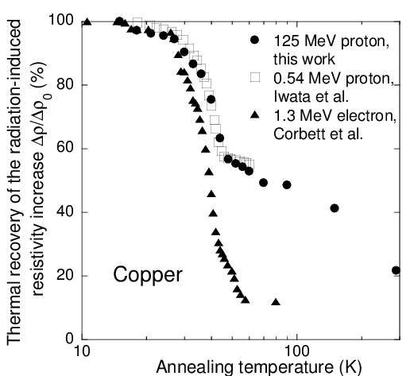
Recovery of defects through annealing after irradiation
Annealing effects up to certain temperatures were observed using isochronal schedule.
Warming the sample by the electric heater at annealing temperature.
(2) Holding the temperature of the sample constant for 10 min.
(3) Cooling the sample to 12 K.
(4) Measuring the electric resistivity
of the sample at 12 K.
Behavior of resistivity recovery for 125 MeV is similar to that for 0.54 MeV.
Essentially no damage was recovered below 15 K, where Frenkel defects were almost immobile.
Notes:
After irradiation, the annealing effects up to certain temperatures
were observed using the isochronal schedule [20] as follows:
(1) Warming the sample by the electric heater at the annealing
temperature.
(2) Holding the temperature of the sample constant for 10 min.
(3) Cooling the sample to 12 K.
(4) Measuring the electric resistivity of the sample at 12 K.
This figure shows the ratio of the remaining radiation-
induced resistivity (Dq) to the initial radiation-induced
resistivity (Dq0) plotted as a function of the annealing temperature.
The thermal recoveries for 1.3 MeV electron irradiation [20]
and 0.54 MeV proton irradiation [21] are also plotted in Fig. 6.
We find that the behavior of the resistivity recovery for 125 MeV
protons is similar to that for 0.54 MeV protons.
Essentially no damage was recovered below 15 K, where Frenkel defects were almost immobile.

Slide 22
Outline
Introduction
Development of cryogen-free cooling system
Measurement of damage rate of the copper sample with 125 MeV proton irradiation at 12 K
Comparison of displacement cross section with PHITS results

Slide 23
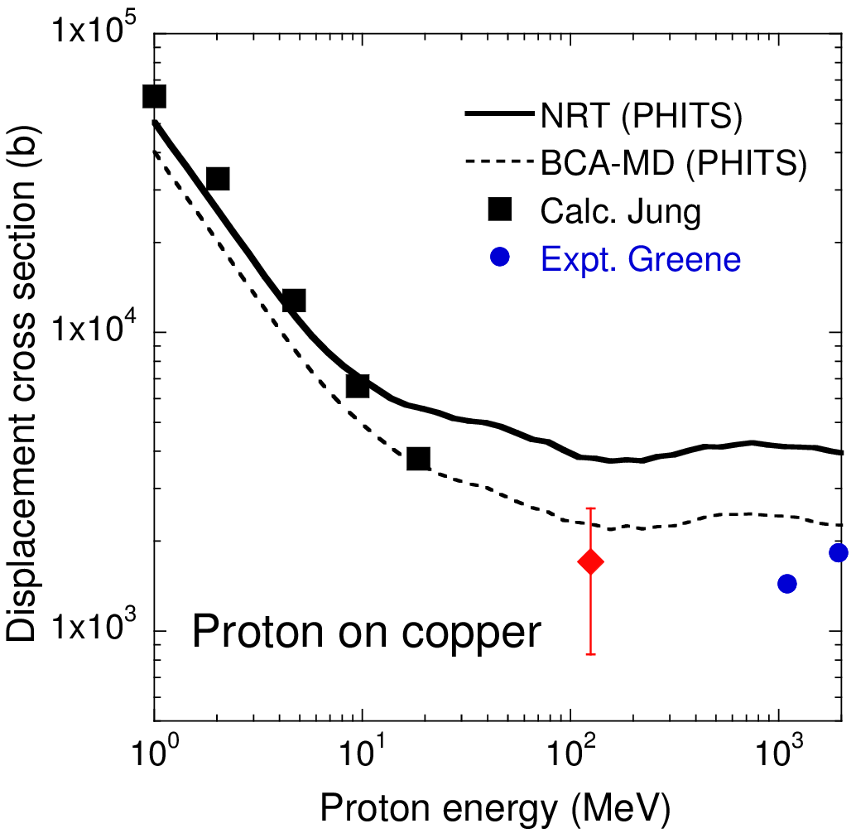
Displacement cross section
Large difference between experimental data
and NRT (no defect production efficiency)
The measured data agrees better with
BCA-MD (defect production efficiency)
Main uncertainty comes from ρ_{FP} .
Damage rate
=3.41Ωm³
Resistivity change / Frenkel pair density
Can be derived from damage rate measurements in single crystals under electron irradiation at low temperature
2.0 x 10⁻⁶ Ωm, 50 % uncertainty
P. Ehrhart, U. Schlagheck, J. Phys. F:
Metal Phys. 4 (1974) 1575–1588.
It has not been studied under high-energy proton irradiation.
Notes:
This graph shows experimental data and calculated results.
We can see The experimental data at 125 MeV is similar to the experimental data for 1.1 and 1.94 GeV.
Large differences can be seen between the measured data and rNRT.
The measured data agree better with rBCA-MD including defect production efficiency,
but the cross-sections
for 125 MeV protons differ by 0.88 between the experimental and calculated results.
In this work, Main uncertainty of cross section comes from Frenkel pair resistivity ρ_{FP}
Which is defined as ratio of resistivity change to Frenkel pair density.
Frenkel pair resistivity was 2 times 10-6 Wm obtaind from this literature and
Same values has been used in experiments by Greene.
According to the paper by Ehrhart, this value was obtained using scattering method of X-ray and have 50 % uncertainty.
it has not been studied for high-energy protons causing nuclear reactions.
Therefore, theoretical and experimental studies of qFP
in the high-energy (>100 MeV) region are desirable.
The ratio of the experimental cross-section to the calculated
cross-section gives the percentage of defects created in the initial
cascade that survive [9]. Large differences can be seen between
the measured data and rNRT. The measured data agree better with
rBCA-MD including defect production efficiency, but the cross-sections
for 125 MeV protons differ by 0.88 between the experimental
and calculated results. From the results of the annealing tests
shown in Fig. 6, after annealing with irradiation below 15 K, the
resistance did not change. Therefore, the thermal motion of the
defects in the experiment would not be the main reason for the difference
between rexp and the calculated results.
The main reason for this discrepancy comes from qFP in Eq. (3).
As mentioned above, qFP changes from 1.15 106 Xm to
3 106 X m under different experimental conditions [24], and
it has not been studied for high-energy protons causing nuclear
reactions. Therefore, theoretical and experimental studies of qFP
in the high-energy (>100 MeV) region are desirable.
Because the temperature for the experiments (12 K) was near
that at the MD calculations (10 K), the defect production efficiency
in the experiment for the damage energy below 20 keV would be
almost the same as that in the MD calculation [30]. According to
Stoller [31], the MD results did not exhibit a strong dependence
on irradiation temperature at 100, 600 and 900 K, and the results

Slide 24
Summary
Compact cryogenic irradiation system has been developed.
Copper wire was sandwiched between two 1.5-mm-thick AlN.
Sample was cooled by conduction coolant via Al and OFHC.
Minimum temperature of sample was 12 K after cooling.
Beam fluence was measured by Faraday cup calibrated by activation.
After 1.45×10¹⁸ protons/m²,
electrical resistance increase was 1.53 μΩ.
Damage rate for 125 MeV was similar to that for 1.1 and 1.94 GeV.
σ_{BCA-MD} is in better agreement with experimental data than σ_{NRT}.

Slide 25
Future plan
Improving cooling system.
Measurements under 125 MeV proton irradiation on Al at FFAG.
Move the device to other facilities, such as RCNP, J-PARC.
Measurements for 100 MeV - 10 GeV proton irradiation on metals.
Details are in Journal of Nuclear Materials 458 (2015) 369–375.
Supported by a Japan Grant-in-Aid for Young Scientists (B) (25820450)
and “Clarification of material behaviors in accelerator driven systems by an FFAG accelerator” carried out under the Strategic Promotion Program for Basic Nuclear Research of the Ministry of Education, Culture, Sports, Science and Technology of Japan.
Notes:
In future plan, first, we will improve cooling system and measure damage rate under 125 MeV proton irradiation on Al at KURRI.
After that, we will move the device to other facilities, such as RCNP, J-PARC and measure the data for 100 MeV - 10 GeV proton irradiation on metals.
Details are in Journal of Nuclear Materials 458 (2015) 369–375. Please see this paper, if you are interested in this work.
This work was supported by the Japanese financial supports.

Slide 26
Thank you for your attention.

Slide 27
Fixed-Field Alternating Gradient (FFAG) accelerator facility
at Kyoto University Research Reactor Institute (KURRI)
that can be characterized by its time-independent magnetic fields
(fixed-field, like in a cyclotron) and the use of strong focusing
(alternating gradient, like in a synchrotron).

Slide 28
Resistance thermometer: The current is confined to one pair of current leads with the sensor voltage measured across the voltage leads.
4000
2000
1000
The resistance of thermometer is changed by hundred Ω order with changing temperature.
The resistance change due to irradiation is negligible.
10
100

Slide 29
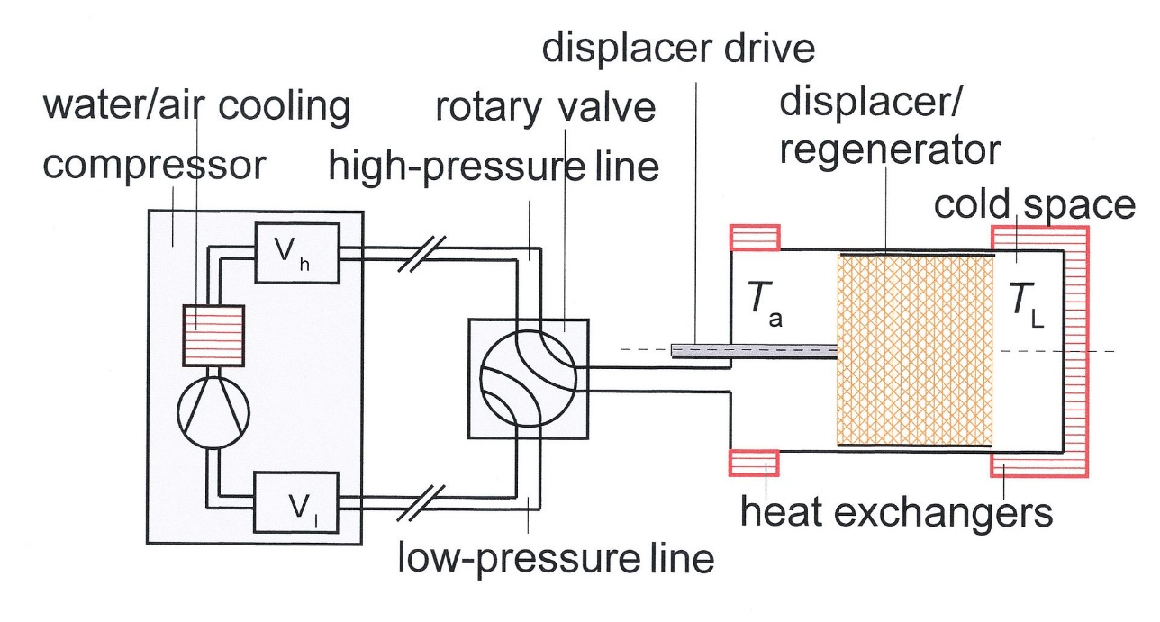
Gifford-McMahon (GM) coolers
Compact and cost effective cooler
The cold head contains a compression and expansion space, a regenerator, and a displacer.
The pressure variations in the cold head are obtained by connecting it periodically to the high- and low-pressure sides of a compressor.

Slide 30
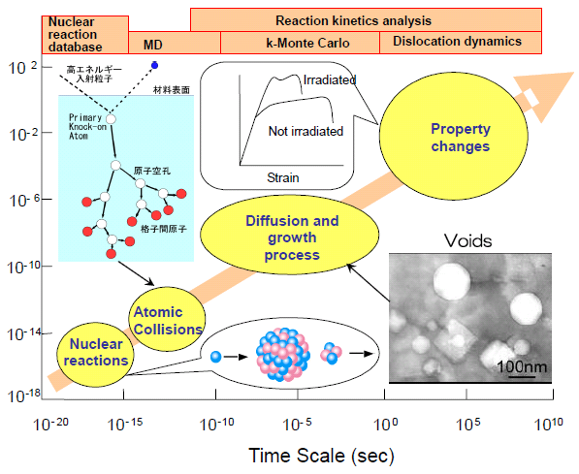
Scale of irradiation effect
Nuclear reaction
PHITS
Change of material properties
Primary Knock-on Atom
Vacancy
Size (m)
Size (m)
Diffusion and growth process
e.g. Thermal conductivity,
electrical resistivity
interstitial atom
Atomic collisions
Nuclear reactions
10⁻²⁰ 10⁻¹⁵ 10⁻¹⁰ 10⁻⁵ 10⁰ 10⁵ 10¹⁰
PHITS treats nuclear reaction and approximation of displacement damages
Courtesy Prof. T. Yoshiie NIM B 269 (2011) 1740.
Notes:
This slide shows the scale of irradiation effects.
There are some modeling depending on time and size scale.
At the beginning of irradiation effecs, nuclear reactions produce PKA and secondary particles.
Then PKA creates vacancy and interstitial atom.
Phits treats nuclear reaction and approximation of displacement damages and calculates DPA values.
After the atomic collisions, diffusion and growth process and change of material property occur.

Slide 31
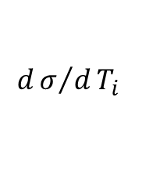
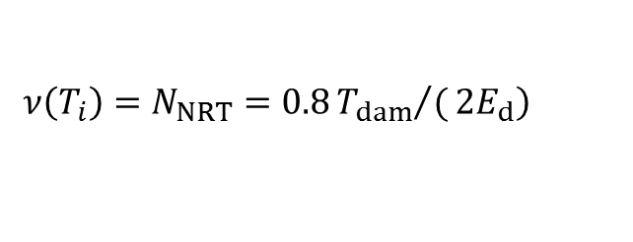
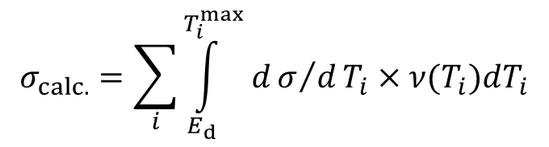



Why is damage rate important?
The average number of displaced atoms per atom of a material
DPA (displacement per atom) =
Displacement cross section
Calculation
Measurement
$$σ_{calc.}=\sum_{i}{\int_{E_{d}}^{T_{i}^{max}}{dσ/dT_{i}}}×ν(T_{i})dT_{i}$$
Irradiation at cryogenic temperature
Recombination of Frenkel pairs
by thermal motion is well suppressed.
$$dσ/dT_{i}$$
:recoil atom energy distribution
$$\left.ν\left(T_{i}\right)=N_{NRT}=0.8{T_{dam}}/(2E_{d}\right)$$
Damage rate
$$ν\left(T_{i}\right)$$
: number of defects
$$T_{dam}$$
: Damage energy
Δρ_{metal}: Electrical resistivity change(Ωm)
Ed : threshold displacement energy
Φ: Beam fluence(1/m²)
or
$$ν\left(T_{i}\right)={ηN}_{NRT}$$
ρ_{FP}: Frenkel-pair resistivity (Ωm)
Defect production efficiency by MD-BCA
J. Nucl. Mater. 49 (1973/74) 161.
Notes:
DPA refers to the average number of displaced atoms per atom of a material.
DPA is defined by the integral of displacement cross section times irradiation fluence.
It is also related the number of Frenkel pairs.
Displacement cross section is obtained by calculation and measurements as follows.
In calculation, displacement cross section is expressed by the integral of recoil atom energy distribution and number of defects.
Number of defect is obtained by NRT model with damage energy to lattice atom and threshold displacement energy.
Or number of defect is obtained with defect production efficiency by MD-BCA.
In experiments, we can not measure DPA directly.
Displacement cross section could be experimentally validated in Irradiation at cryogenic temperature
when created defects are frozen and Recombination of Frenkel pairs
by thermal motion is well suppressed.
Experimental cross section is expressed by damage rate defined as the ratio of electrical resistivity change to beam fluence.
Frenkel-pair resistivity is given by other researchers.
Useful information for degradation of the stabilizer of superconductor
.

Slide 32
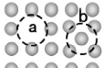
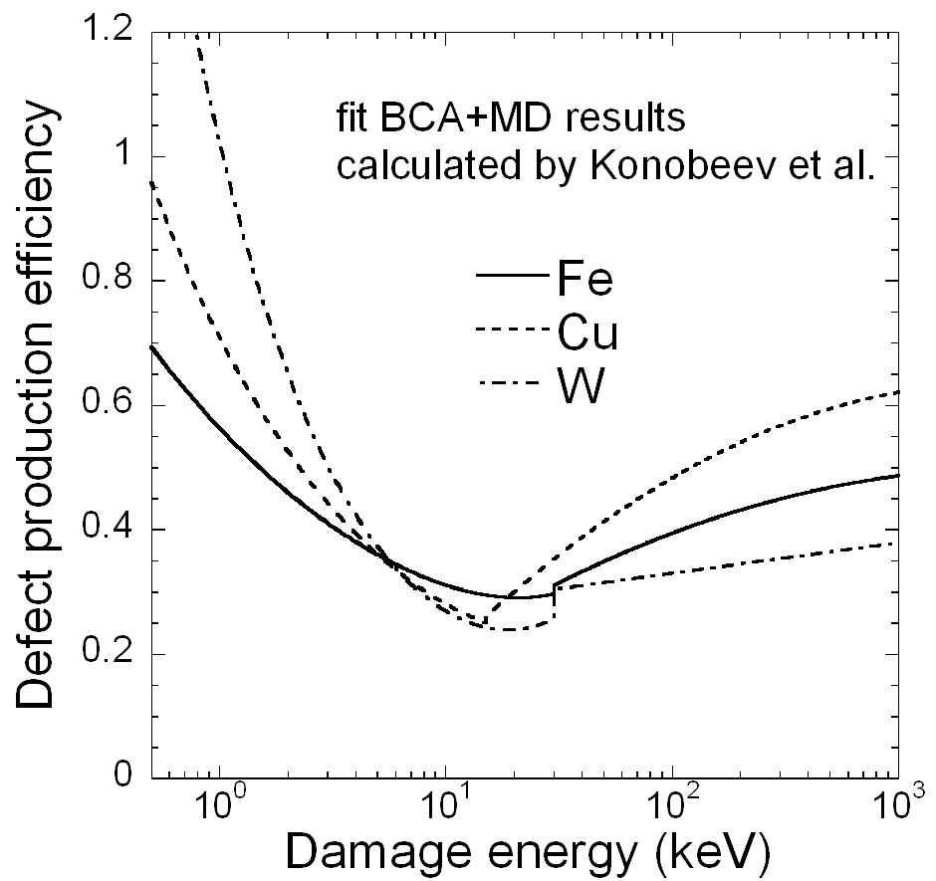
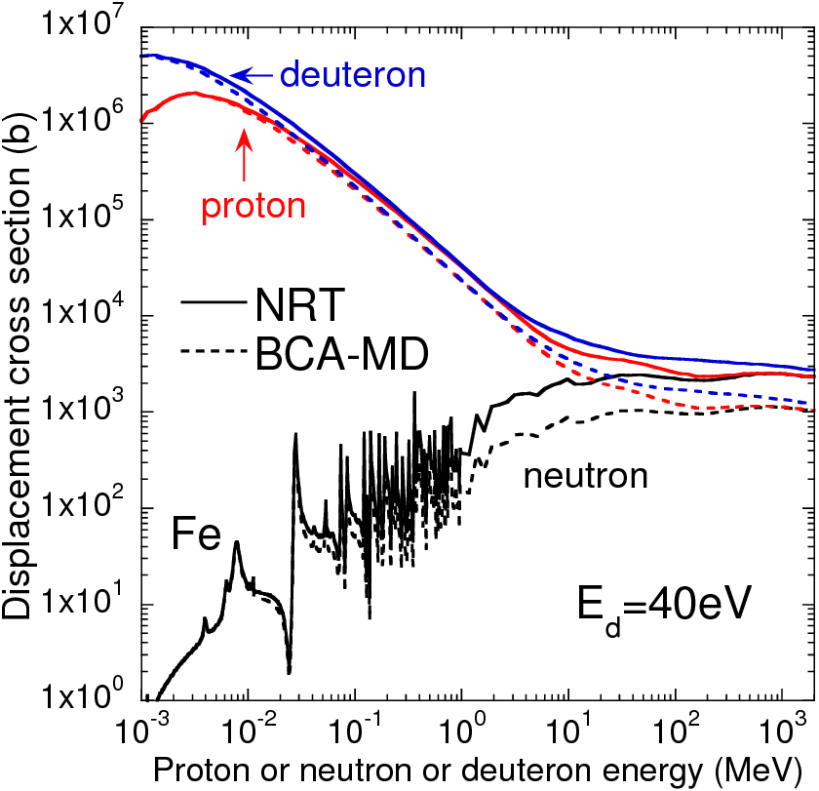
Defect production efficiency
New theoretical consideration based on the Molecular Dynamics (MD), Binary Collision Approximation (BCA) have shown that many initial vacancies and interstitials will recombine during the cascade evolution.
R.E. Stoller, Primary radiation damage formation,
in: Comprehensive Nuclear Materials, Elsevier Ltd., Amsterdam, 2012, pp. 293–332.
Defect production efficiency
(number of survived defects to NRT predictions)
A.Yu. Konobeyev et al, proc. of AccApp’07(2007) 241.
PHITS
MD
BCA
Notes:
Recently, New theoretical consideration based on the Molecular Dynamics (MD), Binary Collision Approximation (BCA) have shown that many initial vacancies and interstitials will recombine during the cascade evolution.
Defect production efficiency is ratio of number of stable displacements at the end of collision cascades to number of defects calculated by NRT model.
and it is the function of damage energy.
It has been studied by Konobeyev using BCA+MD simulations and It is available for limited materials such as Fe, Cu, W and so on.
They were picked up and fitted from results available in the literature.
In this work, we calculated two types of displacement cross sections.
One is sigma NRT calculated with n=1.
Another is sigma MD with n reported in papers.
The number of stable displacements is calculated using MD and BCA models.
and the defect production efficiency was obtained from this paper.
efficiency is a function of damage energy.
This graph shows displacement cross section for proton into Cu. The X axis is the proton energy.
Black and blue points show calculated results by Jung and by Lu, and red points are experimental data.
You can see that Displacement cross section with ετα reproduces the experimental data in the high-energy region.

Slide 33
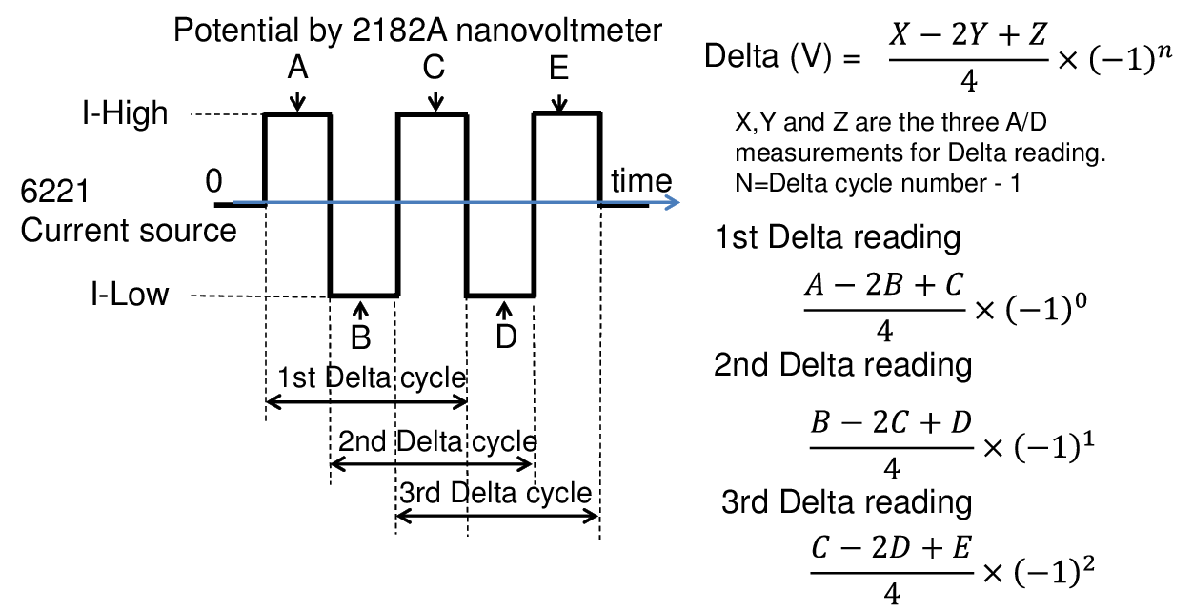
Electrical resistance of copper wire
Four-prove technique using delta mode
V+
Nano-voltmeter
works by sourcing pulses with opposite polarity
V-
2182A Keithley Inc.
Taking the difference between the positive
and negative pulse measurements
TRIG link
RS232
I+
PC
Labview
Source:6221
I-
±100 mA
Cancel effects of thermal electromotive force
Notes:
The electrical resistance of the copper wire was measured using
a combination of a current source and a nano-voltmeter .
This apparatus performs the four-prove technique using the delta mode, which works by
sourcing pulses with opposite polarity and taking one measurement during each pulse.
Taking the difference between the positive and negative pulse measurements cancels the effects of the thermal
electromotive force [19].
A current of ±100 mA was fed into the copper wire with the polarity changing at a frequency of 10 Hz.
The precision of this resistance measurement was ±0.01 lX, corresponding to a resistivity of ±3 fX m.
Electrical resistivity was defined as this equation using ….
As Length and area of the sample were fixed, electrical resistivity was obtained by R, easily.
Next slide shows cooling test.

Slide 34
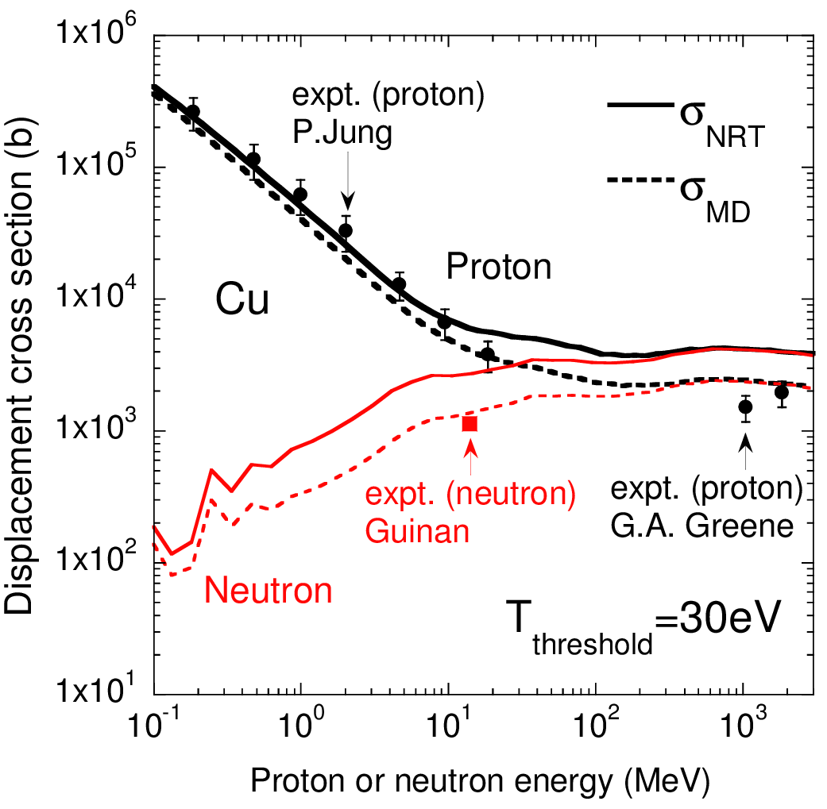
はじき出し断面積の実験値と計算値の比較
η: 欠陥生成効率

Slide 35
PHITS simulation
Average energy E_{ave} of a charged particle in a region
(E_{ave}, M₁, Z₁)
Displacement cross section σ
e1
e2
Range(e1)
Range(e2)
Delt=Range(e1)-Range(e2)

