Slide 1



Study on Magnesium Diboride SC Links for HiLumi-LHC
Workshop on Radiation Effects in Superconducting Magnets and Materials 2015 (RESMM'15)
A. Bignami, F. Broggi, C. Santini
RESMM’15 East Lansing May 12th 2015

Slide 2
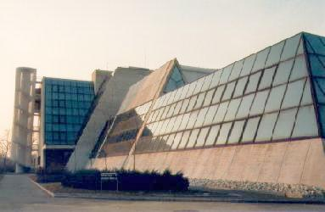
LASA Laboratorio Acceleratori Superconduttività Applicata
Andrea Bignami
Andrea.Bignami@mi.infn.it
RESMM’15 East Lansing May 12th 2015

Slide 3
Outline
HiLumi-LHC
WP 6 Cold Powering
Point 7 (P7) Studies Approach
Point 1 (IP1) “ “
Simulations and Results
Data Analysis and Conclusions

Slide 4
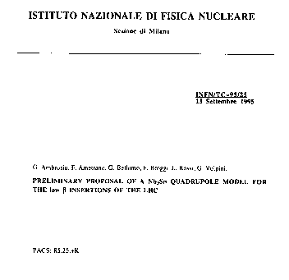
Previous Experiences on Magnet Energy Deposition (I)
Study of a new Nb₃Sn design for the LHC insertion quad started in 1995, suggested by the Milan group (L.Rossi)
Ended in 1998
(1999 final report)

Slide 5
Previous Experiences on Magnet Energy Deposition (II)
NED (EU) - Candia (INFN); EUCARD – HHH
Study of the LHC Phase II upgrade
AMTW Accelerator Magnet Technology Workshop on beam generated heat deposition and quench levels in LHC magnet, CERN, March 2005
3rd CARE-HHH-APD Workshop LHC-LUMI-06
‘Towards a Roadmap for the Upgrade of the CERN & GSI Accelerator Complex’
IFIC, Valencia, Spain – 16-20 October 2006
CARE-HHH-APD Mini-Workshop IR'07 Frascati, November 2007

Slide 6
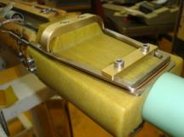
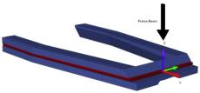
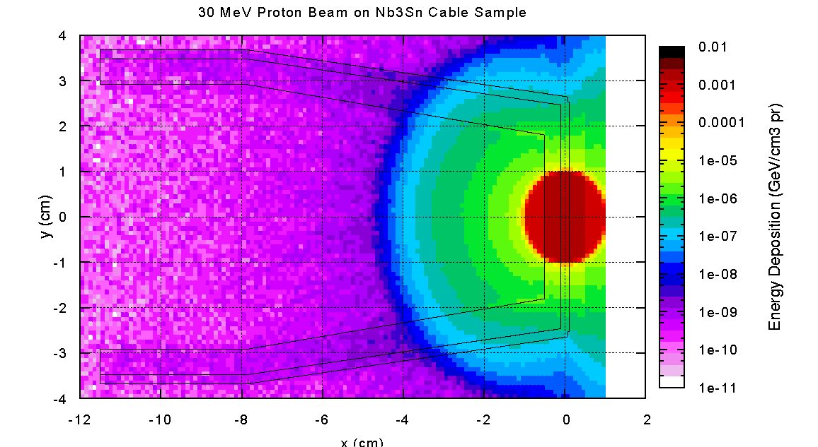
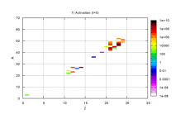
Previous Experiences on Magnet Energy Deposition (III)
After the LHC accident there was a stop in the upgrade studies
Start again with the SIT (Superconducting Irradiation Test) because of lacking on informations and data on radiation effects on the magnet material Nb₃Sn
Ti5
Nb₃Sn cable
SimpleGeo Plot

Slide 7
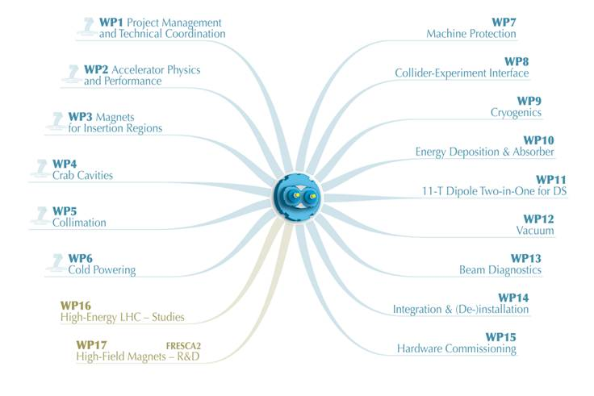
Hi-Lumi-LHC Project

Slide 8
WP6 Structure (Coordinator A. Ballarino (CERN),
Deputy coordinator F. Broggi (INFN))
CERN activity
CERN activity
“Cold Powering”
Task 1
Coordination
CERN/INFN
Integration
Prototypes construction
Cryostat
- Prototypes test
- System design
- Series specification
- Series construction
- Integration
- Operation
Civil engineering
Interfaces
(mech, vacuum, electr)
Task 2
Cryogenics
CERN
Vacuum
Task 3
Electr. Transf.
Cryostat
Univ. South
SC cables/SC link
Cryostat of SC link
Task 4
Energy Dep.
Material
INFN
Current leads
Fluka team
Protection

Slide 9
Cold Powering via Superconducting Links
Advantages of remote powering:
Safer long-term operation of powering equipment (power converters, current leads and associate auxiliary devices) located in a radiation-free environment;
Safer access of personnel to equipment for maintenance, repair, diagnostic and routine tests interventions;
Reduced time of interventions on power converters, current leads and DFBs if the powering equipment is located outside of the tunnel areas – gain in machine availability ;
- Free space in the beam areas which becomes available for other equipment.
Courtesy of Amalia Ballarino
2nd Joint HiLumi LHC-LARP Annual Meeting
_{Frascati 14-16 November 2012}

Slide 10
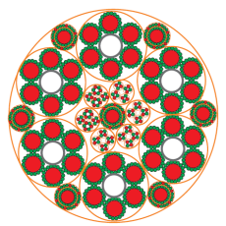
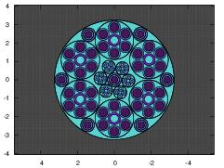

Real Link
Fluka Model
Cu
MgB₂ , Φ = 0.85 mm
18 MgB₂ wires
Φ = 6.5 mm
Cable layout
6x20kA , 7x3kA, 4x0.4kA, 8x.12kA
Φext ∼ 65 mm
Courtesy A. Ballarino
This implementation of the cable is the one used in all the simulations.

Slide 11
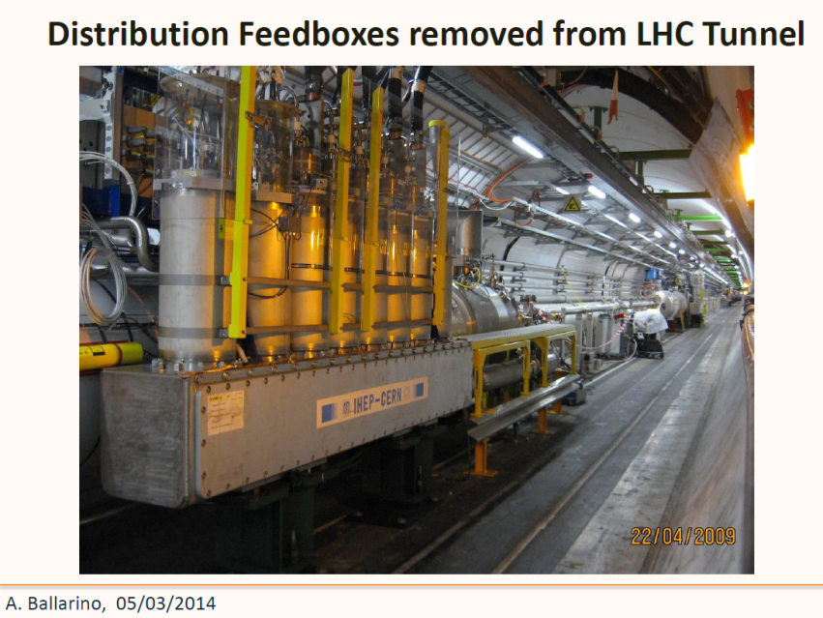

Slide 12
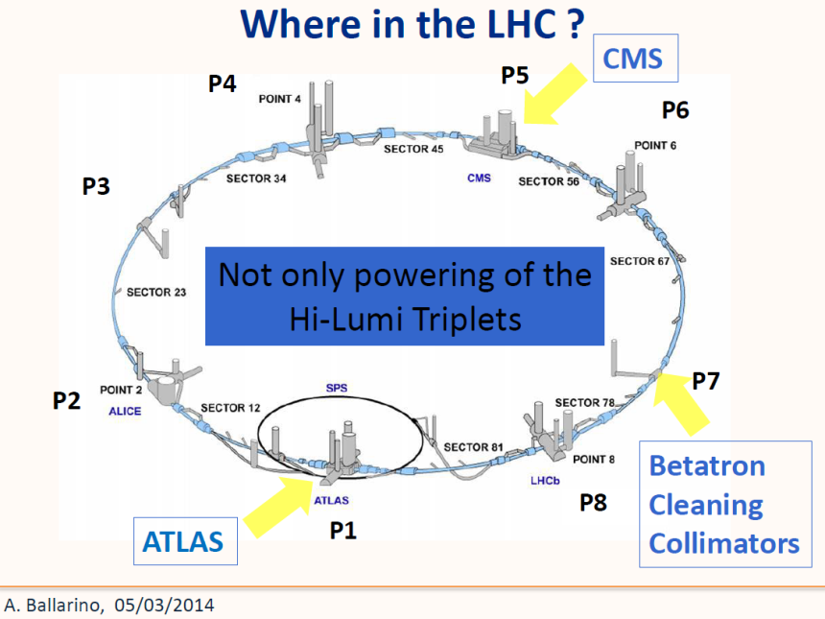

Slide 13
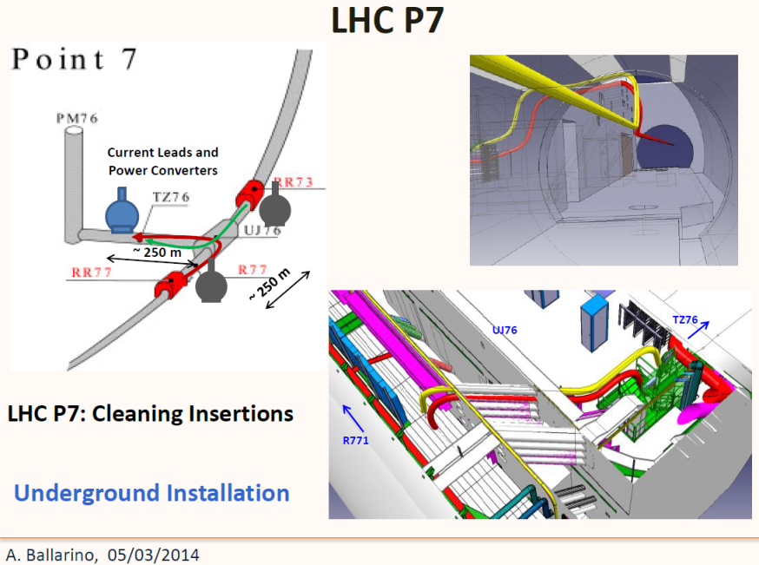

Slide 14
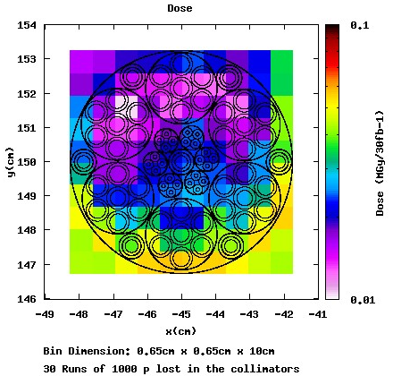
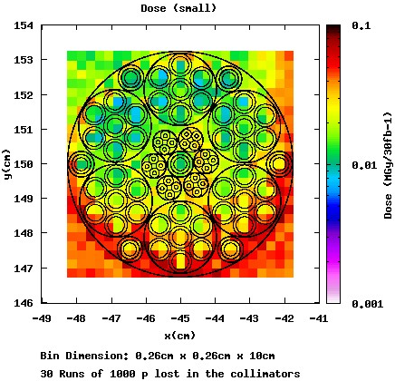
P7 Dose
The maximum dose is about 40 kGy integrated over a period of 30 fb⁻¹
If also we extrapolate proportionaly to 3000 fb⁻¹ we will obtain only 4 MGy over the whole period of exercise

Slide 15
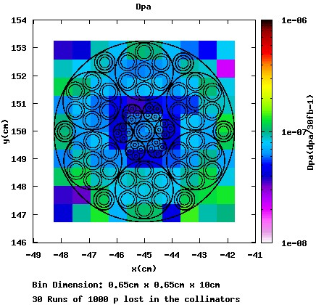
P7 Dpa
The dpa is about 10⁻⁷ over all the cable. This value give us no concern, because it is almost 1 order of magnitude smaller than the one in IP1

Slide 16
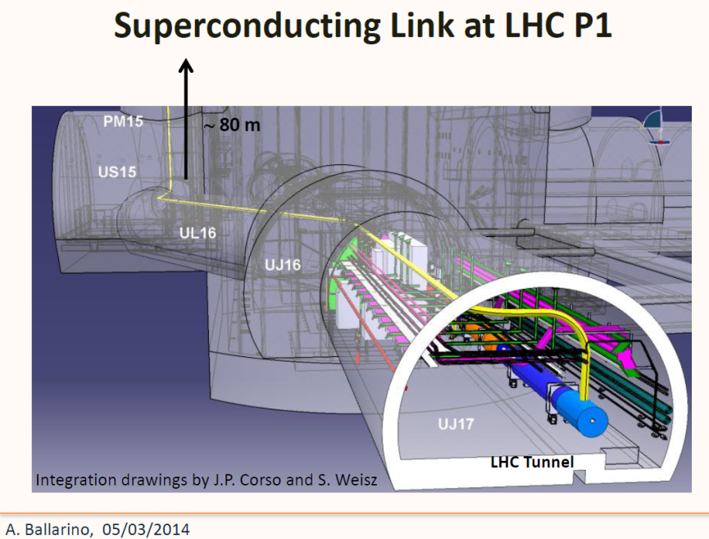

Slide 17
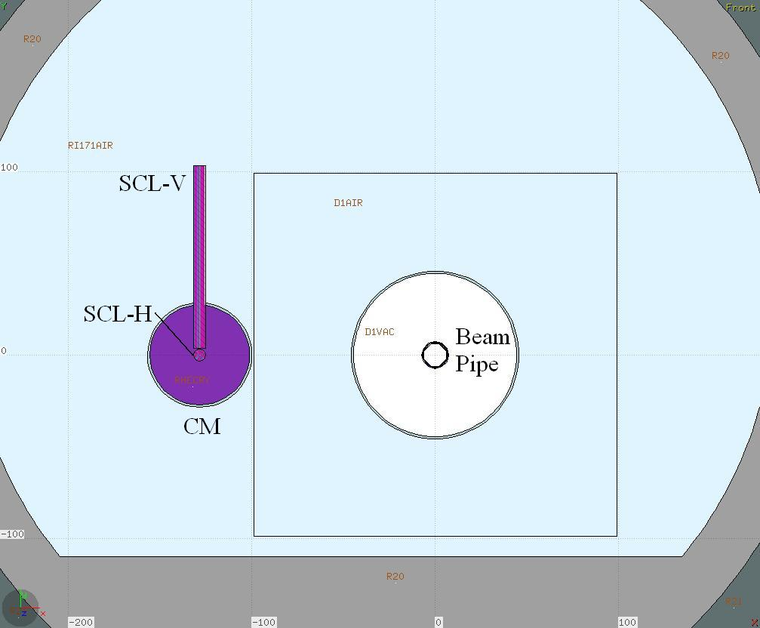
Connection Module IP1
Aside the Beam Pipe, near the D1, has been implemented the Connection Module (CM), in which are simulated the Horizontal (SCL-H) and the Vertical (SCL-V) that will be connected with the magnets power supplier.

Slide 18
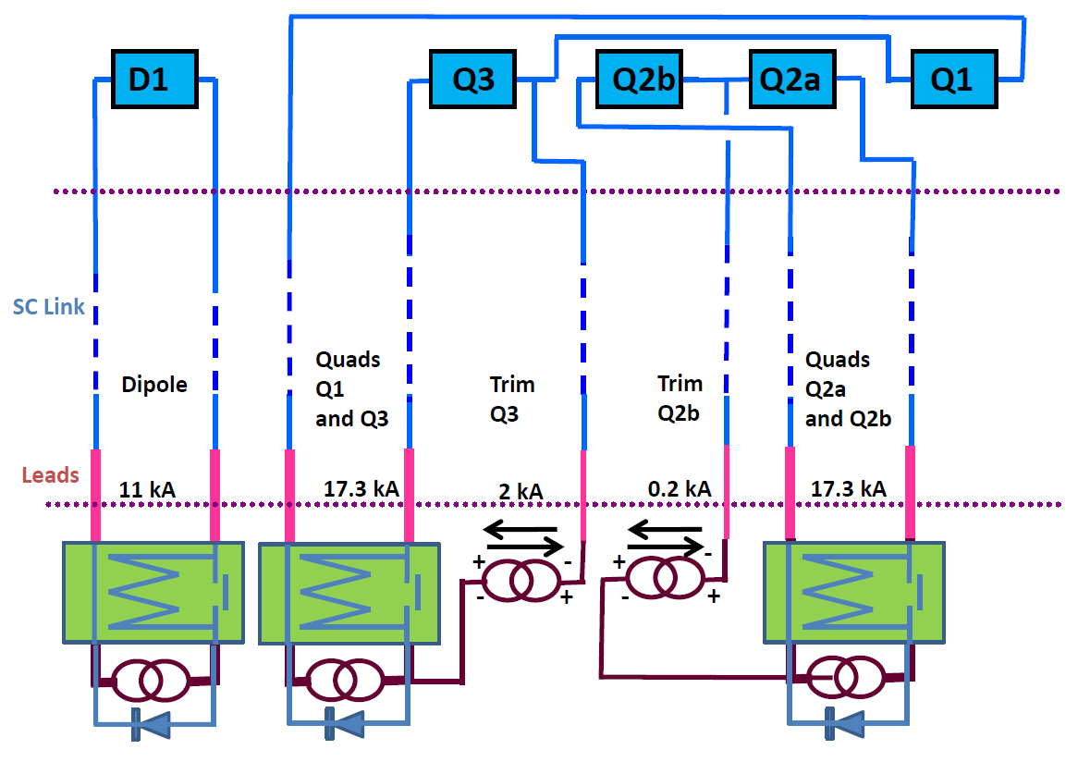
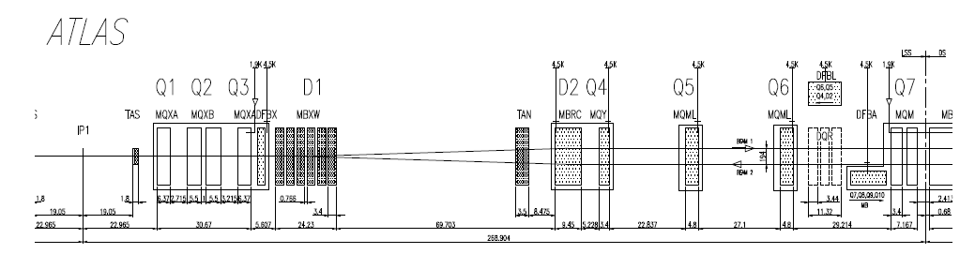
Powering Scheme and Links Layout
For this configuration the link coming from the surface will arrive just after D1 (at about 80 m from IP) and will run aside the quads

Slide 19
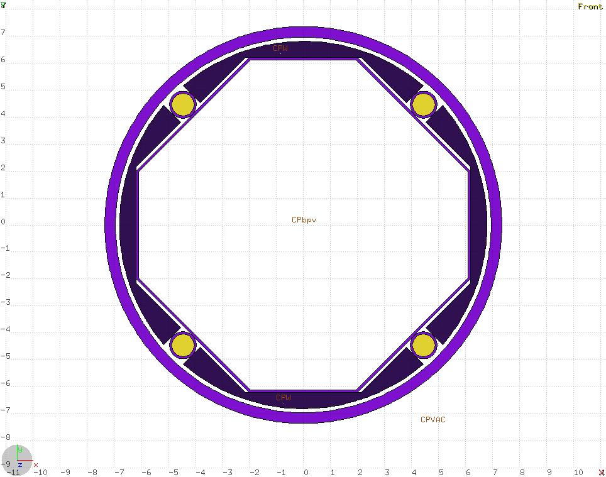
New Beam Screen IP1
For this simulation has been used a new version of the Beam Screen, with major shelding at 45 degrees, in order to protect the components from the debries that follows the focusing-defocusing path.

Slide 20
IP1 Dose
The maximum dose in the cable, normalized to 3000 fb⁻¹, is about 0.1 MGy, a value that does not represent a concern for the normal operations.

Slide 21
IP1 Dpa
The maximum dpa in the horizontal cable, still normalized to 3000 fb⁻¹, is about 10⁻⁶, also in this case a value that does not represent a concern for the normal operations.
The values for the vertical cable are about the same.

Slide 22
Conclusions
The dose value in the links will not be a concern for the normal operation of the machine over a work time of 3000 fb⁻¹
Also the DPA value should not represent an issue.

Slide 23
What’s Next
Simulations for Point 5 It can be guessed a similar situation

Slide 24

Acknowledgment
Thank You for Your attention
F.Cerutti , L.S. Esposito, E.Skordis
(CERN FLUKA Team)

