Slide 1
Radiation Heat Load and Coil Lifetime Calculations in Support of FRIB Dipole Magnet Design
Dali Georgobiani, Mauricio Portillo, Marc Hausmann
Facility for Rare Isotope Beams, Michigan State University

Slide 2
Outline
Introduction
Radiation Transport Scope within FRIB project
Superconducting Dipole SCD1 in FRIB Preseparator
Calculation Formalism
Analysis Examples:
Dipole beam blocker design challenge
Dipole component heat loads and coil lifetimes
Summary and Conclusions
References

Slide 3
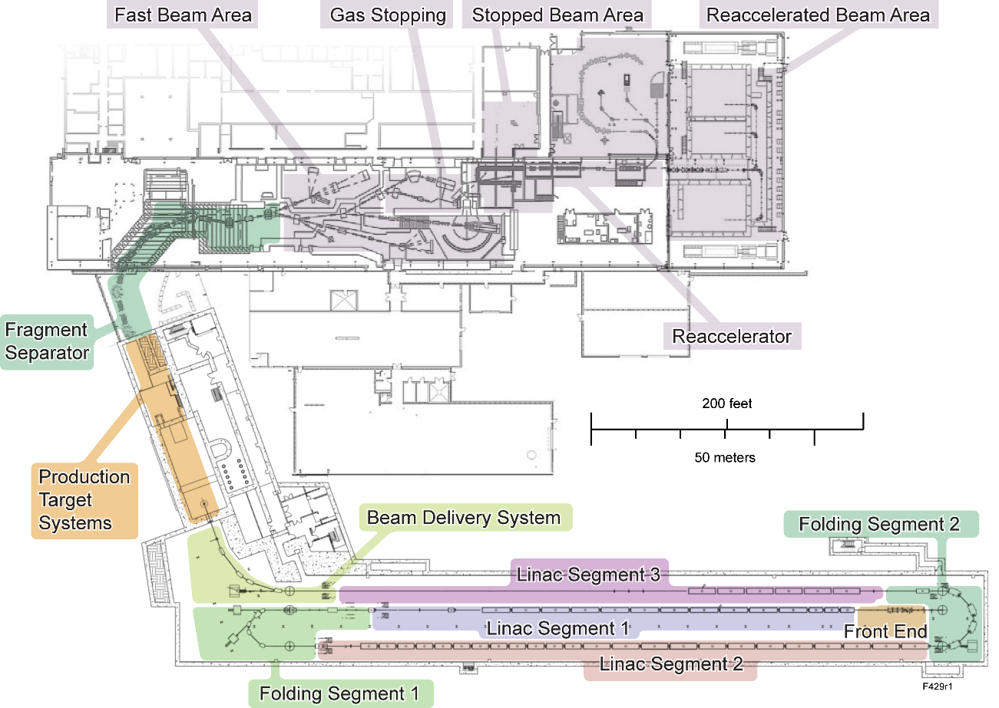
FRIB Radiation Transport Scope Radiation Transport Calculations Support Technical Design and Safe Operation of Entire Project
Experimental Systems
Bulk, local shielding
Personnel doses, public doses (skyshine, emissions)
Component and material choices
Component life
Hands-on capabilities, remote handling
Personnel doses
Non-conventional utilities
Personnel doses, public doses (emissions)
Accelerator Systems
Bulk, local shielding
Personnel doses, public doses (emissions)
Component and material choices
Component life
Hands-on capabilities
Personnel doses
Non-conventional utilities
Personnel doses, public doses (emissions)
Experimental areas
Bulk, local shielding
Personnel and public doses
Component and material choices
1 kW rare isotope beams
400 kW beam (~ 100 kW at target, ~ 300 kW at beam dump)
1 W/m beam losses

Slide 4
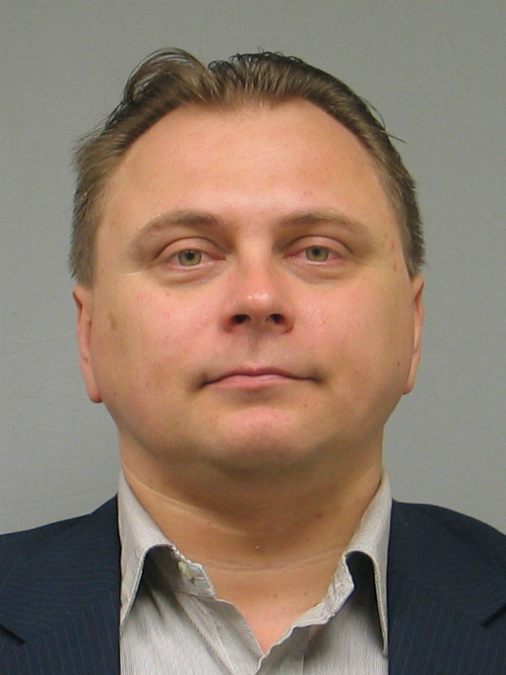
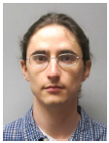
Radiation Transport Group
Reg Ronningen is Radiation Transport Department Manager
Radiation Transport Group members:
Reg Ronningen
Dali Georgobiani
Mikhail Kostin
Jeremy Northum

Slide 5
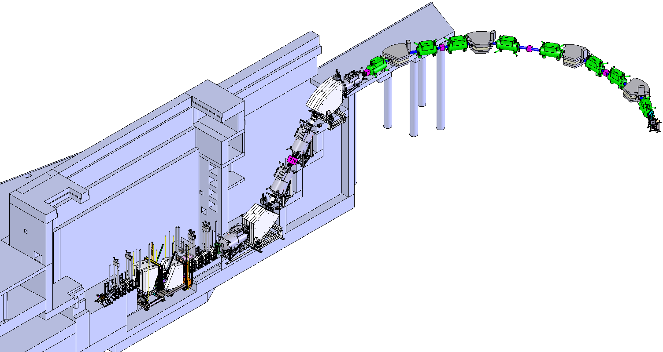
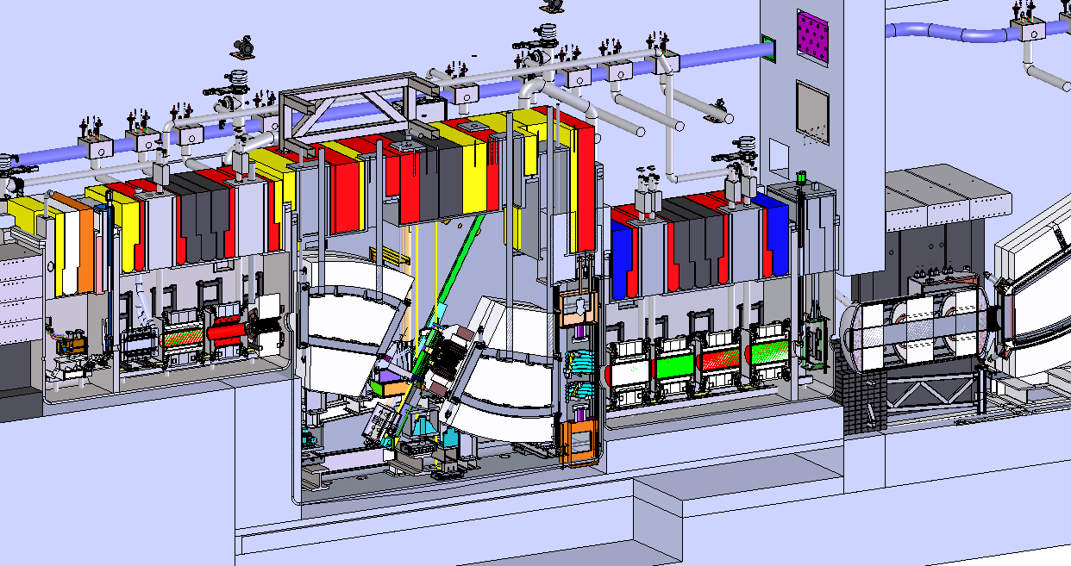
Fragment Separator
Three stage fragment separator for production and delivery of rare isotopes with high rates and high purities to maximize FRIB science reach
Primary beam power of 400 kW
Beam energies of ≥ 200 MeV/u
Hot cell: High radiation environment
Radiation heat loads to magnets
Component lifetime concerns

Slide 6
Preseparator Components
Beam Dump Vacuum Vessel
Target Vacuum Vessel
SCD1
Wedge Vacuum Vessel
Beam
SCD2
Target Assembly
Beam Dump Assembly
Wedge Assembly
SC dipoles

Slide 7
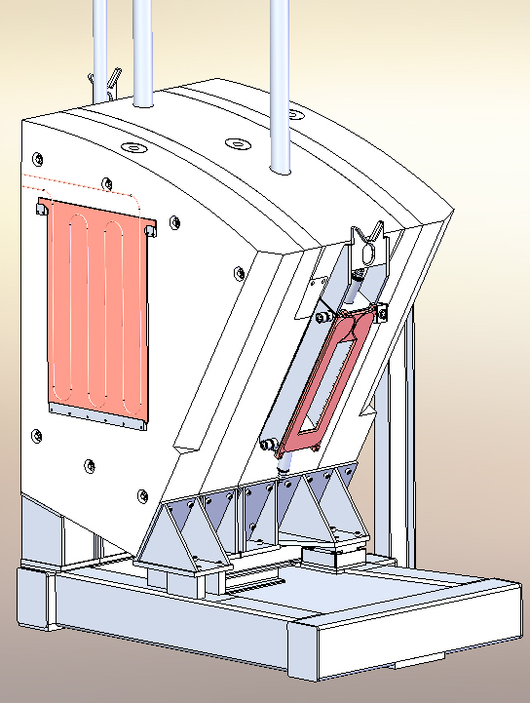
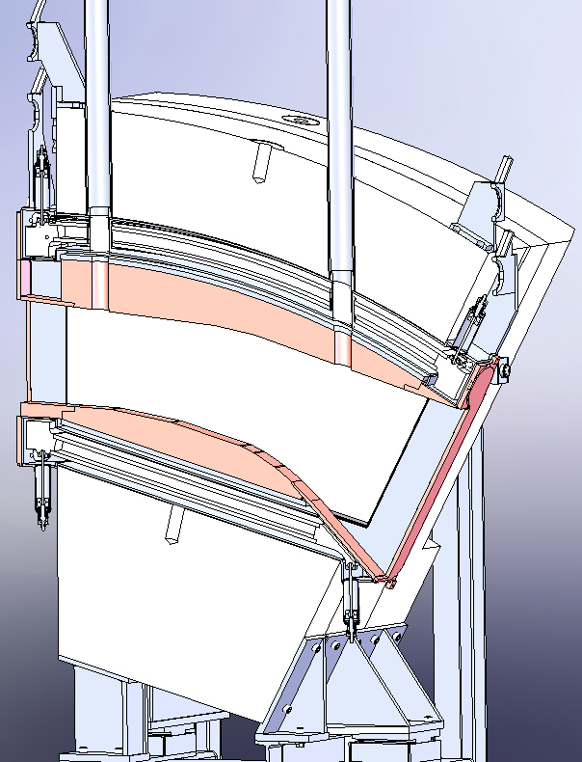
SCD1 Mechanical Design
Superconducting dipole SCD1

Slide 8
Unique Position of the SCD1 Magnet
Beam induced effects on magnets and other components are important to FRIB operations
Power losses need to be removed efficiently
Lifetimes depend on radiation doses
Beam optics modes affect the loss characteristics
Requires beam physics and radiation transport calculations
Optics modes developed to maximize rare isotopes to experiment yet minimize damage
Losses studied for SCD1 because it has the largest chance for beam power deposition
No separation upstream of it
Nominally no primary beam after the beam dump following this dipole
FRIB preseparator magnets and other elements
Target
SCD1
Wedge
Beam Dump

Slide 9
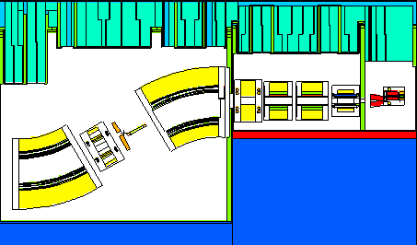
Radiation Transport Calculations
Calculations based on models developed from mechanical and facility design
Model, materials updated as needed
Updates provided by mechanical design group and magnet systems department
Magnetic fields used correspond to those needed for beam optics
Different situations/settings that place beam in different locations provided by fragment separator group
Detailed power deposition information provided to the magnet designers and engineers for final magnet design
Calculations include coil radiation dose leading to coil lifetime estimates
Magnet heat loads drive the design of cooling water loops and cryogenic components
Radiation transport model
Beam
SCD1

Slide 10
Introduction
Radiation Transport Scope within FRIB project
Superconducting Dipole SCD1 in FRIB Preseparator
Calculation Formalism
Analysis Examples:
Dipole beam blocker design challenge
Dipole component heat loads and coil lifetimes
Summary and Conclusions
References

Slide 11
Improvements in Design of SCD1
Settings for neutron-rich light rare isotopes lead to large deflection of primary beam in SCD1 (e.g. ¹⁸O primary beam in ⁸He setting)
Primary beam (~ 300 kW beam power) would have hit cryostat
Cryostat interference identified with primary beam at exit corner
Design of exit corner opened up to remove interference
Primary beam clears magnet hardware
Beam blockers introduced to control power deposition into cryostats
Beam blockers optimized to protect dipole cryostats from direct beam
Heat load calculations performed to guide the dipole design and blocker optimization
Cryostat interference with primary beam
Optimum beam blockers

Slide 12
Calculation Input and Methodology
Radiation transport code PHITS and beam optics codes COSY and LISE⁺⁺ results are compared to validate the codes against each other
A specific set of beam parameters used:
¹⁸O beam incident on 2.48 g/cm² graphite target
Beam energy 200 MeV/u; beam power 400 kW
Beam rigidity for fragment of interest (⁸He) is 8 T-m

Slide 13
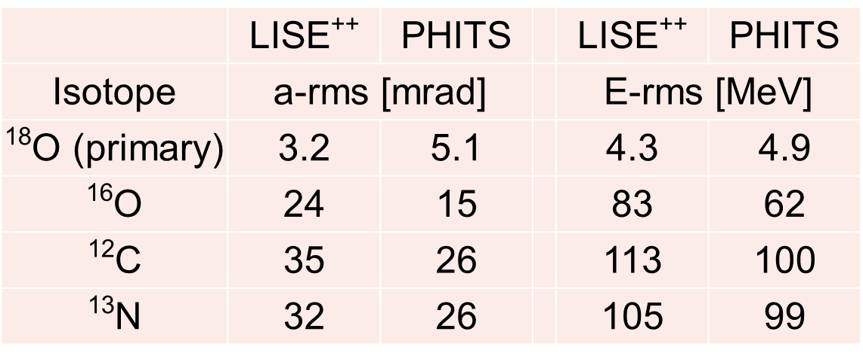
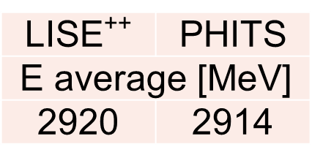
Angular and Energy Straggling Comparison
Best match between available models of angular and energy straggling selected via side-by-side comparisons.
RMS values calculated after target for both the primary beam and fragments, as well as average energies, are in reasonable agreement as shown in the tables.
Angular and energy straggling RMS values calculated with LISE⁺⁺ and PHITS for the primary beam and fragments
Average energy of the primary beam after the target

Slide 14
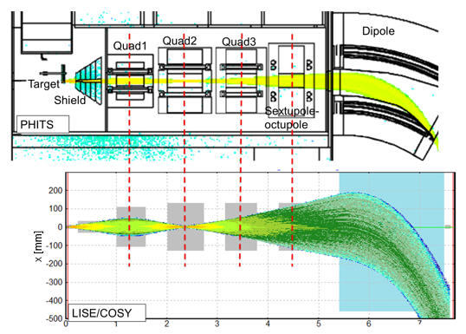
Beam Optics Comparison
Beam envelopes for ¹²C fragments from target shown
Beam optics and fragment distributions are similar in PHITS and LISE⁺⁺

Slide 15
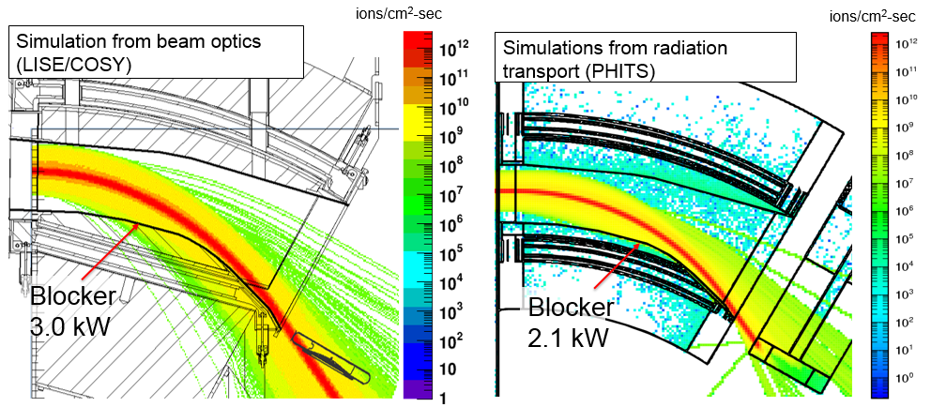
Particle Flux Maps
Both the primary beam ¹⁸O and reaction products shown
Total heat loads into the bottom blocker calculated by PHITS and by LISE⁺⁺ are in reasonable agreement

Slide 16
SCD1 Beam Blocker: Design Summary
Based on PHITS calculations, beam interference conditions in the SCD1 components were identified and resolved as follows:
Increasing width of dipole exit window opening
Primary beam clears magnet hardware safely
Adding top and bottom beam blockers inside of dipole gap
Stops intense fragments near the primary beam
Reduces the radiation heat load to cryostat
Optimizing the blocker shape
To minimize direct beam losses while maintaining adequate shielding
Developing optimal beam optics settings
To minimize losses to all surrounding dipole components
Calculations of induced thermal losses with PHITS aid designs of water and helium cooling

Slide 17
SCD1 Design Improvements: Analysis Summary
Radiation transport code PHITS -- with particular settings for straggling and energy loss as well as its fragment production model -- was validated against beam optics codes LISE⁺⁺/COSY
Good agreement demonstrated
Flux maps from both codes show similar distributions
Power deposition to the lower blocker is calculated to be 3 kW for LISE⁺⁺/COSY and 2.1 kW for PHITS
The lower value can be explained by the lower angular spread for reaction products using the PHITS model
The outcome of this study provides design requirements for SCD1 in terms of the beam conditions

Slide 18
Introduction
Radiation Transport Scope within FRIB project
Superconducting Dipole SCD1 in FRIB Preseparator
Calculation Formalism
Analysis Examples:
Dipole beam blocker design challenge
Dipole component heat loads and coil lifetimes
Summary and Conclusions
References

Slide 19
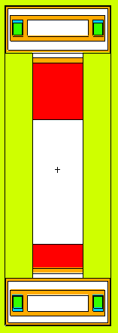
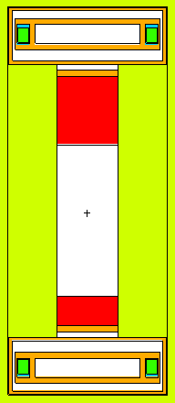
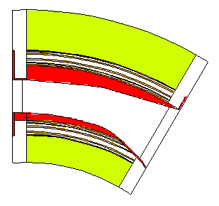
Change from HTS to LTS Technology
Calculations performed to support Low Temperature Superconductor (LTS) magnet choice
Model has changed by moving coils into yoke by 5 cm at each side
Original coil location
New coil location
SCD1
Coils
Beam
direction
Pole tips
Power density map position
d
d+10cm

Slide 20
Extreme Cases
Benchmark cases defined having potential for the most extreme conditions on the magnets
Oxygen primary beams tend to pose the most extremes
Large fraction of the beam reacts
Products and primary beam characterized by some of the highest phase spaces after the target
Production of ⁸He from ¹⁸O
Due to large ⁸He magnetic rigidity:
Causes large overfocusing of most products
Causes large deflection in dipole, hence high losses towards lower region
Production of ⁹C from ¹⁶O
Due to low ⁹C magnetic rigidity:
Causes large underfocusing of most products
Low deflection in dipole, hence most losses towards upper region
Overfocusing and underfocusing may cause more losses at focusing magnet before the dipole

Slide 21
Calculation Input
Beam Physics group provided beams and magnetic fields
¹⁶O, 294 MeV/u, 400 kW; product ⁹C
Worst case for the upper region of the dipole
¹⁸O, 200 MeV/u, 400 kW; product ⁸He
Worst case for the lower region of the dipole
¹⁸O, 266.4 MeV/u, 400 kW; product ¹⁰Be
Worst case for the poletips
Coil material assumed to be NbTi + Cu + Cyanate Ester
Coil lifetimes calculated assuming radiation tolerance of 100 MGy
Radiation tolerance in various materials

Slide 22
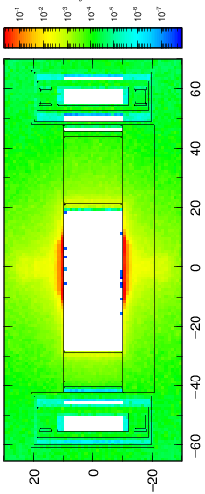
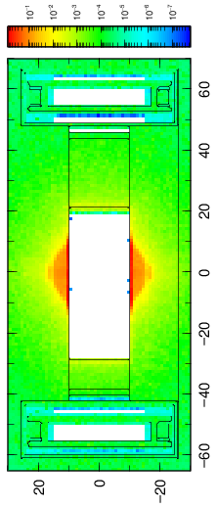
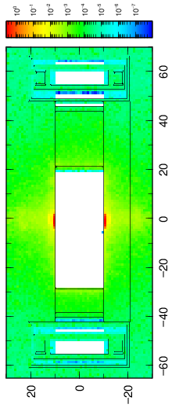
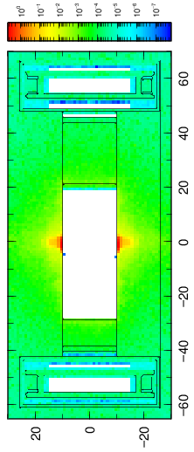
Power Density Maps
Power density (heat load) map examples in the dipole
¹⁶O, 294.4 MeV/u
¹⁸O, 266.4 MeV/u
Power density (W/cc)
Power density (W/cc)
Power density (W/cc)
Power density (W/cc)
HTS
LTS
HTS
LTS
Height (cm)
Height (cm)
Height (cm)
Height (cm)
Width (cm)
Width (cm)
Width (cm)
Width (cm)

Slide 23
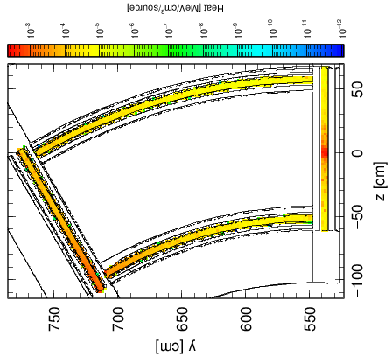
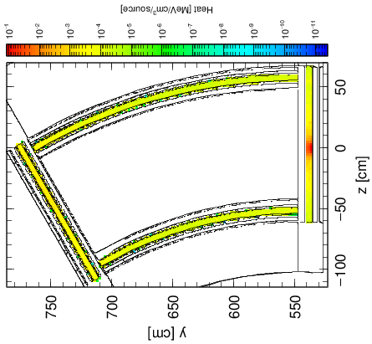
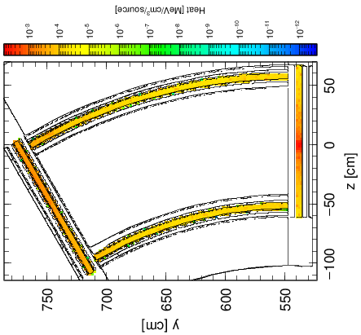
Dipole Coil Heat Load and Lifetimes
Heat Load (W/cc)
Heat Load (W/cc)
¹⁸O, 200 MeV/u
Peak coil heat load, mW/cc: 5 (HTS), 2 (LTS)
Coil lifetimes, years: 16 (HTS), 41 (LTS)
Higher than life of facility
¹⁶O, 294.4 MeV/u
Peak coil heat load, mW/cc: 100 (HTS), 7 (LTS)
Coil lifetimes, years: 0.8 (HTS), 12 (LTS)
LTS design improves lifetime dramatically
HTS
LTS
Beam
Heat Load (W/cc)
Heat Load (W/cc)
HTS
LTS

Slide 24
Coil Lifetimes: Other Examples
¹⁸O, 266.4 MeV/u
Peak coil heat load, mW/cc: 30 (HTS), 20 (LTS)
Coil lifetimes, years: 2.7 (HTS), 4.1 (LTS)
⁴⁸Ca, 261 MeV/u
Peak coil heat load, mW/cc: 20 (HTS), 10 (LTS)
Coil lifetimes, years: 4.1 (HTS), 8.2 (LTS)
Coil heat loads and lifetimes greatly vary depending on the primary beam conditions (magnetic field settings, path, etc.)
Keep in mind: Most of the time, we expect to run different beams that do not present extreme cases in terms of heat loads

Slide 25
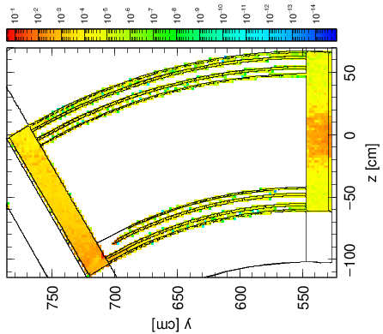
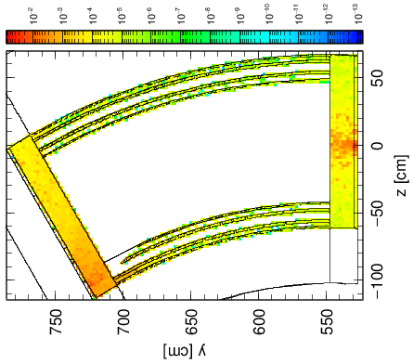
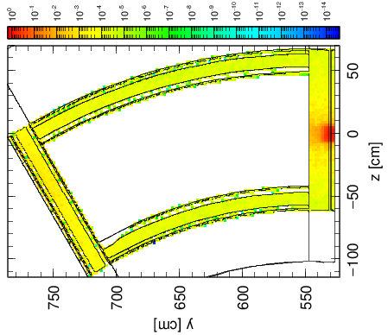
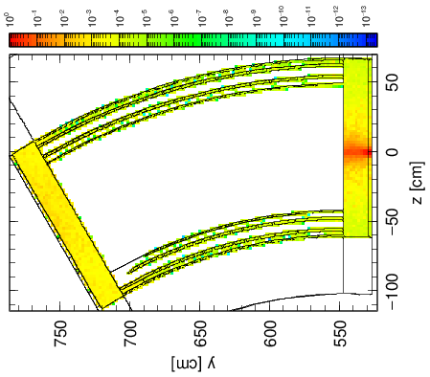
Dipole Cryostat Heat Load
¹⁸O, 200 MeV/u
Total heat load, W: 27 (HTS), 15 (LTS)
Worst cases for HTS; but implementing LHS sharply reduces heat load:
¹⁶O, 294.4 MeV/u
Total heat load, W: 714 (HTS), 81 (LTS)
¹⁸O, 266.4 MeV/u
Total heat load, W: 807 (HTS), 69 (LTS) (maps not shown)
Heat Load (W/cc)
Heat Load (W/cc)
HTS
LTS
Beam
Heat Load (W/cc)
Heat Load (W/cc)
HTS
LTS

Slide 26
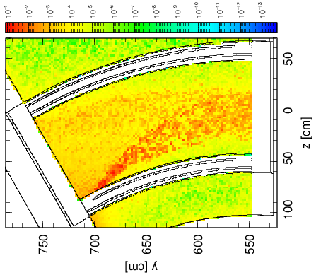
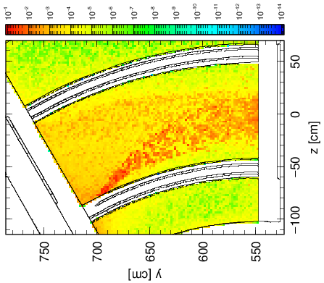
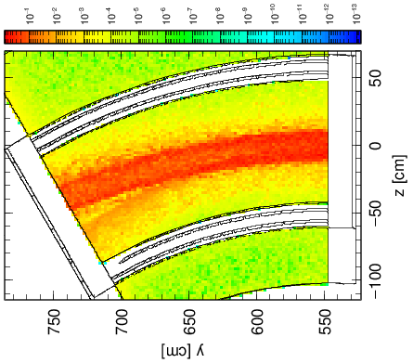
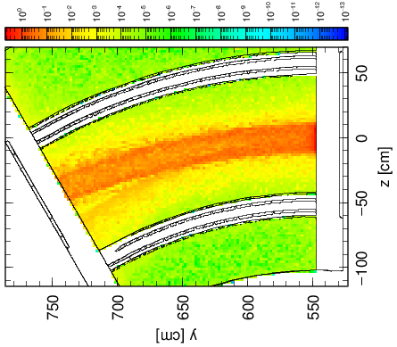
Pole Tip Heat Load
¹⁸O, 200 MeV/u
Total heat load, W: 93 (HTS), 116 (LTS)
25% increase to pole tip; eliminates having this loss at the cryostat
¹⁶O, 294.4 MeV/u
Total heat load, W: 2533 (HTS), 3252 (LTS)
28% increase
¹⁸O, 266.4 MeV/u
Total heat load, W: 5160 (HTS), 5690 (LTS)
10% increase (maps not shown)
Heat Load (W/cc)
Heat Load (W/cc)
HTS
LTS
Beam
Heat Load (W/cc)
Heat Load (W/cc)
HTS
LTS

Slide 27
SCD1 Component Heat Load Conclusions
Calculations performed support Low Temperature Superconductor (LTS) magnet choice
Heat load maps used as a diagnostic tool and to optimize design
Calculated heat loads define requirements for the cryogenic system
Geometry changes reflecting LTS design reduce radiation heat loads into coils and cryostats
LTS coils provide adequate lifetime for operation in radiation environment

Slide 28
Summary
Radiation transport code PHITS and beam optics codes COSY and LISE⁺⁺ results were compared to validate the outcome of radiation transport calculations
Good agreement between the radiation and beam transport codes has been demonstrated
Based on PHITS calculations, beam interference conditions in the SCD1 components were identified and resolved
Beam blocker designs have been optimized
SCD1 component heat load calculations support Low Temperature Superconductor (LTS) magnet choice
Reduced radiation heat loads into coils and cryostats

Slide 29
References
T. Sato, K. Niita, N. Matsuda, S. Hashimoto, Y. Iwamoto, S. Noda, T. Ogawa, H. Iwase, H. Nakashima, T. Fukahori, K. Okumura, T. Kai, S. Chiba, T. Furuta and L. Sihver, "Particle and Heavy Ion Transport Code System PHITS, Version 2.52 ", J. Nucl. Sci. Technol. 50:9 (2013) 913-923.
K. Makino, M. Berz, "COSY INFINITY Version 9“, Nucl. Instr. and Meth. Phys. Res. A 558 (2005) 346-350.
O.B. Tarasov, D. Bazin, "LISE++: Radioactive beam production with in-flight separators “, Nucl. Instr. and Meth. Phys. Res. B 266 (2008) 4557-4664.

Slide 30
Acknowledgements
I would like to express my gratitude to the RESMM’15 organizers…
…To my colleagues at FRIB for all their help and guidance…
…And to fellow participants for their attention!
This material is based on work supported by the U.S. Department of Energy Office of Science under Cooperative Agreement DE-SC0000661, the State of Michigan and Michigan State University. Michigan State University designs and establishes FRIB as a DOE Office of Science National User Facility in support of the mission of the Office of Nuclear Physics.

