Slide 1



Study of the Displacement Per Atom in the n-alpha Reaction on MgB₂ in the Frame of the Hi-Lumi-LHC Project
Workshop on Radiation Effects in Superconducting Magnets and Materials 2015 (RESMM'15)
F. Broggi, A. Bignami, C. Santini
RESMM’15 East Lansing 10-14 May 2015

Slide 2
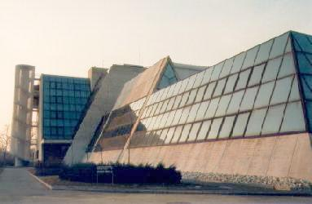
LASA Laboratorio Acceleratori Superconduttività Applicata
Francesco Broggi
Francesco.Broggi@mi.infn.it
Francesco.Broggi@cern.ch

Slide 3
Outline
HiLumi-LHC
WP 6 Cold Powering
What’s new since last year
Irradiation test simulation on MgB₂
What is the relative α and Li importance to DPA ?

Slide 4
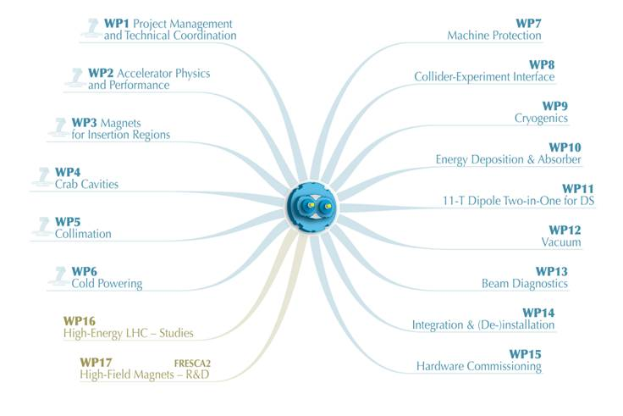
Hi-Lumi-LHC Project

Slide 5
WP6 Structure (Coordinator A. Ballarino (CERN),
Deputy coordinator F. Broggi (INFN))
CERN activity
CERN activity
“Cold Powering”
Task 1
Coordination
CERN/INFN
Integration
Prototypes construction
Cryostat
- Prototypes test
- System design
- Series specification
- Series construction
- Integration
- Operation
Civil engineering
Interfaces
(mech, vacuum, electr)
Task 2
Cryogenics
CERN
Vacuum
Task 3
Electr. Transf.
Cryostat
Univ. South
SC cables/SC link
Cryostat of SC link
Task 4
Energy Dep.
Material
INFN
Current leads
Fluka team
Protection

Slide 6
Cold Powering via Superconducting Links
Advantages of remote powering:
Safer long-term operation of powering equipment (power converters, current leads and associate auxiliary devices) located in a radiation-free environment;
Safer access of personnel to equipment for maintenance, repair, diagnostic and routine tests interventions;
Reduced time of interventions on power converters, current leads and DFBs if the powering equipment is located outside of the tunnel areas – gain in machine availability ;
- Free space in the beam areas which becomes available for other equipment.
Courtesy of Amalia Ballarino
2nd Joint HiLumi LHC-LARP Annual Meeting
_{Frascati 14-16 November 2012}

Slide 7
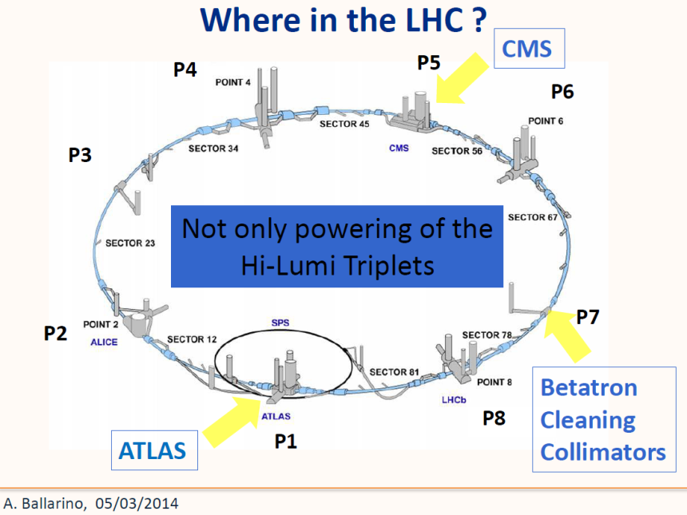

Slide 8
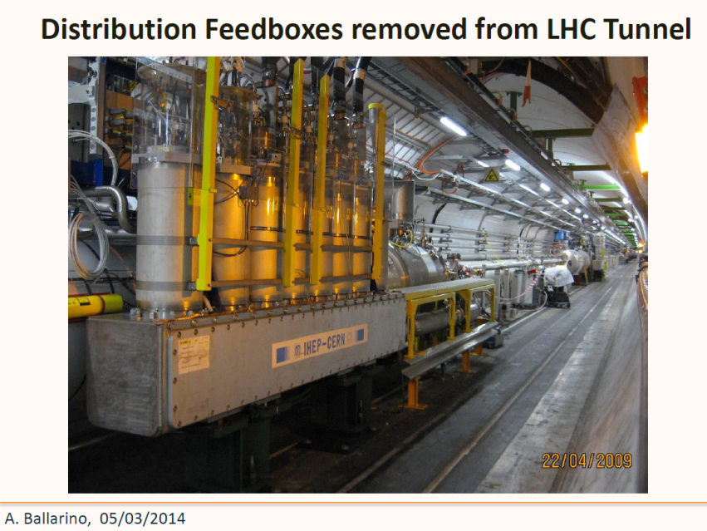

Slide 9
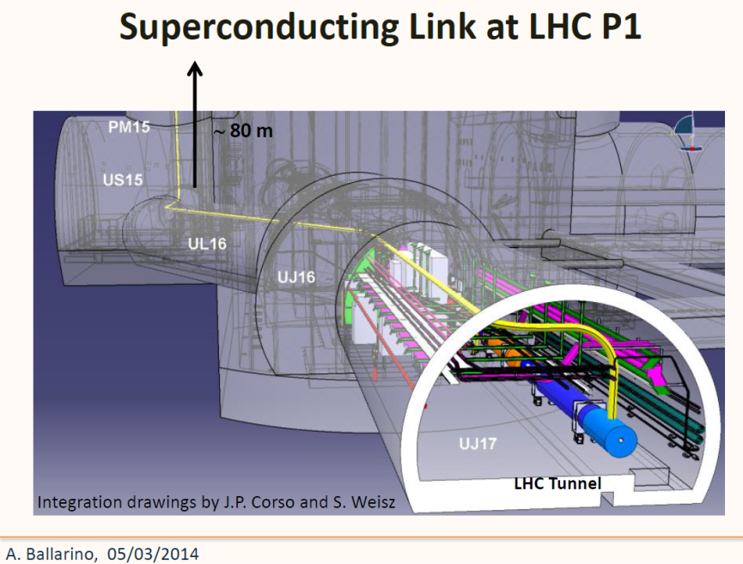

Slide 10
What’s Next (May 2014)
Implement the Links geometry in the LHC Layout in FLUKA (DONE see Andrea’s talk)
Simulations for Point 5 (to be done)

Slide 11
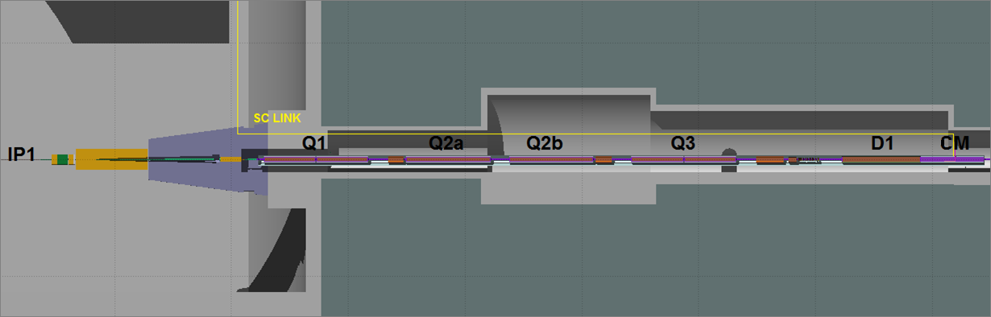
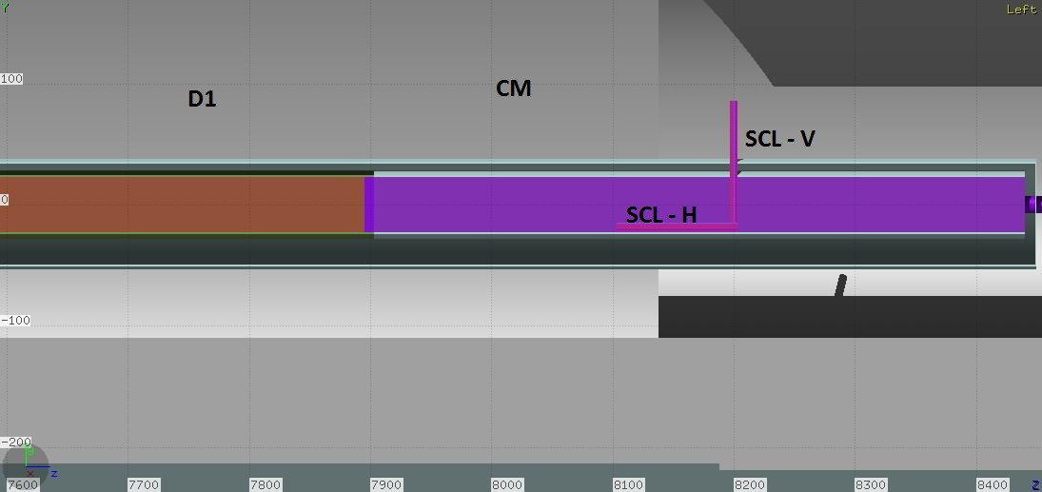
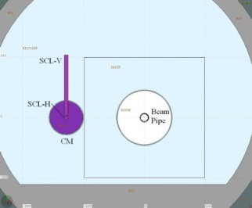
SCL Routing into the tunnel
Two possible routings of the SCL have been investigated:
1) Arrive from surface closer to IP1. The SCL runs aside the triplet and then connect to the Connection Module (CM), aside the beam pipe
2) Arrive from surface
after D1

Slide 12
Particle Fluencies (option 1)
(From Q1 to the SCL 1 m above Q1)
Escaping from Q1
28% photons (1250 ph/event) 9% of the kinetic energy is from photons (3.2 GeV/event)
71% neutrons (3143 n/event) 65% from neutrons (22.8 GeV/event)
Entering the SCL
33% photons (12.5 ph/event) 14% of the kinetic energy is from photons (33.8 MeV/event
67% are neutrons (25.4 n/event) 68% from neutrons (170 MeV/event)
12
12

Slide 13
Particle Fluencies (option 2)
(To the SCL in the CM after D1)
Entering the SCL in the Connection Module
95% photons (126 ph/event) 35.8% of the kinetic energy is from photons (295 MeV/event)
2.4% neutrons (3.2 n/event) 6.3% from neutrons (51.6 MeV/event)
13
13

Slide 14
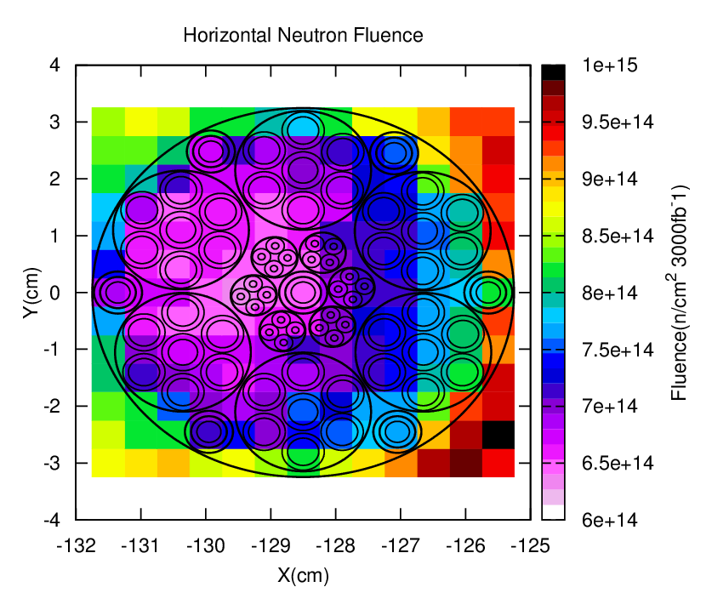
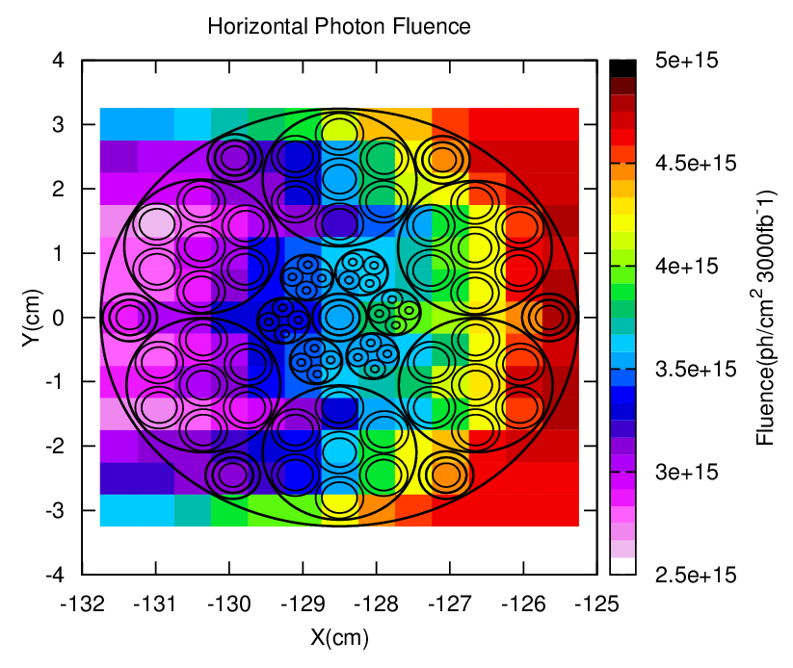
Fluencies
Neutron and photon fluencies in the Horizontal part of the SCL inside the CM (at 3000 fb⁻¹)

Slide 15


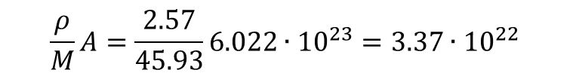
Simulation progress
Definitive definition of the cable geometry and material
Cu
MgB₂ , Φ = 0.85 mm
18 MgB₂ wires
Φ = 6.5 mm
Cable layout
6x20kA , 7x3kA, 4x0.4kA, 8x.12kA
Φext ∼ 65 mm
Courtesy A. Ballarino
Considering 1 m Link length ; S=33.2 cm², ρ=2.57 g cm⁻³ density
Being M=45.93 g/mol the MgB₂ molar mass
$$\frac{ρ}{M}A=\frac{2.57}{45.93}6.022∙{10}^{23}=3.37∙{10}^{22}$$
Pure MgB₂ atoms cm⁻³
$$3.37∙{10}^{22} ×33.2×100×2×0.245×0.2=1.1×{10}^{25}$$
¹⁰B atoms m⁻¹

Slide 16
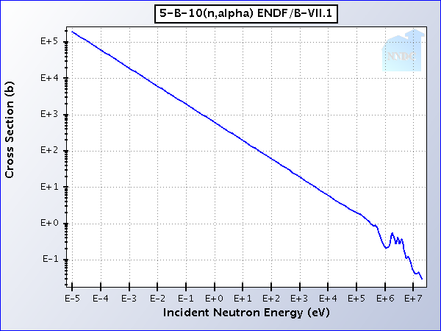
Boron Consumption
B_{nat}= 80% ¹¹B + 20% ¹⁰B
¹⁰B slow neutron cross section for this reaction is about 4×10³ barn at room temperature (E_{n}=0.025 eV) and 1.5×10⁴ barn at 20 K (E_{n}=0.0017 eV)
As from the data before the n entering the SCL inside the CM (Option 2) are about 3.2 n/event.
At an integrated luminosity of 3000 fb⁻¹ LHC will collect about 3·10¹⁷ p-p events, so the
total amount of n in the SCL will be about 1·10¹⁸ .
The number of ¹⁰B atoms (see slide 15)is much higher than 1 · 10¹⁸ and even supposing 1 capture reaction per neutron
the ¹⁰B consumption is negligible

Slide 17
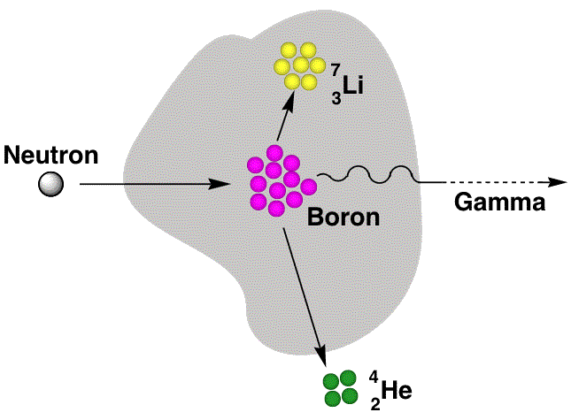
n Boron capture reaction
What is the contribution of alpha particles and of Li ion to the DPA?

Slide 18
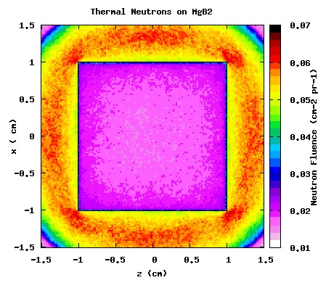
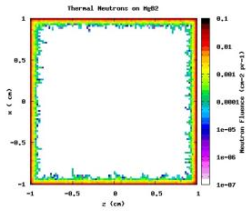
Neutrons on MgB₂ Simulations
MgB₂ with natural composition of B (80% ¹¹B – 20% ¹⁰B)
Thermal Neutrons (isotropic source)
TARGET (2x2x2 cm³)
n
The transport cut-off : hadrons 10⁻⁶ GeV neutrons 10⁻¹⁴ GeV
x
z
Target
damage energy threshold = 25 eV
Central section:
neutrons react at the surface (self shielding effect)
18

Slide 19
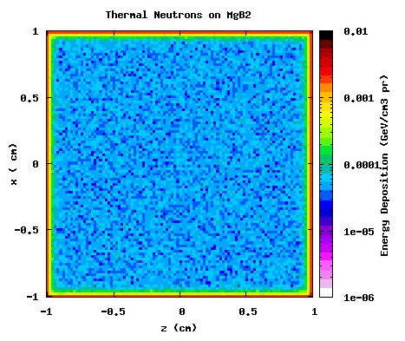
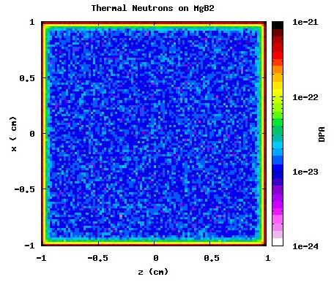
Energy Deposition and DPA
Energy Deposition
1.11E-03(±0.03%) GeV/pr
DPA
3.66E-23 (±0.03%)
Tsukuba November 20th 2014
19

Slide 20
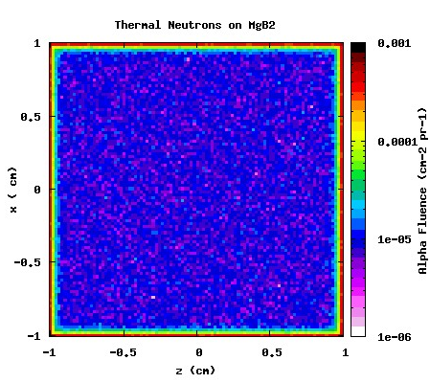
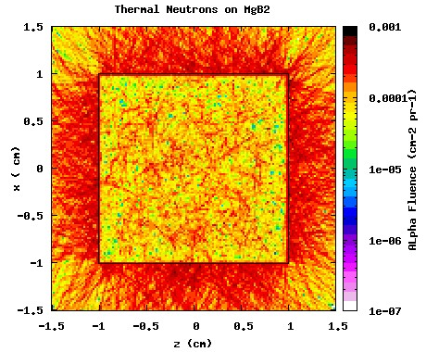
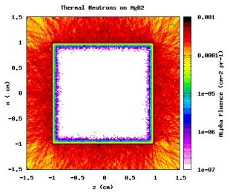
α Fluence
Reactions occurring at the surface cause a high fluence of alfa particle outside
Tsukuba November 20th 2014
20
20

Slide 21
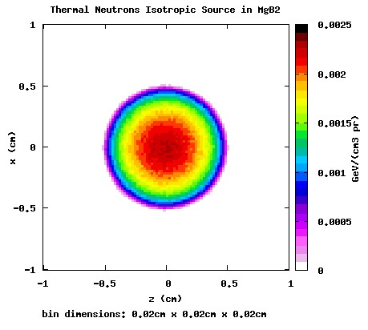
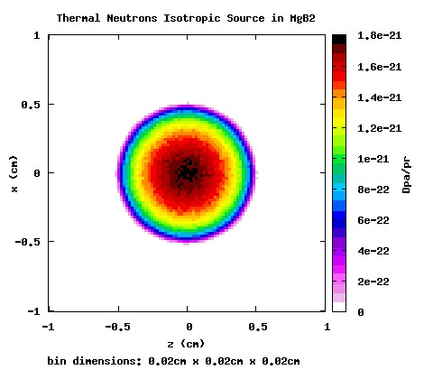
Single contribution (of α and Li)
Simulation with single internal isotropic source
α
n
Li
Target
α
n
Li
For the other different cases studied (alpha and Li) there are similar plots
These plots have not any absolute meaning, they just show that all the energy is deposed inside the sample (and the corresponding DPA is all provided inside them) and so the results can be compared.
21

Slide 22
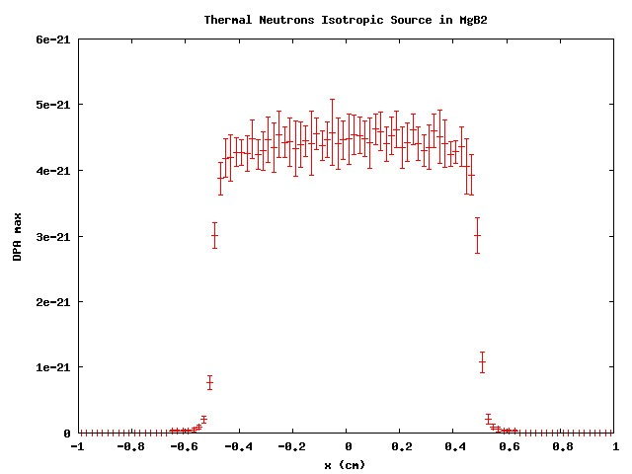
Considerations
The most significant parameter for the DPA is its the peak value. As a matter of fact the mean value of the DPA, as it is defined, indicates that every atom undergoes to the given amount of displacement.
It is evident that it does not happen because from previous figures the energy deposition and DPA occur in a limited part of the target, so it is meaningless to attribute a DPA to the whole region.
Conversely the peak value gives an indication of the localized radiation damage and this can give effects on the material characteristics.
22

Slide 23
Single contribution (of α and Li)
Maximum and average DPA in the MgB₂ target induced by the reaction products of the boron capture.
Reaction occurrence |  | Max DPA [DPA/primary]±Err% | Mean DPA [DPA/primary]±Err%
94% | Alpha (1.47 MeV) | 15.911∙10⁻²² ± 7.9 | 6.1633∙10⁻²²± 0.001
 | Lithium (0.84 MeV) | 32.968∙10⁻²² ± 6.9 | 11.952∙10⁻²²± 0.001
 | Photon (0.482 MeV) | == | ==
6% | Alpha (1.777 MeV) | 16.422∙10⁻²² ± 6.3 | 6.3141∙10⁻²²± 0.002
 | Lithium (1.015 MeV) | 31.447∙10⁻²² ± 6.6 | 12.240∙10⁻²²± 0.001
23

Slide 24
DPA Evaluation (of α, Li and n)
Combining the data with the corresponding weight we have
 | Max DPA [DPA/primary]±Err% | Mean DPA [DPA/primary]±Err%
Alpha | 15.942∙10⁻²² ± 7.8 | 6.1724∙10⁻²²± 0.001
Lithium | 32.876∙10⁻²² ± 6.8 | 11.969∙10⁻²²± 0.001
Neutron | 46.295∙10⁻²² ± 5.0 | 18.345∙10⁻²²± 0.001
Summing the contribution of the alpha particle with the Lithium one:
15.942∙10⁻²² + 32.876∙10⁻²² = 48.818∙10⁻²² ± 0.257 max DPA
6.1724∙10⁻²² + 11.969∙10⁻²² = 18.141∙10⁻²² ± 0.001 mean DPA
Internal neutrons
46.295∙10⁻²² ± 2.334∙10⁻²² max DPA
18.345∙10⁻²² ± 0.001∙10⁻²² mean DPA
The Lithium contribution to DPA is 66-67% of the total (the sum of the alpha and Lithium)
The contribution of the alpha is about 33-34%
24

Slide 25
Considerations
PEAK VALUES
The peak value calculated by the sum of the alpha and Li contribution is about 6% higher that the values given by the neutrons.
This because we assume that every neutron reacts with ¹⁰B realizing one Li and one alpha particle.
MEAN VALUES
For the mean DPA calculated by the sum of the alpha and Li contribution is about 1% lower that the DPA induced by the neutrons.
This is probably due to the statistics, and anyway this value (the mean DPA) in our analysis is less important, as explained before.
25

Slide 26
Conclusions and Perspectives
Irradiation tests vs. simulations comparison …. (lowering of the Tc enhancing of the upper critical field)
Code benchmarking
Correlations between DPA and SC properties …

Slide 27
Acknowledgment
Thank You for Your attention
Michael Eisterer (ATI, Wien)

