Slide 1
Status of the FRIB Fragment Separator Superconducting Magnets
Earle Burkhardt FRIB Magnet Systems Department Manager

Slide 2
Outline
Overview
Current construction status
LINAC layout
Fragment separator layout
Superconducting magnets in high radiation environment
Target facility
Magnet design
Change from HTS to LTS for dipoles in hot cell

Slide 3
Team
Team members from the FRIB Experimental Systems Division
Georg Bollen
Tom Borden
Dan Cole
Shailendra Chouhan
Rick Swanson
Reg Ronningen
Dali Georgobiani
Earle Burkhardt

Slide 4
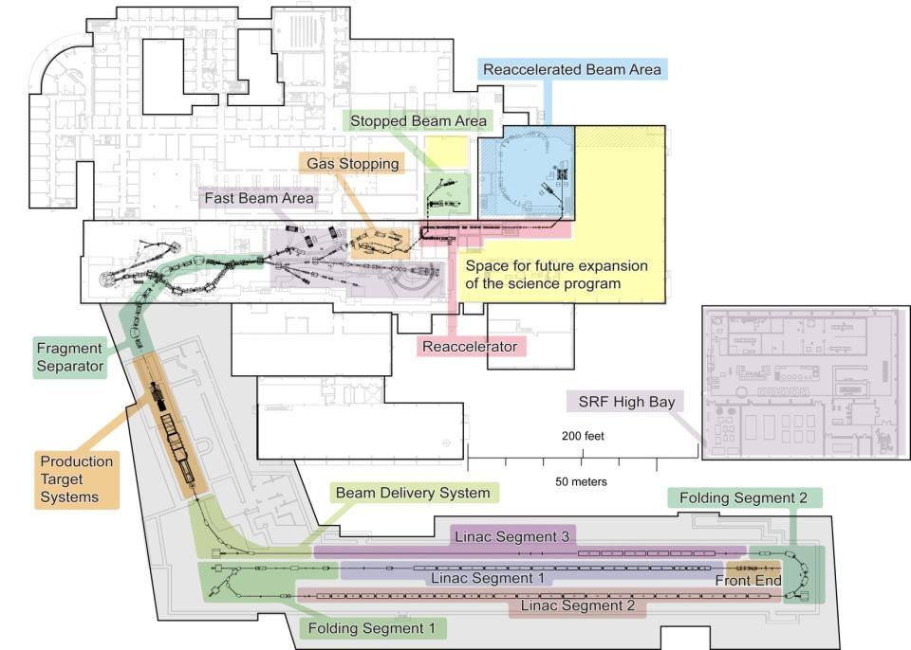
FRIB - Facility for Rare Isotope Beams at Michigan State University
Rare isotope production via in-flight technique with primary beams up to 400 kW, 200 MeV/u uranium
Fast, stopped and reaccelerated beam capability
Upgrade options
Energy 400 MeV/u for uranium
Isotope separation on-line
Multi-user capability
World-leading next-generation rare isotope beam facility

Slide 5
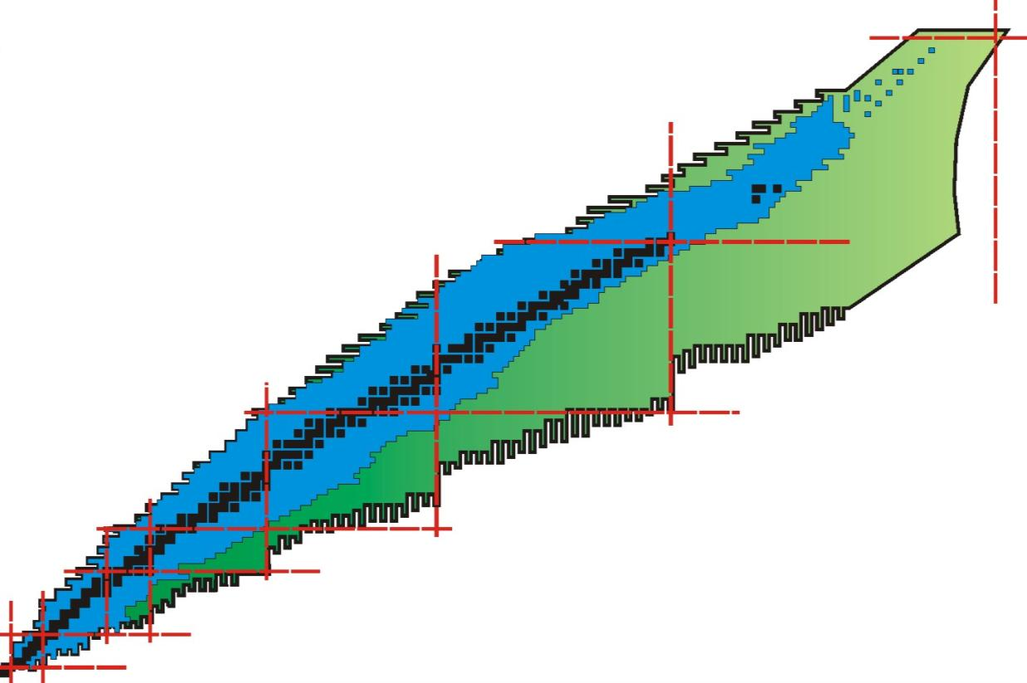
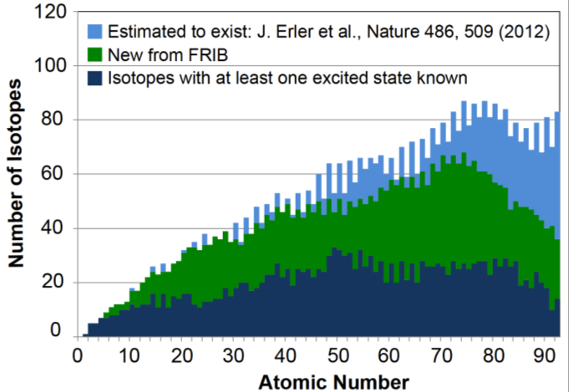
FRIB Beams Will Enable New Discoveries
Available today
New territory to be explored with FRIB
about 3000 known isotopes

Slide 6
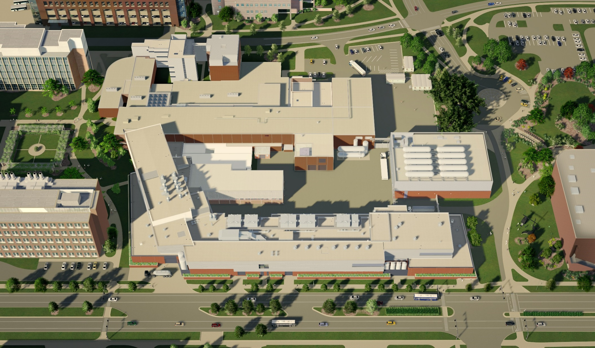
Conventional Facilities Site Layout

Slide 7
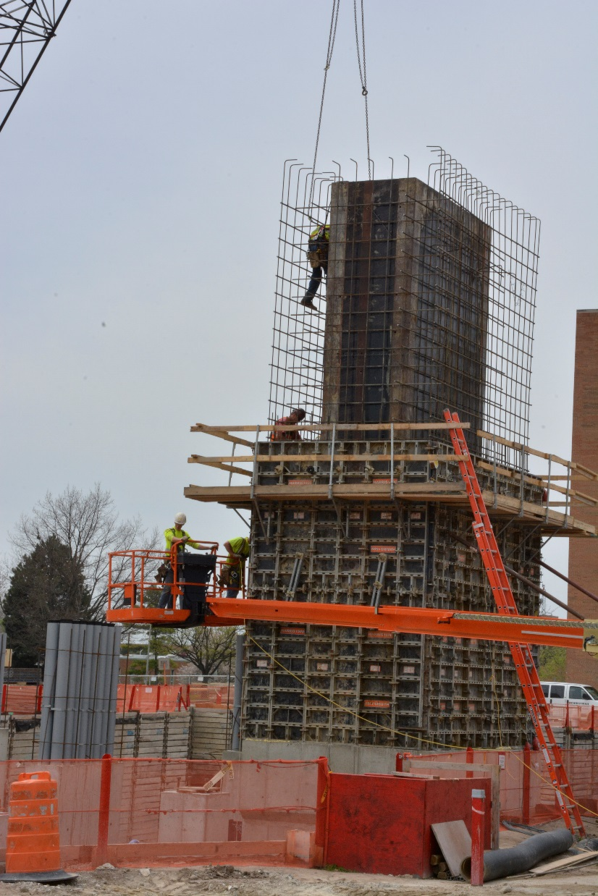
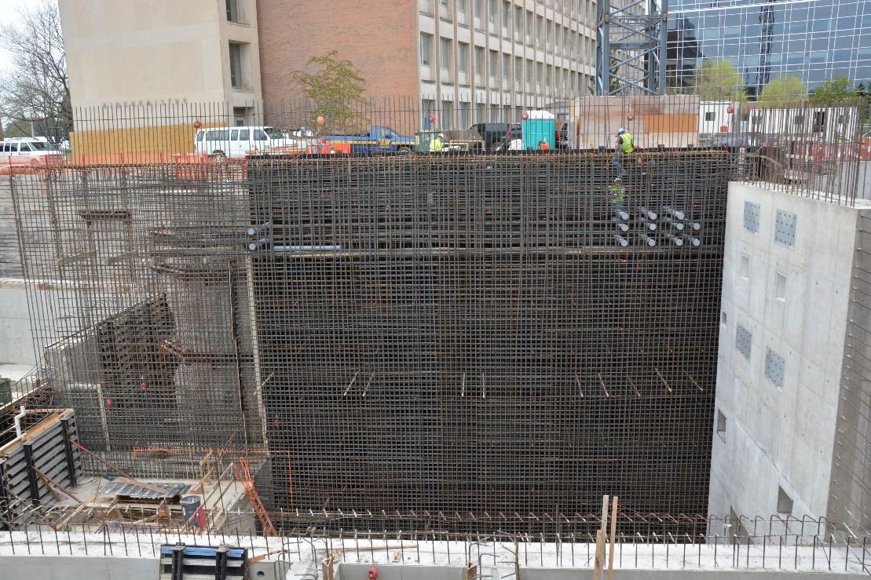
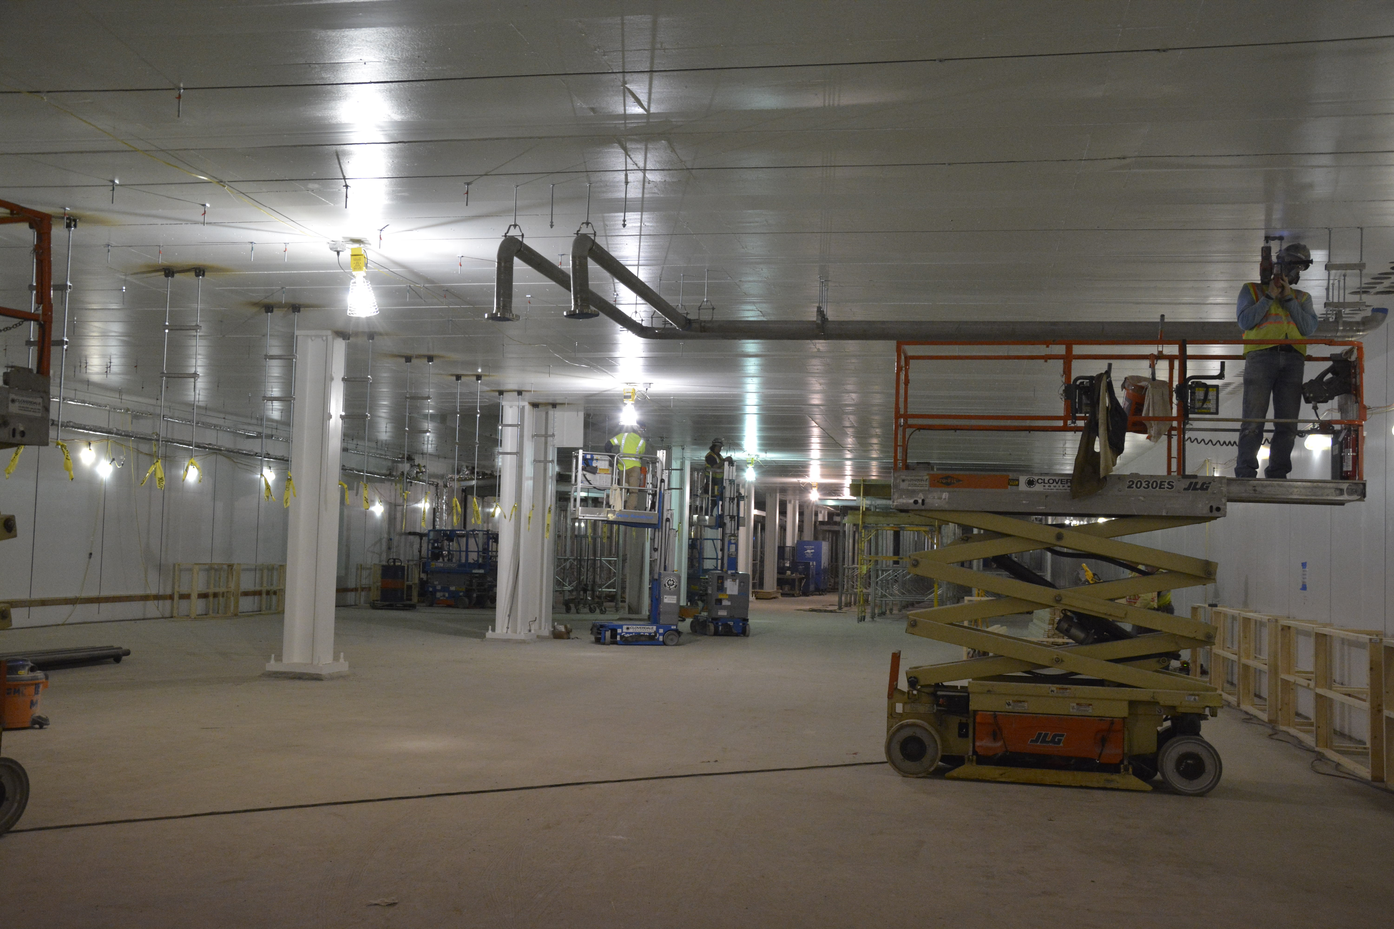
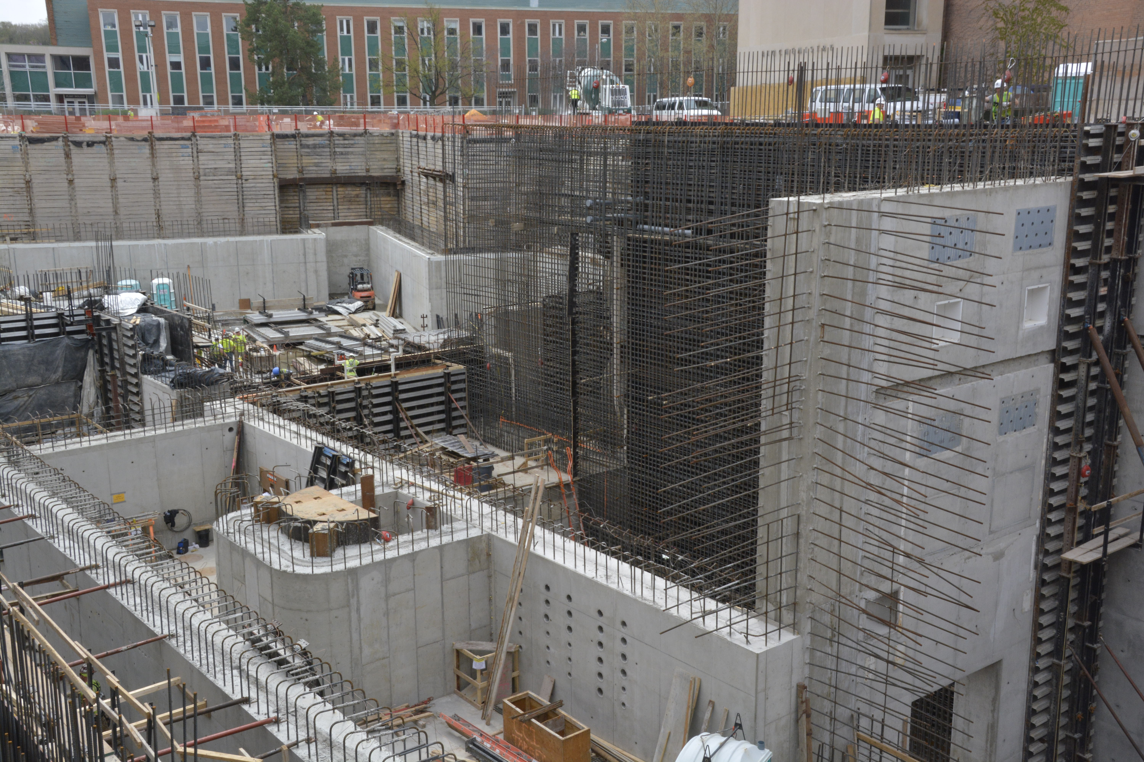
FRIB Construction Progress [1]
Structural steel erection for surface building underway
Backfill: 46,178 tons = 65% complete
Resteel: 1,799/2,800 tons = 64%
Concrete: 24,468/43,000 yards = 53%
Caissons have been completed
Ongoing installation of hangers and piping in linac tunnel
Forming and placing resteel for the west wall of the hot cell
Placing resteel for hot cell wall
Performing work on tunnel exhaust shaft
Newly painted linac tunnel
View of target area from northeast

Slide 8
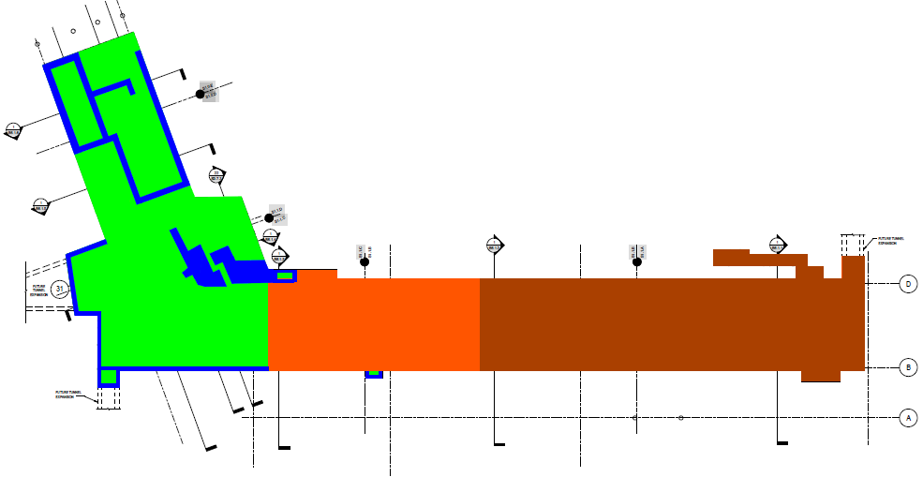
FRIB Construction Progress [2] FRIB Concrete as of 29 April 2015
= Tunnel slabs poured
= Tunnel walls poured
= Tunnel lid poured
= Backfilled to grade

Slide 9
FRIB Driver Accelerator Layout

Slide 10
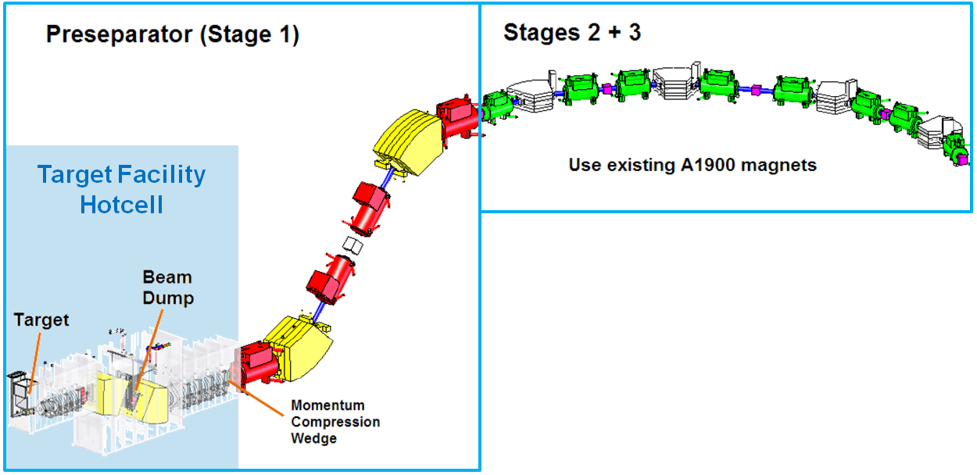
Fragment Separator
Scope
In-flight separation of rare isotopes with high acceptance and high resolution
Leverage rare isotope production at 400 kW beam power
Provide purest-possible rare isotopes beam to maximize science reach
Technical specifications
High-acceptance preseparator provides first beam purification step, provides defined location(s) for primary beam dump
2 additional separation stages to guarantee high beam purity
Provide future upgrade opportunities for isotope harvesting

Slide 11
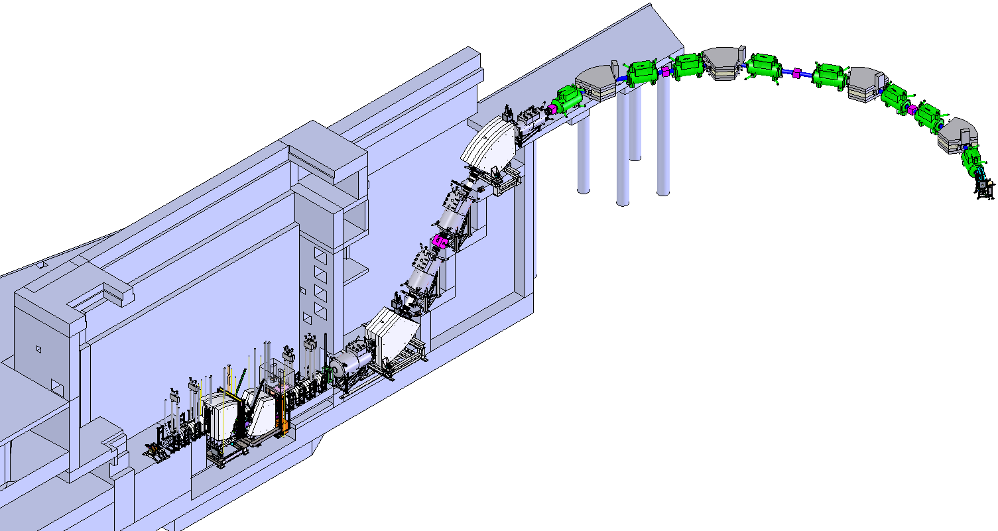
Fragment Separator Magnets
Existing NSCL A1900 magnets reconfigured
Vertical section
Front end of pre-separator
New designs for cold iron quadrupoles and dipoles
Known technology
Low risk
Highest radiation environment
Life-of-facility concerns
High radiation heat loads
B2-Georgobiani

Slide 12
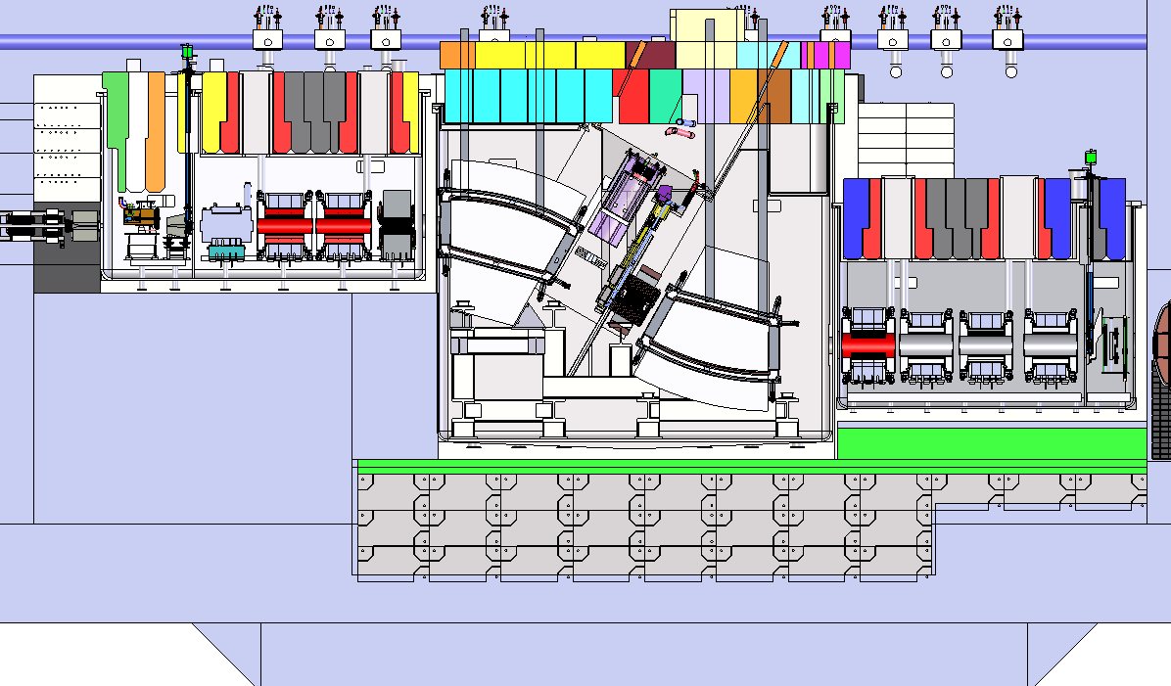
Fragment Separator Mechanical Design
All components in high radiation area in vacuum vessels (~200 t)
Beamline from linac
RT quadrupole
SC dipoles
North hot cell wall
SC quadrupoles
SC quadrupoles
Target
Resistive octupole
Target
vacuum vessel
Metal shield
Beam dump
Room temperature Multipole
Wedge
vacuum vessel
5m
Beam dump
vacuum vessel
Steel shield blocks
Wedge assembly

Slide 13
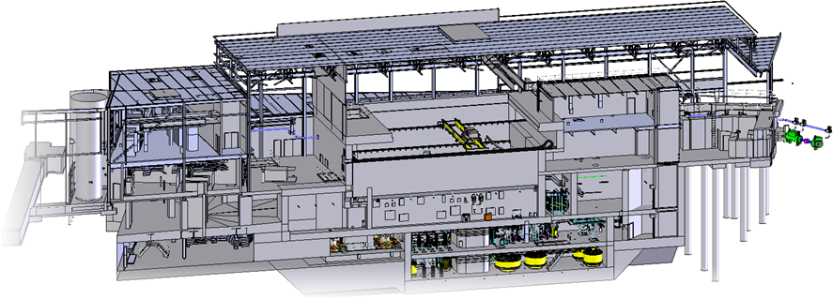
Target Facility Design
Fragments
End of beam delivery system

Slide 14
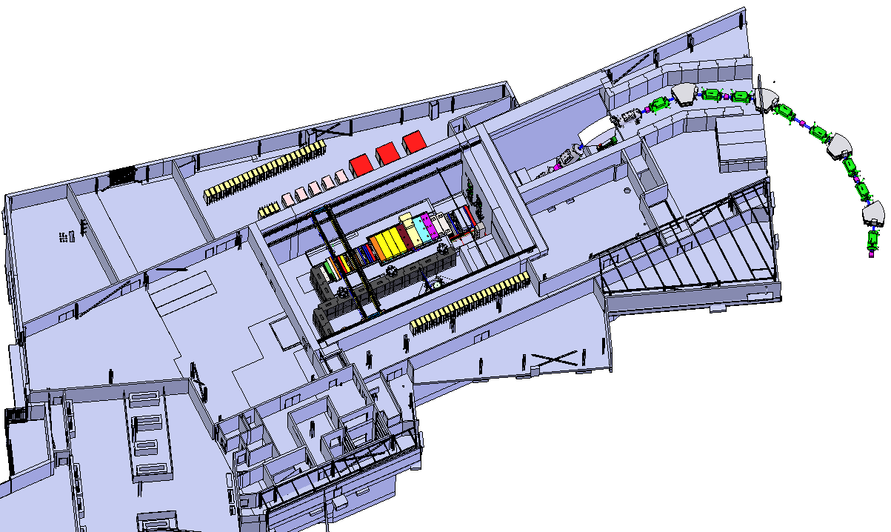
Target Facility Design Interior Layout
Hot Cell
Target Facility Magnet Power Supplies
Labyrinth to Beam Line
High Bay Loading Dock
Access control from NSCL building
Waste Handling Hatch
Access control from loading dock

Slide 15
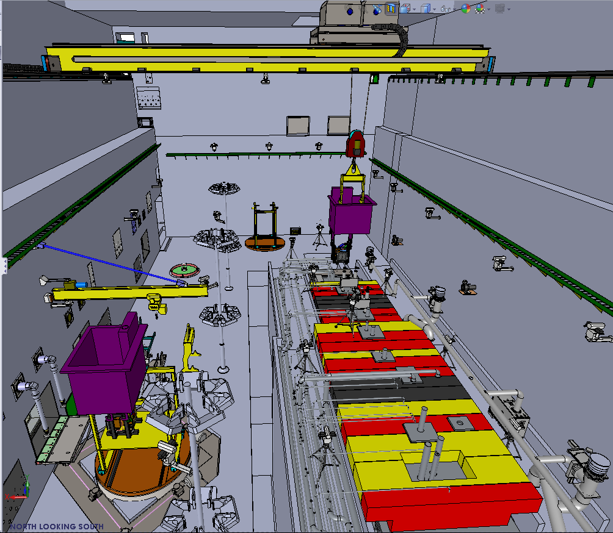
Target Facility Hot Cell
The system will maintain activated preseparator beam line components located in the hot cell and manage activated waste
Hands on access with beam off and shielding in place
Remote operations with shielding removed or beam on
Magnets designed with remote handling capabilities
Serviced in this hot cell
20 ton crane
Vision system
Utility embeds
Bottom loading port
(access to waste handling gallery)
Hot cell lighting
In-cell tooling
Window workstation
RH equipment lift
Temporary waste storage

Slide 16
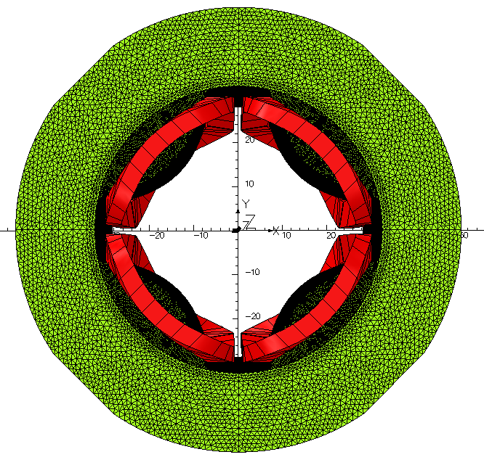
Fragment Separator Magnet Design
Full 3D TOSCA model for detailed optimization
Detailed flux distribution, forces, quench analysis
Example: quadrupole FSQ9
Field gradient exceeds requirement by 12%
Effective length within 5% of goal
Integrated strength exceeds requirement
Meshed 3D model of FSQ9

Slide 17
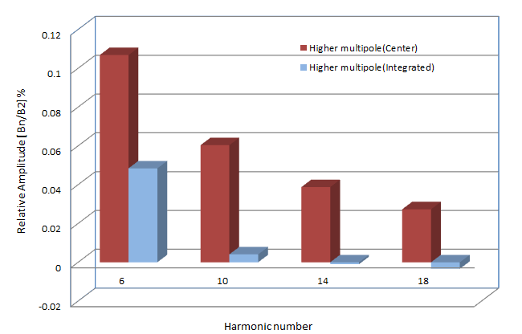
Fragment Separator Magnet Design Magnet Field Quality Example: FSQ9
3D model shows pure quadrupole field at 0.1% level
Simulated field quality exceeds requirements
Similar, but longer magnet FSQ10 has even better field quality
Harmonic analysis results for FSQ9
Relative strength of FSQ9 higher order harmonics (center and integrated)
 | FSQ9 (center, R = 12 cm) |  | FSQ9 (integrated, R = 12 cm)
Order | Amplitude | Relative Amp.[%] | Amplitude | Relative Amp.[%]
2 | -11432.5 | 100 | -712519 | 100
6 | -12.2 | 0.1 | -345 | 0.05
10 | -6.9 | 0.06 | -29 | 0.004
14 | -4.4 | 0.04 | 7.1 | -0.001
18 | -3.1 | 0.03 | 24 | -0.003

Slide 18
Warm iron quad (half)
Connection box
Link
Yoke key
Quad Coil
Support
Multipole coils

Slide 19
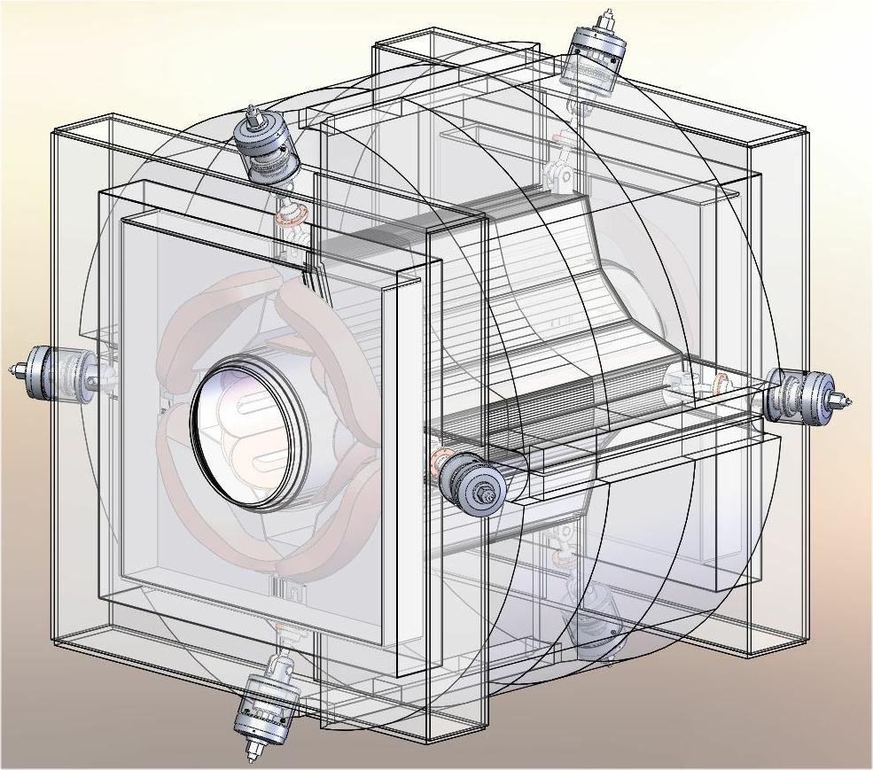
Warm Iron Quad

Slide 20
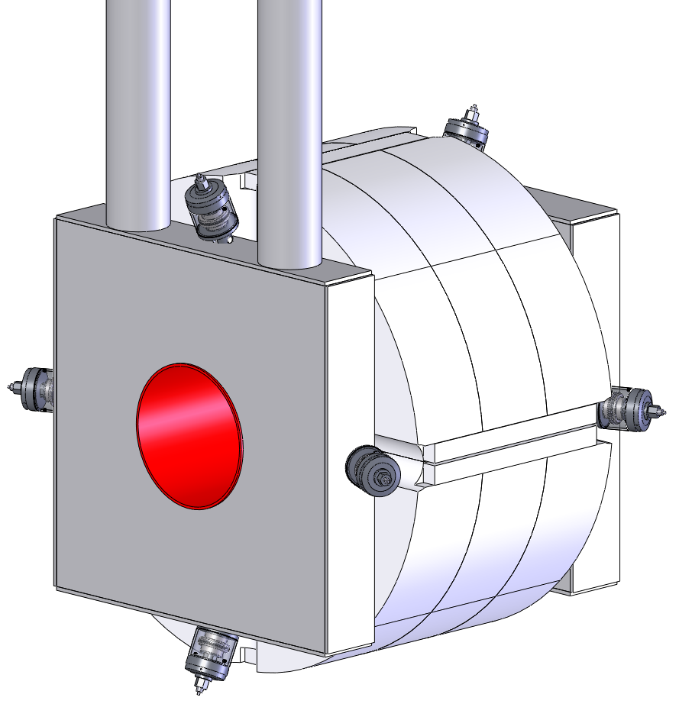
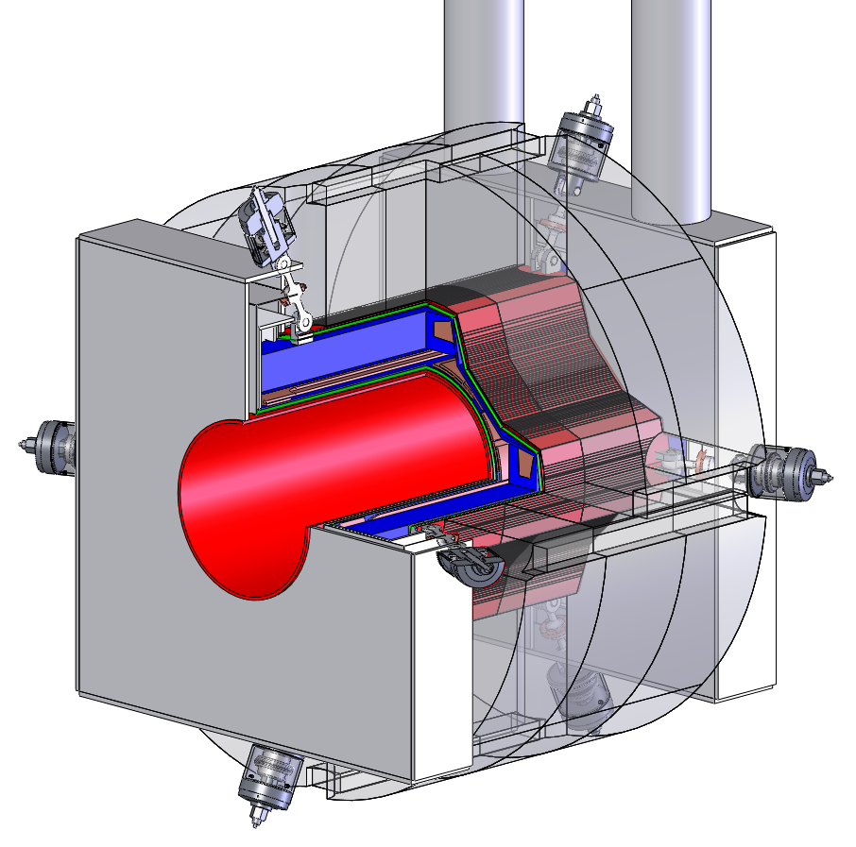
Warm Iron FRIB Quadrupole Features
Warm iron quadrupole coils are not supported by the yoke iron like the cold iron quad design
Coils need a support structure to deal with coil forces of up to 40,000 kgf/linear m
Electrical Leads &
Helium Return
Liquid Helium Supply Port
Support Links
Coil Backbone Support
Support Links Limited to 10 W Heat Load Total
MSU SC Magnet

Slide 21
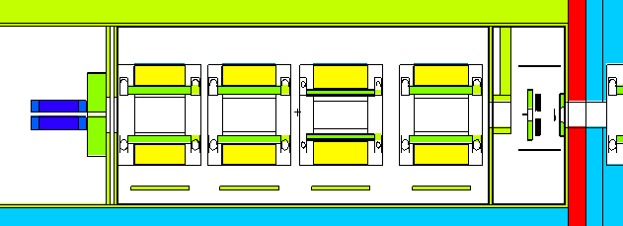
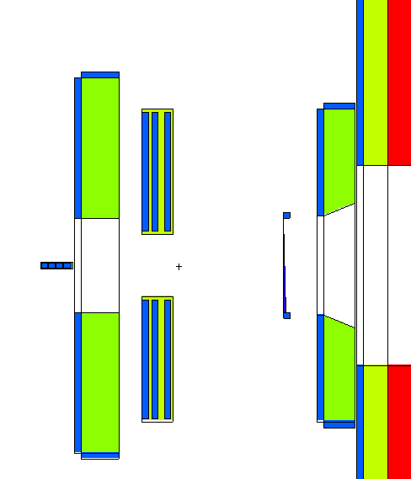
Detailed Magnet Models for Simulations Basis for Reliable Prediction of Radiation Effects
Power deposition in magnet structures drives the detailed design of magnet components, non-conventional utilities, cooling water loops, cryogenic requirements
Continuous improvements of target, beam dump, and wedge vacuum vessel models that contain updated magnet components (geometry, dimensions, materials, structures)
Wedge vacuum vessel
slits
Q_D1137
Q_D1147
Q_D1158
Q_D1170
shield
catcher
wedge
Beam dump 2
magnet supports
collimator

Slide 22
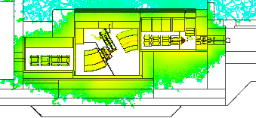
Calculations of Radiation Power Deposition
Power deposition in shielding drives detailed shielding design, such as concrete placement near the vacuum vessels
Power deposition in magnet yokes and coils drives the detailed design of magnet components, non-conventional utilities, cooling water loops
Radiation power
deposition from
Ca-48 beam at
239.5 MeV/u
(baseline energy)

Slide 23
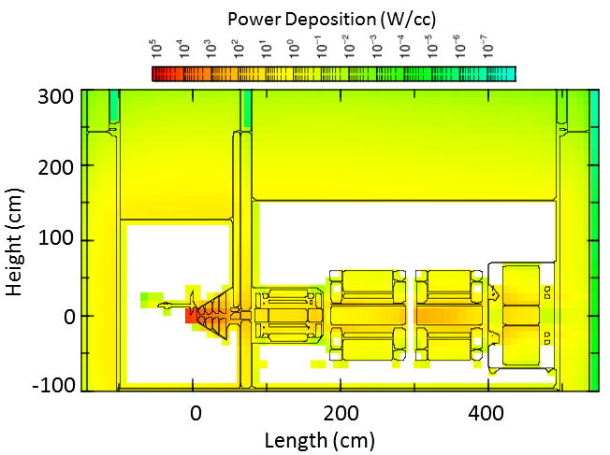
Calculations of Radiation Power Deposition
Power deposition drives detailed vacuum vessel and external shielding design
Power deposition maps are used as a diagnostic tool to make sure there is no excessive heating
Radiation power deposition from ⁴⁸Ca beam at 549 MeV/u (upgrade energy)

Slide 24
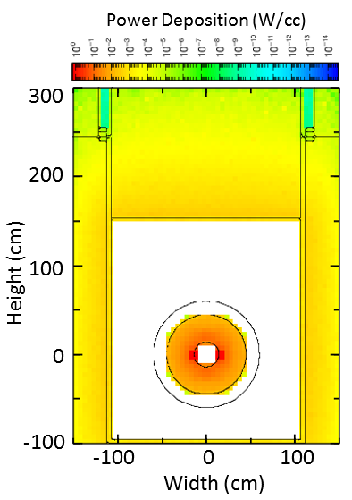
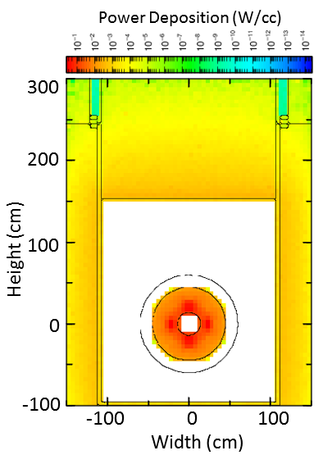
Magnet Thermal Shield Power Deposition Study Supports Cryogenics Detailed Design
40 K thermal shield power deposition information also provided to the magnet designers and engineers for improvements towards detailed magnet shield cooling design and shield optimization
Calculated heat loads become requirements for the cryogenic system
Power deposition in the target vacuum
vessel magnet 40 K thermal shields
Beam (at 400 kW) | ⁴⁸Ca, 240 MeV/u | ⁴⁸Ca, 549 MeV/u
Magnet | Deposited power, W
Q_D1024 | 12.7 | 120
Q_D1035 | 200 | 325
a
b
Power deposition in the front (a) and back (b) parts of Q_D1035 thermal shield

Slide 25
Magnet Yoke Power Deposition Study Supports Cooling Loop Design
Cooling will be provided to all magnet yokes in the hot cell
Cooling may not be required for some magnet yokes
Detailed heat load information is used to design water cooling loops
Detailed heat load information also provided to the magnet designers and engineers for improvements towards final magnet designs
Power deposition in the target vacuum vessel magnet yokes
Beam (at 400 kW) | ⁴⁸Ca, 240 MeV/u | ⁴⁸Ca, 549 MeV/u
Magnet | Deposited power, W
Q_D1013 | 60 | 330
Q_D1024 | 0.4 | 3
Q_D1035 | 4 | 50
S_D1045 | 550 | 7420
First 3 quads and resistive multipole
This analysis has been published in T40204-CA-000104 “Radiation Energy Deposition in Preseparator Magnets and Lifetime Estimates”; the numbers presented here are updated due to latest model changes reflecting design details

Slide 26
Magnet Yoke Power Deposition Study Determines Cooling Loop Design
Power deposition is highest after the beam dump
Cooling is required for most magnet yokes
Detailed heat load information is used to design water cooling loops
Detailed heat load information also provided to the magnet designers and engineers for improvements towards detailed magnet designs
Beam (at 400 kW) | O-18 | Ca-48
Energy, MeV/u | 637 | 239.5
Magnet | Deposited power, kW
Q_D1013 | 0.80 | 0.11
Q_D1024 | 0.30 | 0.04
Q_D1035 | 0.32 | 0.04
S_D1045 | 1.60 | 0.11
DV_D1064 | 1.84 | 0.19
S_D1092 | 16.2 | 3.20
DV_D1108 | 11.8 | 2.50
Q_D1137 | 1.54 | 7E-3
Q_D1147 | 0.08 | 2E-3
Q_D1158 | 0.03 | 8E-4
Q_D1170 | 0.02 | 5E-4
before beam dump
after beam dump

Slide 27
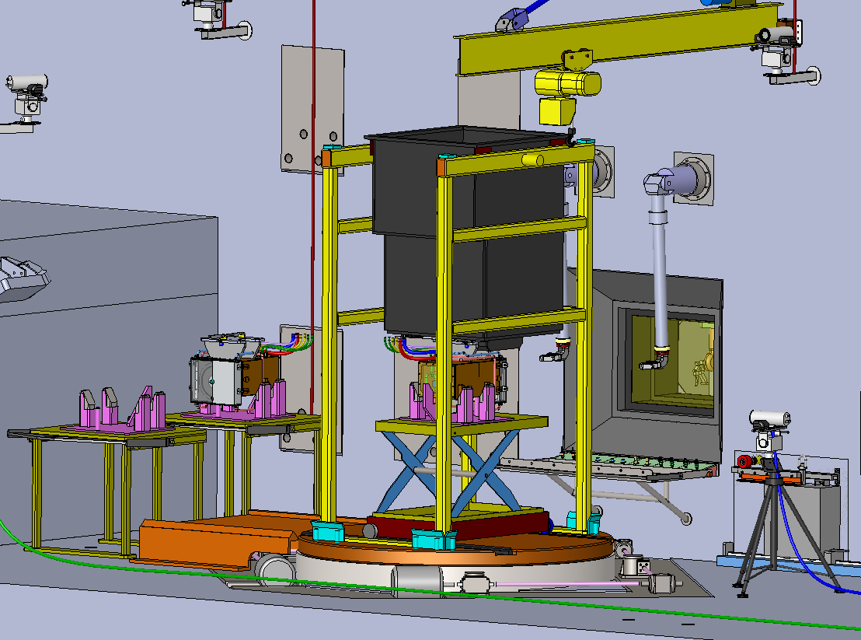
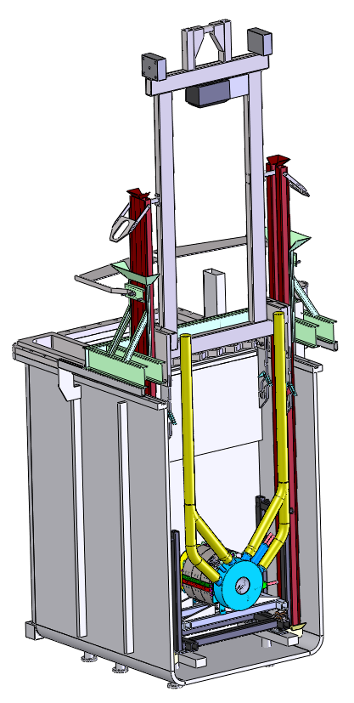
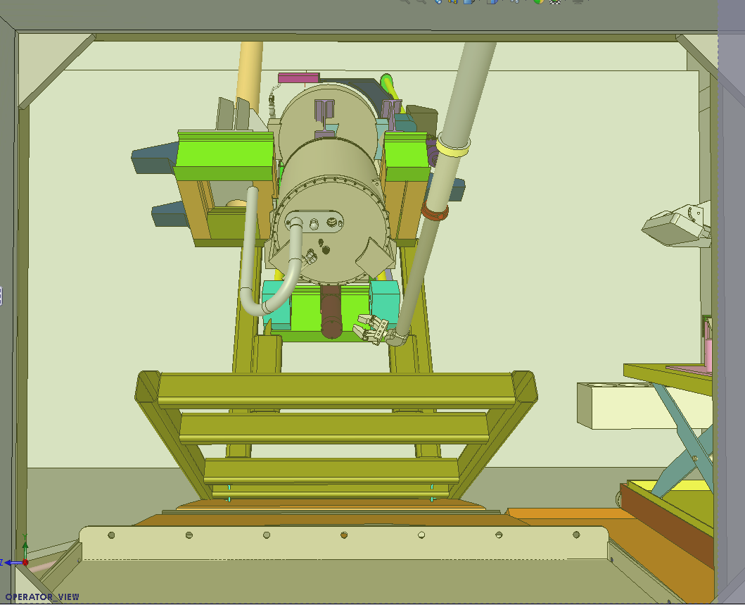
Fragment Separator Remote-Handling Equipment
Technical design/specification of equipment to be procured complete, procurements released
Master slave manipulators
Wall tubes, shield plugs and manipulators delivered
Shield windows
Windows and liners have been delivered, shield plugs also delivered
20-ton crane ordered
Remote tooling/handling design follows component design
Tooling design for Superconducting (SC) quadrupoles and dipole magnets substantially complete and reviewed
Cold-test facility operational
Making use of master slave manipulators for design and procedure validation

Slide 28
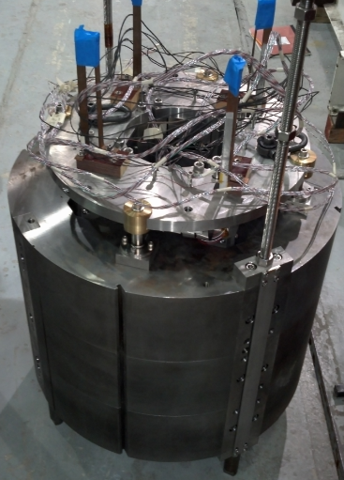
Change from HTS to RT and LTS Technology Reduce Cost and Risk, Increase Performance
Main motivation for HTS was high radiation on coils
Life-of-facility coils attractive feature
No heat load at 4.5 K
HTS quad R&D at BNL very successful
However, complexity of using prototype as final magnet greater than anticipated
Initial estimation of cost of HTS tape for 30° dipoles was too low
Expectation was for cost to decrease and performance to increase
Initial design operated close to critical current (I_{c}); however improvement in I_{c} less than expected
In order to maintain safe critical current margin, cost of HTS tape increased significantly
Necessary quench protection still in early stage of development for dipole magnet
BNL plan to use quadrupole quench protection for HTS dipoles may not be viable because of larger inductance
Significant development needed to prove effectiveness of quench protection system
Would need large inductance magnet in order to test this

Slide 29
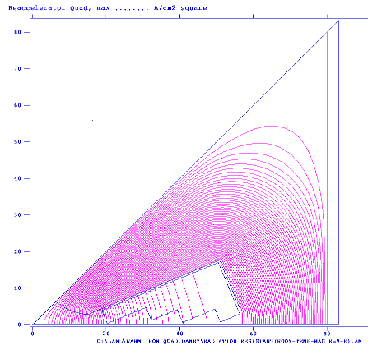
Change from HTS to RT for FSQ1 RT Has Low Risk
Initially, room-temperature design was considered
Relatively low-field → RT magnet a viable option
RT option not possible for other quadrupoles
2D design complete and meets requirements
Better field quality than current HTS prototype magnet
Water cooling loop in target vessel has enough spare capacity
Design approach
Copper conductor with metal oxide insulation
RT quad could be built outside
In the long term, HTS is the most attractive option

Slide 30
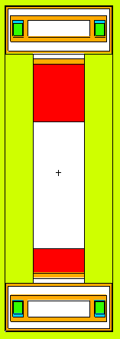
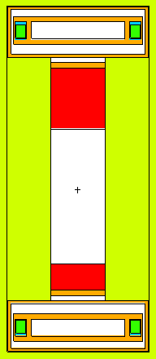
Planned Change from HTS to LTS for 30° Dipole LTS is Suitable Technology
LTS coils provide adequate lifetime for operation in radiation environment
Possible if moving coils back 5 cm into yoke
Significant reduction in radiation
Cyanate ester epoxy provides at least decade long lifetime (assuming worst-case beam)
Aluminized Kapton as radiation resistant MLI
Additional LTS advantages
Very established technology, similar to magnets already fabricated in house
Fast charging ramp-rate makes beam tuning more efficient
Original coil location
New coil location
Coils
Pole tips
d
d+10cm

Slide 31
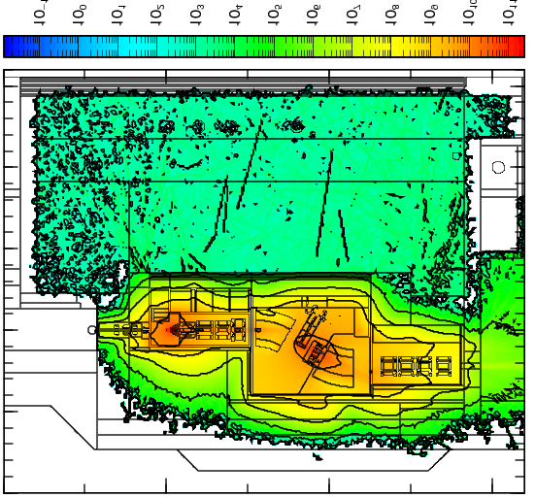
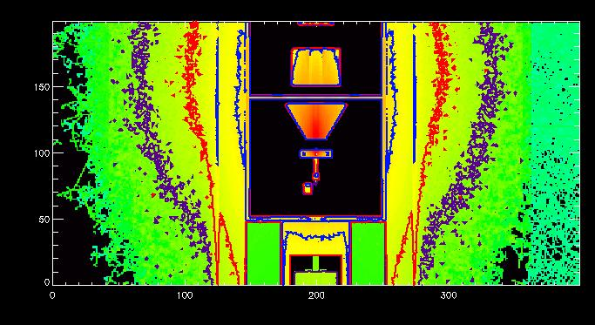
Radiation Transport Analyzed to Determine Life-time of Magnets
Heat map of zone close to Target
Hot Cell Dose Rates

Slide 32
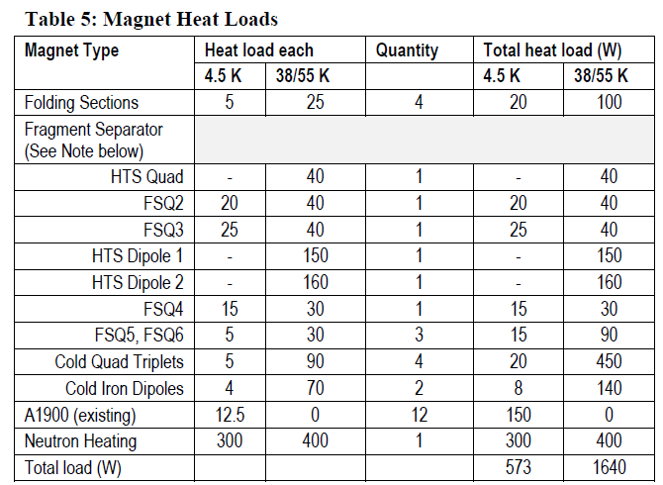
Planned Change from HTS to LTS for 30° Dipole Cryogenic Performance is not an Issue
Heat loads at 4.5 K greatly reduced
Worst-case beam (¹⁶O 294.4 MeV/u)
Original: ~250 W per dipole (500 W total)
New: ~81 W per dipole (162 W total)
Cryogenic plant capacity can handle the additional 4.5 K heat loads
Worst case for coil lifetime
Original: 5 years
New: 12 years
Manageable, and could still replace LTS dipoles with HTS in the future
Summary of FRIB Cryogenic Heat Loads T30200-TD-000244
Original coil location
New coil location
Estimates for worst-case beam
Additional 100W
Worst-case for 30° dipoles will increase neutron heating on 4.5 K stage, but decrease heating on 38 K stage
Overall cooling is manageable
A1900 on existing refrigeration system

Slide 33
Change from HTS to LTS for 30° Dipole Other Issues Addressed
Magnetostatic design
Field uniformity
Pole tip profile remains essentially unchanged → very little impact
Operating current – LTS will meet requirements after moving coils out 5 cm
Amp-turns will need to increase slightly, but NbTi @ 4.5 K has much better critical current density (J_{c}) than HTS tape @ 38 K
Remote handling concept for removal of cryostat-pole tip package unchanged
20 ton maximum weight limit not exceeded
HTS design
cryostat + pole tips ≈ 7.4 tons; keystone ≈ 9.0 tons
LTS design estimate
cryostat + pole tips ≈ 9.0 tons; keystone ≈ 10.1 tons

Slide 34
Schedule
Winding 4 focusing solenoids in house
CIQTs and warm iron quads will be assembled in parallel paths
CIQTs
Winding of multipole coils has begun
CIQT4 is first followed by CIQT1 ~6 weeks later
Warm iron quads
FSQ5a and FSQ5b will be assembled at same time
Dipoles are last magnets to be assembled
Fabrication scheduled to begin December 2016

Slide 35
Summary
Magnets in the hot cell
Highest radiation environment
Magnet designs mostly complete
HTS→LTS change still being finalized
Dipole design being optimized
Transition to HTS coils in future upgrades

