Slide 1
JLab Preliminary Cryomodule Production Plans
T. Reilly
E. Daly
17-JUL-2014

Slide 2
Acknowledgements
Special Thanks –
E. Daly, K. Macha, J. Henry, K. Harding, T. Arkan

Slide 3
Outline
Production Strategy
CM Production Preparations
Cavity Qualification
String Assembly
CM Assembly
Summary

Slide 4
Cryomodule Collaboration
Fermilab is leading the cryomodule design effort
Extensive experience with TESLA-style CM design and assembly
Basis: 3-D model & drawings of similar ILC CMs (e.g. Type III+)
Jefferson Lab and Cornell are partners in design review, costing, and production
Cornell and JLab both have valuable CW CM design experience
Jefferson Lab sharing half the 1.3 GHz production
Recent 12 GeV Upgrade production experience
Argonne Lab is also participating in cryostat design
Beginning with system flow analyses and pipe size verification
Experienced SRF and cryogenic personnel at ANL may be available for other collaborative tasks
Courtesy of T. Peterson, SRF Weekly Mtg, DEC 2013

Slide 5
Strategy – One Design, Two Production Lines
Designs for Prototype and Production CMs (aim to satisfy PR and CM FRS)
Identical Prototypes - utilize as much existing hardware as possible to reduce schedule risk and reduce overall cost while achieving the same performance as the production CMs
Identical Production Designs - utilize as much of the DESY/XFEL design as practically possible to reduce schedule risk and reduce overall cost
FNAL produces 16 CMs; JLab produces 17 CMs
Identical Parts Received at Partner Labs
Well-developed drawing packages, clear requirements and specifications
Concurrent reviews within LCLS-II project
Procurement activities – lead technical contacts at Jlab/FNAL/SLAC work together during all phases
Identical Tooling Interfaces
Interfaces between CM hardware and tooling are identical
Avoid adding custom features to CM
Adapt non-CM hardware interfaces to Lab-specific tooling
Equivalent Processes yielding Equivalent Performance
Recognize that some tools are different at each lab (e.g. HPR, vertical testing systems, vacuum leak checking equipment, etc.)
Monitor key process variables in consistent fashion (e.g. samples to verify etch rates)

Slide 6
Opportunity to Learn from CEA Colleagues
Production of CMs is currently ramping up!

Slide 7
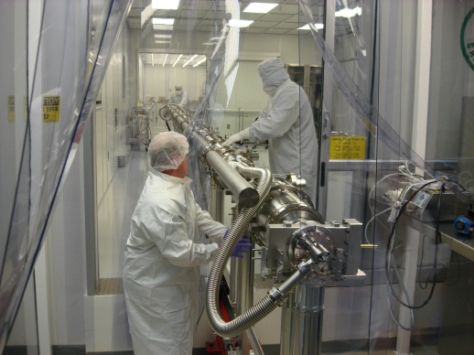
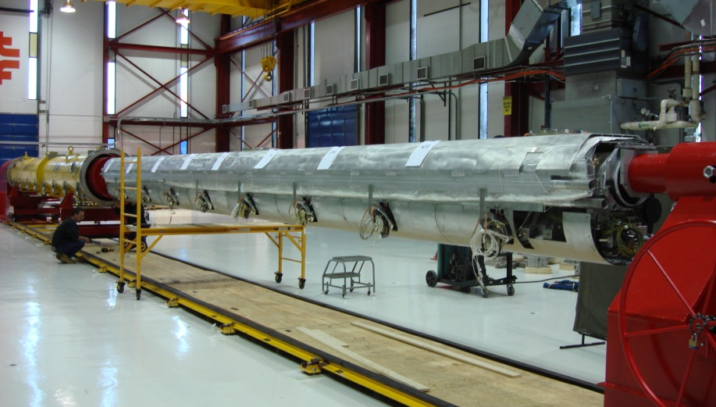
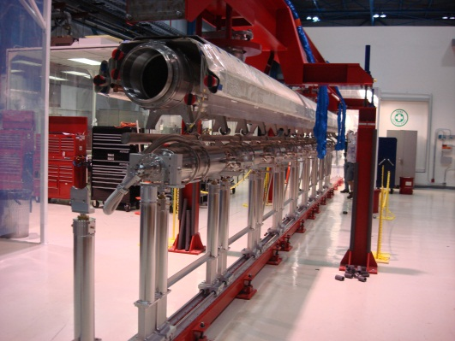
Leverage FNAL’s ILC-style CM Production Development
Cavity String Assembly
Insertion of Cold Mass into Cryostat Assembly
Cryomodule Ready for Transport On-site
Cold Mass Assembly
Courtesy of T. Arkan, FNAL

Slide 8
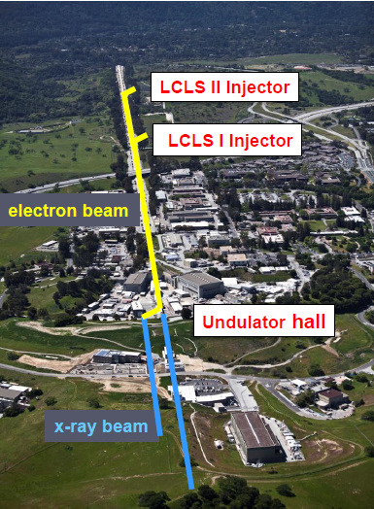
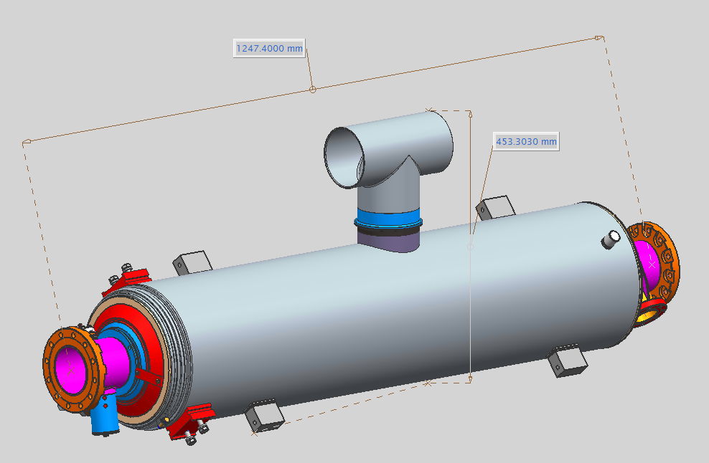
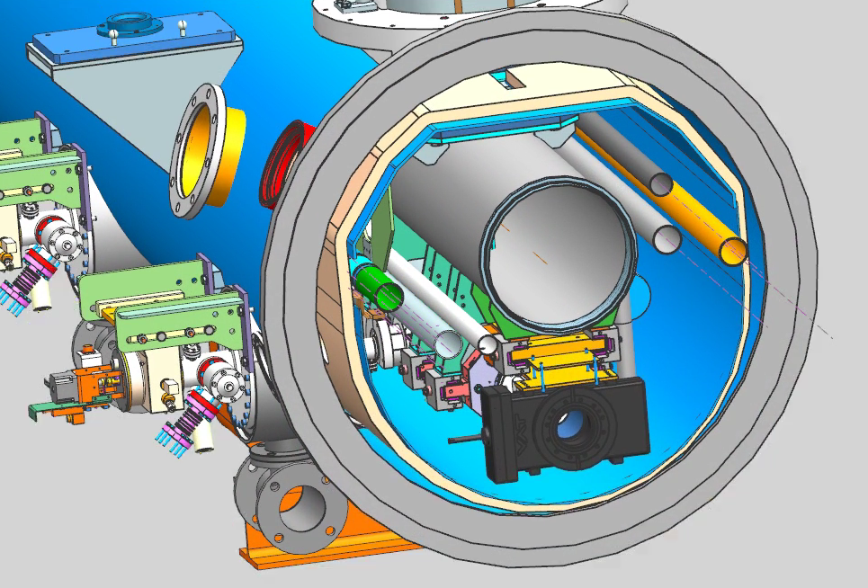
LCLS-II Cavity/Cryomodule Process at JLab
Supplier
Partners
JLAB SRF Facility
Receiving in SRF Inventory
Mechanical Inspection CMM
Component | FNAL | JLAB | SLAC
Niobium | X
Cavities |  | X
HOM/FP Feed through |  | X
Cavity Flanges - VTA Testing |  | X
Cavity Flanges - HTB Testing | X | X
Helium Vessels |  | X
FPC- Fundamental Power Couplers |  |  | x
Cavity String Bellows |  | X
Cavity String Hardware | X
Magnet | X
BPM- Beam Position Monitors, | X
HOM Absorber | X
Gate Valve |  | X
2-Phase Pipe Bellows | X
End Lever Tuner |  | X
Magnetic Shielding | X
GRHP Sub-assembly Gas Return Header Pipe, Cryostat, Intercept, Thermal Shield, Multi-layer Insulation etc. | X
Vacuum Vessel | X
Instrumentation |  | X
Interconnect Parts |  | X
Shipping Frames / End Caps |  | X
X = Lead Laboratory (as of 20Mar2014)
Courtesy of A. McEwen, JLab
Cavity /Helium Vessel Prep. & Test
VTA RF Test in liquid Helium @ 2 K
Cavity String Assembly & Leak Test
Assemble Cavity String - Class 10 Clean Room
Courtesy Chi-Chang Kao, SLAC
Cryomodule Assembly
Instrumentation & Wiring
Tuners, MLI– Multi Layer Insulation,
Cryogenic Circuits , magnetic shielding, alignment
Super Insulation Cabling & Shield
Vacuum Vessel & Final Alignment
Install Cryogenic Supply Interfaces
Horizontal Test Preparation
Pressure Test & Leak Check (vacuum)
Commissioning at SLAC
Install Cryomodules in Accelerator, cool to 2 K
Weld & certify leak tight , pressure test
check Controls,
Gradient & Dynamic Heat Load - Q_{o}
Cryomodule Test in “Test Cave”
Cryomodule integrity @ 2 K
Tuners - Range, Hysteresis, & Resolution/ Sensitivity
Cavities for Gradient & Dynamic Heat Load Q_{o}
LCLS-II 1.3 GHz
Dressed Cavity, Doped and Ready for VTA Testing
LCLS-II 1.3 GHz Cryomodule
Cryomodule shipping to SLAC
JLAB support for installation of first 3 Cryomodule

Slide 9
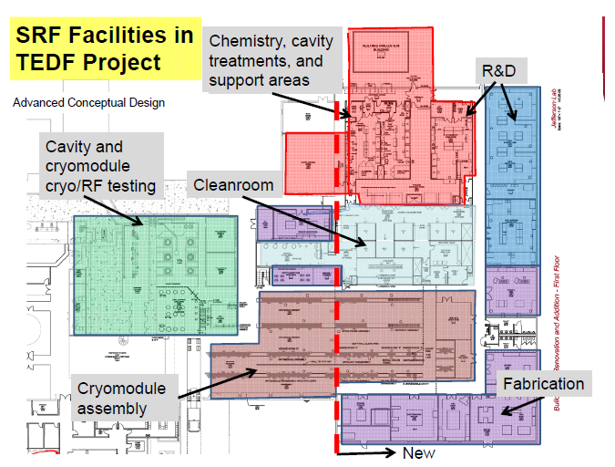
SRF Facilities at JLab
Located in Annex –
Receiving
Inspection
Inventory
Start
Offsite considered for additional storage
CMM/RF Checks
Ship

Slide 10
CM Production Preparations
Adapt existing infrastructure and facilities to accommodate LCLS-II components, sub-assemblies, final assembly and testing
Define processes and tooling required for component handling, assembly and testing
Develop test plans – key activities are cavity qualification from vendors and cryomodule acceptance testing
Employ SRF QA Tools used for 12 GeV 100 MV CW cryomodules (aka C100) production and SNS production

Slide 11
Planned Production Rate
Vertical Testing of Bare/Dressed Cavities
Capacity - 4 cavities per week reserved for LCLS II
Planned qualification rate – 2 cavities per week (C100)
Cavity String
Capacity and Planned Rate – 1 per ~ 4 weeks
Cold Mass and CM Assembly Tools
Capacity – 2 CM per month for LCLS II
Planned rate – 1 CM per ~ 5 weeks
Horizontal Testing Bench – supports Qo R&D and Production
Capacity – 1 test per month
Planned rate - ~ 1 cavity per CM during production
Cryomodule Testing Facility (CMTF)
Capacity & planned rate – 1 CM per ~ 6 weeks

Slide 12
Vertical Test Area / Horizontal Test Bench
VTA
Up to four test stands available for production acceptance testing capable of testing one cavity at a time
Utilize same cavity hardware (test flanges, feedthroughs, etc.) provided by project to cavity suppliers
Small modifications required to existing supports
Ensure low magnetic field environment (“magnetic hygiene”)
HTB
Support High Qo R&D
Plan to conduct five tests during production effort to provide feedback on cavity assembly process or for production development activities
Modifications to top hat for XFEL-style FPC and small modifications to existing supports

Slide 13
Facilities Improvements: Assembly Tools
Main Cavity Tools
Clean room tooling* - small fixtures for coupler installation, flange alignment, VTA testing hardware
Cavity Handling Cages*
Cavity Processing Tool Improvements (e.g. HPR, Heat Treatment Furnace, Horizontal EP)
Two sets of carriages for cavity string
Cavity Handling and Storage Equipment
Main Cold Mass and Cryomodule Assembly Tools
Cold Mass Spreader Bar* - Supports / Positions Cold Mass for cavity string attachment
Cold Mass Installation into Vacuum Tank
Vacuum Tank Supports
Spreader Bar* - Lifts Cryomodule
Shipping Frame & End Caps*
*Design exists, purchase copies

Slide 14
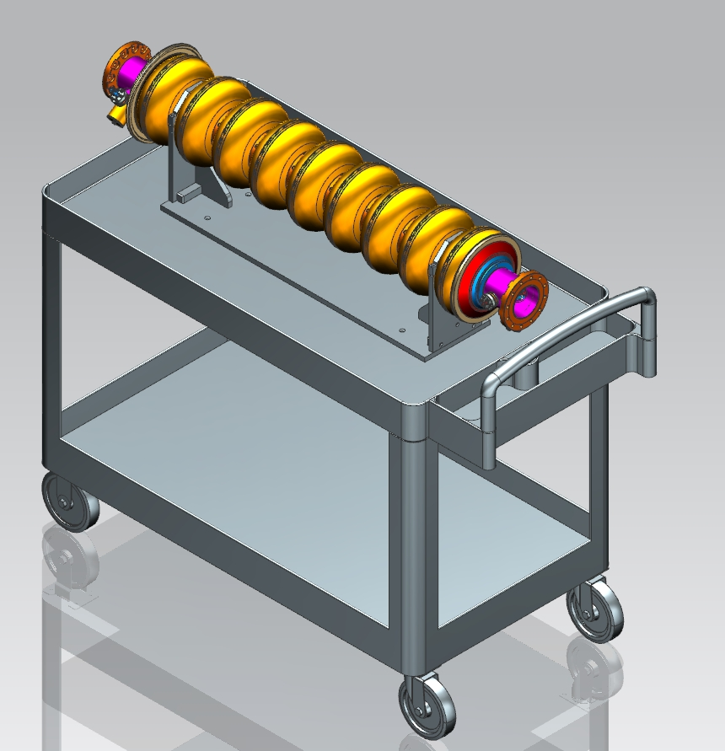
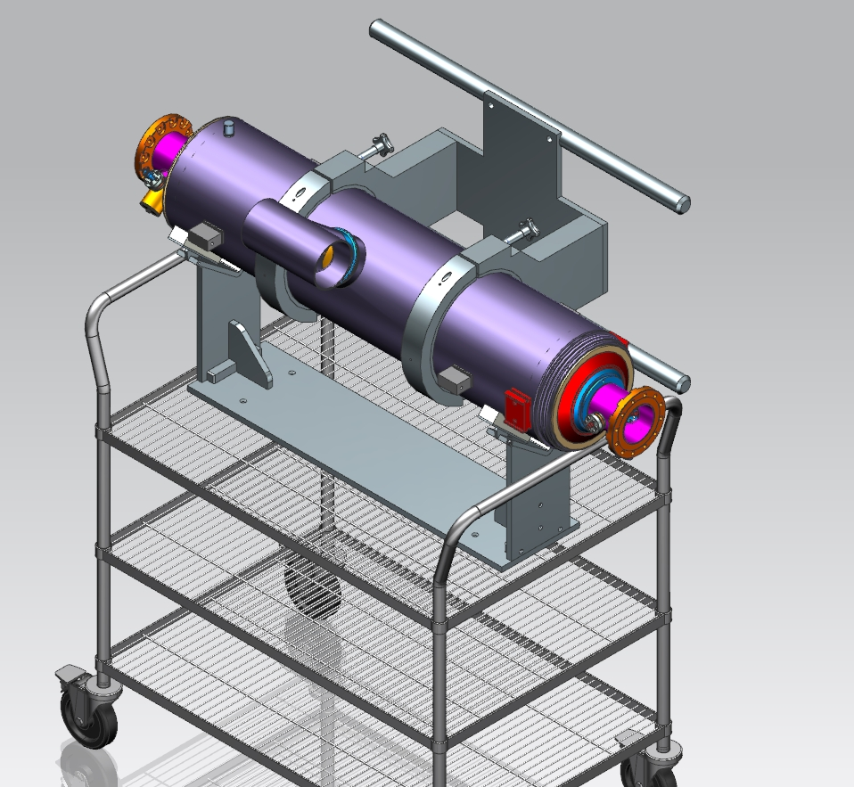
Cavity Handling and Storage Tooling

Slide 15
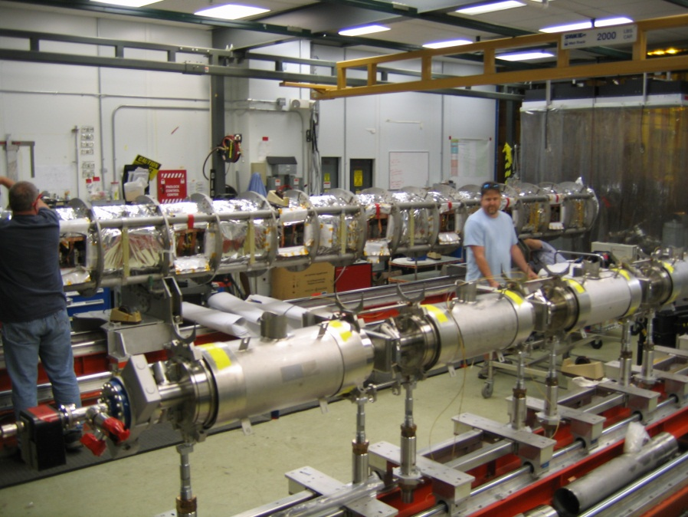
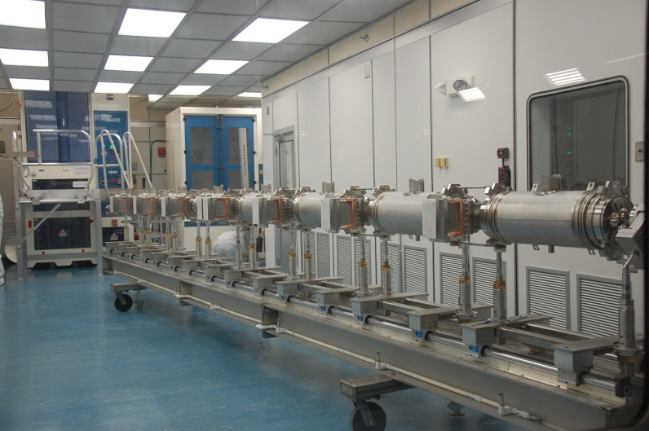
Cavity String Assembly in Clean Room
“Lollipop” supports for each cavity
TBD for SC magnet and bpm
Use mobile rail system rather than rail-in-floor used at DESY, CEA/Saclay and FNAL
Transfer to CM assembly rails for cold mass assembly

Slide 16
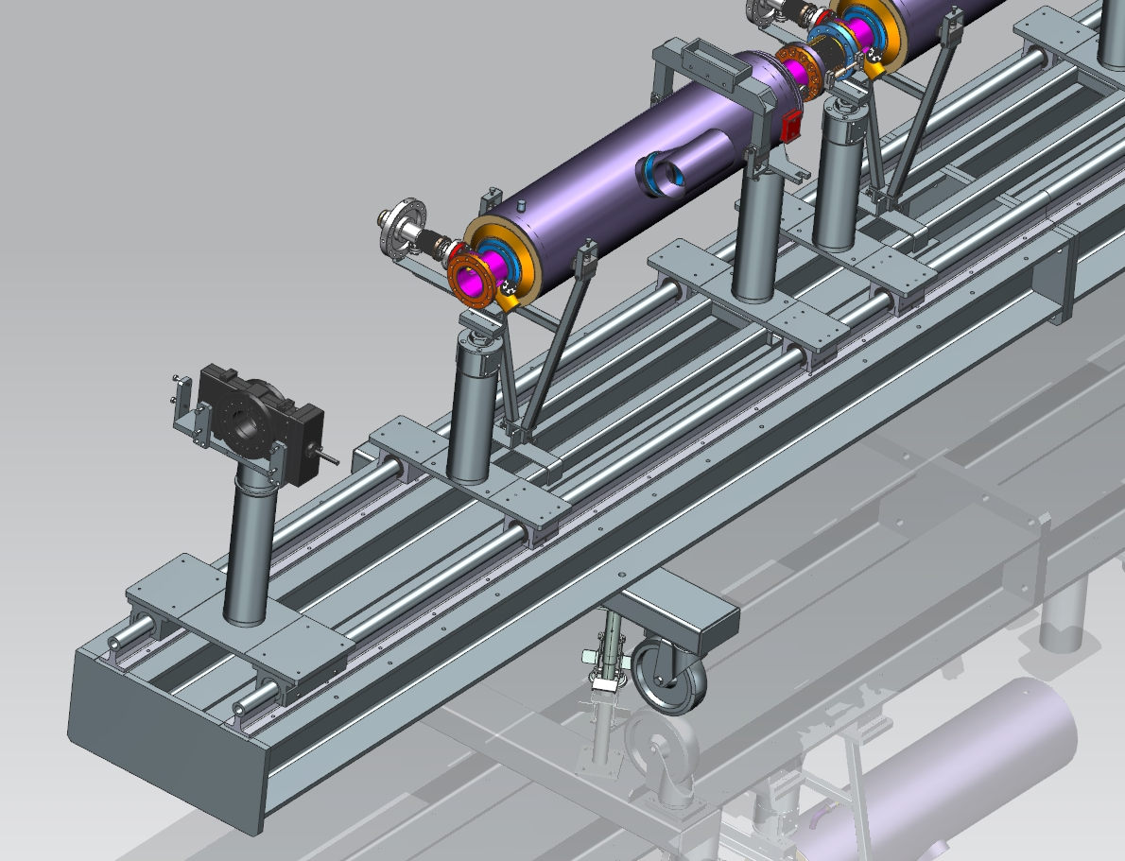
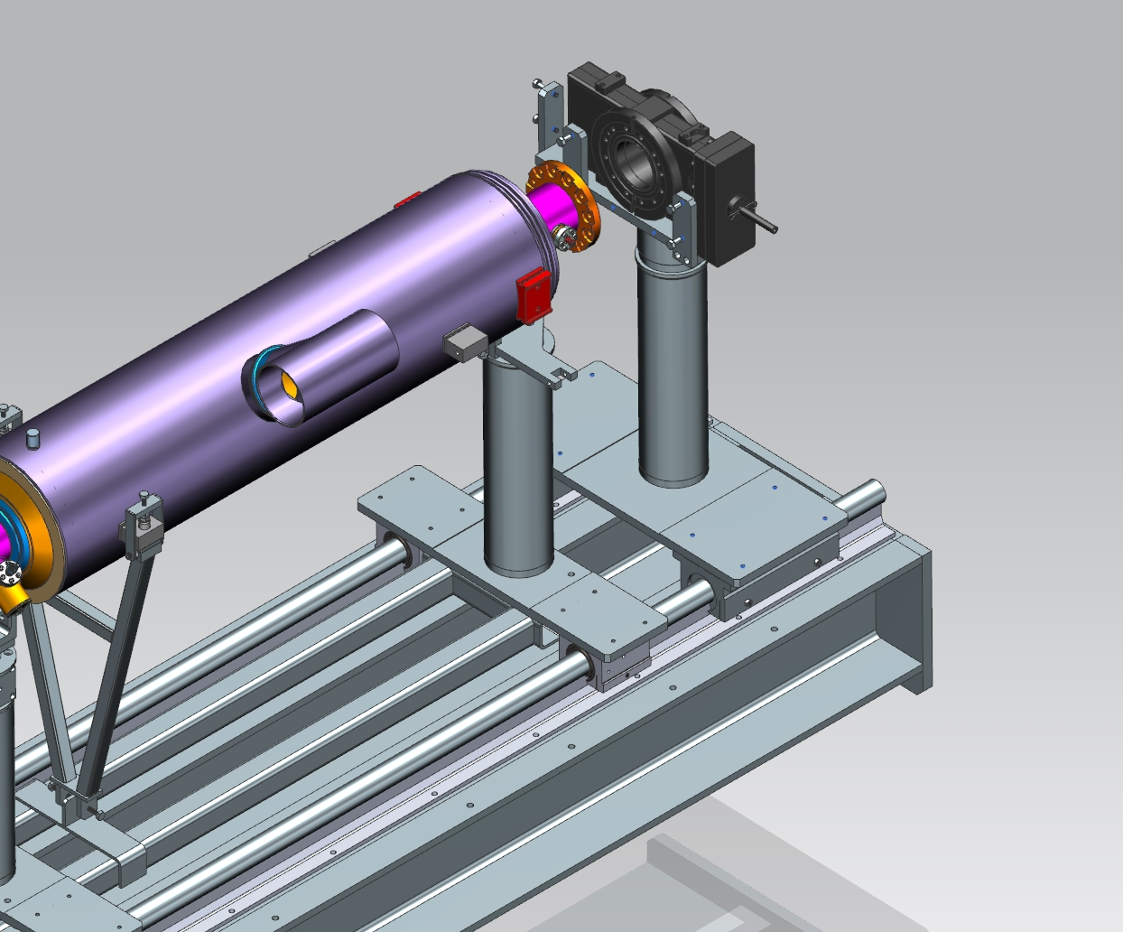
LCLS-II Cavity String on JLab-style Rails

Slide 17
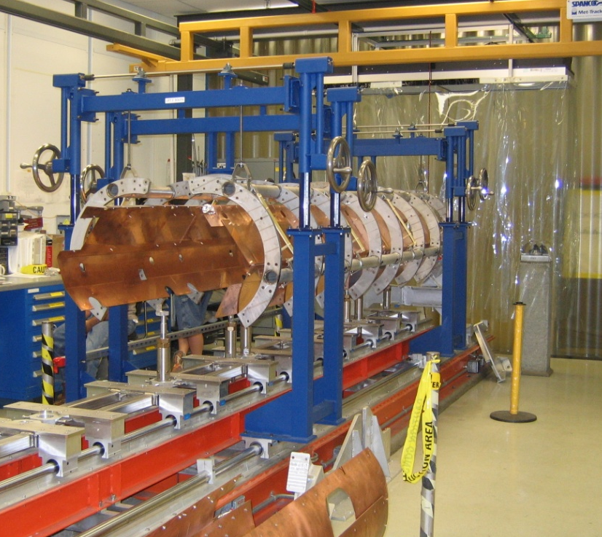
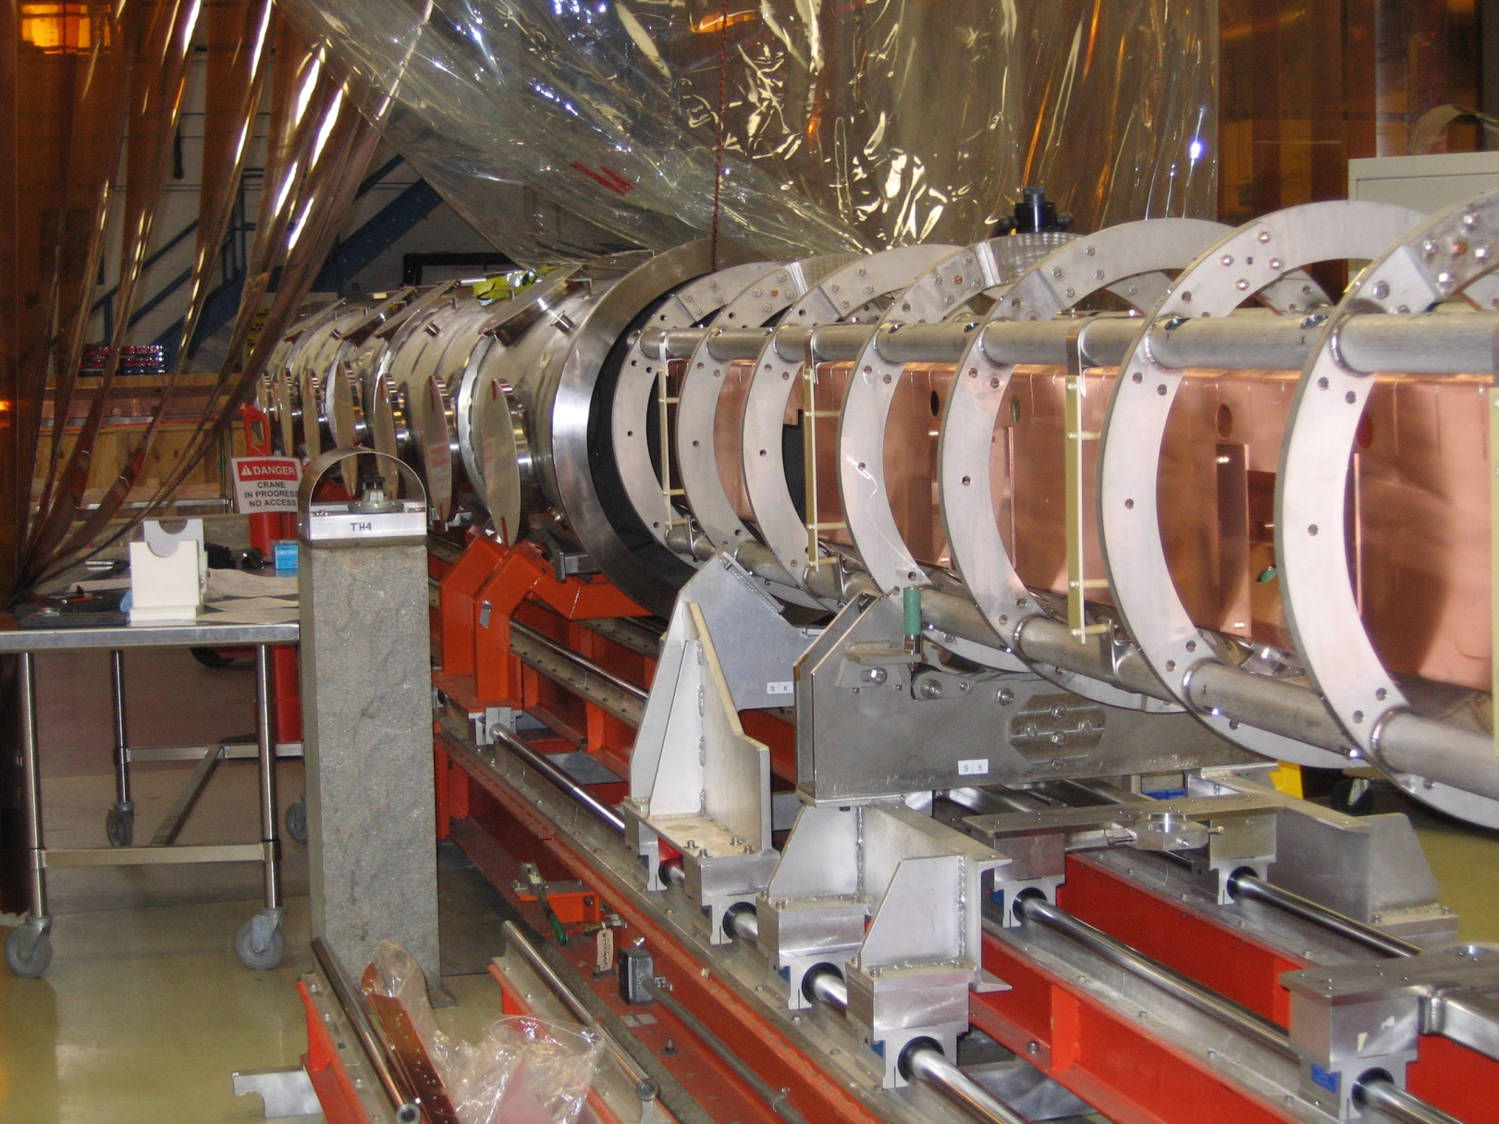
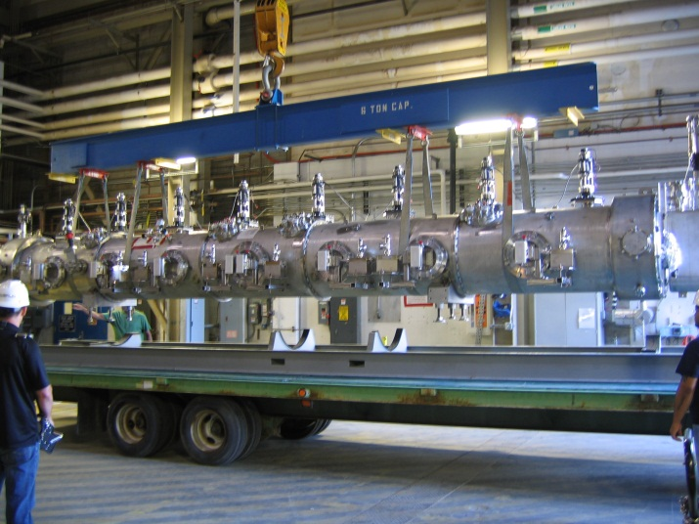
Cold Mass / VV Assembly
“Lollipop” supports for each cavity
TBD for SC magnet and bpm
Considering use of two-rail system to transfer cavity string onto Return Pipe
Considering use of two-rail system to transfer cold mass into vacuum vessel
Crane access in high-bay for shipping

Slide 18
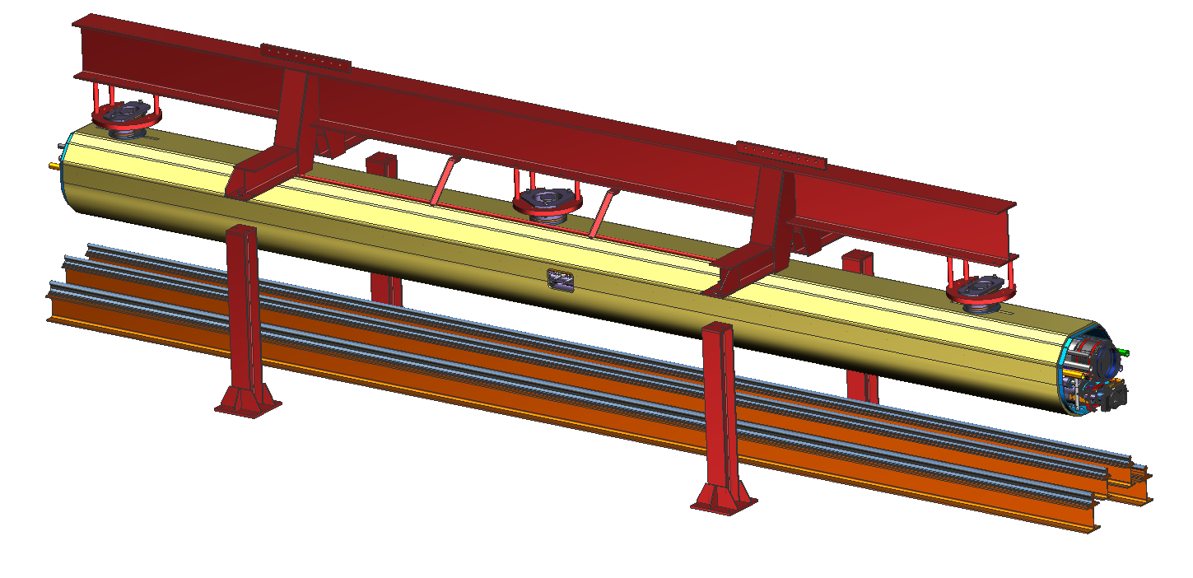
LCLS-II Cold Mass with FNAL Tooling above JLab-style Rails
“Four-Post” Fixture
Cold Mass Assy
Existing JLab Rail System

Slide 19
Facilities Improvements : Testing in CMTF
End Cans (2 sets to support CM production rate)
Connects CM to CTF valve box via u-tubes
Interfaces for valves, LL and diodes to monitor and control helium flow/inventory
Provides reliefs for primary circuit, shield circuit and insulating vacuum space
HPRF
Receive 1.3 GHz 10 kW Solid-State Amplifiers (SSAs)
Procure Circulators
Modify Waveguide and Interlocks
Run line power to SSA/Circulators
Provide controls in CMTF Control Room
LLRF
RF Instrumentation (arc detectors, IR sensors, etc.)
Provide digital controls in CMTF Control Room
Software development
Cryogenic Test Facility (CTF)
Improve return side piping to reduce overall pressure drop from CMTF
Ensure recovery system (pumping, compression) provides base pressure of 0.031 atm (23 torr) in the CM helium bath

Slide 20
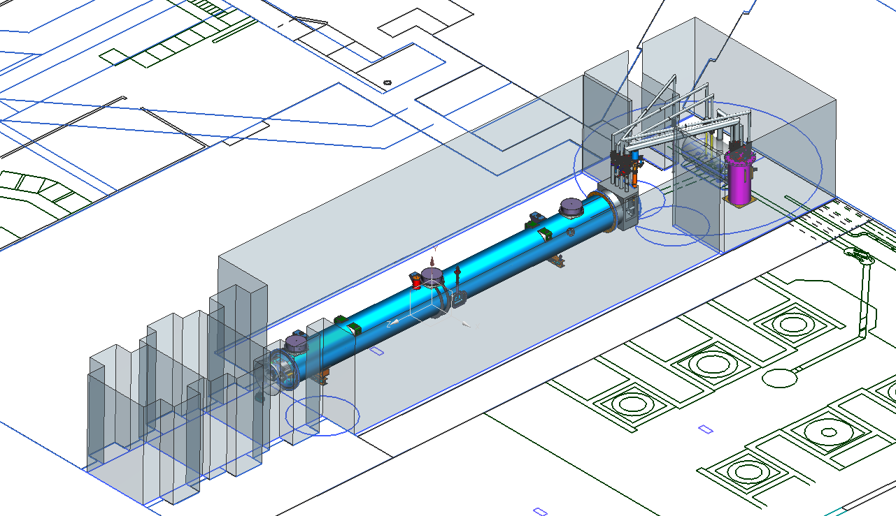
JLab CMTF : Production Rate Limiter
HPRF system suitable for individual cavity testing or 8 cavities in short duration steady state
TBD system for testing SC magnet
Magnetic shielding encloses testing volume reducing external fields to less than 50 mG
Cryogenic capacity for testing individual cavities in CW mode
End Caps – specific for LCLS-II CM testing
Interface to CM piping and existing junction box using u-tubes

Slide 21
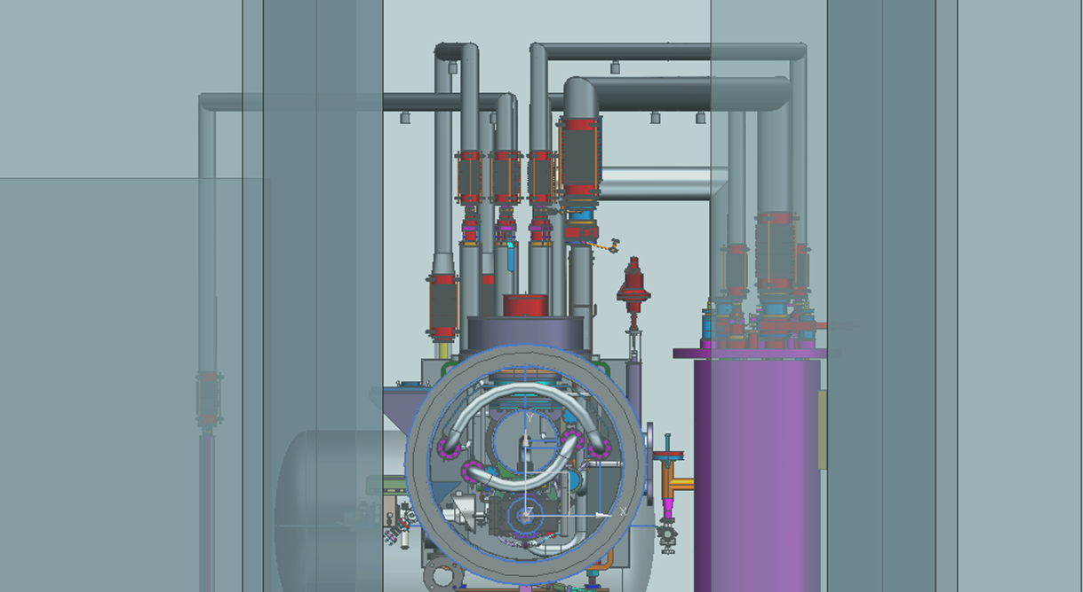
CMTF Conceptual Layout
JUNCTION BOX
* = New Hardware
END CAP*
BAYONET BOX*
BAYONET U-TUBE*
CAVE DOOR
(CLOSED)
HEAT EXCHANGER
End view of CM with bayonets connecting JB, HX and BB

Slide 22
JLAB LCLS-II Cavity Qualification and String assembly
Outline for production of the LCLS-II cavity testing and string assembly within the JLAB facility.

Slide 23
Receipt of the dressed cavities
Inspection
Receive and enter into Inventory system
Visual receipt inspection
RF receipt inspection
CMM/dimensional receipt inspection

Slide 24
Cavity Qualification
Field Emission Limited
Remove Bottom Beam Line Flange
Detach from Test Insert
Transport Back To VAA
High Pressure Rinse
Assemble
No
Receipt Inspection
Transport to Vertical Attachment Area
Attach to Test Insert
RF/CMM Inspection
Cleaning
Wipe down
Active pumping (?)
Transport to Vertical Test Area
Qualification Test
Iso-6 area
Yes
Place in Storage Rack
Detach from Test Insert
Transport back to VAA
Under vacuum
Stage for String Assembly

Slide 25
Cavity transport into the clean room
Performed in ISO-6 clean area in Production Chem Room
Clean cart, then load cavity onto cart.
Wipe the cavity clean for transport into the clean room.
Lint free wipes
IPA or UPW wipe down?
Blow dry/clean with clean ionized N2
Transfer cavity and cart into the pass-thru
Ready-to-Test Cavity

Slide 26
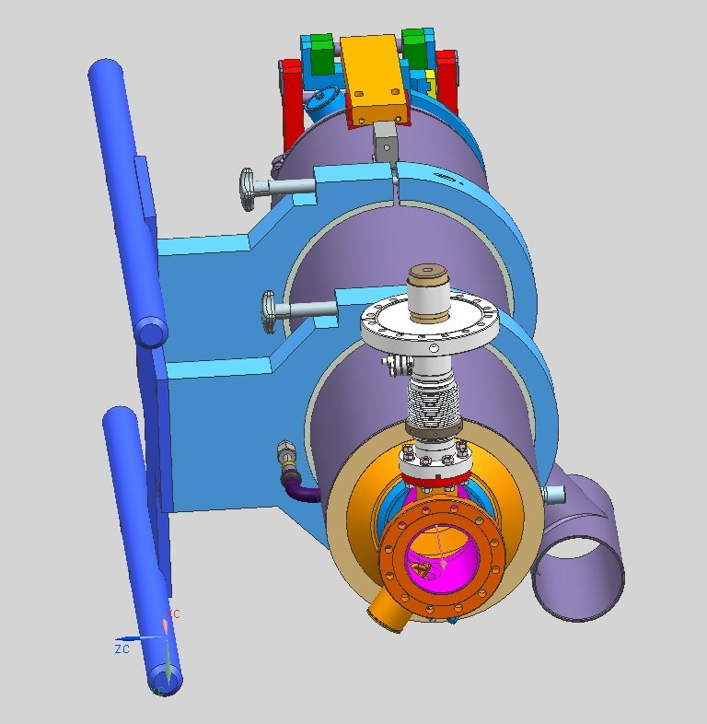
Load the dressed cavity onto the VTA test stand

Slide 27
Load the dressed cavity onto the Test Stand
Using the Backtech lift, attach the two arm lift tooling to pick-up the cavity off the wire cart.
Turn the cavity from horizontal to vertical using the Backtech pivot assembly.
Install the cavity into the test stand support fixture.
Connect pump down line, establish vacuum, open valve to cavity
Continuous pumping while on test insert

Slide 28
VTA Test
Preform VTA qualification testing.
Dedicated dewars (7&8) for LCLS II
Low magnetic field, controlled with compensation coils
4 dedicated test inserts (identical configuration)
Test cavities – test plan under development
If the cavity passes it will be put onto a storage rack for string assembly. (Next slide)
If the cavity fails
If FE limited, return to clean room, drop bottom flange, HPR, assemble bottom flange, re-test
If something other than FE, path TBD

Slide 29
Qualified Cavities Staged for String Assembly
Cavities return to clean room post VTA test via crane lift to VAA
Exterior of cavities are not clean
TBD what to do
Wipe down in Prod Chem room, then store?
Cavities will be isolated, left under vacuum and installed on the clean room storage rack.
The Backtech equipped with the two arm tooling will be used for transfer.

Slide 30
General String Component Cleaning Practices
All string associated components are cleaned and bagged in the ISO-6 section of Production Chem room
UHV cleaning includes ultrasonic cleaning with surfactant (Micro-90, Liquinox)
Currently revisiting best practices for UHV cleaning
Blown dry with “clean” nitrogen
Bagged and placed into ISO-5 pass-thru
String components are un-bagged as needed (just-in-time) for assembly
Blown clean to “low” particulate count, then staged on clean room cart
TBD for couplers (cleaning? leak checking? bagged ready to install?)

Slide 31
String Assembly - Cavity Prep
Each cavity will be bled-up with clean dry nitrogen in preparation for HPR in the clean room
Cavity beam lines will be disassembled
The cavity will be installed into a cage for HPR
The Backteck with two arm fixture will be used to lift the cavity into the cage supports
Cavity will be HPR in new HPR tool
Cavity will be placed in an isolated ISO 4 chamber for overnight drying
Typical rate is two cavities per day

Slide 32
Cavity installed in cage- Ready for HPR

Slide 33
Transfer post HPR cavities onto the assembly rail

Slide 34
Cavity string assembly process closely follows Fermi practices
Exceptions
JLab plans to bleed up and HPR each cavity just before installing into lollipops on string assembly rail system
Historically, cavities on rail system are not under vacuum, or under an N2 purge. Cavities beam lines are blanked off.
Open for discussion…
Traffic in clean room is kept to a minimum
Only string assembly techs are permitted in SA area
Assembly process and tooling is planned to be similar to Fermi
Detailed discussions are forthcoming
From processes and techniques to frequency of clean room garment and glove change outs

Slide 35
Cryomodule Assembly

Slide 36
Status and Plans
Focus has been on floor plans, layouts, and tooling
Intent is to structure CMA similar to FNAL
CMA I, CMA II, Vacuum Vessel, Final Assembly
Plan is to, in general, complete similar set of task in each stage as FNAL, making changes to fit Jlab specific CMA area layout

Slide 37
CMA I Primary Task
2-phase helium pipes & bellows welding
Cavity magnetic shields installation
Tuner system installation
Cavity insulation installation
Temperature sensors instrumentation and RF cables installation
Cavity helium vessel lugs needle bearings and housings installation
Various leak checks / pressure tests of the helium circuit
Various electrical and RF checks
Courtesy of Tug Arkan

Slide 38
CMA II Primary Task
Put the cold mass on the 4 support spreader bar fixture
Align cavity string to GRHP to 0.1 mm (laser tracker)
Complete the interconnect magnetic shielding assembly
Complete the coupler heat shields intercepts assembly
Complete cooling straps assembly to the cavities HOM
Complete the harnessing of the instrumentation wires & RF cables
Various electrical checks
Weld the magnet current leads to the magnet instrumentation box
Various leak checks of the helium circuit
Courtesy of Tug Arkan

Slide 39
Vacuum Vessel Primary Task
Install and weld lower 5K aluminum shields
Wrap 10 layers of MLI
Install and weld 80K shields
Lay and wrap 30 layers of MLI
Trim insulations around main couplers, magnet and cold mass support posts
Slide vacuum vessel onto the cold mass
Align cold mass to the vacuum vessel (laser tracker)
Courtesy of Tug Arkan

Slide 40
Final Assembly
Install warm part of the main power couplers + RF Waveguides
Route & terminate instrumentations wires and RF cables to the feedthrough flanges on the vacuum vessel
Install warm end coupler vacuum/pumping lines
Pump down and leak check warm end coupler vacuum
Pump down and leak check beamline vacuum
Pump down and leak check insulating vacuum
Install End Cans and Prep for CM Test
Courtesy of Tug Arkan

Slide 41
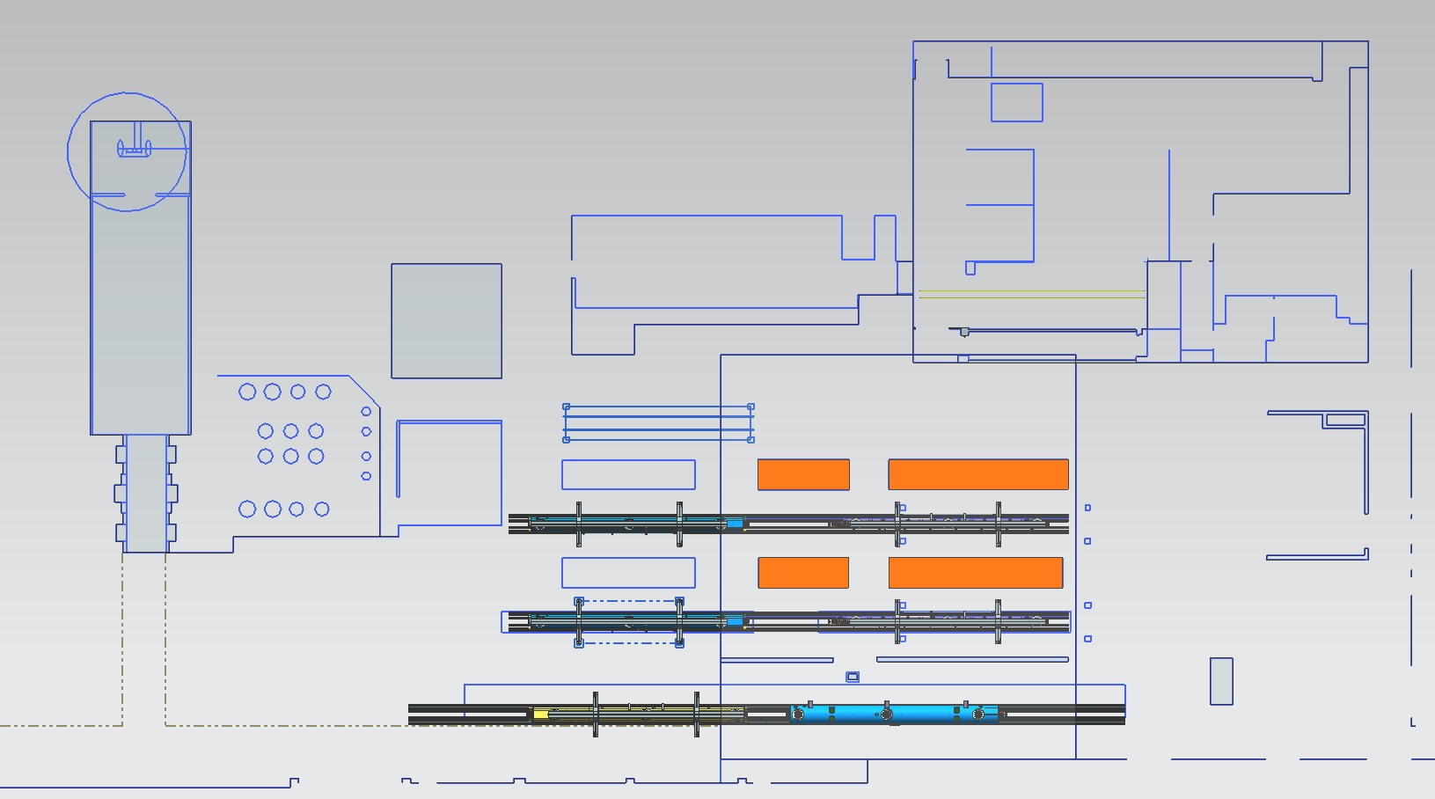
CM Assembly Area Work Flow
String Assembly
CMTF
CMA II
CMA I
Final Assembly
Vacuum Vessel

Slide 42
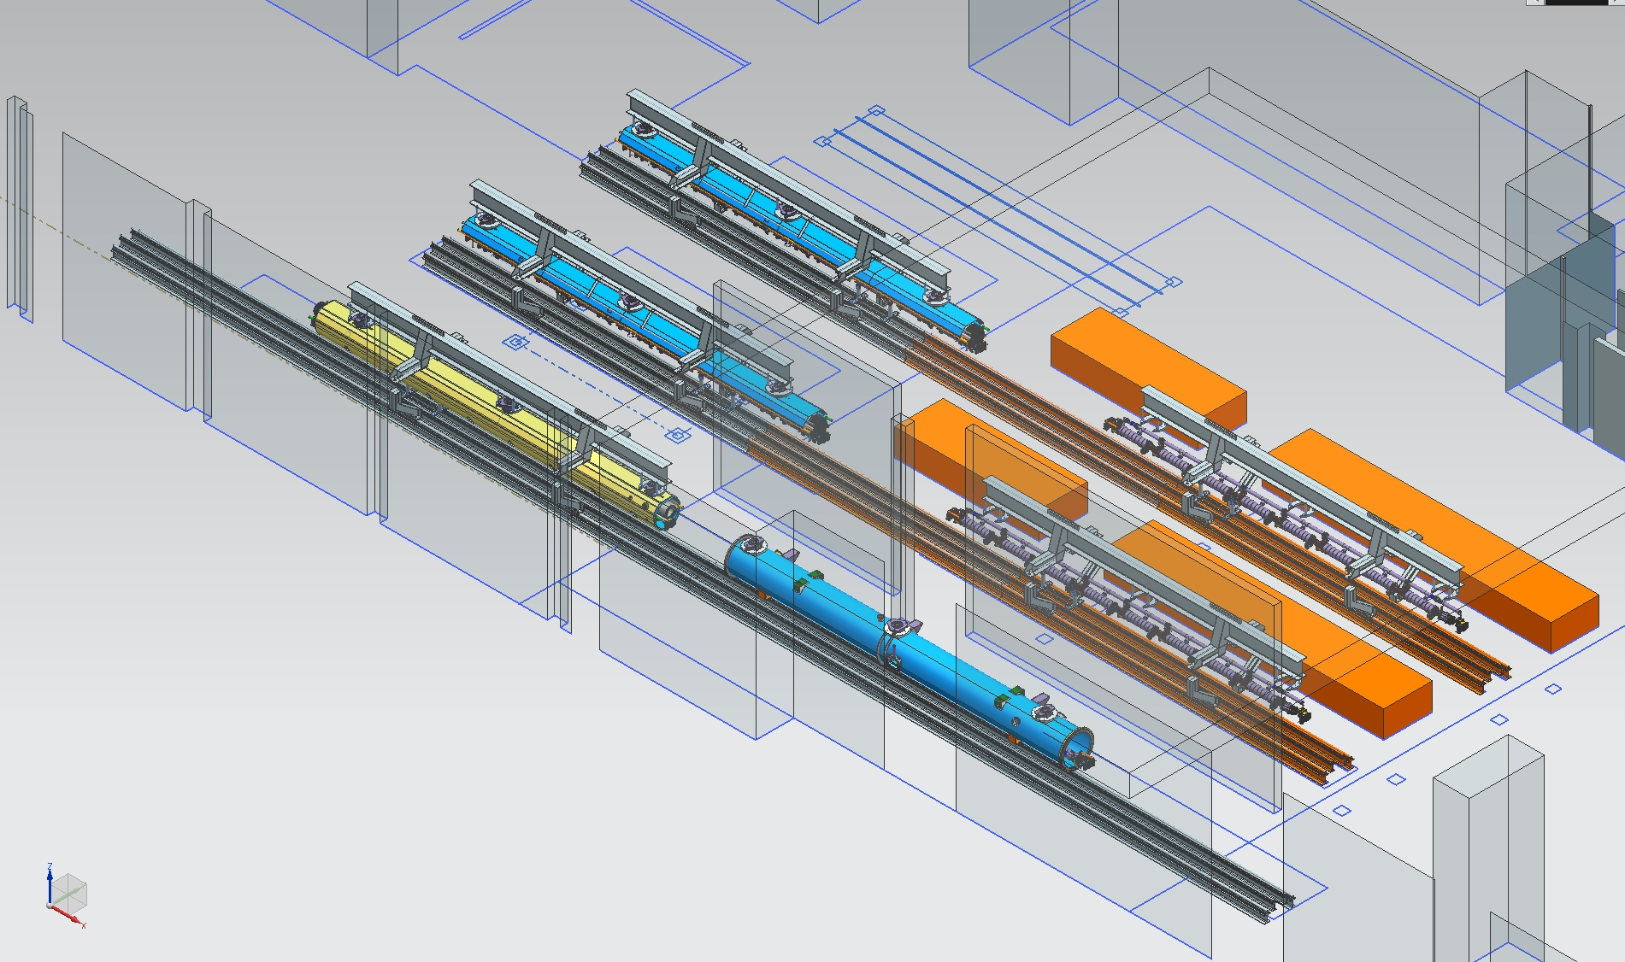
Aerial Iso View of CM Assembly Area

Slide 43
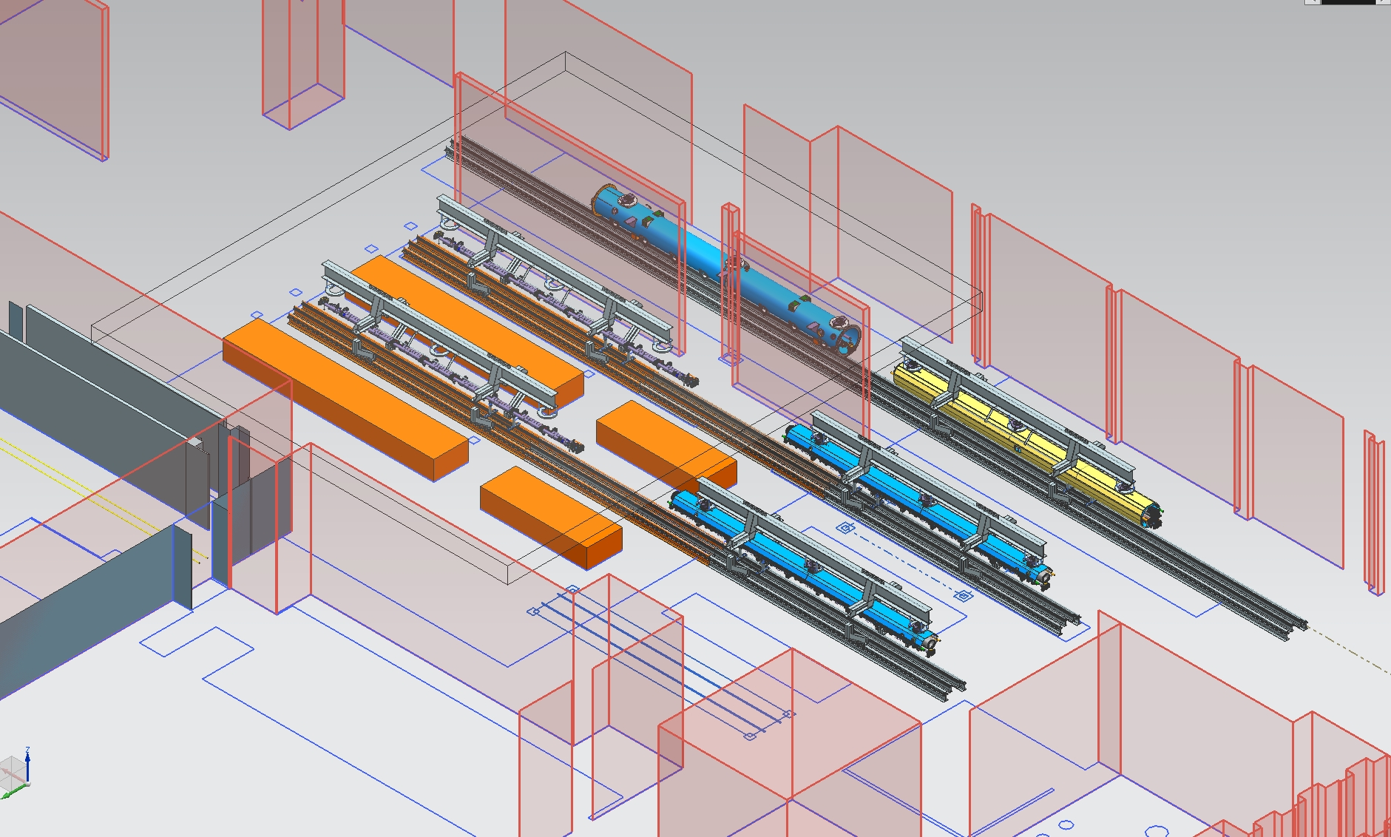
Aerial Iso View of CM Assembly Area

Slide 44
Elevation View of CM Assembly Area Looking North

Slide 45
Side Elevations of CM Assembly Area
CMA II
CMA I
Vacuum Vessel

Slide 46
Cryomodule Test

Slide 47
JLab CMTF : Production Rate Limiter
Test cycle planned to be ~ 5 weeks
HPRF system suitable for individual cavity testing or 8 cavities in short duration steady state
TBD system for testing SC magnet
Magnetic shielding encloses testing volume reducing external fields to less than 50 mG
Cryogenic capacity for testing individual cavities in CW mode
End Caps – specific for LCLS-II CM testing
Interface to CM piping and existing junction box using u-tubes

Slide 48
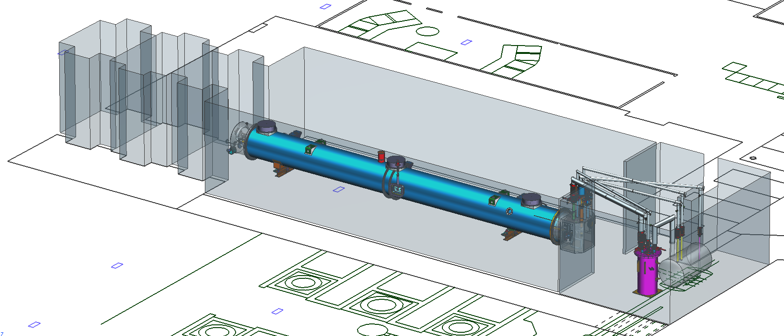
CMTF Conceptual Layout

Slide 49
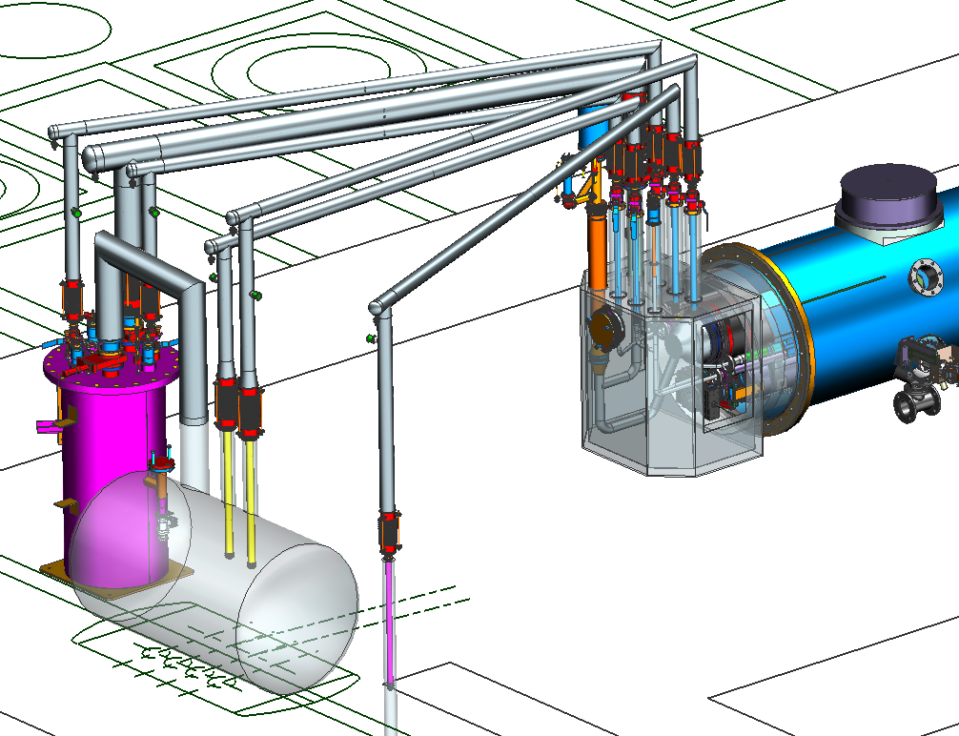
PRIMARY RETURN
PRIMARY FROM CM TO HX
PRIMARY FROM HX TO CM
PRIMARY TO CM
SHIELD SUPPLY
SHIELD RETURN

Slide 50
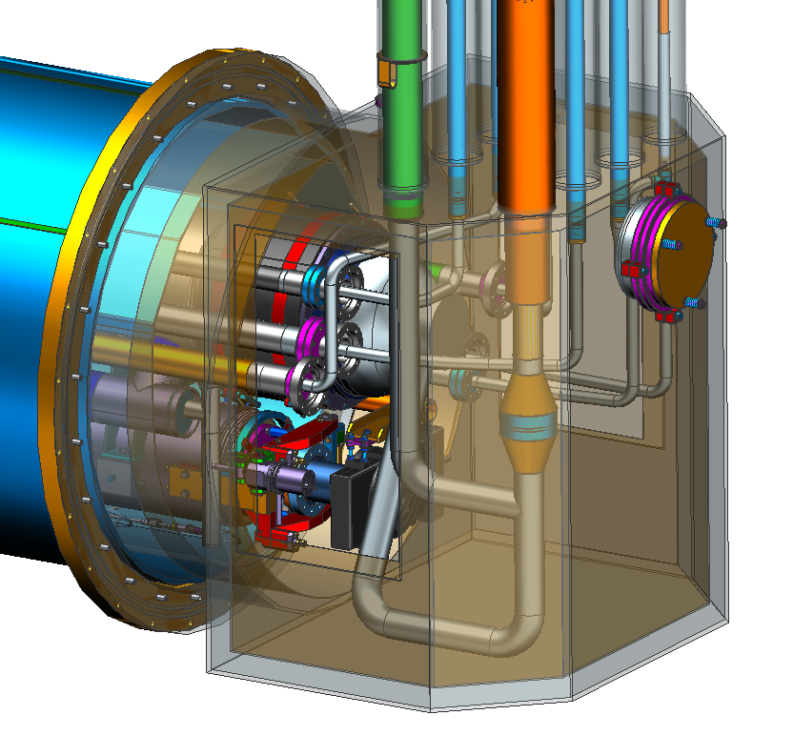
End Can Configuration

Slide 51
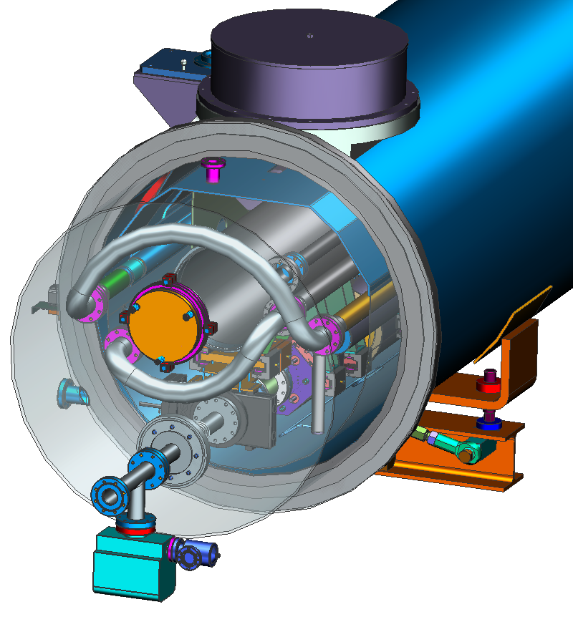
End Can Configuration
SHIELD JUMPER
5K FWD JUMPER

Slide 52
Wrapping Up

Slide 53
Six Month Look Ahead
R&D - Support ramp-up of cavity testing for high Qo and the prototype cryomodule activities
Infrastructure Design
Complete designs for JLab-specific assembly tooling and fixtures
Complete designs for End Cans
Complete designs for upgrading CMTF controls, instrumentation and RF hardware
Procurement
Start procurements for cavity and cryomodule assembly tooling and fixtures
Start end can procurement
Start procurement of CMTF LLRF and HPRF components
Procedures
Define draft procedures for cavity qualification, string assembly, cryomodule assembly and CM test to support Prototype

Slide 54
Summary
Goal for production of CMs at Jlab/FNAL is “identical design, identical parts, equivalent processes to yield equivalent performance”
Infrastructure development supports this goal
Continued need to engage in detailed discussions for assembly processes
Some key items – Continuous pumping during VTA test, HPR prior to string assembly, bleed and N2 purge during string assembly, general cleaning practices
Overall Plan for Cryomodule Design & Production
R&D / Design Modifications Complete FY14
Infrastructure / Tooling FY14/15
Prototype CMs (2 units) FY15
Start of Production 1.3 GHz CMs (33 units) FY16
Rates of 1 CM per 6 – 8 weeks in current plans
Start of Installation at SLAC FY17
Completion of CM construction @Jlab FY18

Slide 55
Thanks for your attention!
Questions?

Slide 56
Backup Material

Slide 57
LCLS-ll Tooling process flow
This presentation is a Draft outline of tooling required for assembling the LCLS-ll cavity strings.

Slide 58
VTA qualification
Degrease/ clean the cavity
Cavity will be placed on a cleaned cart in the chem-room. After hand and ionized nitrogen cleaning the cavity with cart can be transferred into the clean room. (If this is the way we choose to clean?)
The cavity can be on a cart designed to grab and lift the cavity using a back-tech cart equipped with a two arm lift tool.
Note: The cavity is assumed to be already under vacuum.

Slide 59
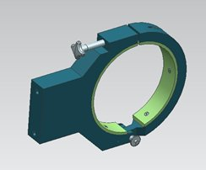
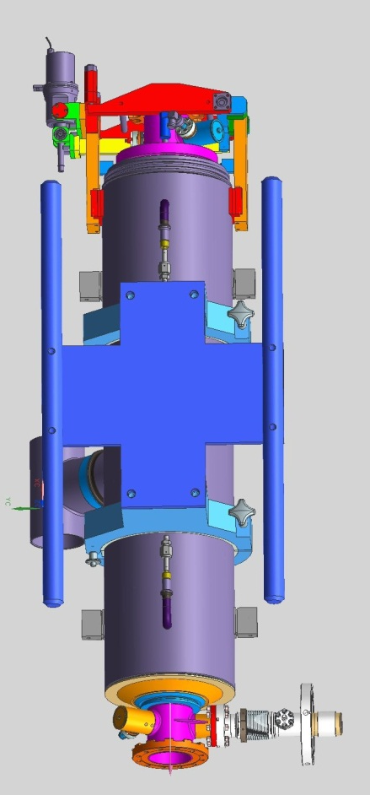
Two arm lift tooling
Lift arm
Lift arm assembly

Slide 60
Tooling for hanging cavity into test stand
VTA flanges are not pictured. As previously noted the cavity is already under vacuum.
Test stand pump line may be connected to actively pump the cavity during VTA test cycle?

Slide 61
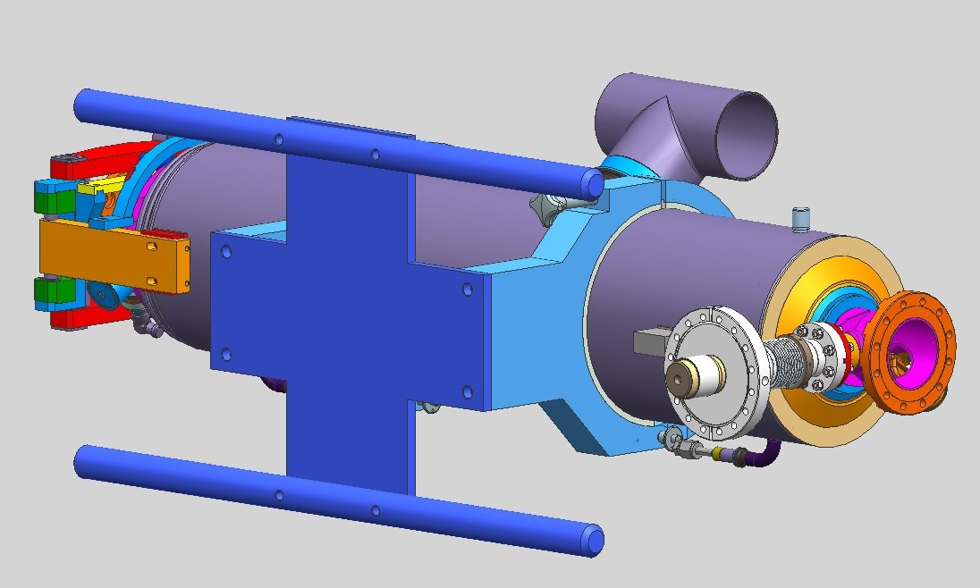
Transfer cavity to clean room.
Using two arm tooling remove from stand and transfer to string rail.
Install cavity onto rail and install roll tooling.
Note: When to bleed-up the cavity? Can be done on test stand or on the rail. Tooling will be required for this activity after an agreed method is determined.

Slide 62
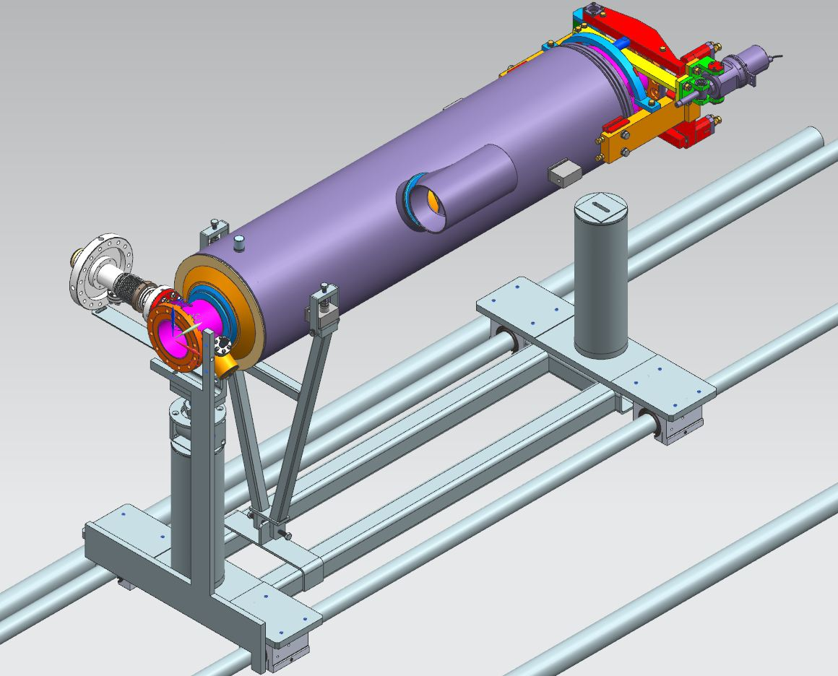

Slide 63
Bridge level is used to set roll

Slide 64
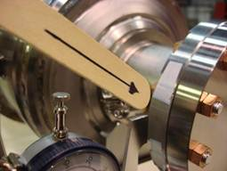
Align the cavity
A special wedge is used if the cavity flange has flats.
Dial indicators are used to set x-y.
All cavities are aligned similar to Jlab techniques.

Slide 65
Gate valve preparation
The gate valve is installed to rail tooling.
Fermi assembles 2.75” valve assembly to valve on rail. (We typically would do this at the bench, then mount sub-assembly to string.)

Slide 66
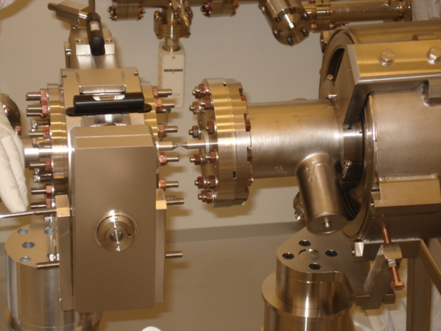
Gate valve alignment
Align gate valve to the cavity
Different tooling is shown in presentation for alignment.
Note: We’ve always hand installed valves. Valve alignment tooling will add length to assembly rail. Seems like a cleaner method over Jlab method.

Slide 67
Assemble gate valve to cavity
Gate valve is allowed to slide on rail to bring valve to cavity.
30 NM torque is used.

Slide 68
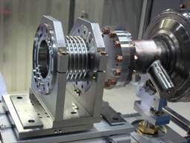
Interconnecting bellows
The bellows is installed into the tooling on the bench.
The sub-assembly is installed on the rail. next to the cavity.

Slide 69
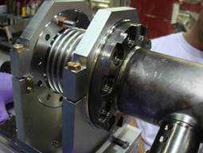
Alignment and assembly of the bellows
Alignment rods are used for alignment of the bellows.
Flat gauge bar is used for parallelism.
Slide bellows to cavity for connection.

Slide 70
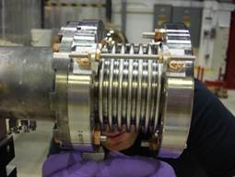
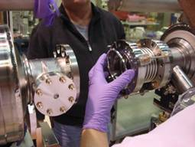
Bellows assembly Continued
Install bellows adjustment rods.
Slowly bring the second cavity to the bellows and make connection.
Note: I didn’t understand how the bellows length is set? Does the tooling automatically set this?

Slide 71
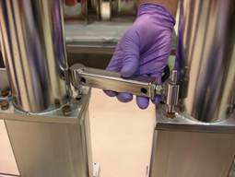
Lock Lollipops
Install lock between lollipop assemblies.

Slide 72
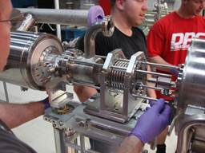
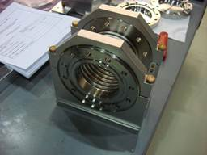
Bellows installation between cavity and magnet assembly
Install short bellows into tooling
Do we have two sets of bellows tooling? One for long and one for short?
Align bellows using alignment rods.

Slide 73
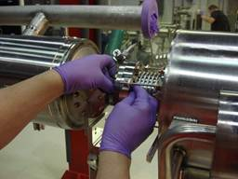
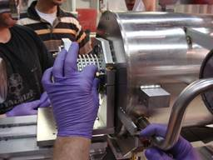
Complete bellows assembly between magnet and cavity
Assemble bellows to magnet
Slide bellows to magnet and bolt together.
Bolt bellows to cavity

Slide 74
Install the three bellows stiffeners
How do we set length?

Slide 75
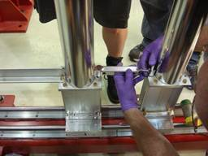
Install the lollipop tie rod.

Slide 76
Pump-down and final leak test
Install couplers?
Install tuner or temporary support?
Pump-down the cavity string. (I think all tooling for the pump-down is shown in this presentation.)

Slide 77
Misc.
Clean room rail system.
Existing rail will need to be extended or a new rail will need to be built.
Logistics for rail location inside the clean room for string assembly.
Transfer of the cavity string to the cryostat assembly area. With 40’ of string can we make the turn before hitting the first cryostat rail system if transferring out of the double doors?
Tuner supports?

Slide 78
Noted differences between Fermi methods and JLab
If I understand correctly each cavity sub-assembly is leak tested. That’s 8 leak tests plus the magnet sub-assembly. Each cavity would be bleed-up and pumped as a string. No mention of coupler installation yet which could mean bleed-up again.
Tuner supports are not typically needed for similar size cavities at Jlab.

