Slide 1
2014 AAC Workshop
Staging of Muon-based Neutrino Sources at Fermilab (from NuSTORM to NuMAX)
Chuck Ankenbrandt
Muons, Inc. Physicist
and Fermilab Scientist Emeritus
July 14, 2014

Slide 2
Outline
Introduction
The situation P2P5 (prior to P5)
P5 happens… (hits the fan)
Possible paths forward, or How to surVive P5
Staging NuSTORM
Possible paths from NuSTORM to NuMAX
Possible layout and siting
Features
Advantages

Slide 3
Introduction: the Situation P2P5
The Muon Accelerator Program (MAP) launched the Muon Accelerator Staging Study (MASS), which in early May issued a set of recommendations.
The staged approach included NuSTORM as a first step and NuMAX+ as the ultimate neutrino factory.
MAP and MASS experienced strong support from several review committees.
The layout that MASS suggested (cf. the next slide) illustrates their recommendations.

Slide 4
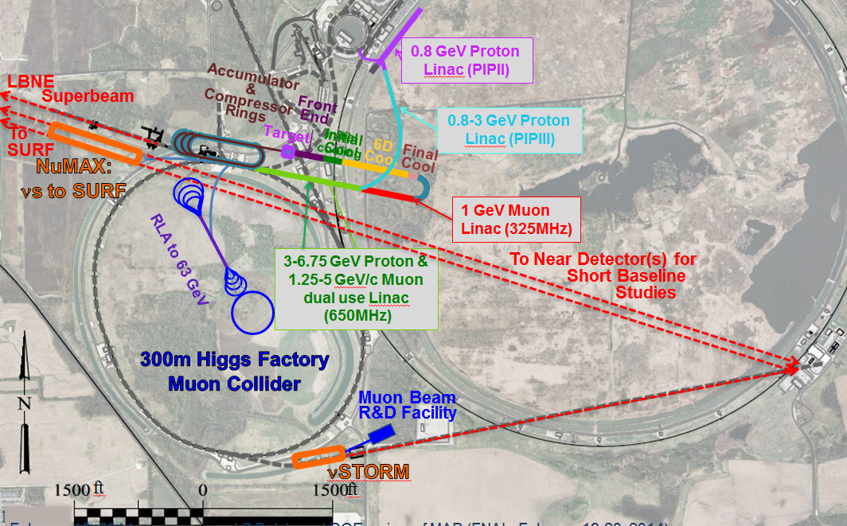
Layout from MASS recommendation document

Slide 5
Introduction: P5 happens
On May 22, P5 issued a set of recommendations, including the following:
The high value of θ₁₃ may make it possible to study long-baseline oscillations well enough without a neutrino factory.
NuSTORM ($0.35B) doesn’t fit within the budget constraints.
Five stages of grief begin within MAP: denial, anger, bargaining, depression, acceptance.
The last stage, acceptance, can perhaps be avoided if the situation is reversible.
Bargaining has begun. If it’s successful, then perhaps depression is also avoidable.
Bargaining should establish a path forward. What should we advocate?

Slide 6
First, Let’s Stage NuSTORM
NuSTORM was the first step.
It was deemed too expensive.
There’s a reasonable way to stage it, with a much less expensive first stage.
The first step in the revised plan is arguably the most important, and really the only step that requires an early decision.

Slide 7
A flexible path forward, or How to surVive* P5
First, stage NuSTORM with an affordable first stage.
Then, find further economies amongst facilities by:
exploring and exploiting MAP-PIPn-LBNF synergies
maximizing and exploiting NuSTORM-NuMAX synergies
Finally, deploy the resulting synergistic stages flexibly, depending on what’s needed for physics at the time.
*Note similarity to Fermilab Safety Slogan “Take 5ive”
(but with V, the Roman numeral for five)

Slide 8
The Three Goals of NuSTORM
Short-baseline oscillation physics
Longshot possibility of exciting physics results
This goal is the major cost driver.
Neutrino interactions, esp. ν_{e} interactions
Needed for analysis of data from ν detectors
Interesting physics in its own right
Testbed for Neutrino Factory concepts
Plus a nice byproduct: a muon test beam

Slide 9
Why is NuSTORM so expensive?
The SBO physics needs a lot of flux. So:
Intense proton beam: major target station
Large magnet apertures
Very long straight sections
Horn, injection, extraction devices, dump…

Slide 10
Staging NuSTORM: Ideas
Stage NuSTORM by separating the physics goals.
Start with the most affordable goals.
Short-baseline oscillation physics is the most expensive goal.
It is literally the “killer app”! But not in a good way… ☺
It may never be needed! Signals may go to ~0 or to >5 sigma before the oscillation physics results would be available from NuSTORM.
A study of electron neutrino interactions is important to a large segment of the HEP community. Besides its inherent interest, it would facilitate analysis of experiments like LBNE and HyperK.
NuSTORM as proposed would produce tens of millions of electron neutrino interactions. Only need tens of thousands for 1% statistics.
Locating the NuSTORM ring near or at the NuMAX ring would create more possibilities and enhance the synergies.

Slide 11
A flexible staged approach to NuSTORM, with a decision tree
In the first stage of NuSTORM, measure ν interactions using a simple muon ring. Then:
Are short-baseline oscillations still compelling?
If not, then proceed to implement NuMAX in stages.
If so, then does NuMAX exist yet?
If so, then use cold muons in NuMAX ring to provide the needed flux for short-baseline oscillation physics.
If not, then build NuSTORM as proposed.

Slide 12
Ideas for a Cheap First Stage of NuSTORM
Locate a muon ring where several proton sources are available.
e.g. protons from Booster, MI, PIP-N, …
Use quadrupoles compatible with NuMAX in the ring. Maybe use surplus Accumulator dipoles.
A thin pion production target might be internal to the ring.
Then could parasitically use, e.g., LBNE proton beam passing thru.
Set p_{π} = p_{μ} ; then the circumference could be relatively short.
Much less $$$ than NuSTORM as proposed: lower beam power, smaller apertures, much shorter circumference, someone else’s proton beam, no injection devices, only near detectors.
Could also extract a muon test beam if desired.

Slide 13
NuSTORM and NuMAX
Some NuSTORM / NuMAX Similarities
Same beam particles: muons
Similar energies: ~ 5 GeV
Both are muon decay rings to produce neutrino beams
Possibly similar ring lattices and shapes
Some NuSTORM / NuMAX Differences
Short baseline / Long baseline oscillation physics
Uncooled beam / cooled beam (except in commissioning phase)
Pions produced by ~ 120 GeV protons / ~ 6.75 GeV protons
Proton beam power ~ 100 kW / ~ 1 MW
Ring apertures: Huge / Large
NuSTORM can look at neutrinos from pion decay

Slide 14
Paths from NuSTORM to NuMAX
Decisions, decisions… or why flexibility is important
Is a short-baseline oscillation experiment called for? If so…
Should we do it like NuSTORM? Then replace magnets and target station, etc.
Or should we do it as part of NuMAX? Then “bend the paper clip” of the NuMAX ring.
If a short-baseline osc. expt. is not needed, proceed to NuMAX.
That means megawatt-class proton beam and target, muon front end, muon acceleration, etc.
Refer to the following site layout:

Slide 15
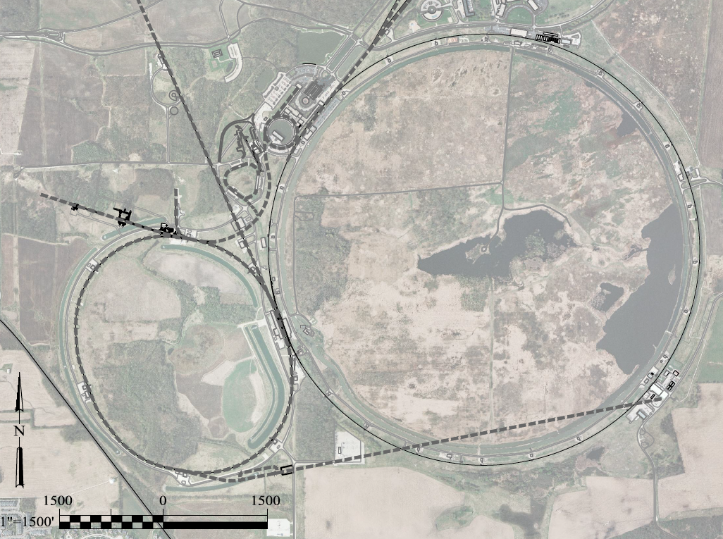
1 GeV Proton Linac
Front End 4D Cool 6D Cool
8GeV
120GeV
1-3 GeV Proton Linac
3-7 GeV Proton & 1-5 GeV Muon Linac(s)
~1 GeV Muon Linac (325MHz)
Muon Beam R&D Facility
νSTORM
A 6 TeV Muon Collider would have a similar circumference as the Tevatron Ring
ft
ft
LBNE
Superbeam
To
SURF
NuMAX:
νs to SURF
300m Higgs Factory
Muon Collider
RLA to 63 GeV
Accumulator & Compressor
Rings

Slide 16
Features of the Proposed Plan
Exploit synergies of NuSTORM and NuMAX
NuSTORM and NuMAX use same (bi-directional) target complex
Muon test beam is generated where production cooling facilities will eventually be located
Beams from Booster and Main Injector can be delivered to the production target
Describe flow of beams with reference to the site layout

Slide 17
Muon storage ring(s): possibilities
Exploit synergies of NuSTORM and NuMAX
Can run NuSTORM two ways:
With hot beam from Main Injector (as in NuSTORM proposal)
With cold beam from muon facility
At first, the ring is horizontal, pointing toward DZero, and uses protons from the Main Injector.
Second config: straight sections “hinged” toward LBNE
Can feed LBNE and NuSTORM simultaneously

Slide 18
An even cheaper first step
The first muon storage ring could be a low-energy (few hundred MeV) ring with several purposes.
Provide cold extracted muon beams.
Demonstrate cooling.
Gain experience with muon storage rings.
This ring could also exploit the internal target idea.
In fact, two or more muon rings could share the same production straight section (Cf. my N-Ring CircUS paper)

Slide 19
Cosmic rays
There are about 10¹⁰ muons per second striking the Fermilab site from above.
An intense beam, albeit with quite large emittances
The price is right.
Not even P5 can turn this beam off!

