Slide 1
NCRF Cavities in Strong Magnetic Field: Is This Still an Issue?
Derun LI
Lawrence Berkeley National Laboratory
AAC Workshop, San Jose, California
July 15, 2014

Slide 2
Outline
Introduction
Status of current R&D programs and plans
RF breakdown studies at 805-MHz and 201-MHz in strong magnetic field at MTA, Fermilab
Two type of RF cavities
Vacuum cavities
Modular cavity design, fabrication and testing
All season cavity (Muons Inc.)
High pressure RF cavities
MICE
MICE prototype RF cavity testing using single cavity vessel
Summary

Slide 3
Introduction
High gradient normal conducting RF (NCRF) cavities are needed for muon ionization cooling channels; these cavities must operate in a strong magnetic field
Active R&D efforts and experimental programs under the US Muon Accelerator Program (MAP) focusing on
Vacuum RF
High pressure RF and beam testing
Near term plans
Support MICE: MICE prototype cavity testing at MTA
Modular cavity testing: RF breakdown studies
HPRF loaded with dielectric material

Slide 4
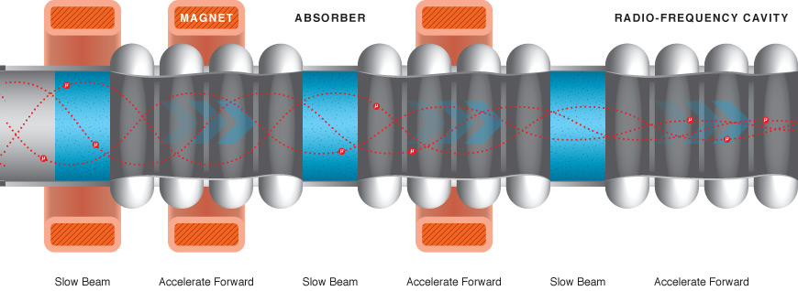
Muon Ionization Cooling
Ionization cooling is the only practical scheme to cool muon beams, requires
High gradient RF cavities compensate for lost longitudinal energy in absorbers
Strong magnetic field to confine muon beams
Design, engineering and construction of a real muon ionization cooling section
Demonstrate that NCRF cavities at high gradient (for instance, 201 MHz at ∼16 MV/m, 805 MHz at ~ 25 MV/m) operate in a few-Tesla solenoidal B field

Slide 5
Examples of Normal Conducting RF Requirements for Muon Beams
Examples of normal conducting RF requirements for muon beams: Muon capture, bunching, phase rotation, ionization cooling require
Low frequency normal conducting RF cavities
High RF gradient operation in a few-T to 13 T magnetic fields
* RF gradients of HCC: 19-30 MV/m at Bz on axis from ~ 3 -13T

Slide 6
RF for Muon Ionization Cooling
What we have accomplished so far:
Development of RF cavities with the conventional open beam irises terminated by beryllium windows
Development of beryllium windows
Thin and pre-curved beryllium windows for 805 and 201 MHz cavities
Design, fabrication and tests of RF cavities at MTA, Fermilab
805 MHz pillbox cavity with re-mountable windows and RF buttons
Box cavity to test magnetic field insulations: ExB effects
All season cavity (Muons Inc.)
201 MHz MuCool cavity with thin and curved beryllium windows
Baseline design for MICE cavity
HPRF cavities and beam testing and all season cavity
Design and fabrication of an 805 MHz modular cavity
201 MHz MICE prototype cavity and modular cavity to be tested soon at MTA
Experimental RF test programs at MTA
RF sources at 805 MHz (up to 12 MW) and 201 MHz (up to 5 MW)
Lab-G superconducting magnet (up to 5 Tesla)

Slide 7
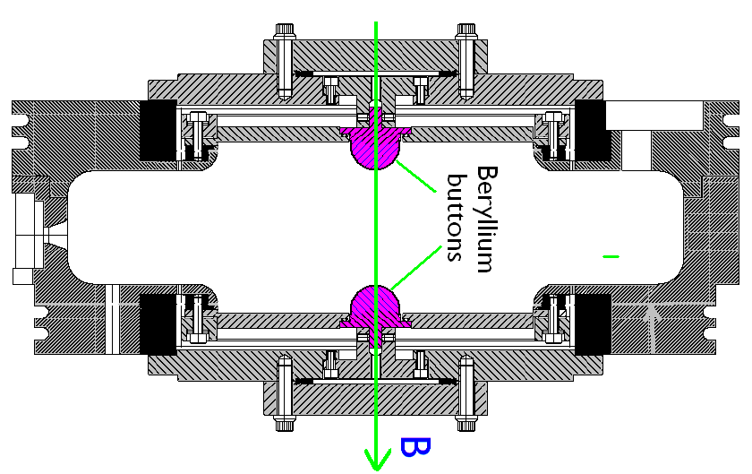
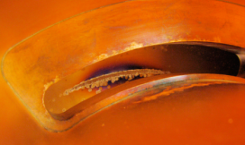
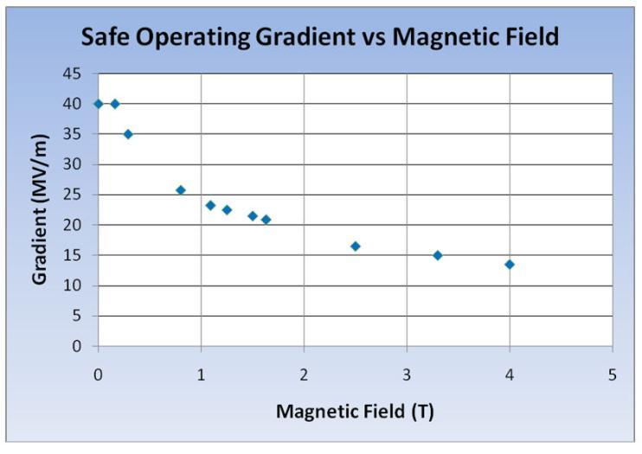
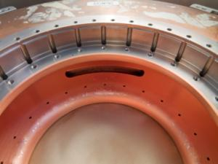
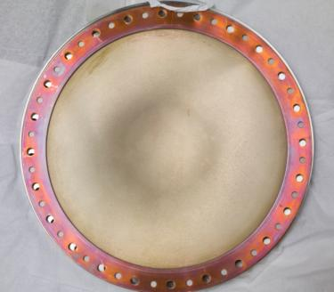
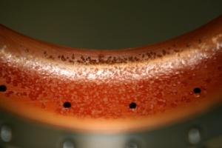
Initial Experimental Observation
Experimental studies using the 805 MHz pillbox (+ button) cavity
RF gradient degradation in strong magnetic field
Cavity surface damage
No damage on Beryllium window
Experimental observation @ the 805-MHz PB cavity
Coupling iris
The 805 MHz PB Cavity
25 MV/m at 3 T
Be window
The results dominated by FE/dark currents at high peak surface field region & B

Slide 8
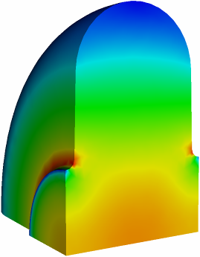
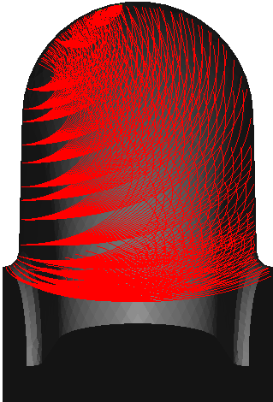
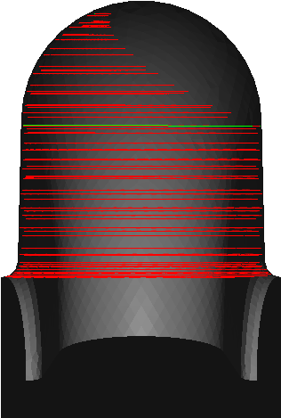
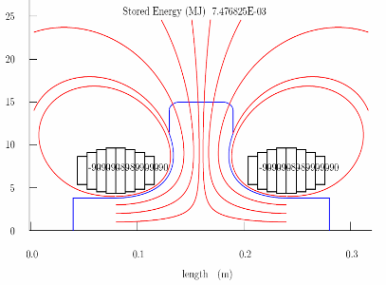
Physics Model for Understanding the RF Breakdown in a Strong B Field
The RF breakdown could be related by heating through field emission with external magnetic field and RF field:
Field emission (dark current) + external magnetic field
Ohmic heating
Possible solutions
Reduce/eliminate FE
Choice of materials
Lower initial temperatures
E field contour
ExB
B=0 T
B=1 T
Magnetic insulation
SLAC simulation of the 805 MHz PB cavity

Slide 9
Current NCRF R&D Strategy
Surface Processing
Reduce (eliminate?) surface field enhancements, field emission
SCRF processing techniques
Electro-polishing (smooth by removing) + HP H₂O rinse
More advanced techniques (Atomic-Layer-Deposition (ALD))
Smooth by adding to surface (conformal coating @ molecular level)
Materials studies: Use base materials that are more robust to the focusing effects of the magnetic field
Cavity bodies made from Be or possibly Mo
High-Pressure Gas-filled (H₂) cavities

Slide 10
RF Program
Design, construction of high gradient RF cavities
Demonstration of operations of high-gradient RF cavities in a strong magnetic field using the testing capabilities at MTA (RF sources + Lab-G magnet)
25 MV/m at 805 MHz
16 MV/m at 201 MHz
Vacuum RF cavity
Reduce/eliminate field emission/dark current
Cavity design
RF power coupler, body, iris, windows, etc.
Material properties
Processing
Use “best-known” practices
High Pressure RF cavity
Suppress the effects of dark current with HP H₂ gas.
Support of MAP D&S studies

Slide 11
805 MHz Modular Cavity
Previous experimental results limited by FE/dark current at high peak field regions (coupling slot and iris)
Surface damage at coupling slot and beam iris regions
Contaminated waveguides or coaxial loop coupler/ceramic RF windows (201-MHz)
Require a new cavity to confirm previous studies and continue R&D
New RF cavity design: modular cavity
Highest accelerating field on beam axis
Lower peak surface field at iris and coupling slot
Cavity material that can withstand high electrical field in a strong B field and with good electrical, thermal and mechanical properties
Beryllium is the best choice and has been demonstrated experimentally

Slide 12
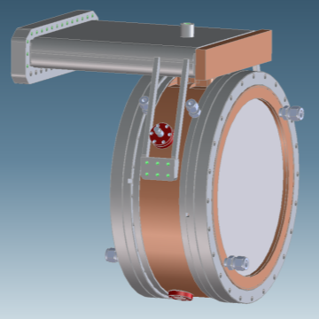
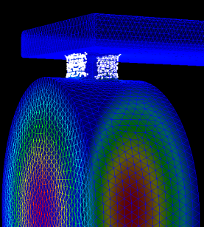
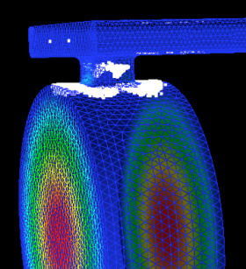
The Modular Cavity Design
Cavity design optimization
Maximum accelerating field on axis
Minimize peak surface field at the coupling region
Minimize MP at B=0 and B=3 Tesla
Allow for detailed systematic studies
Modular design for easy assembly, inspection, parts replacement
Removable endplates (initially Cu; Be, other materials, treated surfaces)
Coupling iris moved to center ring and field reduced (more realistic design for cooling channel)
RF design validated by detailed simulation
Incorporates all lessons learned
MP with & without external B field

Slide 13
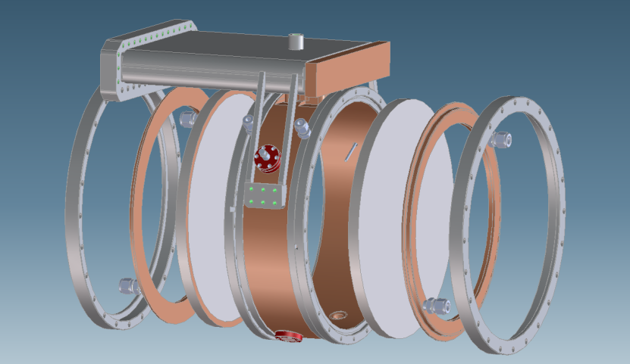
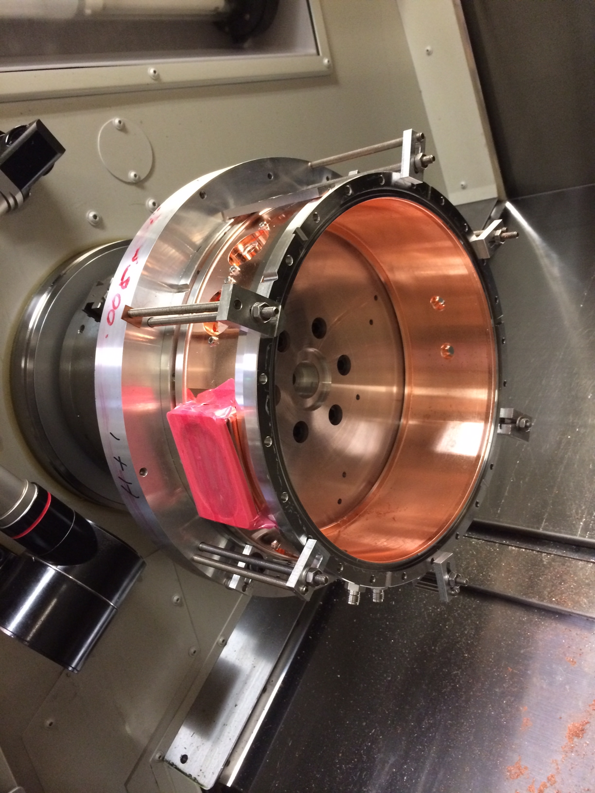
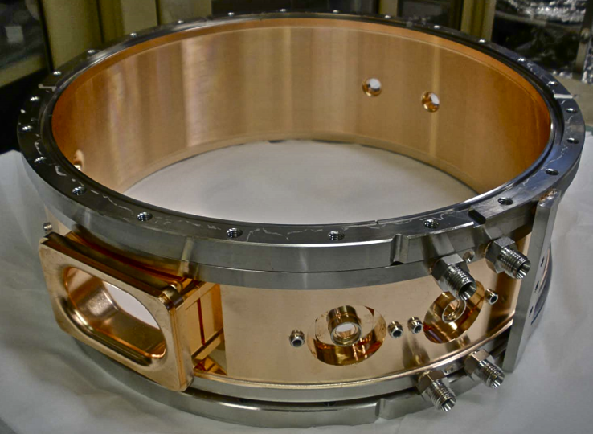
Cavity Fabrication at SLAC
Complete cavity-waveguide system deliver to MTA, Fermilab this month

Slide 14
All Seasons Cavity
Study new structure: All Seasons Cavity (ASC)
Modular pillbox with replaceable endplates
Designed for both vacuum and high pressure
316SS with 25um Cu coating
3.9/6.6/2.7cm-thick center ring/outer/inner plates
Φ29.1 x 12.9cm inner RF volume
1-5/8” coax coupler
Q ~ 28k, frequency 810.+ MHz
1.2MW @ 25 MV/m
No active cooling in design (operational limitation)
Tried external water blanket, did not work
Limited rep rate: 5/2/1/0.5 Hz @ 10/15/20/25 MV/m
Not the ideal test vehicle

Slide 15
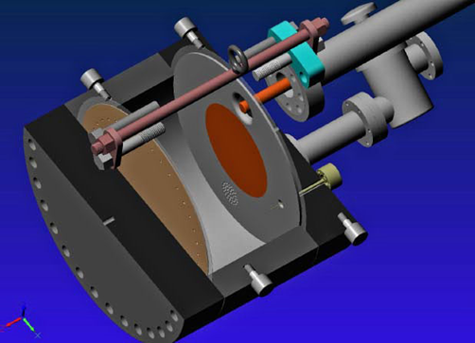
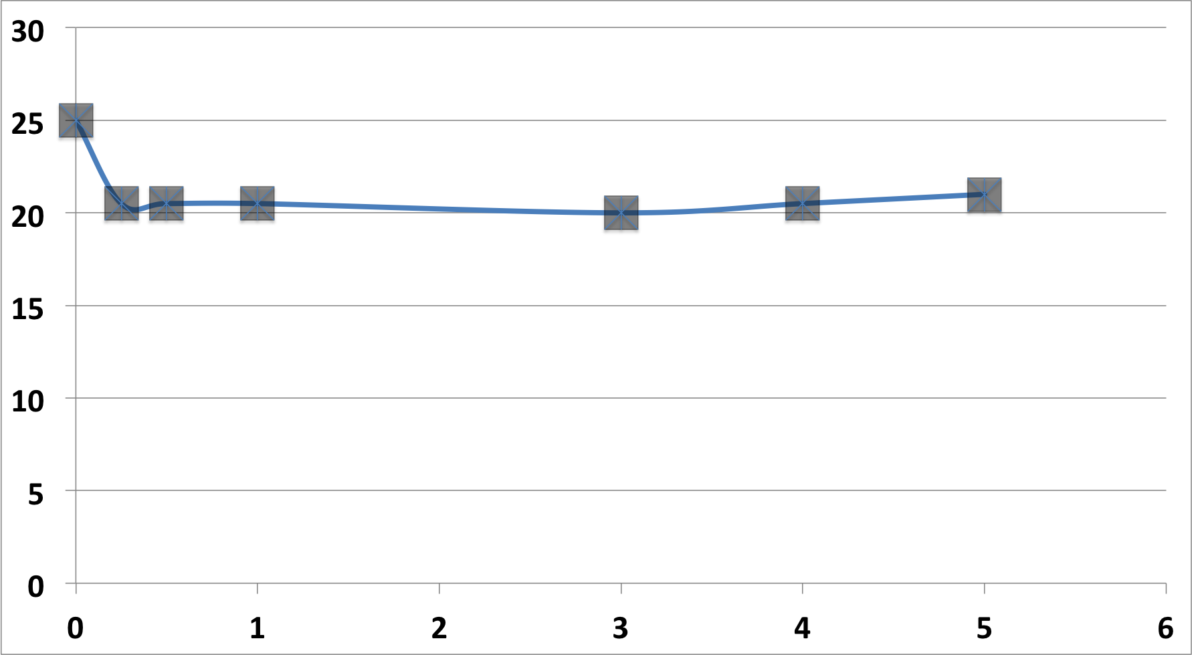
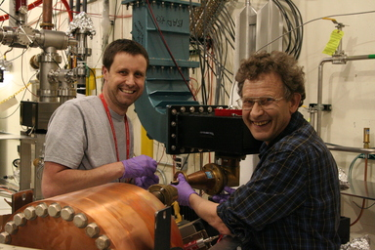
ASC: Results
Significant performance improvement over original the 805 MHz pillbox cavity.
Operated in magnet: 25 MV/m at B=0, 3 T
Re-run with RF pickup
Confirmed B=0 data
20-22 MV/m to 5T
Max. Stable Operating gradient (MV/m)
Very encouraging results !
B(T)

Slide 16
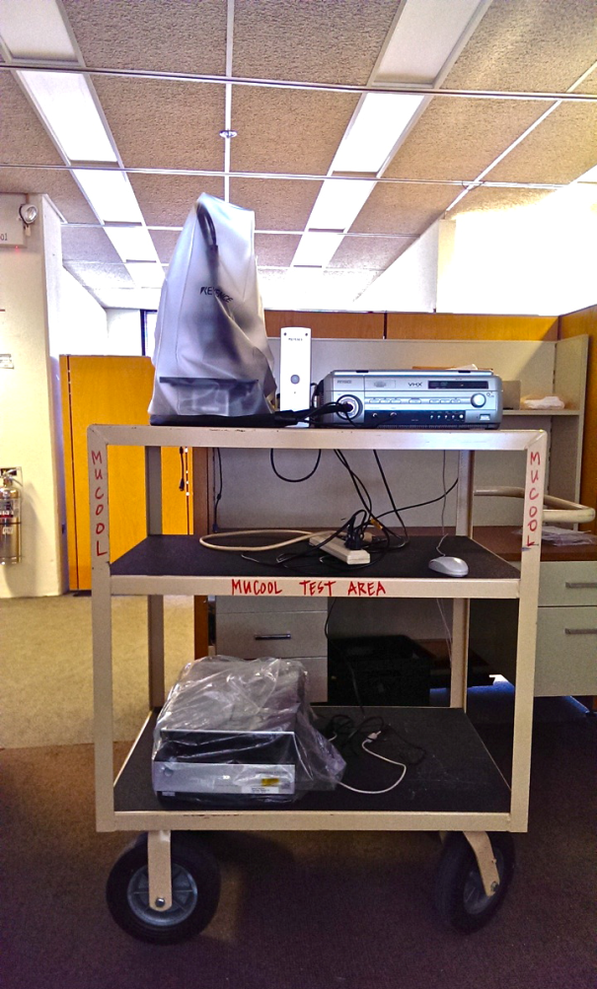
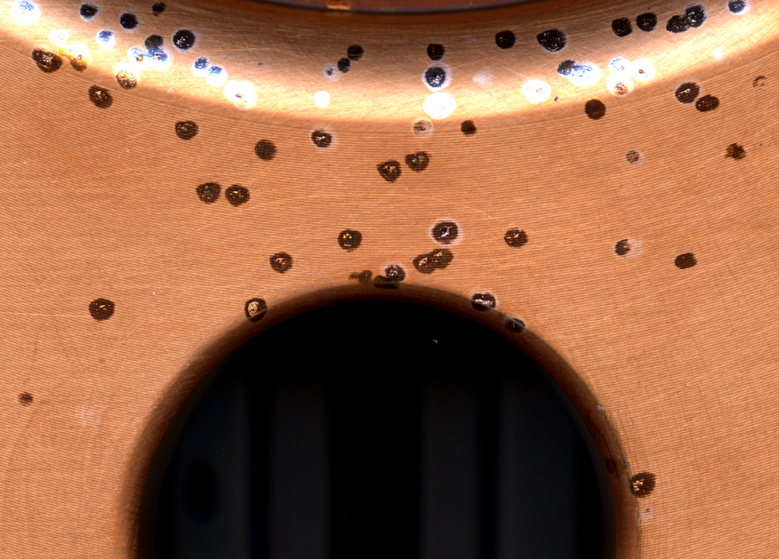
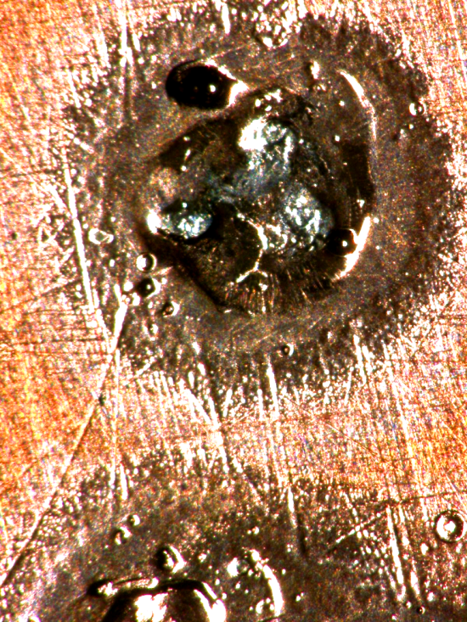
Improved Surface Inspection Capability at FNAL
Digital microscope + flatbed scanner
Frequent, in-situ surface characterization.
Input coupler region of the All-Season Cavity
A close-up of one of the breakdown spots on the All Seasons Cavity taken at 150X magnification

Slide 17
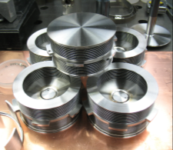
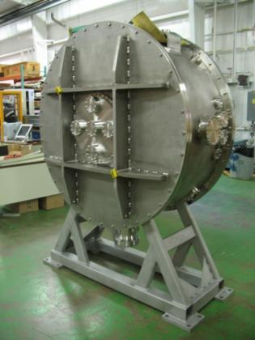
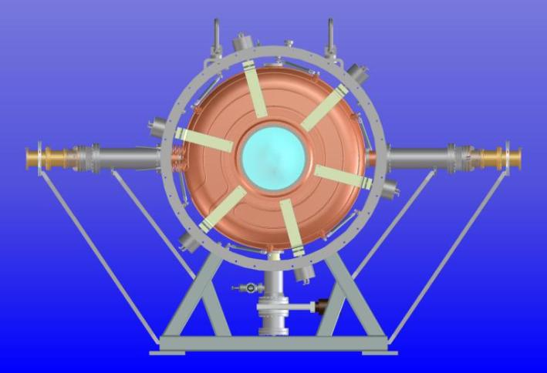
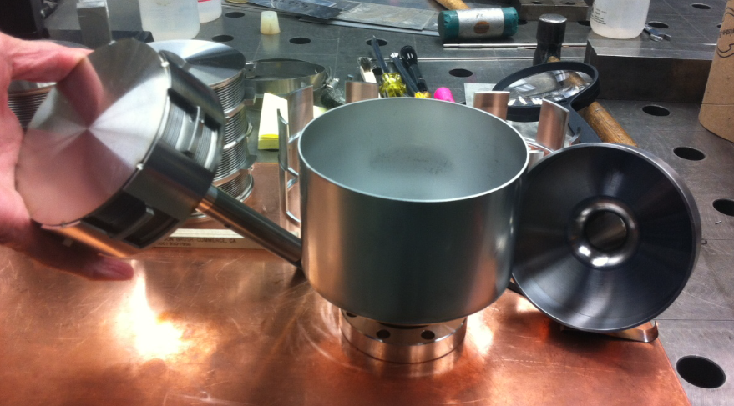
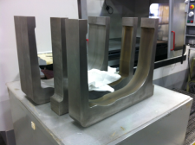
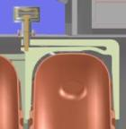
MICE 201 MHz Prototype Cavity
Using the single cavity vacuum vessel at Fermilab
Same dimensions and features that a MICE RFCC vacuum vessel would have
Installation fixtures and cavity handling experience
RF commissioning and testing with external magnetic field
Require a coupling coil magnet for testing at MTA
Configuration of cavity and the vessel
Loop coupler
Loop coupler
Tuner actuator
Tuner arms
6 Tuners
Single cavity vessel
Vacuum pump

Slide 18
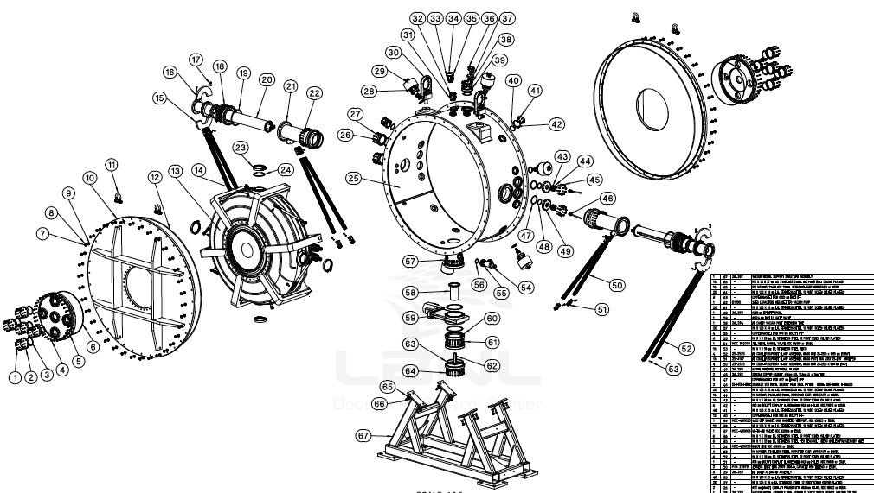
Fixtures and procedures of cavity to vessel
Tuner-actuator installation and testing
Water cooling lines
Cavity support struts
New RF power couplers

Slide 19
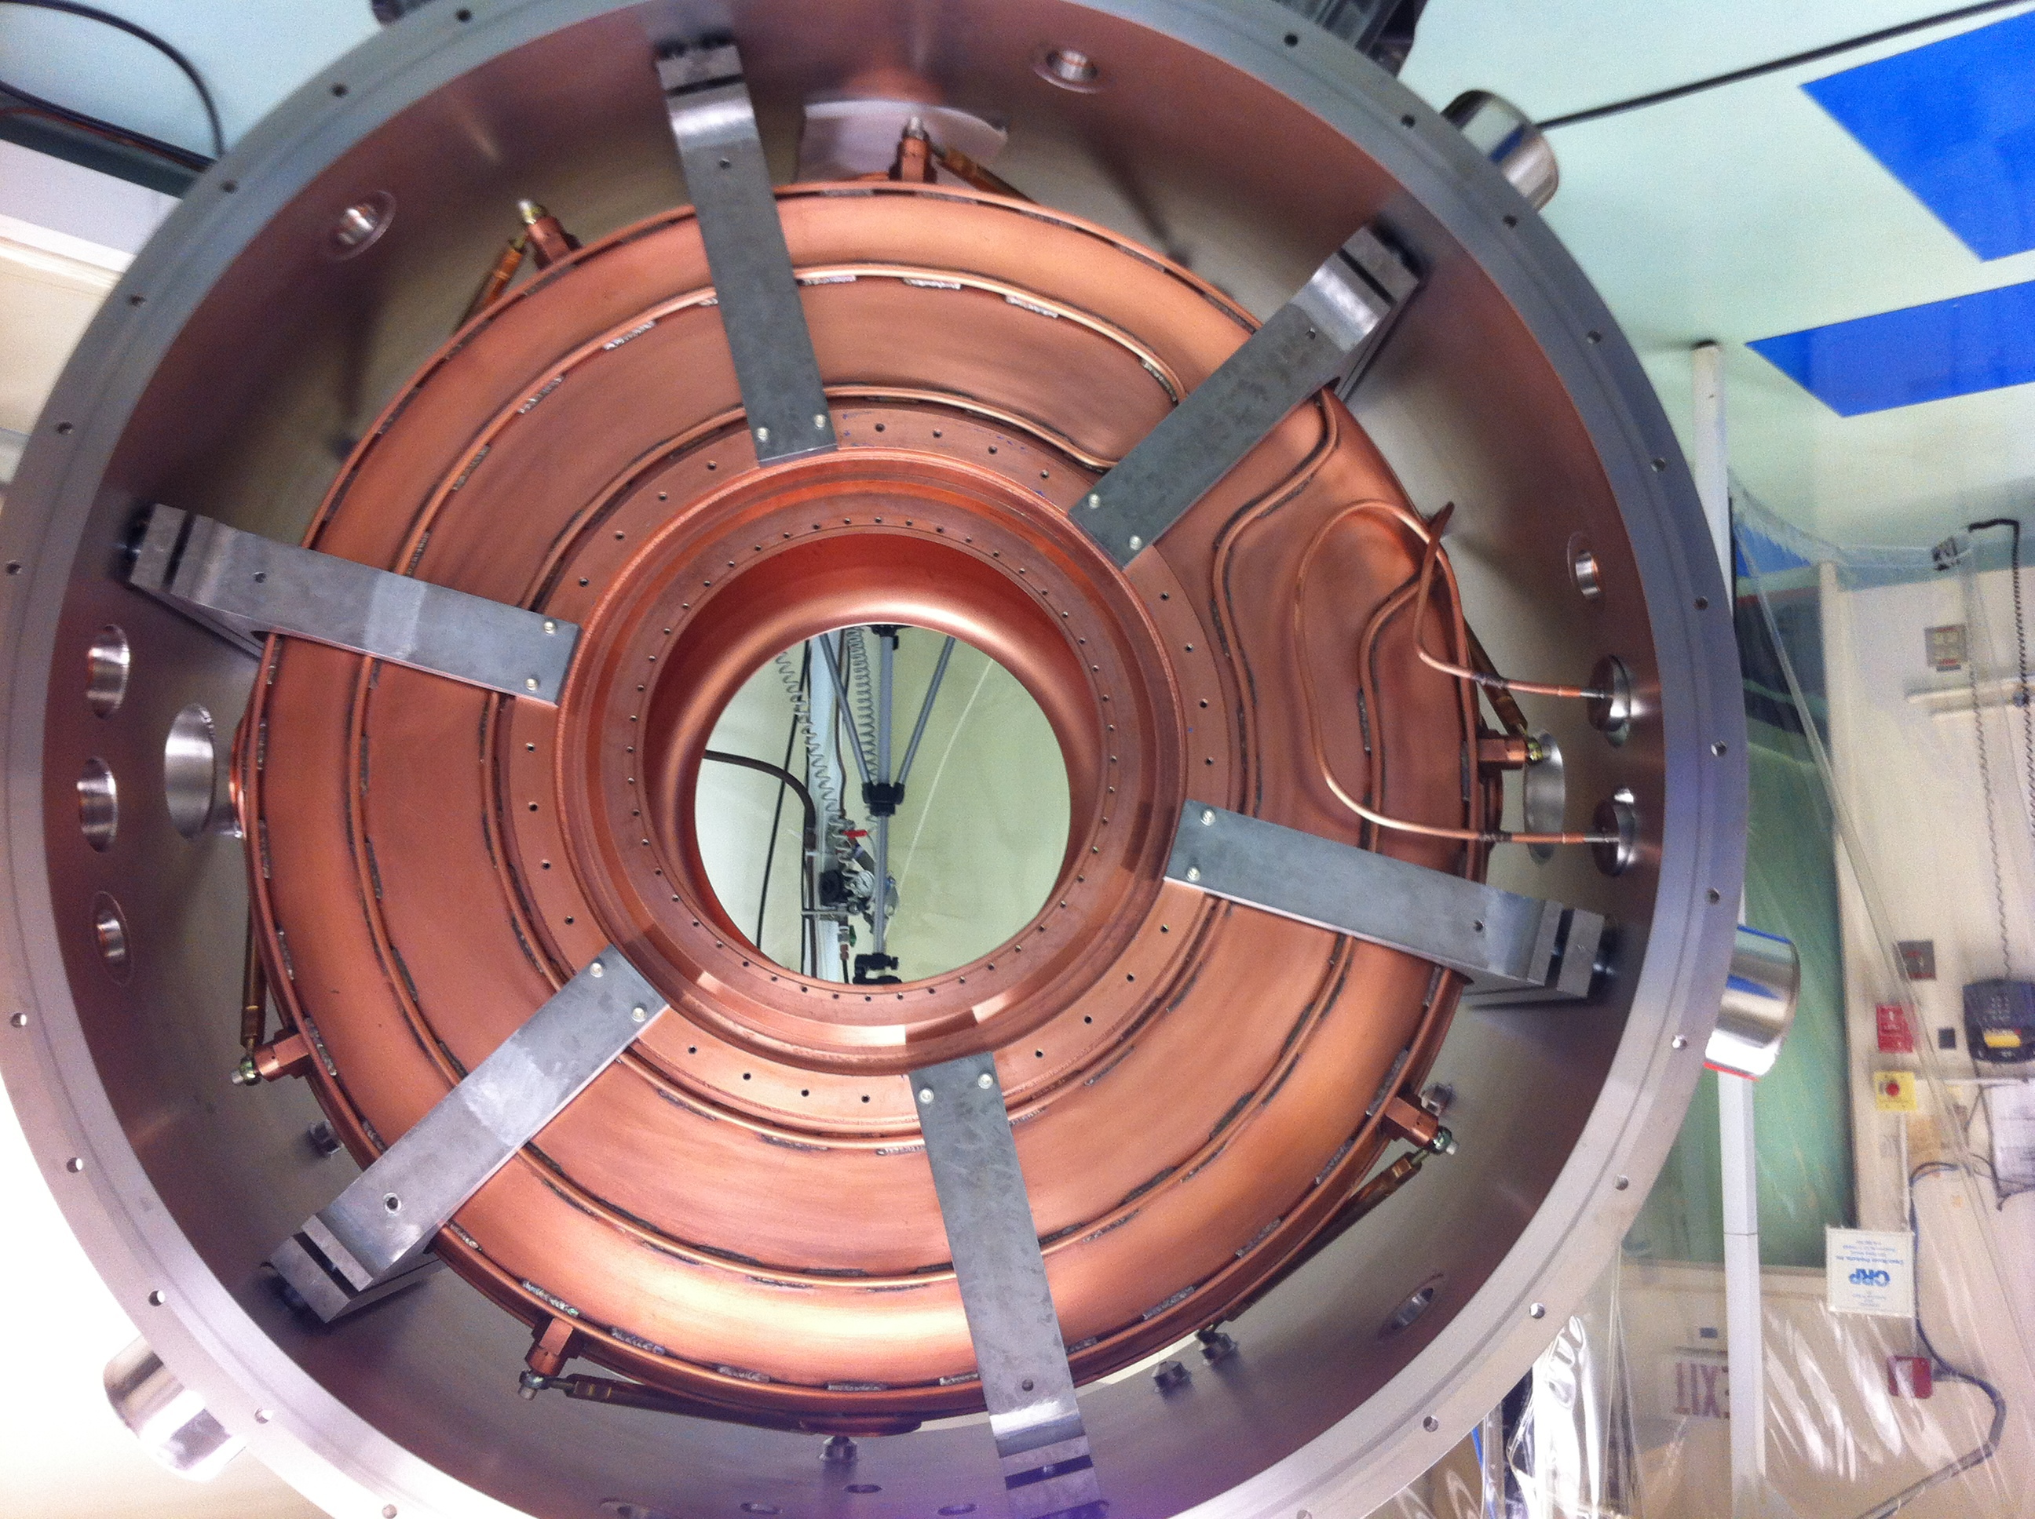
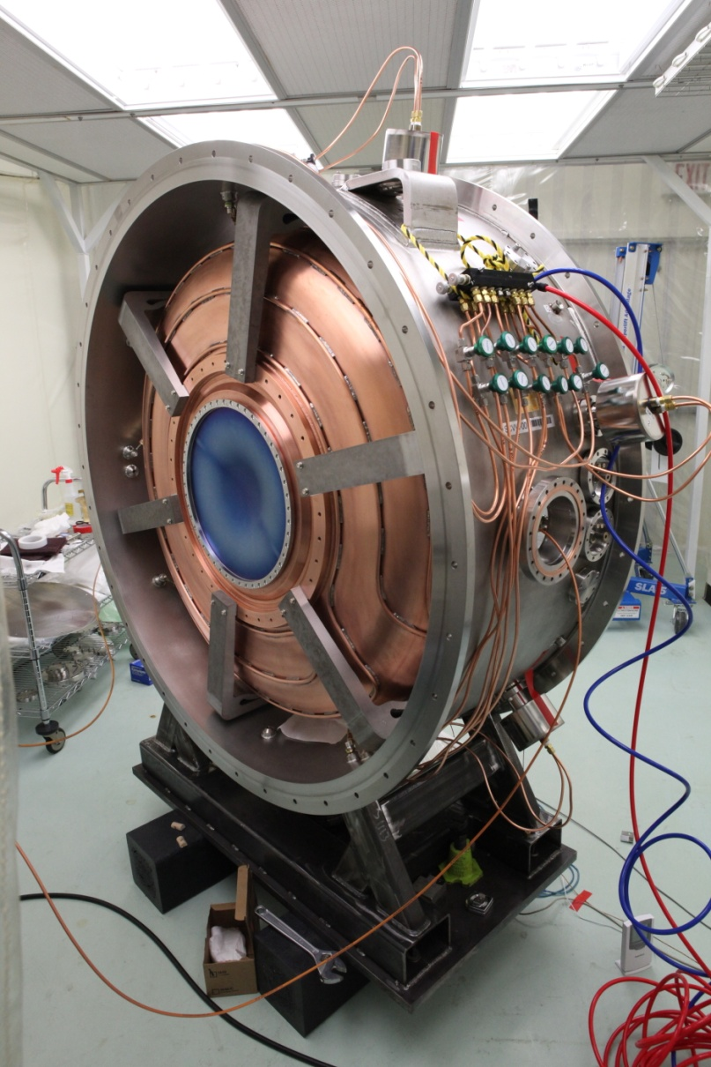
Single Cavity Assembly at MTA
All sub-components fabrication complete, successful cavity-tuner-vessel integration and installation at MTA, Fermilab
RF testing starts soon

Slide 20
High Pressure H₂ filled RF Cavity
Experimental studies of HPRF cavities:
Suppression of breakdown with the use of HP (100 atm) H₂ gas demonstrated ∼ 6 years ago.
In button cavity
No B effect (60 MV/m with and without B)
Breakdown limited by electrodes
Fundamental Question: “What happens when intense beam passes through cavity?”.
Beam testing at MTA

Slide 21
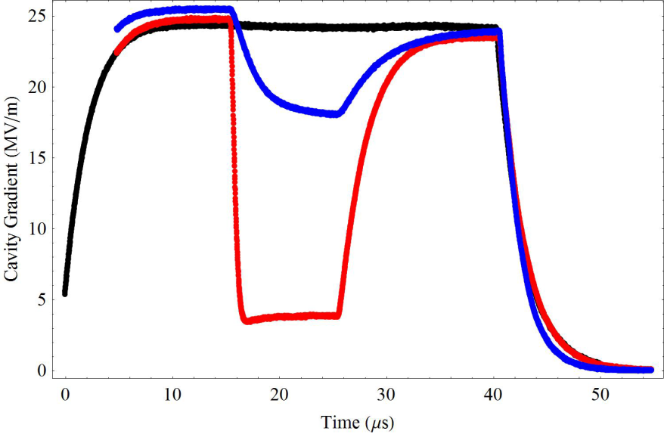
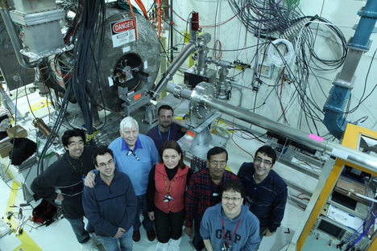
805-MHz HPRF Cavity Beam Test
Wide range of parameters studied
10¹⁰-3x10¹¹ ppp, 5-50 MV/m
300-1520 psi H₂, B=0 and 3T
Electronegative Dopant Studies: SF6 and dry air versus concentration
Ion Mobility Studies: He+air, N2+air, D2
Journal publication:
M. Chung et al., PRL 111, 184802, 2013
Quantitative theory validated by measurement of energy in H2/D2+dopant
Electronegative dopants turn mobile ionization electrons into heavy ions, reducing RF losses by large factor
Results extrapolate well to Neutrino Factory operation and a range of Muon Collider beam parameters
Plasma loading < beam loading
Bunch intensity limits being evaluated
1470psi H₂ a w/beam a add 1% dry air

Slide 22
Physical Review Letter
"All these results indicate that a high pressure gas-filled cavity is a viable technology for muon ionization cooling"

Slide 23
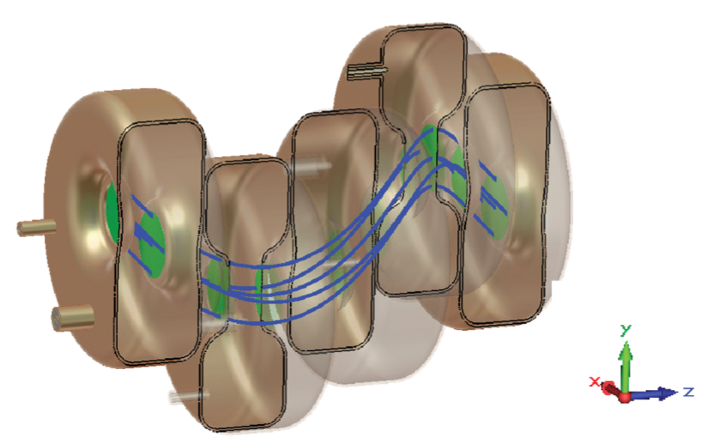
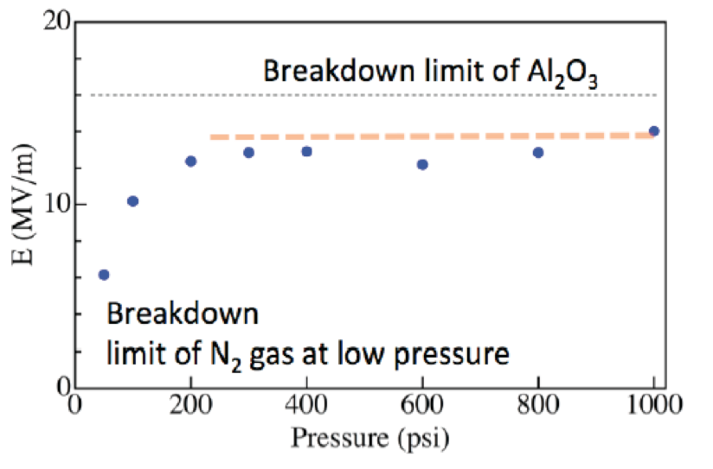
HP H₂ filled RF: Development plan Engineering Considerations
Need to shrink transverse cavity size to reduce magnet apertures in Helical Cooling Channel
Proof-of-principle test: HPRF test cell + alumina
suppression of breakdown up to surface breakdown limit of material
Other samples to be measured at low power
High power test in MTA for promising candidates (suitable dielectric constant, low loss tangent)
Beam test if successful
Also looking at reentrant cavity design (Muons Inc)

Slide 24
RF Effort towards IBS
RF work supports IBS
Vetting RF operating requirements
What RF gradient at a given frequency and magnetic field should we use for IBS?
“NCRF Cavities in Strong Magnetic Field: Is this Still an Issue?”
For vacuum RF cavities, yes!
Vacuum RF: 805 MHz modular cavity
Used to study operation in B and then specify cavity design and fabrication
If successful provides input for design and fabrication of engineering proof-of-principle cavity
If above successful, leads to pre-production prototypes
HPRF
Dielectric loaded and/or re-entrant cavity test cells
If successful provides input for design and fabrication of engineering proof-of-principle cavity
If above successful, leads to pre-production prototypes

Slide 25
Summary
Operation of high gradient NCRF cavity in a strong magnetic field remains to be a challenge, active R&D efforts to understand associated RF breakdown problems and find solution to address them
Minimize/eliminate FE/dark current
Finding an achievable accelerating gradient for a given magnetic field
R&D efforts include
Design, fabrication and testing of the 805 MHz modular cavity
HPRF cavity loaded with dielectric materials
Significant progress in 201 MHz MICE prototype cavity at MTA
Integration and installation at MTA
RF testing starts soon
Recent accomplishments
Encouraging testing results of ASC cavity
Promising beam test results of HP gas cavity and physics model, data analysis and PRL publication
RF study support of MAP IBS

