Slide 1

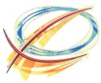
Nonlinear Dynamics with Space-Charge in a Small Electron Recirculator
AAC14, San José, CA, July 16th, 2014
Santiago Bernal on behalf of UMER group,
IREAP, University of Maryland, College Park, MD
Work Supported by the U.S. Department of Energy
IREAP

Slide 2
OUTLINE
UMER LAYOUT AND PARAMETERS
TRANSVERSE DYNAMICS:
  Betatron Resonances with low and high current
  Envelope-Mode Excitation with quadrupole kicker
  Halo (DMA diagnostics) and Envelope Matching
  Nonlinear, IOTA-like Optics with space charge
LONGITUDINAL DYNAMICS:
  Longitudinal Focusing extended to high current
  Solitons observed/simulated
  Multi-Stream Instability observed/simulated

Slide 3
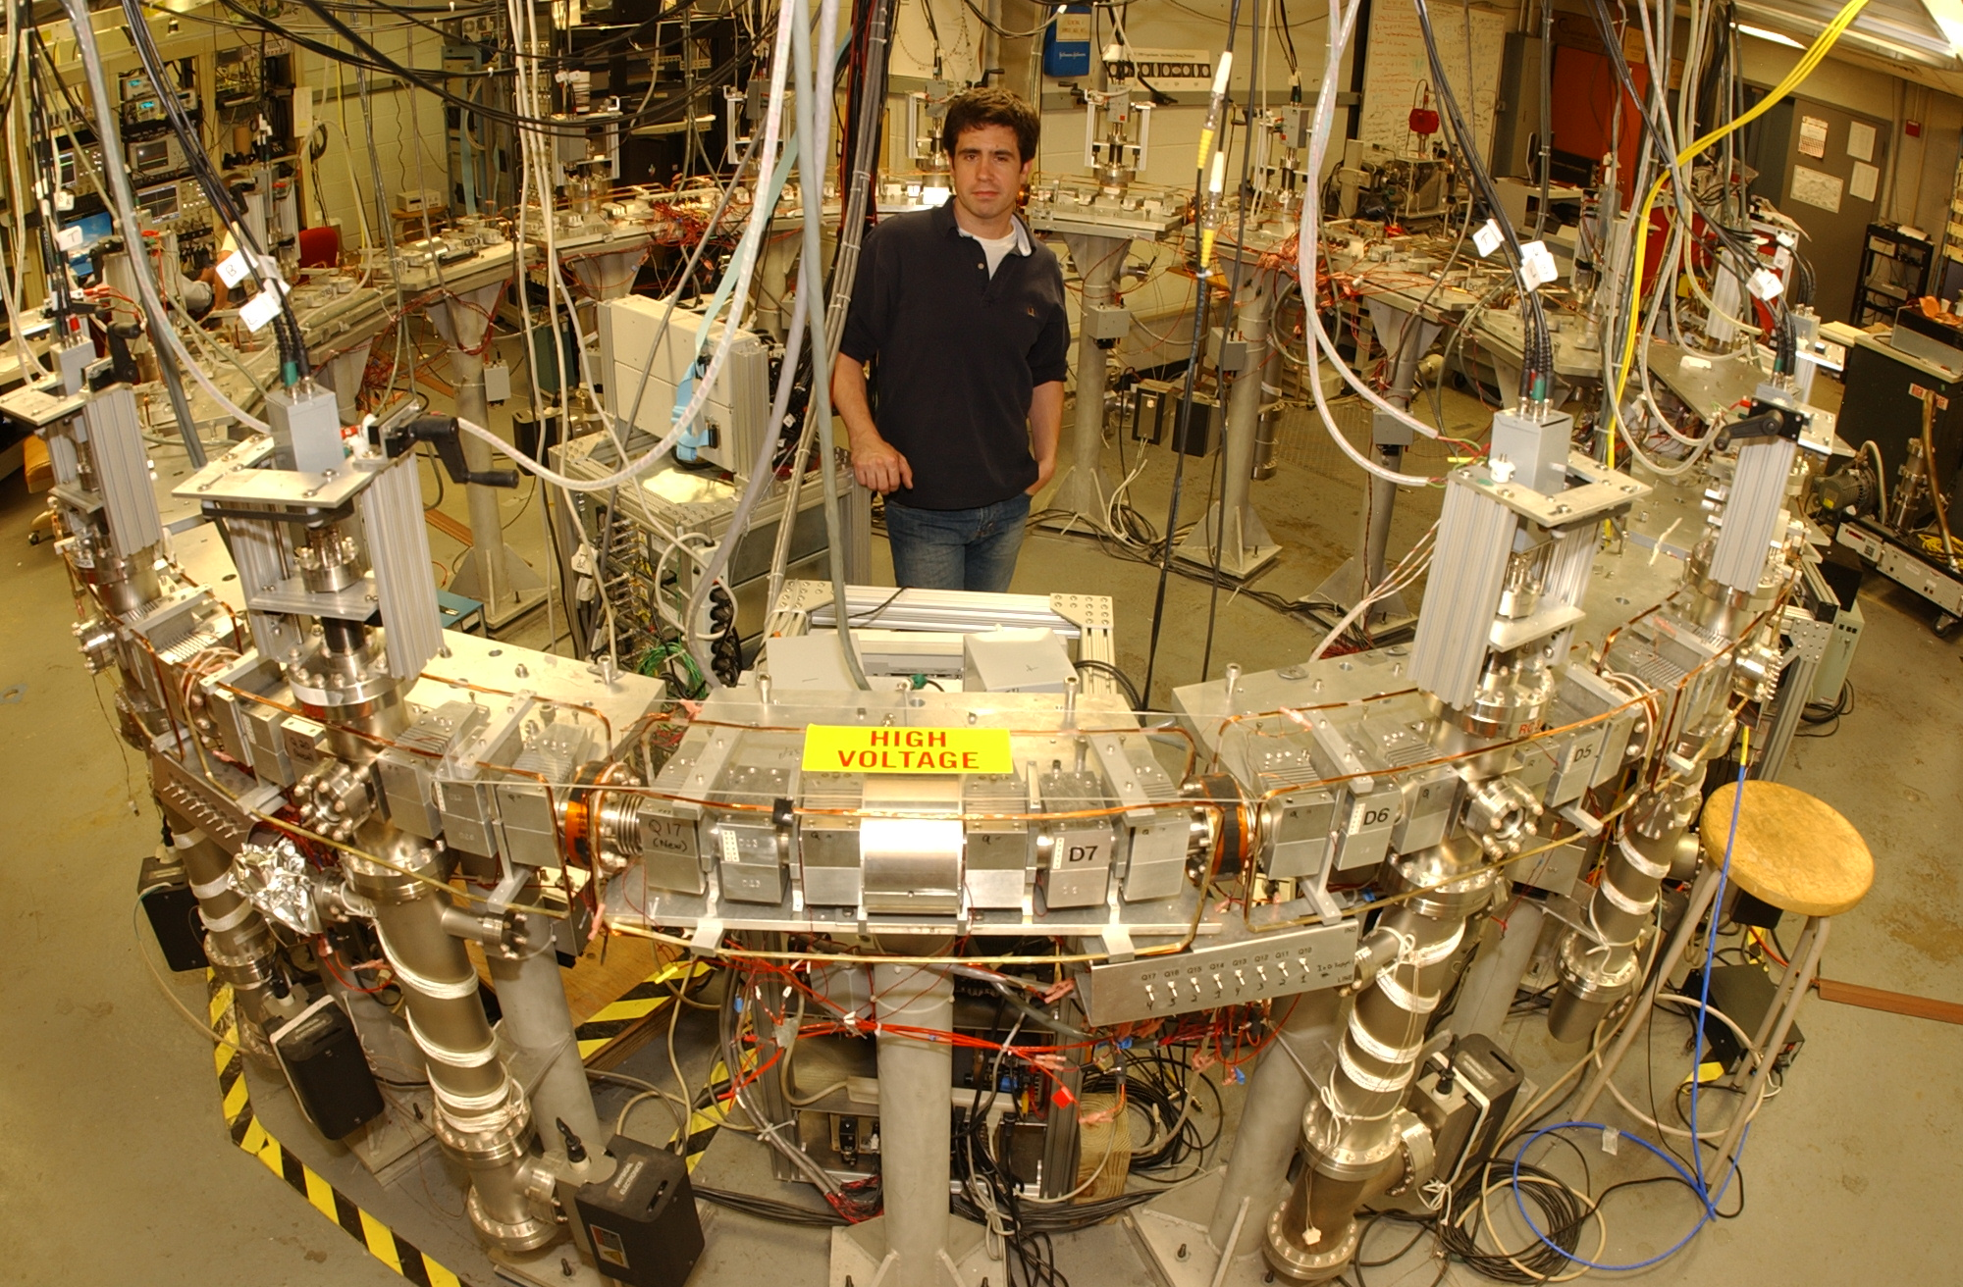
University of MD Electron Ring (UMER)
IREAP

Slide 4
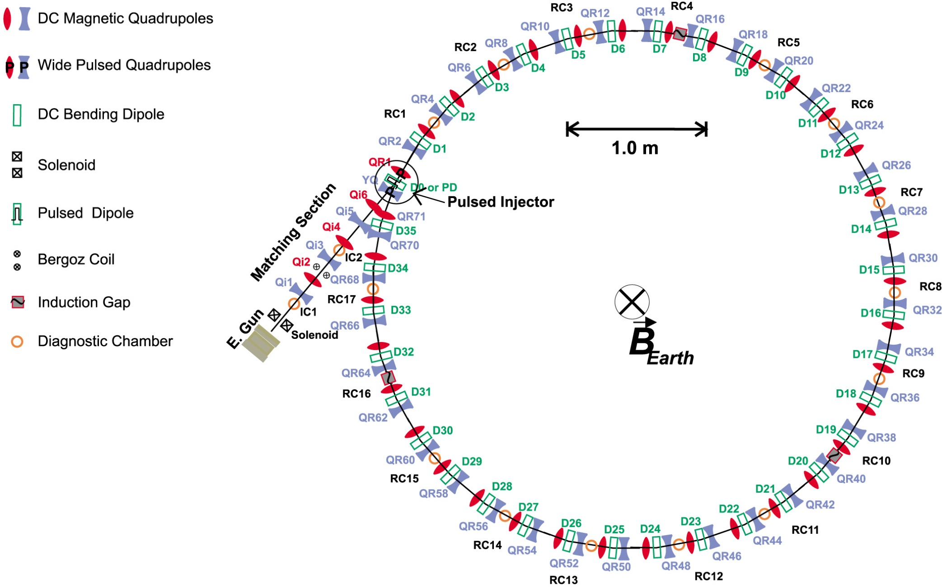
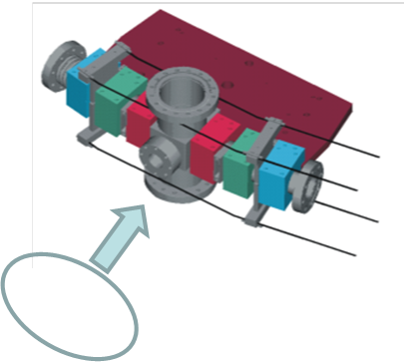
University of Maryland Electron Ring (UMER):
Research on Space-Charge Dominated Beams with Applications to
Intensity-Frontier Advanced Accelerators
Ind. Mod.
D
WCM
Q
D
Energy: ≤ 10 keV, β = 0.20
Current, I: ≤ 100 mA
Emittance*, ε: ≥ 3.0 μm
Lattice period, S: 0.32, 0.64, 1.28 m
Zero-current λ₀: ≈ 1.8, 3.6, 7.2 m
Av. beam radius, a: ≤ 10 mm
Pulse length: 25-100 ns
Lap time: 197 ns
Q
Q
Q
*norm., rms

Slide 5
BEAM PARAMETERS (all @ 10 keV)
Tune ν_{ox}= ν_{oy}= 6.6, std. lattice; Vacuum Pipe Radius = 25.4 mm
 | 0.6 mA | 6.0 mA | 60 μA*
ε_{n,rms} [μm] | 0.4 | 1.3 | 0.16
a_{ave} [mm] | 1.6 | 3.4 | 1.0
ν/ν_{o} | 0.85 | 0.62 | 0.96
Δν_{coh.} | 0.005 | 0.05 | 0.00
Δν_{incoh.} | 0.94 | 2.4 | 0.25
*Similar results for alternative lattice if ν_{ox}= ν_{oy}= 4.2
Additional beam currents: 21, 78 and 104 mA
5
Notes:
The main parameters for beam transport appear in blue.

Slide 6
TRANSVERSE DYNAMICS

Slide 7
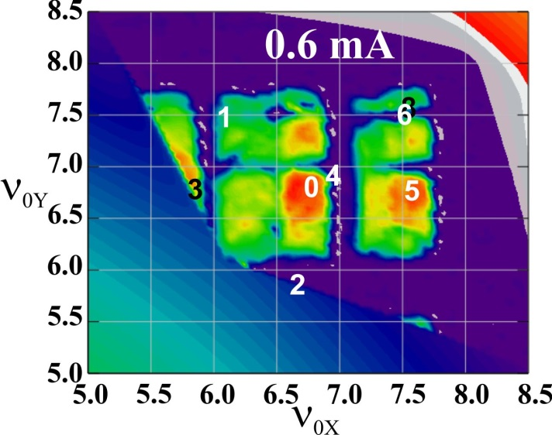
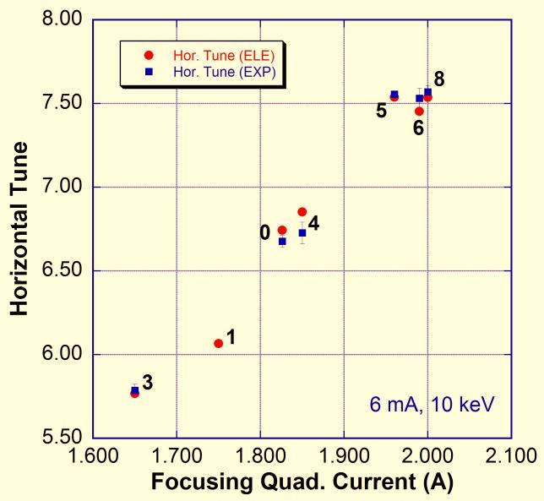
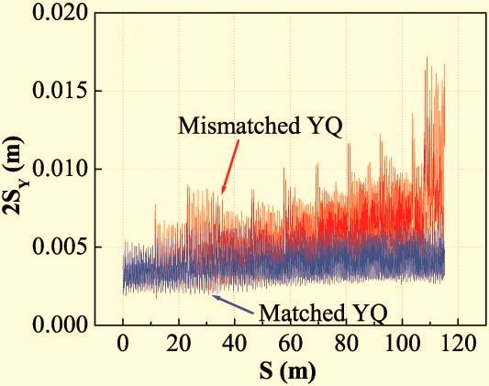
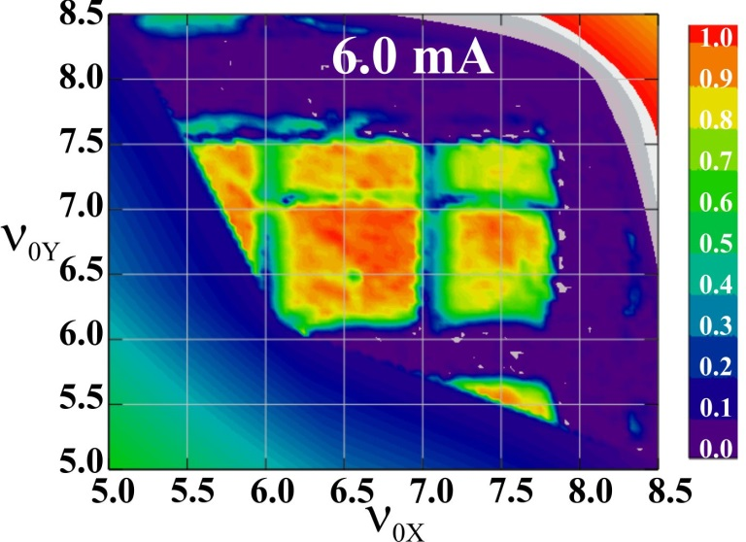
BETATRON RESONANCES AND BEAM CURRENT*:
0.6 mA beam behaves more coherently than 6.0 mA
Transmitted peak beam current
at 10th Turn vs. Bare Tunes:
Measured vs. Calculated (ELEGANT) Tunes
Calculated (ELEGANT) Beam Envelope with space charge
6.0 mA
*S. Bernal et al, Proc. NA-PAC 2013, Pasadena, CA, Sep. 2013

Slide 8
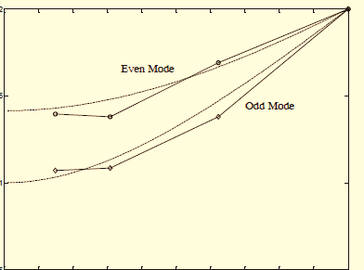
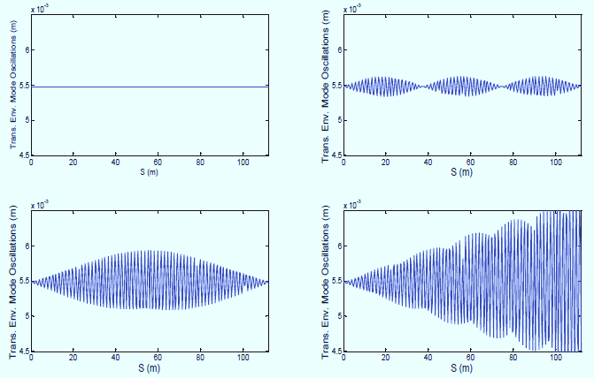
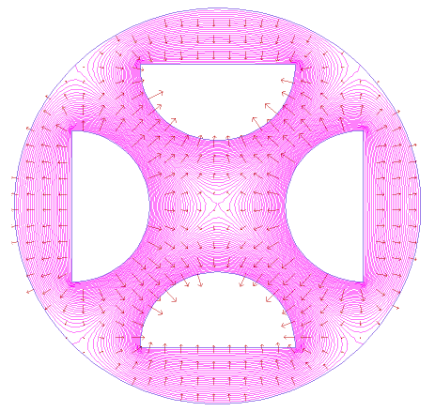
ENVELOPE RESONANCE EXCITATION
(W. D. Stem et al, IPAC 2013 and N-PAC 2013)
6
Norm. Mode Freq. vs. Tune Depression
(WARP and theory)
Phase advances of breathing (even) and quadrupole (odd) envelope modes:
2.0
1.5
Norm. Frequency, ω/ω₀
6.0 mA
Can resonantly excite envelope modes with fast electrostatic quadrupole.
Frequency split depends on tune depression σ/σ₀ , which depends on beam energy, current and emittance.
1.0
21 mA
Tune Depression
0.0
0.1
0.2
0.3
0.4
0.5
0.6
0.7
0.8
0.9
1.0
Transv. Envelope OFF (quadrupole) resonance, NEAR resonance and ON resonance (WARP code results)
Electrostatic
Quadrupole

Slide 9
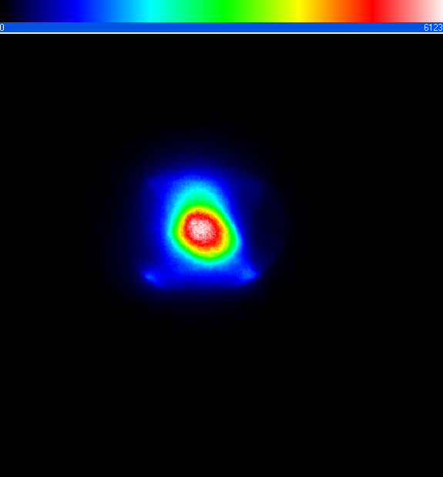

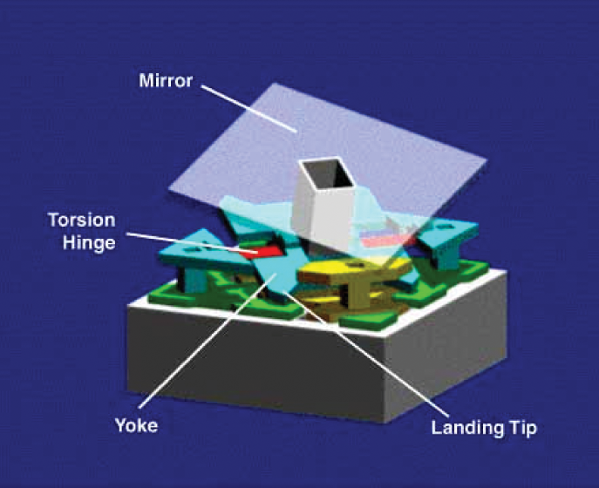
Halo study using high dynamic range diagnostics
[H. D. Zhang et al, Phys. Rev. ST Accel. Beams 15, 072803 (2012)]
mismatched 6mA beam
12⁰
Mask: block by DMD
32mm
y
x
Micro-mirror
architecture
Screen edge
Mask sizes
Achieve dynamic range up to 10⁻⁵
Line plot of sequential images with different mask sizes
Notes:
The red line represent the , even in log scale, the fluctuation is big, only after applying the mask and retaking the picture, the fluctuation shrink, and we can see here a dynamic range of 10⁵ can be achieved. This is a reconstructed picture showed a full dynamic range in log scale.
with smoothing and background subtraction

Slide 10
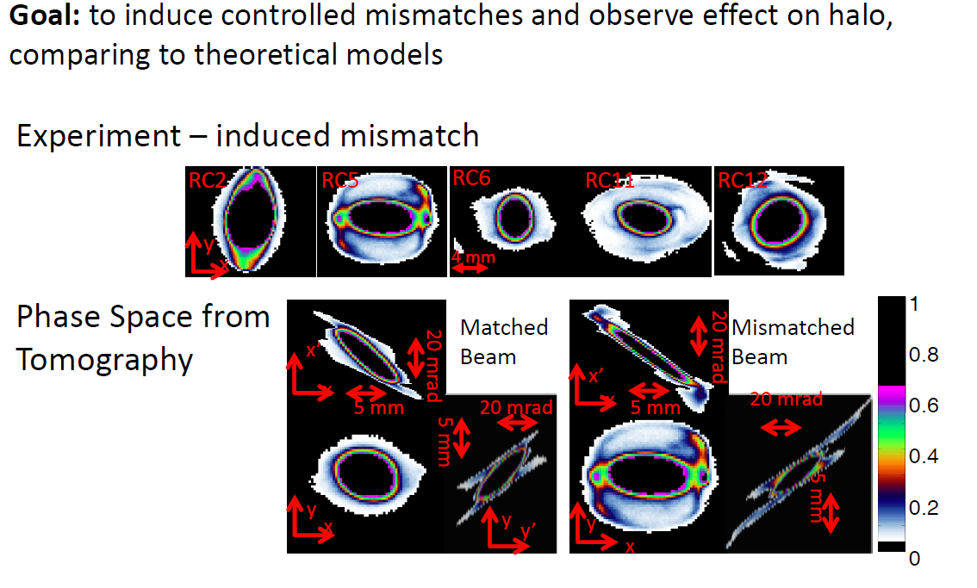
Halo Formation from Mismatch
(H. D. Zhang, B. L. Beaudoin, and R. A. Kishek, N-PAC 2013)

Slide 11
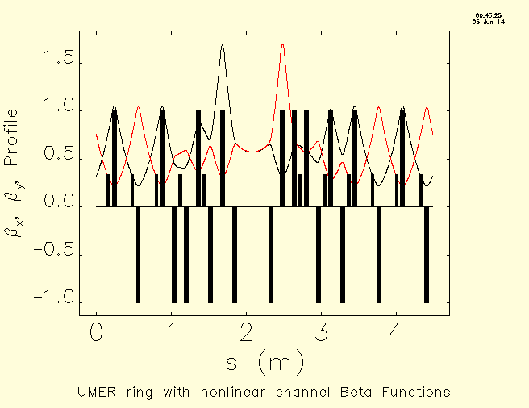
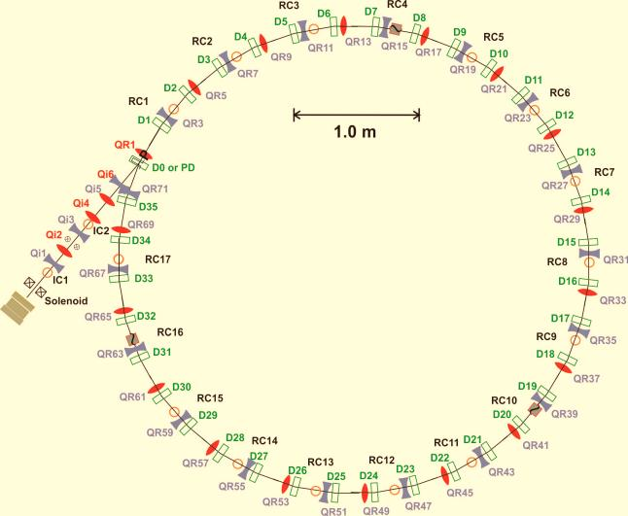
NONLINEAR OPTICS AT UMER: Studies of IOTA-like Optics + Sp. Charge
(See plenary talk by Sergei Nagaitsev, and WG7 talk by Kiersten Ruisard tomorrow)
Generally, nonlinear systems are more stable than linear ones.
Nonlinear focusing leads to amplitude-dependent tunes (tune spread) and nonlinear decoherence*.
Nonlinear decoherence helps mitigate resonances and halo formation. Effect similar to Landau damping.
Role of space charge?
W
Beta Functions in Modified UMER Alternative Lattice (ELEGANT)
(Courtesy of Kiersten Ruisard)
*
L
*S. D. Webb et al, to be published.
UMER Alternative Lattice
*

Slide 12
LONGITUDINAL DYNAMICS

Slide 13
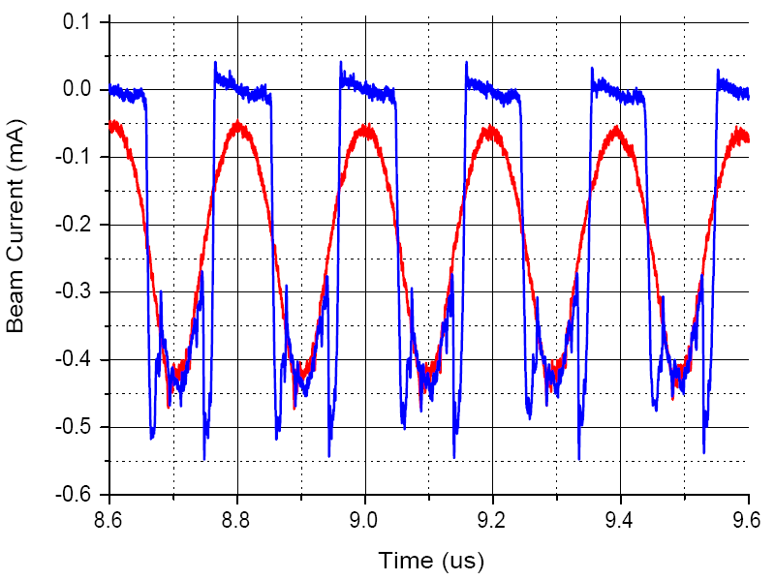
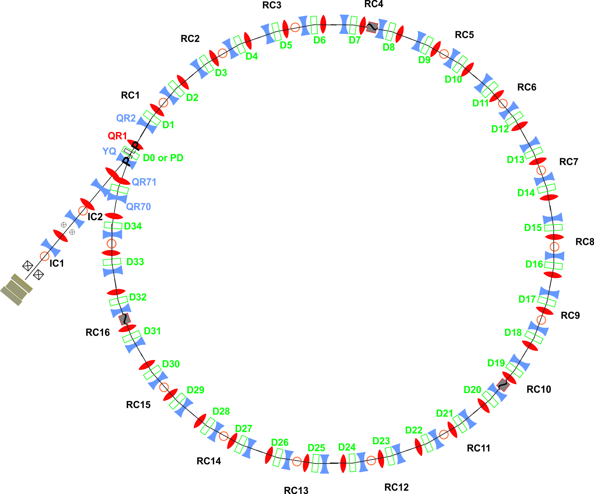
UMER Design Performance Exceeded by a Factor of 10 at Low Current But High Inj. Sp. Charge Tune Shift (0.9)
LONGITUDINAL
FOCUSING
Cell Off (0 V)
Cell On (140 V)
46th Turn
Signal from wall-current monitor at RC10
0.6 mA, 10 keV
13
Notes:
13
highest space charge circulated in a ring! 100 turns design criterion

Slide 14
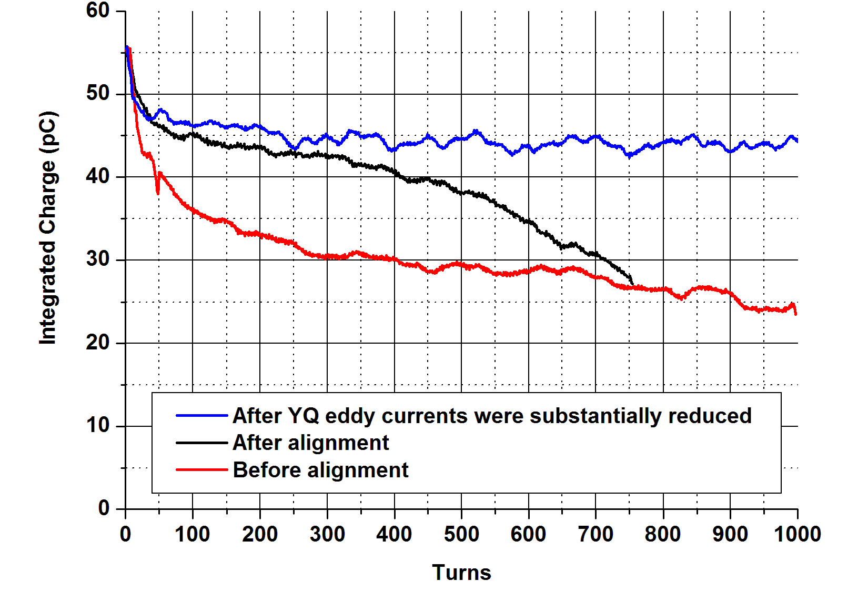
Barrier Bucket Focusing of 0.55mA Beam
Courtesy of Brian Beaudoin

Slide 15
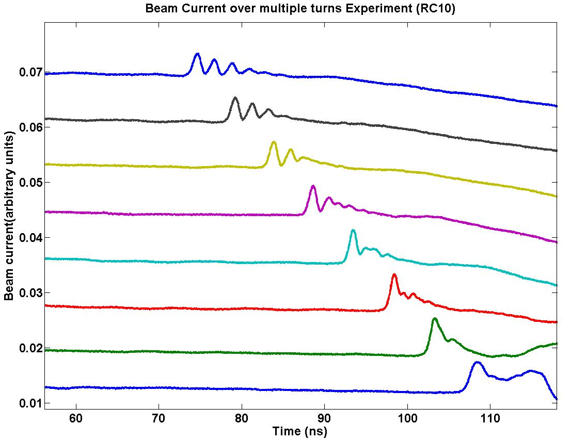
First Experimental Observation of Soliton Wave Trains in Electron Beams
Persistent large-amplitude waves that retain their shape
Evolution of Large-Amplitude Perturbation
Turn 8
Nonlinear steepening
balances wave dispersion
Turn 3
Turn 2
Turn 1
J. Charles T. Thangaraj, Ph.D. Thesis, (2009) and
Y. C. Mo et al, Phys. Rev. Lett. 110, 084802 (2013)
Notes:
15
Originally studied by John Scott Russell (1800s) for interest of design of ship hulls

Slide 16
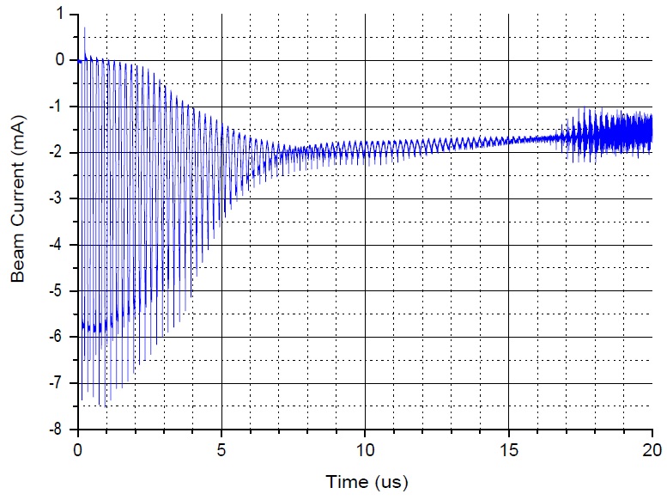
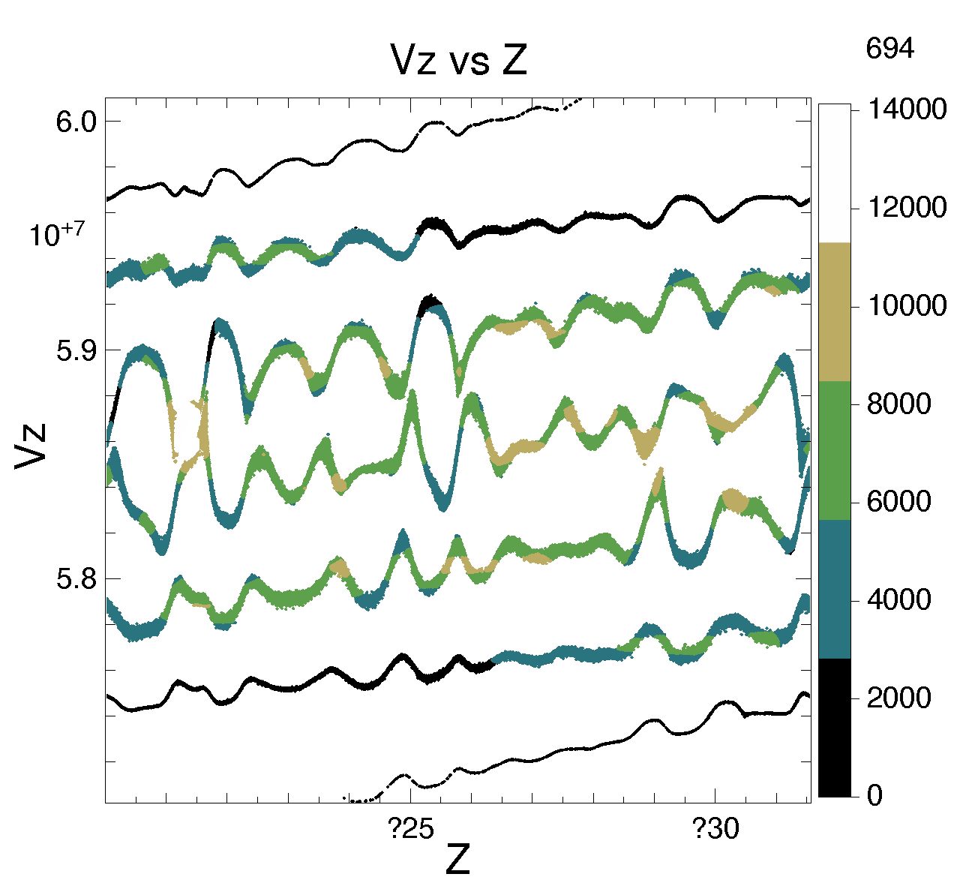
Observation of a Multi-Stream Instability
No longitudinal focusing – Beam expands and wraps around ring
Experimental
Onset of instability
s_{onset} = 952.7m
turns_{onset} = 82.7
6 mA beam
η = 0.5
Phase Space
<c_{s}
Beam becomes “DC”
B.L. Beaudoin, et al, IPAC 2013
0
11.52

Slide 17
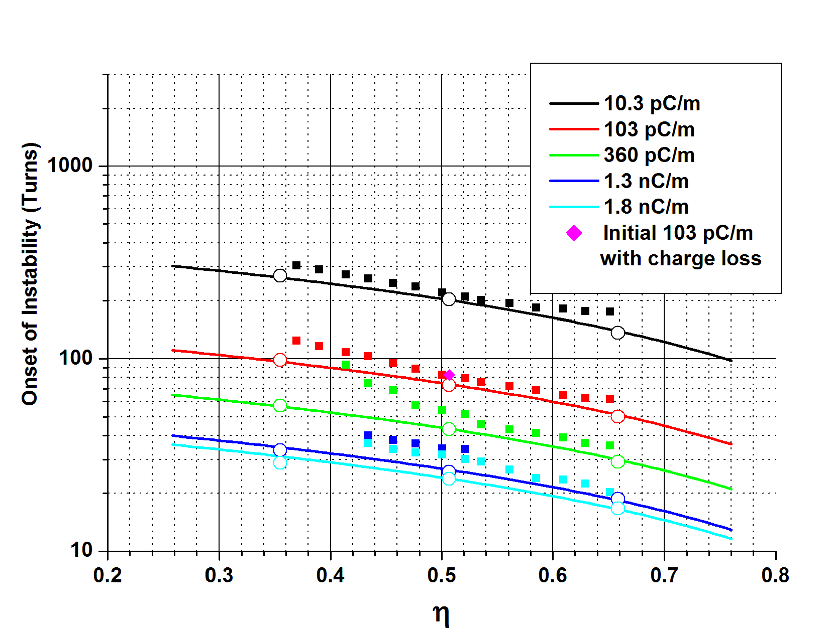
Comparison between Theory, Simulation and Experiment
η = fill factor
= injected pulse length / ring lap-time
Onset of Instability
Λ₀
Experiment
Simulation (WARP)
Theory

Slide 18
SUMMARY/CONCLUSIONS
UMER is a compact, flexible machine for research and training in intensity-frontier beam physics.
We are studying the centroid and collective transverse
dynamics of both emittance and space-charge dominated beams: betatron resonances, envelope mode excitation, and halos.
IOTA-like nonlinear focusing in UMER is being studied
for low and high space-charge intensities (ELEGANT and
WARP codes).
Research on longitudinal dynamics in UMER has revealed important results on bunch containment and space charge waves including soliton wave trains and multi-stream instability.
Notes:
The red line represent the , even in log scale, the fluctuation is big, only after applying the mask and retaking the picture, the fluctuation shrink, and we can see here a dynamic range of 10⁵ can be achieved. This is a reconstructed picture showed a full dynamic range in log scale.
with smoothing and background subtraction

