Slide 1
Space-charge compensation experiments at ASTA
Vladimir Shiltsev, Moses Chung
16 July 2014
2014 Advanced Accelerator Concepts Workshop, San Jose, CA

Slide 2
Space charge effects – Compensation - Motivation
SC – very important (not the only) high intensity beam effect
  There are two approaches to SC: (beside the obvious – “don’t go there!”):
  Limit the time at low energies
    Operate at higher energies as dQ_sc ~ 1/ gamma^2
    Linacs
    Expensive
  Reduce the consequences
    Integrable optics
    Collimation
  Remove the source of the problem
    Compensate/neutralize the SC force
    Add electrons to compensate SC of protons
    Source of e- : external (e-lens) or “in situ” (e- column)
See G.Stancari’s talk
This presentation

Slide 3
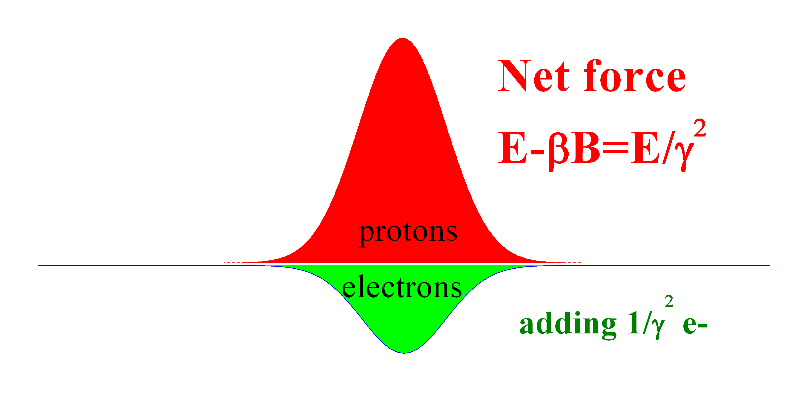

Space Charge Forces & Compensation
Z, beam
direction
B=βE
r, across the beam

Slide 4
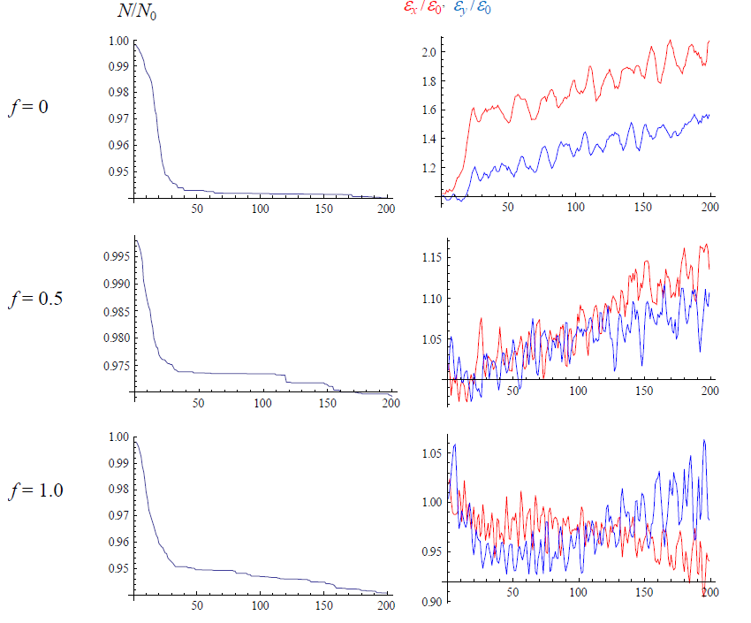
Simulations : FNAL Booster (Yu.Alexahin & V.Kapin, 2007)
Booster:
400 MeV, 474 m
P=24
N_p~4.5e12
dQ_sc=-0.3
“space charge compensation with e-lenses works”
More compensators the better (24→12→3 minimum)

Slide 5
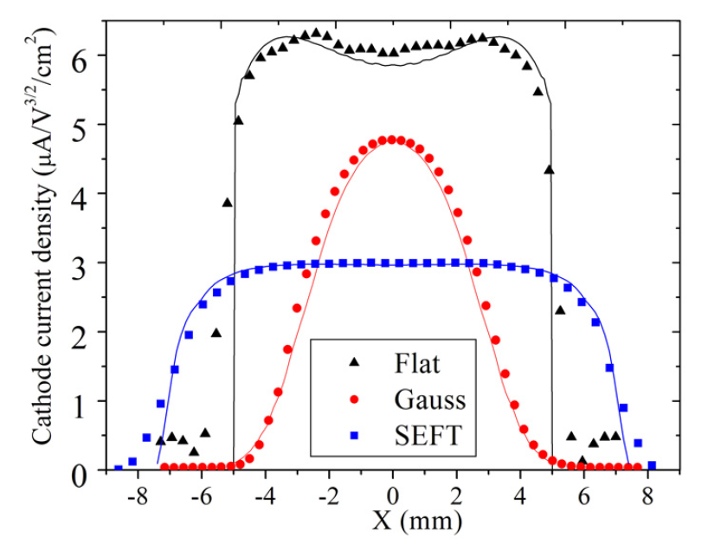
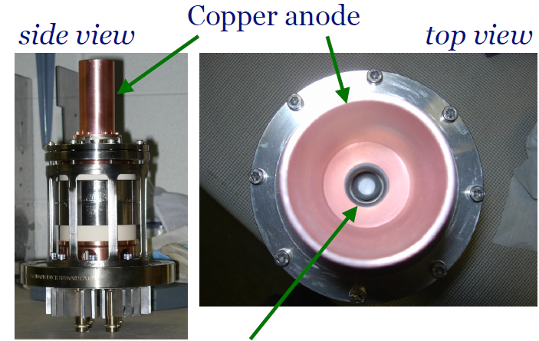
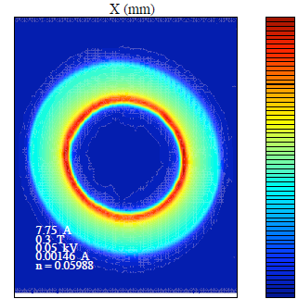

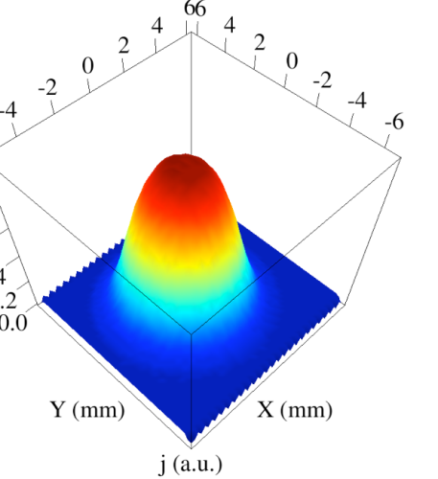
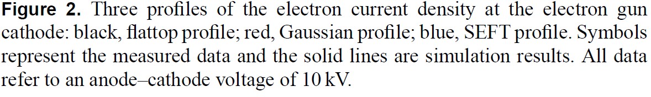
Electron Charge Distribution: E-lens
Electron gun
Shiltsev et al., PRL 99, 244801 (2007). Shiltsev et al., NJP 10, 043042 (2008).
G. Stancari, et al., (2011)
Phys. Rev. Lett. 107, 084802

Slide 6
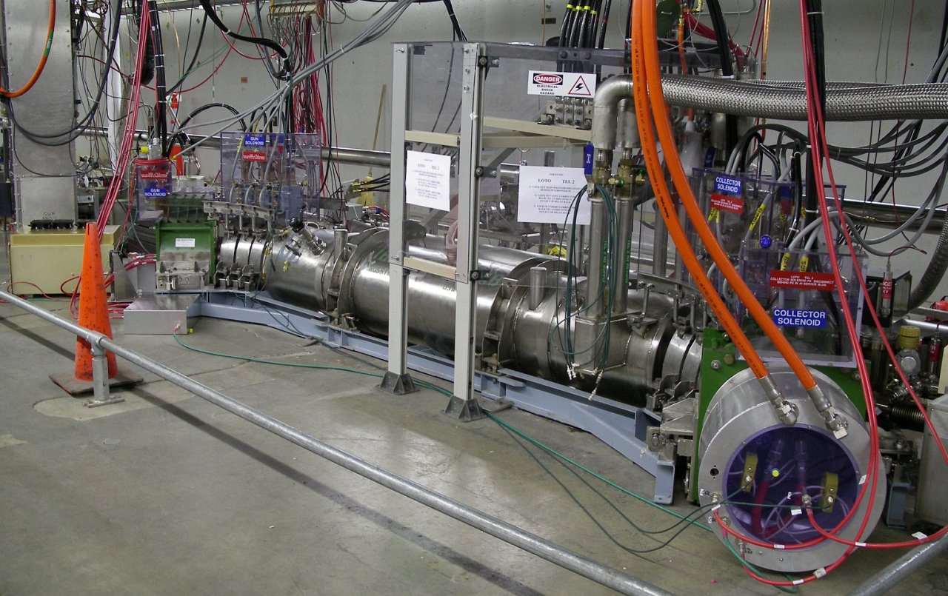
TEL2 in the Tevatron Tunnel (A11)

Slide 7
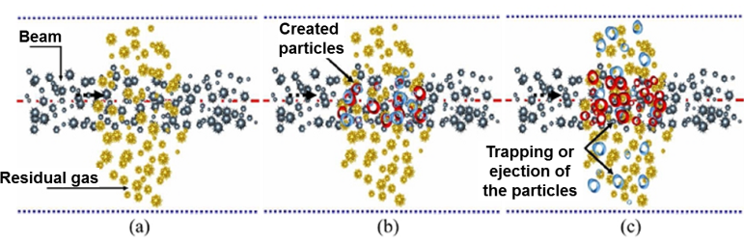
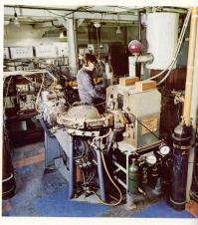
Space-Charge Compensation: Based on neutralization by oppositely charged particles created by the gas ionization
[Courtesy of N. Chauvin, ICIS'11]
PSR at INP (1967)
[Budker, Dimov, Dudnikov et al.]
[M. Reiser, Theory and design of
charged particle beams (1994)]

Slide 8
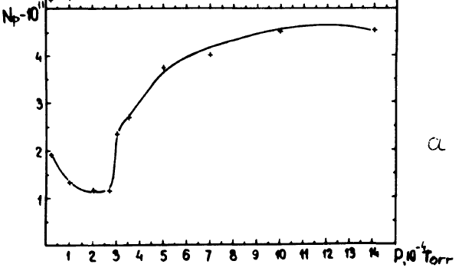
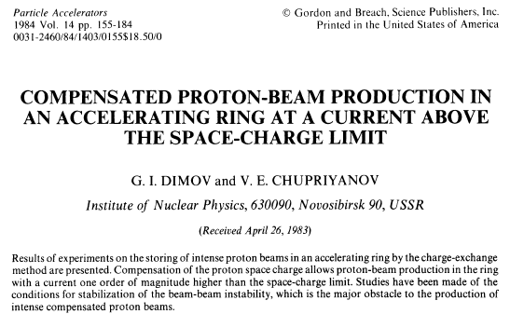
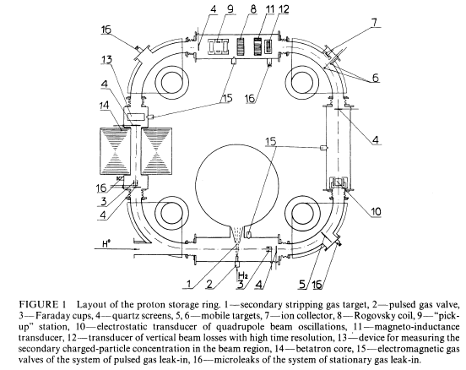
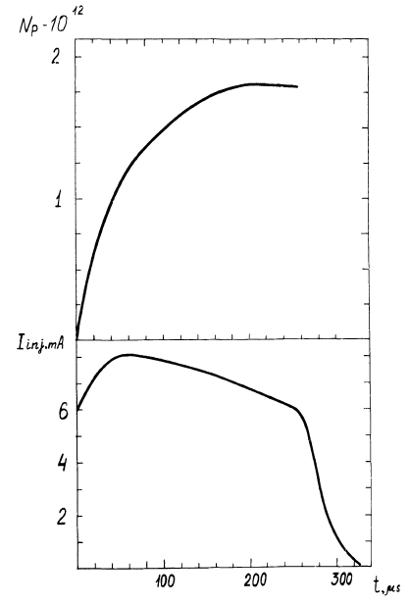
Novosibisrk PSR – x10 SC limit!
1984
1 MeV p
6.7 m
Instabilities
Gases H2, He, N2, Ar
Upto few mTorr
2e12 protons (w H2) = (6-9) x SC limit
~few 100’s turns

Slide 9
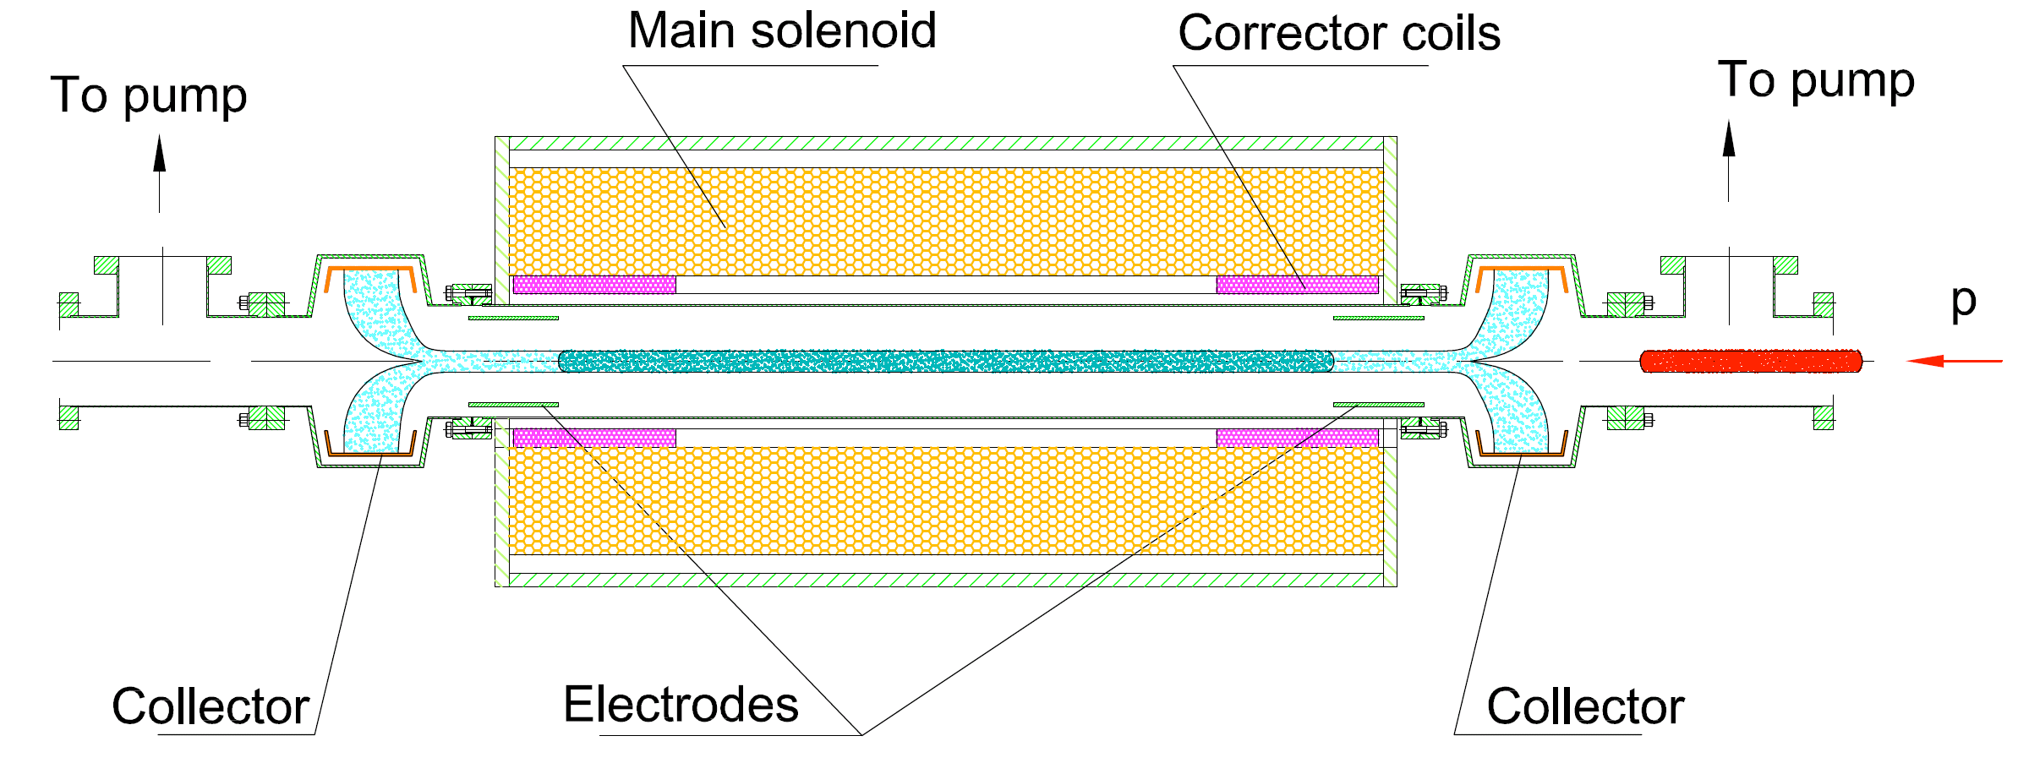
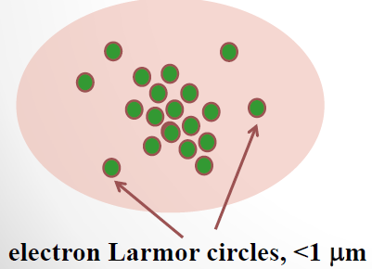
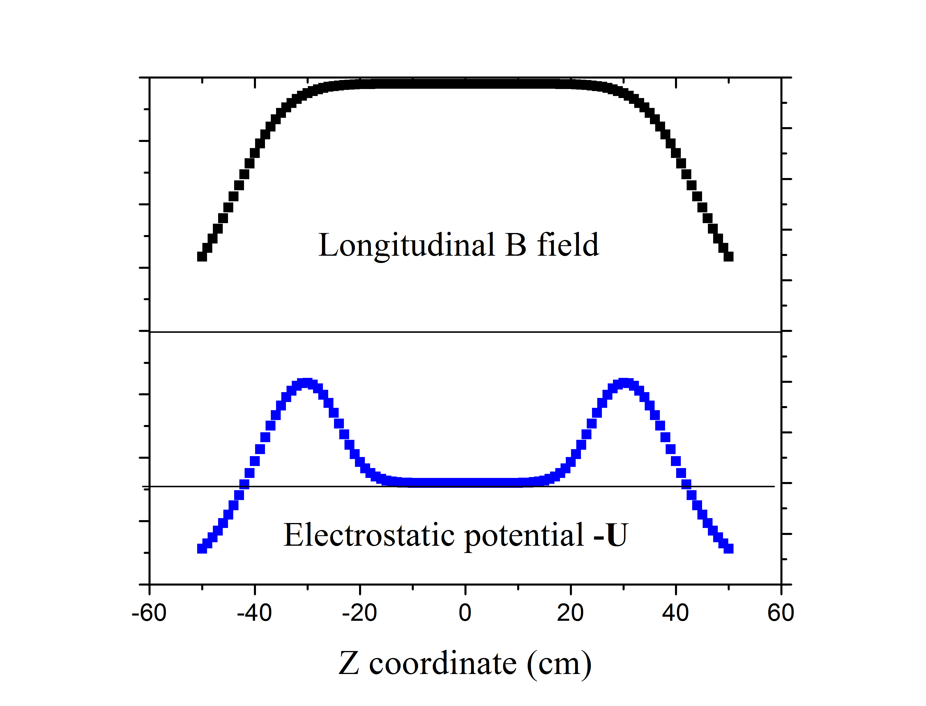
Electron Columns (2007)
“Rotating Wall”
electric-field →
helps stability
Collect ionization electrons +
let ions escape
C.Surko,
A.Kabantsev (UCSD)
J.Fajans (USB),

Slide 10
SCC with e-Lenses/e-Columns
Instead of uniformly distributing electrons around the ring with low concentration :
Electron columns/ lenses will generate HIGH concentration of electrons but over a small fraction of ring circumference:

Slide 11
Issues to Explore in (Theory then) Experiment
Stability of the system (transverse motion)
(Dynamic) matching of transverse p-charge distribution
Appropriate longitudinal compensation (for not-flat proton bunches) eg a la Litvinenko&Wang http://arxiv.org/abs/1405.2352
Electron lenses vs electron columns
Practical implementation (in existing facilities)
= the Need of Experimental Study at a dedicated AARD facility → IOTA Ring at Fermilab’s ASTA

Slide 12
ASTA Facility
IOTA Experiments
  Integrable Optics with NL magnets – with e-’s and p+’s
  Integrable Optics with E-Lens – with e-’s and p+’s
  Space-Charge Compensation with Integr.Opt.(NL&ELens)–need p’s
  Space-Charge Comp’n with E-Columns – need p’s
  OSC test - need e-’s

Slide 13
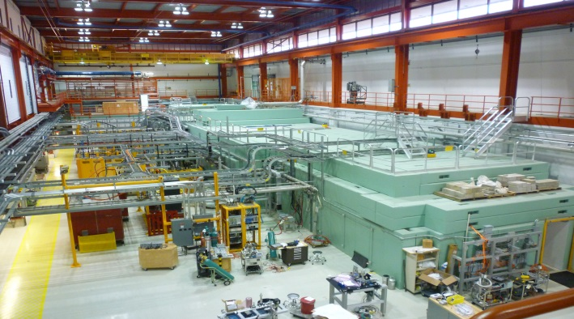
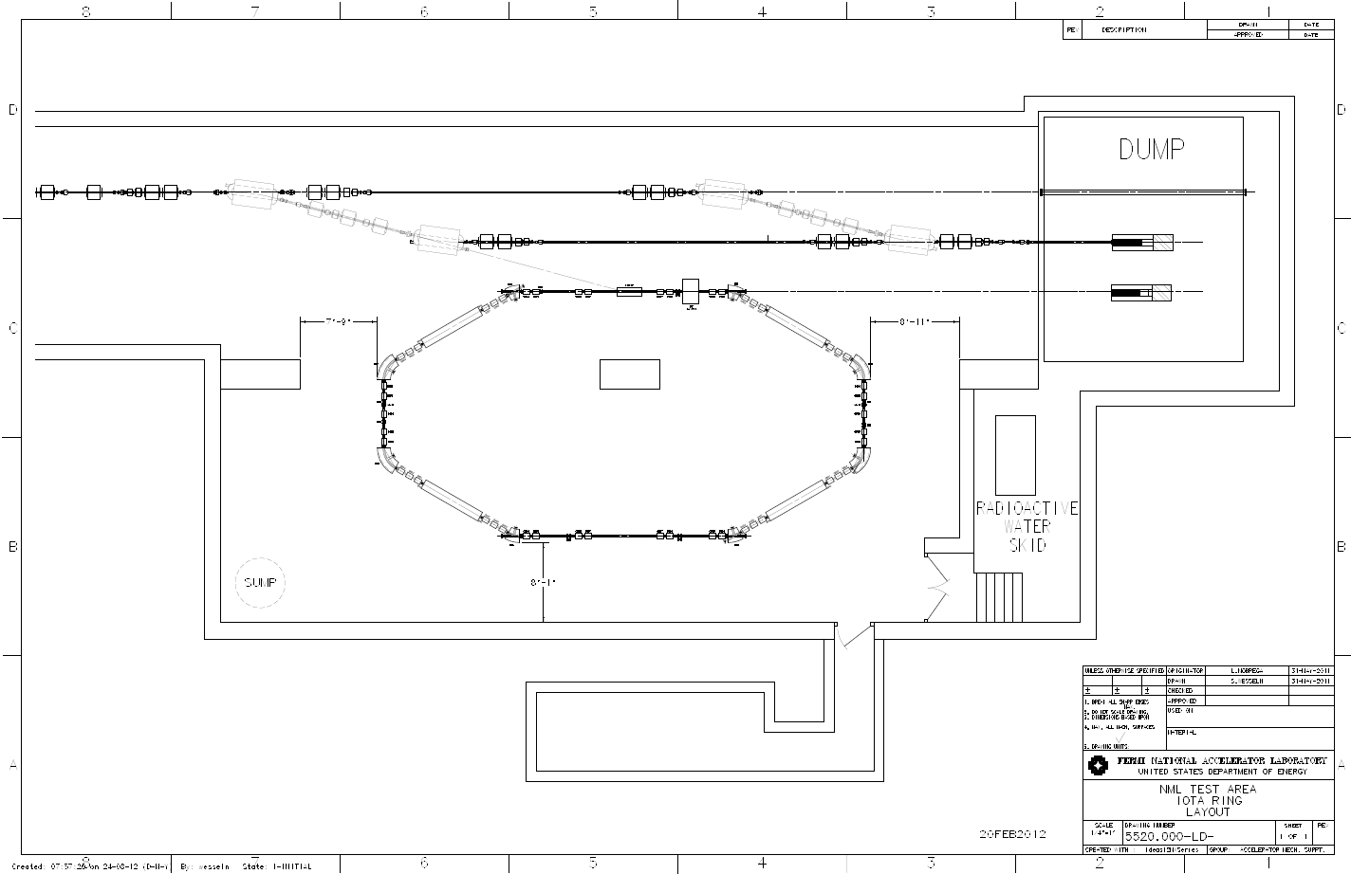
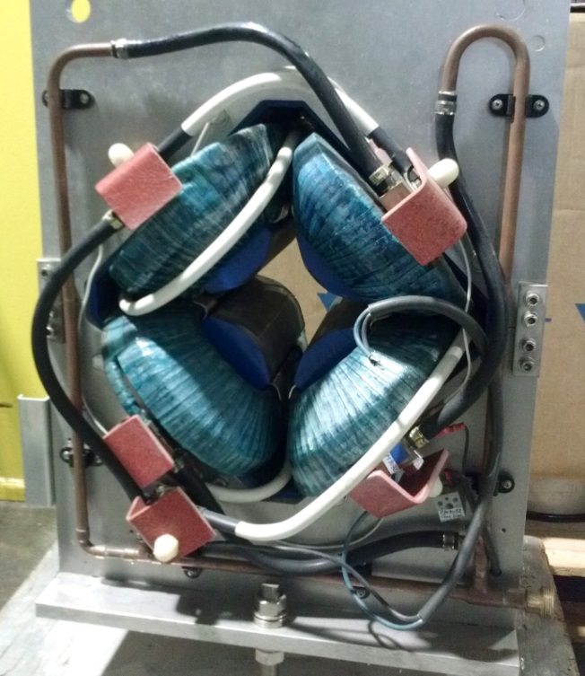
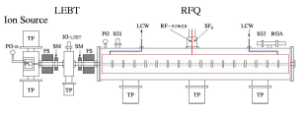
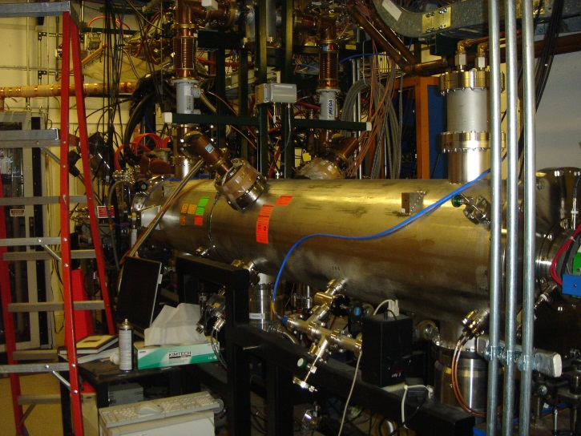
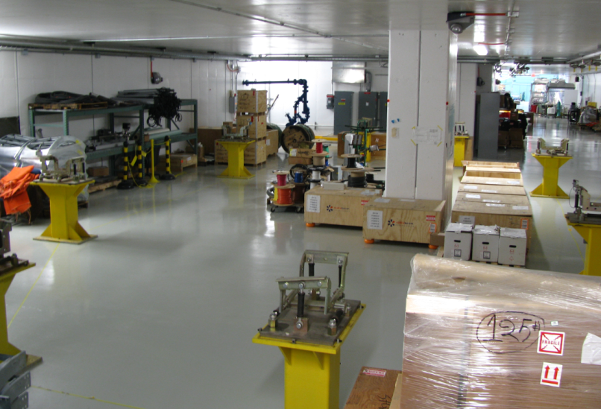
Integrable Optics Test Accelerator
with electron and proton injectors
32 quads from Dubna
Beam from e-Injector
~5 m
HINS RFQ
Reserved for OSC
optical ports
MIT Bates stands

Slide 14
Simulations of Accumulation of Electrons in IOTA
High Intensity high brightness proton beam 2.5MeV kinetic energy injected into IOTA Ring
They ionize the residual gas
1 m long Electron column is set up to accumulate electrons
Dynamics of electrons and ions in E and B fields simulated by WARP-3D, primary proton beam considered stable
We can change B, gas pressure, voltages on the electrodes and geometry of the e-colums (length, # and diameters of trapping electrodes)
Simulations on the NERSC took few weeks

Slide 15
WARP 3D Simulation Parameters
Beam parameters:
Beam species | Proton
Beam energy | 2.5 MeV
Average beam current | 8 mA
RMS beam size | 5.5 mm
Beam distribution | -Uniform in longitudinal direction -Gaussian in transverse direction -Zero thermal spread (for initial test)
Apparatus parameters:
Length | 1 m
Electrode size | 0.1 m
Wall radius | 25 mm
Solenoid field | 0 ~ 1 T
Bias voltage | 0 ~ -4 kV
Typical HINS
Gas parameters:
Main gas species | H2
Pressure | 10⁻³ Torr (for initial test)
Neutralization time | 0.86 μs
Processes considered
Emitted electron energy | ~ 0.026 eV (room temp.) (for initial test)
Numerical parameters:
Statistical weight (real ptl/macro ptl) | 149794
Time step (< 2π/ω_{ce}) | 15 ps
Boundary conditions | Absorbing boundaries for particles

Slide 16
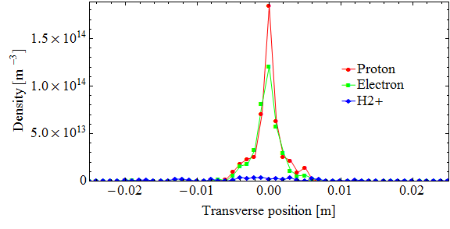
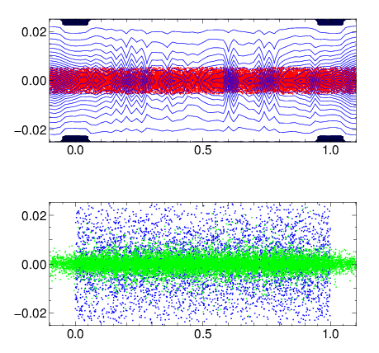
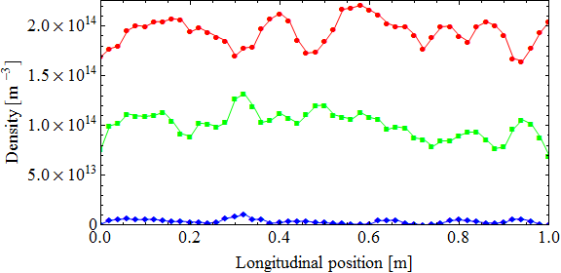
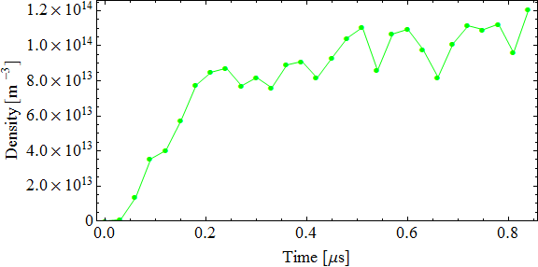
Bsol = 0.0 T, Vbias = 0.0 V (10^-3 Torr)
after 0.86 μs (neutralization time)
x (m)
x (m)
z (m)

Slide 17
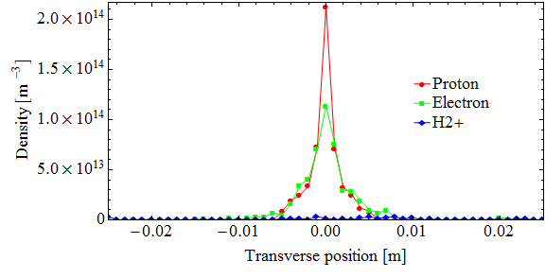
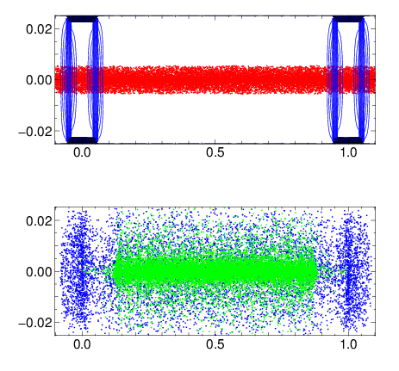
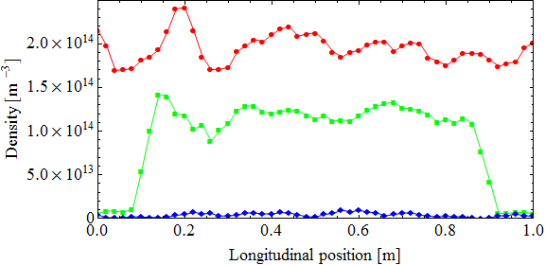
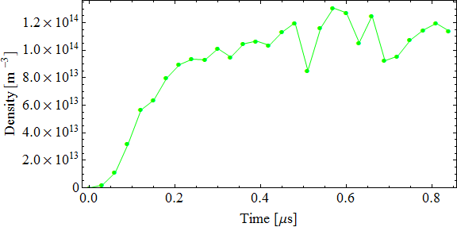
Bsol = 0.0 T, Vbias = -2 kV
after 0.86 μs (neutralization time)
x (m)
x (m)
z (m)

Slide 18
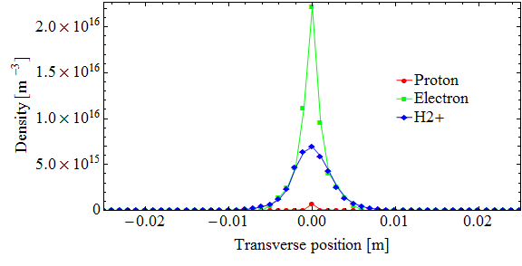
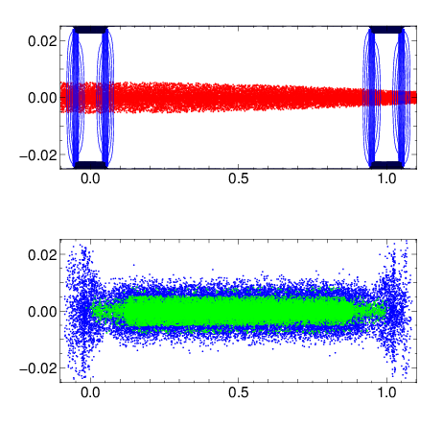
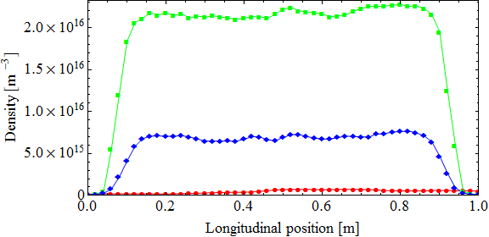
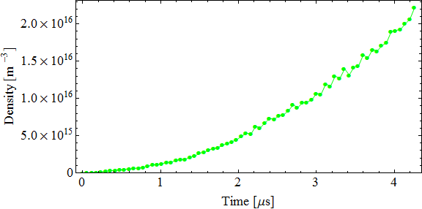
Bsol = 0.5 T, Vbias = -2 kV
after 4.26 μs (5x neutralization time)
x (m)
x (m)
z (m)

Slide 19
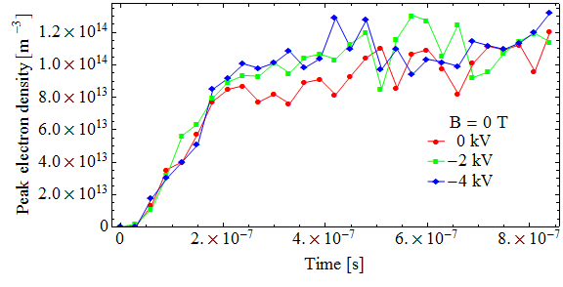
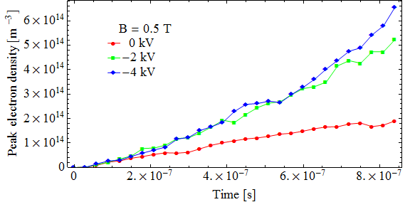
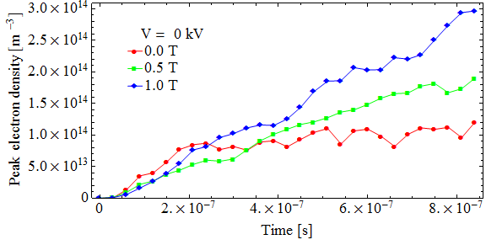
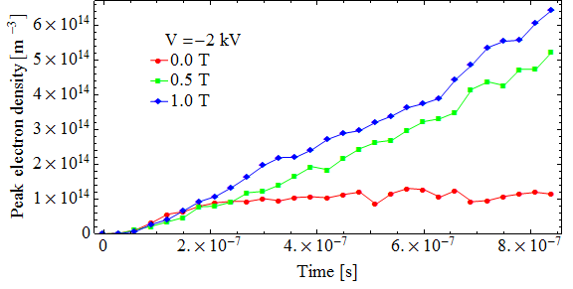
Parameters Varied: B=0,0.5T, 1T, U=0, -2kV, -4kV

Slide 20
Conclusions of simulations so far:
Without longitudinal magnetic field B=0 and no trapping voltage U=0 kV ionization electrons accumulate in the proton beam, concentration is low (~1/2 of p+), size about that of p+, H2+ ions form a broad cloud ~ few %
Without longitudinal magnetic field B=0 but with trapping voltage of U=-2, -4kV ionization electrons accumulate in between the electrodes and H2+ ions accumulate near the electrodes, but concentration of e- is still low (~1/2 of p+), size about that of p+
Longitudinal magnetic field B=0.5T or 1T drastically changes the situation: (with trapping voltage of U=-2, -4kV) transverse diffusion of the ionization electrons and their escape rate become very low, they very effectively accumulate in between the electrodes and significantly overcompensate the primary p+ space-charge by a factor of 2-3, H2+ ions are still present at th e level of few %
Need more studies (see next slide)

Slide 21
Summary:
Compensation of SC forces of high current high brightness high energy proton beams can be done by placing low energy electrons of similar transverse distribution on the proton orbit :
  Produced externally (e- lenses)
  Accumulated ionization electron ( e- columns)
Simulations of the Fermilab booster proton beam dynamics with idealized electron distributions show almost complete suppression of SC effects
SC compensation experiments with e-lenses and e-columns are planned at the IOTA ring at Fermilab’s ASTA
WARP-3D simulations of processes in the electron column show that longitudinal magnetic field of about of less than 1T leads to accumulation of significant number of e- (overcompensation) with trannsverse distribution close to than one of the primary p+ beam
Further modeling should include realistic circulation and dynamics of the primary beam of p+ (external focusing and many passes thru the e-column)

