Slide 1
Quasi-Integrable Optics Experiment at IOTA
Sergey A. Antipov, The University of Chicago
Sergei Nagaitsev, Alexander Valishev, FNAL

Slide 2
Motivation: linear dynamics
Linear focusing lattice – betatron tunes of different particles are almost equal
In ideal case, particle motion is unconditionally stable
Phase space trajectories of perfectly linear 1D motion in normalized coordinates
Notes:
Regular trajectories for small amplitudes
Resonant islands for larger amplitudes
Chaos and particle loss for even larger amplitudes

Slide 3
Motivation: linear dynamics
Linear focusing lattice – betatron tunes of different particles are almost equal
Nonlinearities (both magnet imperfections and specially introduced) make single particle motion unstable due to resonances
Hamiltonian depends on time
Stability depends on initial conditions
Phase space of 1D motion in linear lattice with 1 octupole nonlinearity
Resonance aisles
Chaotic motion
Px (a.u.)
Particles lost
X (a.u.)
Notes:
Regular trajectories for small amplitudes
Resonant islands for larger amplitudes
Chaos and particle loss for even larger amplitudes

Slide 4
Motivation: nonlinear dynamics
Tunes depend on amplitude
Landau Damping increases with the spread of betatron oscillation frequencies. Larger tune spread → beam more stable against collective instabilities.
Can created by adding octupole magnets
If the system is integrable – no resonances
IOTA Goal: create practical nonlinear accelerator focusing systems with a large frequency spread and stable particle motion.
Notes:
McMillan (1967) – first successful 1-D example
Perevedentsev, Danilov (1990 - 1995) – several 1D, 2D examples
Cary etc (1994) – approximate integrability
Danilov, Nagaitsev (2010) – practical 2D integrability

Slide 5
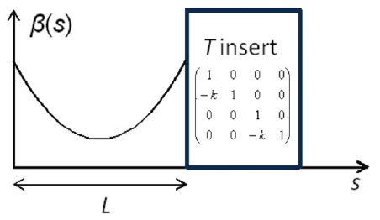
Nonlinear lattice with two invariants
Danilov, Nagaitsev, Phys. Rev. ST Accel. Beams 13, 2010
Element of periodicity:
Two invariants of motion:
1) Hamiltonian
2) I₂(x,p_{x},y,p_{y})
Nonlinear potential, in elliptic coordinates

Slide 6
Integrable Optics Test Accelerator
40 m circumference
4 30° and 60° dipoles
39 quadrupoles
2 drifts for nonlinear magnets

Slide 7
IOTA parameters
Electron Energy | 150 MeV
Number of particles | 10⁹
Ring Circumference | 40 m
Length of NL magnets | 1.8 m
Phase advance per NL section | 0.3
Synchrotron damping time | ~ 1 sec
Equilibrium beam size | ~ 0.1 mm
RF harmonic number | 4
Bunch length | 5 cm

Slide 8
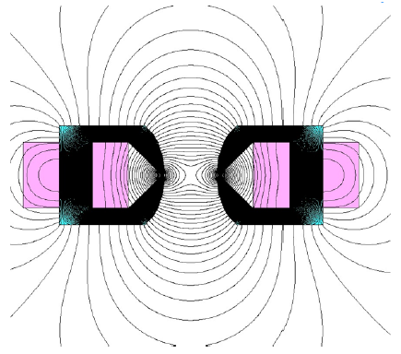
Need a special magnet
Can we do anything with just conventional magnets?
Quadrupoles
Octupoles
Cross-section and field lines

Slide 9
Quasi-integrable Optics
Beta-function in NL magnet section
Octupole magnet strength ~ 1/β(s)³
Hamiltonian does not depend on s:
Questions:
What about the 3rd degree of freedom?
Imperfections
6D Simulations required
18 10cm-long octupole magnets
t = 0.4, c² = 0.01 cm, l = 10 cm

Slide 10
6D simulations
Lifetrac code by D. Shatilov
Tracking
Frequency map analysis
Model includes:
Dipoles, dipole fringe fields
Quadrupoles
RF
Octupoles
No sextupoles
Betatron and synchrotron motion
Chromaticity

Slide 11
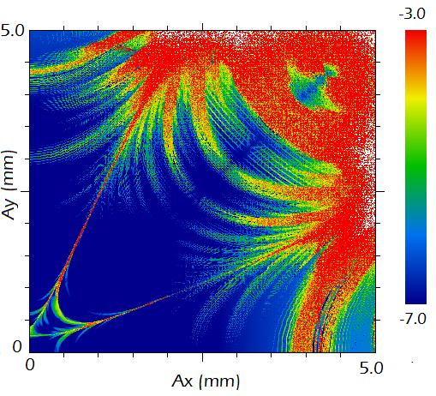
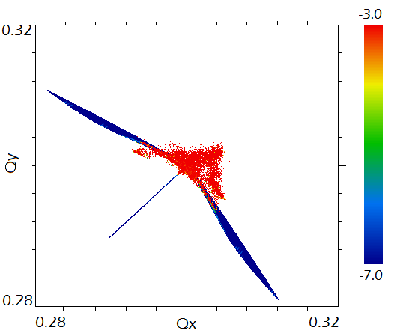
Frequency map analysis: 1 section, octupole magnet
Stable region: 2.5 x 2.5 mm
Tune spread: 0.03

Slide 12
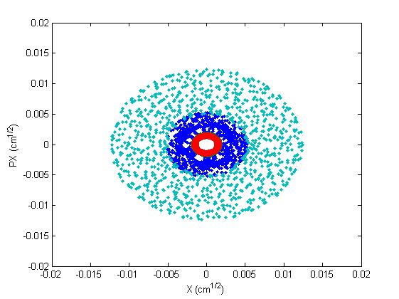
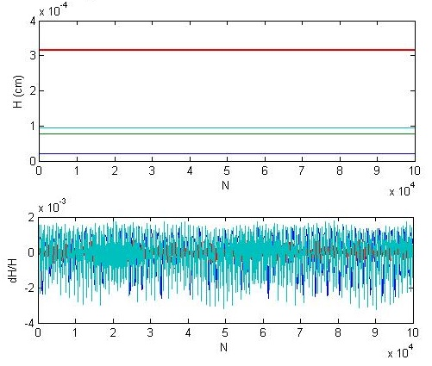
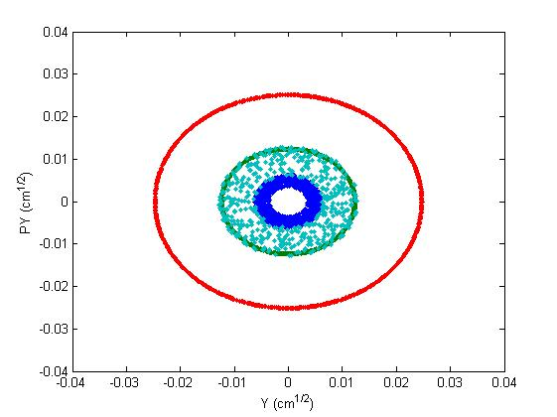
Tracking
Simulated time – 1sec: no particles lost within stable region
Motion is bounded
Hamiltonian is conserved

Slide 13
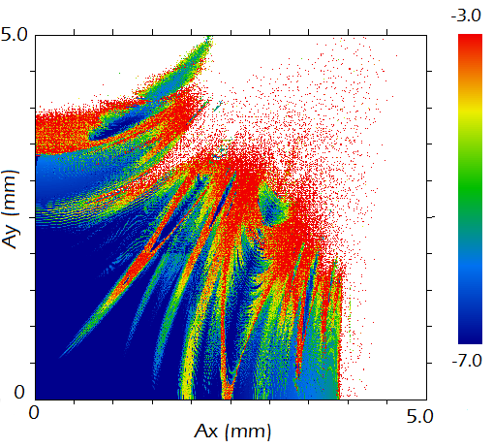
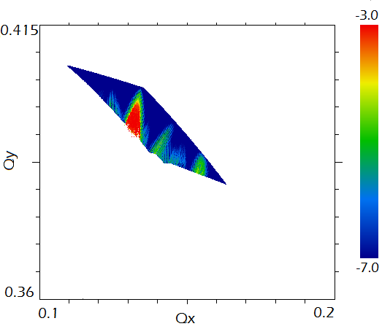
FMA: 1 section, quadrupole + octupole
Stable region: 2.5 x 1.8 mm
Tune spread: 0.05

Slide 14
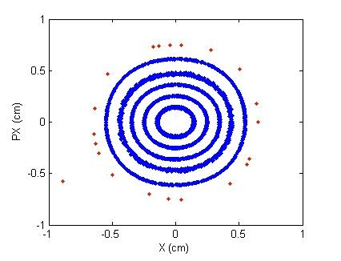
Experimental procedure
Two kickers, horizontal and vertical, place particles at arbitrary points in phase space
Measure beam position on every turn to create Poincare map
As electrons lose energy due to synchrotron radiation, they will cover all available phase space
Can control the strength on the nonlinearity
Final goal – dependence of betatron frequency on amplitude

Slide 15
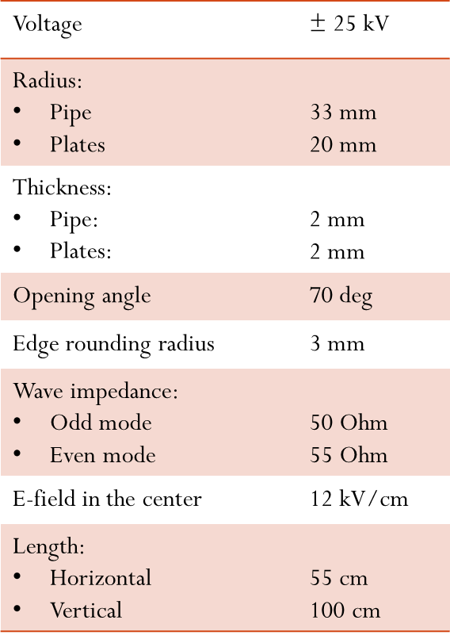
Two kickers create an arbitrary transverse kick
Horizontal + vertical stripline kickers
Rectangular pulses up to 25 kV ~ 100 ns duration.
Repetition rate < 1 Hz
Adjustable voltage 0 – V_{max}
Courtesy A. Didenko

Slide 16
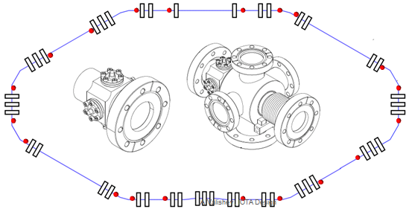
Beam position can be measured precisely
20 horizontal and vertical BPMs
Button type
1 μm closed orbit resolution
100 μm turn-by turn resolution
8 SR ports to measure beam size
A. Valishev, IOTA Design

Slide 17
Octupole imperfections: stable region reduces insignificantly
No imperfections
Octupole error, σ = 0.1

Slide 18
Lattice imperfections: stable region reduces insignificantly
No imperfections
Δβ = 1%, ΔΦ = 3·10⁻³

Slide 19
Sources of error
Lattice imperfections
Beta functions: 0.01 (relative)
Phase advance: 0.001
Octupole magnet errors
Less than 0.1
Bunch transverse size
~ 0.1 mm, RMS
Other:
BPM resolution
FFT
Energy loss
Overall:

Slide 20
Summary
It is possible to achieve tune spreads ~ 10⁻² with just conventional magnet components and still retain large dynamic aperture
Search for optimal combination in terms of tune spread/size of dynamic aperture/complexity of the potential
Compare with full nonlinear potential
Next steps

Slide 21
Thank You for Your Attention

Slide 22
Backup slides

Slide 23
Thick octupoles
While dynamic aperture is limited, the attainable tune spread remains large
Courtesy A. Valishev

Slide 24
Optic functions in the nonlinear section
Equal beta functions in x and y
Zero dispersion

