Slide 1
Generating X-Rays through Channeling Radiation
By Anthony Mercado
University of Illinois at Urbana-Champaign
Supervisor: Tanaji Sen

Slide 2
Background Information
ASTA
Beamline Components
Photoinjector
Crystal ~40μm diamond
Goniometer
X-ray Detector
Figure 1. Design and placement of the devices
in the beamline

Slide 3
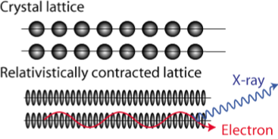
The Goal
Produce X-Rays from ~40MeV electron beam
Channeling Radiation
Sheet of positive charge in a crystal
Relativistic electron
Radiation from transitions between quantum states

Slide 4
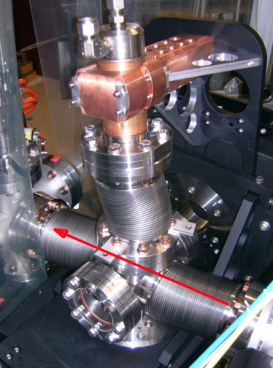
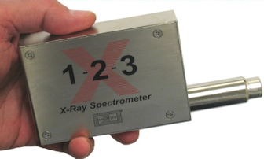
Location of Devices
Figure 2. Goniometer Photo
Figure 3. X-ray Detector

Slide 5
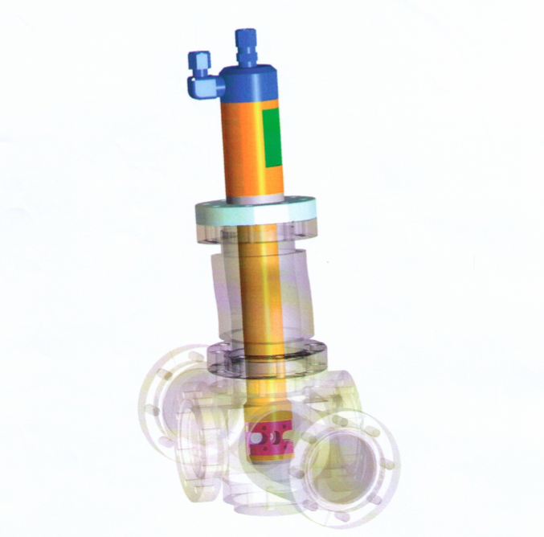
Goniometer
My previous assignment was to design a program to rotate/ translate the machine
We attempted to connect to it via the control system
Figure 4. Sketch of Goniometer

Slide 6
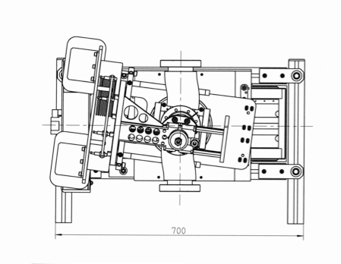
Goniometer design
Figure 5. Sketch of the Top View of the
Goniometer assembly
Figure63. Sketch of goniometer assembly

Slide 7
X-ray Detector
We attempted to connect via the control system and communicate with it
Device that will read the signal
Most of my scripts will contribute to this device and its data

Slide 8
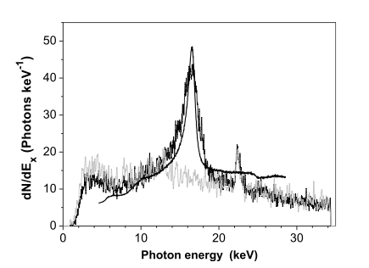
X-ray Spectrum
Measured X-ray signal
Figure 5. Measured signal. Conducted experiment in 2007
( W. Wagner, An intense channeling radiation source)

Slide 9
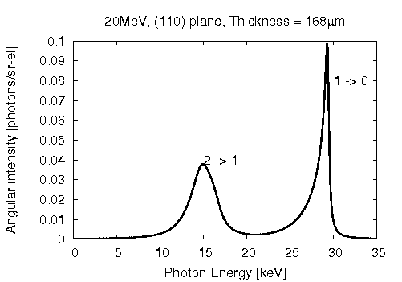
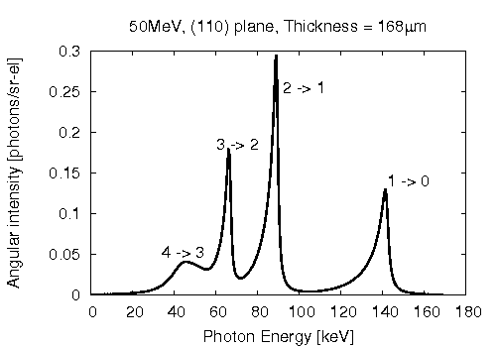
X-ray Spectrum
Simulated X-ray signal
20 MeV, 168 μm
50 MeV, 168 μm

Slide 10
Analysis of X-ray Signal and Beam Current
Corrected Signal
Subtracted Background
Bunch Charge (Q)
Integrated Beam Current
Normalized Photon Intensity =
Signal ⁄ Q

Slide 11
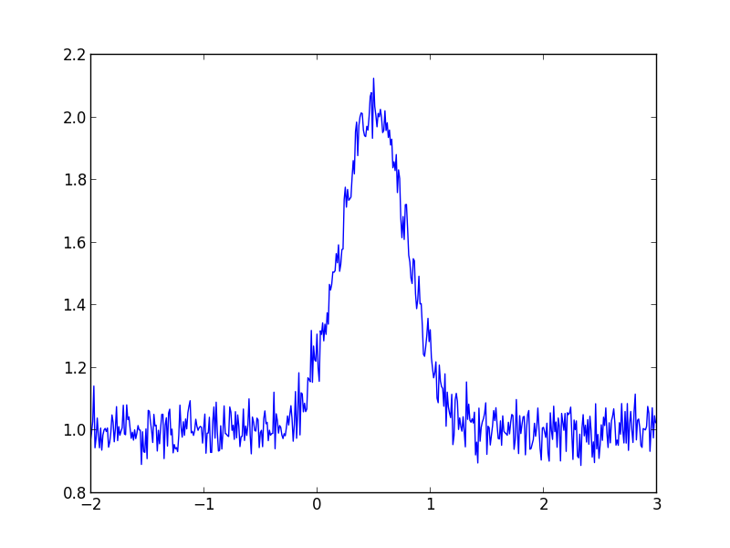
Signal
Simulated X-ray signal done by declaring set values and made by a gaussian function
Axis values are not true values*
For all plots
Amplitude
Photon Energy (keV)

Slide 12
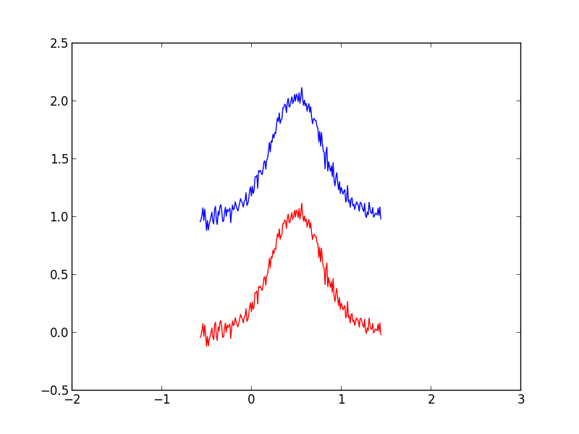
Signal minus Background
Simulated signal minus the average of the background
Background noise is not significant when finding the signal
Blue – the original plot
Red – the corrected signal
Amplitude
Photon Energy (keV)

Slide 13
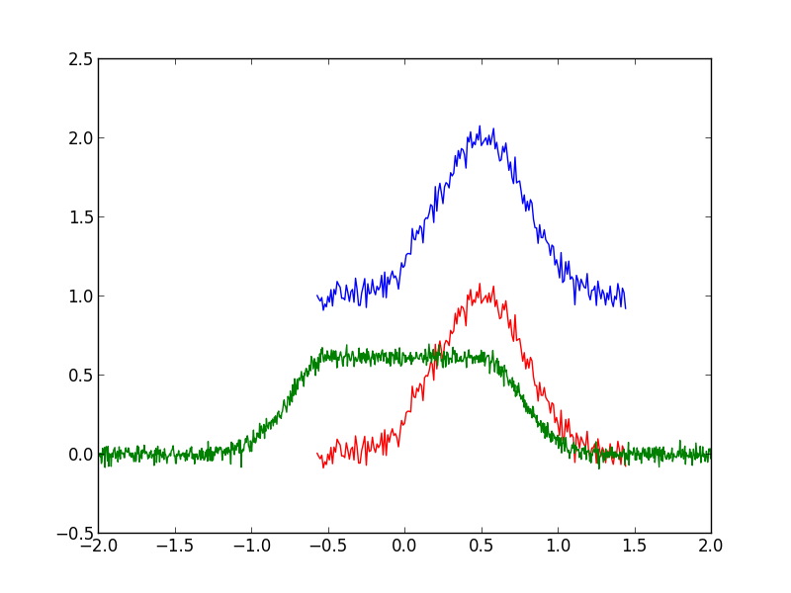
X-Ray Signal and Beam Current
Simulated plot with both the X-ray signal and Beam Current (green)
Axis are set for Beam Current only
Must take the integral of the current for the total bunch charge (Q)
Current (Amps)
Time (s)

Slide 14
Full width at Half-Maximum
Using the signal, the full width at half-maximum value is a standard value to find
Need to find the value for distance comparison
Amplitude
Photon Energy (keV)

Slide 15
Peak Significance
The peaks are what define the x-ray
Any of the background noise is unnecessary because it is not coming from CR
The more narrow the curve, the better quality of the signal

Slide 16
Finding Multiple Peaks
Find the absolute peak
Scan through the plot for next peak
Record what the peak value is and where it is located
Amplitude
Photon Energy (keV)

Slide 17
Conclusion
What my work will contribute t0
No real data yet
The significance of this experiment
Develop a compact X-ray source
Further work that it can benefit
Hospitals
Homeland security
Materials

Slide 18
Acknowledgments
Tanaji Sen
Philippe Piot & Daniel Mihalcea
Ms. Dianne Engram & Ms. Linda Diepholz
Mr. Elliot Mccrory
Ms. Sandra Charles
Todd Seiss
Fermilab Staff
THANK YOU!

Slide 19
Questions?

