Slide 1
Improvement of dose calculation program for patient treatment planning in the Neutron Therapy Facility
FELIPE GIRALDO

Slide 2
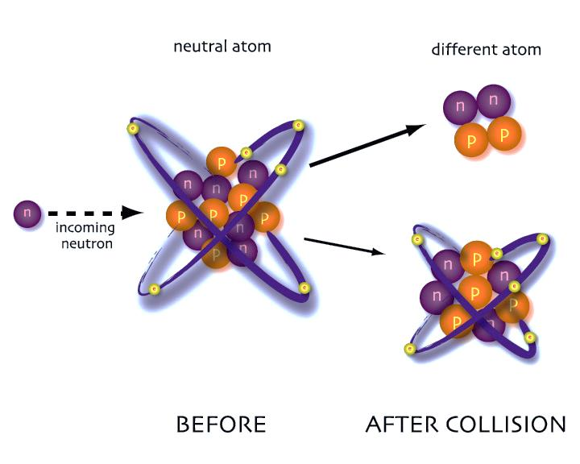
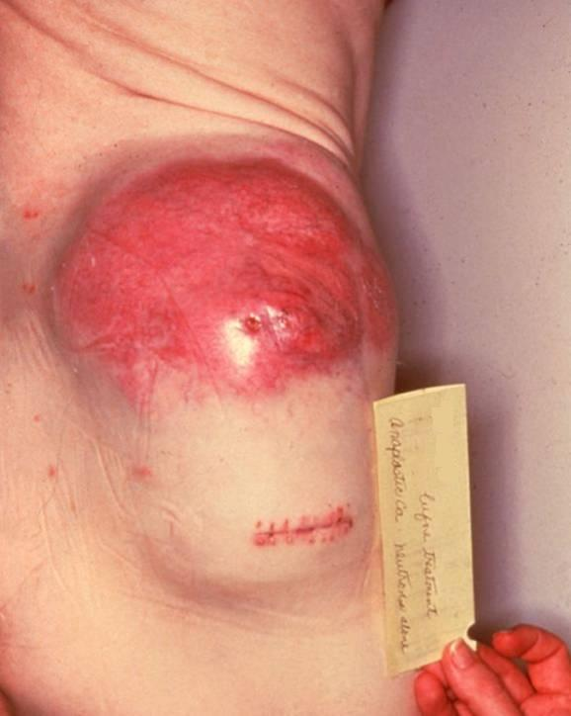
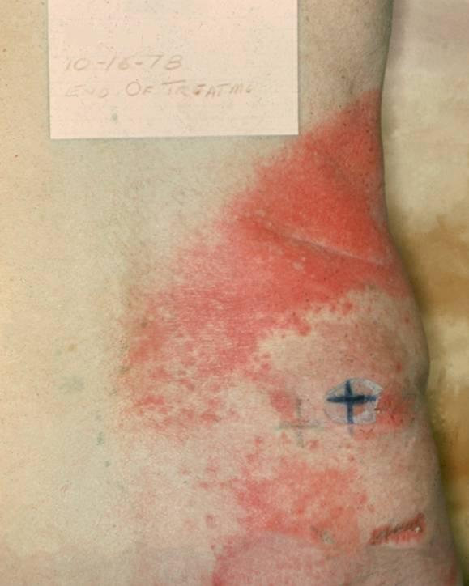
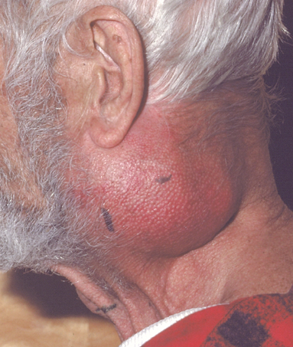
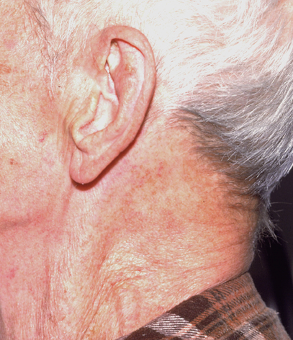
Neutron Therapy
Soft Tissue Sarcoma
Squamous Cell Carcinoma

Slide 3
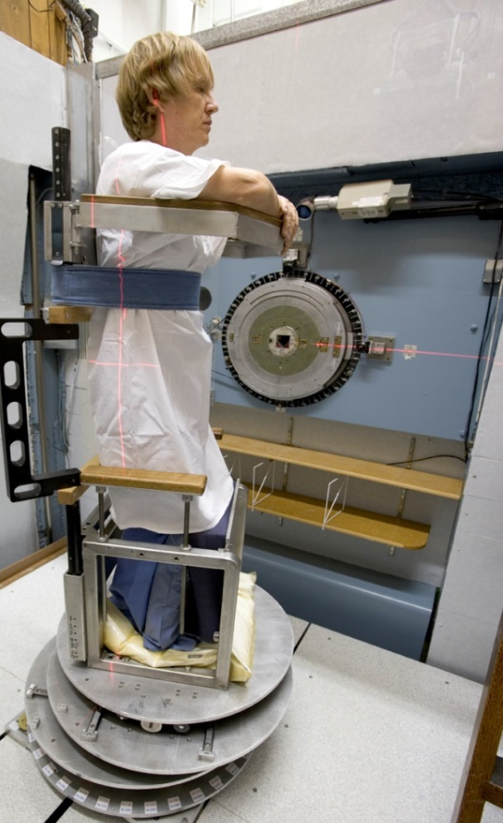
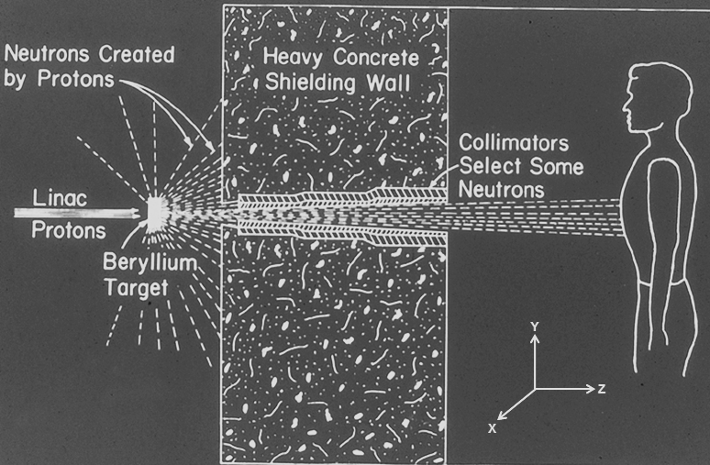
Fermilab’s NTF

Slide 4
Square Data (SD)

Slide 5
Original Algorithm (OA)

Slide 6
Revised Algorithm (RA)

Slide 7
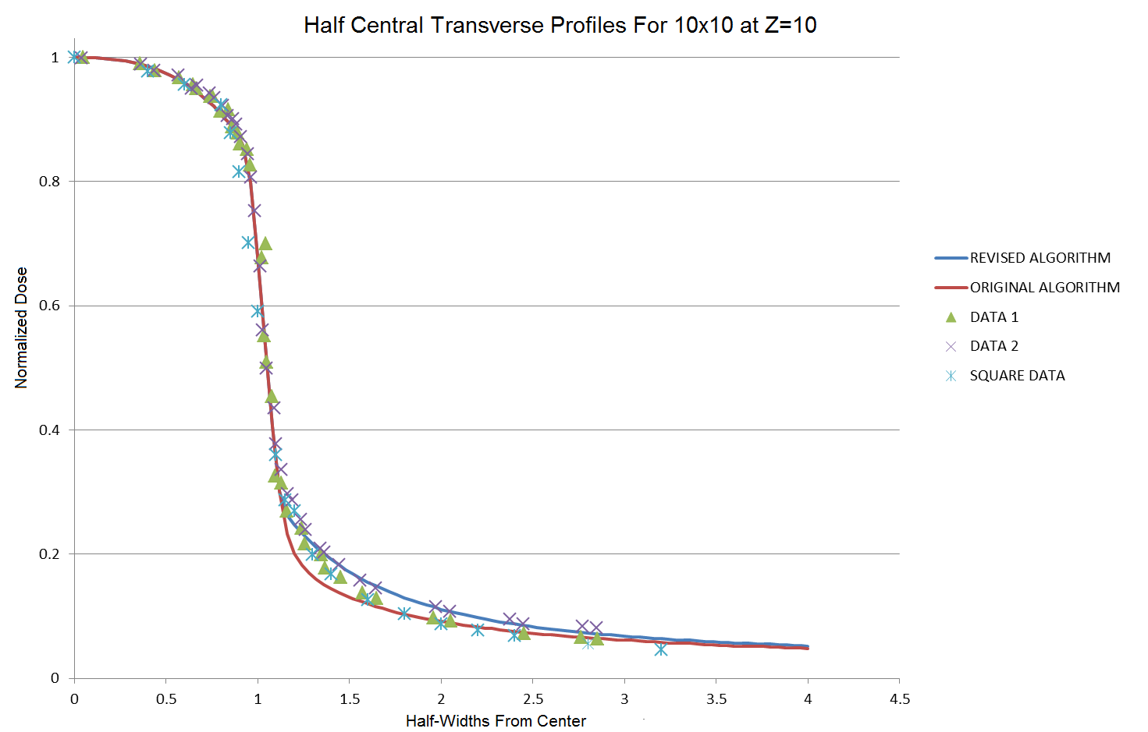
Central Transverse Profiles

Slide 8
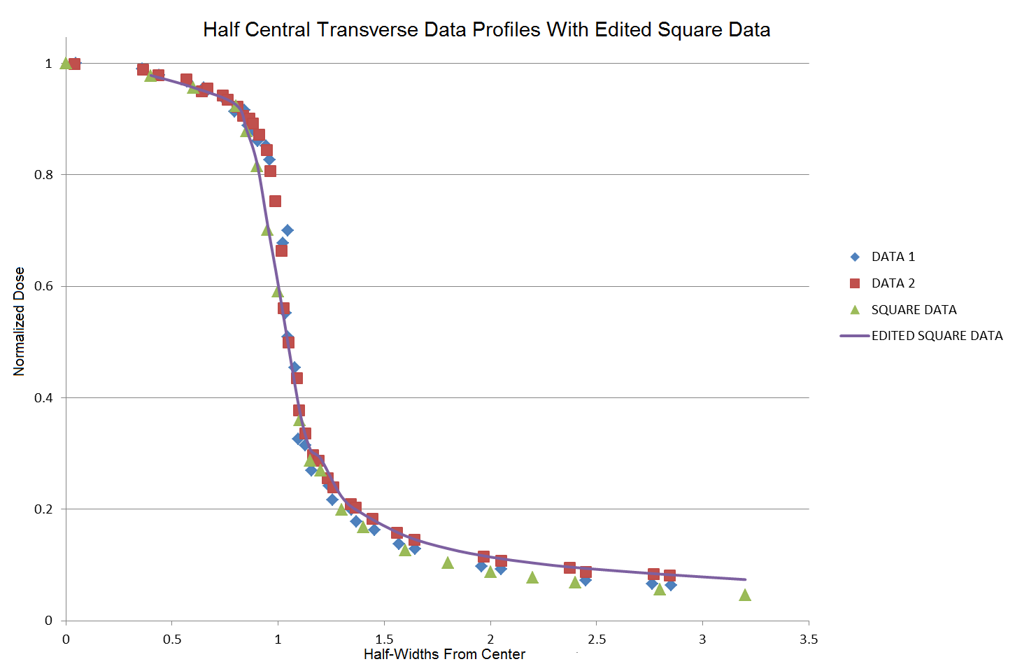
Central Transverse Profiles

Slide 9
Qualitative

Slide 10
Quantitative
TABLE 1
TABLE 2
COVARIANCES

Slide 11
Bibliography
Pictures in “Neutron Therapy” and “Fermilab’s NTF” slides courtesy of the Neutron Therapy Facility at Fermi National Laboratory
Acknowledgments
Special thanks to:
Dr. Thomas Kroc
SIST committee and collaborators
SIST interns

