Slide 1
RESONANCE FREQUENCY SHIFT EFFECTS DUE TO CAVITY LENGTH AND WINDOW VARIATION
By Gabriela Arriaga

Slide 2
Who I am.
Name: Gabriela Arriaga.
Institution: Northern Illinois University.
Major: Physics, junior year.
Fun Fact: I like to crochet toys for children (when there is time)!

Slide 3
Who I am (continued)
Have participated in two previous research programs.
  Research Rookies.
    2 rounds.
  Summer Research Opportunities Program (SROP).
  In total, 5 semesters of research experiences (6 including this experience!).

Slide 4
Who I am (continued).
Homeschooled for most of my education before college.
Am #4 of 8 children
(yes, it is chaotic)!
Am the first child in my family to attend college, and for Physics (Oh, my!)

Slide 5
Agenda
Project Description
  Goal
  Why we care
  Methods
Results and discussion
Thanks
Questions

Slide 6
Project Goals
Design Radio Frequency (RF) cavities for muon cooling channel (for future muon colliders).
Reduce beam size.
Find a mathematical formula to model and predict cavity shift phenomenon.

Slide 7
Why do we care

Slide 8
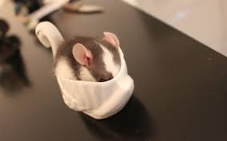

Muon Colliders are smaller than others
It is great to be small.
Can fit anywhere!

Slide 9
Change in energy is small
That is the hope.

Slide 10
What does a muon cooling channel look like?

Slide 11
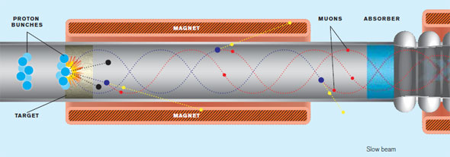
Beginning of the channel

Slide 12
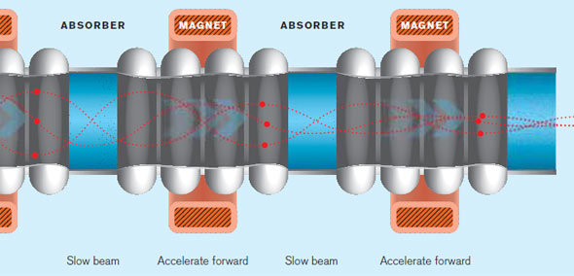
The channel!
(what we are working on)

Slide 13
Methods
Primarily
Simulations (lots of Simulations!) using Superfish.
Mathematica.

Slide 14
What is Superfish?
Superfish is a computer software program created by Los Alamos Laboratory that solves Maxwell's equations for RF, electrostatic, or magnetic cavity problems.
Useful due to “ease” of use and speed.

Slide 15
What is Mathematica?
Software program from Wolfram to manage data and mathematical problems.
Plot neat graphs from data, which can be 2D or 3D.
Model trends.
Ect.

Slide 16
Conditions
Bowed cavity windows
  The window radius (a) ranged from 2cm – 16 cm [increments of 4 cm]
  The bow height of the windows (h) ranged from 0.0 cm – 1.0 cm [increments of 0.2 cm]
Cavity length
  Ranged from 5, 10, and 20 cm.
Cavity radius
  17.65 cm

Slide 17
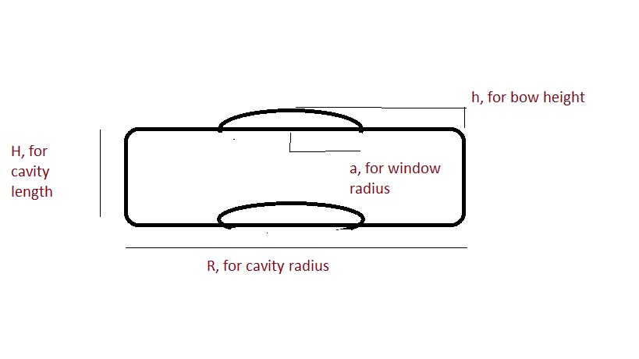
Simple sketch of the idea

Slide 18


My Efforts
Running simulations for the bowed window
Plot the data and trends in Mathematica.
Calculate other properties for the cavities.
Sounds easier than it is!

Slide 19
Bowed cavity windows Results

Slide 20
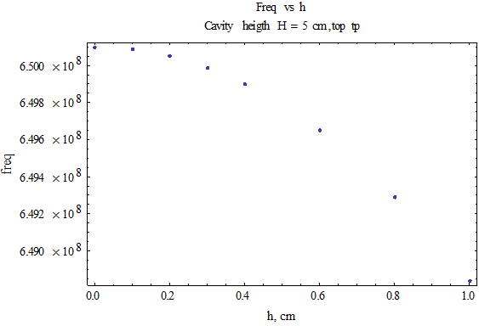
First observation( frequency vs. h)
Frequency decreases as h increases.
Looks parabolic.
Same trend for larger cavity lengths.

Slide 21
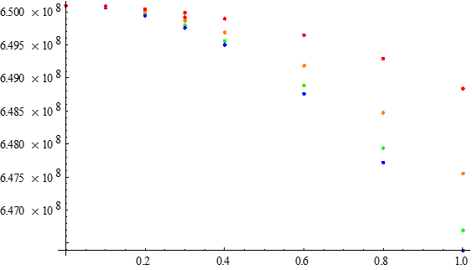
Second observation (frequency vs a)
Parabolic looking as well.
Critical point or minimum at a= 8 cm.
Figure 4: Listplot of frequency change vs bow height. The red dots or for a window radius of 2 cm, green is for 4 cm, blue is for 8 cm, and 0rqnge is for 12 cm

Slide 22

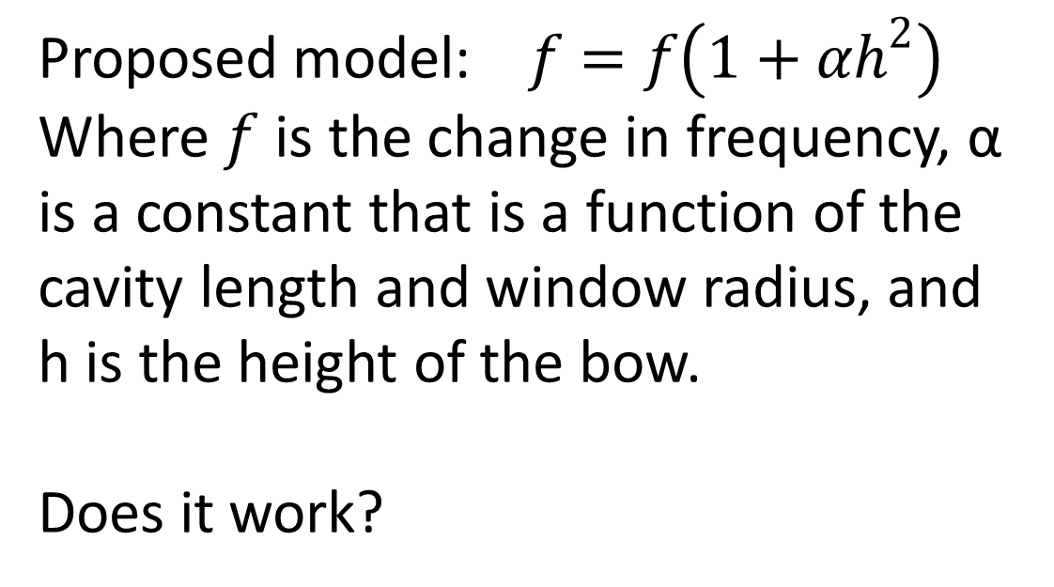
Possible model
Proposed model: $f=f\left(1+αh^{2}\right)$
Where $f$ is the change in frequency, α is a constant that is a function of the cavity length and window radius, and h is the height of the bow.
Does it work?

Slide 23


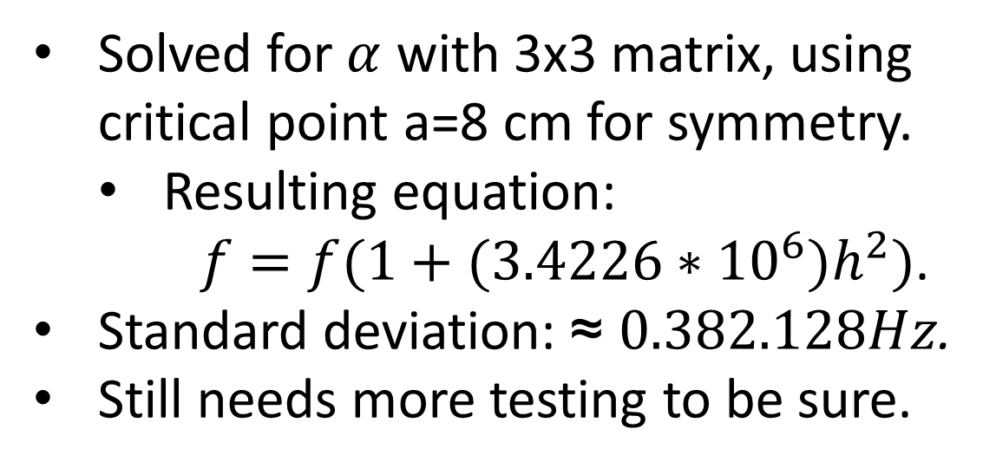
Working out and testing proposed equation
Solved for $α$ with 3x3 matrix, using critical point a=8 cm for symmetry.
  Resulting equation:
  $f=f(1+(3.4226∗10^{6})h^{2})$.
Standard deviation: ≈ $0.382.128Hz$.
Still needs more testing to be sure.

Slide 24
Now for the electric field!

Slide 25
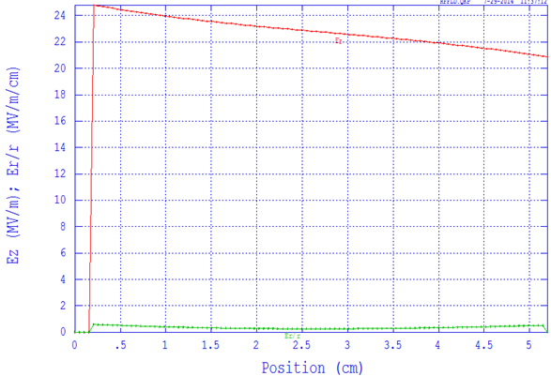
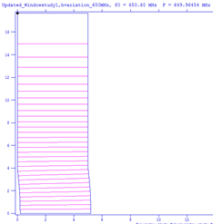
Parmela Tableplot

Slide 26
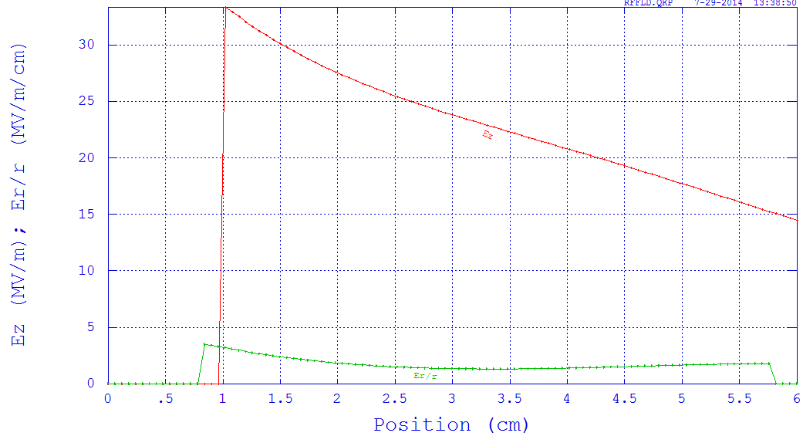
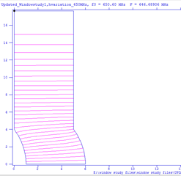
Parmela Tableplot 2
Table plot output from Parmela of a cavity of length 5 cm, window radius 4 cm, and bow heigth of 1 cm.

Slide 27
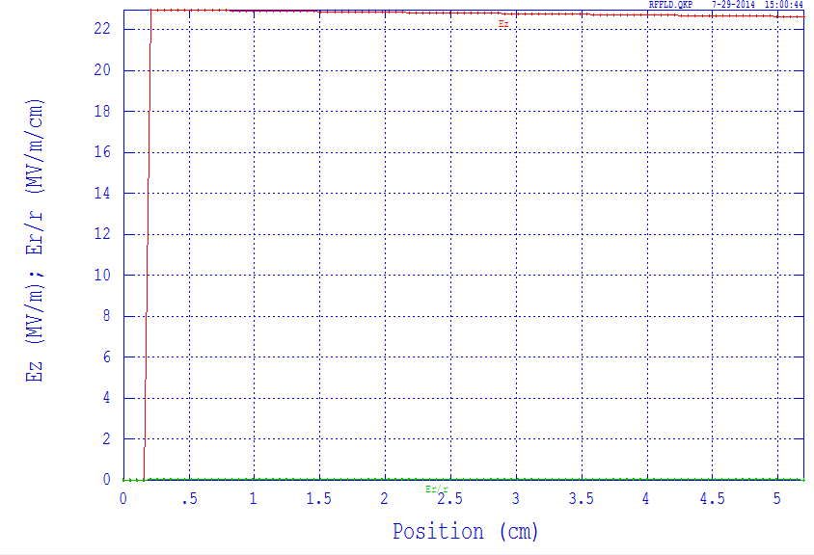
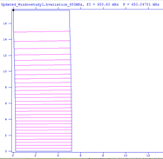
Tableplot 3
Table plot output from Parmela of a cavity of length 5 cm, window radius 16 cm, and bow heigth of 0.2 cm.

Slide 28
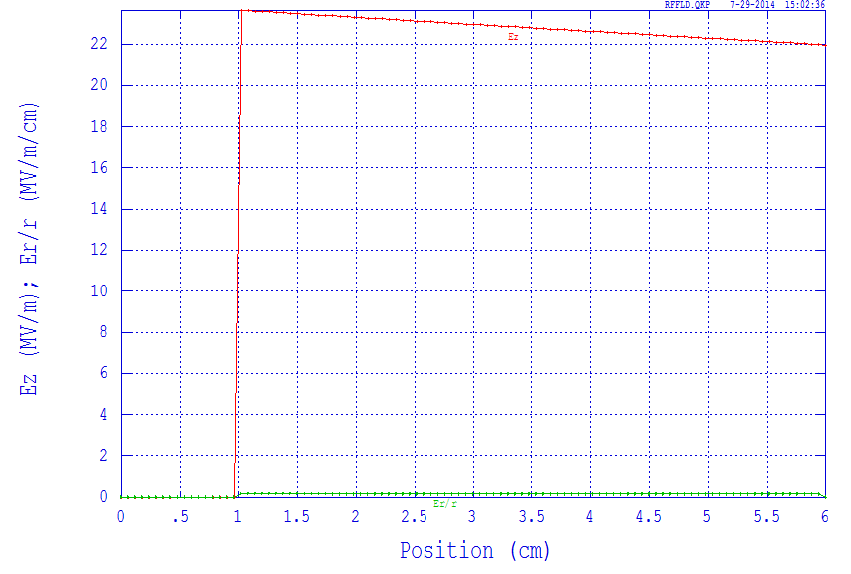
Tableplot 4
Table plot output from Parmela of a cavity of length 5 cm, window radius 16 cm, and bow heigth of 1 cm.

Slide 29


Slide 30
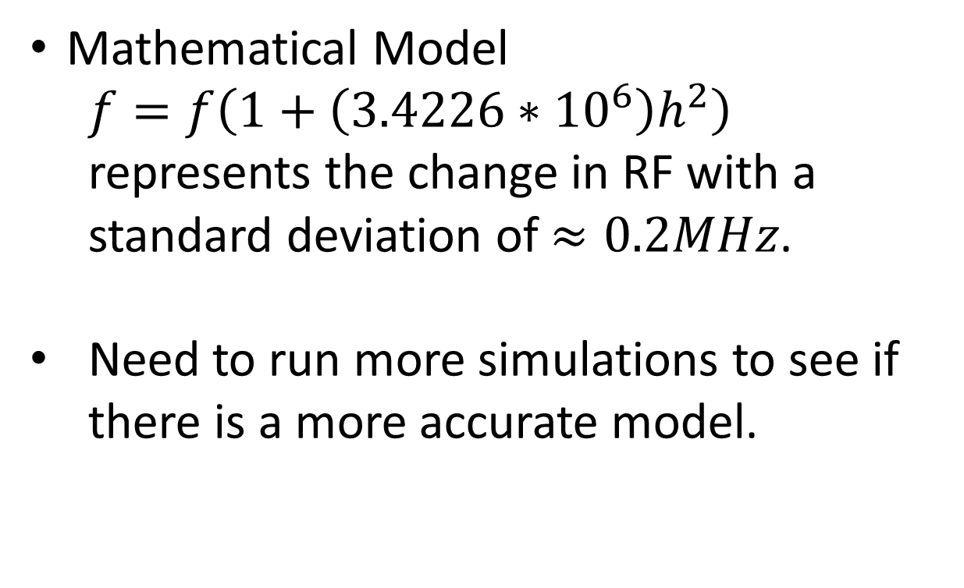
Summary
Mathematical Model
  $f=f\left(1+\left(3.4226∗10^{6}\right)h^{2}\right)$ represents the change in RF with a standard deviation of $≈0.2MHz$.
Need to run more simulations to see if there is a more accurate model.

Slide 31
Summary
Electric field decreases between the two windows, indicating acceleration.
Larger bow heights have a greater effect on electric field change.
Larger window radii reduce this effect.
More analysis needed to develop a model.

Slide 32
Extra Thought and possible next step
Look into multi cell condition.
  What will happen if the windows bow at different heights?
  If bowing is different as beam passes through the structure, how will electric field and beam be effected?

Slide 33
Thanks
Supervisor Katsuya Yonehara, and the rest of the group
Mentors at Northern Illinois University
DOE
SIST committee

