Slide 1
Web Tools for CMS Simulated Radiation Data
Kevin Powell
Florida A & M University
Supervisors: Dr. Pushpa Bhat and Dr. Leonard Spiegel

Slide 2
Outline
The LHC & CMS
Simulations Software & Data Sequence
Web Calculator Tool
Improvements
Summary

Slide 3
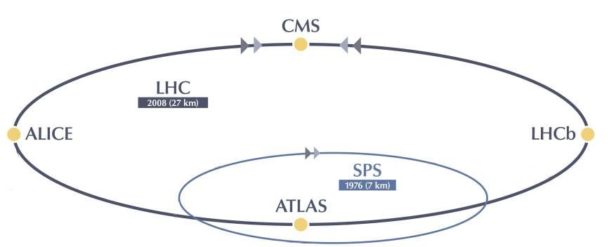
The LHC & CMS
Largest and most powerful collider
Accelerates & collides two proton beams
Designed to run 7 TeV beams. Previous runs were at 3.5 TeV and 4 TeV
Design Luminosity 10³⁴ cm⁻² s⁻¹
Higgs Boson discovery, July 2012
CERN Accelerator Complex, copyright CERN

Slide 4
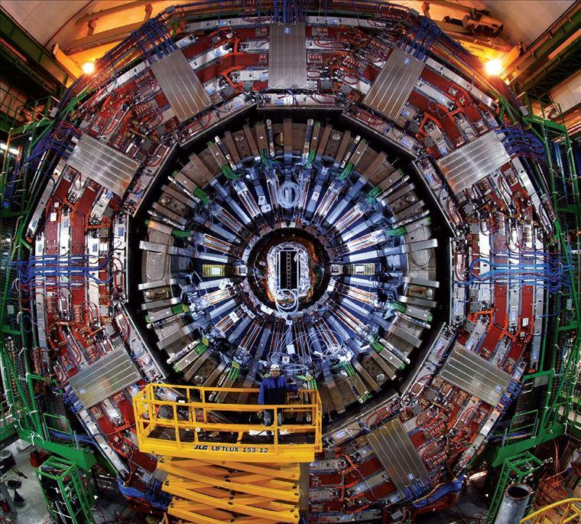
The LHC & CMS
CMS is one of your detectors on the LHC
General purpose detector designed to identify a variety of particles
Very intense radiation environment
To optimally protect the detector & electronics we study simulated events
CMS Detector, copyright CERN

Slide 5
Simulations Software
To study the radiation environment we use FLUKA & MARS Monte Carlo Simulation packages.
Variety of particles tracked through Detector
Quantities Scored
Dose
Fluence
Electron/Positron
Photon
Muon
Neutral Hadron
Charged Hadron
Notes:
we are concerned with the amount and type of radiation that comes into contact with the detector. list and explain all the fluences.. neutron fluence nuetral particles...define dose in gy…

Slide 6
Data Sequence

Slide 7
Calculator Web Tool
Three data viewing options:
Point Calculator
1D Plots
2D Plots
http://uscms.org/uscms_at_work/dmo/siTracker/lhcCalcForm.html

Slide 8
Web Tool Improvements
Key upgrades to the Web Tool:
User Interface Enhancements
Interpolated Data Return
Multi-File System
Notes:
talk about goal here

Slide 9
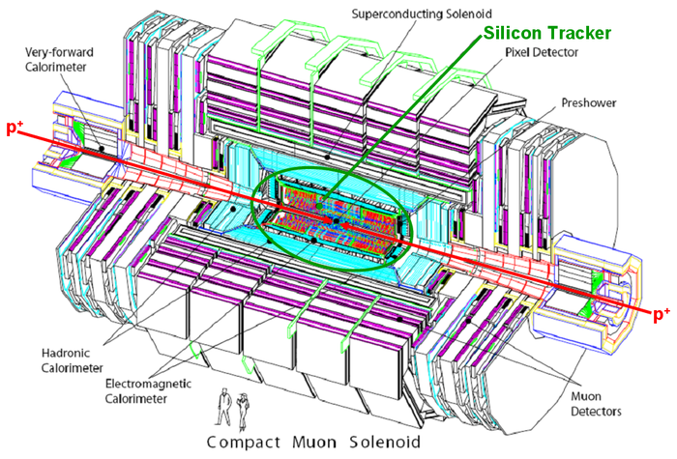
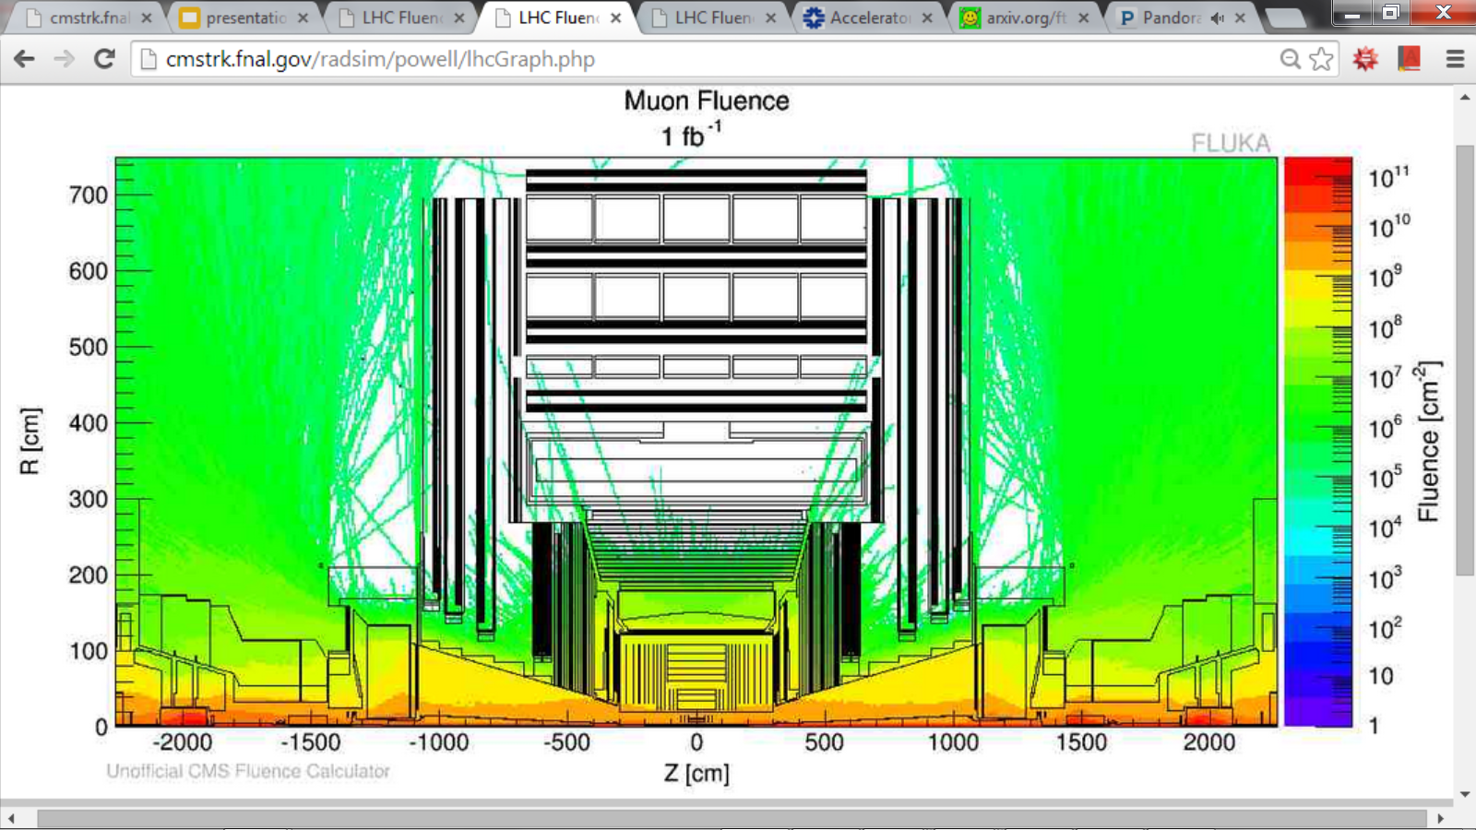
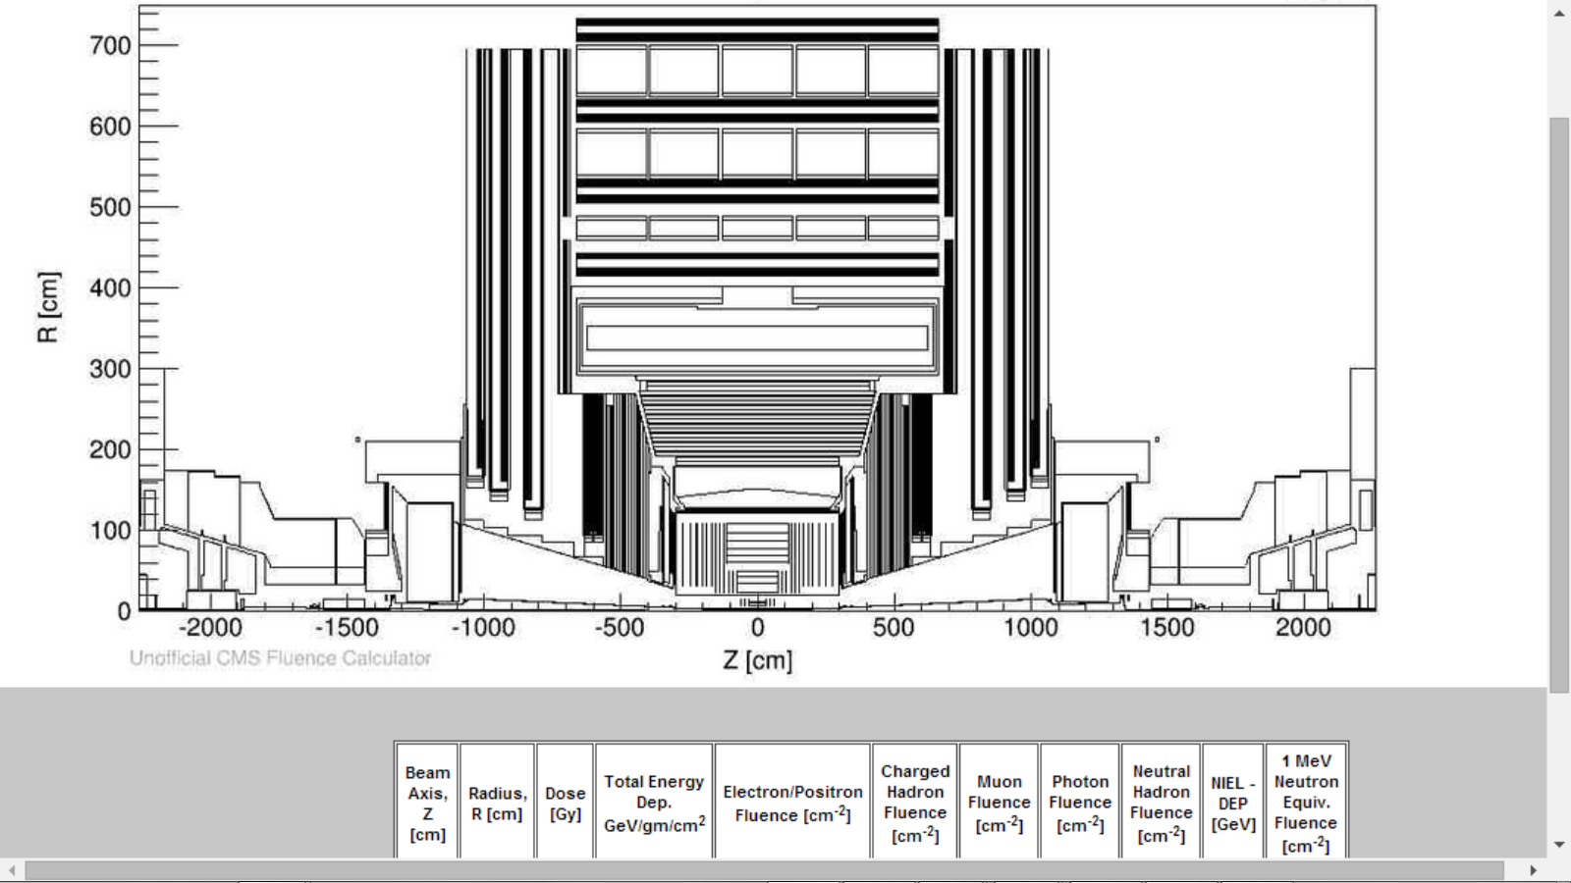
2D Plots
CMS Detector, copyright HEPHY
Data Fetch feature displays all particle quantities.
Notes:
inlcude option for outline of geometry. show slice pic of detector here

Slide 10
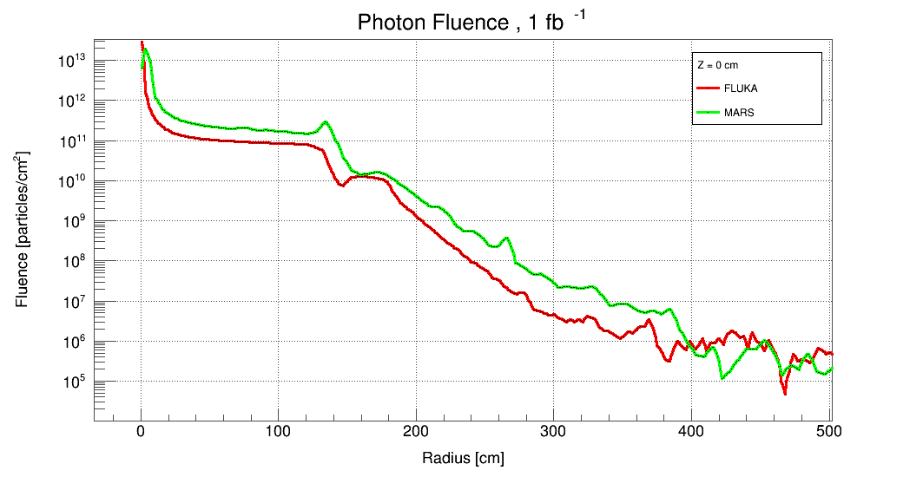
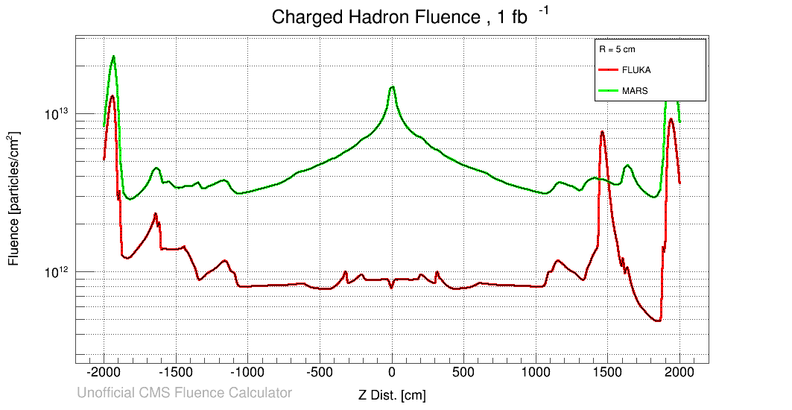
FLUKA vs. MARS 1D Plots
Added Simulation option allows for MARS and FLUKA comparisons

Slide 11
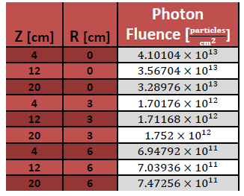
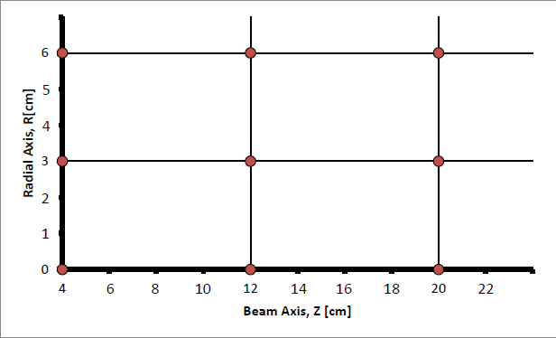
Data Interpolation Extension
Extracted data from FLUKA database
Geometric Visual
P(x,y)
P(x,y)
Notes:
fix equatio, p1

Slide 12
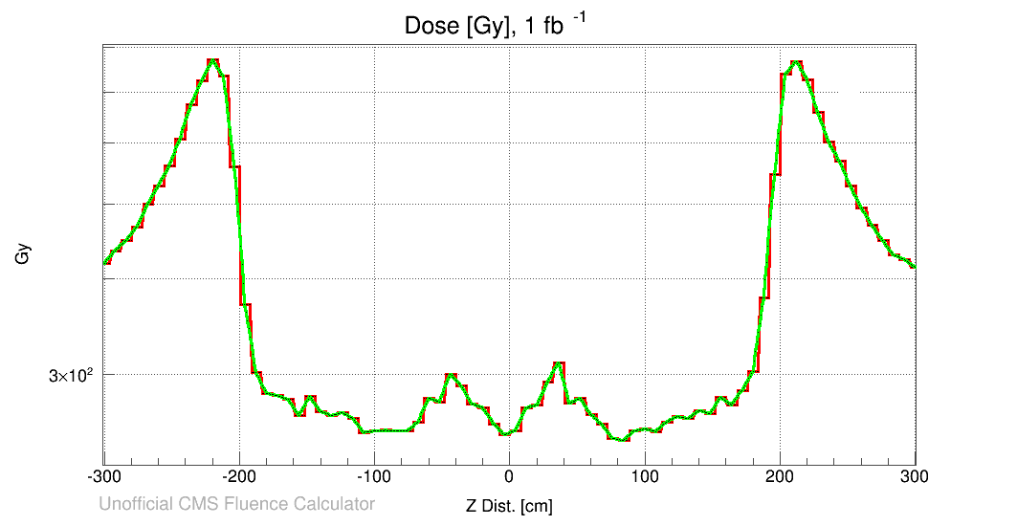
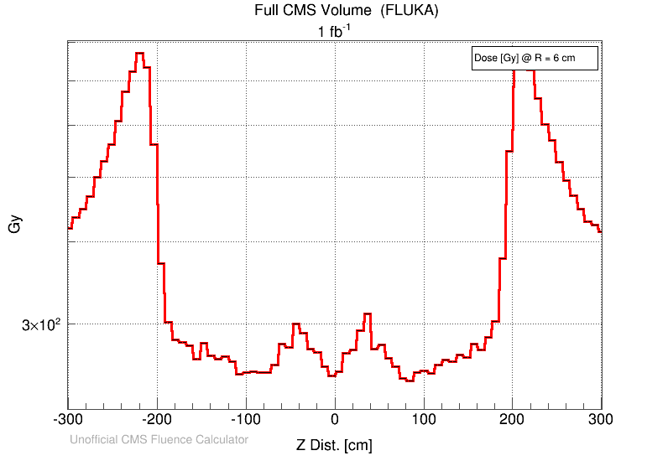
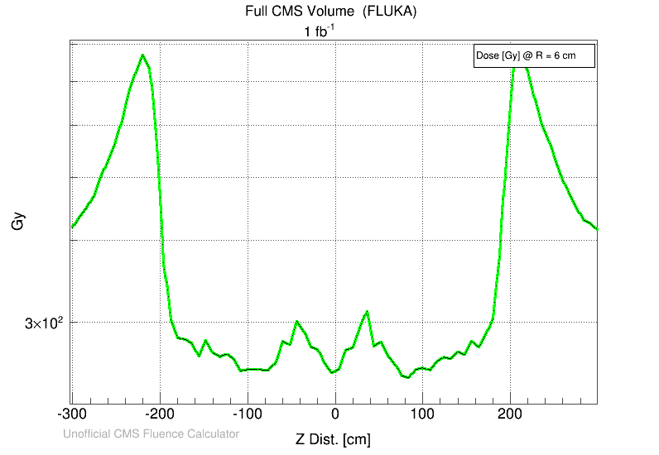
1D Plot: Standard vs. Interpolated
Notes:
superimpose graphs

Slide 13
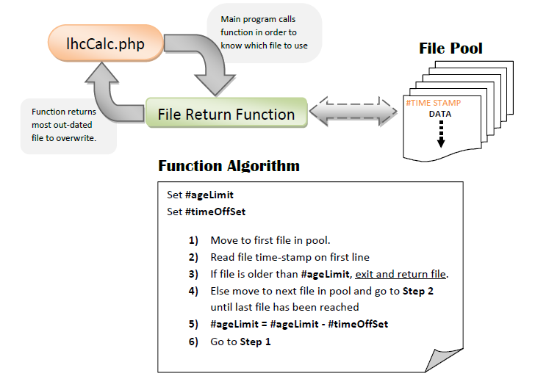
Multi File System
Notes:
maybe explain file permission problem here if time permits.

Slide 14
Summary
Simulated radiation data along with the web tool is important for studying the radiation environment of the CMS Detector.
The Calculator Web Tool has been improved in a number of ways.
Interface Enhancements
Interpolated Data Return
Multi-File System
We were able to compare MARS & FLUKA Simulations with the help of the tool, and are currently investigating the differences.

Slide 15
Special Thanks
Linda Diepholz & the rest of the SIST Committee
Supervisors: Pushpa Bhat & Leonard Spiegel
Co-workers: Graham Stoddard & Sudeshna Banerjee
Mentors: Mayling Wong & David Peterson

