Slide 1


LBNE Tank Purge Manifold
Pressure Drop Calculation
Jeremiah Afolabi
4 August 2014

Slide 2
Background
The Long-Baseline Neutrino Experiment (LBNE) wants to build a very large liquid Argon detector using membrane cryostat technology with passive foam insulation to do neutrino physics.
34 kton total Fiducial Mass at 4850L of Homestake Mine in Lead, SD, USA (~1.5 km underground). Phased approach: currently, at first 2 x 7,134 m^3 membrane cryostats, followed by 2 x ~15,100 m^3.
Construction to start in the 2020 time frame and operations around 2024.
Required LAr purity: less than 200 parts per trillion (ppt) Oxygen equivalent contamination (electron lifetime greater than 1.4 ms) to operate the neutrino detecting Time Projection Chambers (TPCs) inside the LAr.
To ensure that membrane cryostat technology is suitable for this experiment, the LBNE 35 ton prototype has been built and operated, a ~28 m³ membrane cryostat, the first and only membrane cryostat for scientific purpose and available to scientists.
The 1st run of this prototype achieved an electron lifetime of 2.5-3 ms.
A 2nd run will include a TPC along with some cryogenic upgrades

Slide 3
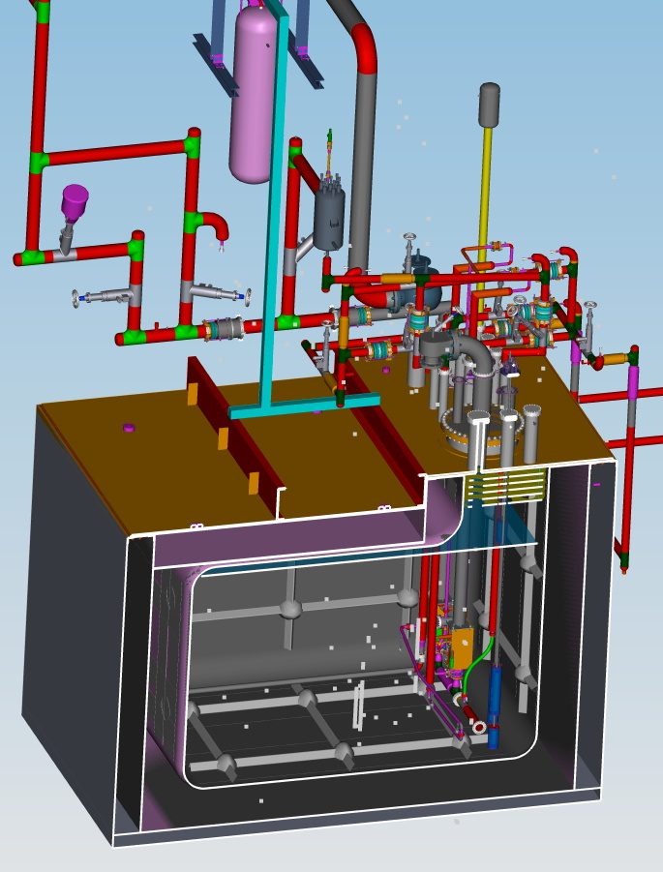
35T Cryostat Overview
Plate B (stainless steel) with risers for
cryogenic services and signal feedthrus
Condenser (refrigeration)
Plate A
(carbon steel)
Thermal radiation shields
Maximum liquid depth
2.565 m
27,700 liter liquid argon volume
Submerged LAr pump
Polyurethane foam
0.4 m thk
Purity Monitors
SS membrane
2 mm thk
Concrete tub
0.3 m thk
4 m

Slide 4
Argon Piston Purge
The primary contaminants are electronegative molecules such as oxygen and water
The cryostat cannot be evacuated with a vacuum pump to remove air (traditional method)
Argon gas is injected into the tank bottom to push the lighter air out the top
This piston purge method was validated by the LAPD project and the 1st run of the LBNE 35T

Slide 5
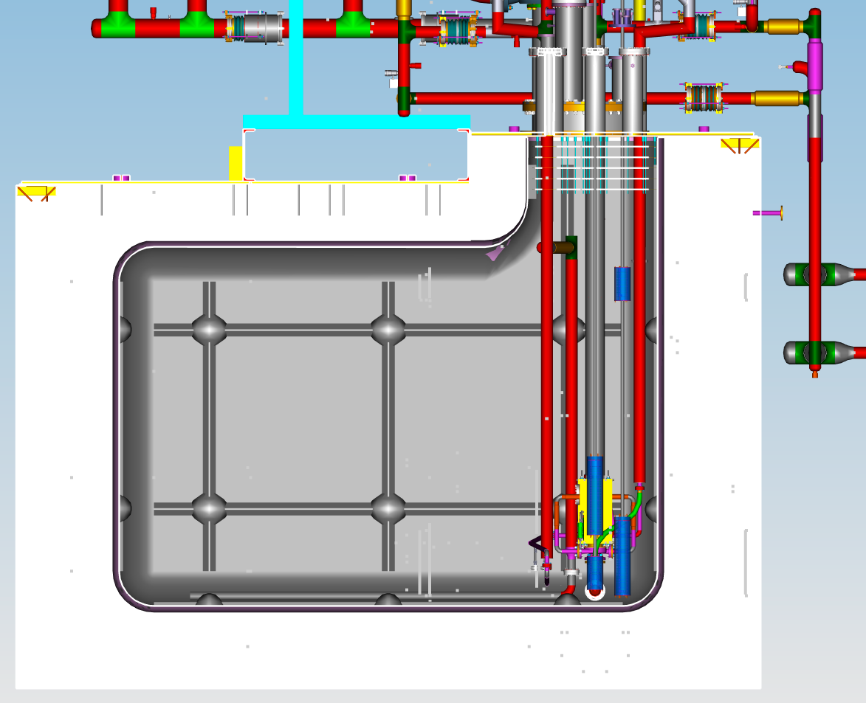
Argon Piston Purge
Gas exits thru 19 separate feedthrus and vents to atmosphere
Argon-Air interface moves upward at 1.2 m/hr
Room temperature argon gas injected at tank bottom thru 25 nozzles aimed downward just above floor - 210 SLPM total or 2.43 hours per volume change.

Slide 6
Motivation
During the purge of the 1st run of the 35T the flow out of the risers was distributed unevenly
Risers close to the vent had a greater flow rate than risers far from the vent
Although this worked the 2nd 35T run will have larger sources of contamination and its desired to ensure all risers are purged effectively
An orifice installed at the outlet of each riser can provide a “tuned” resistance which when matched with the tubing resistance results in the desired flow from each orifice

Slide 7
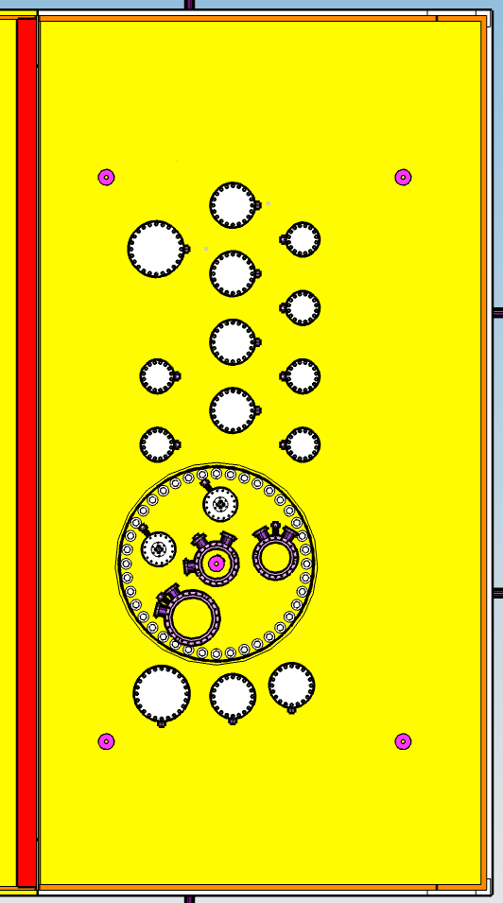
Purge vents outside
During 35T Run 1 flow out of riser K was greater than flow out of riser A
K
A

Slide 8
Purge vents outside
During 35T Run 2 flow out of each riser will be dictated by an orifice at each riser which will mitigate the variable resistance due to different tubing lengths
K
A

Slide 9
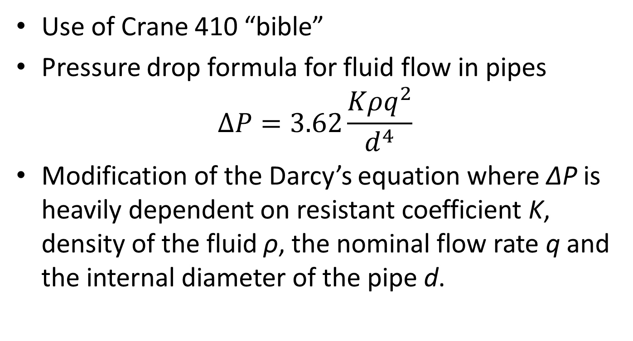
Pressure Drop using Air
Use of Crane 410 “bible”
Pressure drop formula for fluid flow in pipes
$$∆P=3.62\frac{Kρq^{2}}{d^{4}}$$
Modification of the Darcy’s equation where ΔP is heavily dependent on resistant coefficient K, density of the fluid ρ, the nominal flow rate q and the internal diameter of the pipe d.
Notes:
Note that the Crane 410 publication is the bible of basic engineering pressure drop calculations.
Also note that pipe diameter is the largest effect since its raised to the 4th power and flow rate is the next largest effect since its squared.

Slide 10
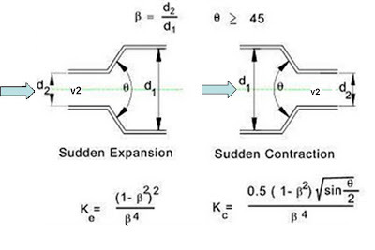
Resistance Coefficient-K
Resistance to flow in pipes are;
  sudden and gradual contraction and enlargement
    Based on the ratio of the diameters and angle of convergence or divergence
  Presence of elbows and tees
    All the elbows are 90˚ standard elbows.
    Resistance across 2 flow paths in a tee are through the run(straight path) and/or through the branch.
    K_{run} and K_{branch} are dependent on the ratio of the single flow to the combined flow and the area ratio.
  Friction due to the straight pipe.
    Depends on friction factor, pipe length and pipe diameter
    Friction factor f is obtained from moody chart based on flow’s Reynolds number and pipe ID
    Flow can either be laminar or turbulent (Re# 2300)
    Pipe length is measured with a tape measure
Summation of all contributing resistance coefficients (K factors) between risers gives an equivalent resistance coefficient for calculating the pressure drop across a particular section
Notes:
Note that first you started simple and calculated the pressure drop for the combined flow thru the measured length of straight piping. The pressure drop was significant which told you that a more detailed calculation was necessary. That’s a big part of engineering. We don’t want to put more effort into a calculation than necessary. Typically starting with a simple calculation tells you if a more detailed calculation is necessary or not.

Slide 11
Nominal Flow rate
Total purge flow rate is fixed at 7.4 SCFM of Argon and divided among 19 risers
Flow rate per riser is estimated based on ratio of individual CSA to the total CSA. Three riser internal diameters (3.87”, 5.87” and 7.87”)
Flow is convergent as 2 or more streams combine to the next riser, hence flow is additive as the schematic shows
Notes:
Note that 7.4 SCFM of argon is injected at the tank bottom. Initially 7.4 SCFM of air exits the tank. This eventually transitions to 7.4 SCFM of argon exiting the tank. Thus calculations have to be done for both air and argon.

Slide 12
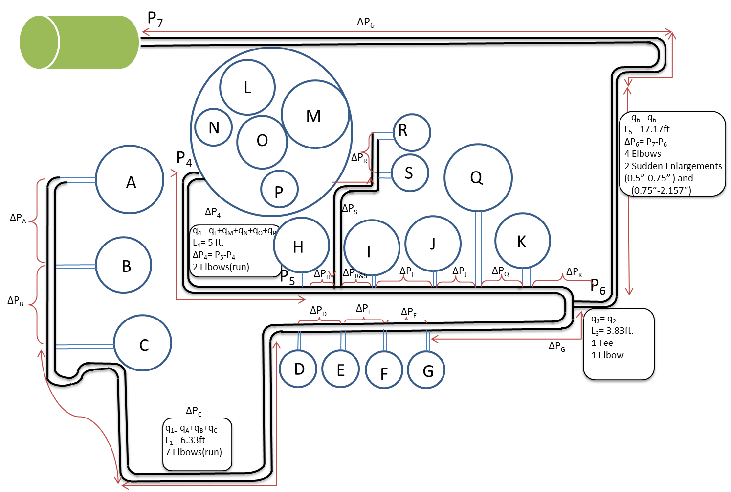
Notes:
Note that the flow rates had to be adjusted to make the pressures of the two streams match at P6. We increased the flow rate in risers expected to contain more contamination and decreased flow in risers expected to have less contamination.

Slide 13
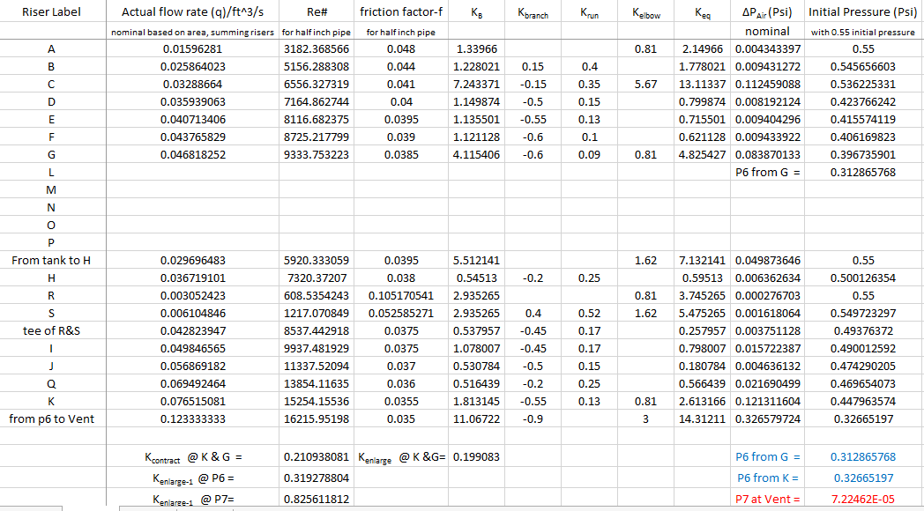
Result
Initial pressure is
reduced from 0.75 to 0.55
to ensure system consistency
With reality
P6 from both branches of the flow
maintain same pressure and the
Outlet pressure is approx. zero showing
Consistency with reality

Slide 14
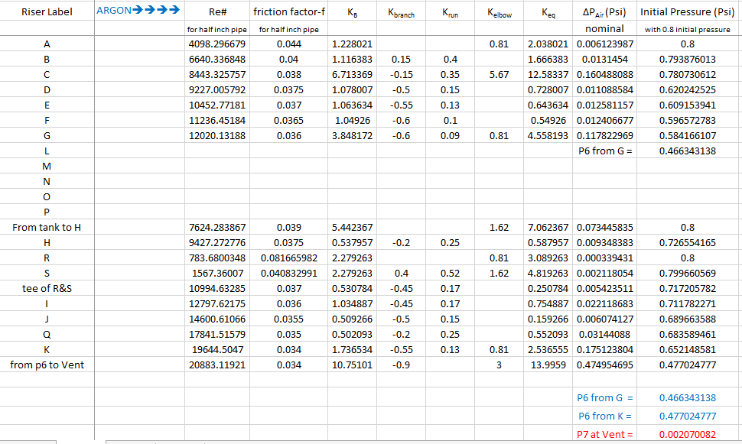
Pressure Drop with Argon
Using volumetric flow rate of air to size the orifices.
We substitute for argon properties to obtain the pressure drop after orifice is size is set
Starting pressure
is higher than air
P6 equal from
Both ends and zero
outlet pressure at P7
Notes:
Be sure to say why the pressure drop is higher with Argon.

Slide 15
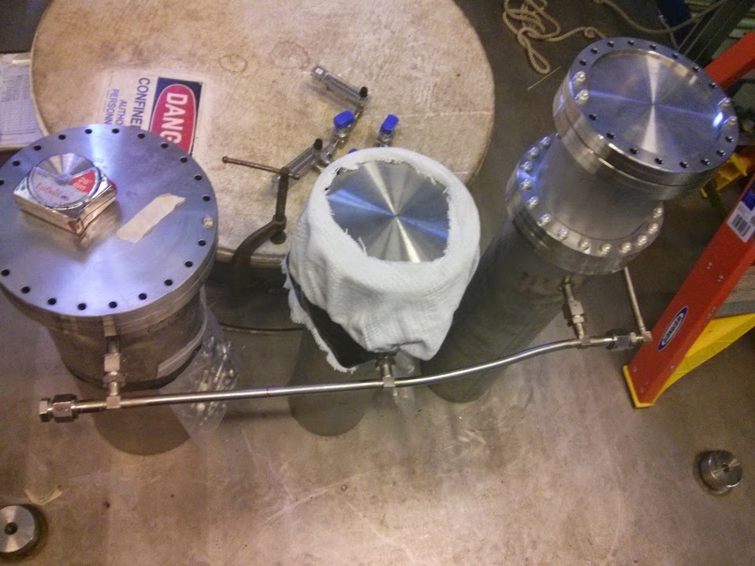
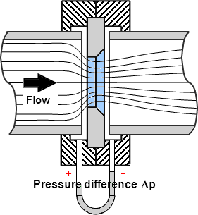
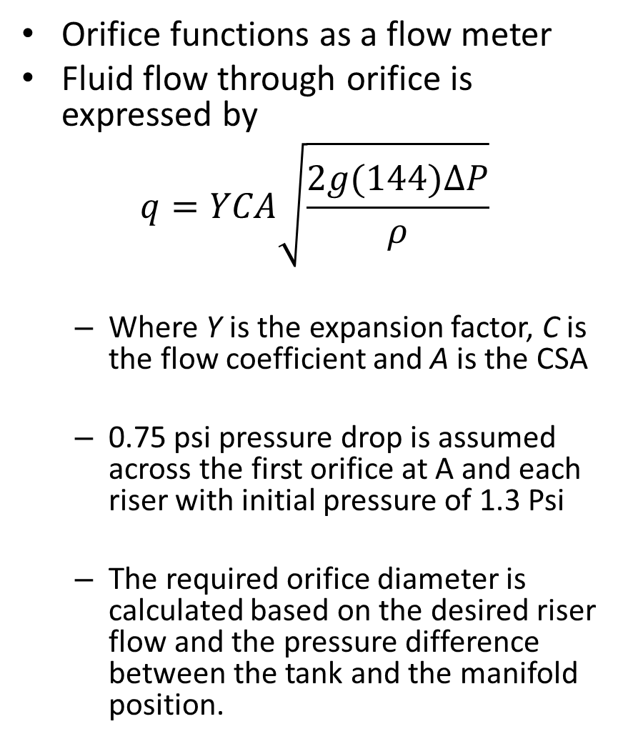
Sizing the Orifice
Riser A
Orifice functions as a flow meter
Fluid flow through orifice is expressed by
$$q=YCA\sqrt{\frac{2g(144)∆P}{ρ}}$$
  Where Y is the expansion factor, C is the flow coefficient and A is the CSA
  0.75 psi pressure drop is assumed across the first orifice at A and each riser with initial pressure of 1.3 Psi
  The required orifice diameter is calculated based on the desired riser flow and the pressure difference between the tank and the manifold position.
Orifice location
Riser A
0.55psi
1.3 psi

Slide 16
Conclusion
The pressure drop model obtained from analysis and calculation during the purge of air and argon out of the LBNE 35T tank is consistent with reality
The tank purge operating pressure for air and argon is 1.3 psig and 1.55 psig respectively which is comfortably less than the maximum allowable tank pressure of 3 psig.
Also the model allows for easy and accurate adjustment of the tank pressure, orifice sizes as well as tank gas should the need arise.

Slide 17
References
Flow of Fluids through Valves Fittings and Pipes: Technical Paper 410m. S.l.: Crane Valves, 1991. Print.
Personal communications with Terry Tope
LBNE Fermilab Website

Slide 18
Acknowledgement
Terry Tope – My Supervisor
The SIST Committee
Dianne Engram
Linda Diepholz
Dr. Davenport
My fellow interns
Fermi National Accelerator Laboratory

Slide 19


Slide 20

Questions

