Slide 1
Development of the Geant4 Validation Web Interface for End Users
K. Nicole Barnett 2014

Slide 2
Outline
Introduction
Background
Evolution and Improvement
Software Tools
Methods
At a glance
IDE
Web page
Managed Beans
Object Class
Results
Summary
Database statistics
Experiment selection
Result refinement
Target
Secondary
Reaction
Beam energy
Dynamically created plot and raw data viewing
Discussion: Significance
Fairly accurate model
Model requiring refinement
Conclusion
Summary
Acknowledgements
PDS Team
Krzysztof Genser
Tomasz Golan
Robert Hatcher
Adam Para
Gabriel Perdue
Hans-Joachim Wenzel
Julia Yarba
References

Slide 3
Introduction: Geant4 Background
Models the interaction of particles with matter
Wide breadth of scope
Education
Medicine
Space and Radiation
High Energy Physics
Ever evolving

Slide 4
Evolution and Improvement
All aspects in scope of critical importance
Constantly Improving
One major release per year
Several minor releases per year (average about 3)
Validation Library
Keep track of improvements between releases
Data base which houses experimental and simulation data
Graphs stored as image blobs – becoming cumbersome
Currently working to present data dynamically at the user’s request

Slide 5
Software tools
NetBeans 8.0 Integrated Development Environment (IDE)
Provides framework within which to edit, compile, and debug code
PrimeFaces 4.0
Library providing rich, easily configurable user interface components
JavaServer Faces (JSF) 2.0
Framework for constructing user interfaces with components
PostgreSQL Database
Database within which the raw data and static images are stored

Slide 6
Software tools
Java
Object oriented programming language with pre-defined classes and class objects
JFreeChart
Chart viewing program which runs directly from Java
JavaScript
Client side data parsing language compatible with web browsers
HighCharts
JavaScript based chart viewing program
XHTML
Webpage formatting language

Slide 7
Methods at a glance

Slide 8
Programming Methods IDE
All Programming, regardless of language, protocol, or tool kit was completed within the NetBeans 8.0 IDE.
Provides immediate feedback for coding discrepancies
Displays compiler read out to easily locate the position of compiler errors
Displays system read out statements for debugging
Capability to display project on built in browser or external browser.

Slide 9
Programming Methods web page
XHTML main framework within which all other web page programing structured
JavaScript used to parse data, complete actions, and fill HighCharts
Heavy reliance on PrimeFaces 4.0 for easily configurable UI components
JSF component library utilized where necessary

Slide 10
Programming methods Managed Beans
Managed Beans act as an intermediary to send request parameters to the Object Class and parse returned data into a usable format
The data is then displayed presented on a JFreeCharts plot backed by a Java servlet and also passed back to the XHTML page

Slide 11
Programming methods Object class
Object classes define non-Java items in such a way that Java can manipulate them.
They receive parameter values from the managed bean; typically a string or integer.
These values are placed into a prepared SQL statement which the object class passes to the database.
They then iterate over the database responses and define them for further parsing before passing them back to the managed bean.

Slide 12
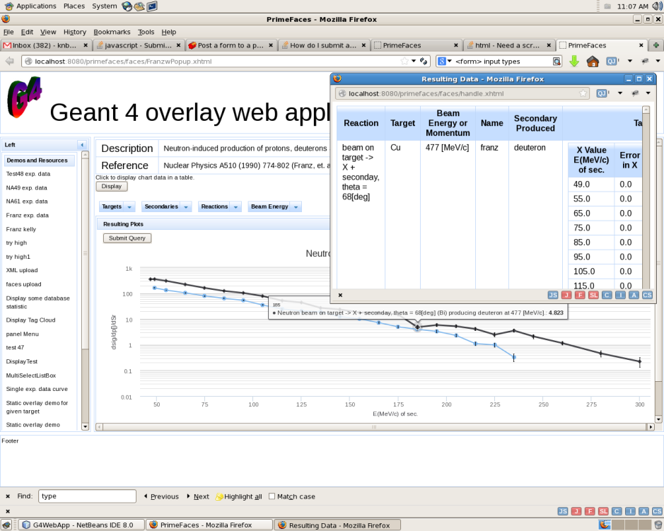
Results
Each individual, complete method functions as intended; however, they are not yet assembled into one coherent web application.

Slide 13
Results: database statistics

Slide 14
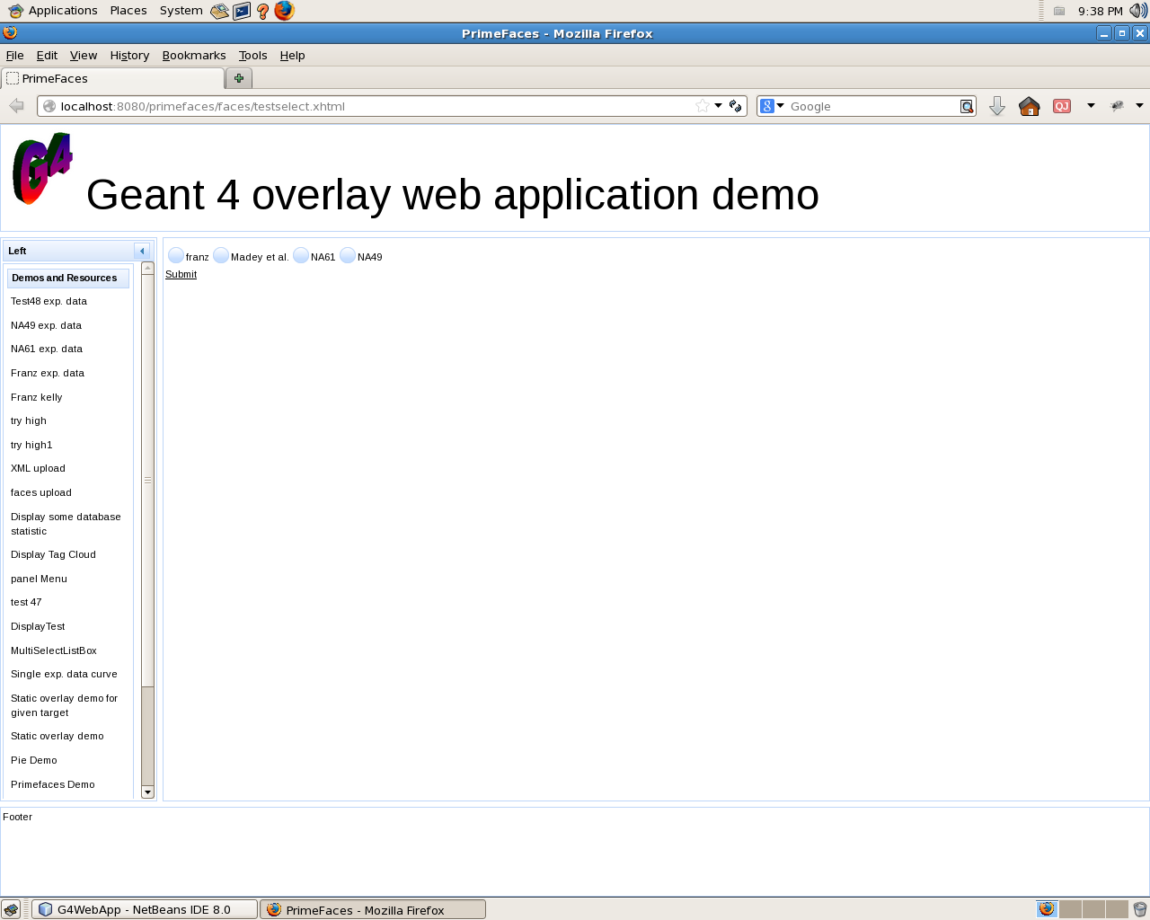
Results: Top Selection

Slide 15
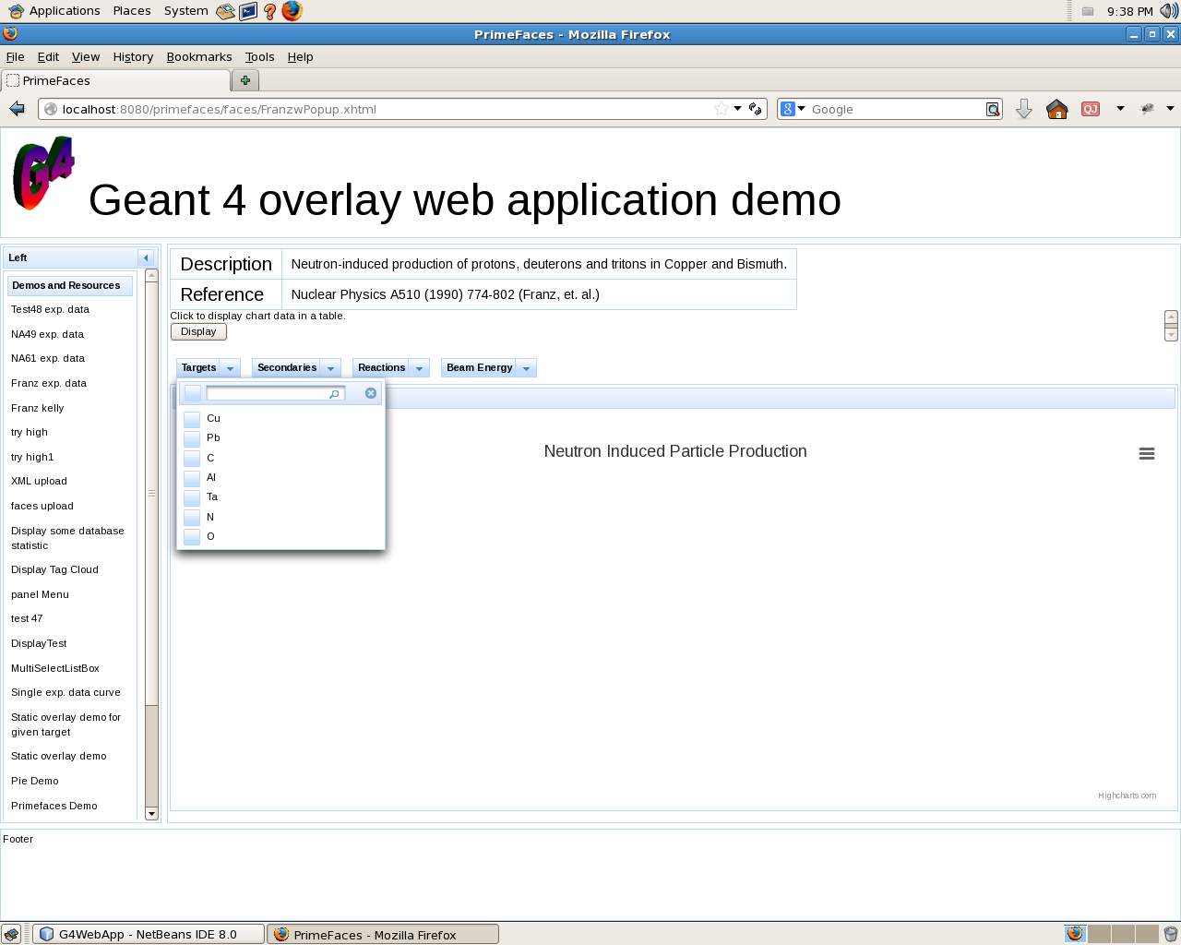
Results: Refine by target

Slide 16
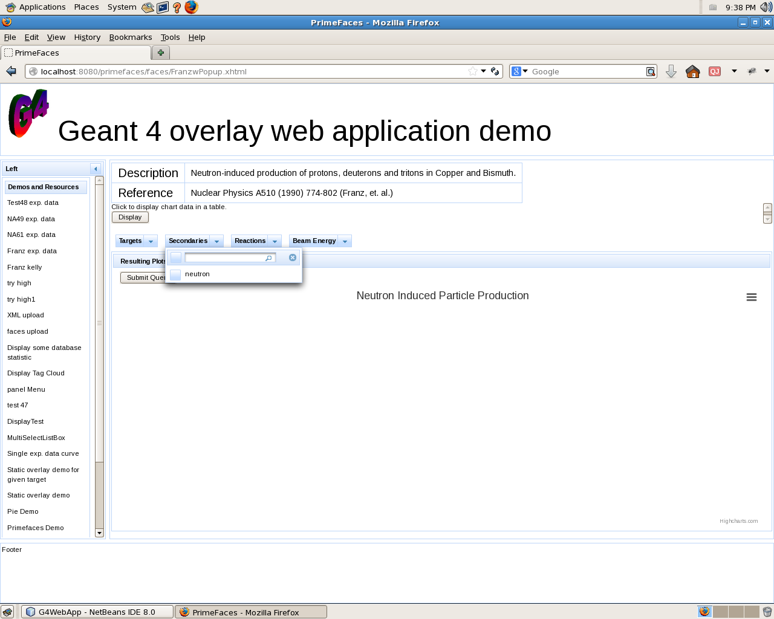
Results: refine by Secondary

Slide 17
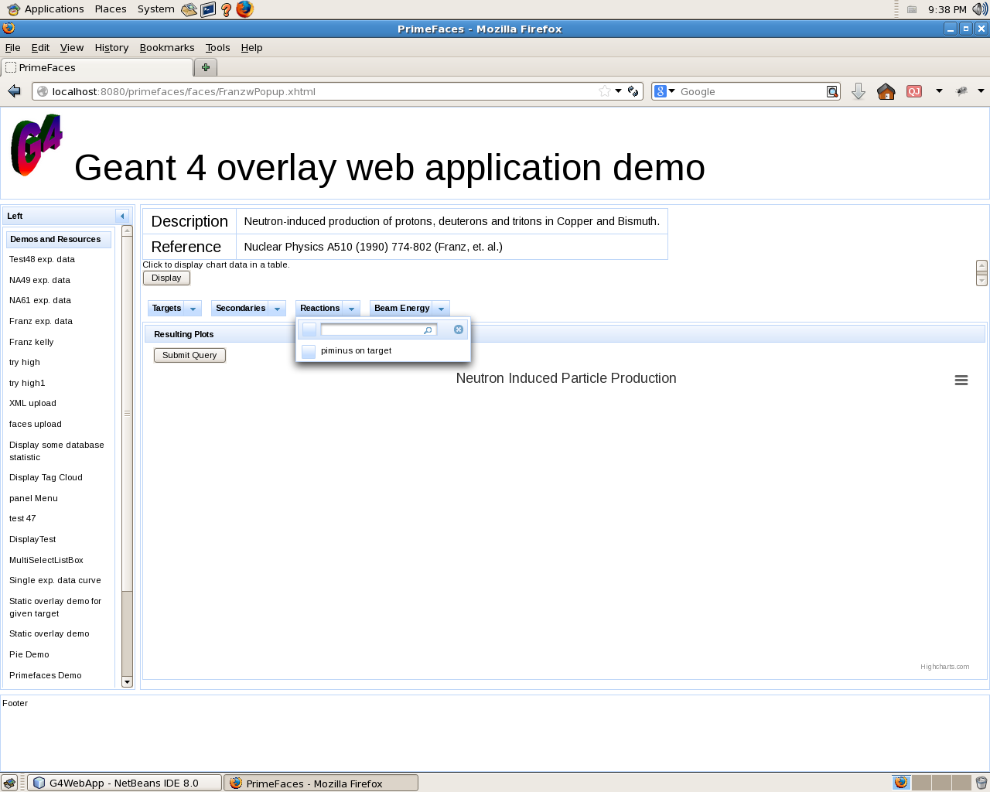
Results: refine by reaction

Slide 18
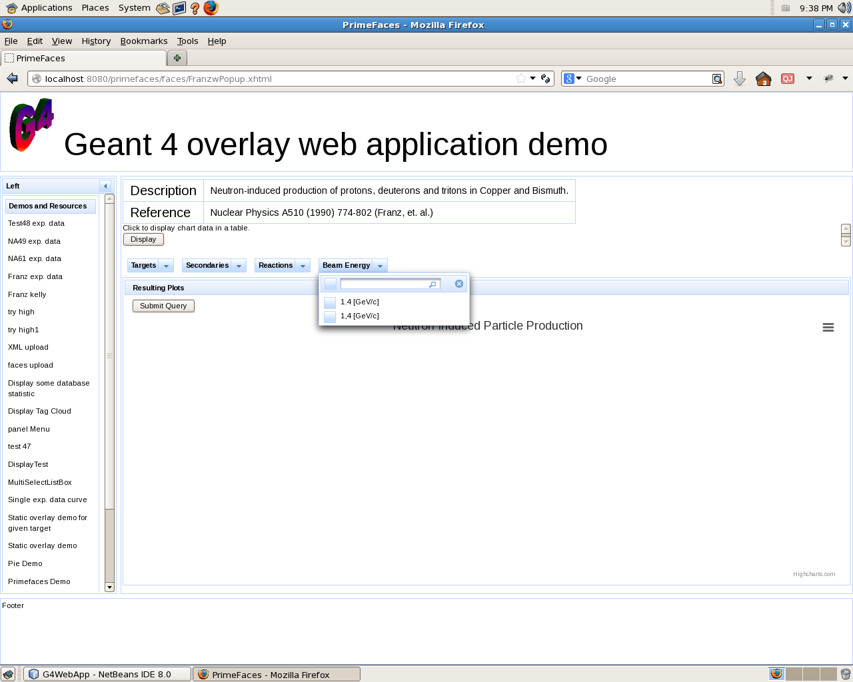
Results: refine by beam energy

Slide 19
Results: dynamically created plot

Slide 20
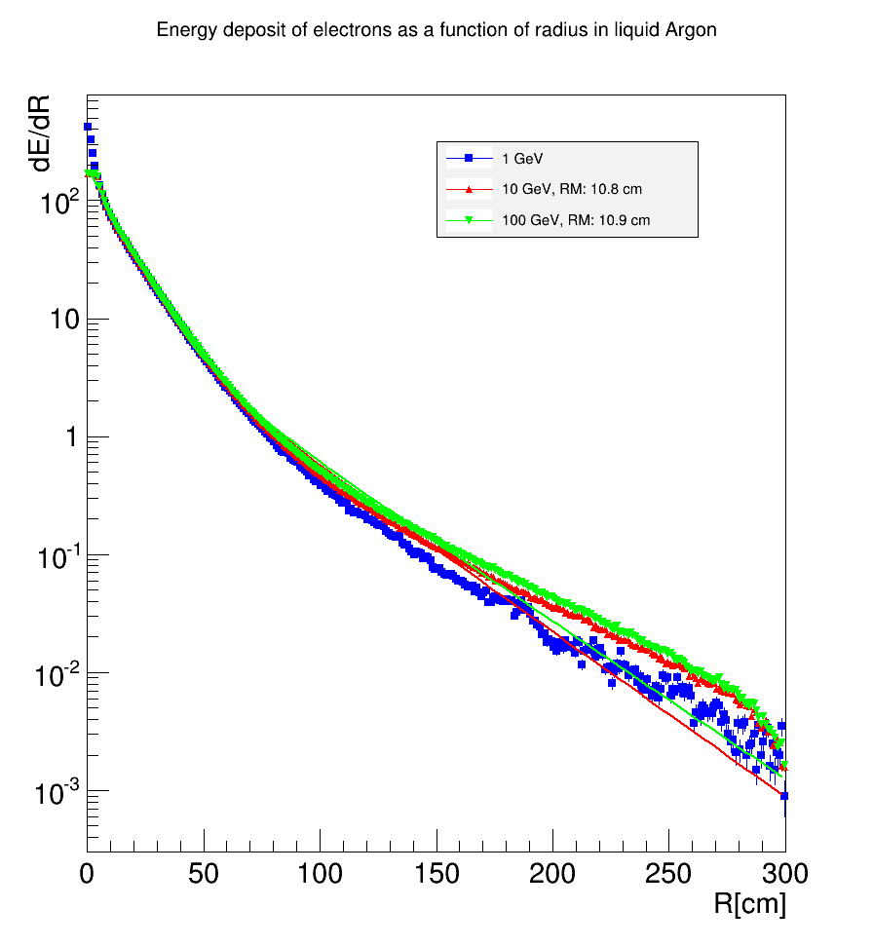
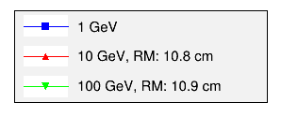
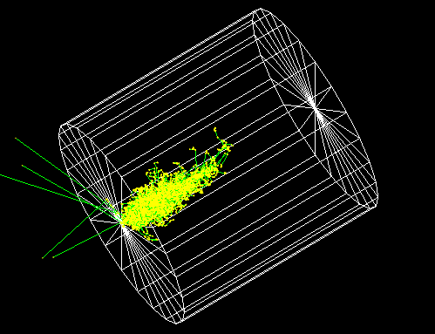
Discussion: Geant4 Validation
Precise liquid argon modeling crucial due to use in future experiments
LArIAT
MicroBoone
LBNE

Slide 21
Discussion: Geant4 Validation
Geant4 is the current standard for modelling physical interaction, and popularity is growing.
As the user base increases, so must ease of use as well as number of tests.

Slide 22
Conclusion
Discussed
What Geant4 is and it’s implications
Current application being created
Materials and Methods
Results and Discussion
Continuous validation is key to improvement
Expanding the validation library is the only means by which to do that
A more diverse, robust validation library from which to draw upon will attract a wider audience

Slide 23
Acknowledgements
Supervisor:
PDS Team:
Hans-Joachim Wenzel
Krzysztof Genser
Tomasz Golan
Robert Hatcher
Adam Para
Gabriel Perdue
Hans-Joachim Wenzel
Julia Yarba

Slide 24
References
[1] K. Kleinknecht, “Measurement of ionization,” in Detectors for Particle Radiation, 2nd ed. Cambridge: CU Press, 1998, ch. 2, sec. 4, pp. 59.
[2] H. Schultz-Coulon, “Calorimetry I: Electromagnetic Calorimeters,” Univ. Heidelberg, Heidelberg, DE, Rep. 2014.
[3] Atlas (2007). Liquid argon properties [Online]. Available: http://lartpc-docdb.fnal.gov/cgi-bin/RetrieveFile?docid=206;filename=Liquid_argon_properties.pdf;version=1

Slide 25
Appendix: Supplemental Material

Slide 26
Example In Medicine: Proton therapy
Bethe-Bloche equation describes the stopping power as a function of the change in energy of the bean per change in distance and
$−\frac{dE}{dx}=Kz^{2}\frac{Z}{A}\frac{1}{β^{2}}\left[\frac{1}{2}\ln{\frac{2m_{e}c^{2}β^{2}γ^{2}T_{max}}{I^{2}}−β^{2}−\frac{δ(βγ)}{2}}\right]$
$K≡4πN_{A}r_{e}^{2}m_{e}c^{2}/A$

Slide 27
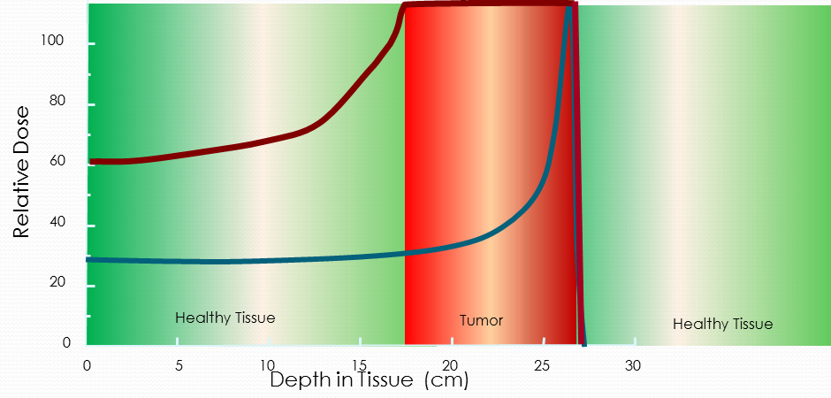
Example In Medicine: Proton therapy
A Bragg Peak is the point at which an element looses momentum and deposits most of its energy.
By varying the beam intensity over time, the Bragg Peak can be spread out.

Slide 28
Liquid Argon
Property | Value
$ρ$ (density) | 1.4 $g/{{cm}^{3}}$
$R_{M}$ (Moliere Radius) | 9 – 11 cm
$X_{0}$ (Radiation Length) | 14 cm
$Z$ (Atomic Number) | 18
$A$ (Atomic Weight) | 39.94
IA (Nuclear Interaction Length) | 83.6 cm

Slide 29
Geant4 simulation of EM shower in Liquid Argon
10 GeV Beam
Liquid Argon Target
Radius: 3 m
Length: 6 m

Slide 30
Transverse Electromagnetic shower profile
Radius within which 90% of the interactions occur
Literature: 9-11 cm ^{[1]}
Geant4: 11.31 cm
$F$ $\left(z\right)= αe^{−\frac{R}{R_{M}}}+ βe^{−\frac{R}{λ_{min}}}$ ^{[2]}
$α≡$ short depth parameter
Dominates within the Moliere Radius
$β≡$ long depth parameter
Dominates beyond the Moliere Radius
It is important to note the parameters of the double exponential formula are highly correlated, so one must carefully interpret the 11.32 cm.

Slide 31
Transverse Electromagnetic shower profileRadius (M_{R})
Primarily energy independent except at tails ends

Slide 32
Longitudinal Profile
$\frac{dE}{dt}=E_{0}{\left(\frac{Z}{X_{0}}\right)}^{α}e^{−β\left(\frac{Z}{X_{0}}\right)}$ ^{[2]}
Radiation length (X₀)
Characterizes the material
When used as a unit of
measure, produces the
same curve regardless of
the target material
Fit for 𝑋₀
12 (10 Gev)
13.7 (100 GeV)
14.6 (1000 GeV)

Slide 33
Shower Max (t_{max})
Depth at which the maximum energy is deposited.
$t_{max}=\ln{\frac{E_{0}}{E_{c}}}−1$ ^{[2] (Rule of thumb)}
By nature, “rule of thumb” is imprecise
Peak Energy (GeV) | 1 | 10 | 100 | 1000
Manual Calculation (cm) | 33 | 65 | 97.4 | 129.6
G4 (cm) | 40 | 70 | 105 | 137

Slide 34
Shower Max (t_{max})

