Slide 1



Designing a Continuous-Wave RF Cavity for Bunch Rotation in Support of Experiments Mu2e and g-2
Aaron Smith under the mentorship of Joseph Dey
Accelerator Devision/RF Department

Slide 2
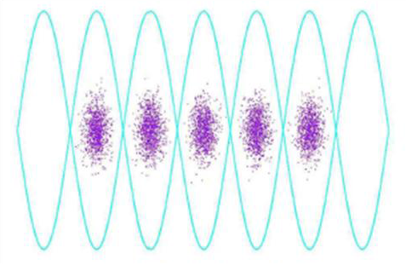
Beam Bunches
RF systems cause the beam to form bunches
The bunch size (width/time) is determined by the
frequency of the RF system
Protons in a bunch rotate from front to back, back to front

Slide 3
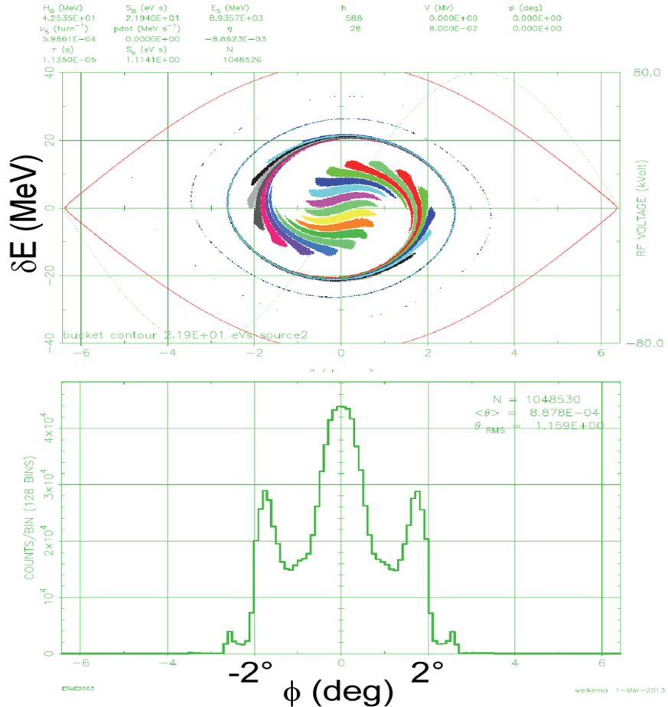
Mu2e and g-2 requirements
The same RF system will be used for both experiments
g-2 requires a smaller bunch length than Mu2e
Therefore, RF is being designed
to meet g-2
Cavities also need to be able to
run CW (continuous wave)
Excessive heat necessitates
the design of new cavities
1° = 31 nsec
Bunch Length Requirements Full width
Mu2e | g-2
250 nsec | 149 nsec

Slide 4
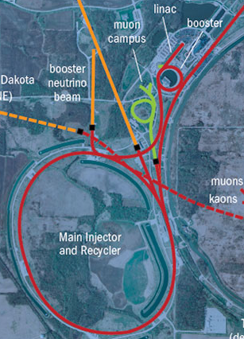
Cavity Placement/Use
Seven new 2.5 MHz cavities
for Recycler Ring
One new 2.4 MHz cavity for
Delivery Ring
Recycler Ring will create four
bunches which are extracted
one at a time into the
Delivery Ring
Delivery Ring 2.4 MHz cavity
will be used to preserve bunch
width

Slide 5
Designing the Cavity
New cavities require
  Water cooling system
    The copper tubing needs to be able to enter/exit the cavity without causing an electrical arc due to potential differences
  Resonance at 2.4/2.5 MHz
    This requirement is a condition of the experiments and parameters of the accelerating systems at Fermilab
  Small footprint due to limited tunnel space
  Sufficient gap voltage (10kV)
    Simulations of the beam show that the cavities need 10kV difference across the gap
  A matched load for power transfer efficiency
    If our cavity does not appear like a 50 ohm system, power will be reflected back into the amplifiers

Slide 6
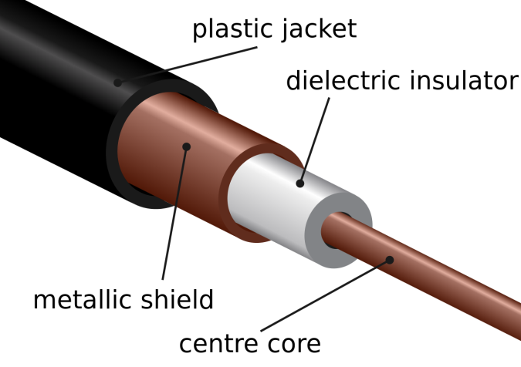

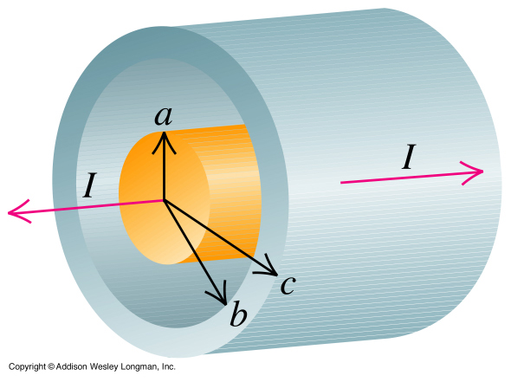

Resonant Cavity
Significant factors are:
  Inner/outer conductor radius
  Dielectric material
  Length
The cavity will produce a standing wave
similar to the characteristics of a quarter
wave resonator

Slide 7
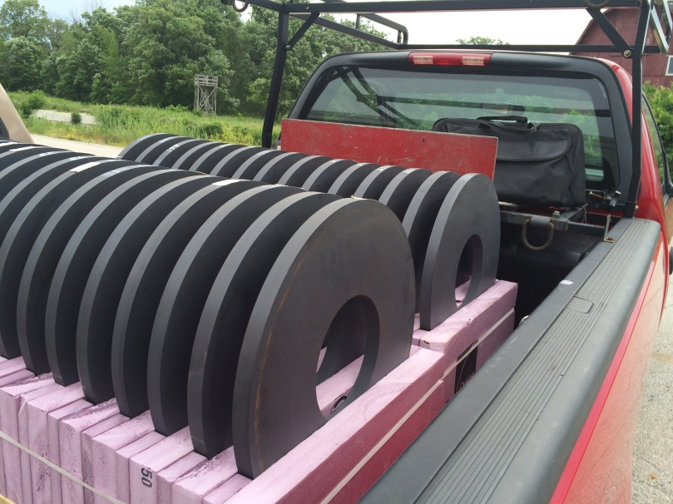
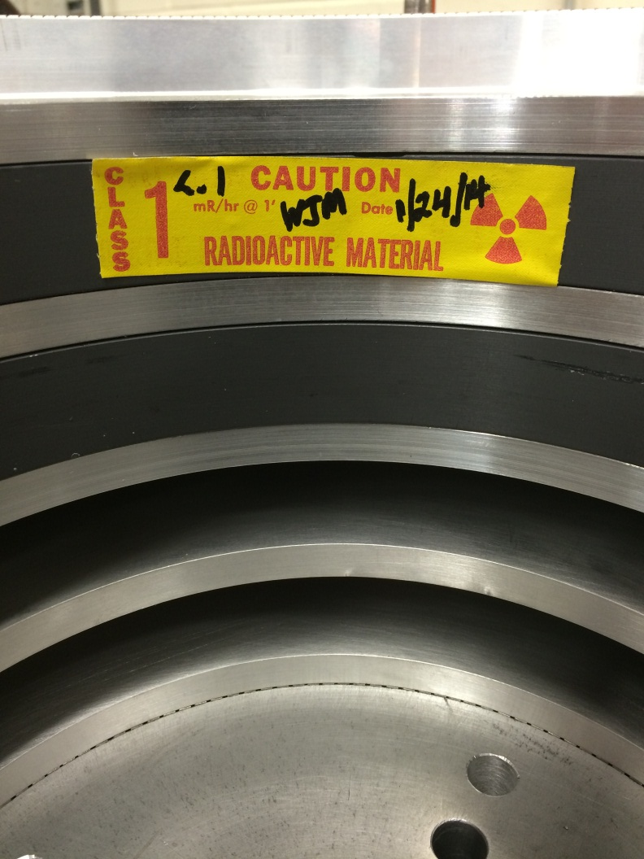
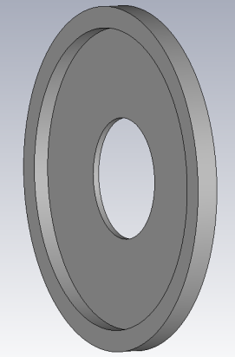
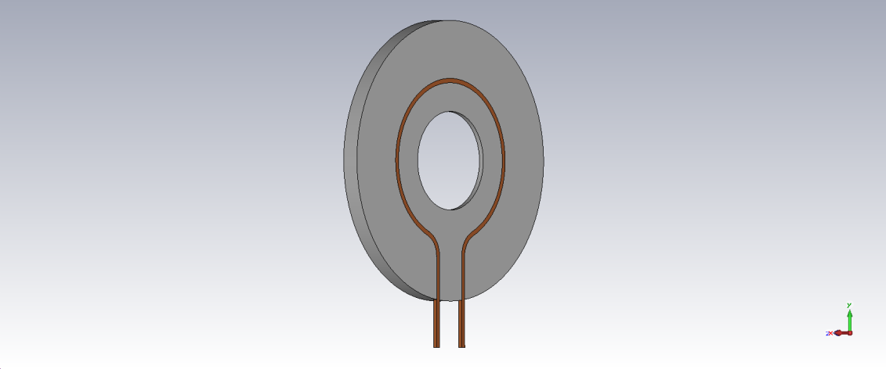
Aluminum/Ferrite Stack
22.5 in.

Slide 8

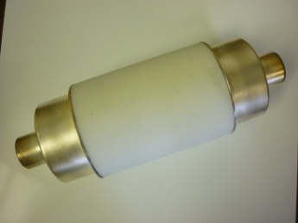
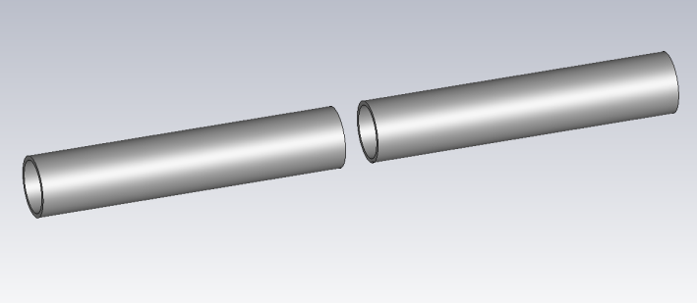
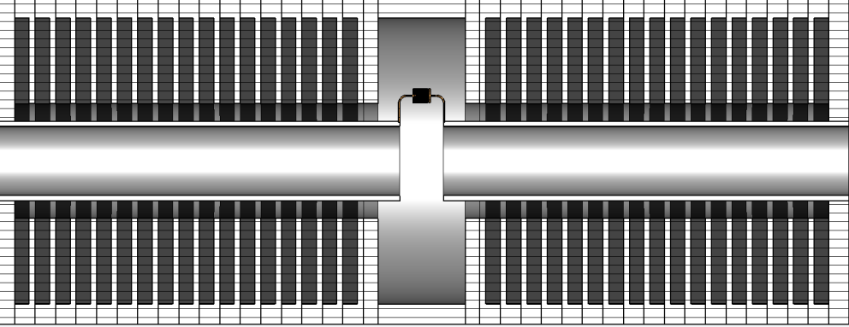
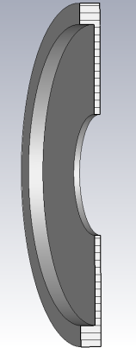
Cavity Cross-section/Components
~5 ft.

Slide 9
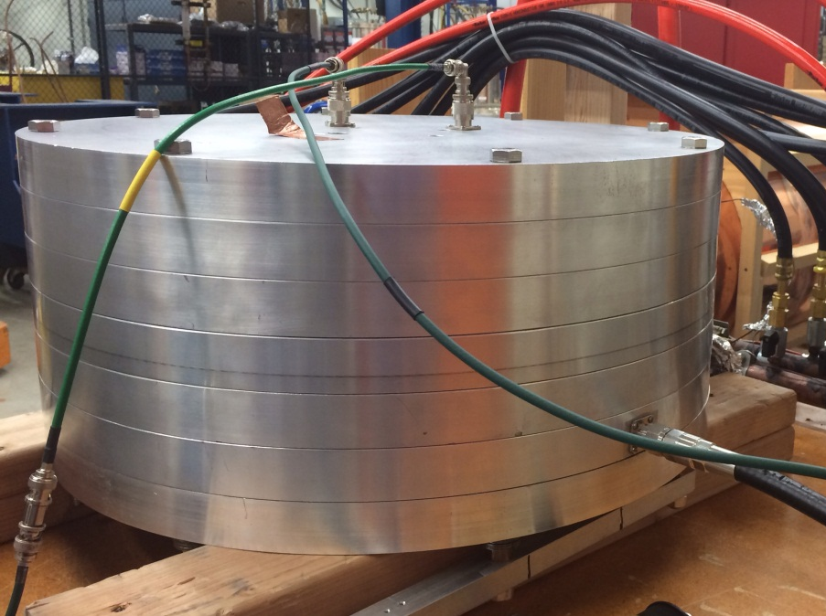
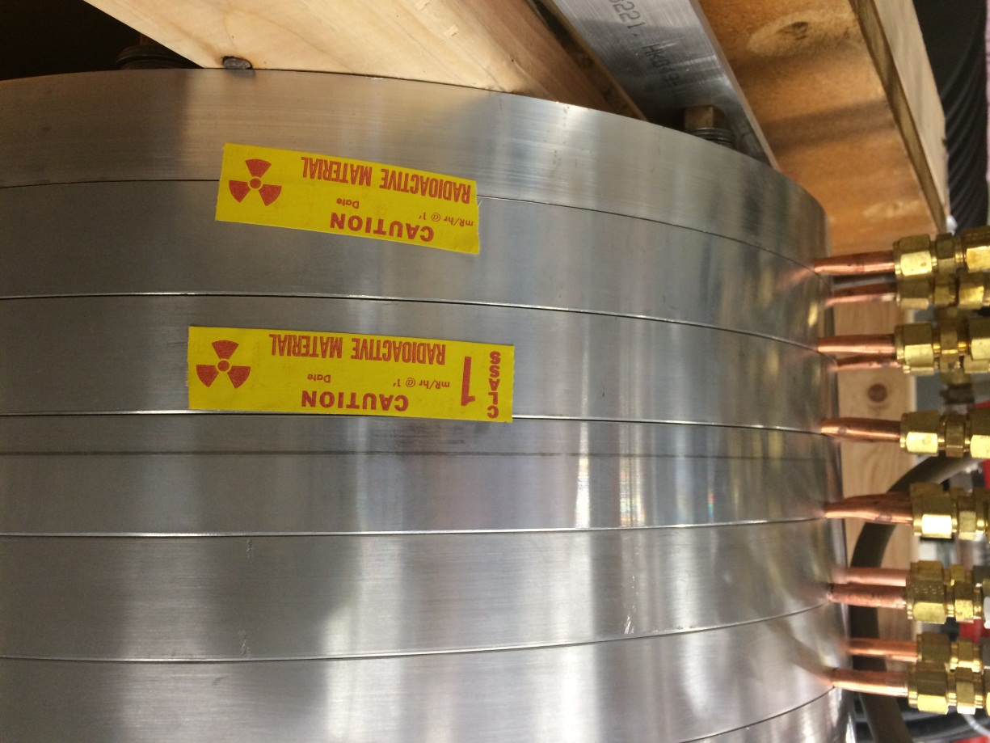
Test Cavity/Water Tubing

Slide 10
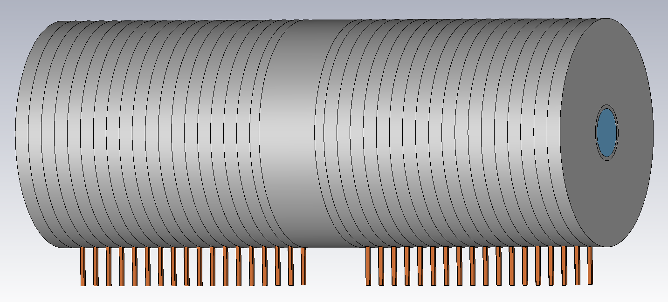

Full Cavity
The cavities for the Recycler Ring and the Delivery Ring will have the same design
~5 ft.

Slide 11


Power Reflection
A mismatched load reflects
power back to the amplifier
@ 28Ω lose ~80W out of 1kW
@ 63Ω lose ~13W out of 1kW
28Ω 63Ω
RF input

Slide 12
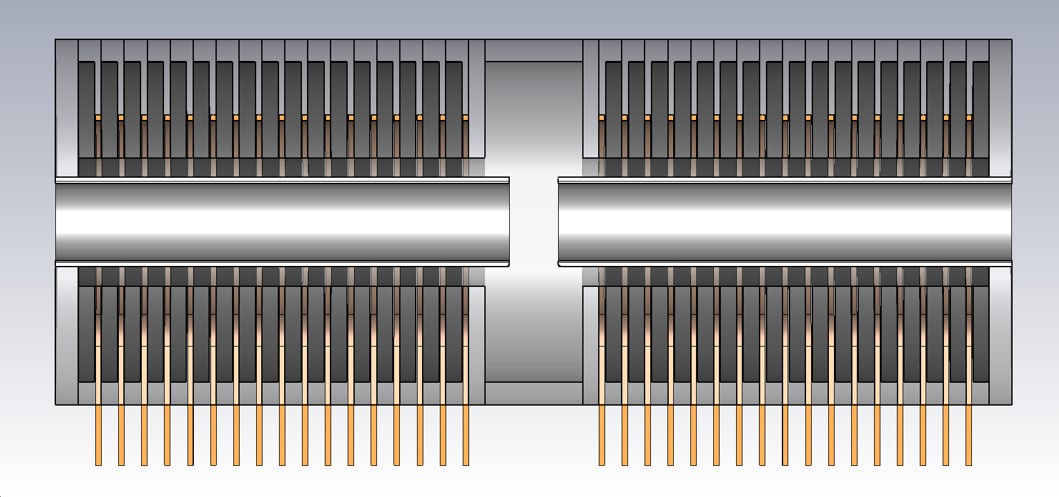
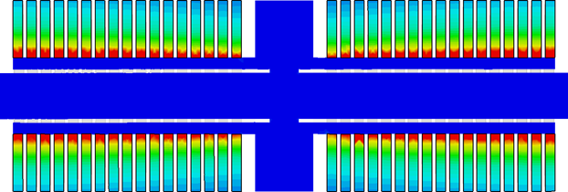
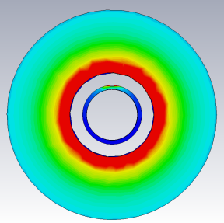
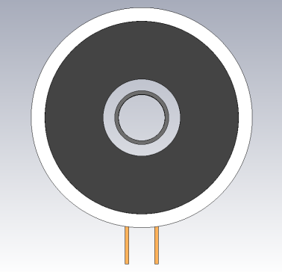
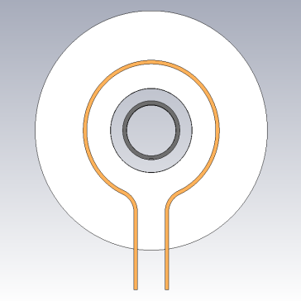
Magnetic Heating/Ferrite
Main source of heating comes from magnetic flux in ferrite
Ferrite permeability is a function
of temperature
Over heating will change the Q
factor of the cavity and change
the resonant frequency
Heating fairly consistent through
all ferrite because wave only
rotates 28⁰

Slide 13
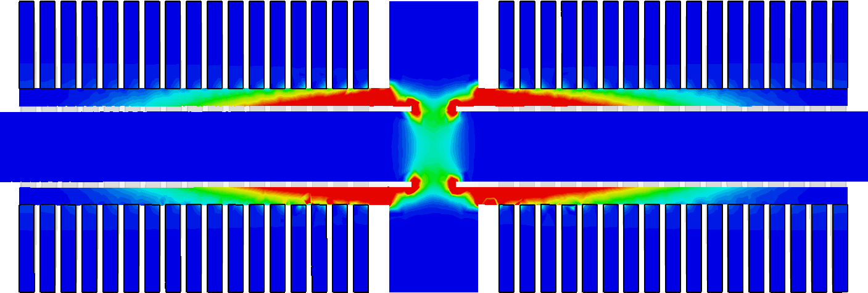
Electrical Arc
Alters the quality factor of the cavity and changes the resonant frequency
Previous cavities have had this issue due to water cooling tubing passing through the outer conductor
The copper tubing exited the
cavity through holes in the
outer conductor, and were of
different potential
The new cavity design
eliminates this issue by keeping
the tubing electrically outside
the outer conductor
As the electrical density graph
shows, the most likely place
for an arc to occur is between
the inner conductor, near the
gap and the corner of the outer
conductor.
At the voltages required, this
should not be an issue

Slide 14
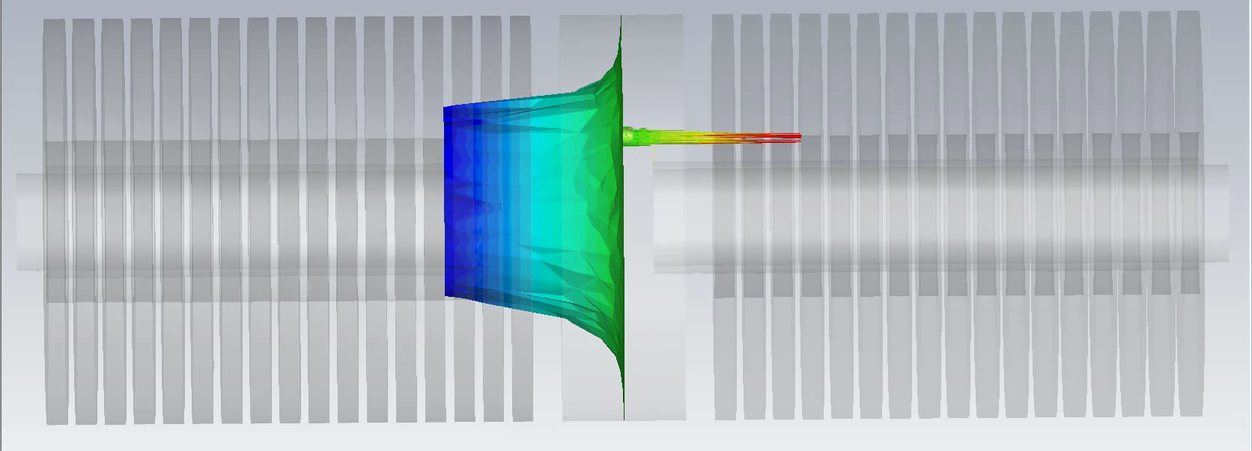
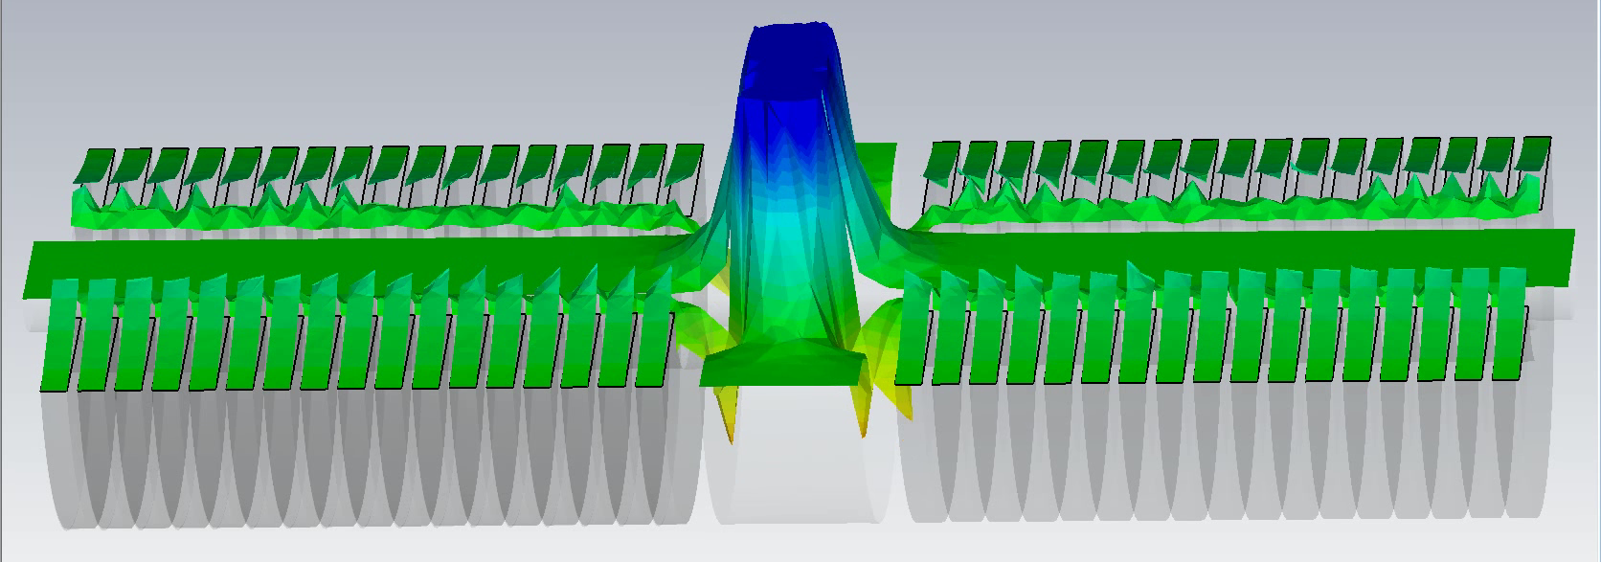
Z-directional Force
The electric field across the gap is used to
impose a force on the proton beam in the
z-direction
By creating a voltage difference
on either side of the gap we
create the electric field
This electric field provides the
force which causes the bunch
rotation and maintains the
beams structure

Slide 15
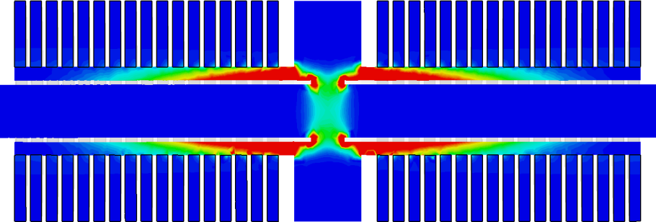
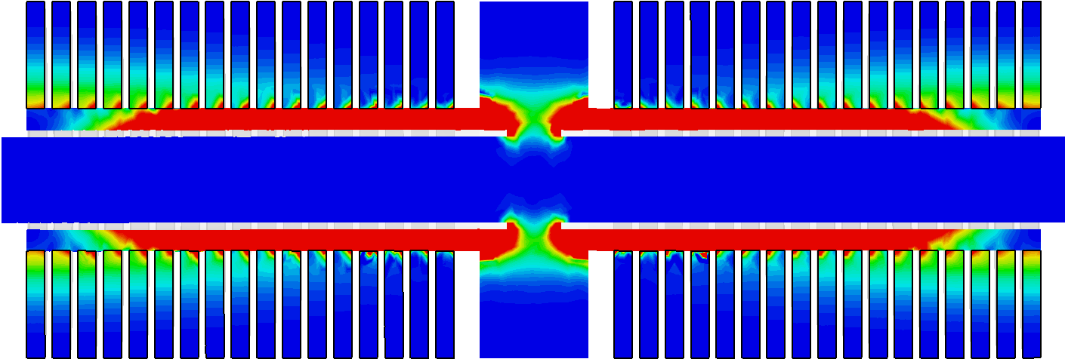
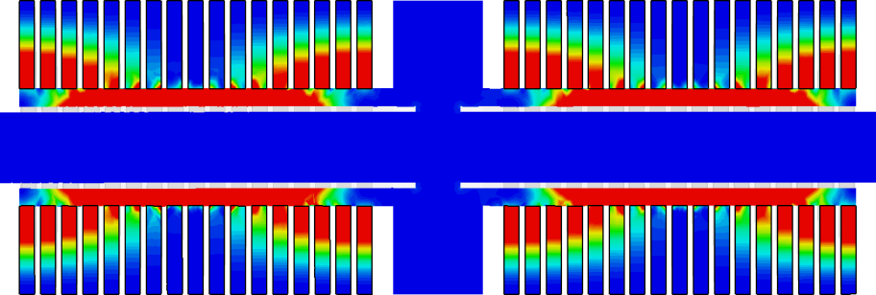
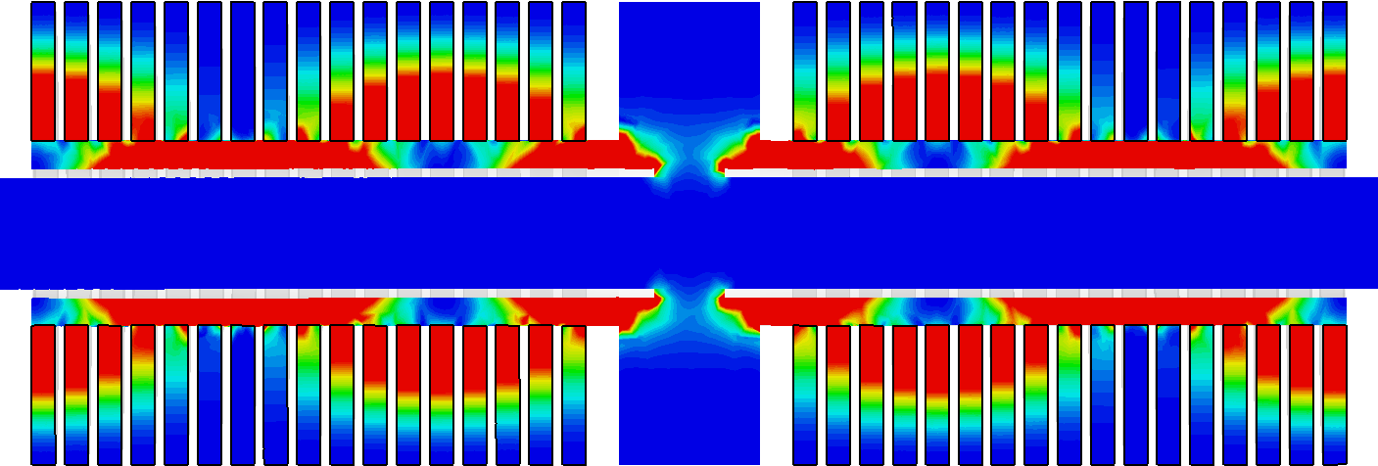
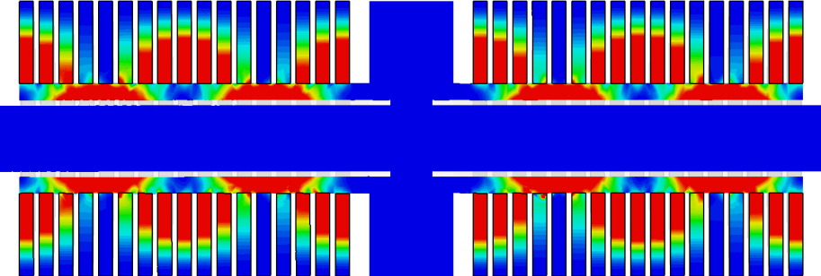
E-Field Harmonics
First five harmonics @ 2.5, 6.5, 11.5, 12.7, 13.9 MHz

Slide 16
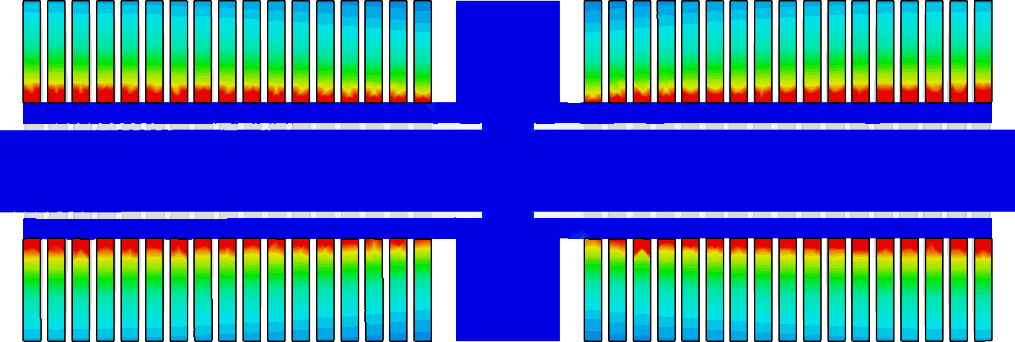
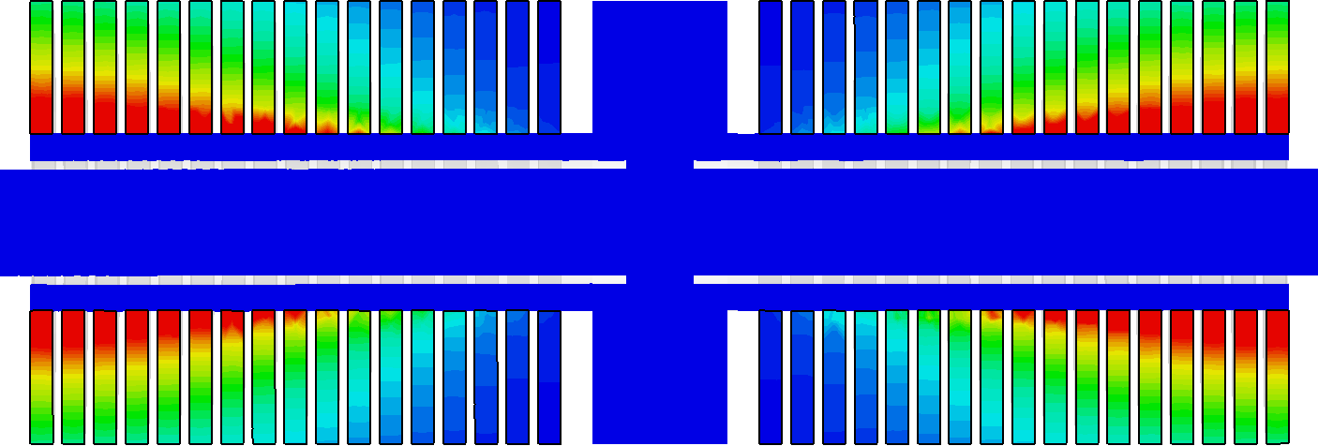
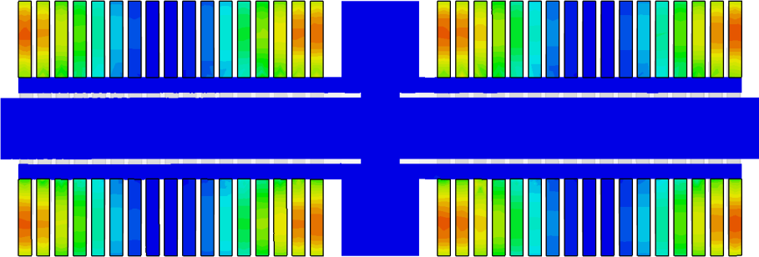
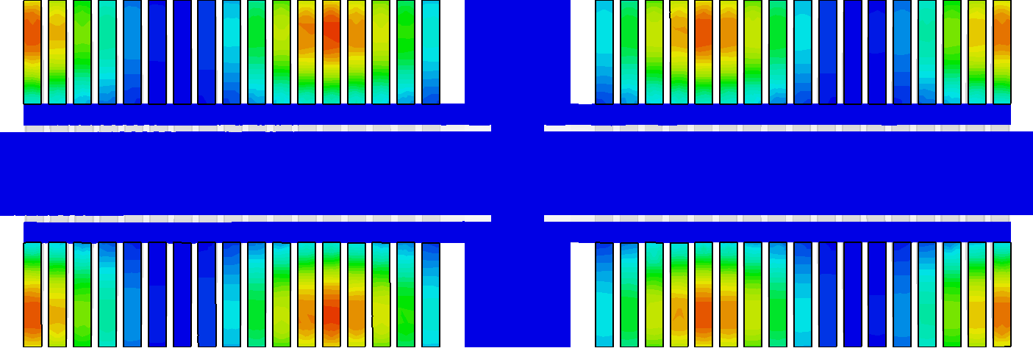
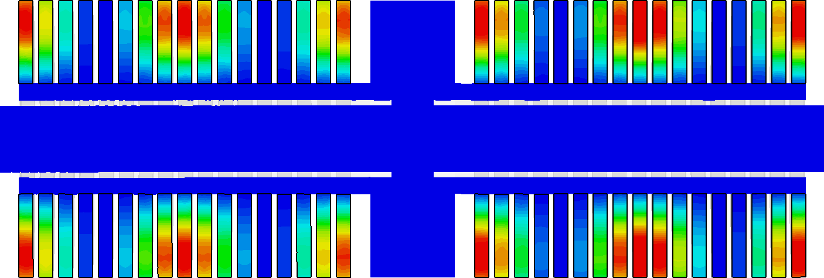
M-Field Harmonics
First five harmonics @ 2.5, 6.5, 11.5, 12.7, 13.9 MHz

Slide 17
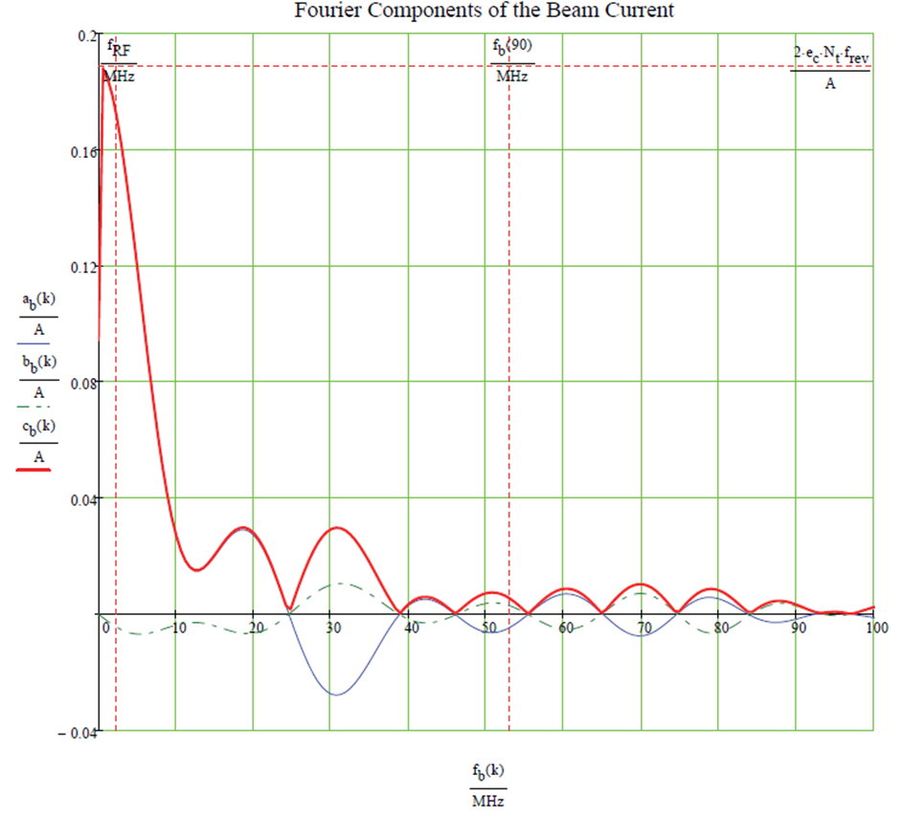
Induced Currents
Higher order modes are primarily delivered by the proton beam
Can calculate induced
currents on cavity
due to beam
Does not appear
significant
If issue, can implement
harmonic dampeners

Slide 18
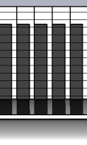
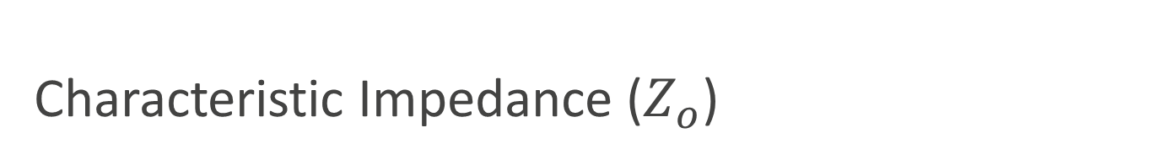


Characteristic Impedance ($Z_{o}$)
Function of ratio between inner/outer conductors and the dielectric material
Impacts gap voltage and necessary
capacitor
$${ Z}_{Average}$$
$.. { Z}_{1} { Z}_{2}{ Z}_{1} Z_{2}$ ..

Slide 19

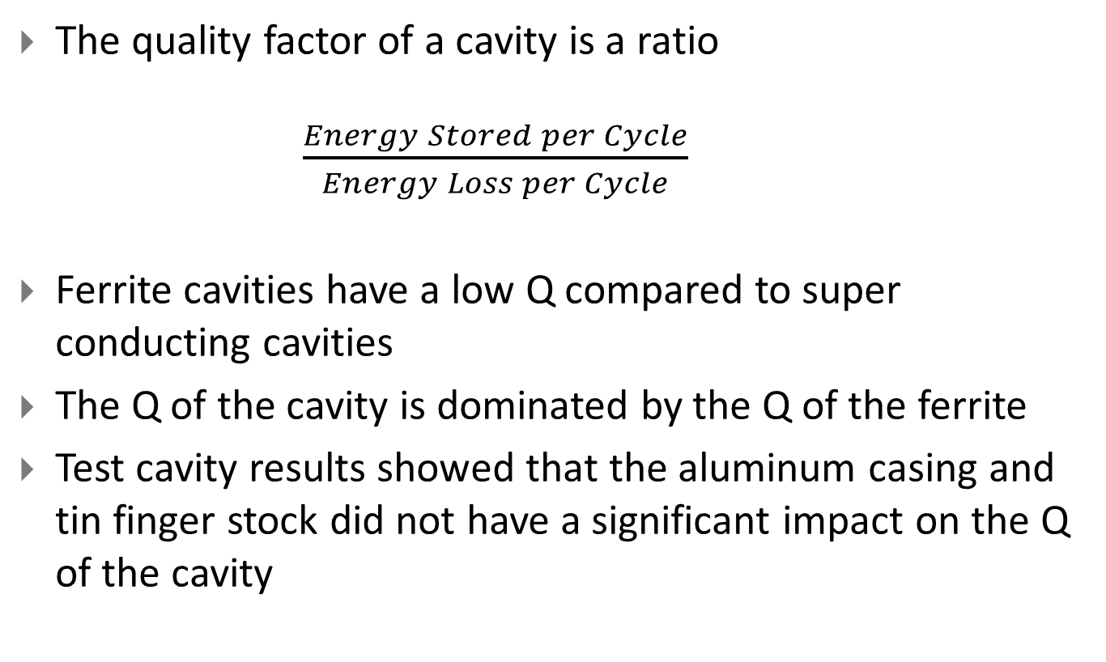
Quality Factor ($Q$)
The quality factor of a cavity is a ratio
$\frac{Energy Stored per Cycle}{Energy Loss per Cycle}$
Ferrite cavities have a low Q compared to super conducting cavities
The Q of the cavity is dominated by the Q of the ferrite
Test cavity results showed that the aluminum casing and tin finger stock did not have a significant impact on the Q of the cavity

Slide 20
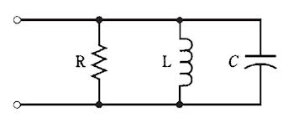
Rshunt (Shunt Impedance)
Rshunt of 25kΩ yields 10kV with 1kW input power
Total cavity length ~1.5m
Power distribution across 34 ferrite is acceptable
⁺
V
₋
Rshunt
Ferrite
Cap

Slide 21
Conclusions
By using circuit models, CST Microwave Studio and a five ferrite test cavity we
  Showed proof of concept of the cavity design
  Demonstrated the sufficiency of the water cooling system
  Found the cavities characteristic impedance and Q factor
  Determined an appropriate Rshunt for the needed voltage
  Identified the size of the capacitors
  Calculated the appropriate RF input point on the cavity
  Determined the frequency of the higher order modes

Slide 22
Special Thank You
Joseph Dey
SIST Committee Members
  Sandra Charles, Linda Diepholz, Dianne Engram, Gustavo Canselo, Bill Freeman, Elliott McCrory, Vivian O’Dell, David Peterson, and Mayling Wong-Squires
RF Department

Slide 23

Questions?

