Slide 1
Optimization of the Data Acquisition Software (PxSuite DAQ) for the Silicon Strip Telescope at FTBF
Clifford Denis
SIST Intern, Fermilab
Ramapo College of New Jersey
08/04/2014

Slide 2
Background
What is the Silicon Strip Telescope?
Created by the Detector Instrumentation Group (DIG) at Fermilab
Built to track particles’ trajectories
Used at the Fermilab Test Beam Facility (FTBF) to provide tracking information for different Detectors Under Test
What are the main components?
The Silicon Strip Detector
The CAPTAN Boards (DAQ Hardware)
The PxSuite (DAQ Software)

Slide 3
Si-Strip and DAQ layout

Slide 4
The Si-Strip Telescope

Slide 5
The Si-Strip Telescope and DAQ
The Strip Station
Two strip planes mounted orthogonally
A strip plane is made of 639 strips, each 60 microns wide and 9cm long
Overlap area of ~4x4cm²
The CAPTAN Board (DAQ Hardware)
Compact And Programmable daTa Acquisition Node
Octagon-shaped electronic board designed for acquisition, processing and control of data in High Energy Physics
Can be customized connecting other electronic devices (including additional CAPTANs) through the main buses

Slide 6
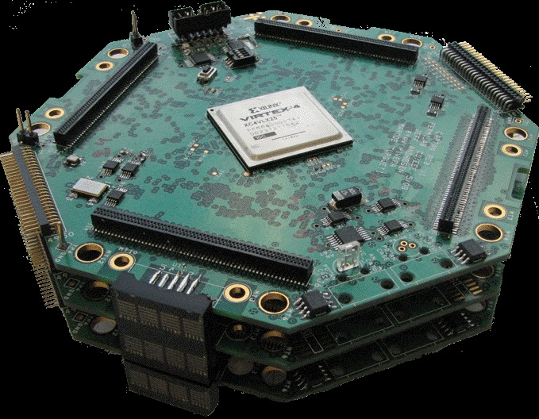
The Si-Strip Telescope and DAQ
Fig. 4 - The CAPTAN Board
Fig. 3 - The Strip Station

Slide 7
The PxSuite
The PxSuite (DAQ Software)
Written in C++, HTML and JavaScript
Interface that lets the user program and interact with the hardware through a web-based graphical user interface
The Configuration Files
Used to configure the telescope and the DAQ hardware
Sample actions include: setting the clock source, the clock speed, enabling and disabling strips, setting the threshold sensitivity of the strips

Slide 8
Diagram of the PxSuite DAQ Software

Slide 9
The Issues
Accessibility
Some parts of PxSuite code not so easy to read
Lacking methods to perform direct operations on registers
Performance
Taking a lot of time to communicate to the hardware

Slide 10
Accessibility
Created methods that perform specific operations.
Directly modify individual bits of the register STRIP_CSR (setting the BCO clock state, enabling the stream, etc.)
Directly set the frequency according to the clock source (External or Internal).
Communicate directly with the configuration files, therefore avoiding the need to modify the source code itself (getting the state of the clock from configuration file, etc).

Slide 11
Performance
Implemented methods that minimize the response time.
Send commands concurrently, therefore reducing the time the program has to wait for an acknowledgment from the hardware.
Compare sent and received buffers, making sure they are correctly interpreted.
Create a register from the hardware’s acknowledgment while starting data acquisition.

Slide 12
Example of Code

Slide 13
Conclusions and Future Work
Conclusions
PxSuite code is now easier to read
PxSuite performs faster than before
Future Work
There are more registers to work on, a lot more!
PxSuite can probably be made even faster

Slide 14
THANKS!!!
Lorenzo Uplegger (Supervisor)
Ryan Rivera (Second Supervisor)
Kelly Stifter (co-worker)
Daniel Parella (co-worker)
Fermilab and the SIST committee

Slide 15
Any questions?

